Slide 1
Web-based Apps in .NET
P. Sumathy
Assistant Professor
Department of Computer Science
Bharathidasan University

Slide 2
Objectives
“Real-world applications are typically multi-tier, distributed designs involving many components — the web server being perhaps the most important component in today's applications...”
Web-based applications
IIS
WebForms

Slide 3
Web-based applications…

Slide 4
Application design
Many applications are designed with N levels or "tiers"
good separation of concerns
enables reuse of back-end tiers across varying FEs
object
object
Front-end
object
Presentation
Business
Data Access
Data

Slide 5
Web-based applications
Web-based apps offer many advantages:
extend reach of application to people AND platform
based on open, non-proprietary technologies
Two types:
WebForms: GUI-based app displayed in browser
WebServices: object-based app returning raw XML
browser
HTTP, HTML
Web server
Web
Page
obj
obj
custom FE
SOAP, XML
obj
obj
other App

Slide 6
Internet Information Services - IIS…

Slide 7
Internet Information Services (IIS)
IIS is Microsoft's Web Server
runs as a separate process "inetinfo.exe"
requires a server-like OS: Windows NT, 2000, XP Pro
multi-threaded to service thousands of requests…
client
IIS
client
client
.
.
.
Windows Server

Slide 8
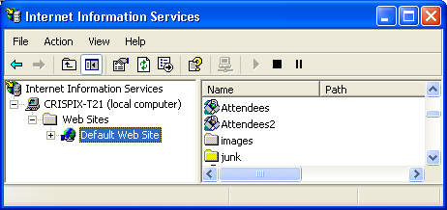
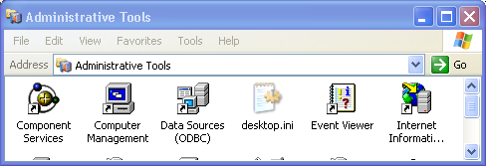
Configuring IIS
Configured manually via:
control panel, admin tools, Internet Information Services

Slide 9
A web site
IIS deals with web sites
A web site = a web application
How IIS works:
each web site has its own physical directory on hard disk
each web site is assigned a virtual name for that directory
users surf to web site based on virtual name
Example:
web site lives in C:\Inetpub\wwwroot\WebSite
web site's virtual name is "AAAPainting"
IIS maps virtual to physical…

Slide 10
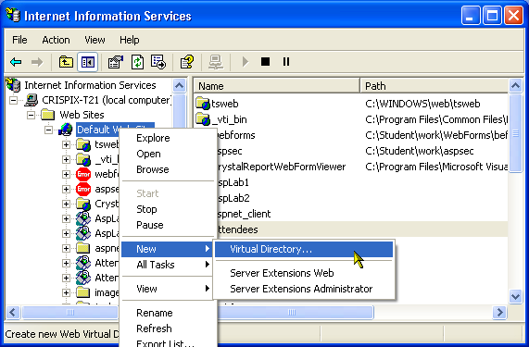
Creating a virtual directory
When in doubt, right-click :-)
right-click on "Default Web Site", New, Virtual Directory…

Slide 11
Types of web sites
From IIS's perspective, 2 types:
static
dynamic

Slide 12
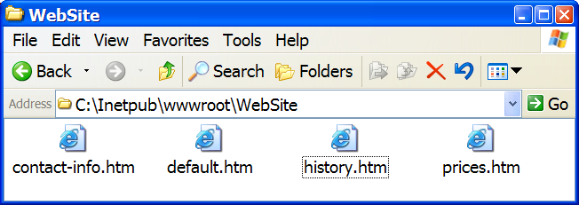
Static web sites
A static web site has the following characteristics:
all web pages are pre-created and sitting on hard disk
web server returns pages without any processing
<title>Welcome to AAA Painting</title>
<html>
<h3>Welcome to AAA Painting</h3>
<HR>
<ol>
<li> <A HREF="history.htm">History of our company</A>
<li> <A HREF="prices.htm">Pricing</A>
<li> <A HREF="contact-info.htm">How to contact us</A>
</ol>
<HR>
</html>

Slide 13
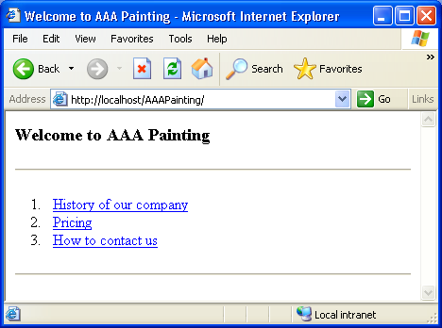
HTML
Static web sites are typically pure HTML
pages may also contain script code that runs on client-side
<title>Welcome to AAA Painting</title>
<html>
<h3>Welcome to AAA Painting</h3>
<HR>
<ol>
<li> <A HREF="history.htm">History of our company</A>
<li> <A HREF="prices.htm">Pricing</A>
<li> <A HREF="contact-info.htm">How to contact us</A>
</ol>
<HR>
</html>

Slide 14
Dynamic web sites
A dynamic web site involves server-side processing
How does IIS tell the difference?
based on file extension of requested web page…
Example:
static request: http://localhost/AAAPainting/default.htm
dynamic request: http://localhost/Workshop/default.asp

Slide 15
ASP
Active Server Pages
Microsoft's server-side programming technology
ASP based on scripting languages, interpreted
ASP.NET based on .NET languages, compiled, faster, …
http://host/page.asp
IIS
client
ASP
engine
HTML

Slide 16
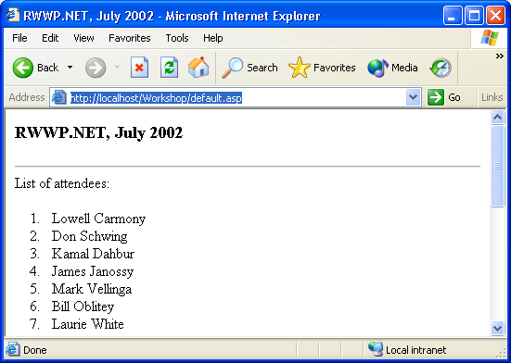
Example
We want to dynamically create web page of attendee's
i.e. generate the page by reading names from a database
IIS
ASP
Page

Slide 17
ASP page — part 1, presentation
default.asp
ASP page = HTML + code…
<title>RWWP.NET, July 2002</title>
<html>
<h3>RWWP.NET, July 2002</h3>
<HR>
List of attendees:
<ol>
<%
Call OutputAttendees( )
%>
</ol>
<HR>
</html>
<SCRIPT LANGUAGE="VBScript" RunAt="Server">
Sub OutputAttendees()
.
.
.
inline code block

Slide 18
ASP page — part 2, logic
default.asp
Sub OutputAttendees()
Dim dbConn, rs, sql, firstName, lastName
sql = "Select * From Attendees"
Set dbConn = CreateObject("ADODB.Connection")
Set rs = CreateObject("ADODB.RecordSet")
dbConn.Open("Provider=Microsoft.Jet.OLEDB.4.0;" + _
"Data Source=C:\Inetpub\wwwroot\Workshop\Attendees.mdb")
rs.ActiveConnection = dbConn : rs.Source = sql : rs.Open
Do While Not rs.EOF
firstName = rs("FirstName")
lastName = rs("LastName")
Response.Write("<li> " + firstName + " " + lastName)
rs.MoveNext()
Loop
rs.Close : dbConn.Close
End Sub
</SCRIPT>

Slide 19
The key to web programming…
It's a client-server relationship
client makes request
server does some processing…
client sees OUTPUT of server-side processing

Slide 20
Part 3
WebForms…

Slide 21
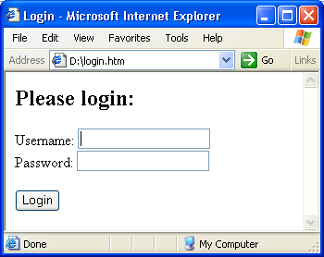
Traditional form-based web apps
HTML already supports the creation of form-based apps
<HTML>
<HEAD>
<title>Login</title>
</HEAD>
<BODY>
<h2>Please login:</h2>
<form method="get" action="Main.htm" id="Login">
Username: <INPUT type="text" id="Name"> <BR>
Password: <INPUT type="text" id="pwd"> <BR> <BR>
<INPUT type="submit" value="Login">
</form>
</BODY>
</HTML>

Slide 22
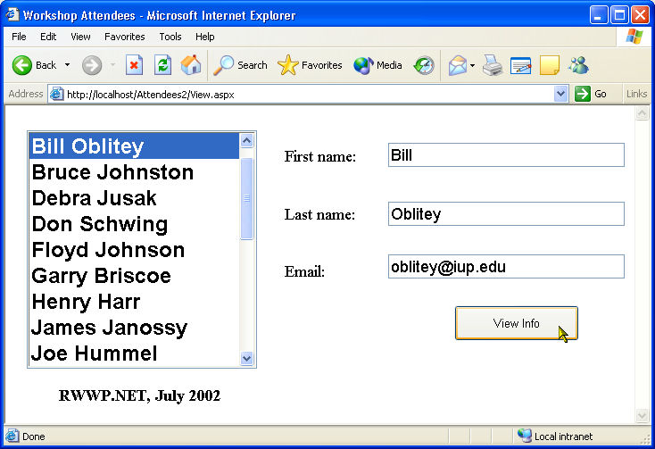
WebForms
Web-based, form-based .NET apps
Based on many technologies:
IIS
ASP.NET (extension to IIS)
.NET Framework SDK (CLR, FCL, tools)
Visual Studio .NET (drag-and-drop creation)

Slide 23

Abstraction
Like WinForms, WebForms are based on classes in FCL
separates WebForm app from underlying platform
instance of
FCL class
System.Web.UI.Page
object
CLR
Windows OS

Slide 24
Creating a WebForm app
Good news: much like creating a WinForm app!
create appropriate project in Visual Studio
design form(s) via drag-and-drop of controls
program events

Slide 25
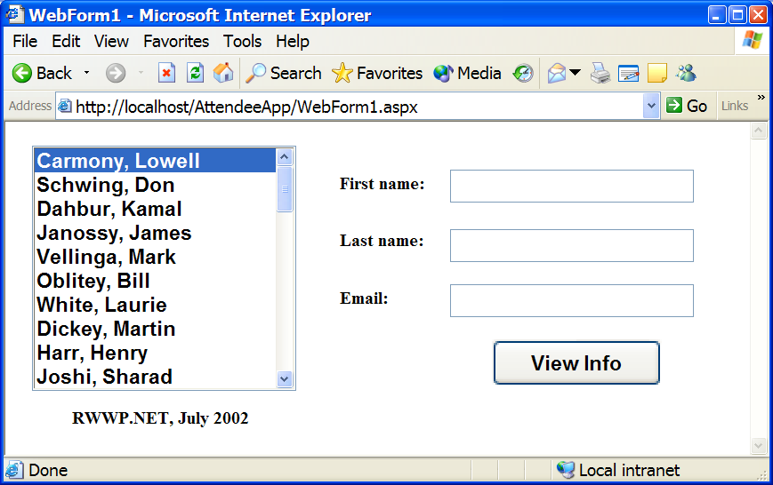
Example
A simple WebForms app to view attendee info from DB

Slide 26
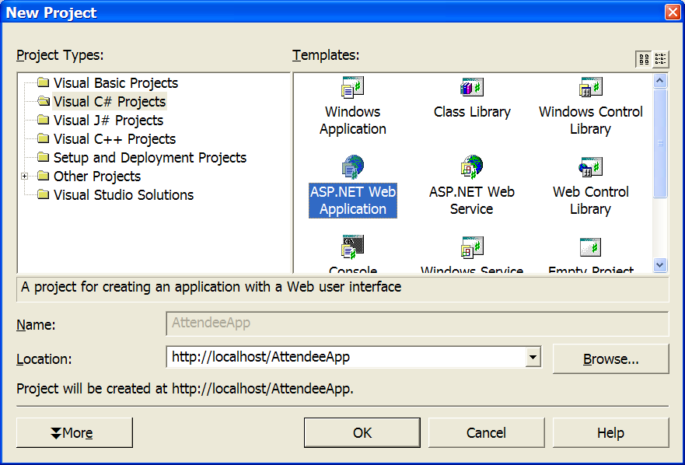
(1) Create ASP.NET Web App project
Location = name of web site = "http://localhost/AttendeeApp"
virtual directory: AttendeeApp
physical directory: C:\Inetpub\wwwroot\AttendeeApp

Slide 27
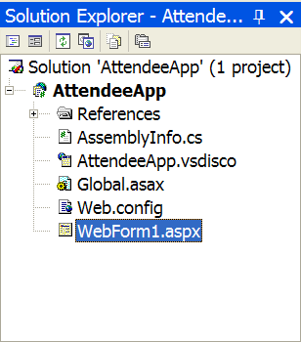
(2) Project layout
VS .NET configures IIS for you
VS .NET creates web site for you
contains 1 form-based web page
named WebForm1.aspx by default
ignore other files for now…

Slide 28
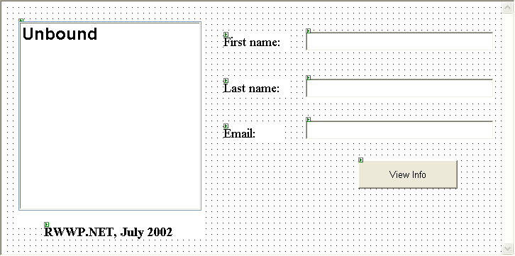
(3) Design WebForm
Just like a WinForm
drag-and-drop from toolbox…

Slide 29
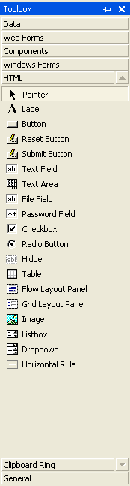
Web controls vs. HTML controls
Toolbox contains 2 types of controls:
those under Web Forms
those under HTML
Both generate pure HTML on client
though sometimes with JavaScript!
Web controls:
work like WinForm counterparts
HTML controls:
mimic standard HTML controls

Slide 30
(4) Implement events
WebForms are event-driven, as you would expect:
on Page_Load, fill list box from database
on cmdViewInfo_Click, display info about selected attendee
In each case, standard C# database programming…
private void Page_Load(...)
{
IDbConnection dbConn = null;
try {
dbConn = new OleDbConnection(sConnection);
dbConn.Open();
.
.
.

Slide 31
(5) Run!
You can run from within VS
You can debug from within VS
How does it work?
starts up a session of IE
attaches debugger to IIS
displays .aspx page marked as "Start Page" in your project
right-click on .aspx page you want to start with
select "Set as Start Page"

Slide 32
(6) Reminder — client-server relationship!
The server contains lots of code
see physical directory…
But the client sees only HTML!
"View Source" in browser…

Slide 33
ASP.NET programming model
On the surface WebForms appear like WinForms
But the programming model is different underneath
due to ASP.NET
due to client-server paradigm

Slide 34
#1: Traditional dialog doesn't work
For example, these do not work:
MessageBox.Show( )
form1.Show( )
Why not?
think about where form would appear…
Solutions:
if you want to tell user something, display via label on page
if you want to show another page, redirect browser

Slide 35
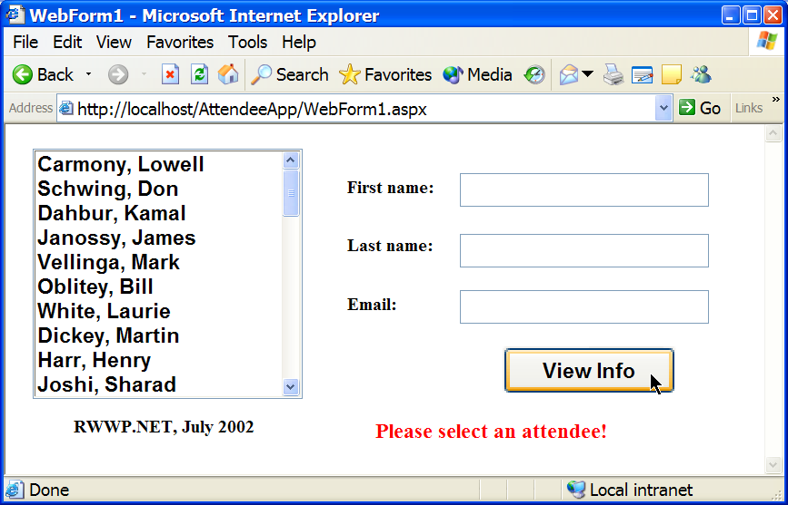
Web-based dialogs
To display a message to user:
private void cmdViewInfo_Click(...)
{
if (this.ListBox1.SelectedItem == null) {
// nothing selected
this.lblErrorMsg.Text = "Please select an attendee!";
return;
}
.
.
.

Slide 36
#2: Fewer events
There are fewer events to program in WebForms
primarily Change and Click events only
Why?
because each event represents 1 round-trip to server for processing
and thus event processing represents a very expensive activity
IIS
client
1. initial request is posted
ASP.NET
engine
2. HTML rendering of page
3. same page is "posted-
back" for event processing
4. HTML rendering of page

Slide 37
#3: AutoPostBack
In fact, some events aren't posted right away…
instead event is "queued" until page is eventually posted back
To force immediate postback?
set control's AutoPostBack property (if it has one)
Example:
list box doesn't postback when you click on an item
instead, event is queued until later (e.g. button is clicked)

Slide 38
#4: Postbacks
There is a distinction made between:
first request that is posted to server for page X by client C
subsequent "postbacks" of page X to client C
Example:
Page_Load event triggers every time
but typically only need to initialize form the first time!
private void Page_Load(...)
{
if (this.IsPostBack) // no need to reload list box!
return;
.
. // first request, load list box from DB
.

Slide 39
#5: Statelessness
Web apps are stateless
Each page request is a self-contained operation:
connection is opened
request is posted
result is returned
connection is closed
Implications? By default:
no session state (i.e. no data for client C across pages)
no global state (i.e. no data across all clients & pages)
postback state *is* maintained for you by .NET
e.g. contents of list box

Slide 40
Summary
Web-based applications are commonplace
Web-based applications are often mission-critical
Two options:
WebForms: form-based
WebServices: object-based
WebForms make Web-based apps far easier to build…

Slide 41
Queries

