Slide 1
Computer Network Security
Mrs. M. Lalli
Assistant Professor
Department of Computer Science
Bharathidasan University
Trichy

Slide 2
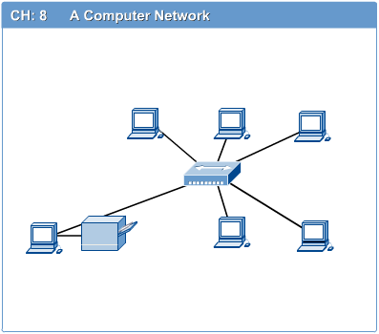
Computer Networks
Computer network connects two or more autonomous computers.
The computers can be geographically located anywhere.

Slide 3
LAN, MAN & WAN
Network in small geographical Area (Room, Building or a Campus) is called LAN (Local Area Network)
Network in a City is call MAN (Metropolitan Area Network)
Network spread geographically (Country or across Globe) is called WAN (Wide Area Network)

Slide 4
Applications of Networks
Introduction to Computer Networks
Resource Sharing
  Hardware (computing resources, disks, printers)
  Software (application software)
Information Sharing
  Easy accessibility from anywhere (files, databases)
  Search Capability (WWW)
Communication
  Email
  Message broadcast
Remote computing
Distributed processing (GRID Computing)

Slide 5
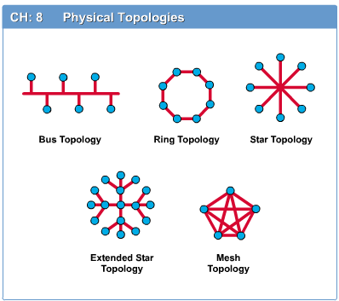
Network Topology
The network topology defines the way in which computers, printers, and other devices are connected. A network topology describes the layout of the wire and devices as well as the paths used by data transmissions.

Slide 6
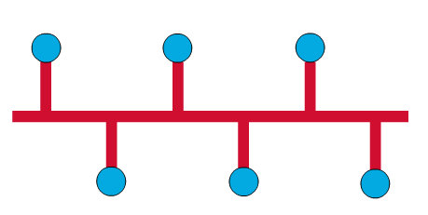
Bus Topology
Introduction to Computer Networks
Commonly referred to as a linear bus, all the devices on a bus topology are connected by one single cable.

Slide 7

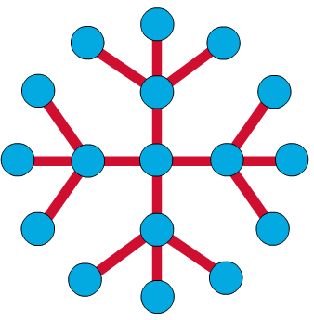
Star & Tree Topology
Introduction to Computer Networks
The star topology is the most commonly used architecture in Ethernet LANs.
When installed, the star topology resembles spokes in a bicycle wheel.
Larger networks use the extended star topology also called tree topology. When used with network devices that filter frames or packets, like bridges, switches, and routers, this topology significantly reduces the traffic on the wires by sending packets only to the wires of the destination host.

Slide 8
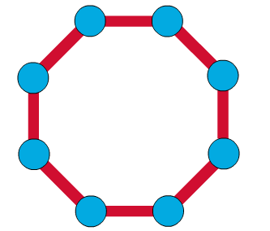
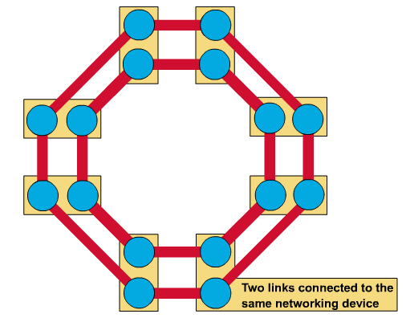
Ring Topology
A frame travels around the ring, stopping at each node. If a node wants to transmit data, it adds the data as well as the destination address to the frame.
The frame then continues around the ring until it finds the destination node, which takes the data out of the frame.
  Single ring – All the devices on the network share a single cable
  Dual ring – The dual ring topology allows data to be sent in both directions.

Slide 9
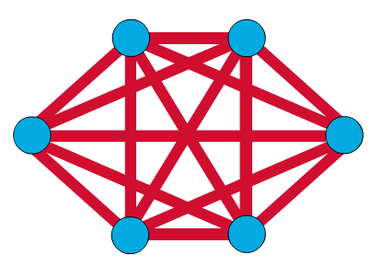
Mesh Topology
The mesh topology connects all devices (nodes) to each other for redundancy and fault tolerance.
It is used in WANs to interconnect LANs and for mission critical networks like those used by banks and financial institutions.
Implementing the mesh topology is expensive and difficult.

Slide 10
Network Components
Introduction to Computer Networks
Physical Media
Interconnecting Devices
Computers
Networking Software
Applications

Slide 11
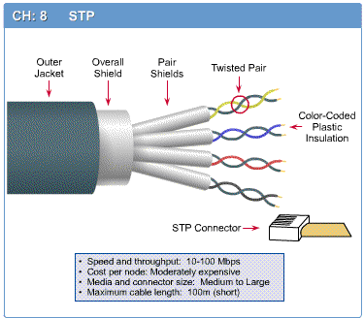
Networking Media
Introduction to Computer Networks
Networking media can be defined simply as the means by which signals (data) are sent from one computer to another (either by cable or wireless means).

Slide 12
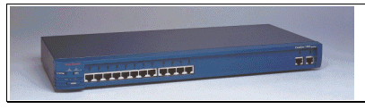
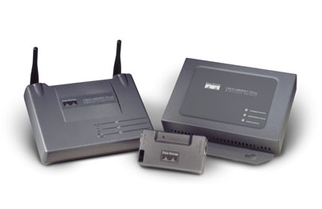
Networking Devices
Introduction to Computer Networks
HUB, Switches, Routers, Wireless Access Points, Modems etc.

Slide 13
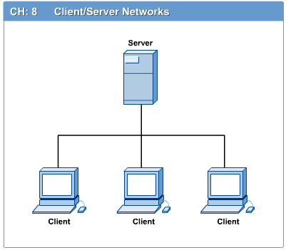
Computers: Clients and Servers
In a client/server network arrangement, network services are located in a dedicated computer whose only function is to respond to the requests of clients.
The server contains the file, print, application, security, and other services in a central computer that is continuously available to respond to client requests.

Slide 14
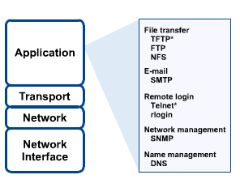
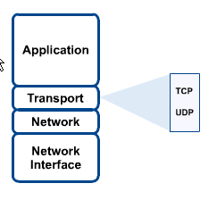
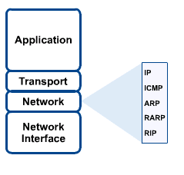
Networking Protocol: TCP/IP

Slide 15

Applications
E-mail
Searchable Data (Web Sites)
E-Commerce
News Groups
Internet Telephony (VoIP)
Video Conferencing
Chat Groups
Instant Messengers
Internet Radio

Slide 16
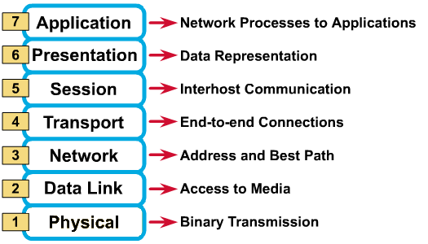
OSI Reference Model: 7 Layers
OSI Model

Slide 17
Open Systems Interconnection
OSI Reference model
  Layer 7 application
  Layer 6 presentation
  Layer 5 session
  Layer 4 transport
  Layer 3 network
  Layer 2 data link
  Layer 1 physical
Sender
Receiver
File
File
File
Each file
is divided
into
packets
Each Packet
will
then be
Encapsulated
with
PROTOCOLS
The protocols
Will be added
systematically
Layer
By layer
The encapsulated
Packet is called
a frame
The received
frame is then
unpacked
in the
opposite order
Transmission Medium

Slide 18
Services Performed at Each Layer
  Layer 7 application
  Layer 6 presentation
  Layer 5 session
  Layer 4 transport
  Layer 3 network
  Layer 2 data link
  Layer 1 physical
  Identification, authentication
  Format conversion
  Set-up coordinate conversation
  Ensures error-free transfer
  Routing of data through network
  Error control and synchronisation
  Placing signals on the carrier

Slide 19
Examples of protocols
  Layer 7 application
  Layer 6 presentation
  Layer 5 session
  Layer 4 transport
  Layer 3 network
  Layer 2 data link
  Layer 1 physical
  E-mail, Web browser, Directory
  POP, SMTP, FTP, HTTP, DNS
  Sockets
  TCP
  IP
  PPP, Ethernet, Token ring
  100baseT

Slide 20
Encapsulation
Device 1
Device 2
Application
data
Application
Presentation
H6
data
T6
Presentation
Session
H5
data
T5
Session
Transport
H4
data
T4
(Packet)
Transport
Network
H3
data
T3
(packet)
Network
Data Link
H2
data
T2
Data Link
Physical
H1
data
T1
Physical
carrier
FRAME
FRAME
FRAME
FRAME
A typical frame
Preamble
Destination
Address
Source
Address
Data
Padding
CRC

Slide 21
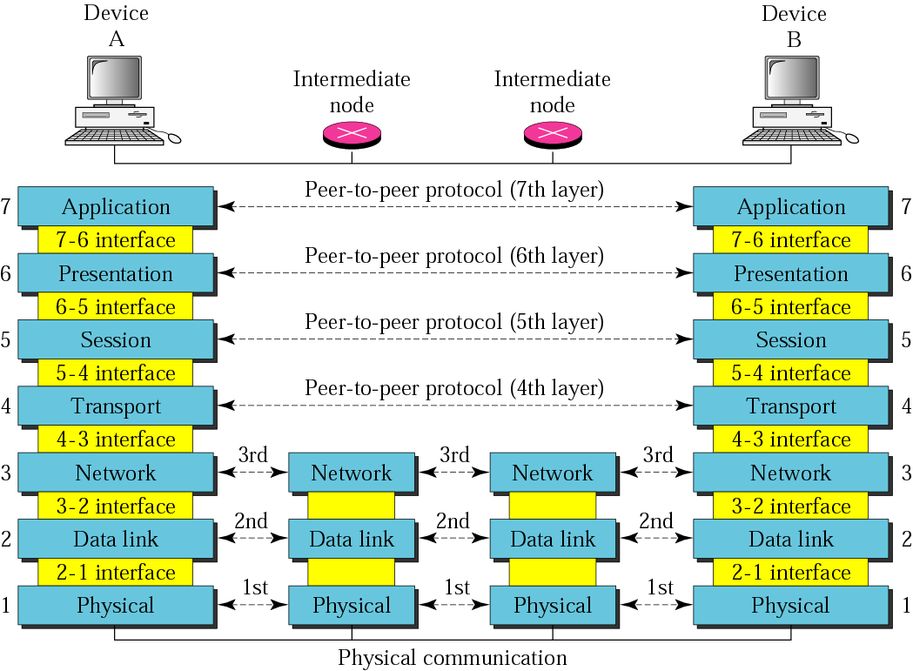
OSI layers

Slide 22
Remembering the 7 Layers
7 - Application All
6 - Presentation People
5 - Session Seem
4 - Transport To
3 - Network Need
2 - Data Link Data
1 - Physical Processing

Slide 23
Error Checking Methods
Parity bit check
Check sum
* data transmitted in blocks, each block added to give a total – checksum
* used in X Modem protocol
Cycle redundancy check

Slide 24
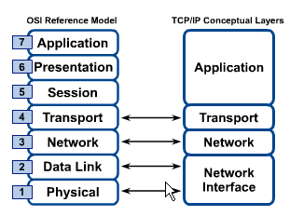
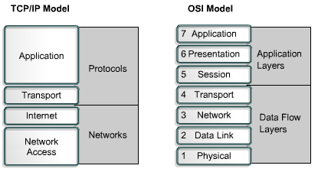
OSI & TCP/IP Models
TCP/IP Model

Slide 25
TCP/IP Model
TCP/IP Model
Application Layer
Application programs using the network
Transport Layer (TCP/UDP)
Management of end-to-end message transmission,
error detection and error correction
Network Layer (IP)
Handling of datagrams : routing and congestion
Data Link Layer
Management of cost effective and reliable data delivery,
access to physical networks
Physical Layer
Physical Media

Slide 26
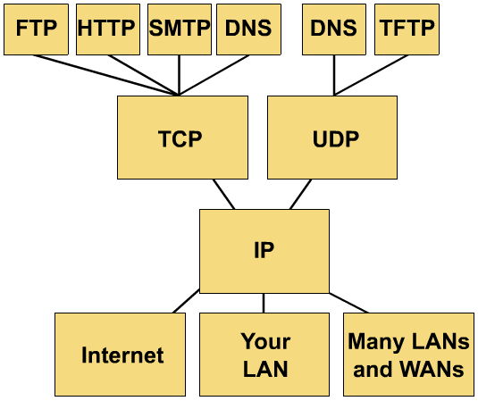
TCP/IP protocol stack

Slide 27
TCP/IP Reference Model
Layer
Protocols
Application
HTTP
TELNET
FTP
SMTP
SNMP
Transport
TCP
UDP
Internet
IP
ICMP
Network Access
(Host-to-network)
ETHERNET
PACKET RADIO

Slide 28
Examples of Communication Systems

Slide 29
Examples of Communication Systems
- E-mail
- Voice Mail - Fax
- Smart Phone - Instant Messaging
- Telecommuting - Video-conferencing
- Groupware - Telephony
- E-Commerce - The Internet
Bulletin board system - The Web
- Global positioning system

Slide 30
Transmitting and Receiving in Communication Systems
Communication concepts
(transmission of data, protocols and handshaking, networks, LANs and WANs,Topologies, Network Access Methods)
Network Hardware
(NICs, Servers, Routers and Switches, Bridges and gateways, Hubs, Transmission media
Network Software
NOSs, Network Operating System Tasks, Logon and Logoff Procedures, Intranets and Extranets

Slide 31
Communication Concepts
Any transmission May be:
analog or digital
Serial or parallel

Slide 32
Serial Transmission
Data is transmitted, on a single channel, one bit at a time one after another
- Much faster than parallel because of way bits processed (e.g. USB drives)
Sender transmitted
Receiver received
1
0
0
1
1
0
0
1

Slide 33
Parallel Transmission
each bit has it’s own piece of wire along which it travels
- often used to send data to a printer
1
0
0
1
Receiver received
Sender transmitted
1
0
0
1
All bits are sent simultaneously

Slide 34
Why Not use Parallel Instead of serial?
Due to inconsistencies on channels data arrives at different times
Because of the way it is transmitted packet switching cannot be used
The above two points makes parallel slower than serial and requires higher bandwidth.
Parallel transmissions are rarely used anymore

Slide 35
Synchronous Vs AsynchronousTransmissions
Synchronous Transmission
all data sent at once and no packet switching
Asynchronous Transmission
Uses stop/ start bits
most common type of serial data transfer
Allows packet switching
Allows sharing of bandwidth (i.e. talk on phone while another person is using internet)

Slide 36
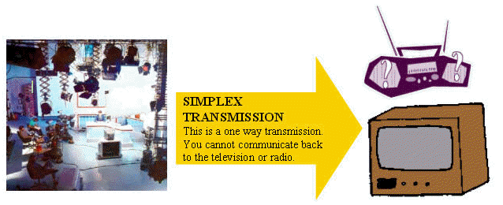
Transmission Direction
- simplex: One direction only

Slide 37
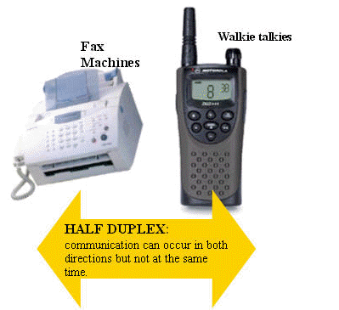
Half Duplex Transmission
half duplex: Both directions but only one direction at a time

Slide 38
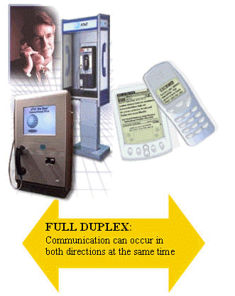
Full Duplex Transmission
full duplex: send and receive both directions at once

Slide 39
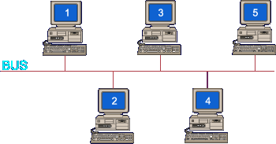
Bridge
Large networks can be separated into two or more smaller networks using a bridge.
This is done to increase speed and efficiency.
This type of network is called a segmented LAN and has largely been superseded by the use of switches which can transfer data straight to a computer and thus avoid bottleneck jams which bridges were designed to fix.
Bridge
Notes:
Devives that connect local area networks
If a BUS or ring then a Gateway needs to be used

Slide 40
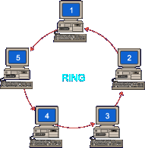
Gateway
Often used to connect a LAN with a WAN. Gateways join two or
More different networks together.
Gateway

Slide 41
Security

Slide 42
In 1980 a computer cracked a 3-character password within one minute.
DID YOU KNOW?
In 1999 a team of computers cracked a 56-character password within one day.
In 2004 a computer virus infected 1 million computers within one hour.

Slide 43
Objectives
Why we secure information?
What are the vulnerabilities?
How to secure information?

Slide 44
Attack Sophistication vs.
Intruder Technical Knowledge
Cross site scripting
Intruder
Knowledge
Tools
“stealth” / advanced scanning techniques
High
Staged
attack
packet spoofing
denial of service
sniffers
distributed
attack tools
sweepers
www attacks
automated probes/scans
GUI
back doors
disabling audits
network mgmt. diagnostics
hijacking
sessions
Attack
Sophistication
burglaries
exploiting known vulnerabilities
password cracking
self-replicating code
Attackers
Low
password guessing
1980
1985
1990
1995
2000

Slide 45
Security Objectives
Confidentiality: prevent/detect/deter improper disclosure of information
Integrity: prevent/detect/deter improper modification of information
Availability: prevent/detect/deter improper denial of access to services

Slide 46
Definition of IS
Information security means protecting information and information systems from unauthorized access (That is modification, inspection, recording or destruction).
Information Security is interrelated with the common goals of protecting the confidentiality, integrity and availability of information.

Slide 47



Friends and enemies: Alice, Bob, Trudy
well-known in network security world
Bob, Alice (lovers!) want to communicate “securely”
Trudy (intruder) may intercept, delete, add messages
Alice
Bob
channel
data, control messages
secure
sender
secure
sender
secure
receiver
data
data
Trudy

Slide 48
Attacks
An attack is any action that violates security.
To analyze the security, it will depend upon the Three factors they are,
Vulnerability – Weakness in the security system
Threats – Set of circumstances that has
potential to cause loss or harm
Controls – Reduces the vulnerability

Slide 49
Types of Vulnerabilities
Hardware Vulnerabilities – Physical damage
Software Vulnerabilities – Deletion, modification & theft
Example :(Logic Bomb, Salami Attack, Trojan horse )
Data Vulnerabilities – Confidentiality, Integrity and Availability

Slide 50
Military Example
Confidentiality: target coordinates of a missile should not be improperly disclosed
Integrity: target coordinates of missile should be correct
Availability: missile should fire when proper command is issued

Slide 51
Commercial Example
Confidentiality: patient’s medical information should not be improperly disclosed
Integrity: patient’s medical information should be correct
Availability: patient’s medical information can be accessed when needed for treatment

Slide 52
Fourth Objective
Securing computing resources: prevent/detect/deter improper use of computing resources
  Hardware
  Software
  Data
  Network

Slide 53
Achieving Security
Policy
  What to protect?
Mechanism
  How to protect?
Assurance
  How good is the protection?

Slide 54
Security Policy
Organizational
Policy
Computerized
Information System
Policy

Slide 55
Security Mechanism
Prevention
Detection
Tolerance/Recovery

Slide 56
Types of Attacks (1)
Interruption – an asset is destroyed, unavailable or unusable (availability)
Interception – unauthorized party gains access to an asset (confidentiality)
Modification – unauthorized party tampers with asset (integrity)
Fabrication – unauthorized party inserts counterfeit object into the system (authenticity)
Denial – person denies taking an action (authenticity)

Slide 57
Types of Attacks (2)
Passive attacks:
  Eavesdropping
  Monitoring
Active attacks:
  Masquerade – one entity pretends to be a different entity
  Replay – passive capture of information and its retransmission
  Modification of messages – legitimate message is altered
  Denial of service – prevents normal use of resources

Slide 58
Malicious Attacks
Method: skills, knowledge, tools, information, etc.
Opportunity: time and access
Motive: reason to perform the action

Slide 59
Computer Criminals
Amateurs: regular users, who exploit the vulnerabilities of the computer system
  Motivation: easy access to vulnerable resources
Crackers: attempt to access computing facilities for which they do not have the authorization
  Motivation: enjoy challenge, curiosity
Career criminals: professionals who understand the computer system and its vulnerabilities
  Motivation: personal gain (e.g., financial)

Slide 60
Methods of Defense
Prevent: block attack
Deter: make the attack harder
Deflect: make other targets more attractive
Detect: identify misuse
Tolerate: function under attack
Recover: restore to correct state

Slide 61
Encryption and Decryption
Encryption : (Encoding a message)
Original message (or) Plain Text is converted to cipher text
Decryption: (Decoding a message)
Cipher text is converted to Plain text
Plain Text Cipher Text Original Msg
Encryption
Decryption

Slide 62
Encryption Technique
( Caesar Cipher)
C_{i} = E(p_{i}) = P_{i} + 3
Plain Text = A B C D E F G H I J K L M N O . .
CipherText = d e f g h i j k l m n o p q r . .

Slide 63
Example for caesar cipher
The Original Message is,
“TREATY IMPOSSIBLE”
The encrypted message is,
T R E A T Y I M P O S S I B L E
w u h d w b l p s r v v l e o h

Slide 64
Firewalls
Firewalls control the flow of network traffic
Firewalls have applicability in networks where there is no internet connectivity
Firewalls operate on number of layers
Can also act as VPN gateways
Active content filtering technologies

Slide 65
Firewall Environments
There are different types of environments where a firewall can be implemented.
Simple environment can be a packet filter firewall
Complex environments can be several firewalls and proxies

Slide 66
Intranets
An intranet is a network that employs the same types of services, applications, and protocols present in an Internet implementation, without involving external connectivity
Intranets are typically implemented behind firewall environments.

Slide 67
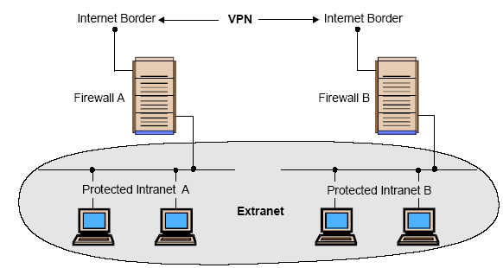
Intranets

Slide 68
Extranets
Extranet is usually a business-to-business intranet
Controlled access to remote users via some form of authentication and encryption such as provided by a VPN
Extranets employ TCP/IP protocols, along with the same standard applications and services

Slide 69
Type is Firewalls
Firewalls fall into four broad categories
Packet filters
Circuit level
Application level
Stateful multilayer

Slide 70
Packet Filter
Work at the network level of the OSI model
Each packet is compared to a set of criteria before it is forwarded
Packet filtering firewalls is low cost and low impact on network performance

Slide 71
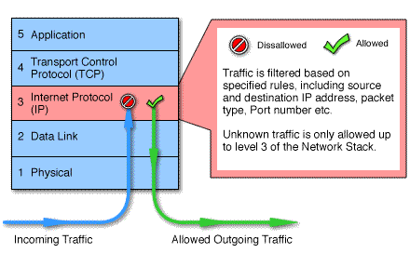
Packet Filtering

Slide 72
Circuit level
Circuit level gateways work at the session layer of the OSI model, or the TCP layer of TCP/IP
Monitor TCP handshaking between packets to determine whether a requested session is legitimate.

Slide 73
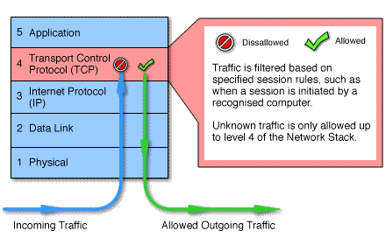
Circuit Level

Slide 74
Application Level
Application level gateways, also called proxies, are similar to circuit-level gateways except that they are application specific
Gateway that is configured to be a web proxy will not allow any ftp, gopher, telnet or other traffic through

Slide 75
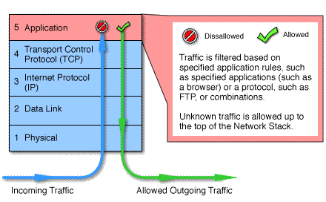
Application Level

Slide 76
Stateful Multilayer
Stateful multilayer inspection firewalls combine the aspects of the other three types of firewalls
They filter packets at the network layer, determine whether session packets are legitimate and evaluate contents of packets at the application layer

Slide 77
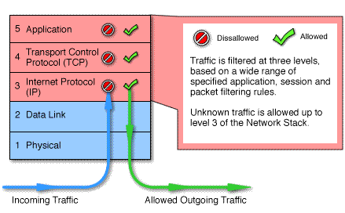
Stateful Multilayer

Slide 78
Outline
Introduction
A Frame for Intrusion Detection System
Intrusion Detection Techniques
Ideas for Improving Intrusion Detection

Slide 79
What is the Intrusion Detection
Intrusions are the activities that violate the security policy of system.
Intrusion Detection is the process used to identify intrusions.

Slide 80
Intrusion Detection Sytems
What is an IDS?
  Definition
  Characteristics
  Examples of existing IDS
Strengths/weaknesses of IDS

Slide 81
What is an IDS?
Definition:
  A piece of software
  Monitors a computer system to detect:
    Intrusion: unauthorized attempts to use the system
    Misuse: abuse of existing privileges
  Responds:
    Log activity
    Notify a designated authority
    Take appropriate countermeasures

Slide 82
Why Use an IDS?
Security is often expensive/cumbersome:
  Cost
  Restrictions on users/functionality
Designers try to offer users “reasonable” levels of security
Security breaches will still occur
Detection allows:
  Finding and fixing the most serious security holes
  Perhaps holding intruders responsible for their actions
  Limiting the amount of damage an attacker can do

Slide 83
IDS Characteristics
Detection Model
  Misuse detection vs. anomaly detection
Scope
  Host based, multihost based, network based
Operation
  Off-line vs. real-time
Architecture
  Centralized vs. distributed

Slide 84
IDS Detection Model
Misuse detection - recognize known attacks
  Define a set of attack signatures
  Detect actions that match a signature
  Add new signatures often
  Examples: ARMD, ASIM, Bro, CSM, CyberCop, GRIDS, Stalker, Tripwire
Anomaly detection - recognize atypical behavior
  Define a set of metrics for the system
  Build a statistical model for those metrics during “normal” operation
  Detect when metrics differ significantly from normal
  Examples: AAFID, MIDAS, NADIR, UNICORN
Hybrid
  Examples: CMDS, DIDS, EMERALD, INBOUNDS, NIDES, RealSecure

Slide 85
IDS Scope
Host based
  Scrutinize data from a single host
  Examples: ARMD, MIDAS, Tripwire
Multihost based
  Analyze data from multiple hosts
  Examples: AAFID, DIDS, CMDS, CSM, NIDES, Stalker
Network based
  Examine network traffic (and possibly data from the connected hosts)
  Examples: ASIM, Bro, CyberCop, EMERALD, GRIDS, INBOUNDS, NADIR, RealSecure, UNICORN

Slide 86
IDS Architecture
Centralized
  Data collected from single or multiple hosts
  All data shipped to a central location for analysis
  Examples: ARMD, ASIM, Bro, CMDS, CSM, CyberCop, DIDS,
  MIDAS, NADIR, NIDES, RealSecure, Stalker, Tripwire, UNICORN
Hierarchical
  Data collected from multiple hosts
  Data is analyzed as it is passed up through the layers
  Examples: EMERALD, INBOUNDS
Distributed
  Data collected at each host
  Distributed analysis of the data
  Examples: AAFID, CSM, GRIDS

Slide 87
Types of Intrusion Detection System(1)
Based on the sources of the audit information used by each IDS, the IDSs may be classified into
  Host-base IDSs
  Distributed IDSs
  Network-based IDSs

Slide 88
Types of Intrusion Detection System(2)
Host-based IDSs
  Get audit data from host audit trails.
  Detect attacks against a single host
Distributed IDSs
  Gather audit data from multiple host and possibly the network that connects the hosts
  Detect attacks involving multiple hosts
Network-Based IDSs
  Use network traffic as the audit data source, relieving the burden on the hosts that usually provide normal computing services
  Detect attacks from network.

Slide 89
Intrusion Detection Techniques
Misuse detection
  Catch the intrusions in terms of the characteristics of known attacks or system vulnerabilities.
Anomaly detection
  Detect any action that significantly deviates from the normal behavior.

Slide 90
Misuse Detection
Based on known attack actions.
Feature extract from known intrusions
Integrate the Human knowledge.
The rules are pre-defined
Disadvantage:
  Cannot detect novel or unknown attacks

Slide 91
Anomaly Detection
Based on the normal behavior of a subject. Sometime assume the training audit data does not include intrusion data.
Any action that significantly deviates from the normal behavior is considered intrusion.

Slide 92
Anomaly Detection Disadvantages
Based on audit data collected over a period of normal operation.
  When a noise(intrusion) data in the training data, it will make a mis-classification.
How to decide the features to be used. The features are usually decided by domain experts. It may be not completely.

Slide 93
Misuse Detection vs. Anomaly Detection
 | Advantage | Disadvantage
Misuse Detection | Accurately and generate much fewer false alarm | Cannot detect novel or unknown attacks
Anomaly Detection | Is able to detect unknown attacks based on audit | High false-alarm and limited by training data.

Slide 94
Intrusion Detection Approaches
Define and extract the features of behavior in system
Define and extract the Rules of Intrusion
Apply the rules to detect the intrusion
Audit Data
3
Training
Audit Data
Features
Rules
Pattern matching
or Classification
1
2
3

Slide 96
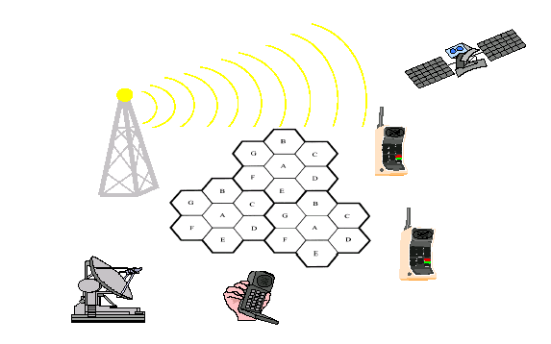
Chapter 1
INTRODUCTION TO WIRELESS COMMUNICATION SYSTEMS

Slide 97
1.1 Evolution of Mobile Radio Communications
Major Mobile Radio Systems
  1934 - Police Radio uses conventional AM mobile communication system.
  1935 - Edwin Armstrong demonstrate FM
  1946 - First public mobile telephone service - push-to-talk
  1960 - Improved Mobile Telephone Service, IMTS - full duplex
  1960 - Bell Lab introduce the concept of Cellular mobile system
  1968 - AT&T propose the concept of Cellular mobile system to FCC.
  1976 - Bell Mobile Phone service, poor service due to call blocking
  1983 - Advanced Mobile Phone System (AMPS), FDMA, FM
  1991 - Global System for Mobile (GSM), TDMA, GMSK
  1991 - U.S. Digital Cellular (USDC) IS-54, TDMA, DQPSK
  1993 - IS-95, CDMA, QPSK, BPSK

Slide 98
1.2 Example of Mobile Radio Systems
Examples
  Cordless phone
  Remote controller
  Hand-held walkie-talkies
  Pagers
  Cellular telephone
  Wireless LAN
Mobile - any radio terminal that could be moves during operation
Portable - hand-held and used at walking speed
Subscriber - mobile or portable user

Slide 99
Classification of mobile radio transmission system
  Simplex: communication in only one direction
  Half-duplex: same radio channel for both transmission and reception (push-to-talk)
  Full-duplex: simultaneous radio transmission and reception (FDD, TDD)
Frequency division duplexing uses two radio channel
  Forward channel: base station to mobile user
  Reverse channel: mobile user to base station
Time division duplexing shares a single radio channel in time.

Slide 100
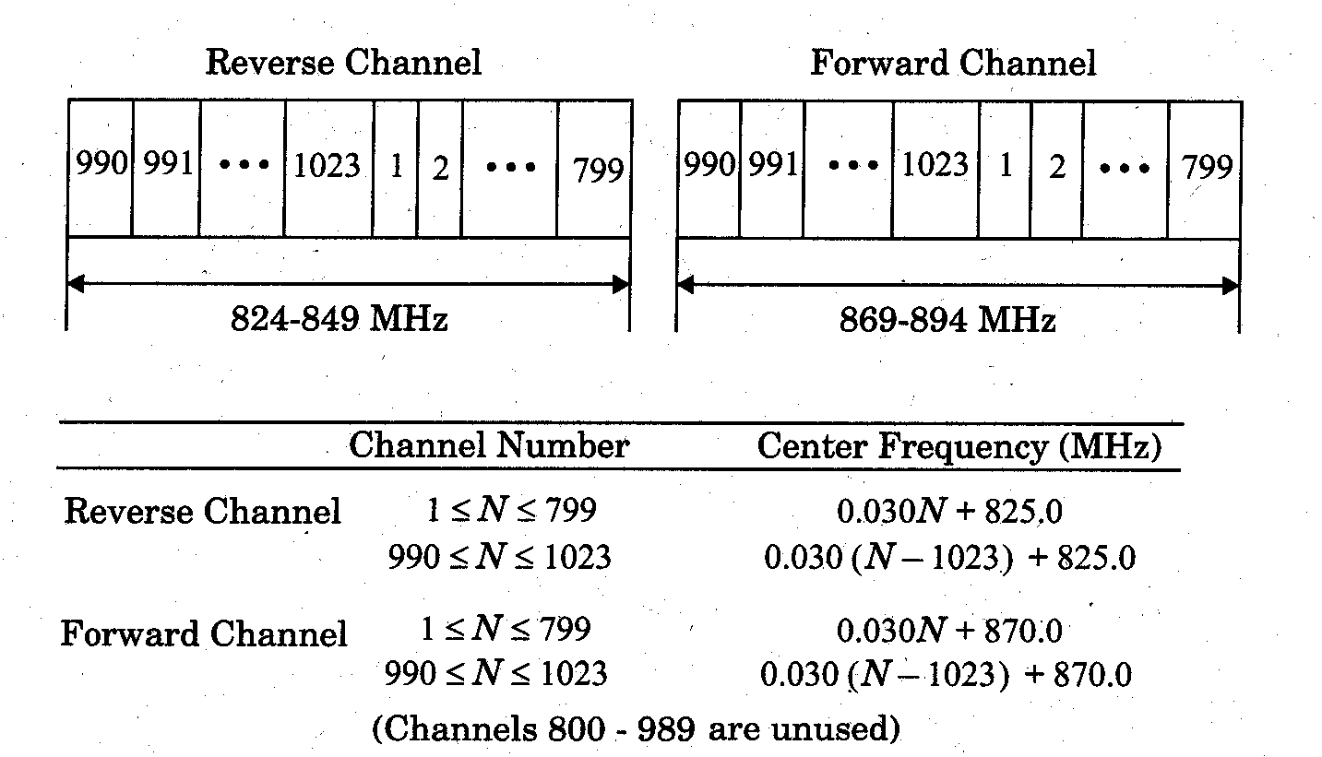

Slide 101
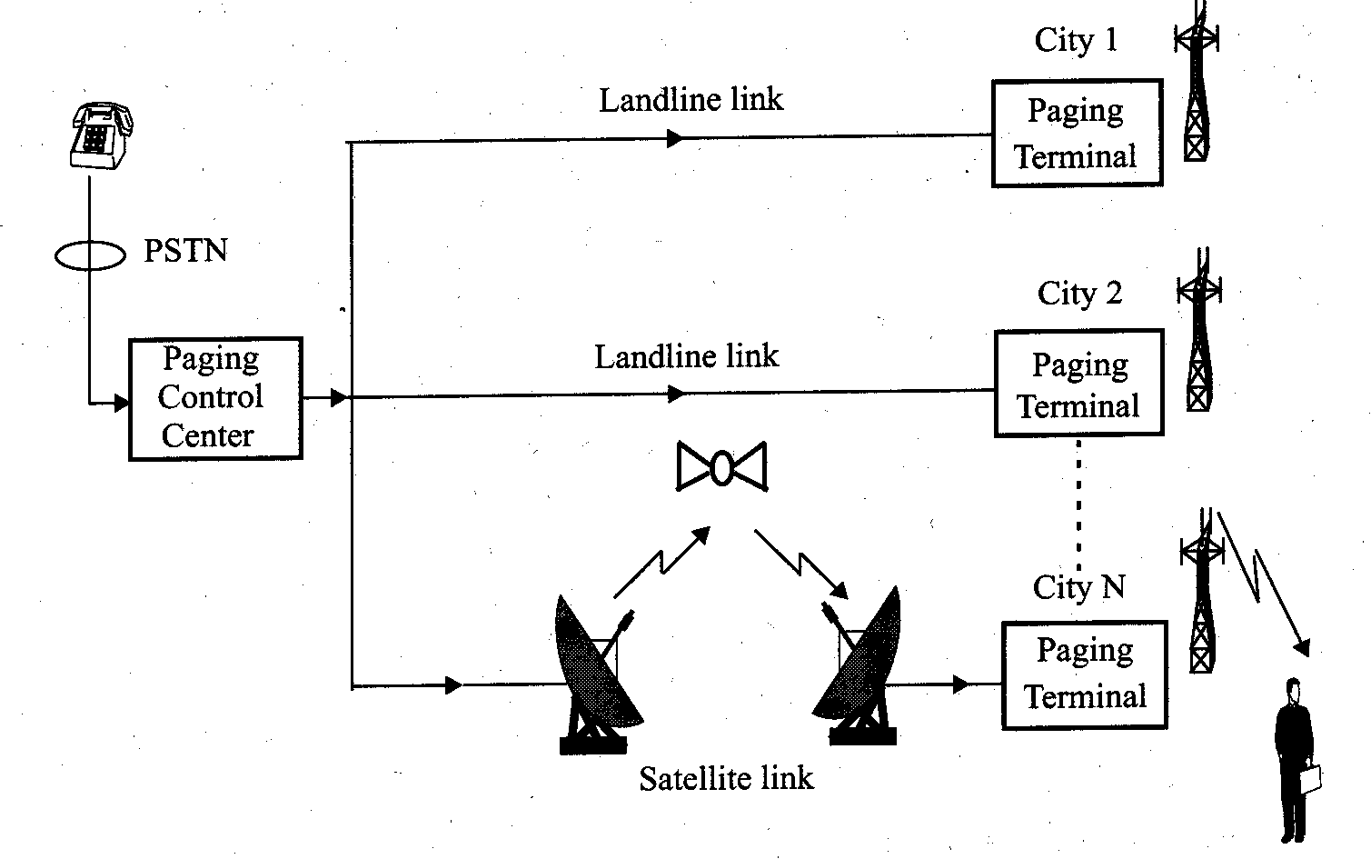
1.2.2 Paging Systems
Conventional paging system send brief messages to a subscriber
Modern paging system: news headline, stock quotations, faxes, etc.
Simultaneously broadcast paging message from each base station (simulcasting)
Large transmission power to cover wide area.

Slide 102
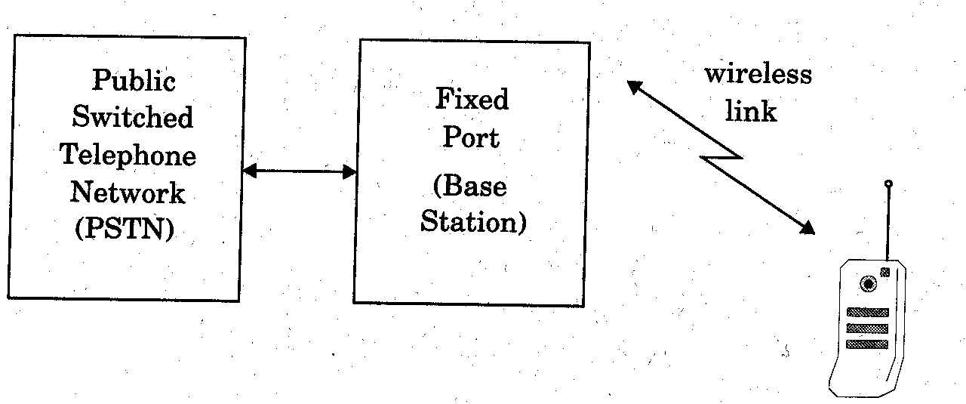
1.2.3 Cordless Telephone System
Cordless telephone systems are full duplex communication systems.
First generation cordless phone
  in-home use
  communication to dedicated base unit
  few tens of meters
Second generation cordless phone
  outdoor
  combine with paging system
  few hundred meters per station

Slide 103
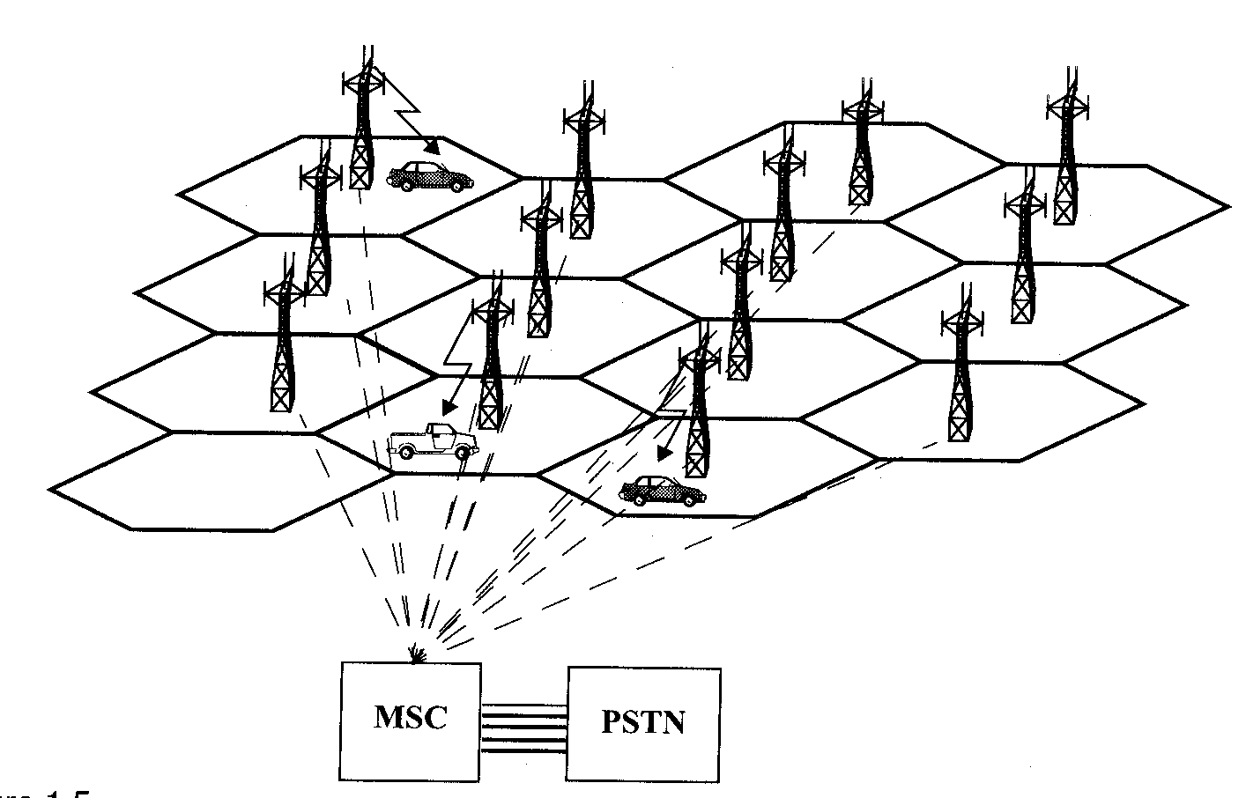
1.2.4 Cellular Telephone Systems
Provide connection to the PSTN for any user location within the radio range of the system.
Characteristic
  Large number of users
  Large Geographic area
  Limited frequency spectrum
  Reuse of the radio frequency by the concept of “cell’’.
Basic cellular system: mobile stations, base stations, and mobile switching center.

Slide 104
Communication between the base station and mobiles is defined by the standard common air interface (CAI)
  forward voice channel (FVC): voice transmission from base station to mobile
  reverse voice channel (RVC): voice transmission from mobile to base station
  forward control channels (FCC): initiating mobile call from base station to mobile
  reverse control channel (RCC): initiating mobile call from mobile to base station

Slide 105
Thank you!

Slide 107

www.studymafia.org
Seminar
On
MOBILE JAMMER
Submitted To: Submitted By:
www.studymafia.org www.studymafia.org

Slide 108
Content
What is Mobile Jammer?
History.
How Mobile Jammer works?
Jamming Techniques.
Design Parameters/Specification.
Block Diagram.
Power Supply.
Types of Jammer Device.
Application.
Future scope of Jamming Technology.
Conclusion.
Bibliography.
2

Slide 109
What is Mobile Jammer?
A mobile phone jammer is an instrument used to prevent cellular phones from receiving signals from base stations.
It is a device that transmit signal on the same frequency at which the GSM system operates, the jamming success when the mobile phones in the area where the jammer is located are disabled.
3

Slide 110
History
Mobile Jammer were originally developed for law enforcement and the military to interrupt communications by criminals and terrorists.
Some were also designed to foil the use of certain remotely detonated explosives.
4

Slide 111
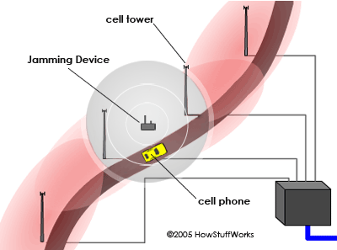
How Mobile jammer works
A jamming device transmits - same radio frequencies of greater power as the cell phone, disrupting the communication between the phone and the cell-phone base station in the tower. It's a called a denial-of-service attack.

Slide 112
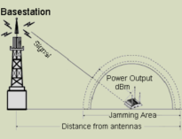
This causes interference with communication of cell phones and towers to render the phones unusable. On most phones, the network would be out of range.
So Jammers work by either disrupting phone to tower freq.. or tower to phone frequencies.

Slide 113
Jamming Techniques
Type "A" Device: JAMMERS
Type “B” Device: INTELLIGENT CELLULAR DISABLERS
Type “C” Device: INTELLIGENT BEACON DISABLERS
Type “D” Device: DIRECT RECEIVE & TRANSMIT JAMMERS
Type “E” Device: EMI SHIELD - PASSIVE JAMMING

Slide 114
Jamming Techniques
1. Type "A" Device: JAMMERS
This type of device comes equipped with several independent oscillators transmitting ’jamming signals’ capable of blocking frequencies used by paging devices as well as those used by cellular systems control channels for call establishment.

Slide 115
Jamming Techniques
2.Type “B” Device: INTELLIGENT CELLULAR DISABLERS
Unlike jammers, Type ”B” devices do not transmit an interfering signal on the control channels. The device, when located in a designated ’quite’ area, functions as a ’detector’. It has a unique identification number for communicating with the cellular base station.

Slide 116
Jamming Techniques
3. Type “C” Device (Intelligent Beacon Disablers)
Unlike jammers, Type C devices do not transmit an interfering signal on the control channels. The device, when located in a designated ’quiet’ area, functions as a ’beacon’ and any compatible terminal is instructed to disable its ringer or disable its operation, while within the coverage area of beacon.

Slide 117
Jamming Techniques
4. Type “D” Device (Direct Receive & Transmit Jammers)
This jammer behaves like a small, independent and portable base station, which can directly interact intelligently or unintelligently with the operation of the local mobile phone. The jammer is predominantly in receive mode and will intelligently choose to interact and block the cell Phone directly if it is within close proximity of the jammer.

Slide 118
Jamming Techniques
5. Type E Device (EMI Shield - Passive Jamming)
This technique is using EMI suppression techniques to make a room into what is called Faraday cage. Although labor intensive to construct, the Faraday cage essentially Blocks or greatly attenuates, virtually all electromagnetic radiation from entering or leaving the cage - or in this case a target room.

Slide 119
Design Parameters/Specification
The frequency bands
Distance to be jammed (D)
Free space loss {F}= Path Loss (dB)= 32.44 + 20 log D(km) + 20log f(MHz)
Power calculations

Slide 120
Block Diagram
Power supply
If section
Rf section
Jamming signals

Slide 121
Power Supply
Transformer
Rectifier
filter
Regulator

Slide 122
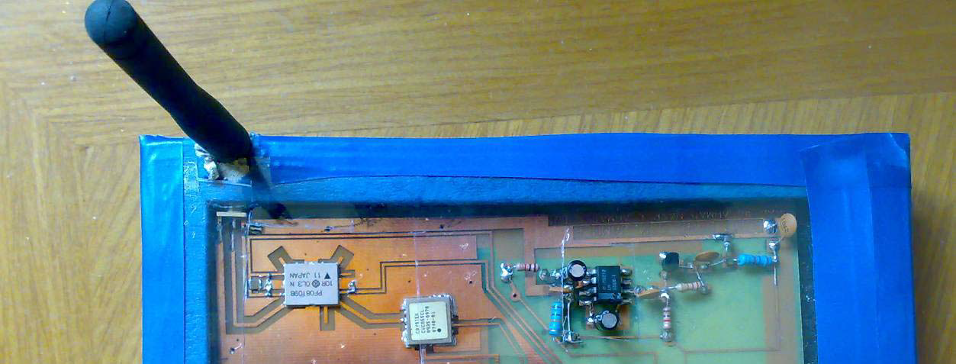
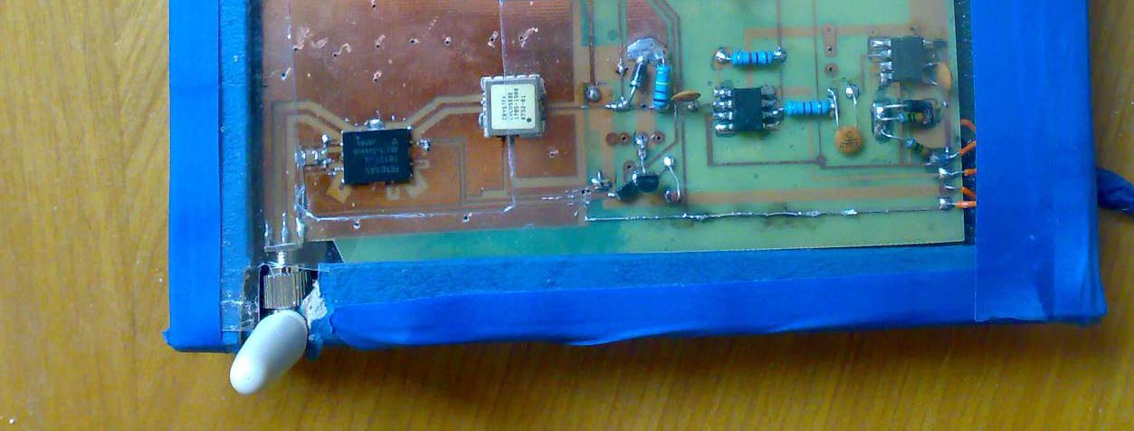
Contd.
Mobile Jammer

Slide 123
Types of Jammer Device
Types of cell phone jammer device. There are many types of cell phone jammer device which is used in our daily life .as we take a example of class room, where we does not want to use of cell phone than there we can use cell phone jammer device. By this we can produce the interface between the cell phone base station and cell phone. resulting it disconnect the cell from base station. and we can not receive the any calls from base station.
For this there are many types of cell phone jammer devices which is given as below:
17

Slide 124
    Remote Control Mobile jammer
    Adjustable Mobile Jammer
    School &Prison Mobile Jammer
    Explosion – Proof Mobile jammer
    Police & Military Mobile Jammer
    Portable Mobile Jammer
18

Slide 125
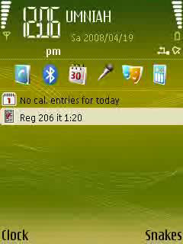
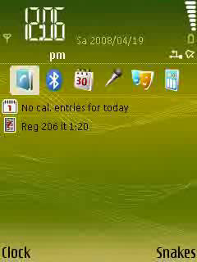
19

Slide 126
Application
To maintain the complete silence in library and lecture hall
To avoid fraud in examination hall
To avoid disturbance in class room
For providing security in business conference, board of directors rooms, seminars, etc.,
For providing calm and peaceful atmosphere in Hospitals
Church/Mosques/Cathedral/Temple/Religious establishment

Slide 127
Future scope of Jamming Technology
While the law clearly prohibits using a device to actively disrupt a cell-phone signal, there are no rules against passive cell-phone blocking.
Companies are working on devices that control a cell phone but do not "jam the signal.

Slide 128
Conclusion
Every technology has good aspect as well as bad aspect the important thing is, how we are using it.
Cell phone jammers are very useful to the society from the anti-social elements. We can save our national leaders. we can restrict the communication network between the anti-social elements by using the Mobile jammers. Cell phone jammers prevent the students from carrying cell phones to the colleges.

Slide 129

Mobile Technologies
Challenges and Case Studies
Phuong Nguyen
University of Basel
Switzerland

Slide 130
Outline
Overview of mobile technologies
Advantages of mobile devices
Challenges
CoMobile, collaborative tasks with mobile phone
Conclusion

Slide 131

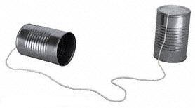
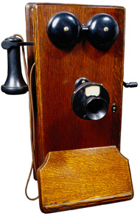
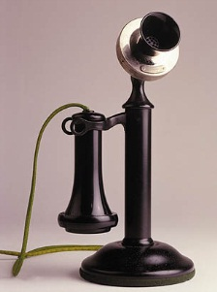
Device for voice communication
Alexander Graham Bell (1876)

Slide 132
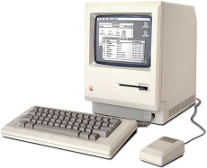

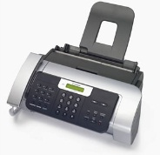

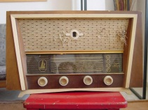

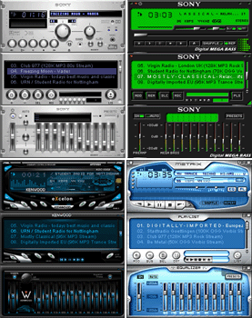
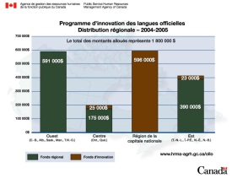
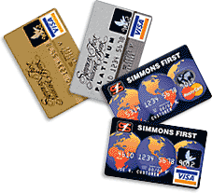
Everyday life‘s tools
Computer
Fax
Radio
Email
Music player
Word processor
Credit cards

Slide 133
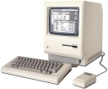






Everyday life‘s tools
Mobile phones are first introduced in mid 1980s
Computer
Email
Word processor
Music player
Smart phone
Additional features can be installed
Fax
Radio

Slide 134
Mobile applications
Banking (check balance, make transaction)
Restaurant (order and payment)
Mobile Payment (ticket, vending machine)
Tourism: tourist guide
Education: mobile learning
Entertainment: interactive digital art
Scientific: controlling and monitoring

Slide 135

Interactive Digital Art - TelcomGallery
Use mobile phone to interact with the object:
- Pressing the phone's keys
Speaking to the phone,
Or simply holding the call.
Voice of the user can change the audio-visual
parameters of the digital artworks in real-time

Slide 136



Mobile devices as remote control

Slide 137
Advantages of mobile devices
Accessible anywhere, anytime
Conveniently controlling and monitoring
Instant notification
Easy to exchange data and information

Slide 138
Challenges
Small screen-size (will remains)
Limited input facilities (will remains?)
Diverse software environments:
OS (Symbian, Linux, Windows Mobile), Language (J2ME, BREW, C++)
Limited bandwidth (will be solved):
GSM->GPRS->UMTS, CDMA, WiFi

Slide 139
Question
How can we use mobile devices efficiently?
(One answer is in next slides)

Slide 140
Uni Basel-CoMobile overview
Collaboration between: web clients and mobile clients
Diverse communication channels:
SMS, MMS, Voice, WAP, HTTP, Bluetooth
Modularity: flexible and extendable

Slide 141

Uni Basel-CoMobile architecture

Slide 142

Example
Jobs done: 40
Queues : 30
Status: OK
Elapsed time: 1 hour
Remain time: 2 hours
Short text can be sent via SMS
What about this text?
Client-side globus-hostname command is not returning a fully qualified domain name (FQN).
The submission scripts use globus-hostname to send information to the server about how to contact the client.
The fix is to make globus-hostname return the FQDN.
There are firewalls and ports (GRAM: 2119, LDAP: 2135) which are not open.
Check that GLOBUS_TCP_PORT_RANGE is set to 3000 to 3090 on the client
(or another range acceptable for the server to contact the client on),
and that all intermediate firewalls are open for this range in both directions.
GRAM Job submission failed because the executable file permissions do not allow execution".
Probable cause: You submitted a script, e.g., globus-job-run symphony:2119/jobmanager-loadleveler $PWD/simple.
ll but simple.ll does not have the execute permission bit set.
The error msg "Authentication Failed remote certificate signed by unknown CA"
means the client cannot find the CA for the cert presented by the server.
Make sure the CA cert is present in the trusted cert dir set with setup-gsi.
Also, check the time is consistent across the machines.
The error msg "GRAM Job submission failed because the connection to the server failed (check host and port)
Make sure that the gatekeeper service is enabled.
The error msg "GRAM Job submission failed because data transfer to the server failed"
means the job manager has problems opening some file.
Make sure $GLOBUS_LOCATION is readable by all the users (mode 755)

Slide 143
Uni Basel-CoMobile demo
Demo : Text to Speech, and access via phone

Slide 144
Uni Basel-CoMobile features
Data submission: send information (text, images, audio, video) via SMS, MMS, voice recording.
Receive SMS notification (replies, reminds, alerts).
Access information via various channels: Voice, SMS, MMS, WAP, Bluetooth.
Search on multimedia contents.

Slide 145
Search with CoMobile
Search on multimedia content
(video, audio, picture):
Using metadata
Automated speech recognition (ASR)
Optical character recognition (OCR)

Slide 146
Conclusion
Mobile devices are being used in various kinds of applications.
Uni Basel-CoMobile: an useful framework that support collaborative activities with mobile devices.
CoMobile is designed for extension and integration with other systems.

Slide 147
Discussion
Cost: Users have to pay for SMS, MMS, as well as voice call. „Flat rate“ package will be common in the near future.
Storage: 1 minute video = 1 MB (approximately). There exists 2GB flash card for mobile phone
Bandwidth: 14.4 kbps (GSM), 140 kbps (GPRS), 1920 kbps (UMTS)

Slide 148




SMS gateway - Kannel
HTTP request to forward SMS Text
RS-232
AT Commands
AT+CNMI=1,2,0,1,1
SMS Text

Slide 149

MMS gateway - Mbuni
Mbuni
HTTP request to forward MMS
RS-232
AT Commands
AT+CNMI=1,2,0,1,1
MMS
Text, Picture, Audio

Slide 150


PBX Asterisk
AGI: Perl, Java, PHP scripts are called
Voice
PCI socket
Telephone line

Slide 151

Uni Basel-CoMobile-Demo

