Slide 1
Total Synthesis of Prostaglandins
Dr. K. SRINIVASAN
School of Chemistry
Bharathidasan University
Thanks to K. W. Shimkin

Slide 2
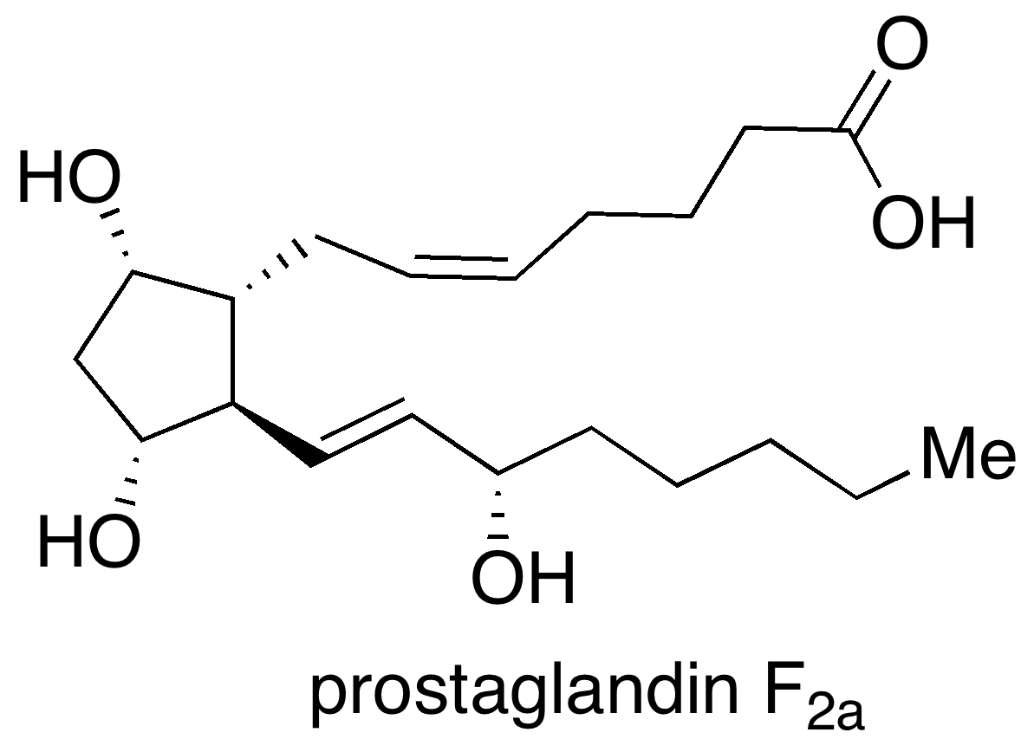
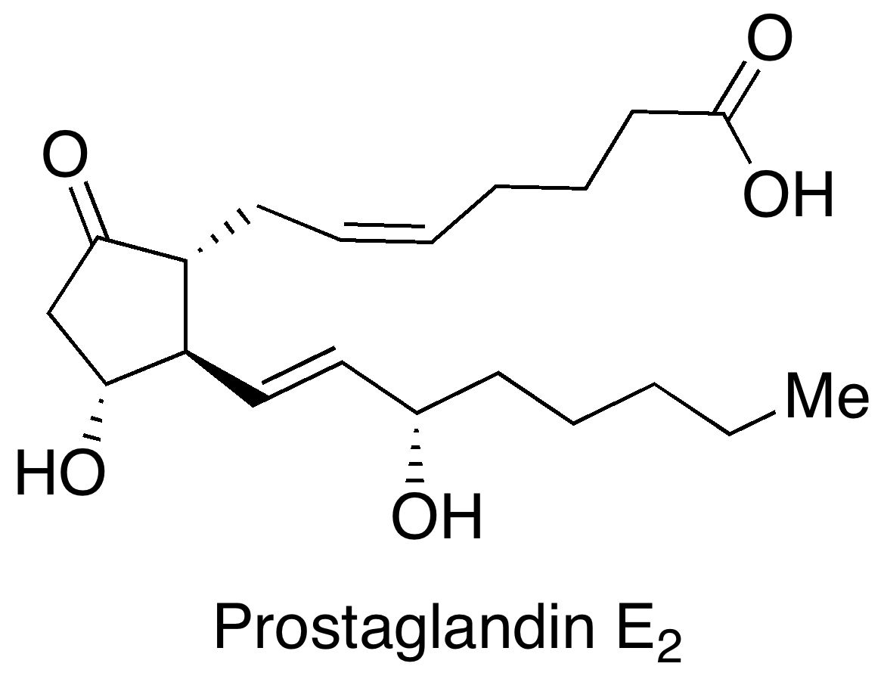
Prostaglandins
Lipid compounds (not hormones)
All contain 20 carbons, 5-membered ring
First isolated from seminal fluid in 1935 (Ulf von Euler).
But it is also produced by various types of cells
Regulate contraction and relaxation of smooth muscle tissues

Slide 3
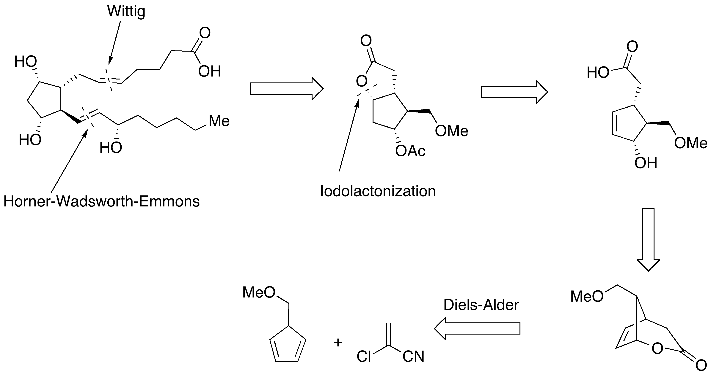
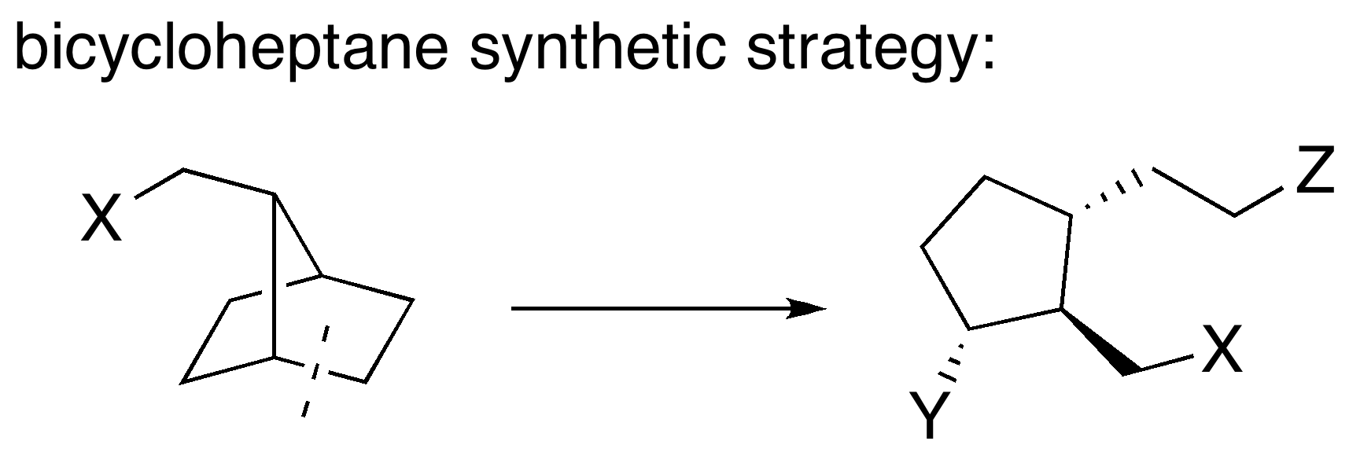
Retrosynthesis
Corey’s Work
Ref: JACS, 1970, 92, 398

Slide 4
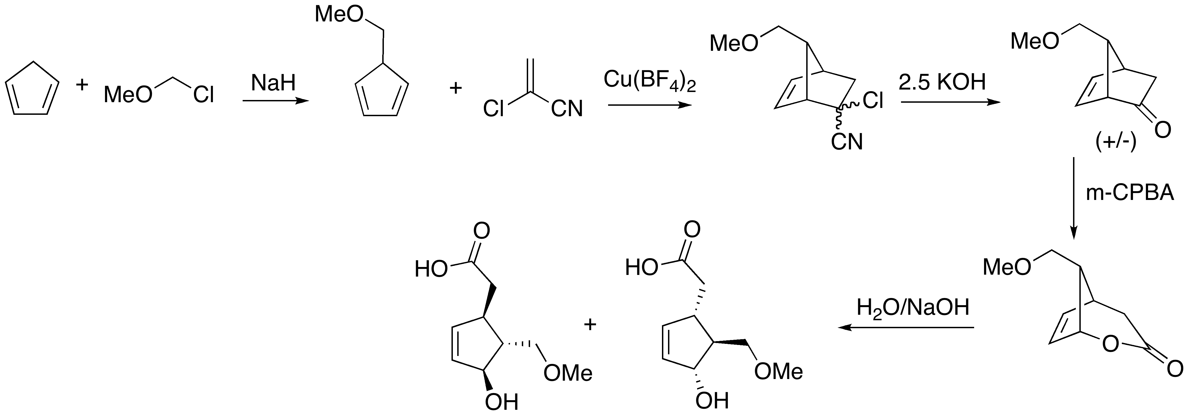
Total Synthesis

Slide 5
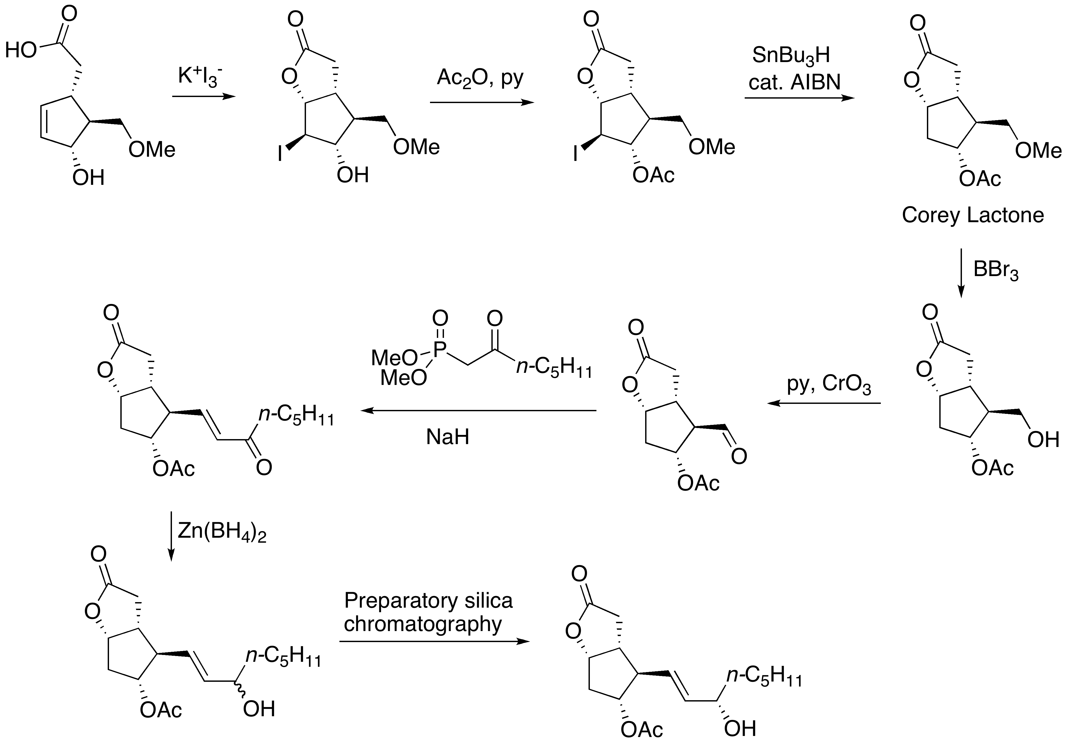

Slide 6
