Slide 1
Aromatic Nucleophilic Substitution: Arynes
Dr. K. Srinivasan
School of Chemistry
Bharathidasan University

Slide 2
INTRODUCTION
W. E. Bachmann, et al., J. Am. Chem. Soc. 1927, 49, 2089–98.
G. Wittig, Naturwissenschaften 1942, 30, 696-703.
J. D. Roberts, et al., J. Am. Chem. Soc. 1953, 75, 3290-91.

Slide 3
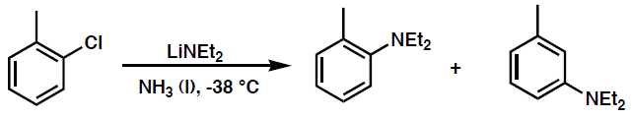
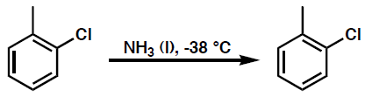
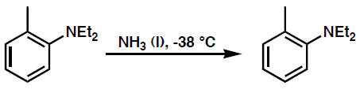
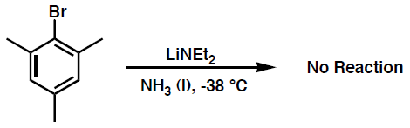
First experimental observations that supported benzyne existence:
J. D. Roberts, et al., J. Am. Chem. Soc. 1953, 75, 3290-91.

Slide 4
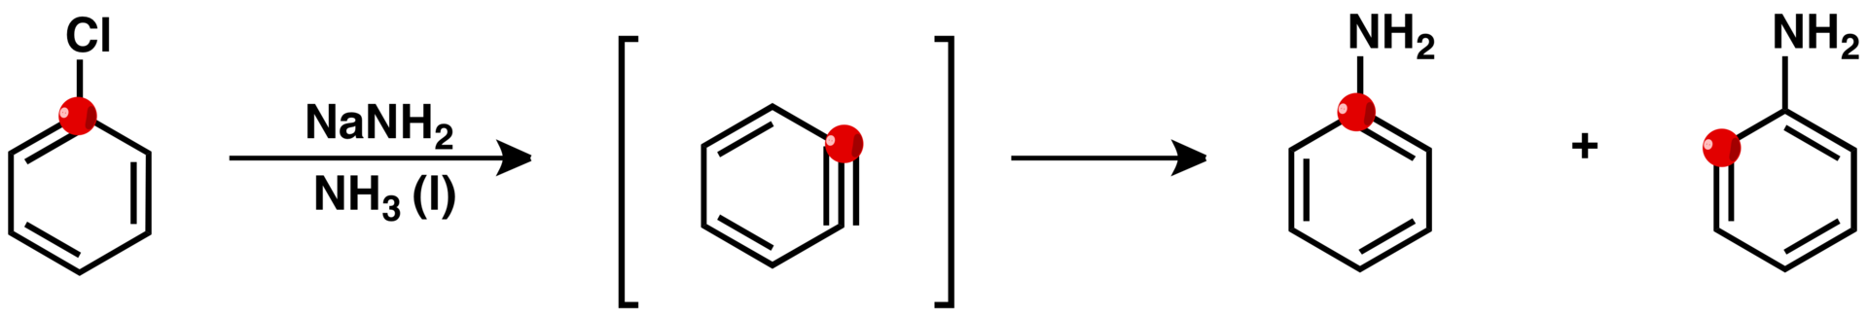

¹⁴C labelling experiment to demonstrate the existence of benzyne.
42%
Practically 1:1 ratio
J. D. Roberts, et al., J. Am. Chem. Soc. 1953, 75, 3290-1.
“These facts as well as the orientation data for various substituents can be accommodated by an elimination-addition mechanism involving at least transitory existence of an electrically neutral “benzyne” intermediate”
Further experimental evidence of its existence
IR J. G. Radziszewski, et al., J. Am. Chem. Soc. 1992, 114, 52–57.
Photoelectron W. C. Lineberger, et al., J. Am. Chem. Soc. 1998, 120, 5279–5290.
NMR R. Warmuth, Chem. Commun. 1998, 59–60.

Slide 5
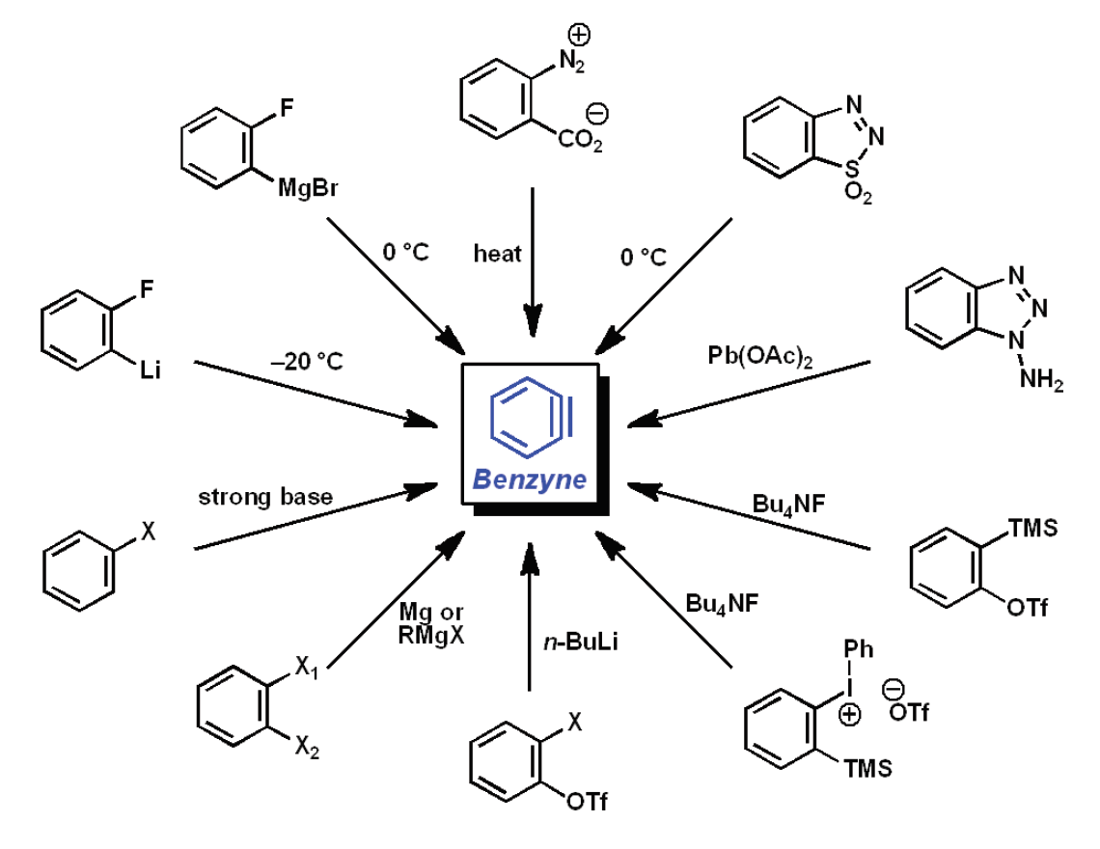
ARYNE GENERATION
Elimination reactions

Slide 6
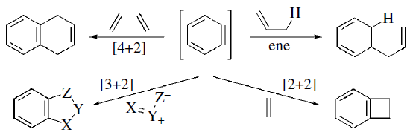
Reactivity of Arynes

