Slide 1
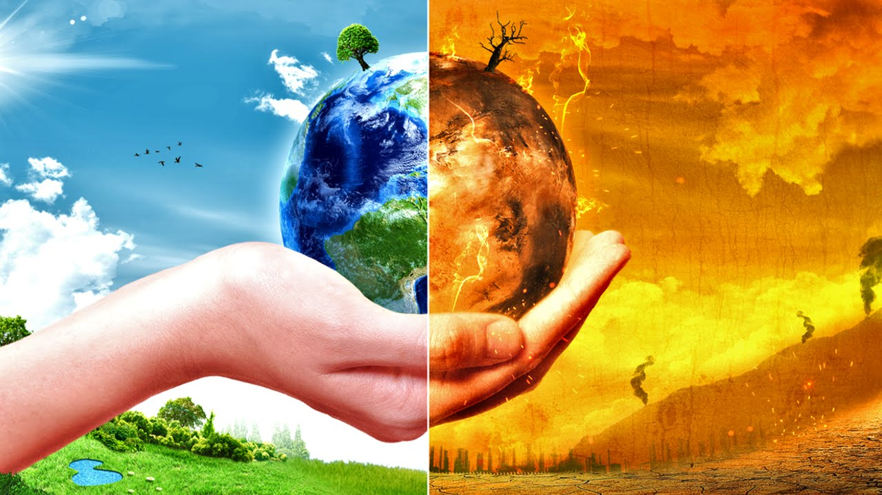
UNIT V: Social Issues and Environment
Climate Change, Ozone Layer Depletion and Air Pollution
Program : M.Sc. Zoology
Semester : III
Course : Environmental Biology

Slide 2
Key Concepts
Components of Earth’s atmosphere
Changes in Earth’s climate over time
Possible effects of global warming
Adapting to climate change
Human impacts on the ozone layer
Protecting and restoring the ozone layer

Slide 3
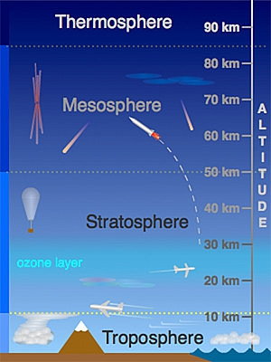
Troposphere
Where weather happens
Location - surface to about 10 km.
Composition - unpolluted air: Nitrogen (78%) Oxygen (21%). Remaining 1% is CO2 (0.0365%), H, He, Ar.
Water vapor is an additional variable amount, .01% to 5%.
Source:https://goo.gl/images/iPXHY6

Slide 4
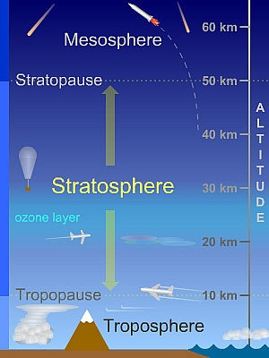
Stratosphere
Where jets fly (at the bottom of it)
Location - Above troposphere, about 10-50 km. Very thin air - virtually no weather, and no turbulence.
Composition- Similar to troposphere, except
water vapor is 1000 x less
ozone is 1000 x greater.
Source:https://goo.gl/images/tXu4PS

Slide 5
Climate and Weather
Climate = long-term atmospheric conditions
Weather = short-term atmospheric conditions
Both climate and weather are dynamic – they change with time

Slide 6
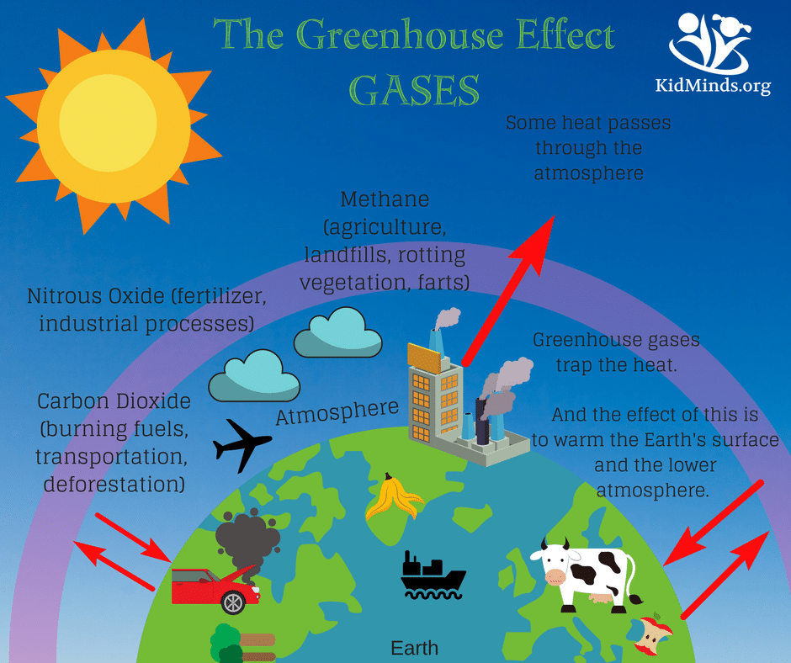

Slide 7
Greenhouse gases
Carbon Dioxide - fossil fuel burning, land clearing/burning.
Methane - Breakdown of organic material by anaerobic bacteria.
Nitrous Oxide - Biomass burning, automobile exhaust.
Ozone – automobile exhaust
Chlorofluorocarbons - Refrigerants, cleaning solvents, propellants.
Source: https://goo.gl/images/xKTuwd

Slide 8
Evidence for Climate Change
20th C was hottest in the past 1000 years
Global temp has risen 0.6°C (1.1°F) since 1861
16 warmest years on record since 1980, 10 warmest since 1990
Glaciers and sea ice are melting
Sea level has risen 100-200 cm over 20th C

Slide 9
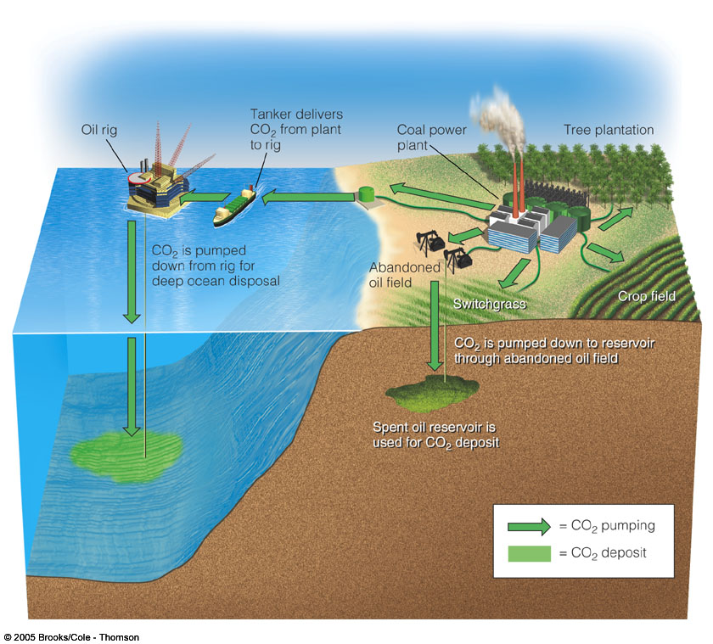
Removing CO₂ from the Atmosphere

Slide 10
CFCs
Chlorofluorocarbons (CFCs) and related chemicals break down ozone in stratosphere
Uses (mostly phased out)
Air Conditioners
Refrigerators
Spray cans
Cleaners for electronic parts
Sterilizing medical instruments
Fumigants for granaries and cargo ships
Source:https://goo.gl/images/t4F2dF

Slide 11
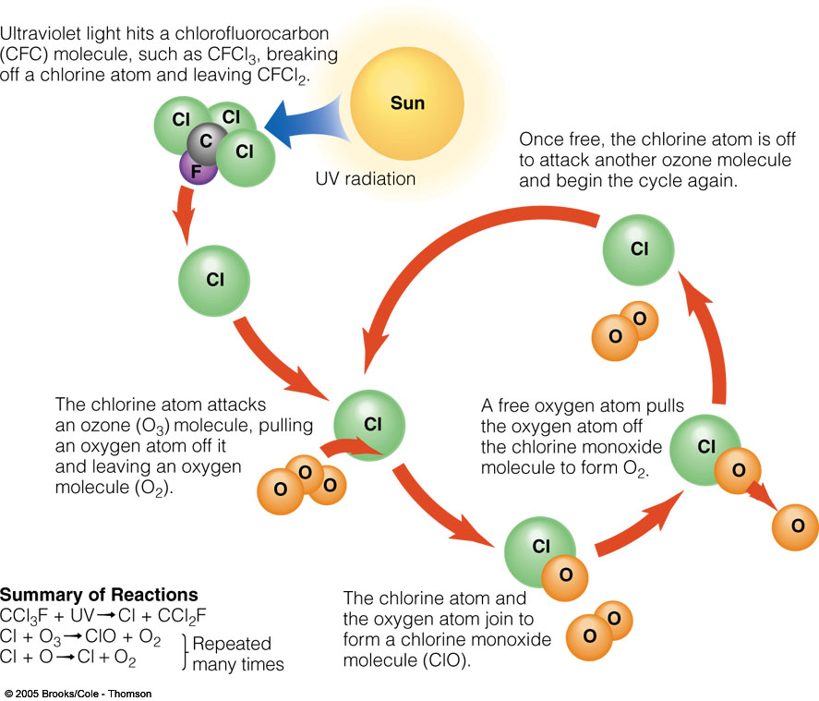
Ozone Depletion in the Stratosphere

Slide 12
Loss of the Ozone Layer: Reasons for Concern
Increased incidence and severity of sunburn
Increase in eye cataracts
Increased incidence of skin cancer
Immune system suppression
Increase in acid deposition
Lower crop yields and decline in productivity

Slide 13
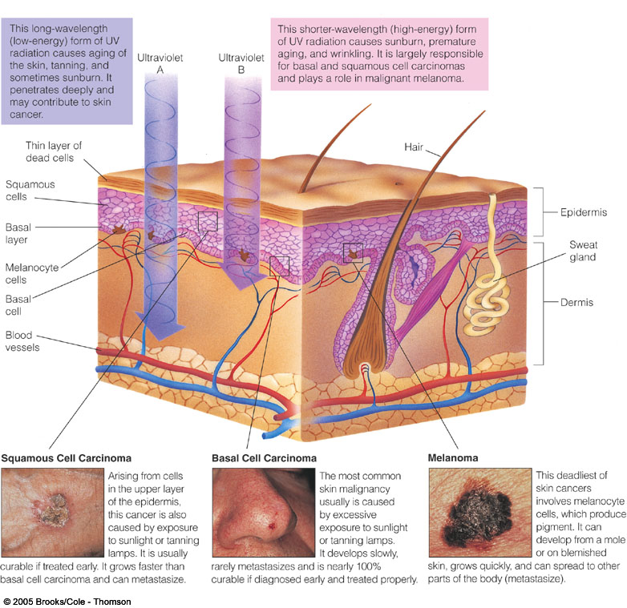
Skin Cancers

Slide 14
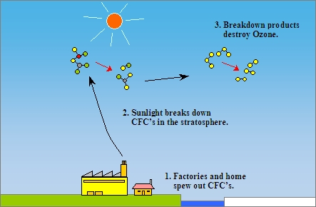
Solutions: Protecting the Ozone Layer

Slide 15
Air Pollution
Key Concepts
Structure and composition of the atmosphere
Types and sources of outdoor air pollution
Types, formation, and effects of smog
Sources and effects of acid deposition
Effects of air pollution
Prevention and control of air pollution
Source: https://goo.gl/images/EgzETk

Slide 16
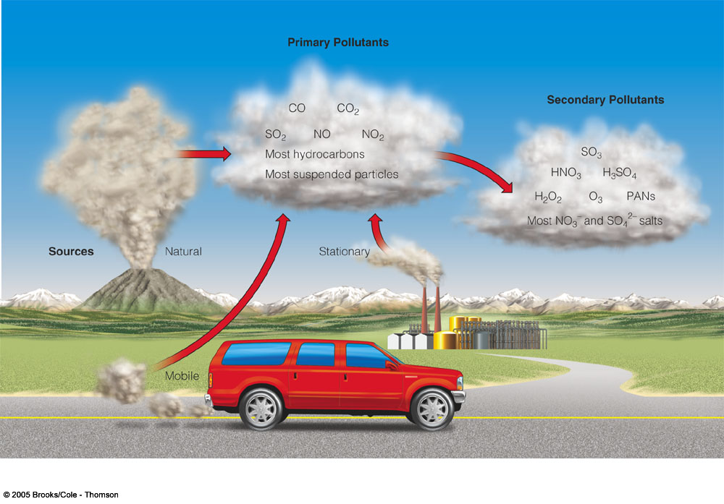
Outdoor Air Pollution
Primary - Released directly from planet’s surface. Dust, smoke particles, Nitrogen, Carbon etc.
Secondary - Formed when primary pollutants react or combine with one another, or basic elements.
Source: https://goo.gl/images/xMx5hm

Slide 17
Primary Air Pollutants
Carbon Monoxide—Produced when organic materials are incompletely burned.
Single largest source is the automobile.
Not a persistent pollutant.
Binds to hemoglobin in blood and makes the hemoglobin less able to carry oxygen.
Most dangerous in enclosed spaces.
Cigarette smoking an important source.

Slide 18
Primary Air Pollutants
Volatile Organic Compounds
Hydrocarbons - Group of organic compounds consisting of carbon and hydrogen.
Evaporated from automobile fuel or remnants of fuel incompletely burned.
Catalytic converters used to burn exhaust gases more completely.

Slide 19
Primary Air Pollutants
Sulfur Dioxide (SO₂)—Sulfur and oxygen compound produced when sulfur-containing fossil fuels are burned.
Burning coal is primary artificial source
Volcanoes and hot springs are natural sources
Mt St Helens releases 50 to 250 tons/day when active
Steam Plant recently: 200 tons/day
After scrubbers installed (cost $250 million): 27 tons/day
SO₂ is also a precursor to acid rain (a secondary pollutant)

Slide 20
Primary Air Pollutants
Nitrogen Oxides (NO, NO₂)—Formed when combustion takes place in the air.
Automobile exhaust is primary source.
NO_{x} is also a precursor to acid rain and photochemical smog (both secondary pollutants) and is a greenhouse gas

Slide 21
Secondary Air Pollutants
Ozone (O3)
PANs (Peroxyacetyl nitrate)
Aldehydes
all three formed by interaction between NOx and VOCs.
Note: - Ozone is a pollutant in the troposphere, but natural and beneficial in the stratosphere.

Slide 22
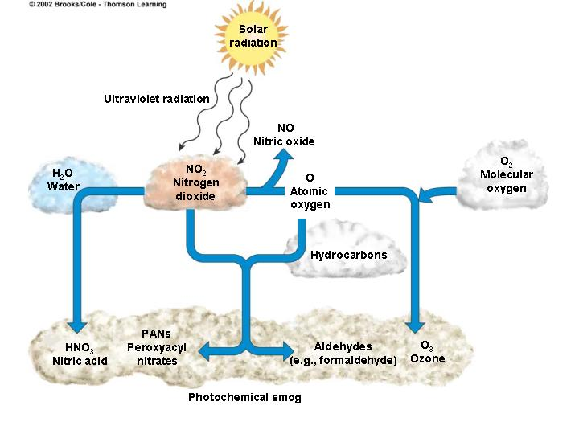
Photochemical Smog
Brown-air smog
Some primary pollutants react under the influence of sunlight (photochemical reaction), including NO_{x}, O₃, PANs. Corrosive, irritating.
Common in urban areas of the west US: cars + sun + mountains.
Source: https://goo.gl/images/A5sQBg

Slide 23
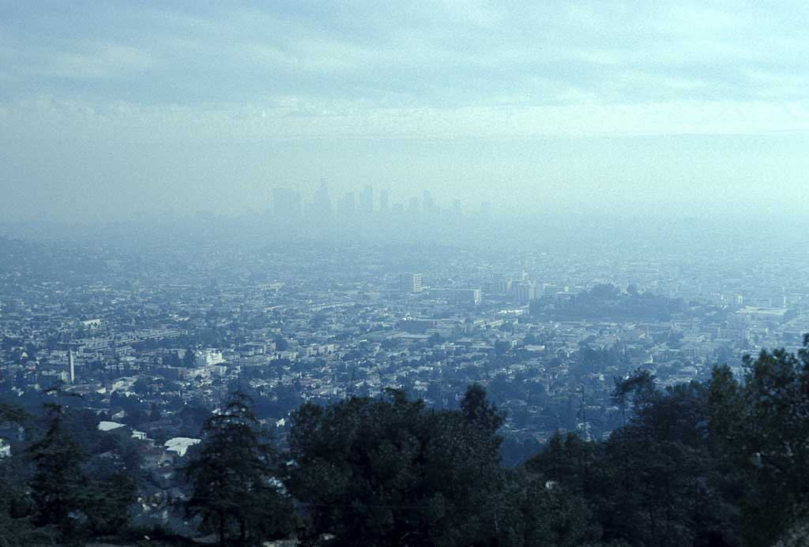

Slide 24
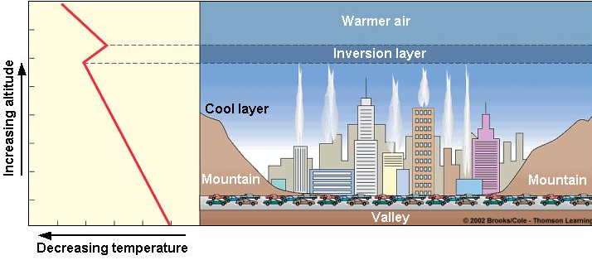
Thermal inversion
warm air normally near surface, pollutants disperse as air rises and mixes
when cool air trapped under warm air, confined by mountains, pollutants do not disperse, intensify with time
Source : https://goo.gl/images/QBYCgo

Slide 25
Acid Deposition and Humans
Respiratory diseases
Toxic metal leaching
Damage to structures, especially containing calcium carbonate
Decreased visibility
Decreased productivity and profitability of fisheries, forests, and farms

Slide 26
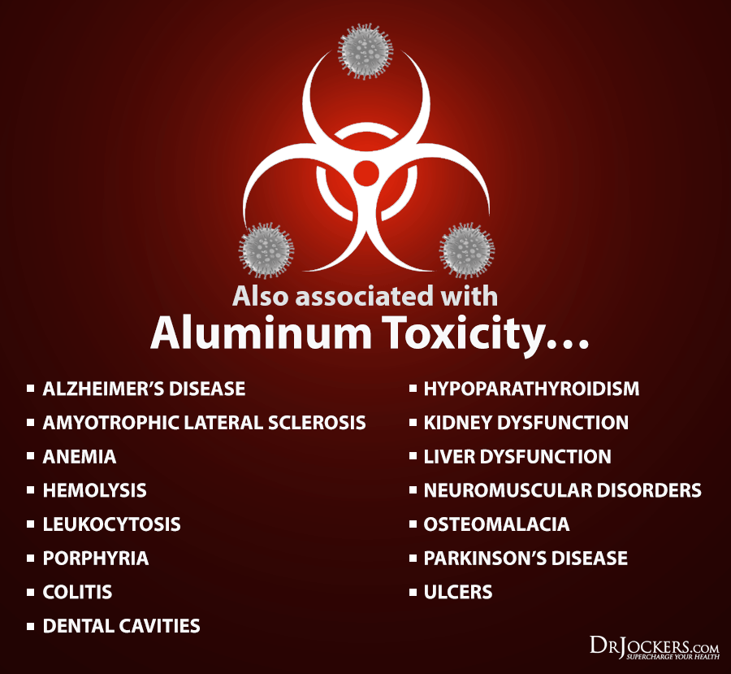
Acid Deposition and Aquatic Systems
Fish declines
Aluminum toxicity
Acid shock
Source:
https://goo.gl/images/mU65TA

Slide 27
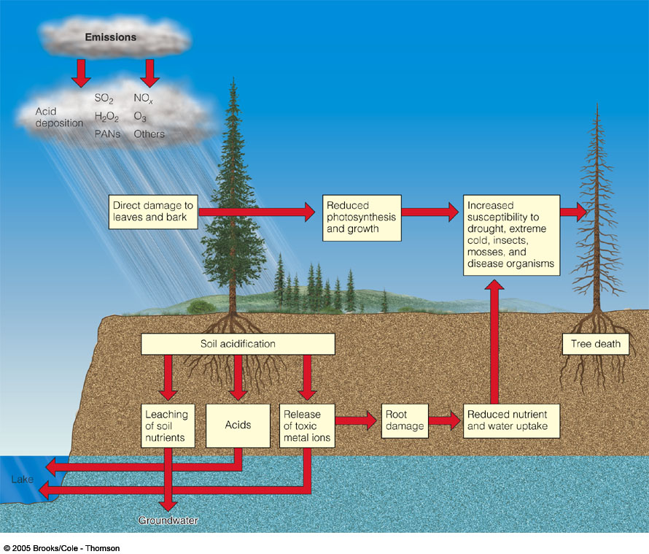
Acid Deposition, Plants, and Soil
Nutrient leaching
Heavy metal release
Weakens trees

Slide 28
Effects of Air Pollution on People
Respiratory diseases
Asthma
Lung cancer
Chronic bronchitis
Emphysema
Premature death

Slide 29
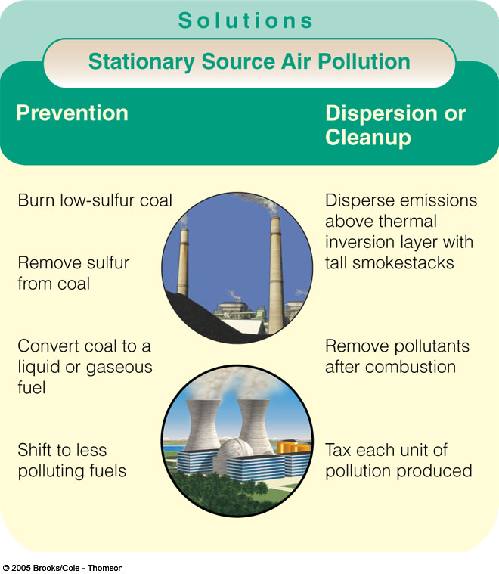
Emission Reduction

Slide 30
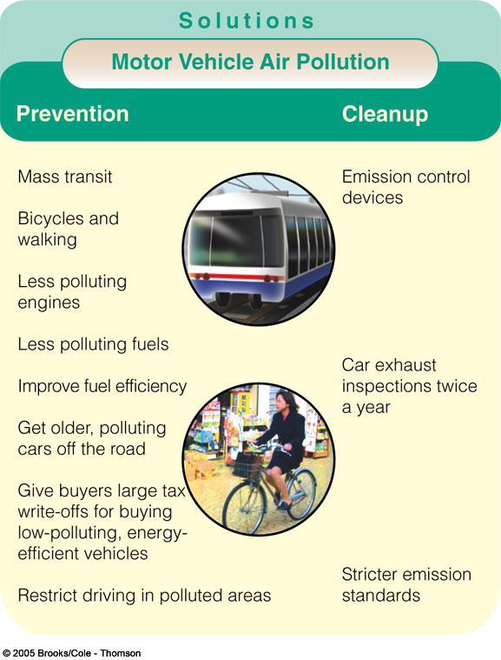
Reducing Motor Vehicle Air Pollution

Slide 31
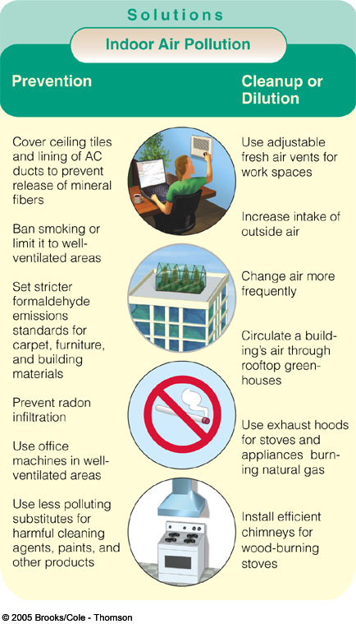
Reducing Indoor Air Pollution source: https://goo.gl/images/vdfkVF

