Slide 1
Waste management
Program: M.Sc. Zoology
Semester: III
Course: General Microbiology

Slide 2
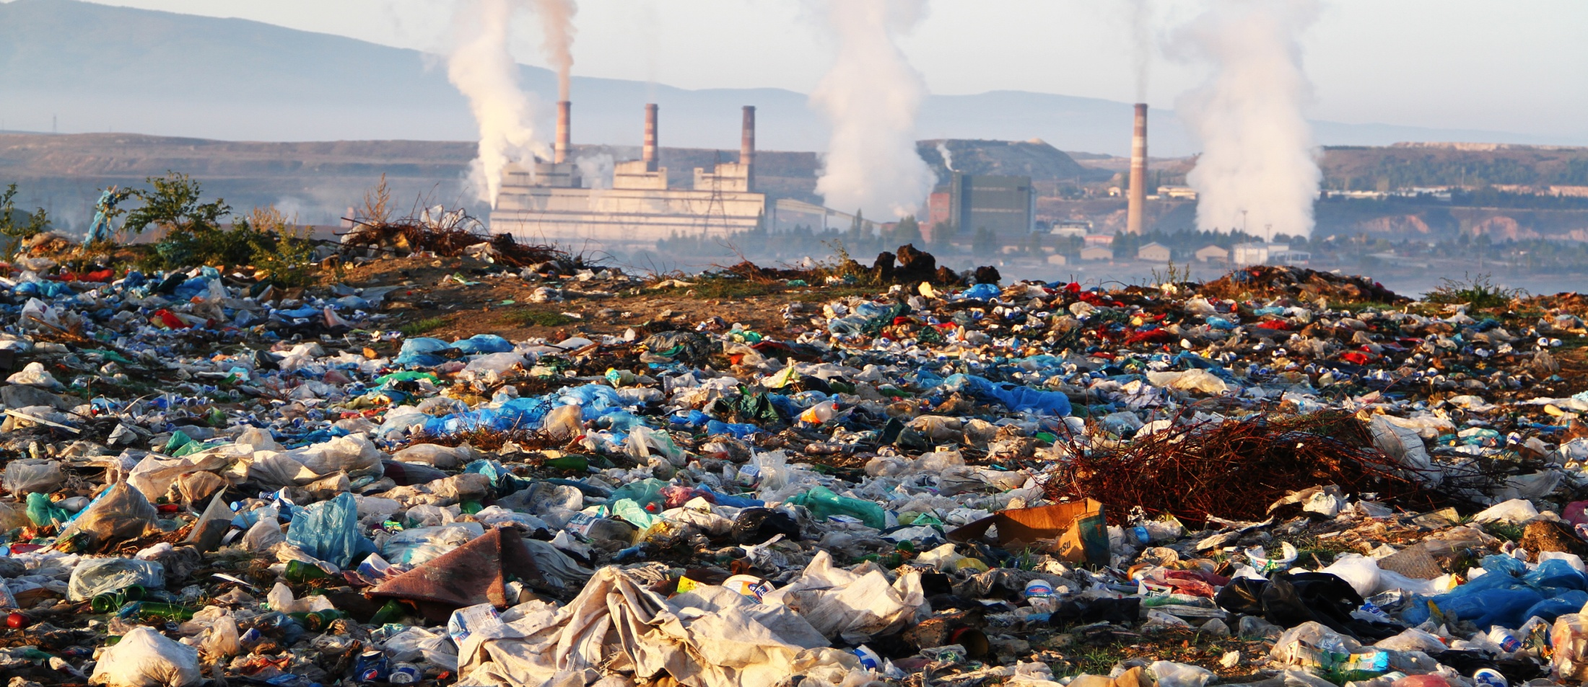
Waste ?
Waste (also known as rubbish, trash, refuse, garbage, junk, litter, and ort) is unwanted or useless materials. In biology, waste is any of the many unwanted substances or toxins that are expelled from living organisms, metabolic waste; such as urea and sweat. SOURCE :https://goo.gl/images/xJ9QXU

Slide 3
Basel Convention
Basel Convention on the Control of Transboundary Movements of Hazardous Wastes and Their Disposal, usually known simply as Basel Convention, is an international treaty that was designed to reduce the movements of hazardous waste between nations, specially to prevent transfer of hazardous waste from developed to less developed countries (LDCs).

Slide 4
Kinds of Wastes
Solid wastes: wastes in solid forms, domestic, commercial and industrial wastes
Examples: plastics, styrofoam containers, bottles, cans, papers, scrap iron, and other trash
Liquid Wastes: wastes in liquid form
Examples: domestic washings, chemicals, oils, waste water from ponds, manufacturing industries and other sources

Slide 5
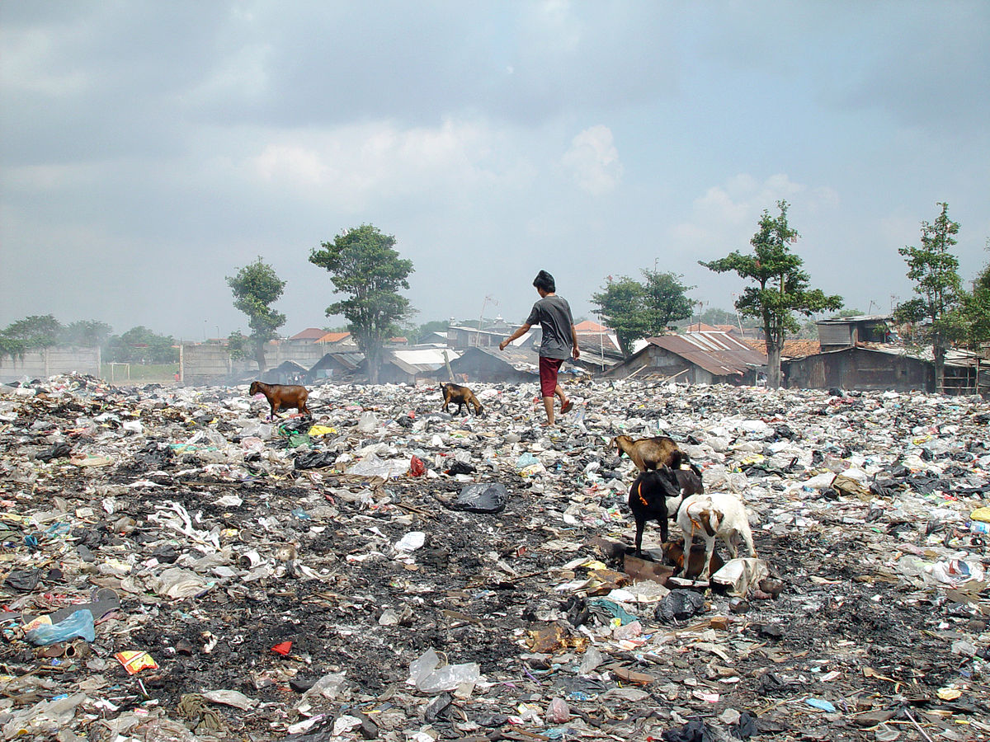
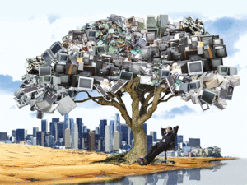
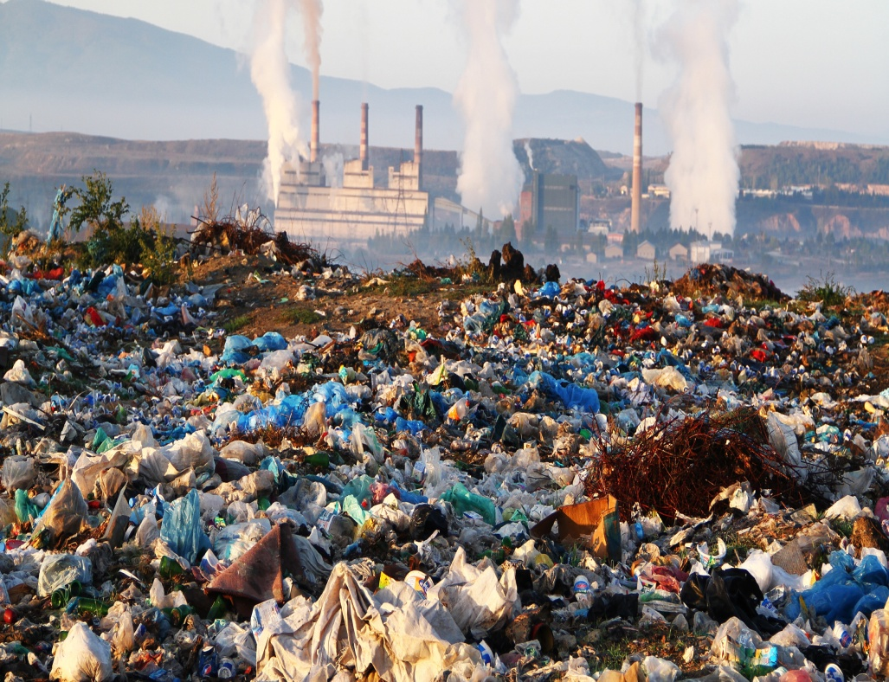

Slide 6
Classification of Wastes according to their Properties
Bio-degradable
can be degraded (paper, wood, fruits and others)
Non-biodegradable
cannot be degraded (plastics, bottles, old machines,cans, styrofoam containers and others)

Slide 7
Classification of wastes according to their origin and type
Municipal Solid wastes
Bio-medical wastes
Industrial wastes
Agricultural wastes
Fishery wastes
Radioactive wastes
E-wastes

Slide 8
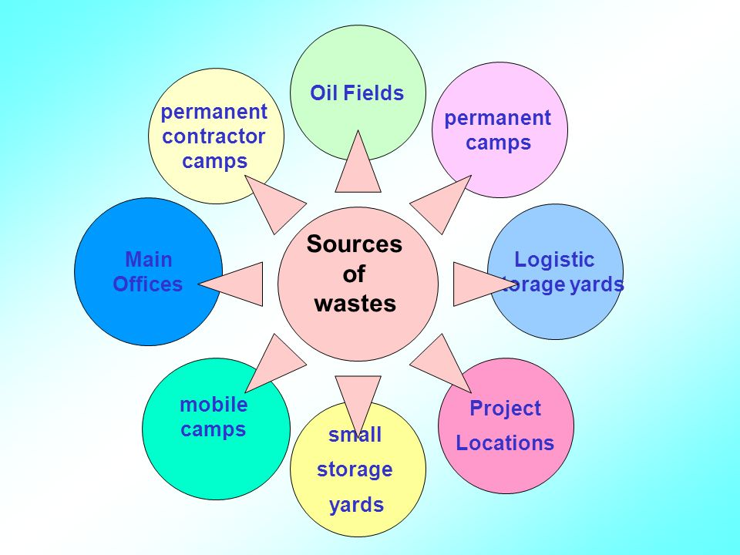

Slide 9
IMPACTS OF WASTE IF NOT MANAGED WISELY
Affects our health
Affects our socio-economic conditions
Affects our coastal and marine environment
Affects our climate

Slide 10
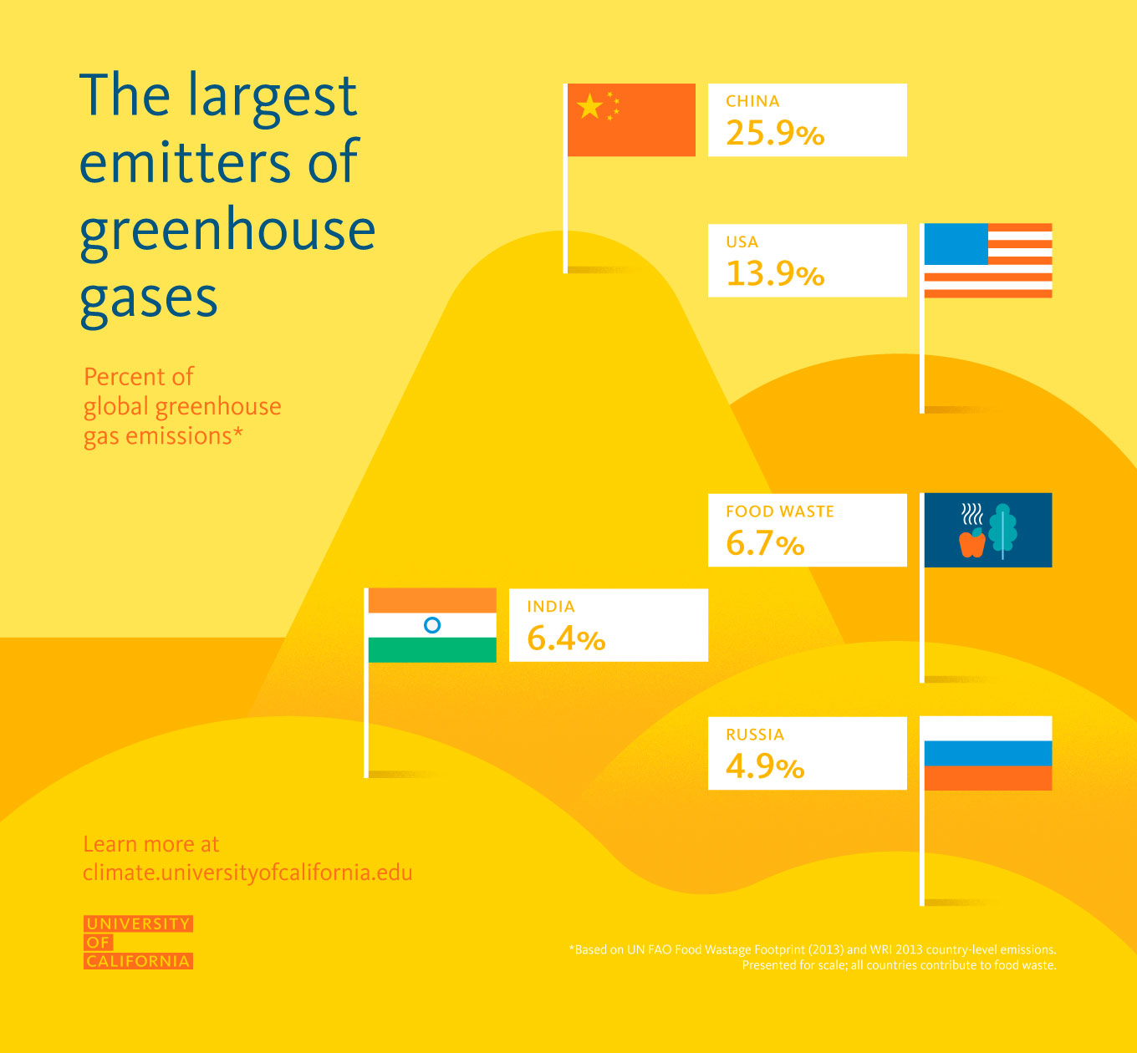

Slide 11
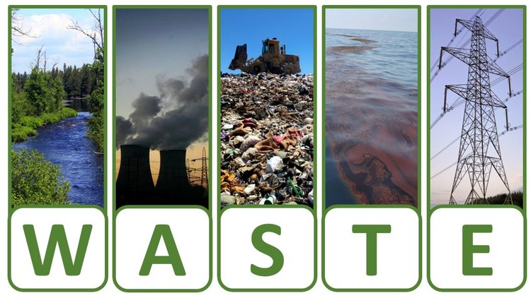
IMPACTS OF WASTE…
SOURCE : https://goo.gl/images/FSVCkF

Slide 12
SOURCES OF HUMAN EXPOSURES
Exposures occurs through
Ingestion of contaminated water or food
Contact with disease vectors
Inhalation
Dermal
Source : https://goo.gl/images/eQZD7E

Slide 13
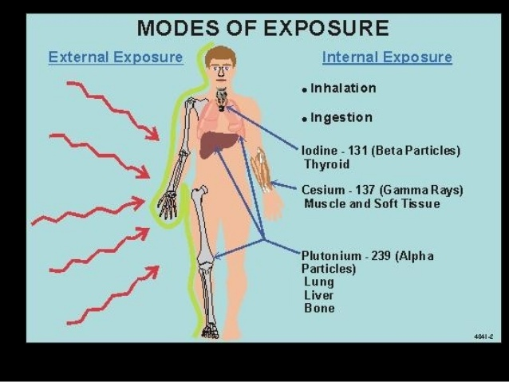

Slide 14
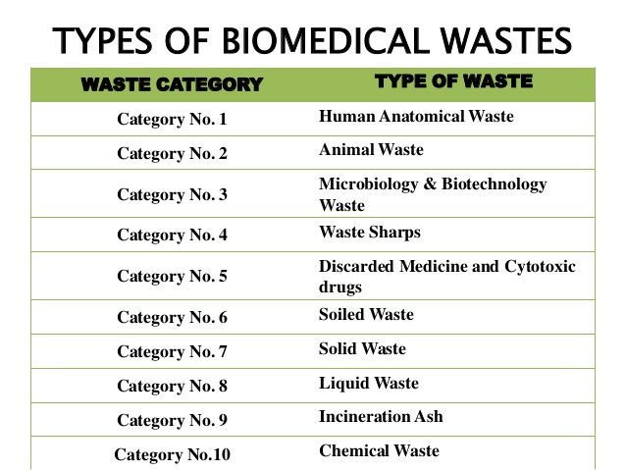
CATEGORIES OF WASTE DISPOSAL

Slide 15
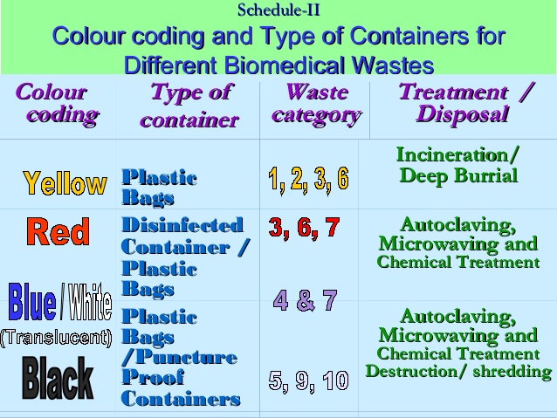

Slide 16
Useful options
Resource recovery
Composting
Vermicomposting
Energy recovery
Incineration
Pyrolysis
Gasification
Bio-methanation or anaerobic digestion

Slide 17
Impacts of waste on health
Chemical poisoning through chemical inhalation
Uncollected waste can obstruct the storm water runoff resulting in flood
Low birth weight
Cancer
Congenital malformations
Neurological disease

Slide 18
Effects of waste on animals and aquatics life
Increase in mercury level in fish due to disposal of mercury in the rivers.
Plastic found in oceans ingested by birds.
Resulted in high algal population in rivers and sea.
Degrades water and soil quality.

Slide 19
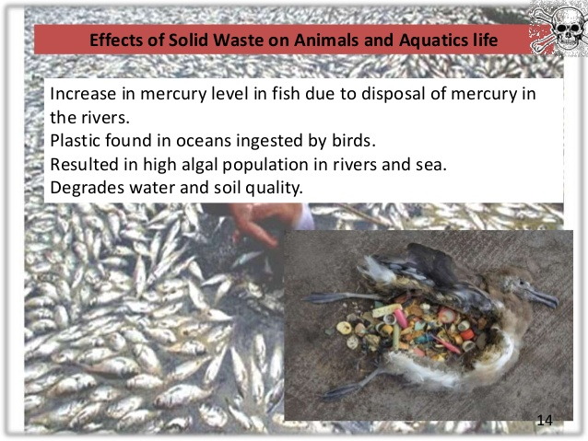
Source : https://goo.gl/images/92fZvQ

Slide 20
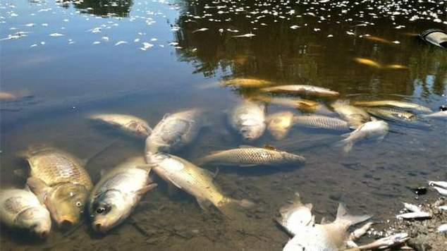
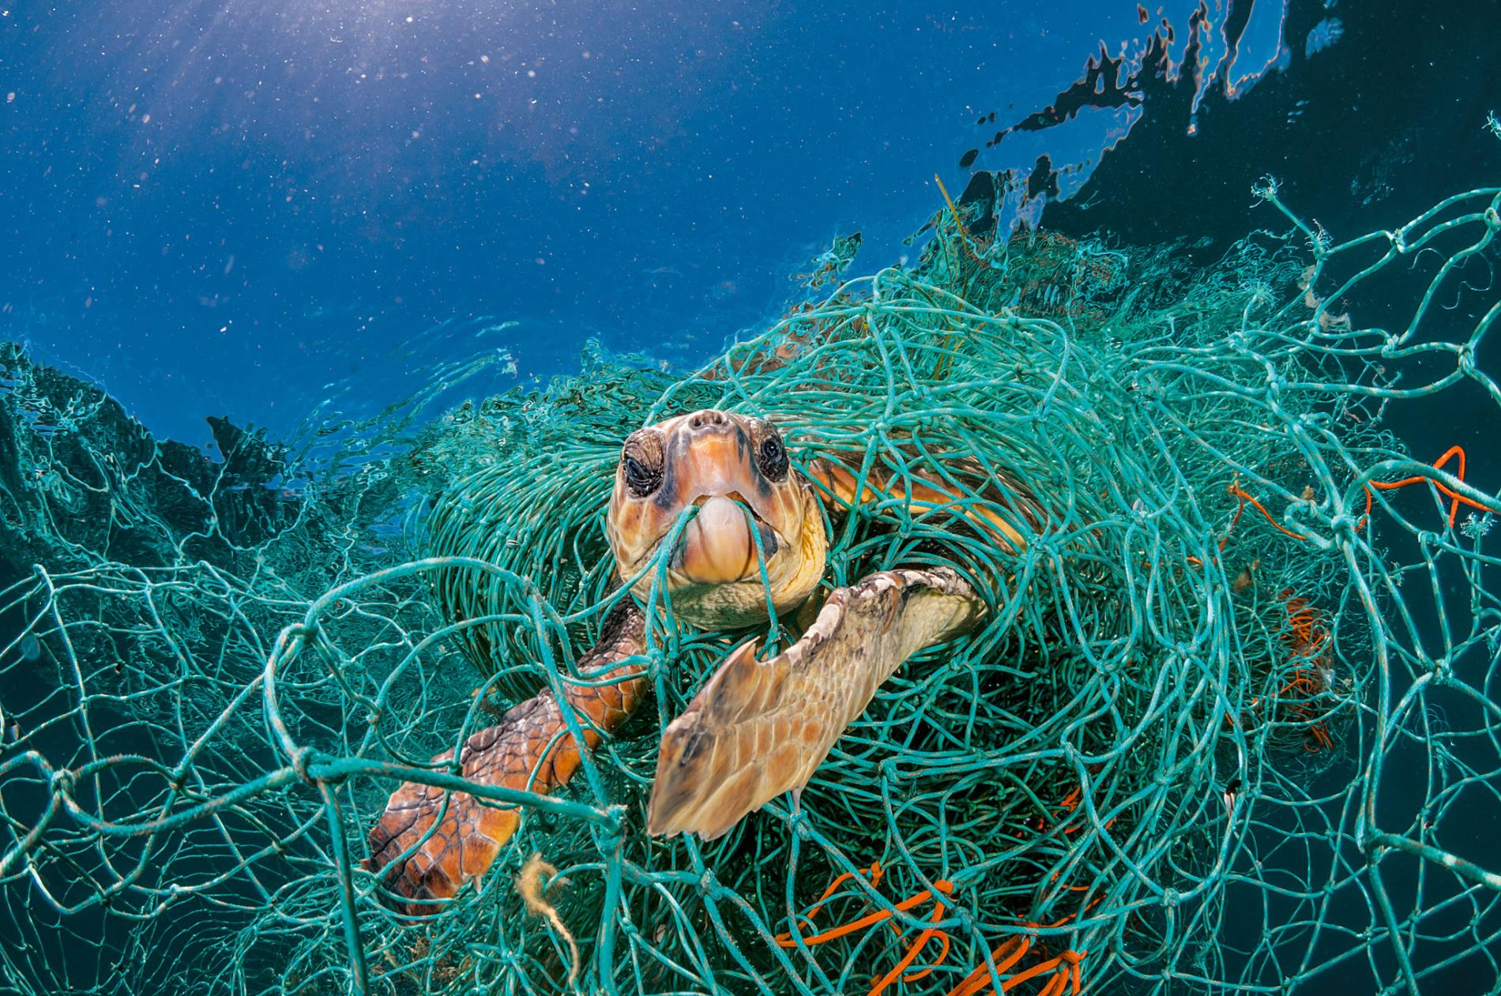
Source :https://goo.gl/images/f7dmYG

Slide 21
WHAT SHOULD BE DONE
Reduce Waste
- Reduce office paper waste by implementing a formal policy to duplex all draft reports and by making training manuals and personnel information available electronically.
- Improve product design to use less materials.
- Redesign packaging to eliminate excess material while maintaining strength.
- Work with customers to design and implement a packaging return program.
- Switch to reusable transport containers.
- Purchase products in bulk.

Slide 22
ecologically sound waste management system which includes
waste reduction
segregation at source
composting
recycling and re-use
more efficient collection
more environmentally sound disposal

Slide 23

Source : https://goo.gl/images/URyz7E

Slide 24

Questions?

