Slide 1
SAMPLING TECHNIQUES AND WATER QUALITY ANALYSIS
Program : M.Sc. Zoology
Semester : III
Course : Environmental Biology

Slide 2
DEFINITION
Sampling is the name or other identification of specific process by which entities of samples have been selected

Slide 3
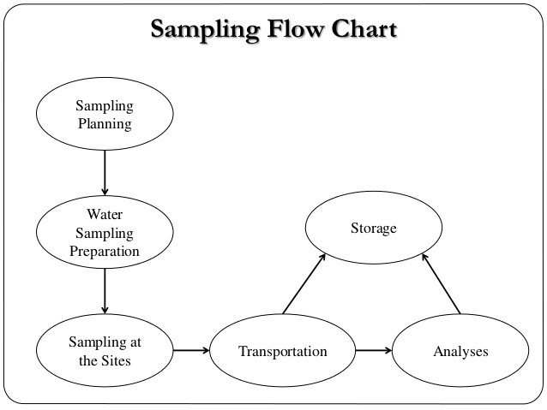
Source : https://goo.gl/images/dKDCkX

Slide 4
GENERAL RULES
Proper handling
Sampling bottle labelling
Sampling collection procedure
Sample transportation
Submitting the sample
Site observation details

Slide 5
SAMPLING METHODS
SYSTEMATIC: points are selected at regular and even intervals, statistically unbiased, it does not generate cluster of sampling points
RANDOM: points selected randomly not arbitrarily. This process ensure any location with in the sampling area has an equal chance of being selected as a sampling point.
JUDGEMENTAL: sampling points are selected on the basis of investigators knowledge of the probable distribution of contaminants at the site.

Slide 6
STRATIFIED: divide the site sub areas according to geological and geographical features, nature of the contamination, former usage pattern, intended future of sub area, and other factors have to be noted. Used in large site with complex contaminants distribution
HAPHZARD: sampling location or sampling time is chosen arbitrarily. Used for homogenous system. Gives biased results. Used as a preliminary screening technique.

Slide 7
CONTINUOUS MONITORING
All the factors have to be monitored
Monitors are available
Automated methods are less expensive then laboratory analyzed samples

Slide 8
TYPES OF SAMPLE
GRAB SAMPLE: collected at a specific location at a certain point
COMPOSITE SAMPLE: thoroughly mixing several grab sample

Slide 9
SURFACE WATER EQUIPMENTS
Sampling using sampling vessels
Simple water sampler
Buckets or samplers with shafts
Insulated water sampler

Slide 10
GROUNDWATER EQUIPMENT
Bialer
Suction lift pump
Submersible pumbs
Air lift samplers

Slide 11
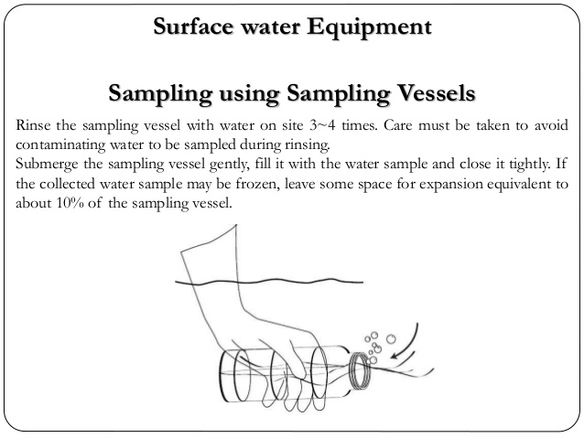
Source : https://goo.gl/images/FSVCkF

Slide 12
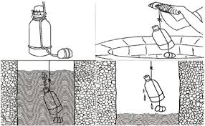
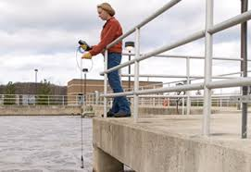

Slide 13
WATER QUALITY ANALYSIS
Water quality refers to physical, chemical, biological characteristics of water
Methods for analysis are selected according to requirements. They are listed below
Volume of the sample to be analyzed, cost, precision, promptness of the analysis as required
Proper sampling, proper labeling, analysis, reporting

Slide 14
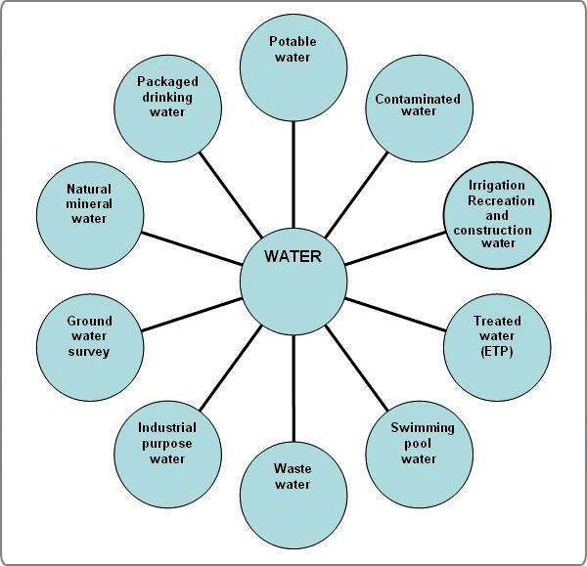
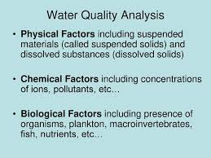
Source : https://goo.gl/images/QwdwZT

Slide 15
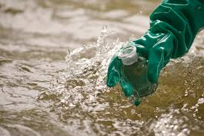
Any Questions?

