Slide 1
Unit I Environmental Biology
Bioethics- Resource Consumption pattern, Equity, Disparity, The rights of animals, The ethical basis of Environment Education and awareness
Program : M.Sc. Zoology
Semester : III
Course : Environmental Biology

Slide 2
Bioethics- Resource Consumtion pattern, Equity, Disparity, The rights of animals, The ethical basis of Environment Education and awareness

Slide 3
Bioethics
The study of ethical and moral implications of new biological discoveries and biomedical advances, as in the field of genetic engineering and drug discovery.
The study of ethical and moral implications of medical research and practise.

Slide 4
Common bioethical issues
Living at risk (eating, wandering, falling)
Deciding appropriate forms of care
Determining legitimate level of restraint
Determining patient preferences without clear instructions
Providing services that take up tremendous resource (e.g., multiple transplants)

Slide 5
Sustainable development
The development that meets the present needs without compromising the ability of future generation to meet their new needs.

Slide 6
Equity
Development, implementation, and enforcement of environmental policies and laws to ensure that no group or community is made to bear a disproportionate share of the harmful effects of pollution or environmental hazards because it lacks economic or political clout.

Slide 7
While much progress is being made to improve resource efficiency, far less progress has been made to improve resource distribution. Currently, just one-fifth of the global population is consuming three-quarters of the earth’s resources.

Slide 8
If the remaining four-fifths were to exercise their right to grow to the level of the rich minority it would result in ecological devastation.
So far, global income inequalities and lack of purchasing power have prevented poorer countries from reaching the standard of living (and also resource consumption/waste emission) of the industrialized countries.

Slide 9
Animal rights
Animal rights is the idea in which some, or all, non-human animals are entitled to the possession of their own lives and that their most basic interests such as the need to avoid suffering should be afforded the same consideration as similar interests of human beings.

Slide 10
Animal rights history
Pythagoras – the first animal right philosopher
Aristotle – non human animals ranked far below humans
Theophrastus - against eating meat

Slide 11
Major animal rights in India
It is the fundamental duty of every citizen of India to have compassion for all living creatures. Article 51A(g).
To kill or main any animal, including stray animals, is a punishable offence. IPC Sections 428 and 429.
Abandoning any animal for any reason can land you in prison for up to three months. Section 11(1)(i) and Section 11(1)(j), PCA Act, 1960.

Slide 12
No animal (including chickens) can be slaughtered in any place other than a slaughterhouse. Sick or pregnant animals shall not be slaughtered. Rule 3, of Prevention of Cruelty to Animals, (Slaughterhouse) Rules, 2001 and Chapter 4, Food Safety and Standards Regulations, 2011.

Slide 13
Environmental education and awareness
Awareness and sensitivity to the environment and environmental challenges
Knowledge and understanding of the environment and environmental challenges
Attitudes of concern for the environment and motivation to improve or maintain environmental quality
Skills to identify and help resolve environmental challenges
Participation in activities that lead to the resolution of environmental challenges

Slide 14
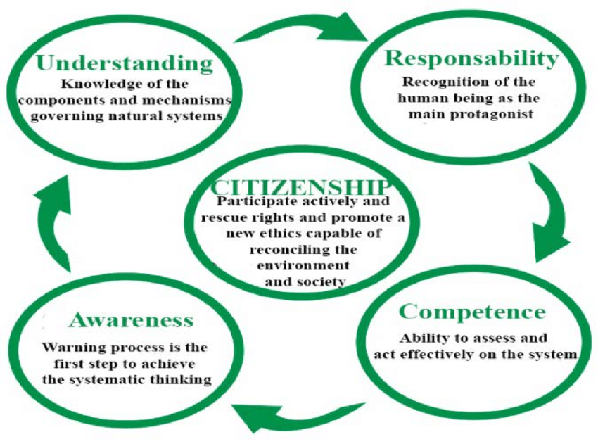

Slide 15
UNESCO, involvement in environmental awareness and education goes back to the very beginnings of the Organization, with the creation in 1948 of the IUCN (International Union for the Conservation of Nature, now the World Conservation Union), the first major NGO mandated to help preserve the natural environment.
UNESCO was also closely involved in convening the UN International Conference on the Human Environment in Stockholm, Sweden in 1972, which led to the setting up of the United Nations Environment Programme (UNEP).

