Slide 1
Unit-V: Industrial Microbiology and Intellectual Property
SCREENING OF MICROBIAL CULTURE
PRIMARY & SECONDARY METABOLITES OF MICROBES
PRODUCTION OF SPIRULINA, ALCOHOL
Course: M.Sc. Zoology
Semester: III
Subject: General Microbiology
Program: M.Sc. Zoology
Semester: III
Course: General Microbiology

Slide 2
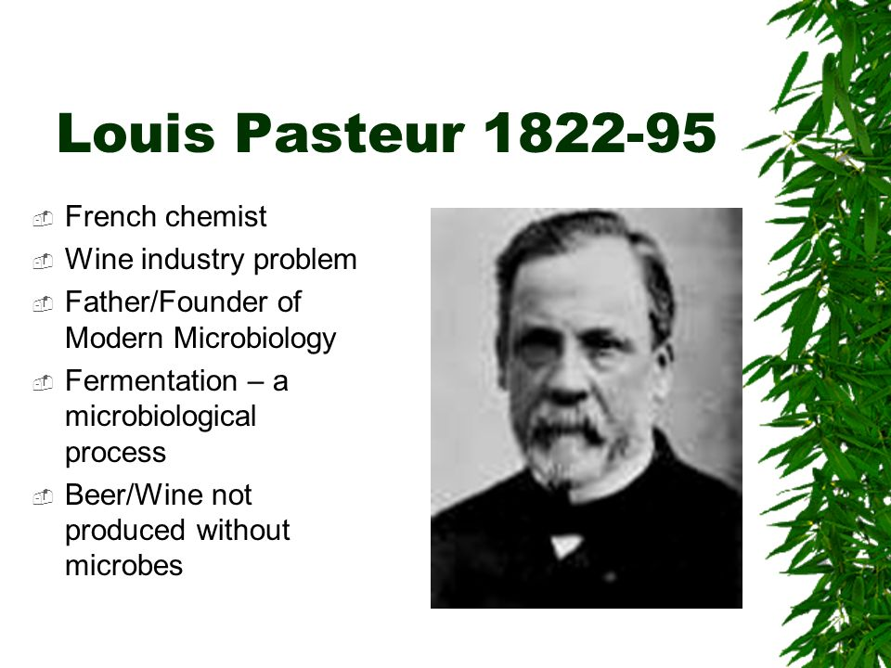

Slide 3
SCREENING OF MICROBIAL CULTURE
Screening - desired microorganisms is determined amongst various other microorganisms.
Isolation and detection of high yielding species from the natural source material containing a heterogeneous microbial population called us screening of microbial culture.

Slide 4
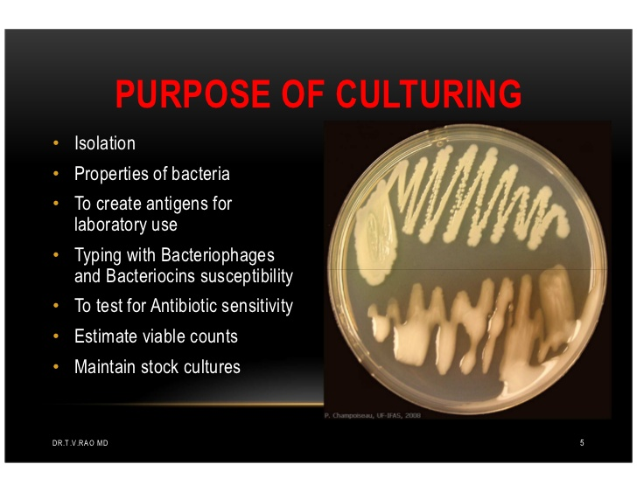

Slide 5
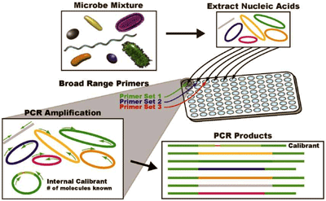
https://www.aacc.org/publications/cln/articles/2012/may/bacterial-id

Slide 6
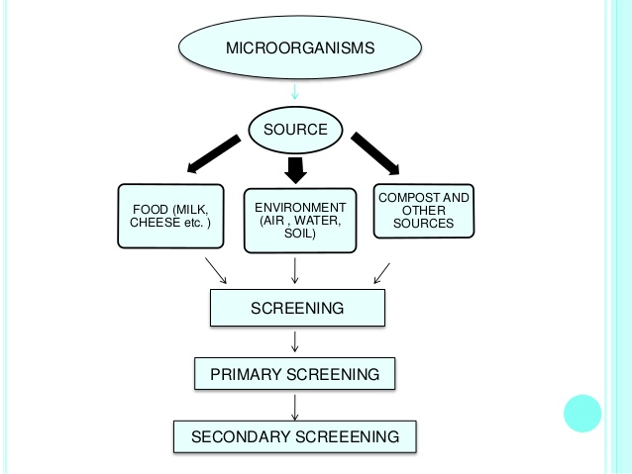
https://www.slideshare.net/MuskanBhardwaj5/screening-86810906

Slide 7
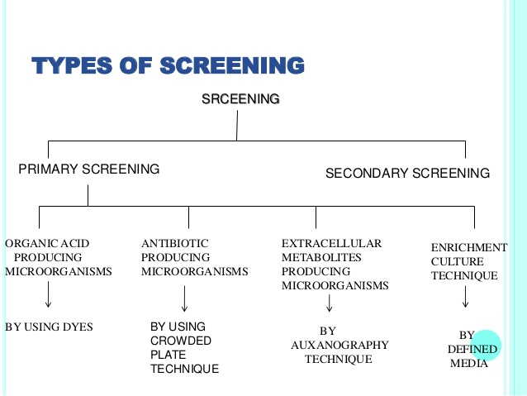
https://www.slideshare.net/MuskanBhardwaj5/screening-86810906

Slide 8
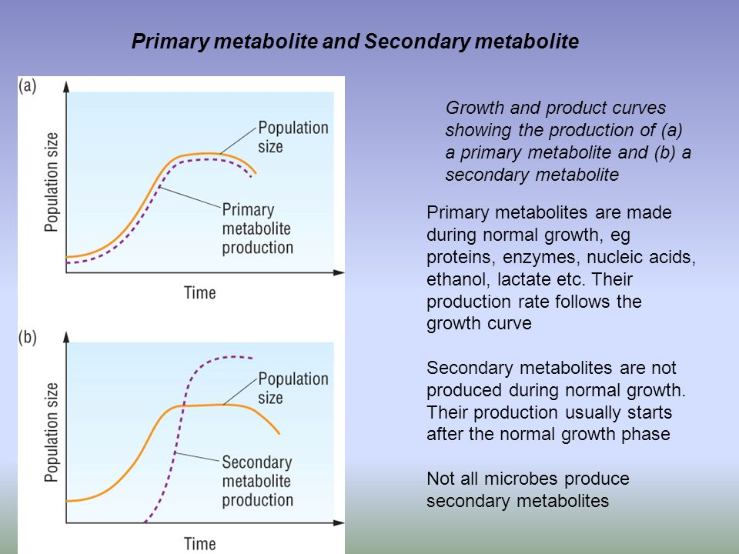
https://slideplayer.com/slide/6319124/

Slide 9
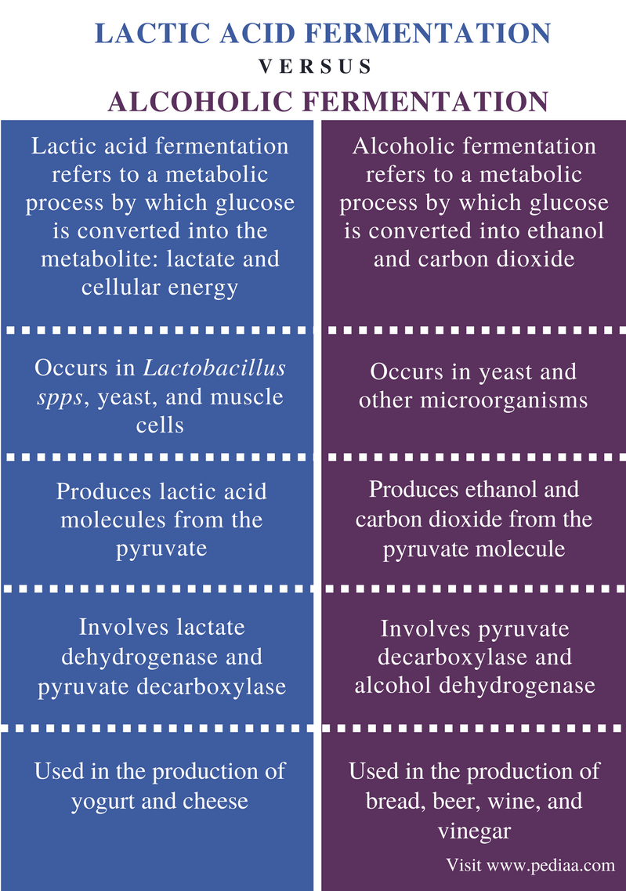

Slide 10
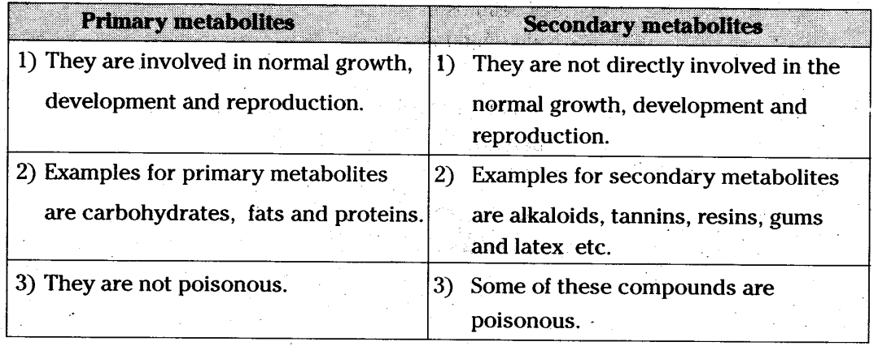

Slide 11
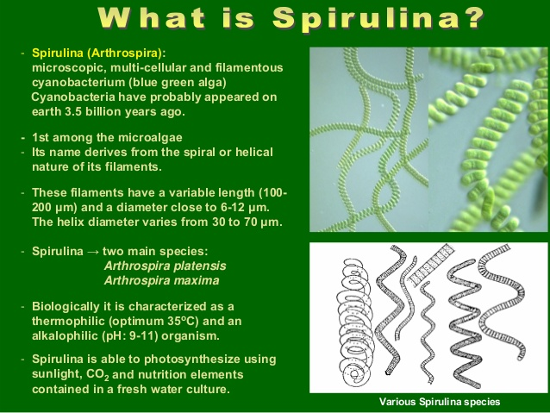
https://www.slideshare.net/ApostolosArvanitis2/the-cultivation-of-spirulina-an-innovative-geothermal-application

Slide 12
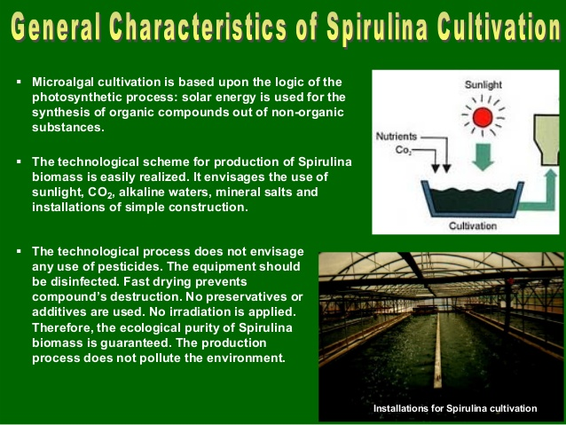

Slide 13
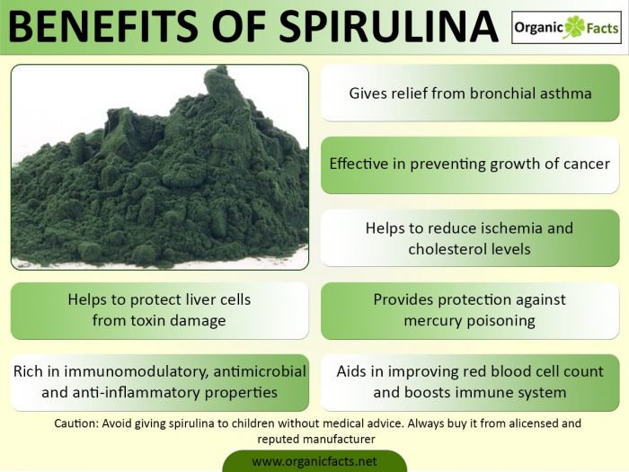

Slide 14
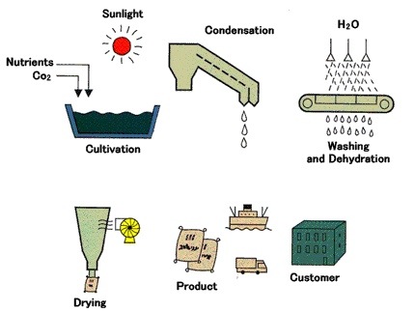
https://www.agrifarming.in/growing-spirulina/

Slide 15
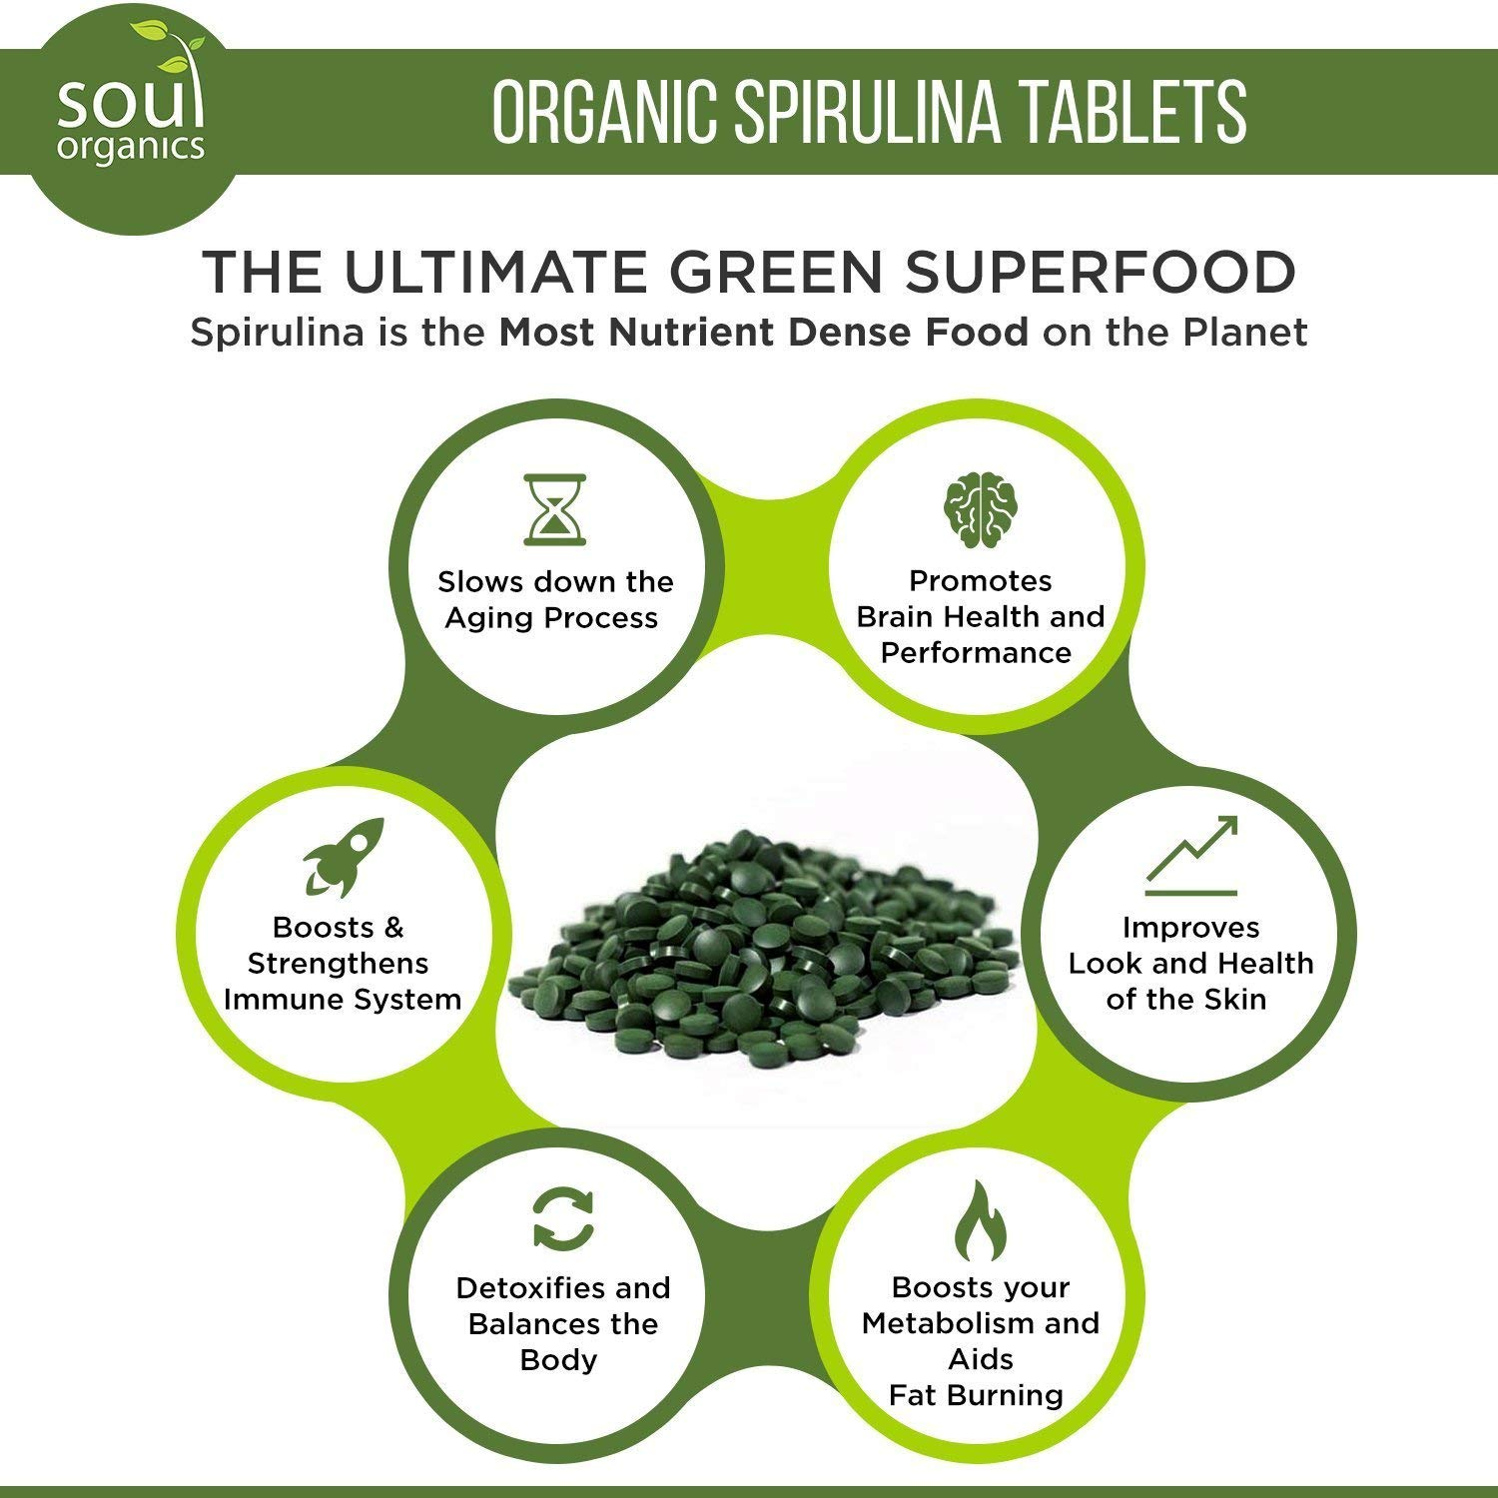
https://jet.com/product/Organic-Spirulina-Powder-Purest-Source-and-Maximum-Nutrient-Density-Vegan-Protei/7074dd35d6a3425ebc7104259a954179

Slide 16
Alcohol
Colourless volatile flammable liquid which is produced by the natural fermentation of sugars and is the intoxicating constituent of wine, beer, spirits, and other drinks, and is also used as an industrial solvent and as fuel.

Slide 17
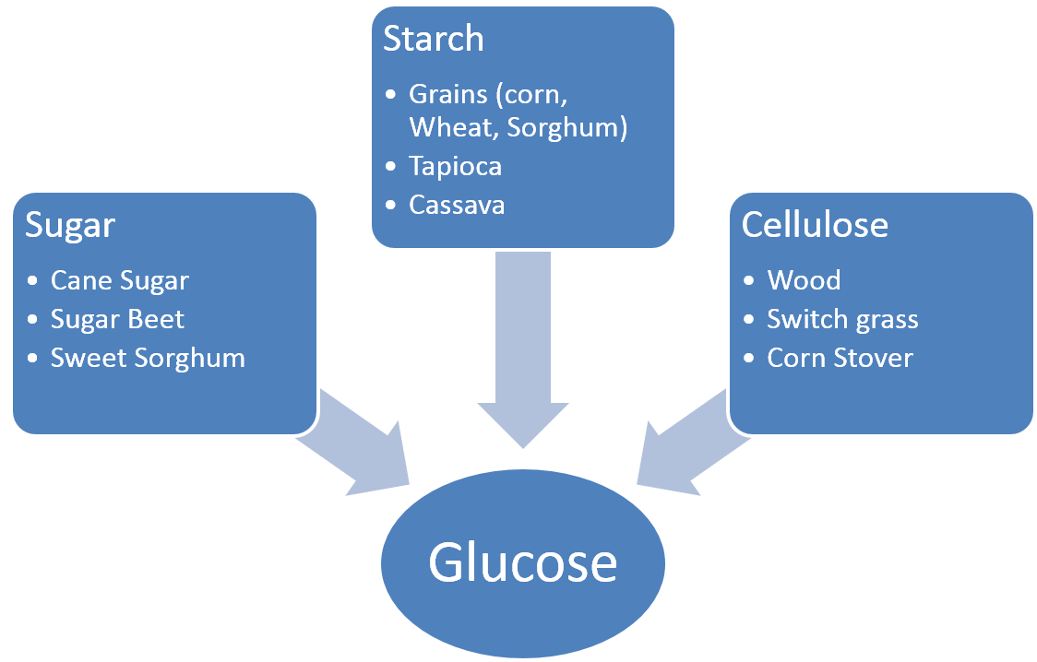
How Alcohol Made?

Slide 18
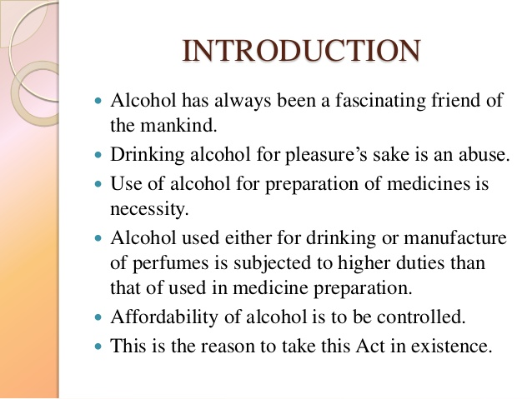

Slide 19
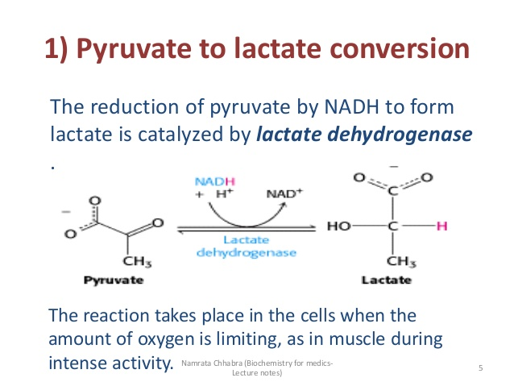
https://www.slideshare.net/namarta28/fate-of-pyruvate-a-quick-review

Slide 20
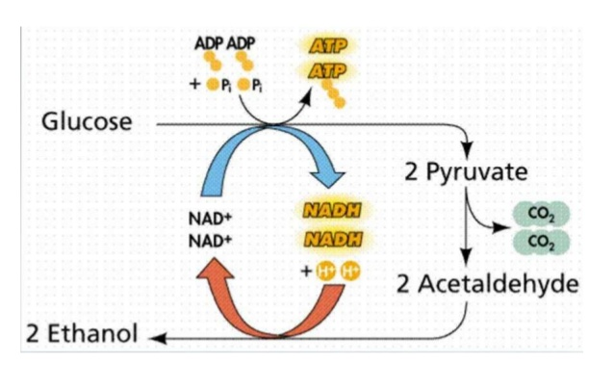
Alcoholic Fermentation

Slide 21
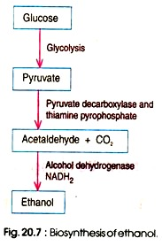
Biosynthesis of ethanol production pathway
http://www.biologydiscussion.com/industrial-microbiology-2/fermentation-industrial-microbiology-2/production-of-ethanol-microbiology/66072

Slide 22
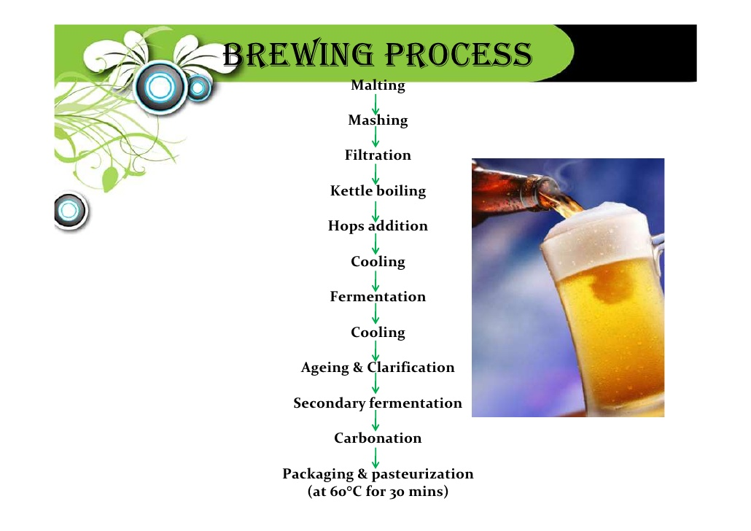

Slide 23
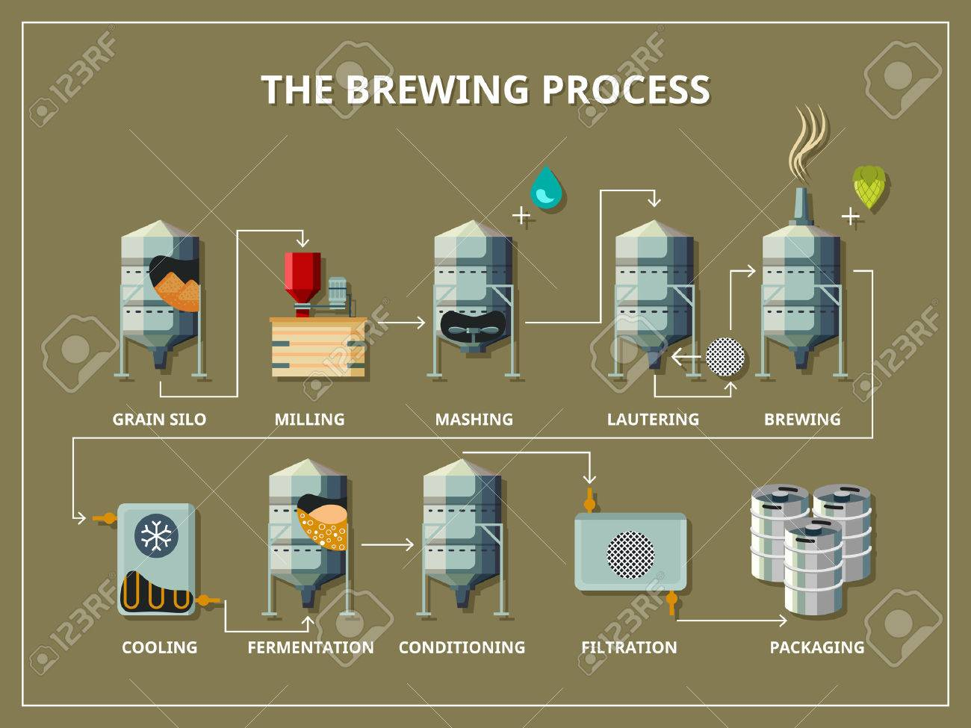
https://www.zoedale.co.uk/blog/info-graphics/the-brewing-process/

Slide 24
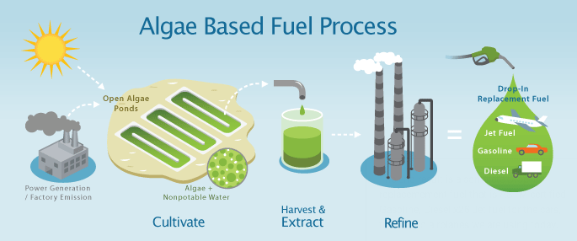
Future prospects
http://en.stonkcash.com/energy-algae/

Slide 25
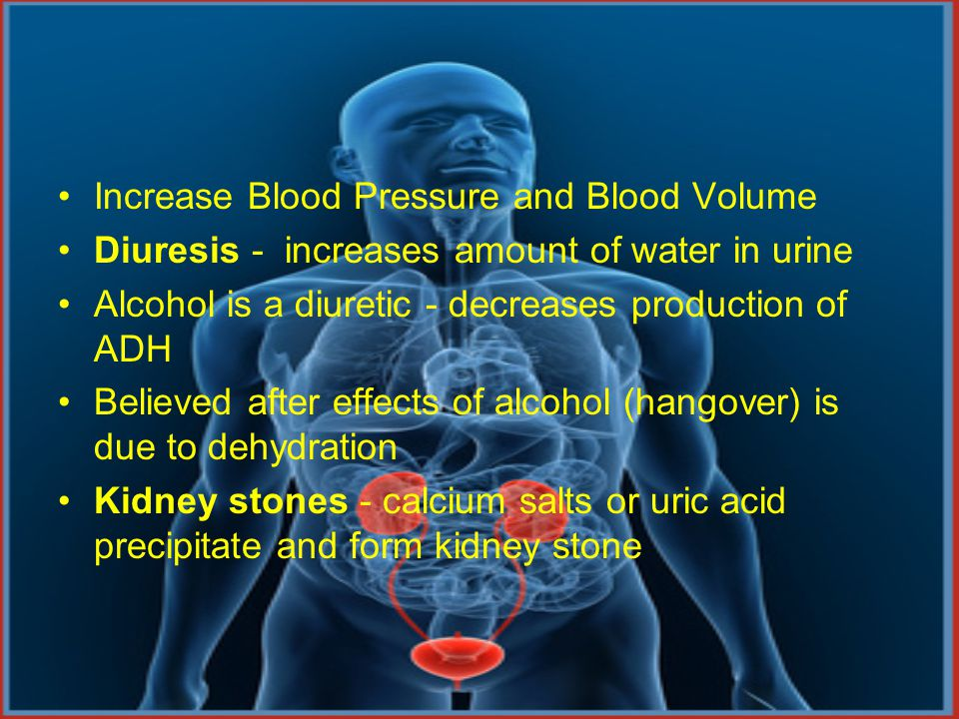
Disadvantages

Slide 26
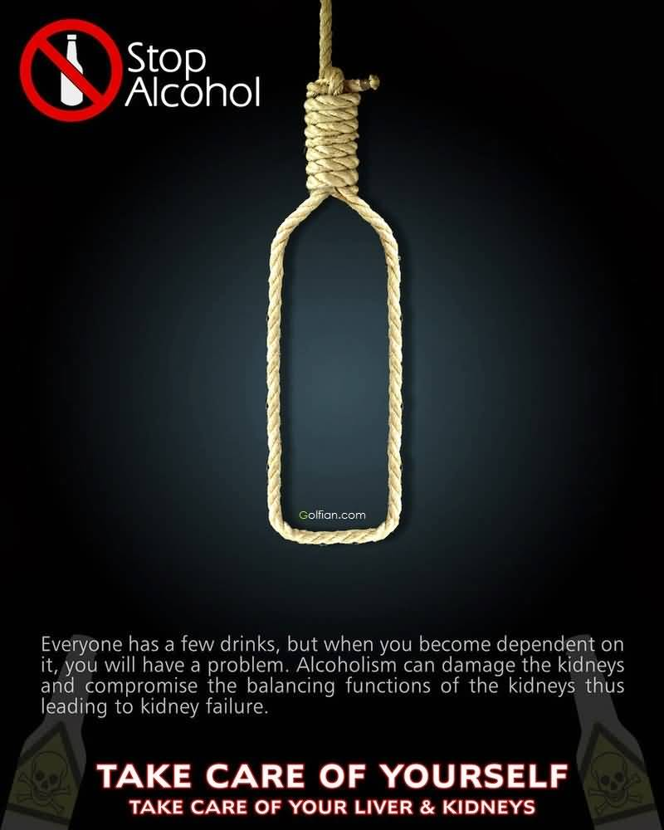
https://in.pinterest.com/pin/72620612717415718/?lp=true

