Slide 1
Vaccines (History, Production and Types)
Unit IV: Role of Microbes in Biotechnology
Program : M.Sc. Zoology
Semester : III
Course : General Microbiology

Slide 2
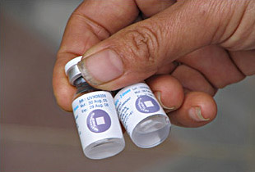
Definition
A vaccine is a biological preparation that improves immunity to a particular disease.
A vaccine typically contains an agent that resembles a disease-causing microorganism, and is often made from weakened or killed forms of the microbe, its toxins or one of its surface proteins.
The agent stimulates the body's immune system to recognize the agent as foreign, destroy it, and "remember" it, so that the immune system can more easily recognize and destroy any of these microorganisms that it later encounters.
Source:http://www.who.int/topics/vaccines/en/

Slide 3
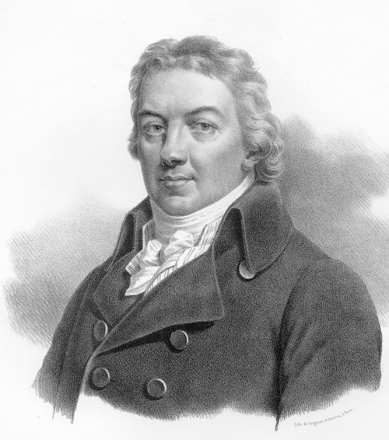
History
Edward Jenner noticed that some dairymaids seemed protected from smallpox if they had already been infected by the much less dangerous virus that caused cowpox.
In 1796, Jenner conducted an experiment, scratching the arm of an 8-year-old boy named James Phipps using material from a cowpox sore in one of these dairymaids.
Source: https://www.healthychildren.org/English/safety-prevention/immunizations/Pages/History-of-Immunizations.aspx

Slide 4
Then he repeated the same experiment, but this time added a small amount of smallpox into the same child.
He hoped that the procedure would immunize the child against the deadly smallpox infection.
In fact, it did. Jenner’s experiment began the immunization age.

Slide 5
Louis Pasteur
Pasteur’s first important discovery in the study of vaccination came in 1879 and concerned a disease called chicken cholera.
Pasteur began investigating anthrax in 1879.
On July 6, 1885, Pasteur vaccinated Joseph Meister, a nine-year-old boy who had been bitten by a rabid dog. The vaccine was so successful

Slide 6
Polio Vaccine
The first polio vaccine was the inactivated polio vaccine.
It was developed by Jonas Salk and came into use in 1955.
The oral polio vaccine was developed by Albert Sabin and came into commercial use in 1961.

Slide 7
Types of vaccines
Live, attenuated vaccines
Inactivated vaccines
Subunit vaccines
Toxoid vaccines
DNA vaccines
Source:https://www.niaid.nih.gov/research/vaccine-types
https://mail.historyofvaccines.org/content/articles/different-types-vaccines

Slide 8
Live, attenuated vaccines
Live, attenuated vaccines contain a version of the living microbe that has been weakened in the lab so it can’t cause disease.
They elicit strong cellular and antibody responses and often confer lifelong immunity.
Examples are Measles, mumps, Influenza

Slide 9
Inactivated Vaccines
inactivated vaccines are produced by killing the disease-causing microbe with chemicals, heat, or radiation.
Such vaccines are more stable and safer than live vaccines.
Examples are Polio (IPV) and Hepatitis A.

Slide 10
Subunit vaccines
Instead of the entire microbe, subunit vaccines include only the antigens that best stimulate the immune system.
In some cases, these vaccines use epitopes—the very specific parts of the antigen that antibodies or T cells recognize and bind to.
Examples are Hepatitis B and Influenza.

Slide 11
Toxoid vaccines
These vaccines are used when a bacterial toxin is the main cause of illness.
Immunizations for this type of pathogen can be made by inactivating the toxin that causes disease symptoms.
Examples are Diphtheria and tetanus.

Slide 12
DNA Vaccines
The direct injection of genetic material into a living host causes a small amount of its cells to produce the introduced gene products.
This inappropriate gene expression within the host has important immunological consequences, resulting in the specific immune activation of the host against the gene delivered antigen.

