Slide 1
Plasmids Properties and Types
Unit: III Microbial Genetics
Program : M.Sc. Zoology
Semester : III
Course :General Microbiology

Slide 2
Plasmids
A plasmid is a small, circular, double-stranded DNA molecule that is distinct from a cell's chromosomal DNA.
In 1952, Joshua Lederberg coined the term plasmid.
Plasmids are mainly found in bacteria, but they can also be found in archaea and multicellular organisms.

Slide 3
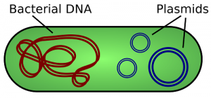
This simplified figure depicts a bacterium’s chromosomal DNA in red and plasmids in blue
Source: https://biologydictionary.net/plasmid/

Slide 4
Properties
Plasmids have a wide range of lengths, from roughly one thousand DNA base pairs to hundreds of thousands of base pairs
carry functions advantageous to the host such as:produce enzymes which degrade antibiotics or heavy metals
The self-replicating unit, in this case the plasmid, is called a replicon

Slide 5
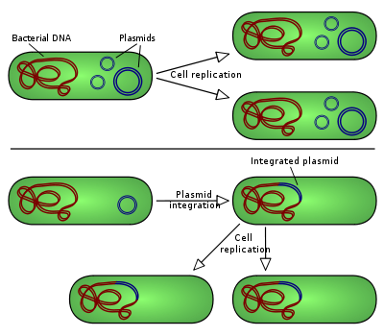
Non-integrating plasmid
Source: https://en.wikipedia.org/wiki/Plasmid

Slide 6
Episomes
Some plasmids can become associated with nuclear chromosome;that plasmid is known as episome.
An episome is a plasmid of bacteria or viral DNA that can integrate itself into the chromosomal DNA of the host organism

Slide 7
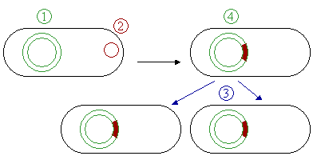
1 Chromosomal DNA. 2 Plasmids. 3 Cell division. 4 Chromosomal DNA with integrated plasmids.
Episomes
Source: http://www.newworldencyclopedia.org/entry/Plasmid

Slide 8
Types of plasmids
There are five main types of plasmids:
1. Fertility F-plasmids
2. Resistance plasmids
3. Virulence plasmids
4. Degradative plasmids, and
5. Col plasmids

Slide 9
Fertility plasmids
Fertility plasmids, also known as F-plasmids
Contains transfer genes that allow genes to be transferred from one bacteria to another through conjugation
F-plasmids are episomes, which are plasmids that can be inserted into chromosomal DNA

Slide 10
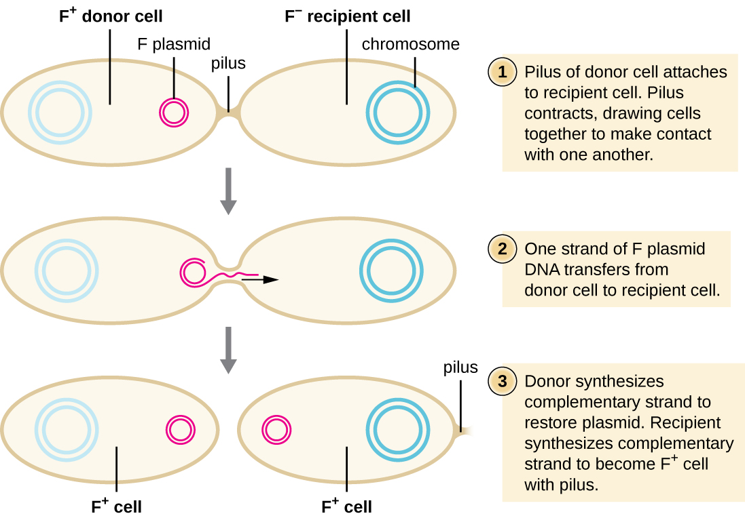
Bacteria that have the F-plasmid are known as F positive (F⁺), and bacteria without it are F negative (F–)
When an F⁺ bacterium conjugates with an F– bacterium, two F⁺ bacterium result.
Source: https://www.quizover.com/microbiology/test/conjugation-of-the-f-plasmid-by-openstax

Slide 11
Resistance Plasmids
Resistance or R plasmids
Contains genes that help a bacterial cell defend against environmental factors such as poisons or antibiotics
Some resistance plasmids can transfer themselves through conjugation
When this happens, a strain of bacteria can become resistant to antibiotics

Slide 12
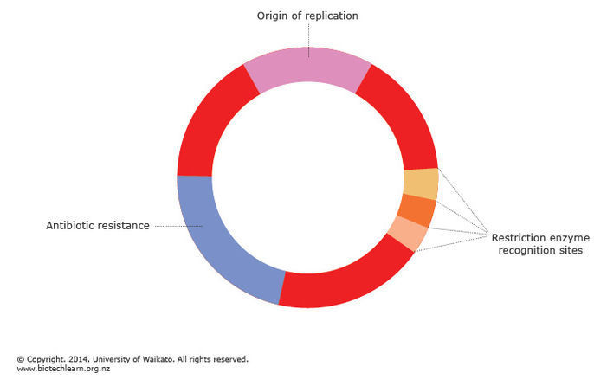
R plasmid
Source:https://www.sciencelearn.org.nz/resources/1900-bacterial-dna-the-role-of-plasmids

Slide 13
Virulence plasmid
It turns that bacterium into a pathogen
It carry genes such as
toxin genes,
adhesin genes and
genes encoding other virulence factors

Slide 14
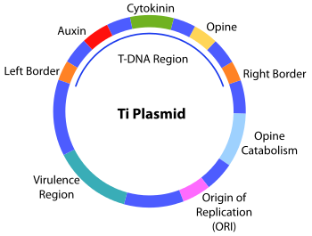
Source: https://en.wikipedia.org/wiki/Ti_plasmid

Slide 15
Degradative Plasmids
Degradative plasmids help the host bacterium to digest compounds that are not commonly found in nature
Such as camphor, xylene, toluene, and salicylic acid
These plasmids contain genes for special enzymes that break down specific compounds
Degradative plasmids are conjugative

Slide 16
Col Plasmids
Col plasmids contain genes that make bacteriocins
which are proteins that kill other bacteria and thus defend the host bacterium
These proteins are also known as colicins
Colicins are by far the best-characterized group of bacteriocins

Slide 17
Applications
Scientists have taken advantage of plasmids to use them as tools to clone, transfer, and manipulate genes.
Plasmids that are used experimentally for these purposes are called vectors.
Researchers can insert DNA fragments or genes into a plasmid vector, creating a so-called recombinant plasmid.
Source: https://www.nature.com/scitable/definition/plasmid-plasmids-28

Slide 18
Thank you

