Slide 1
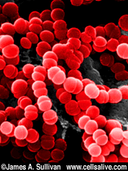

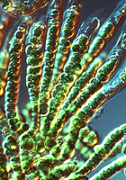
Unit-I: fundamentals of microbiology
Diversity of Microorganisms
Program: M.Sc. Zoology
Semester: III
Course: General Microbiology

Slide 2

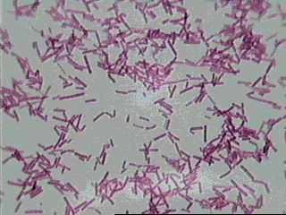







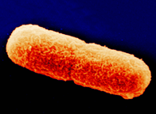
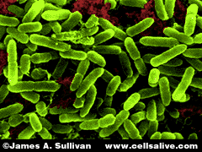
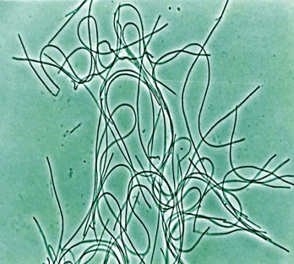

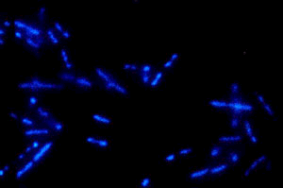
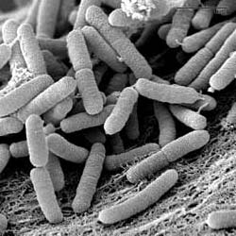
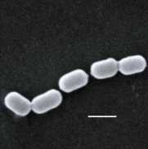
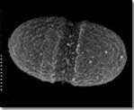
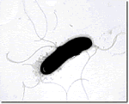
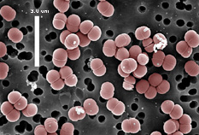
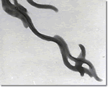
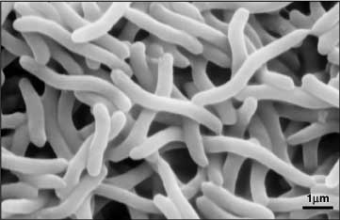
Diversity of Microorganisms
Source: http://www.wadsworth.org/databank.html

Slide 3
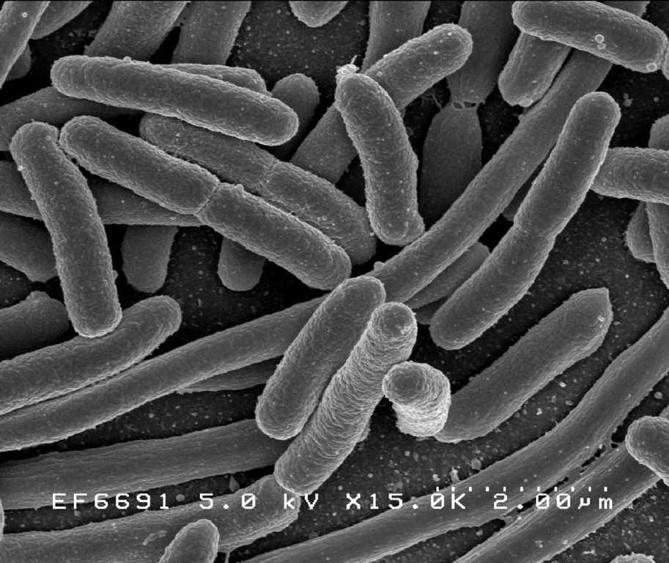
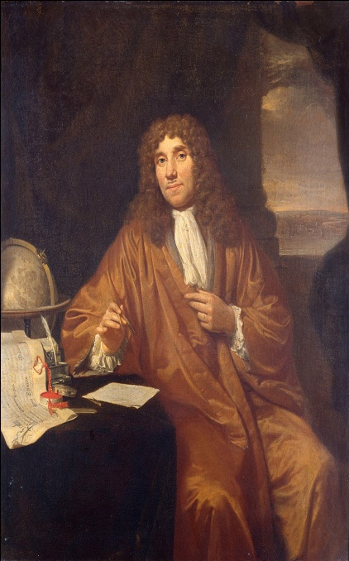
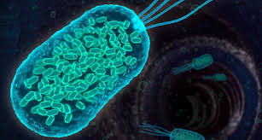
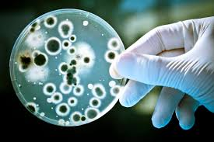
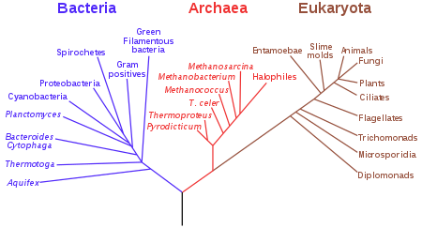
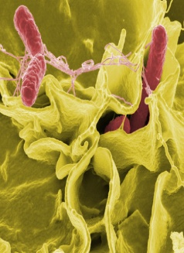
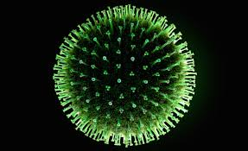
Microorganisms can be found almost anywhere on Earth
Most of the microorganisms are almost microscopic
bacteria, archaea, fungi, protists &
some micro plants also.
But virus are generally not regarded as not living
and it is not consider as microorganisms.
Subfield of microbiology is virology (study of viruses).
Antonie Van Leeuwenhoek, the 1st microbiologist & 1st person observing bacteria in microscope.
Source: https://en.wikipedia.org/wiki/Antonie_van_Leeuwenhoek

Slide 4
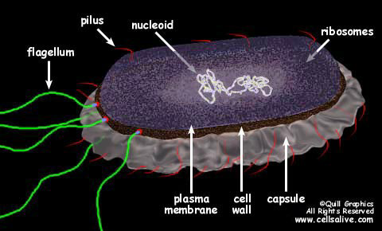
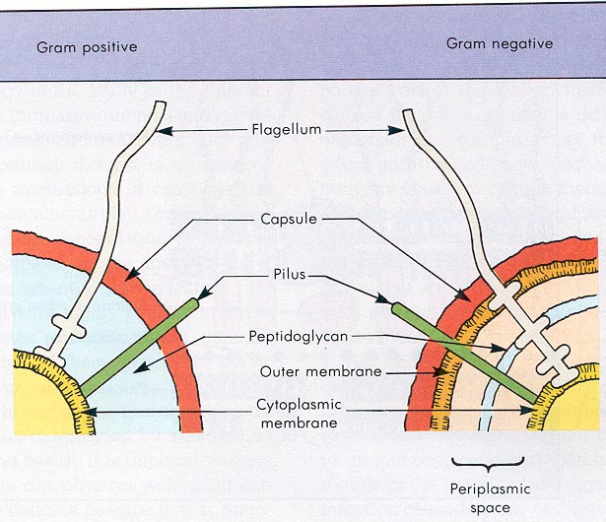
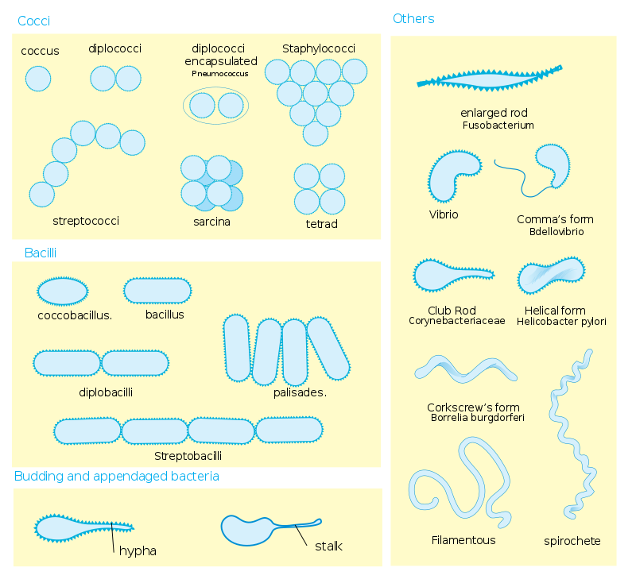
Bacteria
Prokaryotic
Unicellular
No cell nucleus
Thick rigid walled cells
Free living extracellular

Slide 5
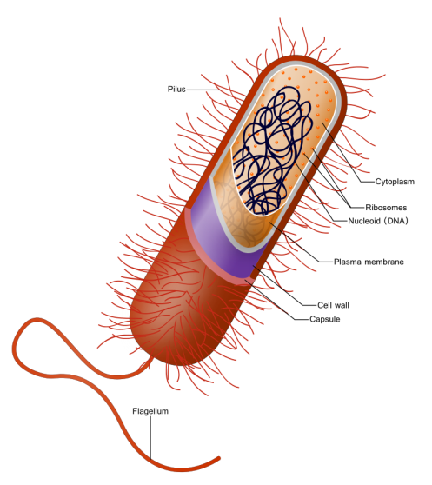
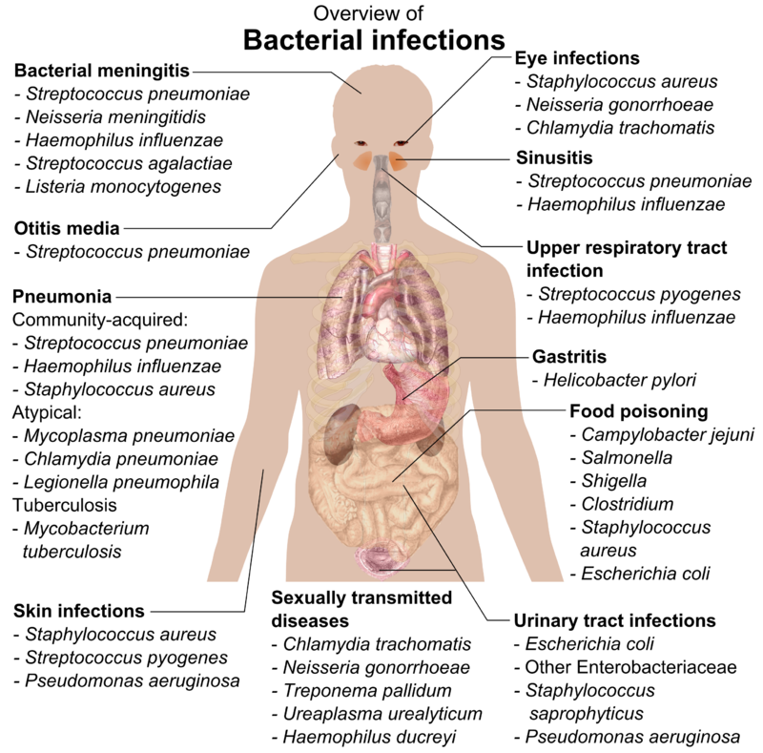
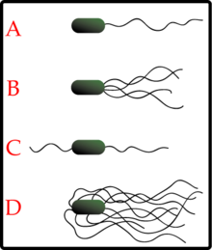
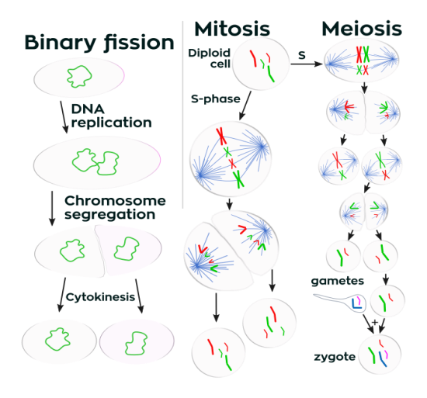
A ) Monotrichous
B) Lophotrichous
C) Amphitrichous
D)Petritrichous
Growth & Reproduction
https://commons.wikimedia.org/wiki/File:Bacterial_infections_and_involved_species.png

Slide 6
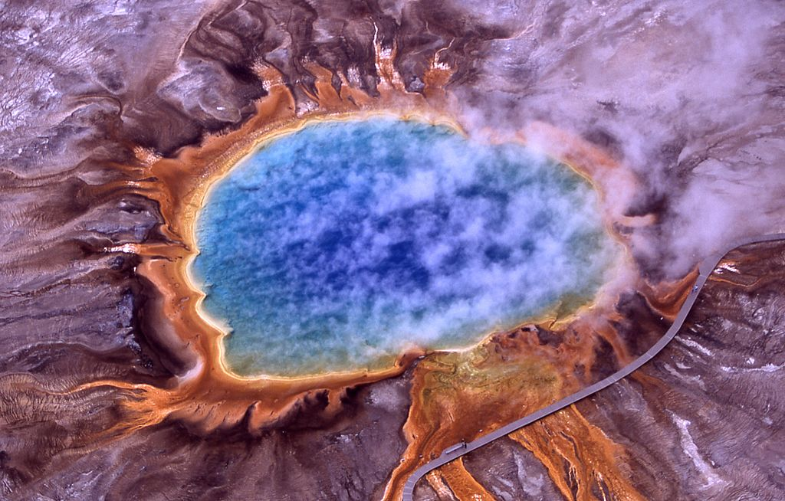
Archaea
Domain of constitute a domain of single celled microorganisms
Unicellular prokaryote with no pipdoglycon in cell wall
Archaea cells having unique properties from other two domain bacteria & eukaryotes
It is viewed as extremophilies living in harsh environments such as hot springs, salt lakes, soils, ocean & marshlands
Extreme environment (Volcanic Hot Springs)

Slide 7
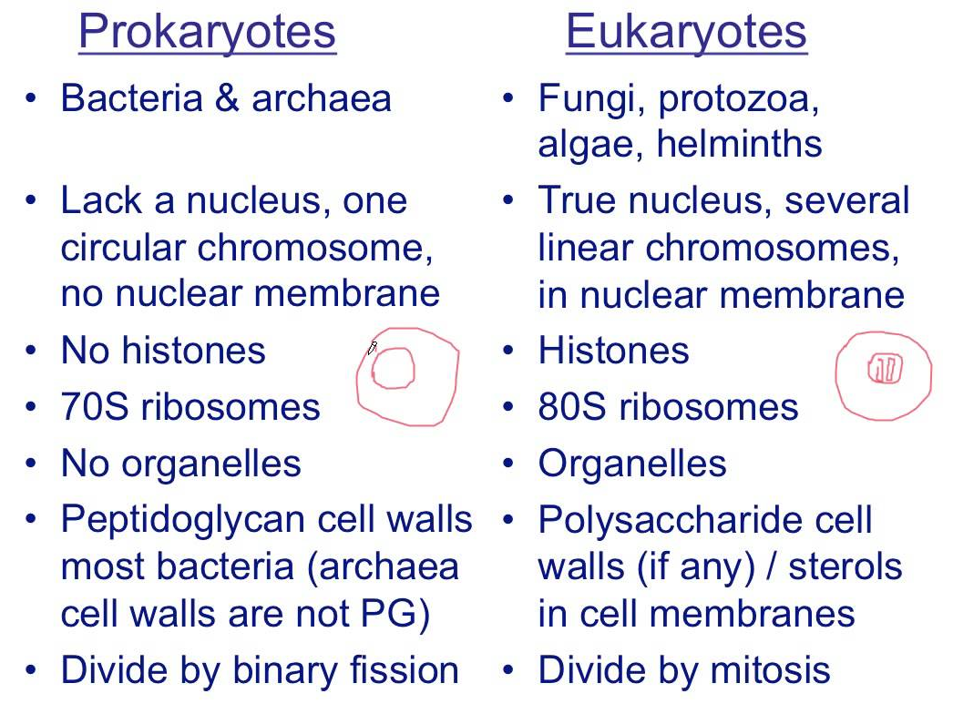
Comparison of Prokaryotes & Eukaryotes

Slide 8
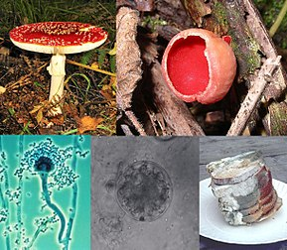
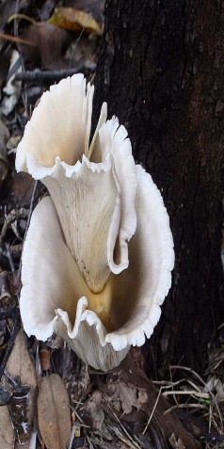
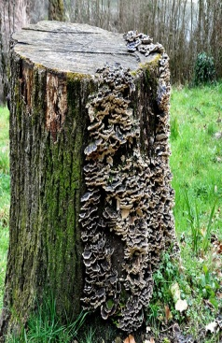
Fungus
Member of group of eukaryotic microorganisms (Yeast & Mold)
Fungi in a different kingdom from plants, bacteria, and some protists is chitin in their cell walls
Fungi do not photosynthesis
Many fungi produce biologically active compounds
which are toxic to animals or plants and are therefore called mycotoxins
Many mushroom species are poisonous to humans
Which is creates the digestive problems or allergic reactions as well as hallucinations to severe organ failures and death
it is difficult to accurately identify a safe mushroom without proper training and knowledge

Slide 9
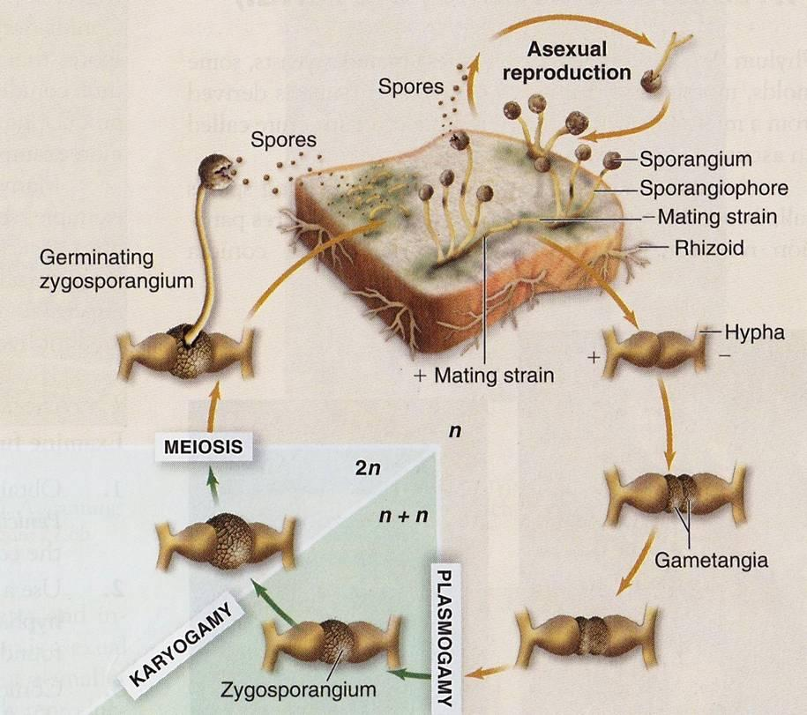

Slide 10
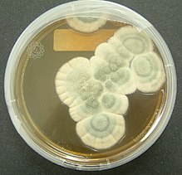
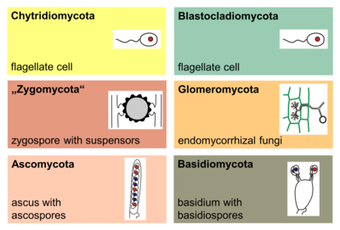
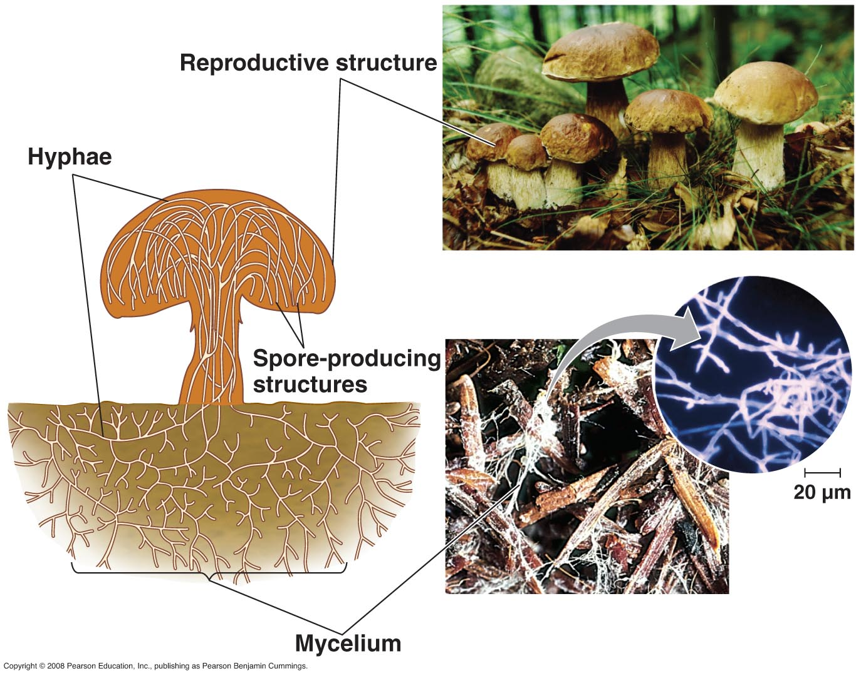
Group of Fungi
Mould Penicillium chrsogenome
Most of the fungi reproduce both sexual & asexual
Sexual reproduction (fusion of 2 fungi)
Asexual reproduction (cells of hyphae break off, they can grow into a new fungus.
https://slideplayer.com/slide/6408577/

Slide 11
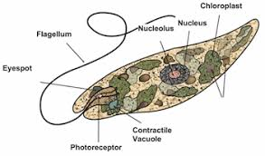
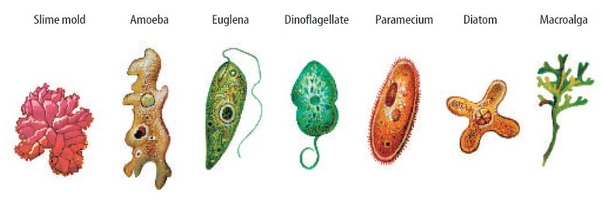
Protists
May be unicellular and multicellular, microscopic or very large, and heterotrophic or autotrophic
Protists can reproduce asexually and sexually
Some protists like spirogyra, haploid protists
It is stressful environmental condition they
can be make spores
Variety of way to get energy from carnivorous, photosynthetic, chemoautrophic and detritivores
https://biology4isc.weebly.com/kingdom-protista.html

Slide 12
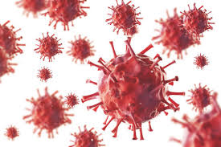
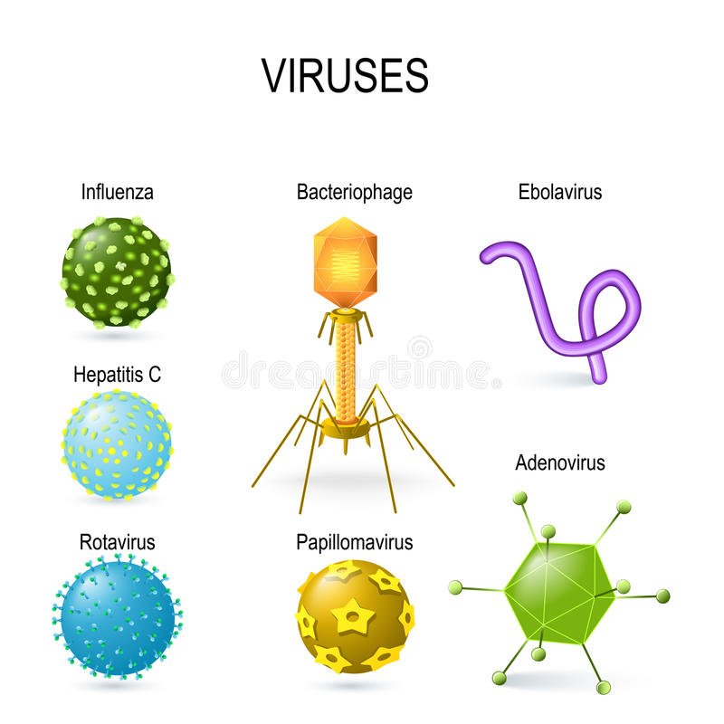
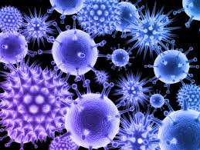
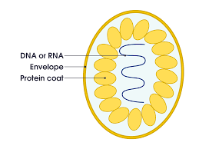
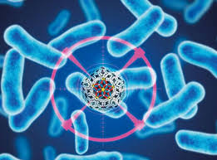
Virus
Small infectious agent
It can infect all forms of living
Which is plants, animals & bacteria
Genetic material made from DNA or RNA or long molecules take genetic information
Virus display a wide diversity of shapes and sizes
Common Viral diseases: common cold, influenza, chickenpox & cold sores
Serious diseases: Ebola virus, AIDS, Avian influenza & SARs caused by virus.
https://www.shutterstock.com/image-vector/viral-shapes-different-viruses-diagram-showing-601115009

