Slide 1
Bioinformatics
Semester : III
Subject code: 17ZOOME31
Department of animal science
Bharathidasan University
Trichy - 24

Slide 2
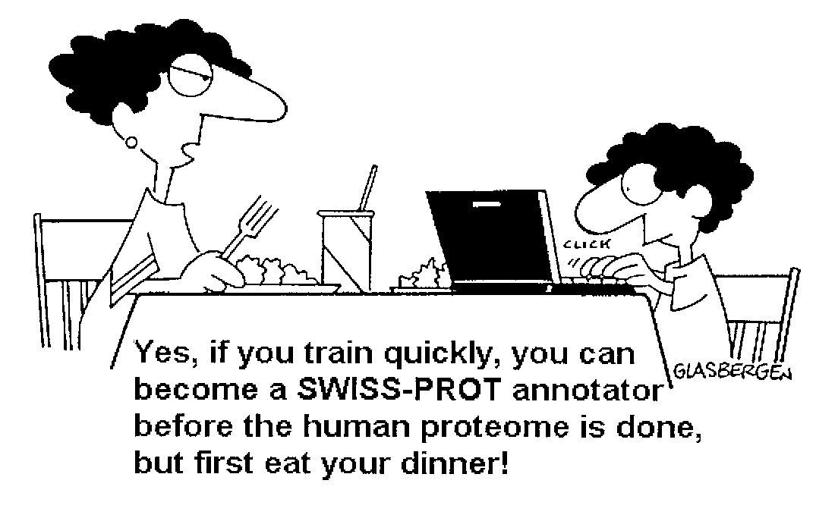
Database or databank?
Initially
Databank (in UK)
Database (in the USA)
Solution
The abbreviation db
Databases

Slide 3
WHAT IS A DATABASE?
A structured collection of data held in computer storage; esp. one that incorporates software to make it accessible in a variety of ways; transf., any large collection of information.
database management: the organization and manipulation of data in a database.
database management system (DBMS): a software package that provides all the functions required for database management.
database system: a database together with a database management system.

Slide 4
What is a database?
A collection of data
structured
searchable (index) -> table of contents
updated periodically (release) -> new edition
cross-referenced (hyperlinks) -> links with other db
Includes also associated tools (software) necessary for access, updating, information insertion, information deletion….
Data storage management: flat files, relational databases…

Slide 5
Database: a « flat file » example
Flat-file database (« flat file, 3 entries »):
Accession number: 1
First Name: Amos
Last Name: Bairoch
Course: Pottery 2000; Pottery 2001;
//
Accession number: 2
First Name: Dan
Last name: Graur
Course: Pottery 2000, Pottery 2001; Ballet 2001, Ballet 2002
//
Accession number 3:
First Name: John
Last name: Travolta
Course: Ballet 2001; Ballet 2002;
//
Easy to manage: all the entries are visible at the same time !

Slide 6
Categories of databases for Life Sciences
Sequences (DNA, protein)
Genomics
Mutation/polymorphism
Protein domain/family
Proteomics (2D gel, Mass Spectrometry)
3D structure
Metabolic networks
Regulatory networks
Bibliography
Expression (Microarrays,…)
Specialized

Slide 7
Categories of databases for Life Sciences
Sequences (DNA, protein)
Genomics
Mutation/polymorphism
Protein domain/family
Proteomics (2D gel, Mass Spectrometry)
3D structure
Metabolic networks
Regulatory networks
Bibliography
Expression (Microarrays,…)
Specialized

Slide 8
NCBI: http://www.ncbi.nlm.nih.gov
EBI: http://www.ebi.ac.uk/
DDBJ: http://www.ddbj.nig.ac.jp/

Slide 9
Literature Databases:
Bookshelf: A collection of searchable biomedical books linked to PubMed.
PubMed: Allows searching by author names, journal titles, and a new Preview/Index option. PubMed database provides access to over 12 million MEDLINE citations back to the mid-1960's. It includes History and Clipboard options which may enhance your search session.
PubMed Central: The U.S. National Library of Medicine digital archive of life science journal literature.
OMIM: Online Mendelian Inheritance in Man is a database of human genes and genetic disorders (also OMIA).

Slide 10
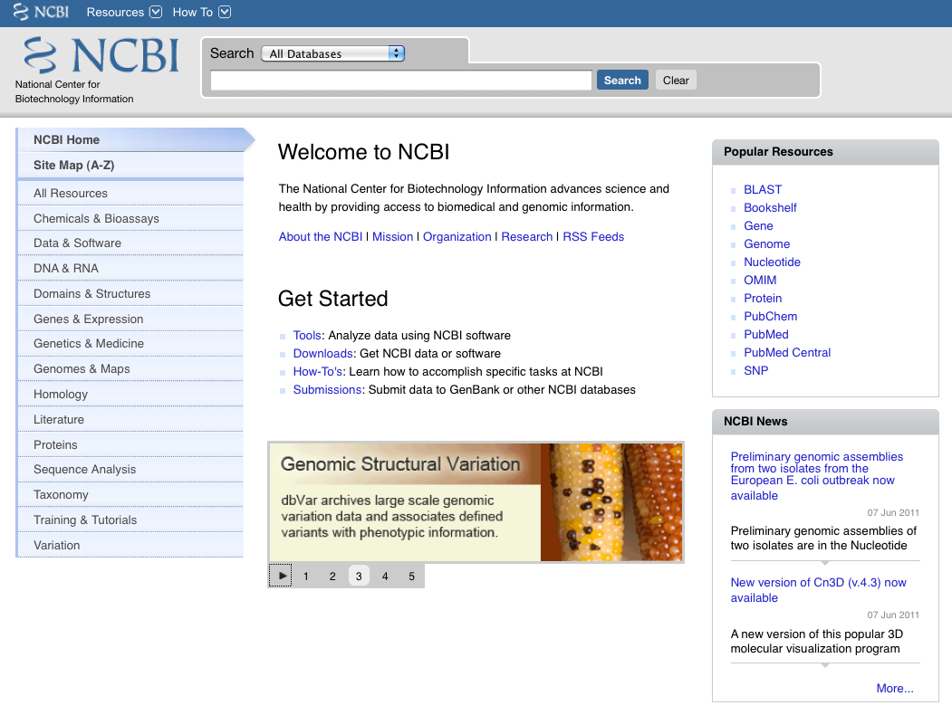

Slide 11
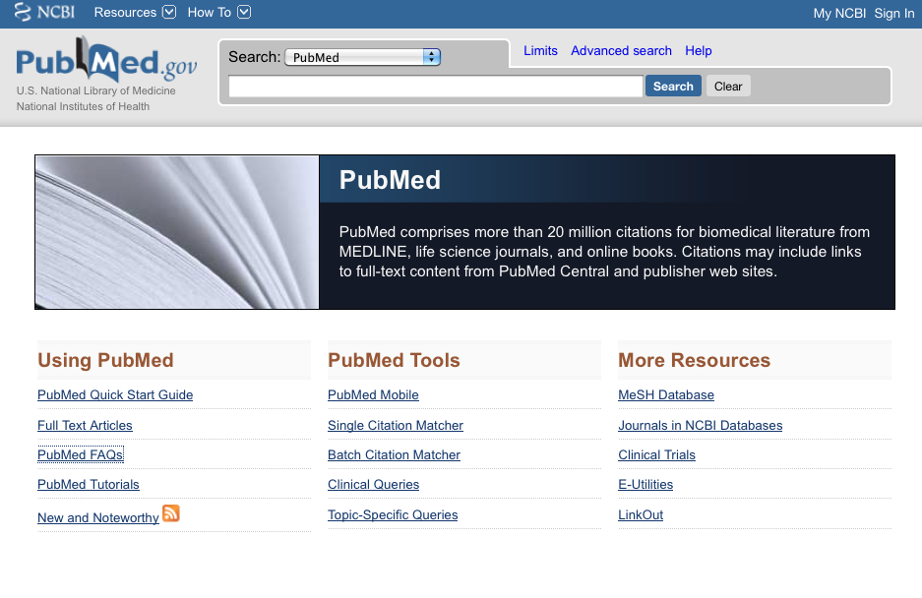
PubMed (Medline)
MEDLINE covers the fields of medicine, nursing, dentistry, veterinary medicine, public health, and preclinical sciences
Contains citations from approximately 5,200 worldwide journals in 37 languages; 60 languages for older journals.
Contains over 20 million citations since 1948
Contains links to biological db and to some journals
New records are added to PreMEDLINE daily!

Slide 12
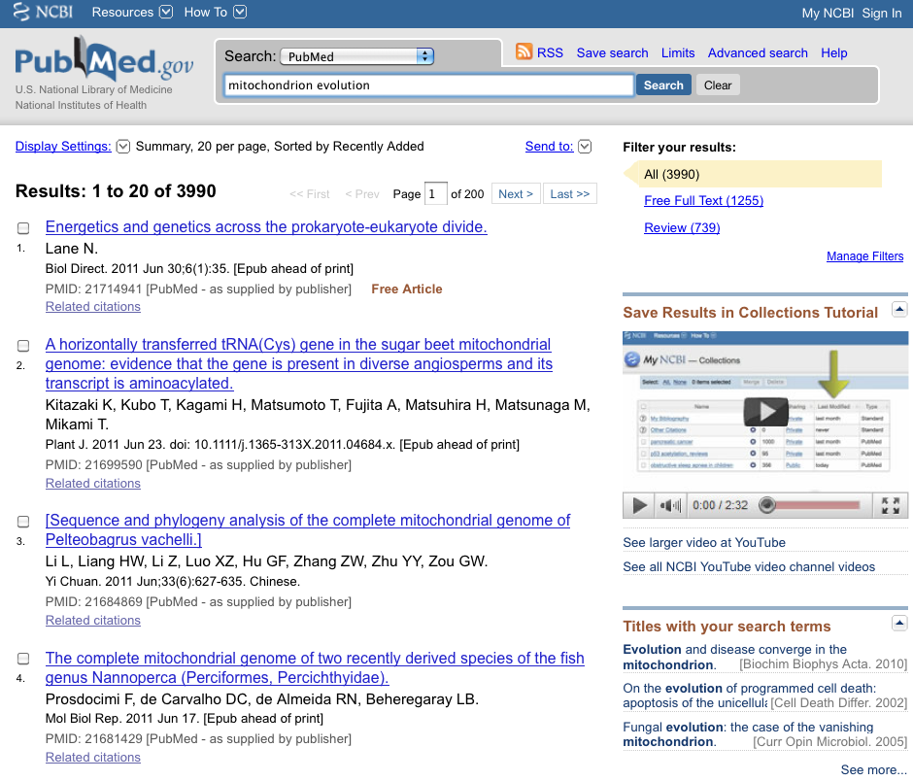
A search by subject:
“mitochondrion evolution”

Slide 13
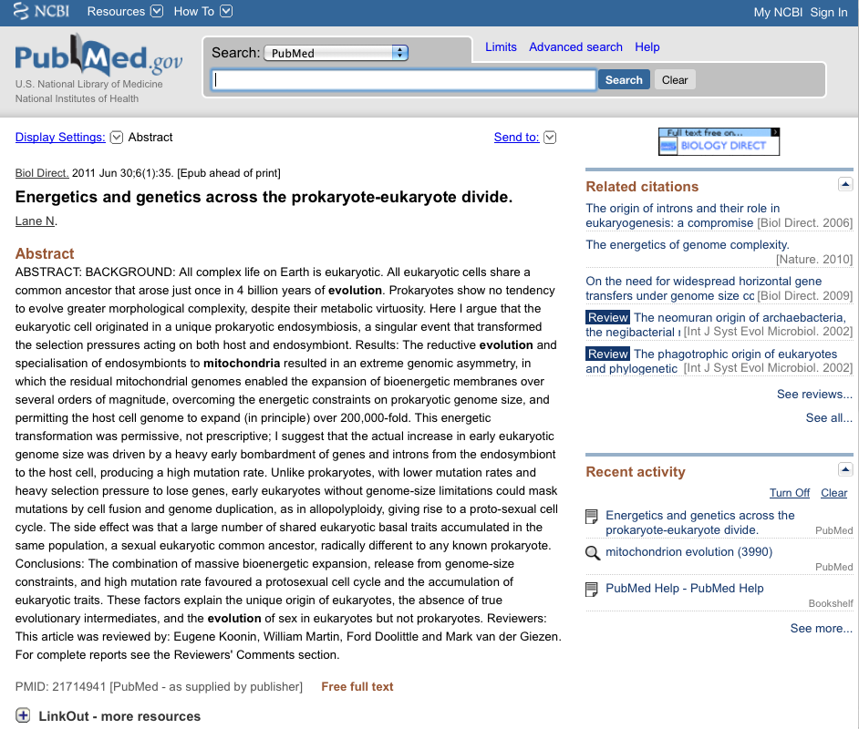

Slide 14
Online Glossaries
Bioinformatics :
http://www.geocities.com/bioinformaticsweb/glossary.html
http://big.mcw.edu/
Genomics:
http://www.geocities.com/bioinformaticsweb/genomicglossary.html
Molecular Evolution:
http://workshop.molecularevolution.org/resources/glossary/
Biology dictionary:
http://www.biology-online.org/dictionary/satellite_cells
Other glossaries, e.g., the list of phobias:
http://www.phobialist.com/class.html

