Slide 1
Pharmacogenomics and proteomics
Semester : III
Subject code: 17ZOOME31
Department of animal science
Bharathidasan University
Trichy - 24

Slide 2
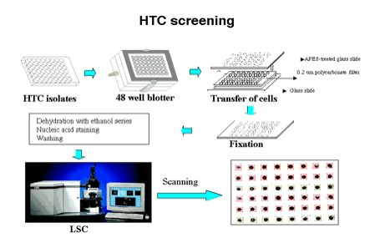
High-throughput screening
High-throughput screening (HTS) is a method for scientific experimentation especially used in drug discovery and relevant to the fields of biology and chemistry.
Through this process one can rapidly identify active compounds, antibodies, or genes that modulate a particular biomolecular pathway. The results of these experiments provide starting points for drug design and for understanding the noninteraction or role of a particular location.

Slide 3
Pharmacogenetics
Pharmacogenetics is the study of inherited genetic differences in drug metabolic pathways (and other pharmacological principles, like enzymes, messengers and receptors) which can affect individual responses to drugs, both in terms of therapeutic effect as well as adverse effects.
The term pharmacogenetics is often used interchangeably with the term pharmacogenomics which also investigates the role of acquired and inherited genetic differences in relation to drug response and drug behaviour through a systematic examination of genes, gene products, and inter- and intra-individual variation in gene expression and function.
In oncology, pharmacogenetics historically is the study of germline mutations

Slide 4
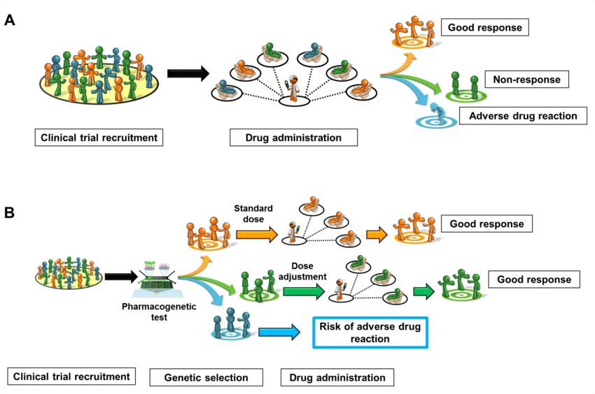

Slide 5
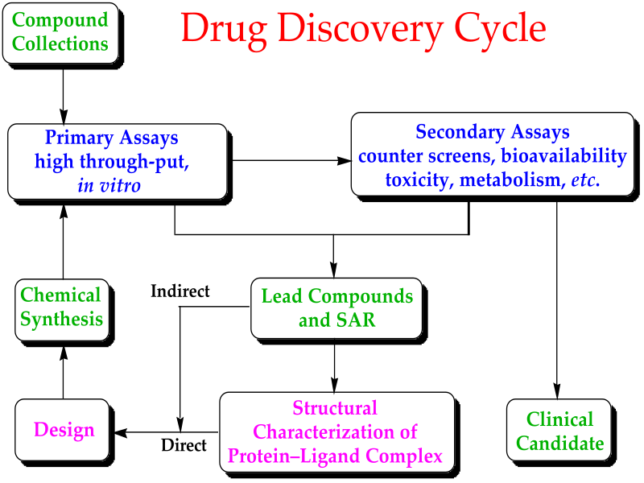
Drug development
Drug development is the process of bringing a new pharmaceutical drug to the market once a lead compound has been identified through the process of drug discovery.
It includes pre-clinical research on microorganisms and animals, filing for regulatory status, such as via the United States Food and Drug Administration for an investigational new drug to initiate clinical trials on humans, and may include the step of obtaining regulatory approval with a new drug application to market the drug.

Slide 6
Proteomics
Proteomics is the large-scale study of proteins.
Proteins are vital parts of living organisms, with many functions. The term proteomics was coined in 1997, in analogy to genomics, the study of the genome.
In proteomics, there are multiple methods to study proteins.
Generally, proteins may be detected by using either antibodies (immunoassays) or mass spectrometry.
If a complex biological sample is analyzed, either a very specific antibody needs to be used in quantitative dot blot analysis (qdb), or biochemical separation then needs to be used before the detection step, as there are too many analytes in the sample to perform accurate detection and quantification.
One major development to come from the study of human genes and proteins has been the identification of potential new drugs for the treatment of disease.
Proteomics is also used to reveal complex plant-insect interactions that help identify candidate genes involved in the defensive response of plants to herbivory.

Slide 7
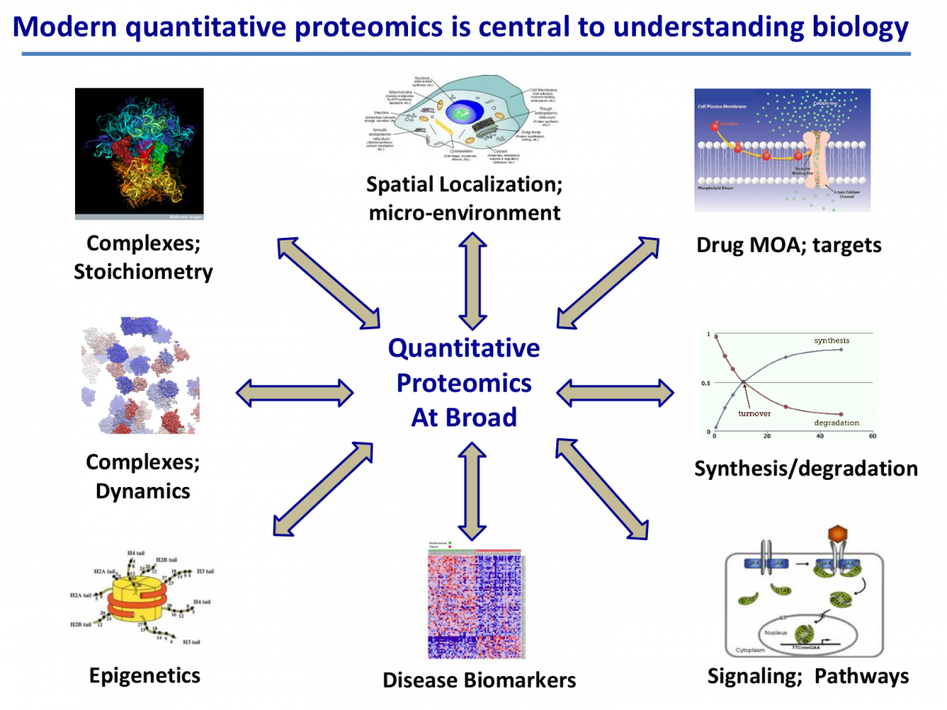

Slide 8
PROTEIN ANALYSIS
Protein analysis tries to explore how amino acid sequences specify the structure of proteins and how these proteins bind to substrates and other molecules to perform their functions.
Protein analysis allows us to understand the function of the protein based on its structure.
Extraction of proteins.
Purification of the protein.
Structural Characterization of the protein

Slide 9
PROTEIN CHARACTERIZATION
Determining the Amino Acid Composition
Involves finding out the amino acids that make up the protein and their number.
Determining the Amino Acid Sequence
Involves finding out the sequence of amino acids of the proteins in their order.
Determining the Molecular mass of the Protein

Slide 10
DETERMINATION OF MOLECULAR MASS BY MASS SPECTROMETRY
Spectrometry: The procedure of observing and measuring the wavelengths of light or other electromagnetic emissions.
Mass Spectrometry involves an ionization source, a mass analyzer and a detector. The ionized hit the mass analyzer. The time the ions take in flight is recorded by triggering a laser pulse.
It depends on one principle
The smaller ions will fly faster and hit the detector first then the larger ions reach. The ions hit the detector in order by mass.

Slide 11
Maldi-tof
Matrix-Assisted Laser Desorption Ionization
It is a soft ionization technique used in mass spectrometry, allowing the analysis of biomolecules (biopolymers such as DNA, proteins, peptides and sugars) and large organic molecules (such as polymers, dendrimers and other macromolecules), which tend to be fragile and fragment when ionized by more conventional ionization methods.
MALDI is attached to a time of flight (TOF) analyzer which measures time it takes for the molecules to travel a fixed distance.

Slide 12
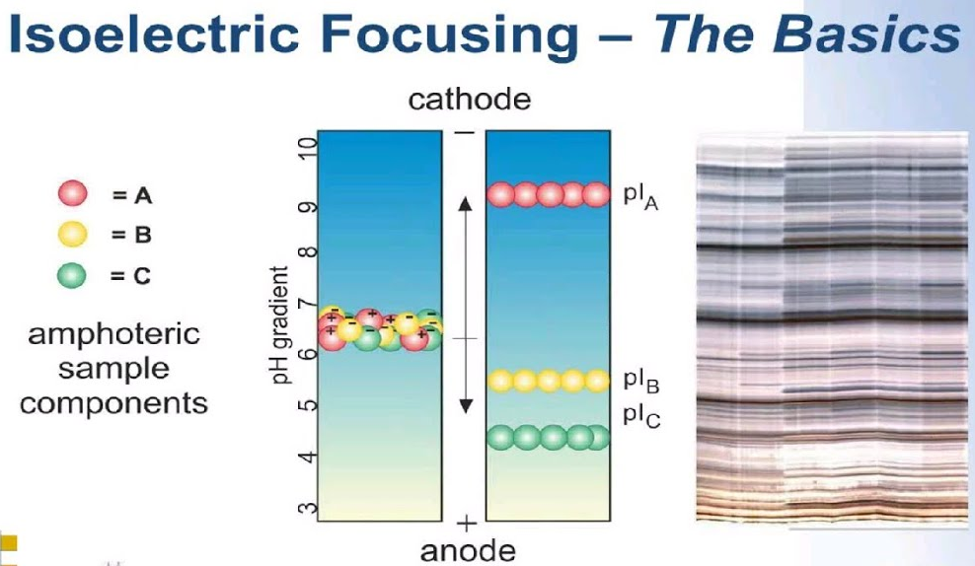
Isoelectric focusing
Isoelectric focusing (IEF), also known as electrofocusing, is a technique for separating different molecules by differences in their isoelectric point (pI).
It is a type of zone electrophoresis, usually performed on proteins in a gel, that takes advantage of the fact that overall charge on the molecule of interest is a function of the pH of its surroundings

Slide 13
Two-dimensional gel electrophoresis
Two-dimensional gel electrophoresis, abbreviated as 2-DE or 2-D electrophoresis, is a form of gel electrophoresis commonly used to analyze proteins.
Mixtures of proteins are separated by two properties in two dimensions on 2D gels
2-D electrophoresis begins with electrophoresis in the first dimension and then separates the molecules perpendicularly from the first to create an electropherogram in the second dimension.
In electrophoresis in the first dimension, molecules are separated linearly according to their isoelectric point. In the second dimension, the molecules are then separated at 90 degrees from the first electropherogram according to molecular mass.
Since it is unlikely that two molecules will be similar in two distinct properties, molecules are more effectively separated in 2-D electrophoresis than in 1-D electrophoresis.

Slide 14
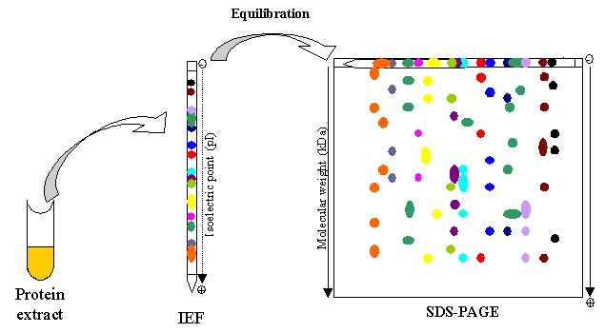

Slide 15
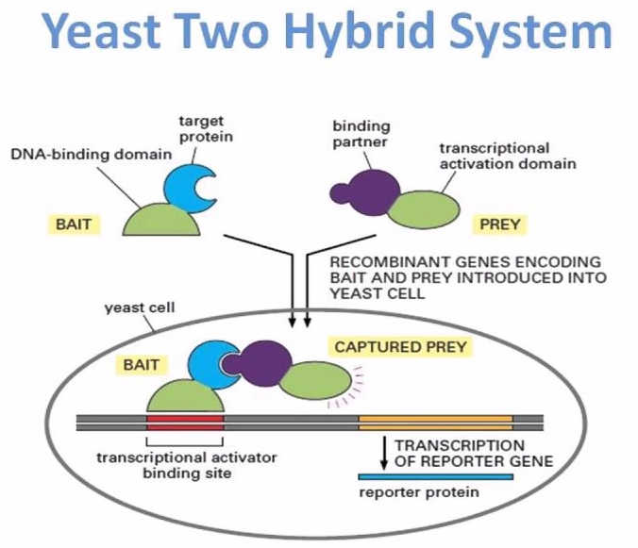
yeast two-hybrid system
Two-hybrid screening (originally known as yeast two-hybrid system or Y2H) is a molecular biology technique used to discover protein–protein interactions (PPIs) and protein–DNA interactions by testing for physical interactions (such as binding) between two proteins or a single protein and a DNA molecule, respectively.
For two-hybrid screening, the transcription factor is split into two separate fragments, called the DNA-binding domain (DBD or often also abbreviated as BD) and activating domain (AD).
The BD is the domain responsible for binding to the UAS and the AD is the domain responsible for the activation of transcription. The Y2H is thus a protein-fragment complementation assay.

