Slide 1
Genome sequencing
Semester : III
Subject code: 17ZOOME31
Department of animal science
Bharathidasan University
Trichy - 24

Slide 2
Gene Prediction
It the process of identifying the regions of genomic DNA that encode genes.
This includes protein-coding genes as well as RNA genes, but may also include prediction of other functional elements such as regulatory regions.
Gene finding is one of the first and most important steps in understanding the genome of a species once it has been sequenced.
Determining that a sequence is functional should be distinguished from determining the function of the gene or its product.
Predicting the function of a gene and confirming that the gene prediction is accurate still demands in vivo experimentation
Pseudogene prediction: Pseudogenes are close relatives of genes, sharing very high sequence homology, but being unable to code for the same protein product.
Metagenomic gene prediction: Metagenomics is the study of genetic material recovered from the environment, resulting in sequence information from a pool of organisms. Predicting genes is useful for comparative metagenomics.

Slide 3
Whole shotgun genome sequencing
In genetics, shotgun sequencing is a method used for sequencing long DNA strands.
It is named by analogy with the rapidly expanding, quasi-random firing pattern of a shotgun.
The chain termination method of DNA sequencing ("Sanger sequencing") can only be used for short DNA strands of 100 to 1000 base pairs.
Due to this size limit, longer sequences are subdivided into smaller fragments that can be sequenced separately, and these sequences are assembled to give the overall sequence.
In shotgun sequencing, DNA is broken up randomly into numerous small segments, which are sequenced using the chain termination method to obtain reads.
Multiple overlapping reads for the target DNA are obtained by performing several rounds of this fragmentation and sequencing.
Computer programs then use the overlapping ends of different reads to assemble them into a continuous sequence.

Slide 4
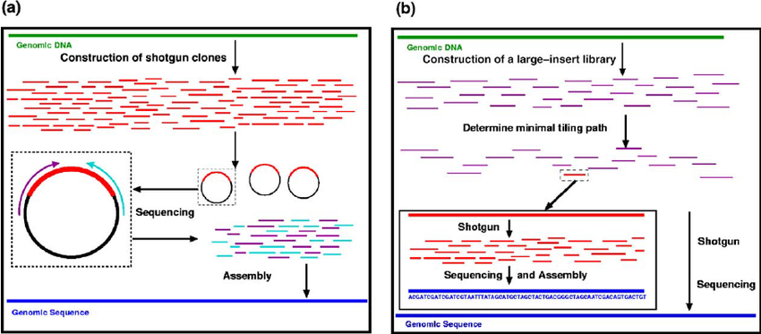

Slide 5
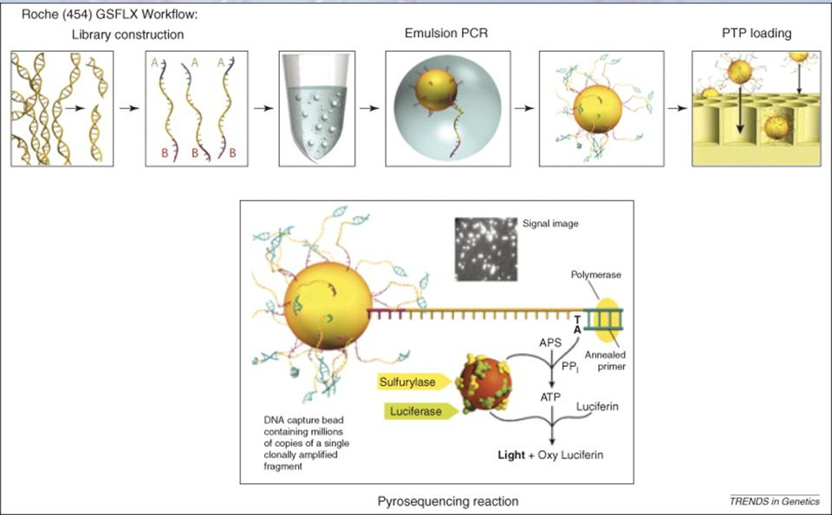
Roche 454 sequencing
The DNA or RNA is fragmented into shorter reads, in this case up to 1kb.
Generic adaptors are added to the ends and these are annealed to beads, one DNA fragment per bead. The fragments are then amplified by PCR using adaptor-specifc primers.
Each bead is then placed in a single well of a slide. So each well will contain a single bead, covered in many PCR copies of a single sequence.
The slide is flooded with one of the four NTP species. So if we flood with Guanine bases, and the next in a sequence is G, one G will be added, however if the next part of the sequence is GGGG, then four Gs will be added.

Slide 6
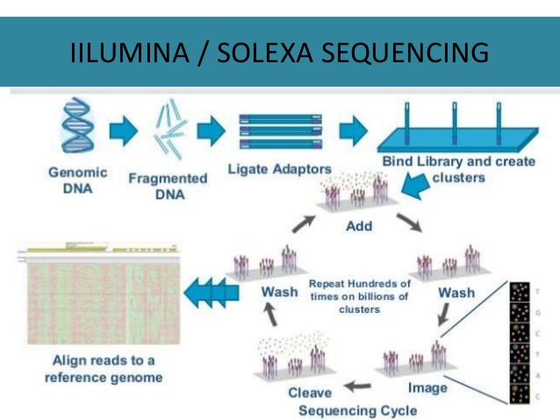
Illumina/Solexa genome sequencing
llumina sequencing has been used to sequence many genomes and has enabled the comparison of DNA sequences to improve understanding of health and disease.
Illumina sequencing generates many millions of highly accurate reads making it much faster and cheaper than other available sequencing methods.

Slide 7
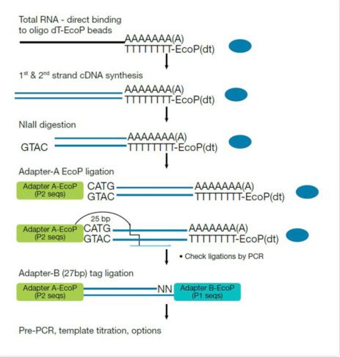
SOLiD Sequencing
SOLiD (Sequencing by Oligonucleotide Ligation and Detection) is a next-generation DNA sequencing technology.
This next generation technology generates hundreds of millions to billions of small sequence reads at one time.
Library Preparation
Template Preparation
Bead Deposition
Sequencing by Ligation
Primer Reset

Slide 8
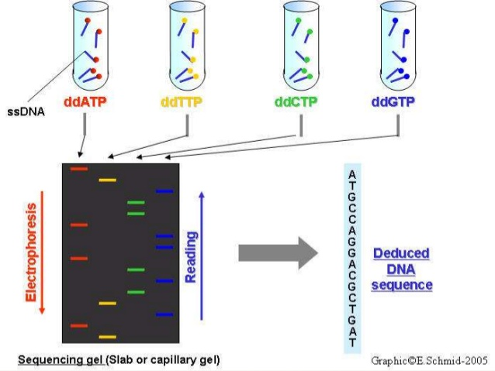
Maxam–Gilbert sequencing
Maxam–Gilbert sequencing is a method of DNA sequencing developed by Allan Maxam and Walter Gilbert in 1976–1977.
This method is based on nucleobase-specific partial chemical modification of DNA and subsequent cleavage of the DNA backbone at sites adjacent to the modified nucleotides.
Maxam–Gilbert sequencing was the first widely adopted method for DNA sequencing, and, along with the Sanger dideoxy method, represents the first generation of DNA sequencing methods.

Slide 9
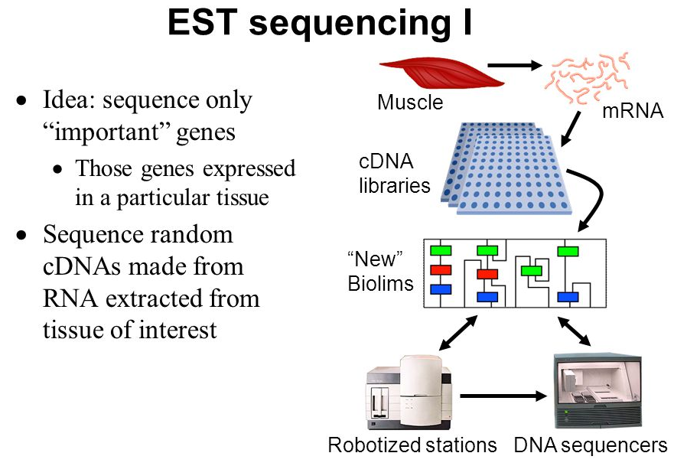
Expressed sequence tag
In genetics, an expressed sequence tag (EST) is a short sub-sequence of a cDNA sequence.
ESTs may be used to identify gene transcripts, and are instrumental in gene discovery and in gene-sequence determination.
The cDNAs identified by EST analysis can be used in standard experiments designed to elucidate their cellular and developmental functions.

Slide 10
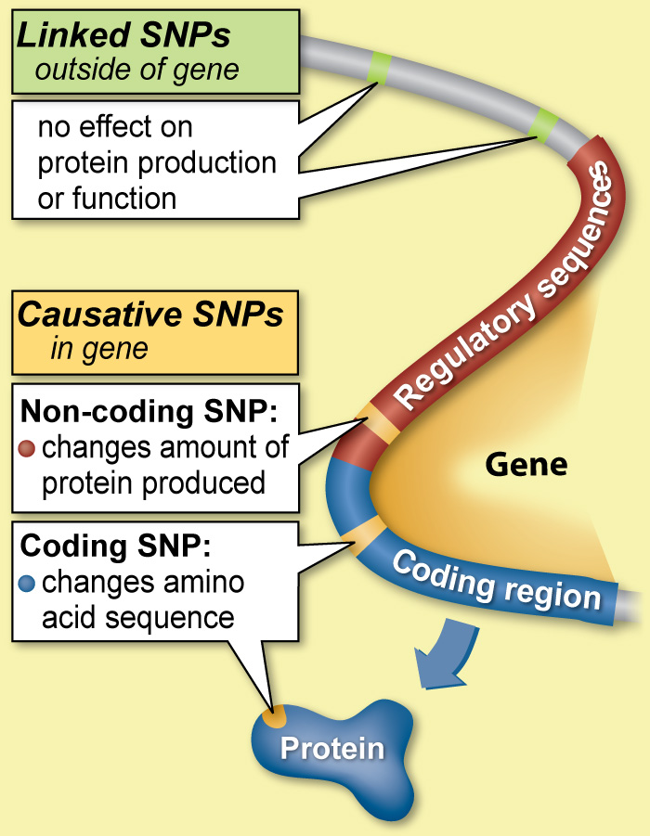
single nucleotide polymorphisms
Single nucleotide polymorphisms, frequently called SNPs are the most common type of genetic variation among people. Each SNP represents a difference in a single DNA building block, called a nucleotide.
It occur almost once in every 1,000 nucleotides on average, which means there are roughly 4 to 5 million SNPs in a person's genome.
These variations may be unique or occur in many individuals; scientists have found more than 100 million SNPs in populations around the world. Most commonly, these variations are found in the DNA between genes.

Slide 11
Human Genome Project
The Human Genome Project (HGP) was an international scientific research project with the goal of determining the sequence of nucleotide base pairs that make up human DNA, and of identifying and mapping all of the genes of the human genome from both a physical and a functional standpoint.
The Human Genome Project originally aimed to map the nucleotides contained in a human haploid reference genome (more than three billion).
The "genome" of any given individual is unique; mapping the "human genome" involved sequencing a small number of individuals and then assembling these together to get a complete sequence for each chromosome.
The work of the Human Genome Project has allowed researchers to begin to understand the blueprint for building a person.
As researchers learn more about the functions of genes and proteins, this knowledge will have a major impact in the fields of medicine, biotechnology, and the life sciences.

Slide 12
DNA annotation
DNA annotation or genome annotation is the process of identifying the locations of genes and all of the coding regions in a genome and determining what those genes do.
An annotation (irrespective of the context) is a note added by way of explanation or commentary. Once a genome is sequenced, it needs to be annotated to make sense of it.
For DNA annotation, a previously unknown sequence representation of genetic material is enriched with information relating genomic position to intron-exon boundaries, regulatory sequences, repeats, gene names and protein products.
This annotation is stored in genomic databases such as Mouse Genome Informatics, FlyBase, and WormBase.
Genome annotation consists of three main steps:
identifying portions of the genome that do not code for proteins
identifying elements on the genome, a process called gene prediction
attaching biological information to these elements

Slide 13
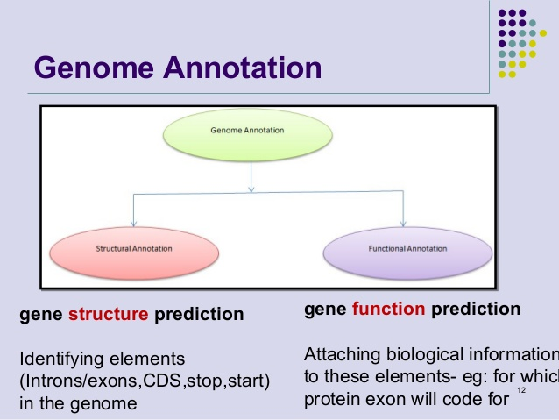

Slide 14
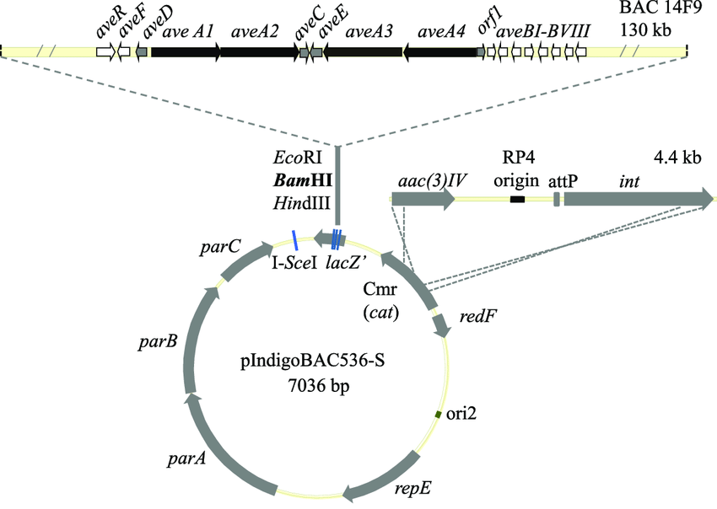
Bacterial Genome atlas BacMap
BacMap is an interactive visual database containing hundreds of fully labeled, zoomable, and searchable maps of bacterial genomes.
The bacterial artificial chromosome's usual insert size is 150–350 kbp. A similar cloning vector called a PAC has also been produced from the DNA of P1 bacteriophage.
BACs are often used to sequence the genome of organisms in genome projects.
BACs were replaced with faster and less laborious sequencing methods

