Slide 1
Genomics and Proteomics:
Omics and their importance
Semester : III
Subject code: 17ZOOME31
Department of animal science
Bharathidasan University
Trichy - 24

Slide 2
Structure and organization of Prokaryotic genome
Chromosomes in bacteria and archaea are usually circular, and a prokaryotic cell typically contains only a single chromosome within the nucleoid.
Because the chromosome contains only one copy of each gene, prokaryotes are haploid.
The DNA in the bacterial chromosome is arranged in several supercoiled domains.

Slide 3
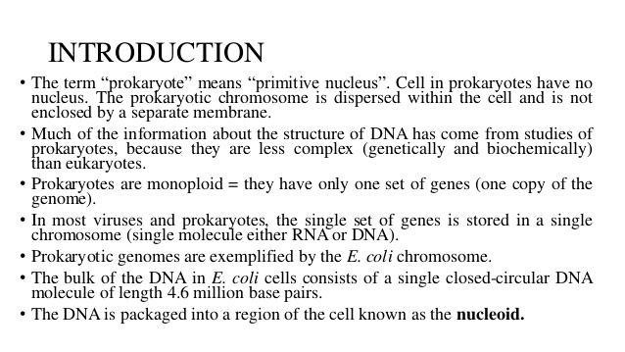

Slide 4
E. coli: A Model Prokaryote
The essential genes of E. coli are encoded on a single circular chromosome packaged within the cell nucleoid
The nucleoid is simply the area of a prokaryotic cell in which the chromosomal DNA is located.
This arrangement is not as simple as it sounds, however, especially considering that the E. coli chromosome is several orders of magnitude larger than the cell itself. So, if bacterial chromosomes are so huge, how can they fit comfortably inside a cell

Slide 5
Prokaryotic Chromosomes | Eukaryotic Chromosomes
Many prokaryotes contain a single circular chromosome. Prokaryotic chromosomes are condensed in the nucleoid via DNA supercoiling and the binding of various architectural proteins. Because prokaryotic DNA can interact with the cytoplasm, transcription and translation occur simultaneously. Most prokaryotes contain only one copy of each gene (i.e., they are haploid). Nonessential prokaryotic genes are commonly encoded on extrachromosomal plasmids. Prokaryotic genomes are efficient and compact, containing little repetitive DNA. | Eukaryotes contain multiple linear chromosomes. Eukaryotic chromosomes are condensed in a membrane-bound nucleus via histones. In eukaryotes, transcription occurs in the nucleus, and translation occurs in the cytoplasm. Most eukaryotes contain two copies of each gene (i.e., they are diploid). Some eukaryotic genomes are organized into operons, but most are not. Extrachromosomal plasmids are not commonly present in eukaryotes. Eukaryotes contain large amounts of noncoding and repetitive DNA.

Slide 6
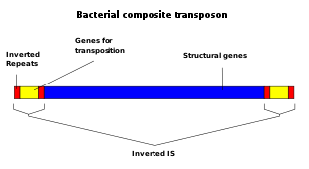
Transposable element
A transposable element (TE or transposon) is a DNA sequence that can change its position within a genome, sometimes creating or reversing mutations and altering the cell's genetic identity and genome size.
Transposition often results in duplication of the same genetic material.

Slide 7
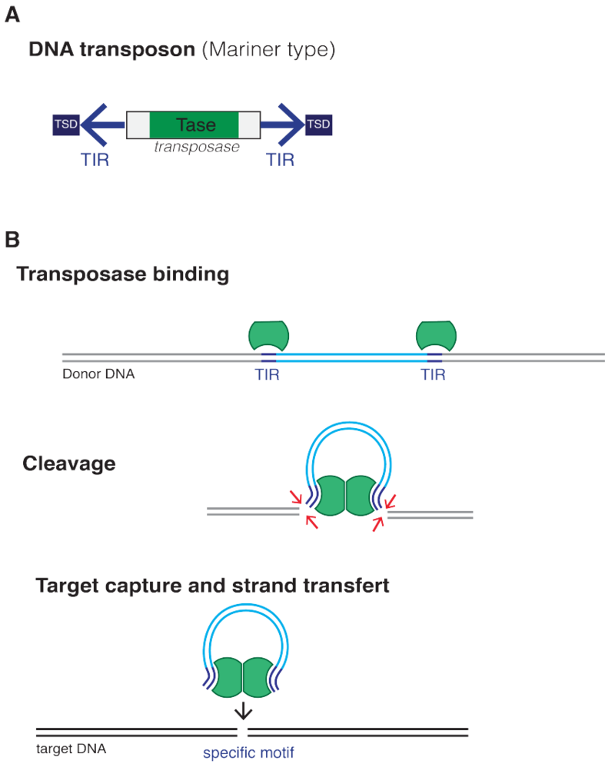
Classification
Transposable elements represent one of several types of mobile genetic elements.
Class I (retrotransposons)
Class II (DNA transposons)
Retrotransposons, with long terminal repeats (LTRs), which encode reverse transcriptase, similar to retroviruses
Retroposons, Long interspersed nuclear elements (LINEs, LINE-1s, or L1s), which encode reverse transcriptase but lack LTRs, and are transcribed by RNA polymerase II
Short interspersed nuclear elements (SINEs) do not encode reverse transcriptase and are transcribed by RNA polymerase III

Slide 8
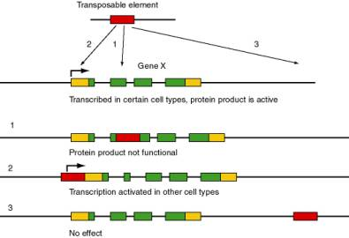

Slide 9
Bacterial Operon
In genetics, an operon is a functioning unit of DNA containing a cluster of genes under the control of a single promoter.
The genes are transcribed together into an mRNA strand and either translated together in the cytoplasm, or undergo splicing to create monocistronic mRNAs that are translated separately, i.e. several strands of mRNA that each encode a single gene product.
Originally, operons were thought to exist solely in prokaryotes (which includes organelles like plastids that are derived from bacteria), but since the discovery of the first operons in eukaryotes in the early 1990s

Slide 10
General structure
An operon is made up of 3 basic DNA components:
Promoter – a nucleotide sequence that enables a gene to be transcribed. The promoter is recognized by RNA polymerase, which then initiates transcription. In RNA synthesis, promoters indicate which genes should be used for messenger RNA creation – and, by extension, control which proteins the cell produces.
Operator – a segment of DNA to which a repressor binds. It is classically defined in the lac operon as a segment between the promoter and the genes of the operon. The main operator in the lac operon is located slightly downstream of the promoter; two additional operators are located respectively. In the case of a repressor, the repressor protein physically obstructs the RNA polymerase from transcribing the genes.
Structural genes – the genes that are co-regulated by the operon.

Slide 11
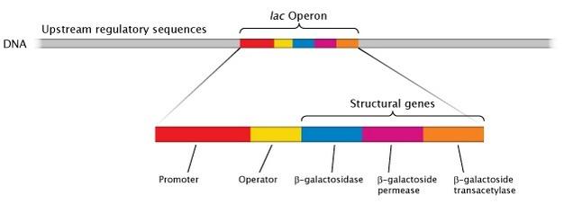

Slide 12
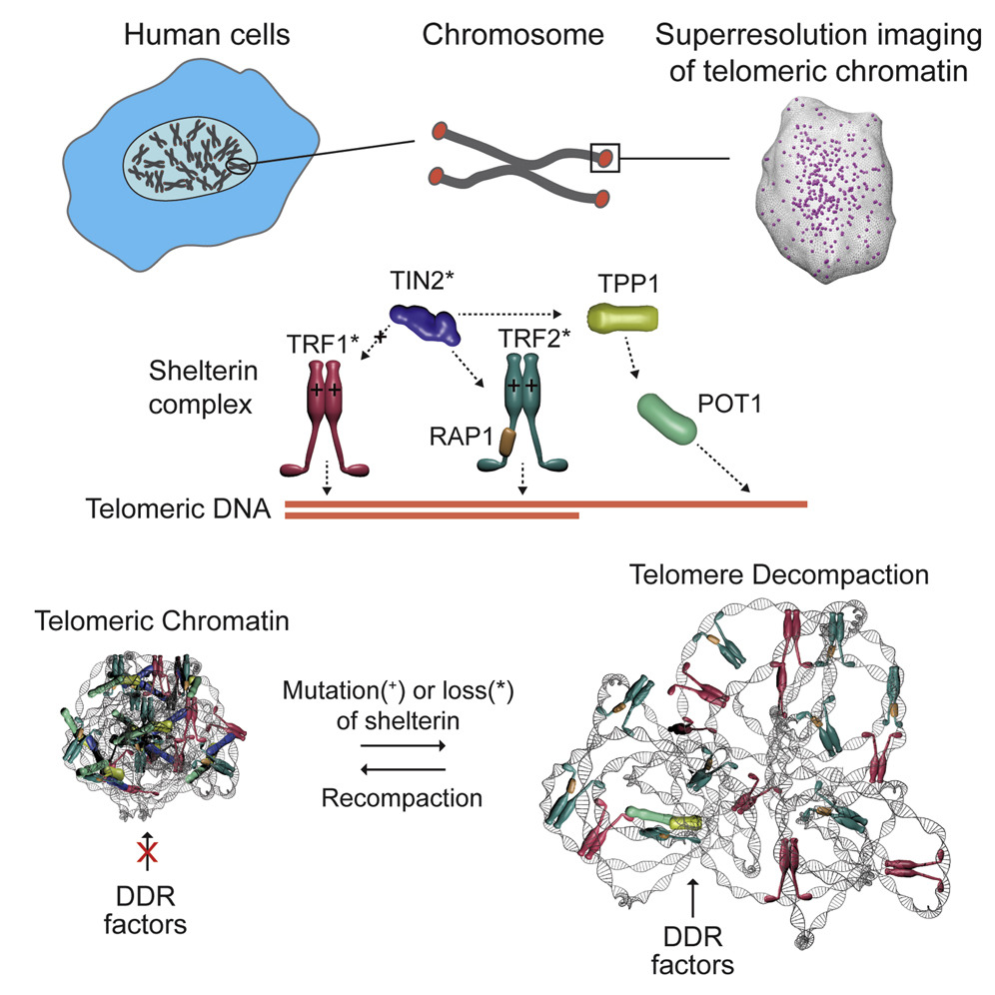
Telomeric and sub-telomeric region

Slide 13
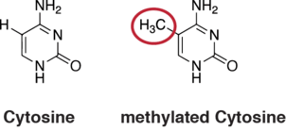
DNA methylation
DNA methylation is a process by which methyl groups are added to the DNA molecule.
Methylation can change the activity of a DNA segment without changing the sequence.
When located in a gene promoter, DNA methylation typically acts to repress gene transcription.
In mammals DNA methylation is essential for normal development and is associated with a number of key processes including genomic imprinting, X-chromosome inactivation, repression of transposable elements, aging, and carcinogenesis.

Slide 14
Gene silencing
Gene silencing is the regulation of gene expression in a cell to prevent the expression of a certain gene.
Gene silencing can occur during either transcription or translation and is often used in research.
In particular, methods used to silence genes are being increasingly used to produce therapeutics to combat cancer and diseases, such as infectious diseases and neurodegenerative disorders.
Gene silencing is often considered the same as gene knockdown.
Types
Transcriptional
Genomic Imprinting
Paramutation
Transposon silencing
Transgene silencing
Position effect
RNA-directed DNA methylation
Meiotic
  Transvection
  Meiotic silencing of unpaired DNA
Post-transcriptional
  RNA interference
  RNA silencing
  Nonsense mediated decay

Slide 15
