Slide 1
Antigen Antibody Complement system Department of Animal Science Bharathidasan University Tiruchirappalli-620024.

Slide 2
1 Concept of Antigen
Antigen is a substances usually protein in nature and sometimes polysaccharide, that generates a specific immune response and induces the formation of a specific antibody or specially sensitized T cells or both.

Slide 3
Immunogens:
Although all antigens are recognized by specific lymphocytes or by antibodies, only some antigens are capable of activating lymphocytes. Molecules that stimulate immune responses are called Immunogens.

Slide 4
An antigen is a molecule that stimulates an immune response.
The word originated from the notion that they can stimulate antibody generation.
The modern definition encompasses all substances that can be recognized by the adaptive immune system.

Slide 5
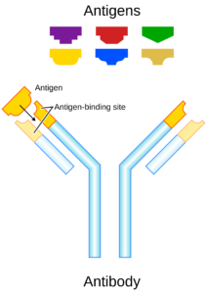

Slide 6
Allergen - An allergen is a substance that causes the allergic reaction. The (detrimental) reaction may result after exposure via ingestion, inhalation, injection or contact with skin.

Slide 7
Antigens can be classified in order of their origins
Exogenous antigens
Exogenous antigens are antigens that have entered the body from the outside, for example by inhalation, ingestion, or injection. By endocytosis or phagocytosis, these antigens are taken into the antigen-presenting cells (APCs) and processed into fragments.

Slide 8
Endogenous antigens
Endogenous antigens are antigens that have been generated within the cell, as a result of normal cell metabolism, or because of viral or intracellular bacterial infection.
Eg: Histocompatibility Leukocyte antigens (HLA)

Slide 9
Autoantigens
An autoantigen is usually a normal protein or complex of proteins (and sometimes DNA or RNA) that is recognized by the immune system of patients suffering from a specific autoimmune disease.

Slide 10
These antigens should under normal conditions not be the target of the immune system, but due to mainly genetic and environmental factors the normal immunological tolerance for such an antigen has been lost in these patients.

Slide 11
2 Characteristics of Antigen
★ Immunogenicity
The capacity to stimulate the production of antibodies or cell-mediated immune responses.

Slide 12
★ Antigenicity: It is the ability of a substance to combine specifically with the antibody or cell surface receptor.
♣ Complete antigen
♣ Incomplete antigen, also known as
hapten.

Slide 13
Incomplete antigens have antigenic determinants, but cannot induce immune responses because they lack one or more of the important attributes needed for this function (one example of an incomplete antigen is a hapten.
Molecular weight <100 KD
Example:
Cardiolipin
Capsular polysaccharides of bacteria

Slide 14
CARRIER MOLECULE
When hapten molecule attached with some macro-molecules & can elicit immune response, these macro-molecules are called carrier molecule.
Hapten carrier complex can act as an immunogen.

Slide 15
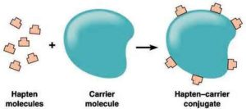

Slide 16
3 Properties of antigen
Foreignness is essential to immunogenicity because self-responsive cells are eliminated during lymphocyte ontogeny, leaving only cells that respond to non-self, so-called "foreign" epitopes.
Specificity
High molecular weight

Slide 17
4 Antigenic epitopes
Epitope,or, Antigenic determinants, are
the portions of antigen molecules that
physically interact with paratopes
(combining sites) of immune response
molecules and therefore actually
"determine" antigen specificity.

Slide 18
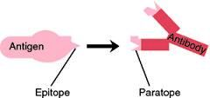

Slide 19
Types of Epitopes
1. Linear epitopes
♣ continuous and found in polysaccharides as well as in both native (nondenatured) and denatured proteins, especially fibrillar proteins.
♣ specificity depends upon primary sequence.
♣ typical size is 5-6 subunits in length.

Slide 20
2. Conformational epitopes
♣ Discontinuous (involve multiple subunits, often located far apart in the primary sequence of the antigen molecule) and are thus found only in native (globular) proteins.

Slide 21
♣3. Neoantigenic epitope: New epitopes produced by protein modification such as phosphorylation or proteolysis.

Slide 22
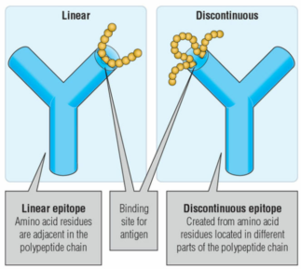

Slide 23
Two different epitopes
B cell epitope, a portion of antigen molecule that is recognized by B cell receptors.
T cell epitope, the region of antigen molecules that are recognized by T cell receptors.

Slide 24
6 Superantigen
Molecules that are potent T lymphocyte mitogens and simultaneously bind to class II MHC molecules. They are often associated with staphylococcal products and are involved in enterotoxemias and toxic shock syndrome in humans.

Slide 25
Superantigens (SAgs) are secreted proteins (exotoxins) that exhibit highly potent lymphocyte-transforming (mitogenic) activity directed towards T lymphocytes.

Slide 26
7 Mitogen
An agent that induces mitosis. Here means to activate T cells and/or B cells without help from APCs.
Lectin, for example, concanavalin A (ConA).
LPS(lipopolysaccharide)
Staphylococcal protein A(SPA)

Slide 27
8 Adjuvant
Adjuvant: The Latin "adjuvans" means to help, particularly to reach a goal.
A substance, different from antigen but when mixed with an antigen & injected with it increases immunogenicity of that antigen, called adjuvant.
Eg: Aluminium potassium sulphate, Aluminium hydroxide.

Slide 28
9 Other antigens
9-1 Heterophilic antigen : A kind of common antigen, existing in human, animals, and microbes.
9-2 Xenogenic antigen
This antigen comes from different genus and generic. For example, pathogenic antigen.

Slide 29
9-3 Allogenic antigen
The specific antigen exists in different individuals. Blood type antigens
9-4 Autoantigen
A pathological term.
BUT, sperm antigen

Slide 30
9-5 Idiotypic antigen
An antibody molecule is some sort of foreign molecule when generated in animal body. Such that immune system recognizes it as Antigen, which is known as Idiotypic antigen.

Slide 31
Factors Influencing Immunogenicity:
1. Foreignness
An antigen must be a foreign substances to the animal to elicit an immune response.
2. Molecular Size
The most active immunogens tend to have a molecular mass of 14,000 to 6,00,000 Da.
Examples: tetanus toxoid, egg albumin, thyroglobulin are highly antigenic.

Slide 32
3. Chemical Nature and Composition
In general, the more complex the substance is chemically the more immunogenic it will be.
Antigens are mainly proteins and some are polysaccharides.
It is presumed that presence of an aromatic radical is essential for rigidity and antigenicity of a substance.

Slide 33
4. Physical Form
In general particulate antigens are more immunogenic than soluble ones.
Denatured antigens are more immunogenic than the native form.

Slide 34
5. Antigen Specificity
Antigen Specificity depends on the specific active sites on the antigenic molecules (Antigenic determinants).
Antigenic determinants or epitopes are the regions of antigen which specifically binds with the antibody molecule.

Slide 35
6. Species Specificity
Tissues of all individuals in a particular species possess, species specific antigen.
Human Blood proteins can be differentiated from animal protein by specific antigen-antibody reaction.

Slide 36
7. Organ Specificity
Organ specific antigens are confined to particular organ or tissue.
Certain proteins of brain, kidney, thyroglobulin and lens protein of one species share specificity with that of another species.

Slide 37
8. Auto-specificity
The autologous or self antigens are ordinarily not immunogenic, but under certain circumstances lens protein, thyroglobulin and others may act as autoantigens.

Slide 38
9. Genetic Factors
Some substances are immunogenic in one species but not in another .Similarly, some substances are immunogenic in one individual but not in others.
The species or individuals may lack or have altered genes that code for the receptors for antigen on B cells and T cells.

Slide 39
10. Age
Age can also influence immunogenicity.
Usually the very young and the very old have a diminished ability to elicit and immune response in response to an immunogen.

Slide 40
11. Degradability
Antigens that are easily phagocytosed are generally more immunogenic.

Slide 41
12. Dose of the antigen
The dose of administration of an immunogen can influence its immunogenicity.
There is a dose of antigen above or below which the immune response will not be optimal.

Slide 42
13. Route of Administration
Generally the subcutaneous route is better than the intravenous or intragastric routes.
The route of antigen administration can also alter the nature of the response.
Antigen administered intravenously is carried first to the spleen, whereas antigen administered subcutaneously moves first to local lymph nodes.

Slide 43
Antibody specificity or Antigen-Antibody Reactions

Slide 44
Antigen-antibody interactions:
Are reversible specific non-covalent biochemical reactions:
Hydrogen bonds (A chemical bond in which a hydrogen atom of one molecule is attracted to an electronegative atom of another molecule)
Electrostatic bonds(A valence bond in which two atoms, attracted by electrostatic forces, transfer one or more electrons between atoms)
Van der Waal forces (forces acting between nonbonded atoms or molecules)
Hydrophobic bonds(The attractive force between molecules due to the close positioning of non-hydrophilic portions of the two molecules
Can be represented by the formula:
K1=constant of association
K2=constant of dissociation
K1
Ag + Ab
Ag Ab
K2

Slide 45
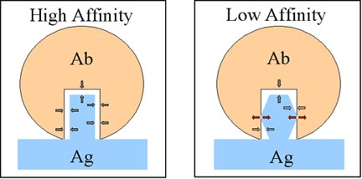
The affinity:
is the strength of the reaction between a single antigenic determinant and a single combining site on the antibody
or it is the association constant for binding (K_{A})
K_{A}= k₁/k₂
Valence: the number of epitopes
Avidity: is the collective affinity of multiple binding sites(affinity+ Valence)

Slide 46
Types of Antigen-antibody reactions:
Precipitation
Agglutination
Neutralization (Antitoxins)
Opsonization
Antibody-dependant cell-mediated cytotoxicity
The complement activation Membrane attack complex

Slide 47
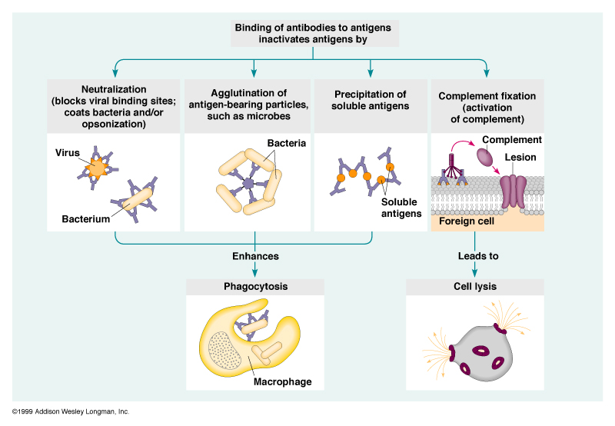
Consequences of Antibody Binding

Slide 48
PRECIPITATION
Is the reaction of soluble Ag with soluble Ab.
The reaction results in the formation of Ag-Ab complexes (lattices)
Antigen
Antibody

Slide 49
The Quantitative Precipitation Reaction:
Varying amounts of Ag are mixed and incubated with Constant volume of antisera
Precipitate is measured, amount of precipitate depends on :
the ratio of Ag : Ab
The Ab avidity
Plot in a curve, three zones are detected:
Zone of Ag excess : insufficient Ab  too small complexes to precipitate
Equivalence zone : large lattice is formed  visible precipitates
Zone of Ab excess : not enough Ag  too small complexes to precipitate

Slide 50
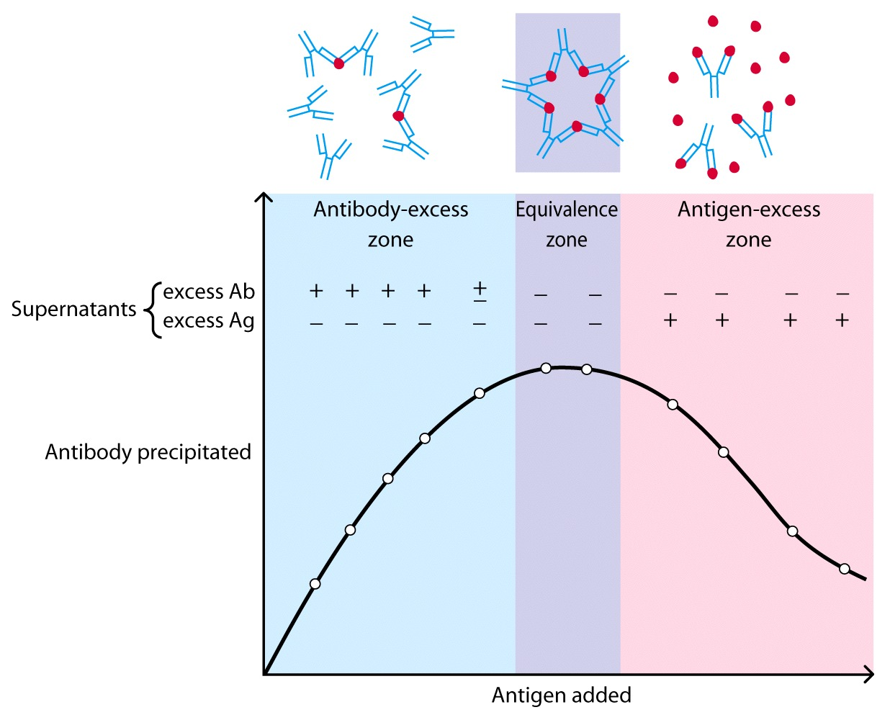

Slide 51
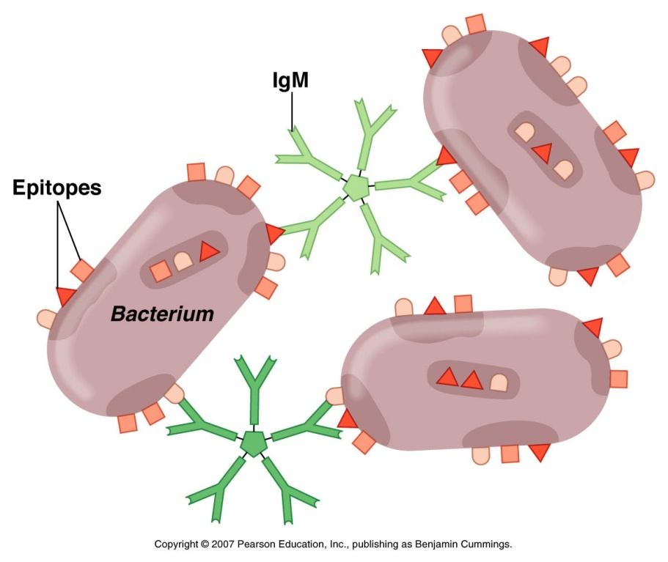
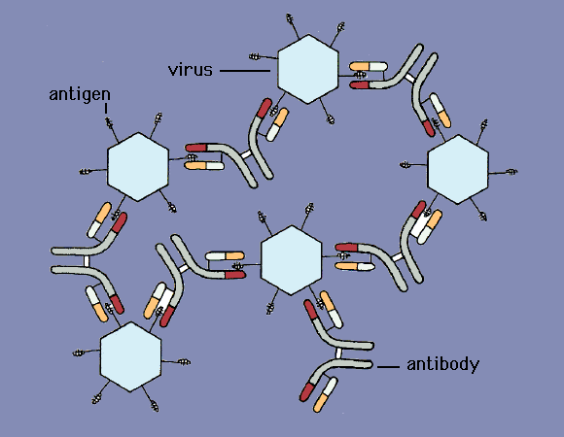
AGGLUTINATION
Abs can bind and cross-link cells or particles  aggregate formation
Entrap microbial invaders
IgM & IgA are the most suitable (IgG in sufficient amounts can agglutinate cells)

Slide 52
Agglutination
RBC
IgM Antibody
RBC
RBC
RBC
RBC
RBC
RBC
RBC
IgG Antibody
RBC
RBC
RBC
Notes:
Study Guide
What is the difference between precipitation and agglutination?

Slide 53
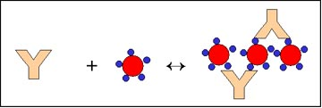
Applications of Agglutination
Agglutination/Hemagglutination:
a. Qualitative agglutination test
Determination of blood types or antibodies to blood group Ags
b. Quantitative agglutination test
Agglutination tests can also be used to measure the level of antibodies to particulate antigens.(titration)
Passive hemagglutination: erythrocytes are coated with a soluble antigen (e.g. viral antigen, a polysaccharide or a hapten) and use the coated red blood cells in an agglutination test for antibody to the soluble antigen

Slide 54
NEUTRALIZATION
Is the binding of Ab to microbial epitopes or soluble molecules(e.g. toxins) which inhibits their binding to host cells.
Abs are mostly IgG & IgA
Used to identify toxins and viruses

Slide 55
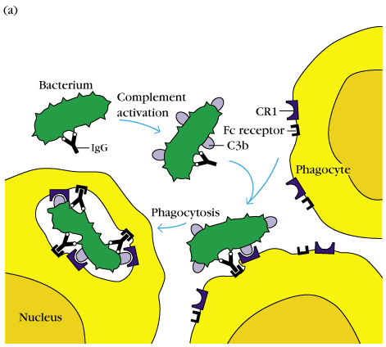
OPSONIZATION
Is the process by which a pathogen is marked (tagged) for ingestion and destruction by phagocytic cells

Slide 56
Antibody-dependant cell-mediated cytotoxicity
Coating of an organism can attract phagocytic cells as well as other cytolytic cells(NK cells, eosinophils)
The organism may be: bacteria, protozoa, parasitic worms
These cells use cytolytic mechanisms to kill those organisms

Slide 57
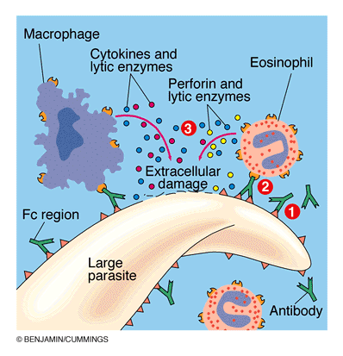
Destruction of Large Parasites by ADCC

Slide 58
Antibodies: Structure And Function

Slide 59
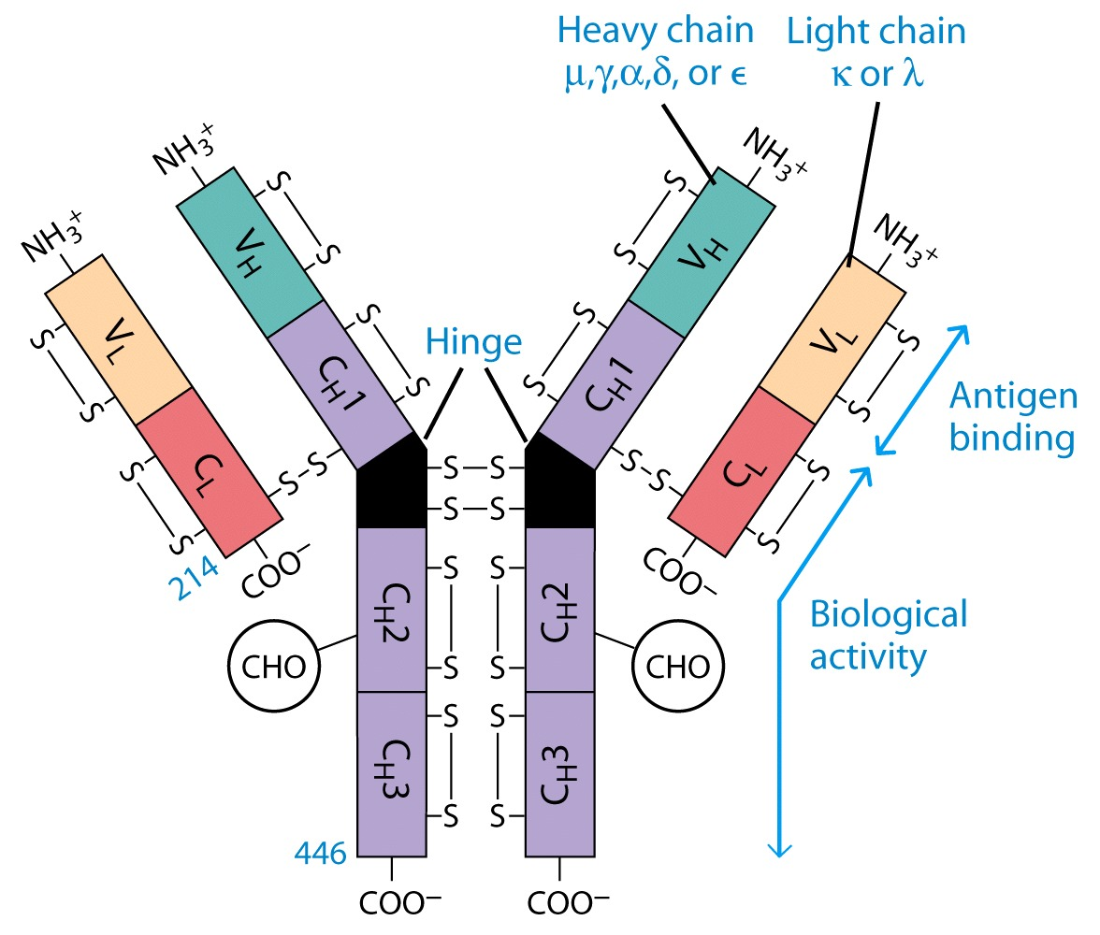

Slide 60
Antibody Structure
Antibodies Are Made Up Of:
2 Light Chains (identical) ~25 KDa
2 Heavy Chains (identical) ~50 KDa
Each Light Chain Bound To Heavy Chain By Disulfide bond (H-L)
Heavy Chain Bound to Heavy Chain (H-H)
First 100 a/a Of Amino Terminal Vary of Both H and L Chain Are Variable
Referred To As V_{L} , V_{H}, C_{H} And C_{L}
CDR (Complementarity Determining Regions) Are What Bind Ag
Remaining Regions Are Very Similar Within Same Ig Class

Slide 61
Antibody Structure
Repeating Domains of ~110 a/a
Intrachain disulfide bonds within each domain
Heavy chains
1 V_{H} and either 3 or 4 C_{H} (C_{H}1, C_{H}2, C_{H}3, C_{H}4)
Light chains
1 V_{L} and 1 C_{L}
Hinge Region
Rich in proline residues (flexible)
Hinge found in IgG, IgA and IgD
Proline residues are target for proteolytic digestion (papain and pepsin)
Rich in cysteine residues (disulfide bonds)
IgM and IgE lack hinge region
They instead have extra C_{H}4 Domain

Slide 62
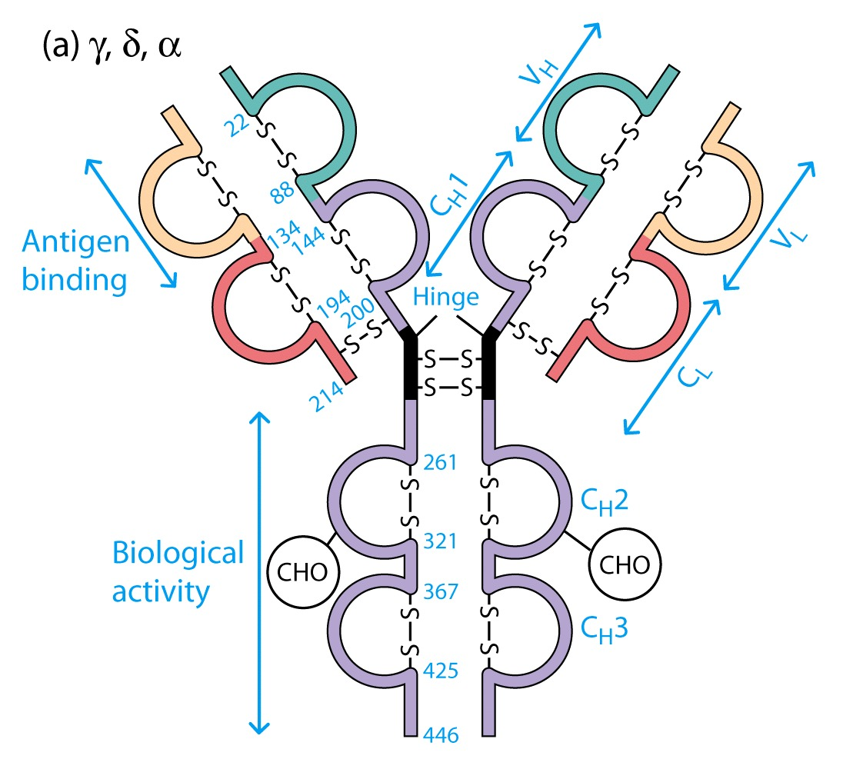

Slide 63
Enzymatic Digestion Of Antibodies
Digestion With Papain Yields
3 Fragments
2 identical Fab and 1 Fc
Fab Because Fragment That is Antigen Binding
Fc Because Found To Crystallize In Cold Storage
Pepsin Digestion
F(ab`)2
No Fc Recovery, Digested Entirely
Mercaptoethanol Reduction (Eliminates Disulfide Bonds)

Slide 64
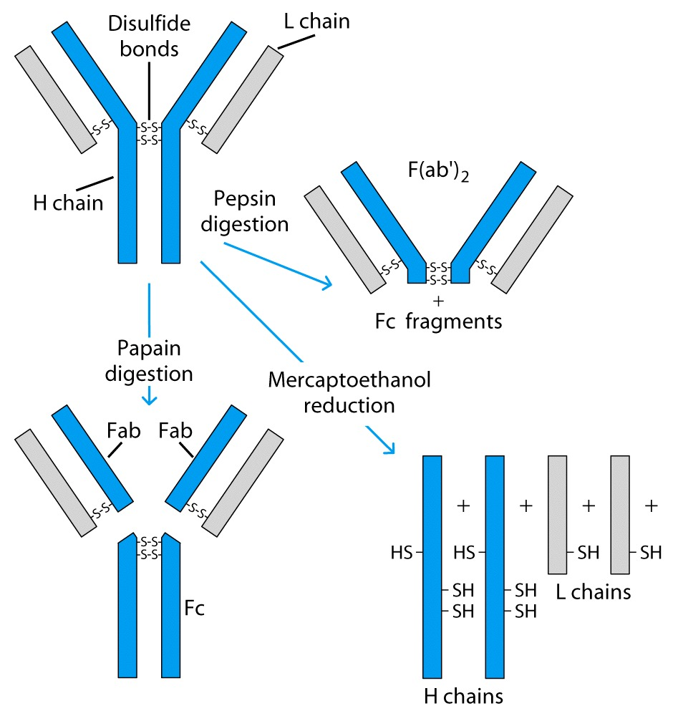

Slide 65
Sequencing Of Heavy Chains
Sequencing Of Several Immunoglobulins Revealed
100-110 Amino Terminus, Highly Variable (V)
Five Basic Sequence Patterns
α,γ, δ, ε, μ
IgA, IgG, IgD, IgE and IgM
The Above Classes Are Called Isotype
Each class can have either κ or λ light chains
Minor Differences Led To Sub-classes For IgA and IgG
IgA1, IgGA2 and IgG1, IgG2, IgG3, IgG4

Slide 66
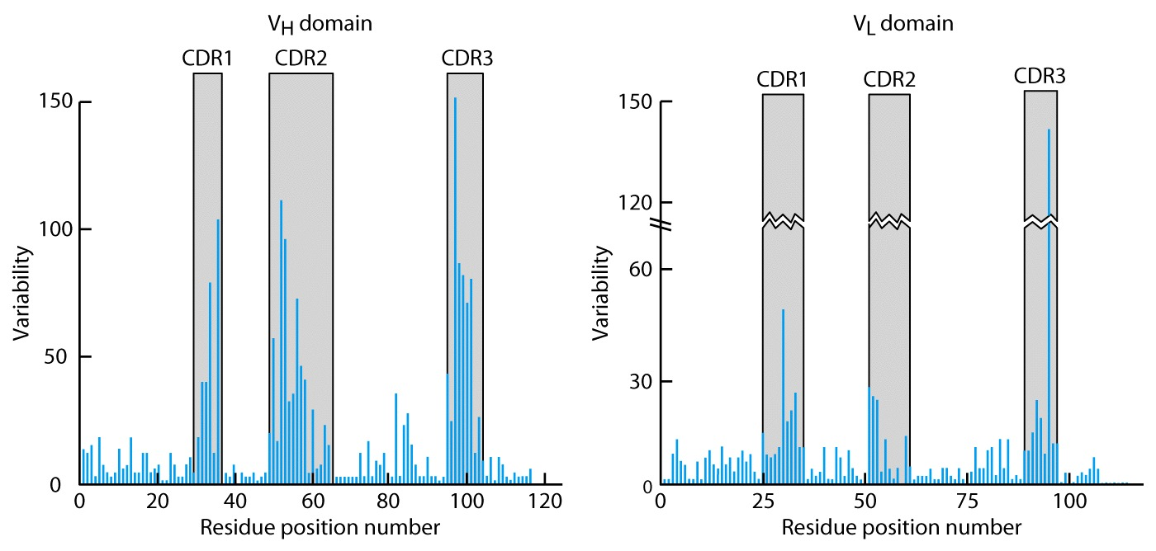
CDR Are Hypevariable

Slide 67
Monoclonal Antibodies
Immunize Animal With Antigen
Multiple Clones Are Generated, Good For In Vivo
For Clinical Diagnosis, Research, One Clone That Reacts To Single Epitope Is Preferred.
Fuse A Myeloma Cell (Cancerous) With A Normal Plasma Cells
Resulting Clones Can Be Cultured Indefinitely
Produces An Antibody Recognizing One Epitope

Slide 68
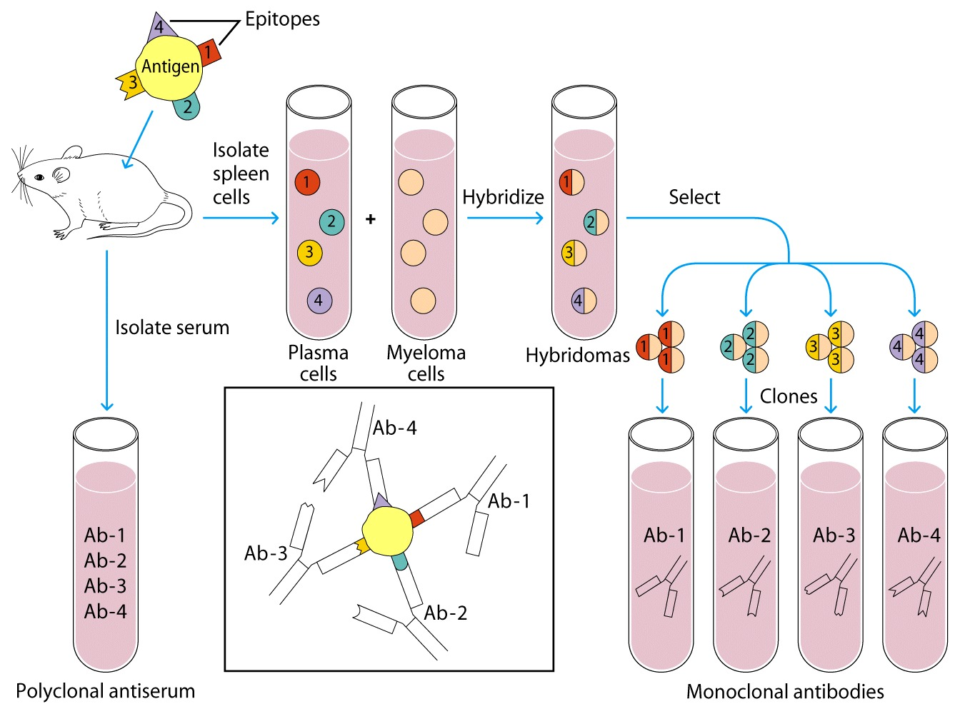

Slide 69
B-Cell Receptor (BCR)
BCR Is An Antibody On Surface Of Cell mIg
Very Short Cytoplasmic Tail, Cannot Transduce Signal
Heterodimeric Molecule Ig-α/Ig-β Transduces (long cytoplasmic tail)

Slide 70
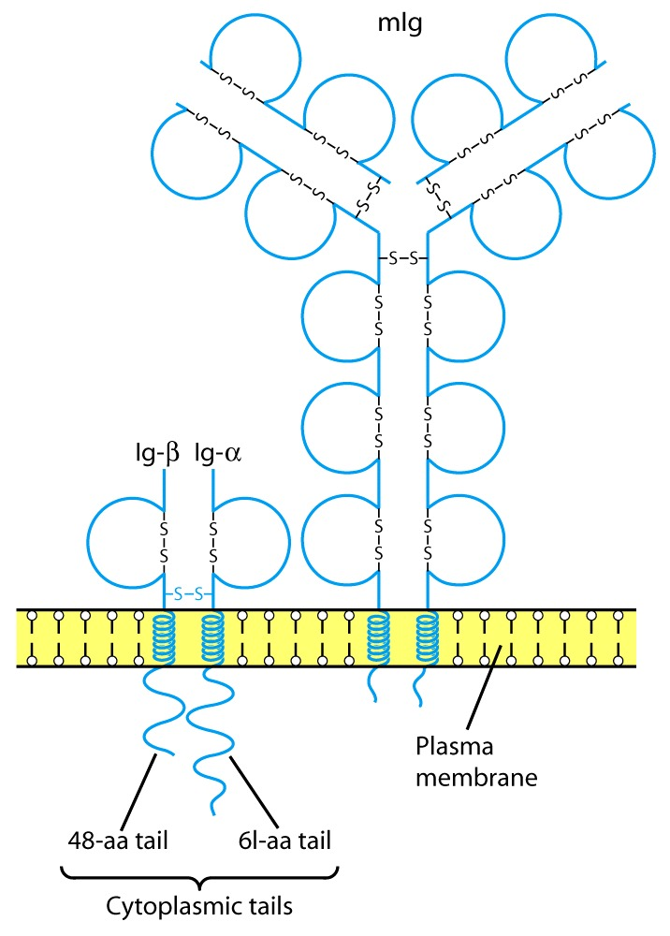

Slide 71
Fc Receptors (FcR) Functions
To Transport Abs Across Membranes
Secretion of IgA Across Epithelium into lumen
Transport of maternal Abs Across Placenta (IgG)
Many Cell Types Use FcR
Ex. Mast Cells, Macrophages, Neutrophils, B, T, NK
Opsonization, ADCC
Poly IgR
Transport of IgA across epithelium
FcR_{N}
Transport of maternal IgG to fetus

Slide 72
Antibody Classes And Biological Activities
IgG
Most abundant immunoglobin 80% of serum Ig
~10mg/mL
IgG1,2,3,4 (decreasing serum concentration)
IgG1, IgG3 and IgG4 cross placenta
IgG3 Most effective complement activator
IgG1 and IgG3 High affinity for FcR on phagocytic cells, good for opsonization

Slide 73
Antibody Classes And Biological Activities
IgM
5-10% of serum immunoglobulin
1.5mg/mL
mIgM (also IgD) expressed on B-cells as BCR
Pentameric version is secreted
First Ig of primary immune response
High valence Ig (10 theoretical), 5 empirical
More efficient than IgG in complement activation

Slide 74
Antibody Classes And Biological Activities
IgA
10-15% of serum IgG
Predominant Ig in secretions
Milk, saliva, tears, mucus
5-15 mg of IgA released in secretions!!!!
Serum mainly monomeric, polymers possible not common though
Secretions, as dimer or tetramer

Slide 75
Antibody Classes And Biological Activities
IgE
Participate in immediate hypersensitivities reactions. Ex. Asthma, anaphylaxis.
Verylow serum concentration, 0.3μg/mL
Binds Mast Cells and Blood Basophils thru FcεR
Binding causes degranulation (Histamine Release)

Slide 76
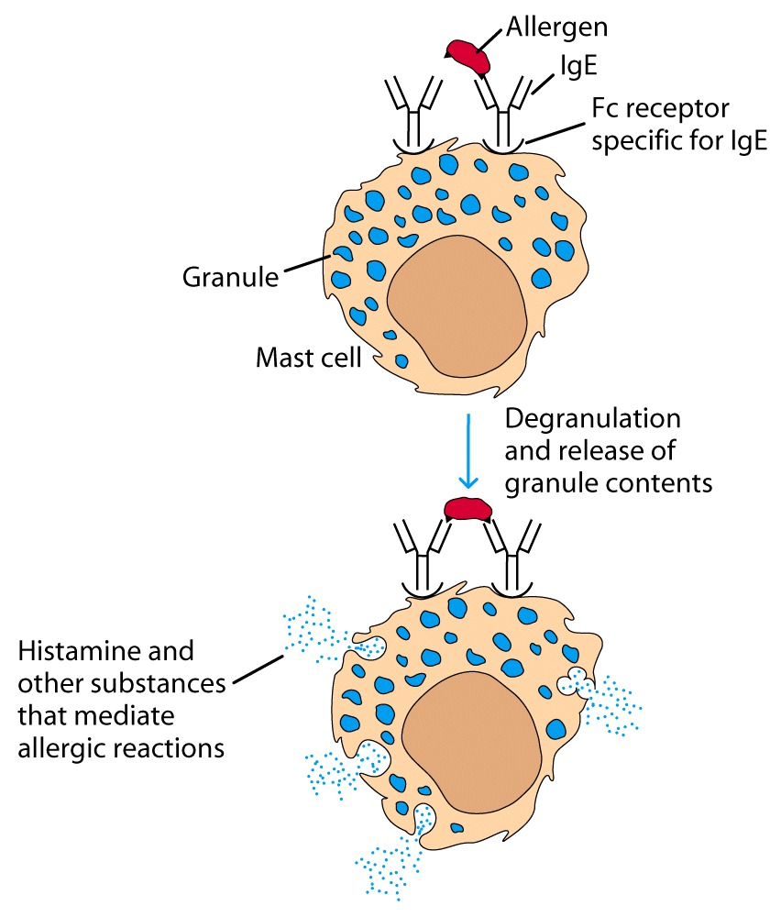
Cross-Linkage of Bound IgE Antibody With Allergen

Slide 77
Antibody Classes And Biological Activities
IgD
Expressed on B-cell Surface
IgM and IgD, Expressed on B-cell Surface
We Do Not Know Any Other Biological Effector Activity
Low serum concentrations, ~30μg/mL

Slide 78
Antibodies Act As Immunogens
Antigenic Determinants on Abs Fall in 3 Categories
Isotypic
Allotypic
Idiotypic
Isotypic
Constant Region Of Ab
If you inject Ab in a different species Anti-Isotype is generated
If within same species, No Anti-isotype

Slide 79
Antibodies Act As Immunogens
Allotype
Even though same isotypes within one species small differences (1-4 a/a) arise in different individuals (form of polymorphism)
If injected with such Ab you generate anti-allotype Ab
Ex. During pregnancy
Blood transfusion

Slide 80
Antibodies Act As Immunogens
Idiotype
Unique V_{H} AND V_{L} binds antigen but can also behave as antigenic determinant
If you inject a monoclonal antibody into a genetically identical recipient then anti-idiotypic antibodies are generated
No anti-isotypic and no anti-allotypic Abs will be generated

Slide 81
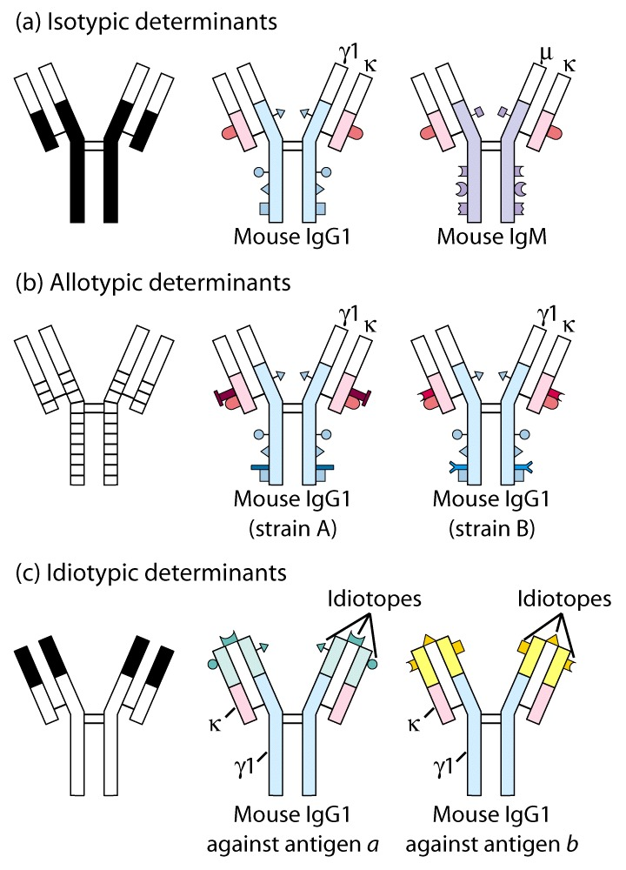

Slide 82
The Complement system

Slide 83
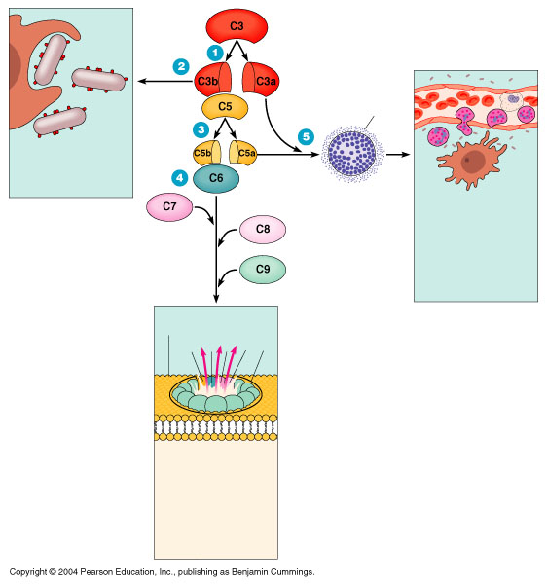
The complement system

Slide 84
The complement system
A defensive system consisting of over 30 proteins produced by the liver and found in circulating blood serum.
Complement kills microbes in three different ways
1. opsonization
2. inflammation
3. Cytolysis

Slide 85
A Cascade system
The complement works as a cascade system.
Cascade is when one reaction triggers another reaction which trigger others and so on. These types of systems can grow exponentially very fast.

Slide 86
Cascade activation
Complement proteins are often designated by an uppercase letter C and are inactive until they are split into products.
Example: C1
When the products are split they become active. The active products are usually designated with a lower case a or b.
Example: C1a and C1b

Slide 87
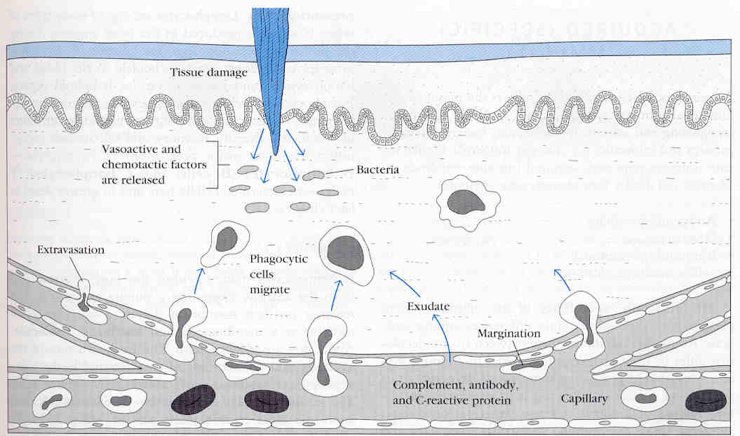
Two Pathways
The complement pathway can be activated by either of two different pathways.
Classical pathway (specific immune system)
alternative (non-specific immune system)

Slide 88
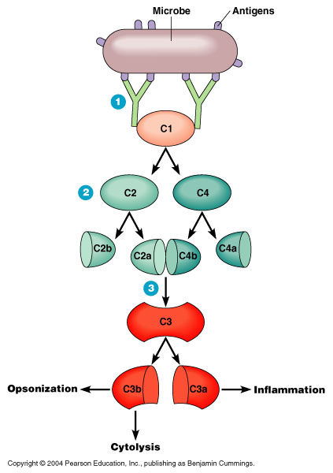
The Classical Pathway
The classical pathway is considered to be part of the specific immune response because it relies on antibodies to initiate it.
C1 becomes activated when it binds to the ends of antibodies

Slide 89
The building of a C3 activation complex
Once C1 is activated, it activates 2 other complement proteins, C2 and C4 by cutting them in half
C2 is cleaved into C2a and C2b
C4 is cleaved into C4a and C4b
Both C2b and C4b bind together on the surface of the bacteria
C2a and C4a diffuse away

Slide 90
C3 Activation complex
C2b and C4b bind together on the surface to form a C3 activation complex
The function of the C3 activation complex is to activate C3 proteins.
This is done by cleaving C3 into C3a and C3b

Slide 91
C3b
Many C3b molecules are produced by the C3 activation complex.
The C3b bind to and coat the surface of the bacteria.
C3b is an opsonin
Opsonins are molecules that bind both to bacteria and phagocytes
Opsonization increases phagocytosis by 1,000 fold.
Bacteria
Opsonins

Slide 92
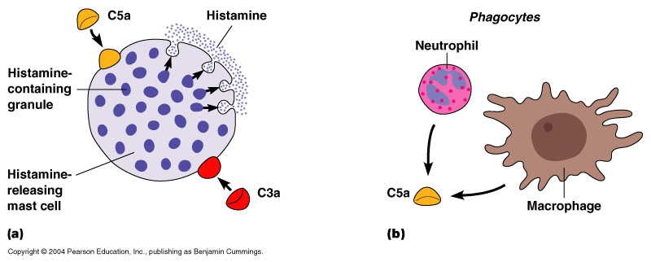
C3a
C3a increases the inflammatory response by binding to mast cells and causing them to release histamine

Slide 93
Building the C5 activation complex
Eventually enough C3b is cleaved that the surface of the bacteria begins to become saturated with it.
C2b and C4b which make up the C3 activation complex has a slight affinity for C3b and C3b binds to them
When C3b binds to C2b and C4b it forms a new complex referred to as the C5 activation complex

Slide 94
The C5 activation complex
The C5 activation complex (C2b, C4b, C3b) activates C5 proteins by cleaving them into C5a and C5b
Many C5b proteins are produced by the C5 activation complex. These C5b begin to coat the surface of the bacteria.

Slide 95
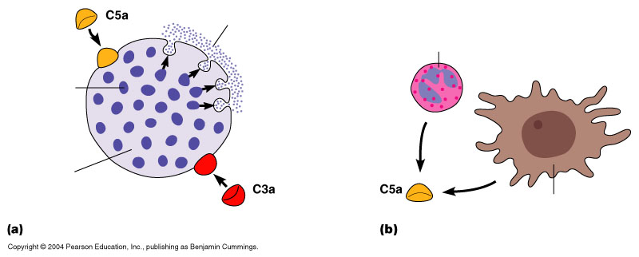
The function of C5a
C5a disperses away from the bacteria.
Binds to mast cells and increases inflammation.
Most powerful chemotactic factor known for leukocytes

Slide 96
Building the Membrane Attack complex
C5b on the surface of bacteria binds to C6
The binding of C6 to C5b activates C6 so that it can bind to C7
C7 binds to C8 which in turn binds to many C9’s
Together these proteins form a circular complex called the Membrane attack complex (MAC)

Slide 97
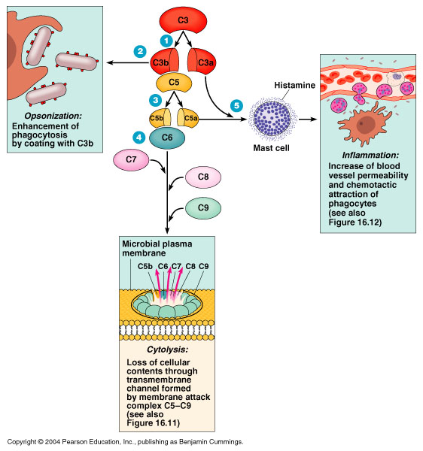
Membrane Attack complex
The MAC causes Cytolysis.
The circular membrane attack complex acts as a channel in which cytoplasm can rush out of and water rushes in.
The cells inner integrity is compromised and it dies

Slide 98
Overview

Slide 99
The alternative pathway
The alternative pathway is part of the non-specific defense because it does not need antibodies to initiate the pathway.
The alternative pathway is slower than the Classical pathway

Slide 100
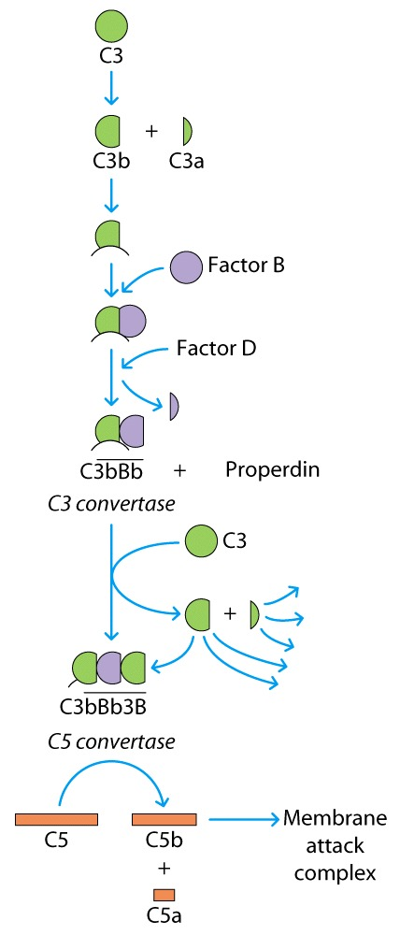
The Alternative complement pathway

Slide 101
Initiation of The Alternative pathway
C3 contains in unstable thioester bond.
This unstable bond makesC3 subject to slow spontaneous hydrolysis to C3b and C3a
The C3b is able to bind to foreign surface antigens.
Mammalian cells contain sialic acid which inactivates C3b

Slide 102
Factor B
C3b on the surface of a foreign cells binds to another plasma protein called factor B

Slide 103
Factor D
The binding of C3b to factor B allows a protein enzyme called Factor D to cleave Factor B to Ba and Bb.
Factor Bb remains bound to C3b while Ba and Factor D disperse away.

Slide 104
The C3 activation complex
Properdin, also called factor P, binds to the C3bBb complex to stabilize it.
C3bBbP make up the C3 activation complex for the alternative pathway

Slide 105
The C3 activation Complex
The C3 activation complex causes the production of more C3b.
This allows the initial steps of this pathway to be repeated and amplified
2X10⁶ molecules can be generated in 5 minutes

Slide 106
C5 activation complex
When an additional C3b binds to the C3 activation complex it converts it into a C5 activation complex.
The C5 activation complex cleaves C5 into C5a and C5b.
C5b begins the production of the MAC.

Slide 107
Overview

