Slide 1
The NERVOUS SYSTEM

Slide 2
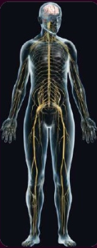
THE NERVOUS SYSTEM
The nervous system is the master controlling and communicating system of the body.
The nervous system CONTROLS AND COORDINATES ALL ESSENTIAL FUNCTIONS of the Human Body

Slide 3
Function of NERVOUS SYSTEM
SENSORY FUNCTION: Nervous system uses millions of sensory receptors to monitor occurring both inside and outside of the body. Those changes are called STIMULI, and the gathered information is called Sensory input.
INTEGRATIVE FUNCITON: The Nervous system process and interprets the sensory input and make s decisions about what should be done at each moment – a process called integration.
MOTOR FUNCTION: The nervous system then sends information to muscles, glands, and organs (effector) so they can respond correctly, such as muscular contraction or glandular secretion.

Slide 4
Structural classification of the Nervous System:
CENTRAL NERVOUS SYSTEM (CNS):
Consists of the brain and spinal cord, which act as the integrating and commanding centers of the nervous system.
They interpret incoming sensory information and issue instructions based on past experience and current conditions.
PERIPEHERAL NERVOUS SYSTEM (PNS):
It is the part of nervous system outside the CNS .
They link all parts of the body by carrying impulses from the sensory receptors to the CNS and from the CNS to appropriate glands or muscles.
Its consists mainly of the nerves that extend from the brain and spinal cord.
Cranial nerves carry impulses to and from the brain.
Spinal nerves carry impulses to and from the spinal cord.

Slide 5
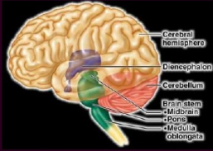
CENTRAL NERVOUS SYSTEM
THE BRAIN:
The brain is located within the cranial cavity of the skull and consists of the cerebral hemispheres, diencephalon, brain stem and cerebellum.
Cerebral hemispheres: Logical reasoning, moral conduct, emotional responses, sensory interpretations and the initiation of voluntary muscle activity.
Functional areas of Cerebral hemispheres include: Sensory areas (receives and interpret sensory impulses), Motor areas (Control muscular movement), Association areas( deal with more complex, integrative functions such as memory, emotions, reasoning, will, judgement, personality traits and intelligence).

Slide 6
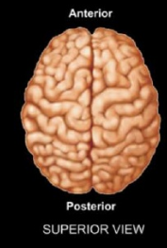
Brain Lateralization
LEFT HEMISPHERE
Right side control
Spoken and written language
Numerical and scientific skills
Reasoning
RIGHT HEMISPHERE
Left side control
Musical and artistic awareness
Space and pattern perception
Insight
Imagination
Generation mental images to compare spatial relationship

Slide 7
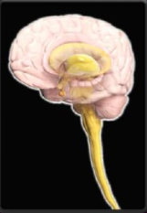
CENTRAL NERVOUS SYSTEM
THE SPINAL CORD
The spinal cord is a reflex center and conduction pathway which is found within the vertebral canal.
It extends from the foramen magnum to L1 OR L2
Nerve: Nerve is a bundle of the neuron fibers found outside the CNS
Cranial Nerves (12 pairs) and Spinal Nerves (31 pairs)
The PNS has two functional divisions
Sensory or Afferent division : Keeps the CNS constantly informed of
events going on both inside and outside the body
Motor or Efferent division: Carries impulses from the CNS to effector organs, muscles and glands

Slide 8
Reflex
Reflexes are programmed, rapid, predictable and involuntary response to stimuli.
Reflexes may be inborn or learned
Reflexes occur over neural pathways called reflex arc and involve both CNS and PNS.

