Slide 1
Endocrine Glands
&
Functions

Slide 2
Endocrinology is concerned with study of the biosynthesis, storage, chemistry, biochemical and physiological function of hormones and with the cells of the endocrine glands and tissues.
The endocrine system consists of several glands, all in different parts of the body that secrete hormones directly into the blood rather than into a duct system.
Hormones have many different functions and modes of action; one hormone may have several effects on different target organs, and, on the other hand, one target organ may be affected by more than one hormone.
Endocrine glands are ductless glands and their secretion is known as hormone.
Along with nervous system it controls and co-ordinate the body functions and maintains a homeostasis. So both endocrine and nervous systems collectively called neuro-endocrine system.
T. Addison is known as Father of Endocrinology. The name hormone was given by Starling in 1902. He discovered secretion hormone.

Slide 3
A hormone is a chemical signal that is secreted into the circulatory system and communicates regulatory messages within the body.
Hormones may reach all parts of the body, but only certain types of cells, target cells, are equipped to respond.

Slide 4
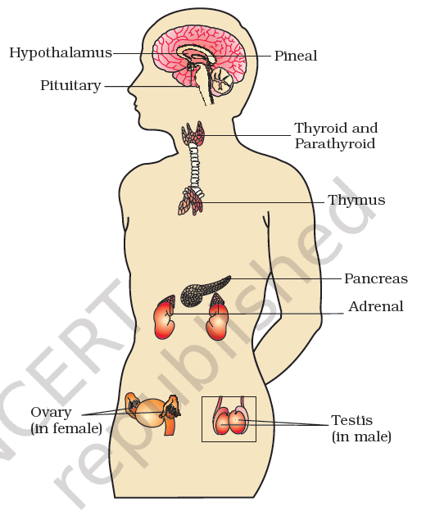
Hypothalamus
Pituitary,
Pineal,
Thyroid,
Adrenal,
Pancreas,
Parathyroid,
Thymus
Gonads (Testis & Ovary)

Slide 5
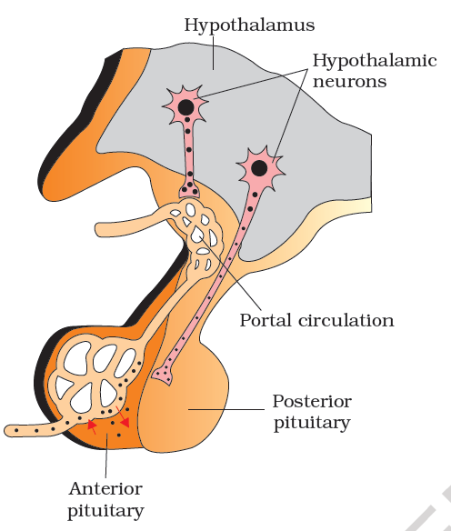
Pituitary:
Antidiuretic hormone (ADH) or Vasopressin,
Oxytocin
Neurohypophysis
Adenohypophysis
Growth hormone (GH),
Prolactin (PRL),
Thyroid stimulating hormone (TSH),
Adrenocorticotrophic hormone (ACTH),
Luteinizing hormone (LH),
Follicle stimulating hormone (FSH).

Slide 6
Growth hormone (GH): stimulates the growth of muscle and bone.
Prolactin (PRL): stimulates milk production.
Thyroid stimulating hormone (TSH): stimulates the thyroid gland to produce thyroxine which stimulates oxidative respiration.
Adrenocorticotrophic hormone (ACTH): stimulates the adrenal gland to produce steroid hormones. Some regulate glucose production, others balance sodium & potassium in the blood.
Luteinizing hormone (LH): plays an important role in the menstrual cycle. It also stimulates the production of testosterone in males.
Follicle stimulating hormone (FSH): plays an important role in the menstrual cycle. In males, it causes the testes to produce a hormone that regulates sperm production.
Melanocyte-stimulating hormone (MSH) – in reptiles & amphibians, this hormone stimulates color change.

Slide 7
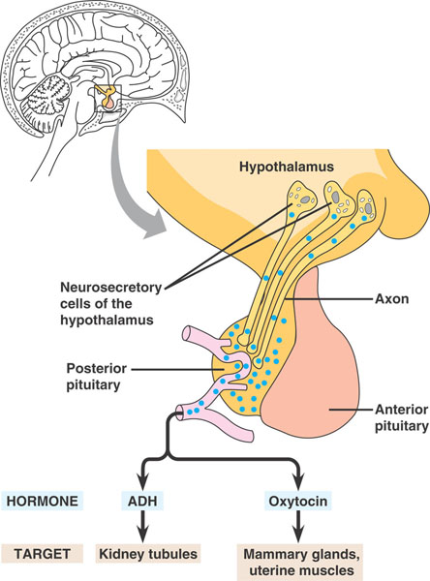
Anti-diuretic hormone (ADH)-Vasopressin : Acts mainly at the kidney and stimulates reabsorption of water and electrolytes by the distal tubules and thereby reduces loss of water through urine (diuresis)
Oxytocin: Initiates uterine contraction during childbirth and milk release in mothers.
These hormones are actually synthesized in the hypothalamus and stored in the posterior pituitary.

Slide 8
Biological Clocks
The pineal gland is located in the brain of most vertebrates:
  Evolved from a light sensitive “third eye”.
  Primitive fish & some reptiles still have a third eye.
  It is secreting melatonin.
  Melatonin controls color change in amphibians & reptiles.
  Release of melatonin is controlled by light/dark cycles.
  The primary functions of melatonin appear to be related to biological rhythms associated with reproduction.
  Circadian rhythms – 24 hours long.

Slide 9
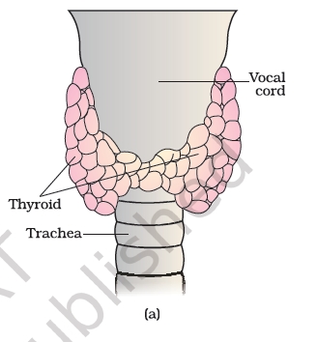
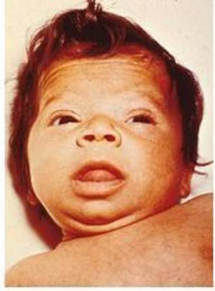
THYROID GLAND, located in the neck, produces:
  Thyroxine – increases metabolic rate and promotes growth. Two iodine-containing hormones, tri-iodothyronine (T3) and thyroxine (T4).
  Calcitonin – stimulates calcium uptake by bones.
  Deficiency of iodine in our diet results in hypothyroidism and enlargement of the thyroid gland, commonly called goiter.
  Thyroid hormones is increased to abnormal high levels leading to a condition called hyperthyroidism which adversely affects the body physiology.

Slide 10
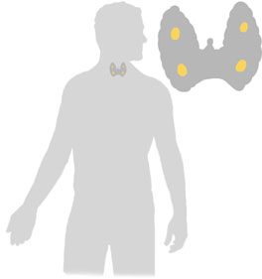
Parathyroids
The parathyroid glands are four small glands attached to the thyroid.
The hormone they produce is parathyroid hormone (PTH) which regulates the level of calcium in the blood.
  Essential that calcium is kept within narrow limits for muscle contraction, including the heart.

Slide 11
Calcium Homeostasis
Two antagonistic hormones, parathyroid hormone (PTH) and calcitonin, play the major role in calcium (Ca²⁺) homeostasis in mammals.
Calcitonin, secreted by the thyroid gland, stimulates Ca²⁺ deposition in the bones and secretion by the kidneys, thus lowering blood Ca²⁺ levels.
PTH, secreted by the parathyroid glands, has the opposite effects on the bones and kidneys, and raises Ca²⁺ levels.
  Also has an indirect effect, stimulating the kidneys to activate vitamin D, which promotes intestinal uptake of Ca²⁺ from food.

Slide 12
Thymus
The thymus plays a major role in the development of the immune system.
This gland secretes the peptide hormones called thymosins.
Thymosins play a major role in the differentiation of T-lymphocytes, which provide cell-mediated immunity.
In addition, thymosins also promote production of antibodies to provide humoral immunity.
Thymus is degenerated in old individuals resulting in a decreased production of thymosins. As a result, the immune responses of old persons become weak.

Slide 13
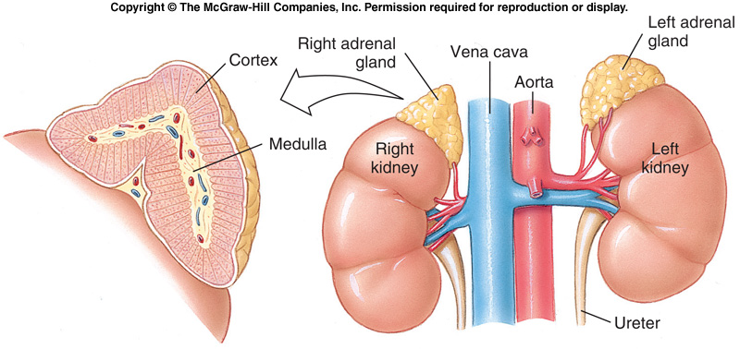
Adrenals
Mammals have an adrenal gland above each kidney.
  Adrenal medulla is the inner core which produces adrenaline (epinephrine) and norepinephrine.
  Adrenal cortex is the outer shell that produces the steroid hormones cortisol and aldosterone.

Slide 14
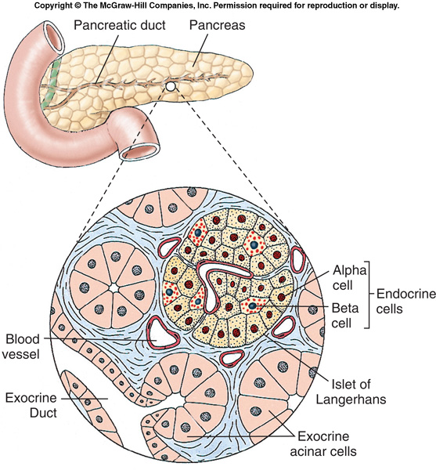
Pancreas
The pancreas is located behind the stomach and is connected to the small intestine by a small tube.
It secretes digestive enzymes into the digestive tract (exocrine function).
Endocrine function – production of insulin and glucagon.

Slide 15
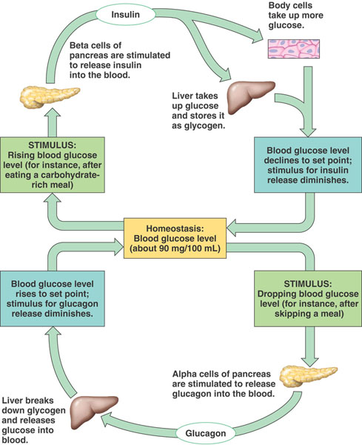
Glucose Homeostasis
The islets of Langerhans in the pancreas secrete insulin (β cells) and glucagon (α cells).
  Insulin removes glucose from the blood.
  Glucagon returns glucose to the blood.
Glycogenesis)
hypoglycemia
hyperglycemia
Gluconeogenesis

Slide 16
Testis
Testis is composed of seminiferous tubules and stromal or interstitial tissue.
The Leydig cells or interstitial cells, which are present in the intertubular spaces produce a group of hormones called androgens mainly testosterone.
Androgens regulate the development, maturation and functions of the male accessory sex organs.
These hormones stimulate muscular growth, growth of facial and axillary hair, aggressiveness, low pitch of voice etc.
Androgens play a major stimulatory role in the process of spermatogenesis.
Androgens act on the central neural system and influence the male sexual behaviour (libido).

Slide 17
Ovary
Ovary produces two groups of steroid hormones called estrogen and progesterone
The estrogen is synthesised and secreted mainly by the growing ovarian follicles.
After ovulation, the ruptured follicle is converted to a structure called corpus luteum, which secretes mainly progesterone.
Estrogens produce wide ranging actions such as stimulation of growth and activities of female secondary sex organs, development of growing ovarian follicles, appearance of female secondary sex characters (e.g., high pitch of voice, etc.), mammary gland development.
Estrogens also regulate female sexual behaviour.
Progesterone supports pregnancy and also acts on the mammary glands and stimulates the formation of alveoli (sac-like structures which store milk) and milk secretion.

