Slide 1
Non Major Elective : Molecular evolution
Code : 17ZOONME32

Slide 2
Population Size

Slide 3
Population ecology :
Science that deals with measuring changes in population size and composition
Identify the factors that cause the changes

Slide 4
What is population ?
A group of individual of the same species of organisms that occupy the same area, using the same resources and acted upon by the
same environmental factors

Slide 5
Population dynamics
Study how and why population size changes over time
Study the factors affecting growth, stability and decline of populations
(birth rate, mortality, survivorship, migration)
All populations undergo 3 phases in life cycle :
- growth, stability, decline

Slide 6
Population Dynamics
Characteristics of Dynamics
  Size
  Density
  Dispersal
  Immigration
  Emigration
  Births
  Deaths
  Survivorship

Slide 7
Properties of Population

Slide 8
The characteristics of populations are shaped by the interactions between individuals and their environment
Populations have size and geographical boundaries.
  The density of a population is measured as the number of individuals per unit area.
  The dispersion of a population is the pattern of spacing among individuals within the geographic boundaries
  The size of a population
Copyright © 2002 Pearson Education, Inc., publishing as Benjamin Cummings

Slide 9
DENSITY

Slide 10
MEASURING DENSITY
Density
Number of individuals per unit of area at a given time
Expressed in terms of items or organisms per unit area
Ex : the number of paddy plants per square meter of a paddy field
Population density varies due to limiting factors

Slide 11
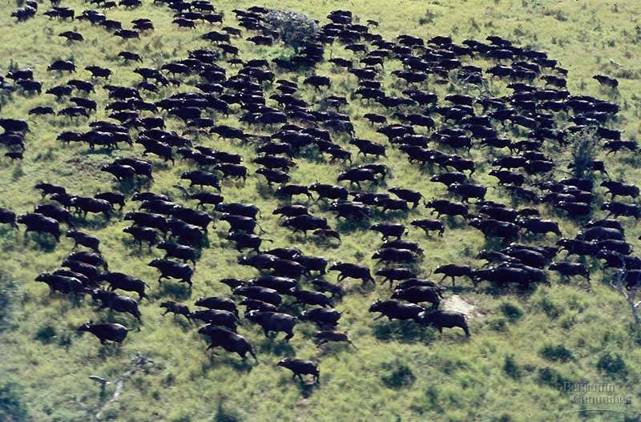
Measuring density of populations is a difficult task.
– We can count individuals; we can estimate population numbers.
Fig. 52.1
Copyright © 2002 Pearson Education, Inc., publishing as Benjamin Cummings

Slide 12
DISPERSION

Slide 13
PATTERN OF DISPERSION
UNIFORM
CLUMPED
RANDOM

Slide 14
Clumped dispersion
Also known as aggregated distribution
Individuals aggregate in patches
Caused by : environment where the resources concentrated in patches
Other factors : mating, limited seed dispersal
Importance : for protection, reducing competition, increasing feeding efficiencies

Slide 15
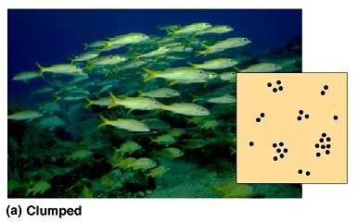
Clumped Dispersion
Copyright © 2002 Pearson Education, Inc., publishing as Benjamin Cummings

Slide 16
Uniform dispersion
Pattern of equally spaced individuals
Caused by the ability to survive anywhere in the habitat
Used the resources found immediately around them
Importance : able to set up the zone of territories for feeding, nesting, breeding

Slide 17
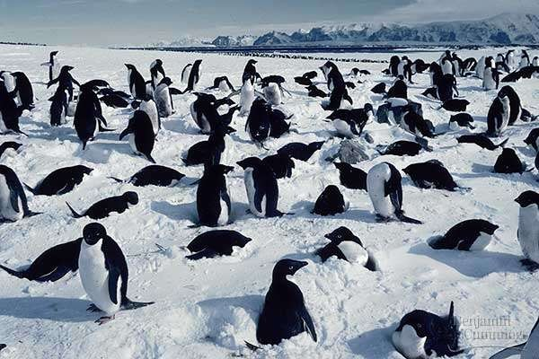
Uniform Dispersion

Slide 18
Random dispersion
Spacing pattern based on total unpredictability
Individual in a population are spaced all over an area in a way that in unrelated to the presence of others
Caused by the ability to live anywhere in a given area except, they are limited to grow wherever they are first set root (for plants)

Slide 19
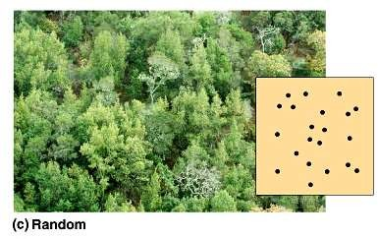
Random Dispersion
Fig. 52.2c
Copyright © 2002 Pearson Education, Inc., publishing as Benjamin Cummings

Slide 20
SIZE

Slide 21
Population of organism able to change over time
Increase in population size usually due to natality (birth rate)
Decrease in population size as a result of mortality

Slide 22
Do you know?
For human, natality is expressed as the number of births per 1000 people per year
  Mortality can be defined as :
- the rate at which individual die
- expressed as the number of deaths per 1000 people per year

Slide 23
How to determine the rate of changes in population?
Changes in time must take into consideration
ΔN / Δt = N (b-d)
Δ = change in equations
N = number of individuals t = time
b = natality
d = mortality

Slide 24
The growth rate or rate of changes (increase or decrease) of population is expressed by r
r = b - d

Slide 25
Immigration and emigration
Immigration (individual enter a population) and emigration (individual leave a population) also affects the growth rate of a population
r = (b - d) + (i – e )
i = immigration
e = emigration

Slide 26
Parameters that effect size or density of a population:
Immigration
Birth
Population (N)
Death
Emigration
Figure 1. The size of a population is determined by a balance between births, immigration, deaths and emigration

Slide 27
FACTORS INFLUENCING POPULATION GROWTH

Slide 28
Population growth can be describe by using a growth curve
  exponential growth curve
  logistic growth curve`

Slide 29
Exponential growth curve
Mode of population that assume birth rate and death rate remain constant over time
Describing an idealized population in an unlimited population
Ignoring immigration and emigration
The result in exponential growth is that if
b > d, r > 0

Slide 30
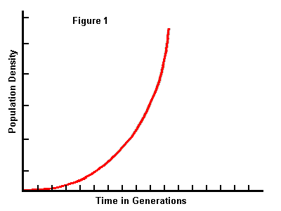
Exponential growth
The growth rate is always positive
NO upper limit to population size

Slide 31
Factors influencing population density
Population density can be affected by the interaction of density-dependent factors and density-independent factors

Slide 32
Density dependent factors
limiting resources (e.g., food & shelter)
production of toxic wastes
infectious diseases
predation
stress
emigration

Slide 33
Density-Independent Factors
severe storms and flooding
sudden unpredictable severe cold spells
earthquakes and volcanoes
catastrophic meteorite impacts

