Slide 1
Non Major Elective : Molecular evolution
Code : 17ZOONME32

Slide 2
Genetic drift and founders effect

Slide 3
Gene pool – total of all the allele in the population
Alleles – chromosome sections that code for specific proteins traits
Examples: Humans have alleles for
blue eyes / brown eyes /green eyes
curly/straight hair
blood type A / B / O / AB

Slide 4
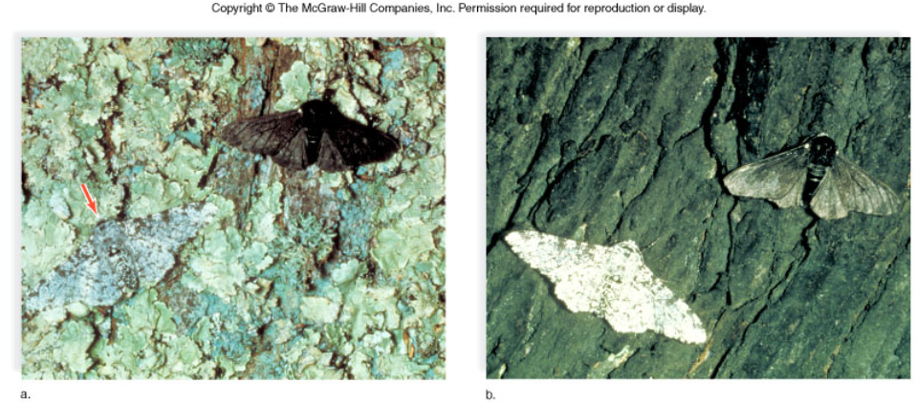
Industrial Melanism
As trees became darker due to industry, darker moths had a better chance of survival. Over time, more darker alleles were present in the population.

Slide 5
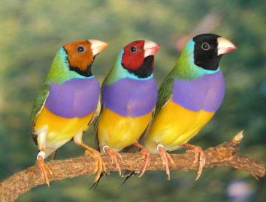
Causes of Microevolution
1. Genetic Mutations
Polymorphism : two or more distinct phenotypes ex blood types, eye color..etc
Mutations (can be harmful or beneficial)
Some mutations may at first appear harmful, but give an advantage if the environment changes. -- this is referred to as RELATIVE FITNESS

Slide 6
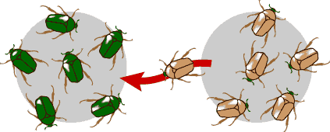
2. Gene Flow
movement of alleles among populations, by migration, increases variation
Can prevent speciation from occurring
Does gene flow increase or decrease diversity?

Slide 7
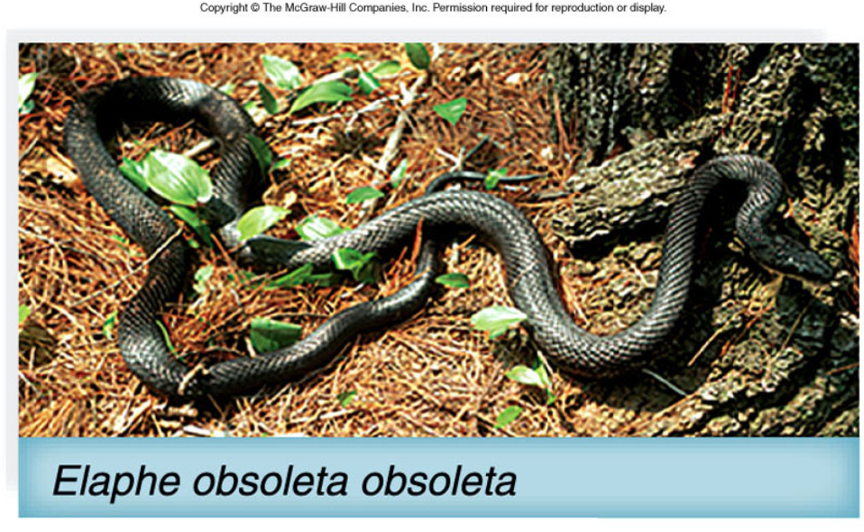
Example of GENE FLOW
Each rat snake represents a separate population of snakes
These snakes remain similar and can interbreed
This keeps their gene pools somewhat similar
They are considered subspecies

Slide 8
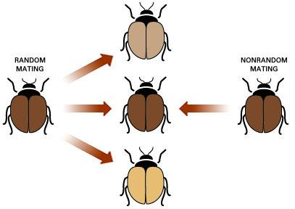
3. Mating a. Random mating is pairing by chance b. Nonrandom mating – individuals choose their mates
Which method of mating do humans use?
Can you think of any organisms that mate randomly?

Slide 9
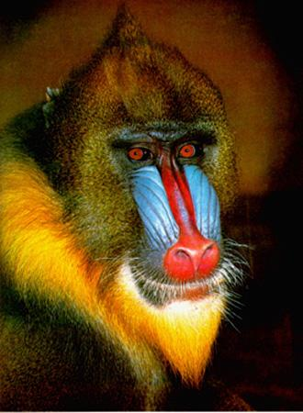
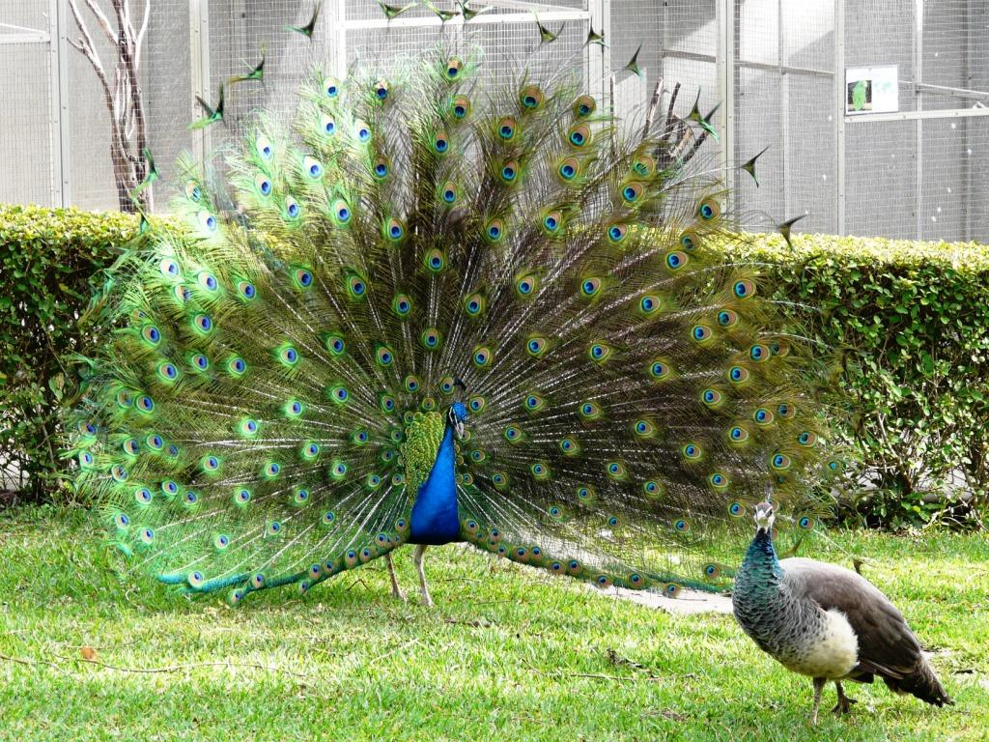
Assortative mating occurs when individuals mate with those that have the same phenotype. Does this increase or decrease the diversity in the population?
Sexual selection occurs when males compete for the right to reproduce and the female selects males of a particular phenotype. (guppies, lions)
This results in some extreme characteristics.
Sexual dimorphism - when males and females of a species look different.

Slide 10
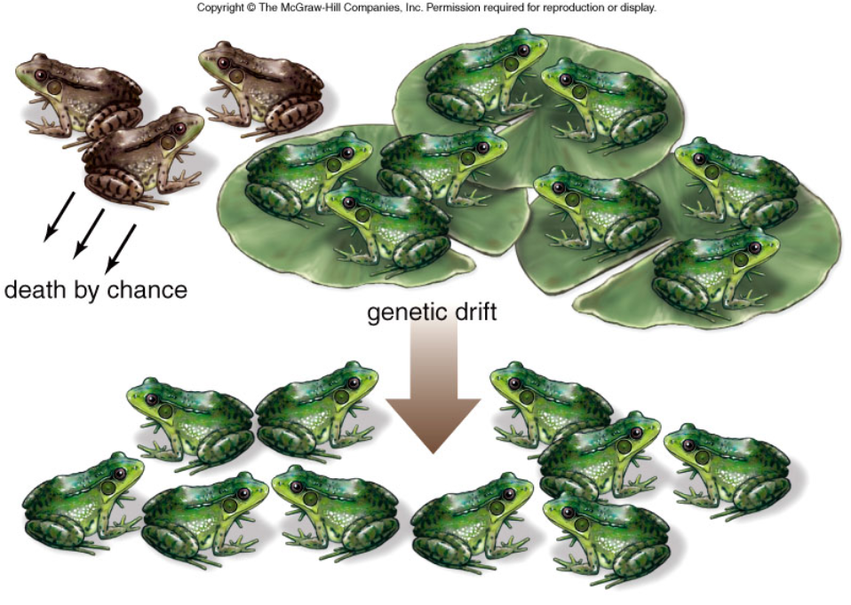
GENETIC DRIFT
Refers to changes in allele frequencies of a gene pool due to chance.
It is more obvious in small populations.

Slide 11
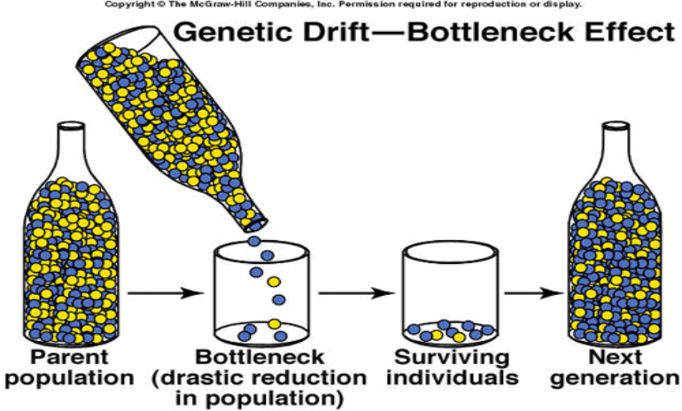
Bottleneck Effect – caused by a severe reduction in population (possibly a Natural disaster), reduces overall diversity.

Slide 12
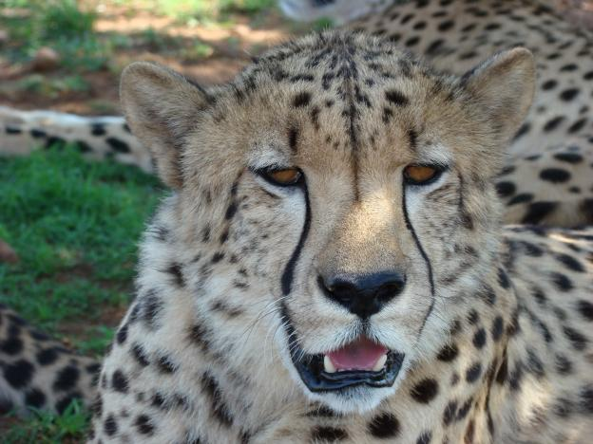
Cheetahs have very little diversity in their gene pool due to bottleneck

Slide 13
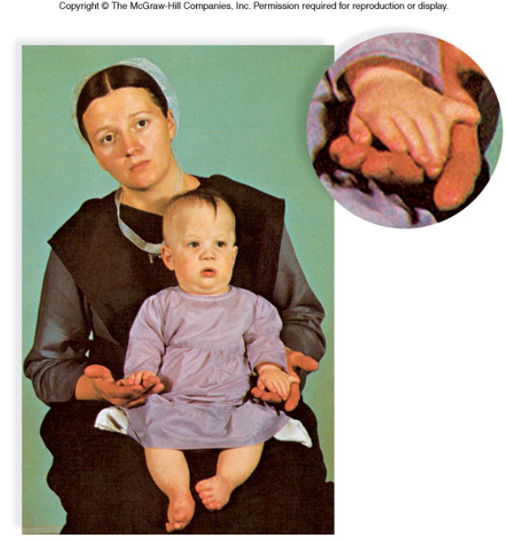
FOUNDER EFFECT
The founder effect is an example of genetic drift where rare alleles or combinations occur in higher frequency in a population isolated from the general population.
EX: Dwarfism in Amish communities Due to few German founders

Slide 14
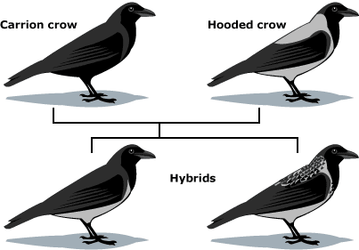
What is a Species?
A group of actually or potentially interbreeding populations (isolated from other groups)
1. Gene Pool
2. Microevolution
3. Gene Flow
4. Phenotype
5. Genetic Drift

Slide 15
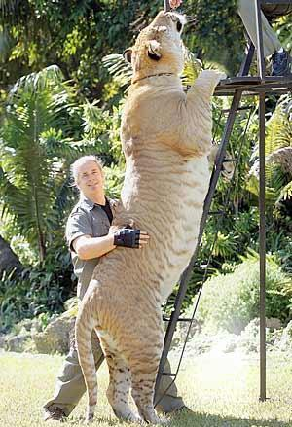
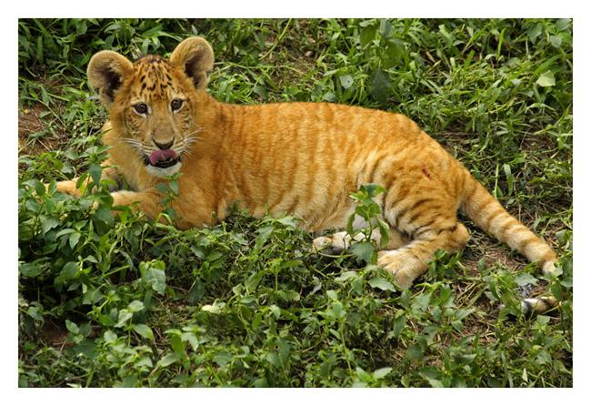
Hybrids occur when members of different species produce offspring...
Lion + Tiger = Liger
Tiger + Lion = Tigon

Slide 16
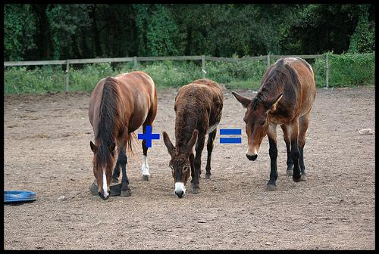
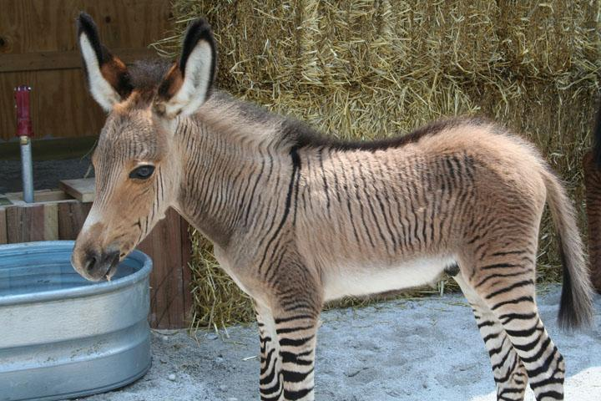
Horse
+
Donkey
=
Mule
Zebra
+
Donkey
=
Zonkey

