Slide 1
Non Major Elective : Molecular evolution
Code : 17ZOONME32

Slide 2
Molecular evolution

Slide 3
What does it mean???
Evolution: any process of formation/growth/development
Molecular evolution: the process of change in the sequence composition of cellular molecules such as DNA
Helps to study the alleles at the molecular level
          evolution biology
          molecular genetics
          Talked about A and a, B and b. etc.,

Slide 4
These alleles confers the fitness ie., what does it mean exactly.
Eg. Eye color, skin color, hairs in ear pinnae etc.,
          Originally by changes in the DNA sequences:
          Mutation : is the permanent alteration of the nucleotide sequence of the genome of an organism
                Silent mutation
                Expressive
                What actually the mutation does in?????
                Original allele: TATTCAGCGA
                Mutant allele : TATTGAGCGA

Slide 5
                Original allele: TATTCAGCGA
                Mutant allele : TATTGAGCGA
                This mutation in the DNA may:
                Change the protein sequence: TCA-AGU-Serine
                TGA-ACU-Thrionine
                Change protein structure (Shape)
                Change biochemical function (charge/active site ptn)
                No effect on structure/function (eg. non-polar to non-polar)

Slide 6
                Change the protein expression
                Expressed in new tissue
                Expressed in new time
                The changes in the tissue/time-----confers the adaptation in some organism.
                eg. salmon fish.

Slide 7
                How much variation in the nature???
Pre
1960’s
Probably little genetic variation
1960’s
Allozymes (different form of same enzyme)
Revealed-high level of variation/segregation of population
1980’s
+
DNA sequencing
In allozyme allele: several major polymorphs and many minor polymorphs were reported

Slide 8
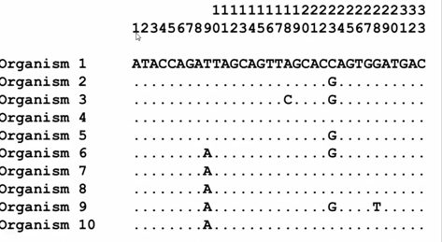
Polymorphism
Major polymorphism- 9, 23 Minor polymorphism- 18, 28

Slide 9
Heterozygosity Vs Polymorphism
          Polymorphism
          Any variation in the DNA seq. that occurs on a population level across the entire species.
          eg., different mouse strains (C57, 129, Castaneus, BALC etc.,)
          Heterozygous
          Differences in the DNA seq fond within one org.
                Eg., SNP that is different between C57 and 129.
                C57 X 129 = F1 will be heterozygous
                Highly heterozygous - lots of differences in polymorphism across the entire genome.

Slide 10
Linkage equilibrium
The random mutation in the genome

Slide 11

Linkage Disequilibrium
Both selection and drift –linkage disequilibrium
Disequilibrium will decline with distance from selected allele

