Slide 1
Non Major Elective : Molecular evolution
Code : 17ZOONME32

Slide 2
Application of Bioinformatics in
molecular evolution

Slide 3
Bioinformatics- comprises various disciplines –Biology, Mathematics, computer science and statistics to develop methods for
storage
Retrieval and
analysis of biological data
Paulien Hogeweg-Dutch system biologist termed “Bioinformatics” in 1970.
Used to
      Characterize gene

Slide 4
      Determining structure
      Physiochemical prop. Of protein
      Phylogenetic analysis
      Performing stimulation-biomolecules interact in a living cell.
      Eg., Druggables to clinical trials
      ADMET (Adsorption, distribution, metabolism, excretion and toxicity)
      Other analysis
          DNA/protein analysis
          Phylogenetic analysis
          3D structure of protein
          Molecular interaction
          simulations

Slide 5
Gene identification and sequence analysis
      Used to understand the different features of biomolecules (Protein/NA)/give its unique function
      Retrieve sequence from public database
      Subjected to tools enable prediction of their
      function,
      structure,
      evolutionary history or
      identification of homologues with a
      greater accuracy

Slide 6
      Tools used
TOOLS | DESCRIPTION
BLAST | Search tool for NA/ protein
HMMER | Homologous protein seq.
Clustal omega | Multiple sequence alignment
Sequerome | Sequence profiling
Protparam | Study physio-chemical properties
JIGSAW Novo SNP | Find gene and splicing site in sequence Find single nucleotide variation
ORF finder | Find ORF
PPP | Prokaryotic promoter predicting tool (upstream of gene)
WenGeSTer | Predict termination site of transcription
GenScan | Predict exon-intron site in genomic seq.

Slide 7
Phylogenetic analysis
      It is procedure used to construct the evolutionary relationship among group of related organism/species
      Used to predict function, track gene flow, genetic relatedness
      Principle of phylogeny is to group based on the higher degree of similarity and closer org. in a tree

Slide 8
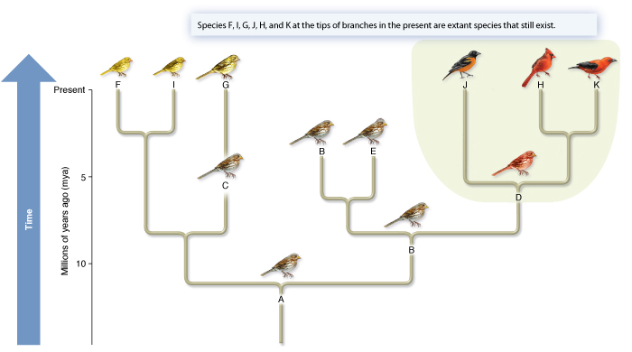

Slide 9
      3 Methods to construct phylogenetic tree
            Distance methods
            Parsimony methods
            Likelihood methods
TOOLS | DESCRIPTION
MEGA | Built phylogen. Tree based on evol. closeness
MOLPHY/PAML | Based on maximum likelihood
PHYLIP | Package of phylogenetic studies
JStree | Open-resource library for view and edit phylogenetic tree for presentation improvement
Treeview | To view the graphics of tree with an option to change the view
Jalview | Editor tool to refine the tree

Slide 10
Sequence Database
      It is a mass collection of biological seq. including NA, protein and polymers (unique key like name)
      It is tool for primary seq. analysis.
      High throughput seq. provide a whole-genome sequence (massive data)
      The submission and storage of this seq. used to develop several public databases.
      Databases- Primary, secondary or composite (depending on the storage)

Slide 11
      Primary database- Yeast-two hybrid assay, affinity chromatography, XRD or NMR (Structure or seq.)
      SWISS-PROT, UniProt, PIR, GenBank, EMBL, DDBJ and protein data bank PDB
      Secondary database- derived from primary (conserved seq, active site of a protein family, conserved sec. st. or motif)
      SCOP, CATH, PROSITE, eMOTIF
      Primary database- archival database
      Secondary- curated

Slide 12
      Composite database- contain information from different primary databases
      NRDB(non-redundant database)- PDB, SWISS-PROT, PIR, PRF); data from Genbank
      INSD (International Nucleotide Sequence Database-NA sequence from EMBL, GenBank, DDBJ)
      UnoProt (Universal Protein Sequence database- PIR-PSD, Swiss-Prot and TrEMBL)
      wwPDB (Worldwide PDB-have a 3D sturcture in the RCSB (Research collaboratory for strctural Bioinformatics), PDB, MSD and PDBj )

Slide 13
Genome Sequence Databases
      It is a mass collection of genome sequences of over 250, 000 species.
      Eg., GenBank, NCBI, Entrez, PubMed
      Sequences-literature, bibiliography, organism, and a set of various other features (coding region, promoters, untranslated regions, terminators, exons, introns, repeated regions and translations)
      Specific databases
            Xenbase - Xenopus Laevis & X. tropicalis
            Saccharomyces Genome database (SGD)

Slide 14
            http://www.yeastgenome. Org/
            WormBase- Caenorhabditis elegans (http://www.wormbase. Org)
            FlyBase-Drosophila melanogaster (http://wfleabase.org)

Slide 15
Other most popular databases
Database | DESCRIPTION
DNA data bank of Japan | International Nucleotide Sequences Database (INSD). One of the biggest
European Nucleotide Archive | Capture and present Nucleotide sequence based on the workflow
GenBank | INSD
Rfam | Collection of RNA families by MSA
Uniprot | Largest collection of protein database
Protein Data Bank | Determine st. and other complex assembly
Prosite & Pfam | Info. Regarding protein family, conserved domains, and active sites
SWISS PROT InterPro | Protein sequences with protein family, conserved domains, and active sites
Proteomics identifications data. | Functional characterization and PTM

Slide 16
Database | DESCRIPTION
Ensembl | Database containing annotated genome of eukaryotes(human, mouse and other vertebrates)
PIR | Genomic and proteomics research
Pathway and signaling | KEGG, CMAP, SGMP, PID, HMDB

Slide 17
Predicting Protein Structure and Function
      Protein fold p into 3D structure to became active
      The correct topology is pre requisite for proteins’ biological function.
Database | DESCRIPTION
COMPOSER, 3D-JIGSAW, MODELLER,
RaptorX | Predict ptn st.
JPRED | Predict sec. st.
PHD | Predict neural network st.
Phyre and phyre2 | Web-based servers for ptn st. prediction
SWISS 2D PAGE

Slide 18
Molecular interaction
      To reduce the time consuming physical approaches such as X-ray crystallography and nuclear magnetic resonance
Database | DESCRIPTION
SMART | Simple modular architecture retrieval tool; multiple information about protein query
AutoDock | Predicts protein-ligand interaction (reliable)
HADDOCK | Protein-protein and protein-DNA
BIND | Molecular interaction and bio-complexes
PathBLAST | Protein-protein interaction network of any selected org. and pathway interaction.

Slide 19
DRUG DESIGNING
      Before bioinformatics, researchers used chemistry, pharmacology and clinical sciences to discover compound
      Target finding databases
      Molecular stimulation: Abalone, Ascalaph, Discover studio, Amber, FoldX
Potential Drug Target database (PDTD), Drug Bank, Therapeutic Target Database, Manually Annotated Targets and Drugs online Resources, DrgPOrt, ChEMBL.

