Slide 1
ORNAMENTAL FISH CULTURE
UNIT I Introduction to Ornamental Fish Culture
Program: M.Sc. Zoology
Semester: III
Course: Ornamental Fish Culture Technology

Slide 2
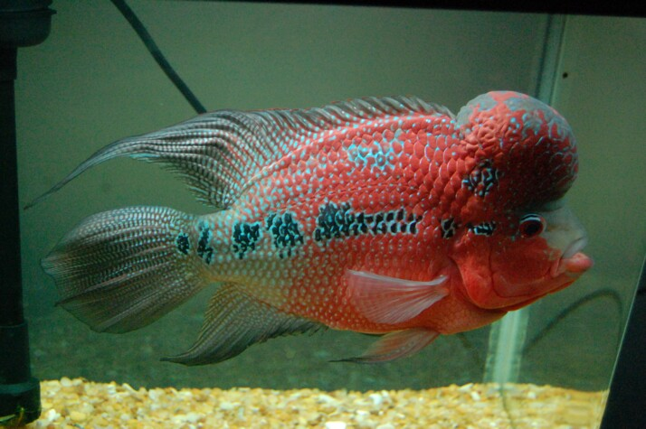
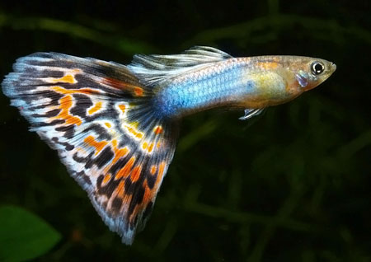
What is Ornamental fish?
Fish is an enterprising aquatic animal . It not only provides us protein but also entertainment.
Many – fishes are beautifully coloured, attrative, graceful in their shape, body-form and movement.
It attracts people from time immemorial are termed as Ornamental fish or Aquarium fish or live jewels.
The culture of ornamental fishes is known as Aquariculture
Source: https://goo.gl/images/QkcCwu

Slide 3
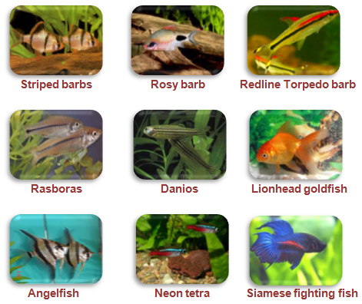
There are over 30,000sp reported around the world of this 800 belongs to the ornamental fishes
They include 8 closely associated families specifically,Anabantidae,callichthyidae,characidae,cichlidae,cobitidae,cyprinodontidae, cyprinidae, poeciliidae.
Aquarium fishes are mainly categorized into two groups namely, egg layers and live bearers.
The culture of ornamental fishes is known as Aquariculture
Source: https://goo.gl/images/ZTMurg

Slide 4
Most of the fish species of North-Eastern region of India possess high values for their attractive coloration pattern, graceful behavior, peculiar body morphology and endemicity.
The major shares of the country's ornamental fish export are captive collection from N-E states comprising about 85% of the total aquarium fish trade of India..

Slide 5
The indigenous ornamental fishes which are available in the rivers of the state are being neglected due to lack of awareness.
Most of these fishes are caught before their first maturity and sold in the market as food fishes.
These indigenous ornamental fishes can easily be collected from the wild resources and can be cultured and reared for keeping in the aquarium.

Slide 6
IMPORTANT ORNAMENTAL FISHES
More than 200 species of freshwater fish are bred in different place of India by the ornamental fish breeders and aquarium hobbyists.
The egg layers lay adhesive or non-adhesive eggs on the glass wall or aquarium plants.
Some parents show parental care and some destroy their eggs so different breeding setups are needed.

Slide 7
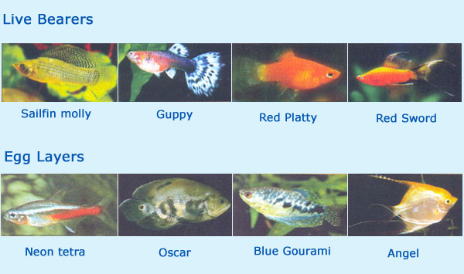
Source: https://goo.gl/images/pNzNYc

Slide 8
In contrast, live bearer fish release young in batches and are easy to breed compared to egg-layers.
Common exotic live-bearers like guppy, molly, swordtail, platy and egg layers like gold fish, koi carp, tiger barb, Siamese fighting fish, tetra, silver shark, angel, red-tailed black shark, red finned shark, etc.
Native ornamental fish include honey gourami, rosy barb, zebra fish, glass fish, loach, etc.

Slide 9
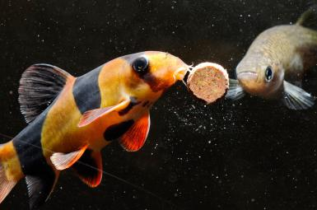
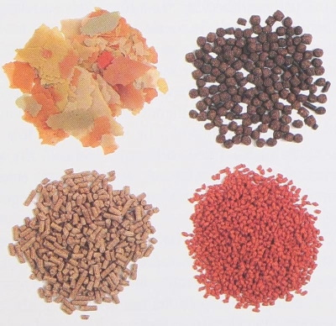
FOOD & FEEDING

Slide 10
FEEDING
The small-scale farmers cannot afford different readymade packed pellet feed or purchasing of artemia cyst drum, which are costly.
They have successfully substituted low cost alternative live feeds. Water fleas, Tubifex or sludge worm, mosquito larvae and chopped earthworm are used by the farmers.
Different homemade feed like whole-wheat bread, vegetable peelings and rice are also fed.

Slide 11
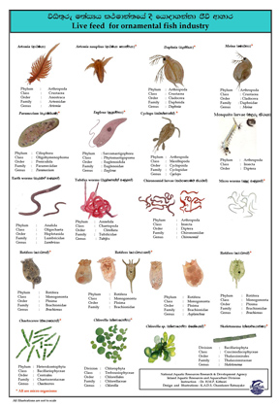
Most farms depend on Daphnia,Tubifex worms and mosquito larvae.
The fish culturists can collect Daphnia from the near by ponds by sieving through fine mesh in the early morning.
Tubifex worms and mosquito larvae are collected from the sewage water channels.
Overfeeding is more harmful than under feeding as the excess feed destroys the water quality.

Slide 12
Management of Water Quality Parameters
Ornamental fish production unit required higher level of expertise for better water quality management as ornamental fishes are more sensitive to poor water quality.
Many ornamental fish will perish in situations where more robust food fish species can survive.
As ornamental fish are kept in tanks more numbers than their food fish counterparts, water quality is most critical.

Slide 13
Where large numbers of fish are kept in small spaces, the buildup of nitrogenous wastes, most notably ammonia, requires the producer to implement measures to manage it properly.
Regular water exchange along with proper aeration overcomes this type of problem in the tanks.

Slide 14
PREVENTIVE HEALTH MANAGEMENT
Proper water quality management by managing the
temperature and pH.
Some of the easily available and economic chemicals and medicines can be used as preventive measuresfor diseases like white spot, mouth fungus, tail and fin rot.
Common salt 15-30 g/L used as bath treatment for 30 min as disinfectant
Methylene blue 2.5 g/L added in aquarium water for water purification
Copper sulfate or potassium permanganate 0.5-1 g/L used as bath treatment for 1 min as disinfectant

Slide 15
Economics of a Small-Scale Breeding and Rearing Unit
The profit of ornamental breeding and rearing unit depends on the carrying capacity, candidate species, management practices and infrastructure.
The marginal farmers who breed or rear the fish have to sell them earlier due to the lack of proper equipment and get less profit.
On the other hand better-off farmers rear the fish to an optimum size and get more profit.
The average cost and return of a minimal breeding and rearing unit of live bearers

Slide 16
CAPITAL COST
2 glass aquarium (2.5 x 2 x 1) m each with lids and fittings 2,500 =5,000.00
3 cement cistern (5 x 3 x 2) m 8,000 = 24,000.00
3 aerator 500 = 1500.00
Other equipments like hand net, buckets, pipes = 4000.00
Sub-total = 34,500.00

Slide 17
Culture cost (Rs.)
200 hundreds female at 10.00 = 2,000.00
50 male at1 5.00 = 750.00
Feed for one year = 7,500.00
Others = 3,000.00
Sub-total = 14,250.00
Total cost (Rs.)
48,750.00
Production
Monthly production of 4,200 young; Yearly production of 50,000 young; 40% male = 20,000; 60% female = 30,000

Slide 18
Sale 20,000 male at 3.00 = 60,000.00
30,000 female at 2.00 = 60,000.00
Total sale 1,20,000.00
Annual profit = (1,20,000.00- 48,750.00) = 72,250.00
Monthly profit = Rs. 6,021.00

Slide 19
CONCLUSION
Culture and breeding of ornamental fishes can be a promising alternative for many people as well as unemployed youths.
It requires little space and less initial investment than most other forms of aquaculture.
For ornamental fish farming, only a clear understanding of habits and biology of the fishes is required.
It can be practiced even in urban areas with little alteration of backyard or roof of a house.
As less manpower is needed, the women or the elders can run small home aquarium units and improve their social and economic upliftment.

