Slide 1
UNIT II
Ornamental Fish Taxonomy
Program: M.Sc. Zoology
Semester: III
Course: Ornamental Fish Culture Technology

Slide 2
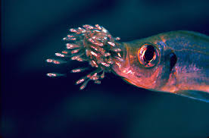
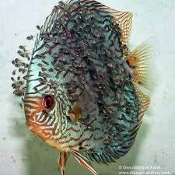
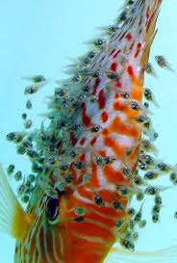
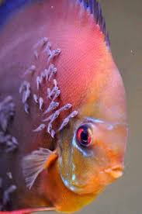
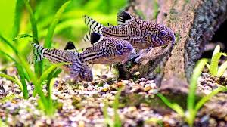
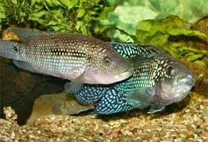
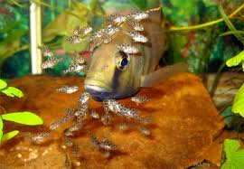
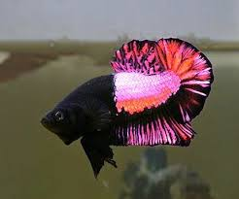
Parental Care Fishes

Slide 3
Important Aspects of Parental Care by the Fishes
Additional Strategies
Selection of Spawning Site
Parental Care by Nest Building
Egg Depositors
Parental Care by Other Means
Parental Care by Mouthbreeders
Parental Care by Modifying Special Parts
Parental Care by Egg Buriars
Influence of Endocrine Glands on Parental Behavior

Slide 4
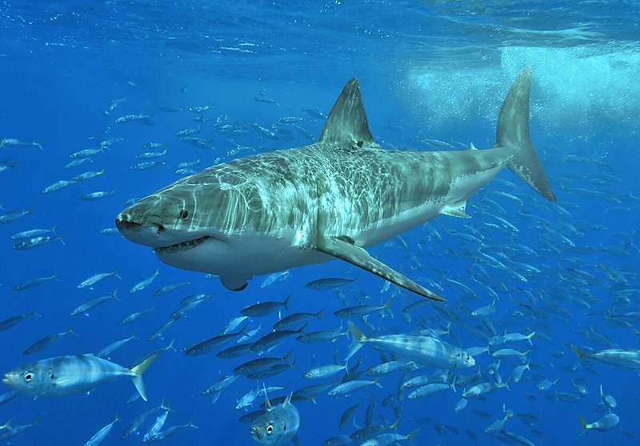
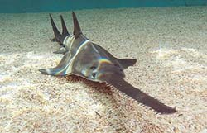
Additional Strategies
  Various types of extra structures are present on the eggs to provide protection to them
  Elasmobranches ( subclass of Chondrichthyes or cartilaginous fish)
  Which includes sharks, rays, skates & sawfish
  The shell gland of oviduct secretes a horny case around the egg
  They can protect them against predation and damage, and to certain extent help in osmotic control

Slide 5
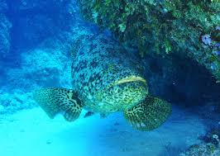
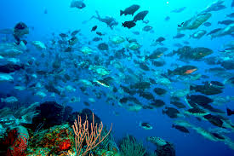
Selection of Spawning Site
Spawning at sheltered place is one of the most primitive types of defense afforded by the parents
Fishes like carps travel long distance within water in search of suitable spawning site and then return to their feeding grounds.

Slide 6
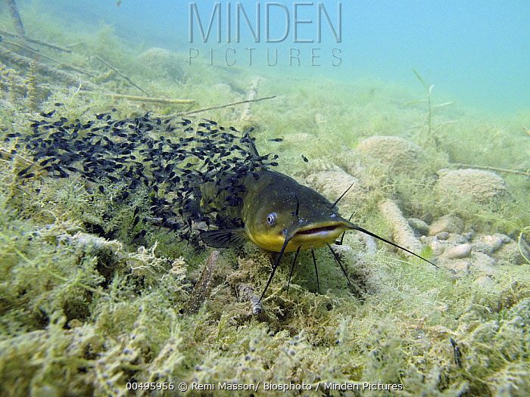
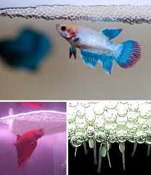
Parental Care by Nest Building
Male keeps the nest intact and keeps a close eye on the eggs
Female should be removed after spawning
During the breeding season male fish develops filamentous structures on their pelvic fins
These filaments are highly vascular, they secrete oxygen into water
Male display the parental care
Nest Building

Slide 7
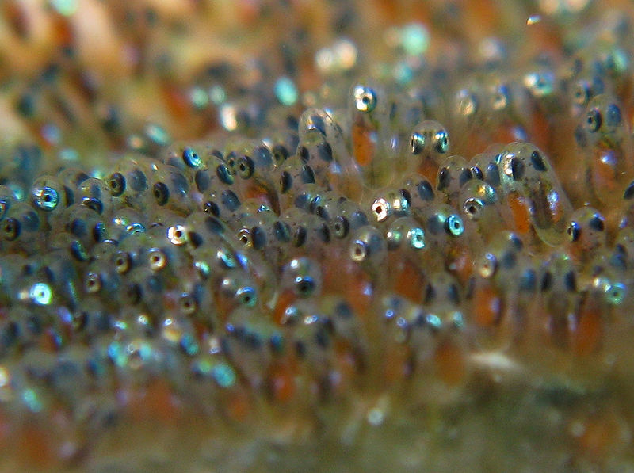
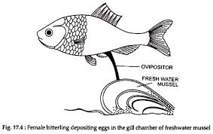
Egg Depositors
The eggs are either laid on a flat surface, like a stone or plant leaf or even individually placed among fine leafed plants like Java moss
The female fish draws out its oviduct to form a long tube just like an insect’s ovipositor.
With the help of this tube the females deposit their eggs in the bivalve shell, a safe place for eggs

Slide 8
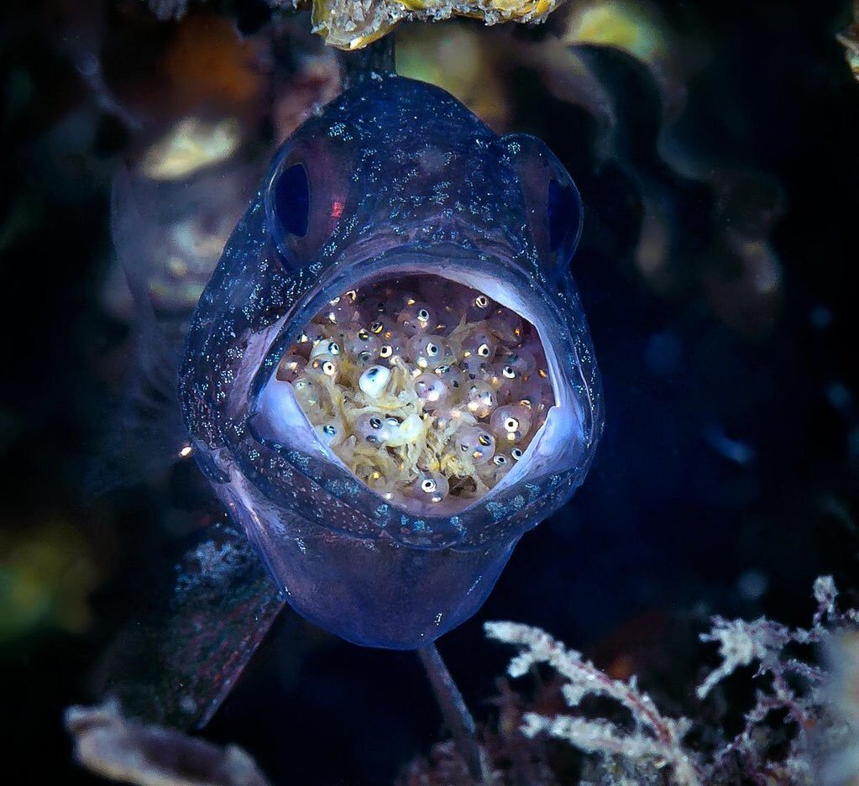
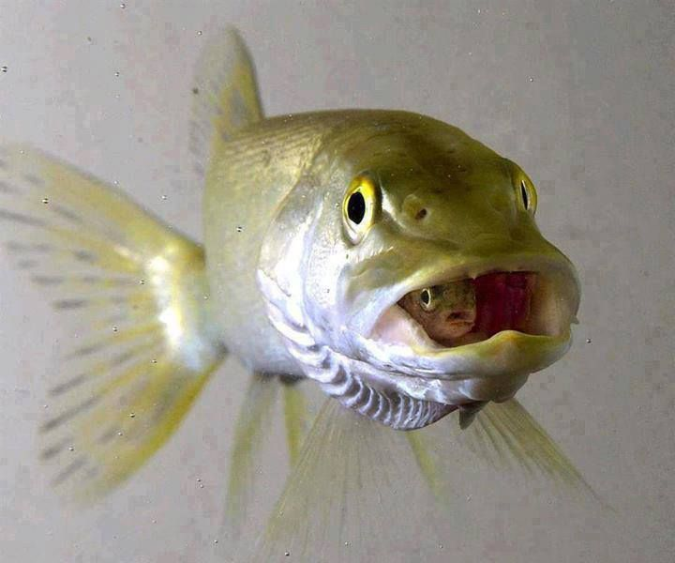
Parental Care by Mouthbreeders
Females usually lay their eggs on a flat surface where the male then fertilizes them
After fertilization the female picks up the eggs and incubates them in her mouth
Female fish keeps the eggs in her buccal cavity and provides shelters to the young ones

Slide 9
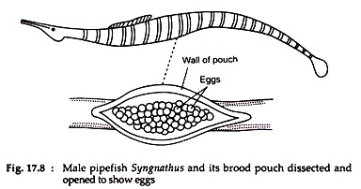
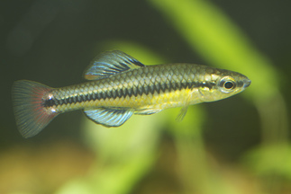
Parental Care by Modifying Special Parts
Some fishes attribute parental care by modifying their organs in special manner
During the breeding season these flaps fuse to form a brood pouch
Female extends its oviduct and deposits the eggs into the brood pouch
Egg Buriars
Killifish are spawn pressing
their eggs into the substrate
Killifish eggs can stay viable for many years in the dried out mud

Slide 10
Influence of Endocrine Glands on Parental Behavior
Fish becomes enable to secrete air bubbles in mucus for building of nest
The Symphyrodon discus hormone prolactin, which is originated from testosterone and is called as paralactin, activates mucus secreting epidermal cells
Nest building behaviour of Betta is controlled by testosterone, which activates only in presence of hormone prolactin
Hippocampus it is prolactin that is responsible for proliferation of epithelium lining of the brood pouch

Slide 11

Thank you…,

