Slide 1
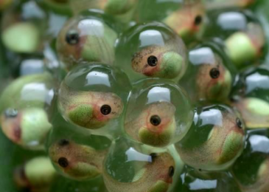
Unit-II Classification and characteristic feature of ornamental fishes
Program: M.Sc. Zoology
Semester: III
Course: Ornamental Fish Culture Technology

Slide 2
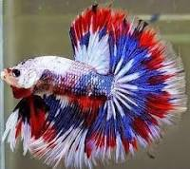
Ornamental Fishes
Ornamental fishes usually very attractive colorful fishes of various characteristics.
Ornamental fishes kept in glass aquarium tanks or a garden pool for fun and fancy.
Fish have some peculiar special characteristics such as body color, morphology, mode of taking food etc.
There are various types of ornamental fishes available all across the world.
Fighter Fish
Betta splendens
Phylum: Chordata
Class: Pisces
Order: Teleostei
Family: Belontidae
Bettas are a member of the group gourami family and are known to be highly territorial.
Source: https://goo.gl/images/E7uWXB

Slide 3
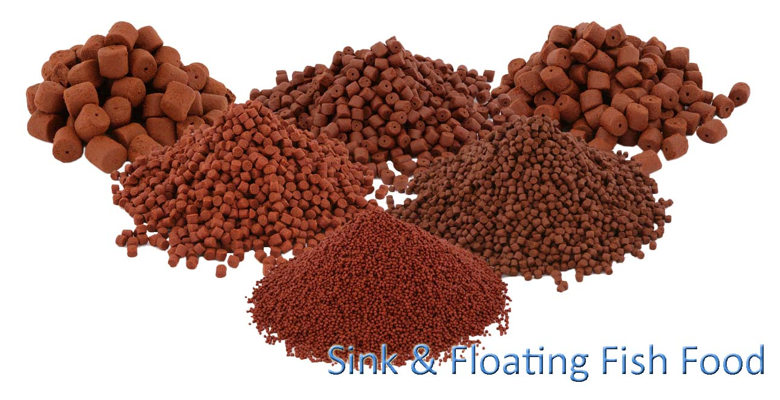
Males in particular are prone to high levels of aggression and will attack each other if housed in the same tank.
Brilliantly colored
Males bigger than the female
Males have elongated fins
Lays eggs
Optimum temperature 24-29◦C
Bubble nest is built. The male guards the eggs.
Feed on zooplankton, crustaceans, and other larvae of mosquitoes & other water bound insects
Frozen diet foods such as brine shrimp,
blood worm, daphnia
Source: https://goo.gl/images/izmiYT

Slide 4
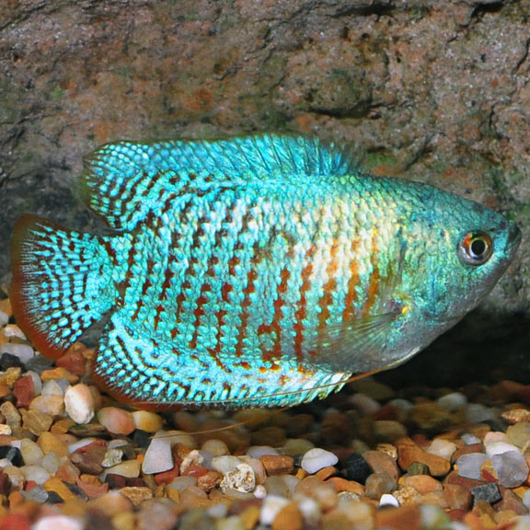
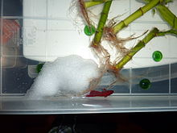
Gourami
Colisa
Phylum: Chordata
Class: Pisces
Order: Teleostei
Family: Osphronemidae
Gourami is an ornamental fish & freshwater fish
It has elongated rays infront of pelvic fins
Temperature 22 to 28◦C
Males is attractive and colorful
Males larger than female & they lay eggs
Exhibit parental care
They are mouth breeders or build bubble nests
Source: https://goo.gl/images/z8ZZdq
Source: https://goo.gl/images/jUBZ7x

Slide 5
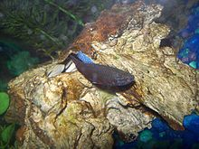
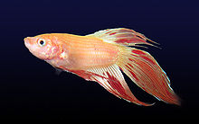
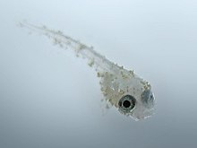
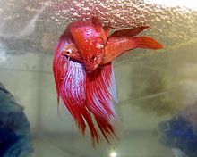
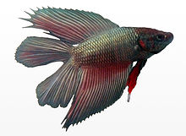
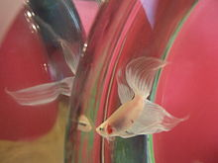
Common features & characteristics of ornamental fishes
Infected velvet disease
Purple & blue female
Dalmatian orange male
Metallic double tail male
Pair spawning in a bubble nest in breeders tank
Male attacking & flaring at his reflection

Slide 6
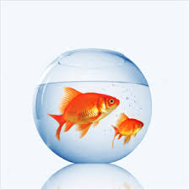
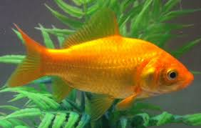
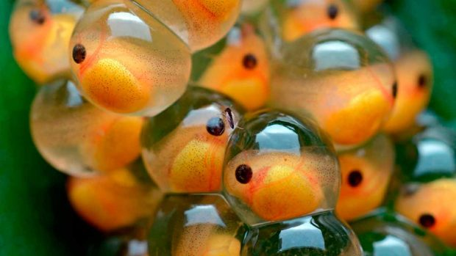
Freshwater ornamental fishes
Gold Fish
Carassius auratus
Phylum: Chordata
Class: Pisces
Order: Teleostei
Family: Cichlidae
Gold fish is an ornamental fish
It belong to carp family
It was one of the earliest fishes domesticated & cold water fish
It is native of china & it has no stomach
So it cannot digest excess of protein
Hence it releases large amount of waste.
Overfed fishes have a trailing of faeces from the cloaca
It lays eggs & maximum length is 59 cm and weight is 4.5 kg
It can produce pigments in light. If left in the darkness, the gold fish turns white
The body is short & the back is smooth & curved
https://goo.gl/images/cjtUcH
Source: https://goo.gl/images/vpnzhv

Slide 7
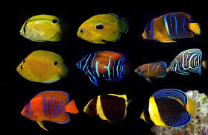
Angel Fish
Pterophyllum scalare
Phylum: Chordata
Class: Pisces
Order: Teleostei
Family: Cichlidae
Angel fish is an ornamental fish.
The three species of Pterophyllum are unusually shaped for cichlids being greatly laterally compressed, with round bodies and elongated triangular dorsal and anal fins
Angelfish are ambush predators and prey on small fish and macro-invertebrates
Angelfish pairs form long-term relationships where each individual will protect the other from threats and potential suitors
It has reaches sexual maturity at the age of six to 12 months or more
In situations where the eggs are removed from the aquarium immediately after spawning, the pair is capable of spawning every seven to 10 days
A number of varieties are available. They are Silver, Veil tail, Black lace, Marble, Black, Golden, Half black and Pearl scale

Slide 8
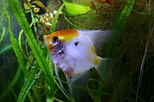
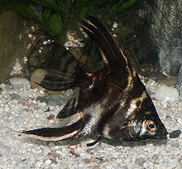
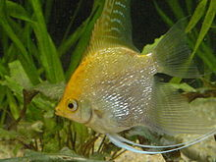
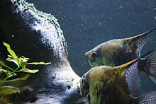
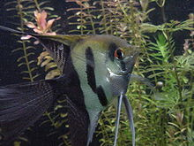
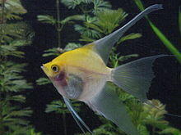
Koi angel fish
Marble angel fish
Gold pearlscale angel fish
Couple spawning
Halfblack veil angelfish
Sunset blushing veil angelfish
Source: https://goo.gl/images/mSnqBU

Slide 9
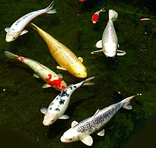
Koi
Cyprinus carpio
Phylum: Chordata
Class: Pisces
Order: Teleostei
Family: Cyprinidae
Koi means carp. It is fast growing and reaches large size
Koi is an informal group of the colored variants of the Amur carp.
The common carp is a hardy fish, and koi retain that durability.
Koi are cold-water fish, but benefit from being kept in the 15–25 °C (59–77 °F) range, and do not react well to long, cold, winter temperatures; their immune systems are very weak below 10 °C. Koi are an omnivorous fish. They eat a wide variety of foods, including peas, lettuce, and watermelon.
Koi food is designed not only to be nutritionally balanced, but also to float so as to encourage them to come to the surface
Source: https://goo.gl/images/ciNwfj

Slide 10
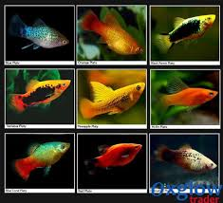
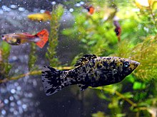
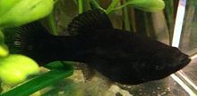
Brackish water fish Molly
Poecilia
Phylum: Chordata
Class: Pisces
Order: Teleostei
Family: Poecilidae
Molly is an ornamental fish
It belongs to the family of swordtails & guppies
It is a brackish water fish
A table spoon of salt is added to the tank for
better performance of molly
It can live for 5 years
It is a live –bearer giving birth to young ones
Not laying eggs
https://goo.gl/images/Pta9EZ
Block spotted molly
Black molly

Slide 11
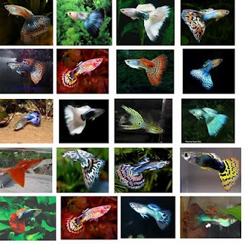
Guppy
Poecilia reticulate
Phylum: Chordata
Class: Pisces
Order: Teleostei
Family: Poecilidae
One of the most popular
freshwater aquarium fish species
They are highly adaptable and thrive in many different environmental and ecological conditions
Wild guppies generally feed on a variety of food sources, including benthic algae and aquatic insect larvae
Guppies are used as a model organism in the fields of ecology, evolution and behavioral studies
Guppies exhibit sexual dimorphism
While wild-type females are grey in body color, males have splashes, spots, or stripes that can be any of a wide variety of colors
Males are typically 1.5–3.5 cm (0.6–1.4 in) long, while females are 3–6 cm (1.2–2.4 in) long
Source: https://goo.gl/images/dVoBQ9

Slide 12
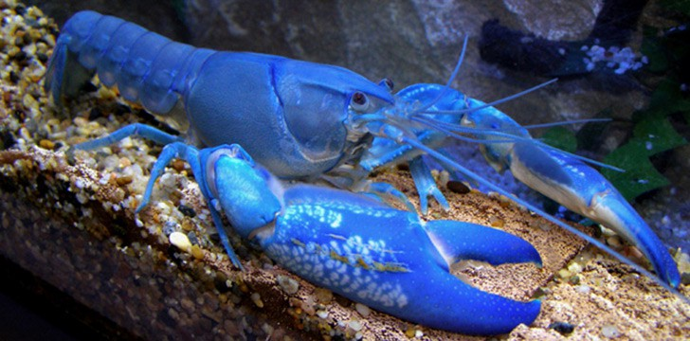
Marine ornamental fishes
Lobsters
Homarus gammarus
Subphylum: Crustacea
Class: Malacostraca
Order: Decapoda
Family: Nephropidae
Lobsters have long bodies with muscular tails, and live in crevices or burrows on the sea floor.
Three of their five pairs of legs have claws, including the first pair, which are usually much larger than the others
Highly prized as seafoods, lobsters are economically important, and are often one of the most profitable commodities in coastal areas they populate
Lobsters are found in all oceans & they live on rocky, sandy or muddy bottoms
Lobsters are omnivores and typically eat live prey such as fish, mollusks, other crustaceans, worms, and some plant life
In general, lobsters are 25–50 cm (10–20 in) long, and move by slowly walking on the sea floor
lobster is cooked, its shell's color changes from blue to orange because the heat from cooking breaks down a protein called crustacyanin, which suppresses the orange hue of the chemical astaxanthin, which is also found in the shell
Source: https://goo.gl/images/LN2m9W

Slide 13
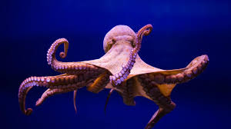
Octopus
Octopus vulgaris
Phylum: Mollusca
Class: Cephalopoda
Order: Octopoda
Super order: Octopodiformes
The octopus is a soft-bodied, eight-armed mollusc of the order Octopoda
The soft body can rapidly alter its shape, enabling octopuses to squeeze through small gaps
They trail their eight arms behind them as they swim
The siphon is used both for respiration and for locomotion
Octopuses have a complex nervous system and excellent sight, and are among the most intelligent and behaviorally diverse of all invertebrates
Octopuses inhabit various regions of the ocean, including coral reefs, pelagic waters, and the seabed; some live in the intertidal zone and others at abyssal depths
Most species grow fast, mature early and are short-lived
During breeding, the male uses a specially adapted arm to deliver a bundle of sperm directly into the female's mantle cavity, after which he becomes senescent and dies
The female deposits fertilized eggs in a den and cares for them until they hatch, after which she also dies
Source: https://goo.gl/images/C9GVYV

Slide 14
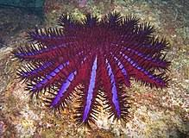
Star Fish
Fromia monilis
Phylum: Echinodermata
Class: Asteroidea
Super order: Valvatacea
Starfish or sea stars are star-shaped echinoderms belonging to the class Asteroidea
Starfish are marine invertebrates
They typically have a central disc and five arms, though some species have a larger number of arms.
The aboral or upper surface may be smooth, granular or spiny, and is covered with overlapping plates
Starfish have tube feet operated by a hydraulic system and a mouth at the centre of the oral or lower surface
starfish is a hydraulic system made up of a network of fluid-filled canals and is concerned with locomotion, adhesion, food manipulation and gas exchange
Starfish can ability to digest food outside the body, starfish can hunt prey much larger than their mouths
Their diets include clams and oysters, arthropods, small fish and gastropod molluscs
starfish are not pure carnivores, supplementing their diets with algae or organic detritus
Source: https://goo.gl/images/tPg793

Slide 15
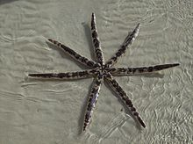
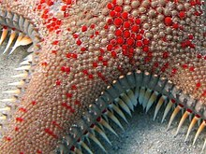
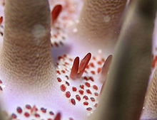
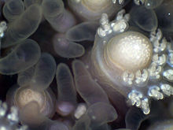
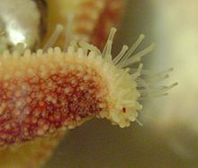
Octopus
Seven armed starfish
Ossicles
Pedicellariae and retracted papulae among the spines
Pedicellaria and papulae
Arm tip of Leptasterias polaris showing tube feet and eyespot

Slide 16
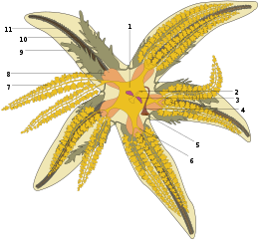
Digestive system and excretion
1. Pyloric stomach,
2. Intestine and anus, 3. Rectal sac,
4. Stone canal, 5. Madreporite,
6. Pyloric caecum, 7. Digestive glands,
8. Cardiac stomach, 9. Gonad,
10. Radial canal, 11. Ambulacral ridge
https://en.wikipedia.org/wiki/Octopus

Slide 17
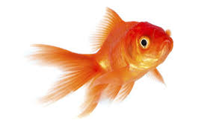
Thank you

