Slide 1
Unit - IV
Health Management
Molecular Diagnosis of Aquatic Animal Diseases
Program : M.Sc. Zoology
Semester : III
Course : Aquaculture Technology

Slide 2
Aquatic Biotechnology
1. Fish health and Nutrition
2.Molecular Cytogenetics
3.Gene transfer technology
4.Genetically modified fish
5.Environmental remediation

Slide 3
Fish health
To develop the comprehensive aquaculture system which has an excellent impact on its production due to its mortality and decreased growth.
Due to the expose of the various bacterial, viral and fungal infections, these fishes loses its survival leads to lower production.

Slide 4
Goals - Fish Health Management:
  Prevent the disease causing pathogens to healthy animals.
  Prevent intensification of existing disease agents.
  Production of healthy, high quality fish.
  Biotechnology can have a direct positive impact on many of the main elements of fish health management, with knock-on effects on other important issues. Rapid detection and identification of pathogens.

Slide 5
  Principle of Fish Health Maintenance
Maintain conditions which are designed to optimize growth, feed conversion, reproduction and survival.
Intensive aquaculture – high numbers, close quarters, lots of food
Enhance natural resistance
Well managed fish have healthy immune systems
Healthy fish give rise to healthier offspring

Slide 6
Diagnostics tools are developed
By detecting the pathogens DNA are being developed.
DNA sequencing, PCR are used to understand the basics and life cycles of the pathogen which able to solve fish diseases by understanding the essential step to diagnose and prevent the disease.

Slide 7
DNA vaccine
Vaccines are the effective to control the disease causing pathogens.
DNA vaccination is differ from gene therapy and it is the intentional transfer of genetic material (RNA/ DNA) to somatic cells for enhance the immune system.

Slide 8
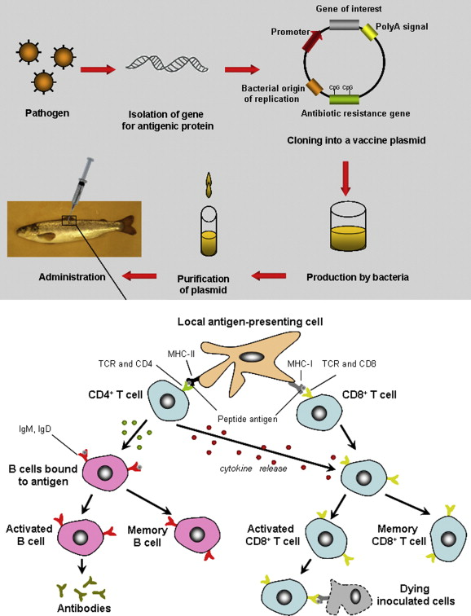

Slide 9
Fish Nutrition
It deals with the production of feeds that supports better growth at low cost.
Many scientists are investing the alternative protein sources like plant based, marine based etc., instead of using fishmeal and oil.
Research directs from effect of nutrients on growth, feed utilization, digestibility, alterations in metabolic pathways, fish health parameters, nutrient bioavailability.

Slide 10
Nutritional requirements for fishes
Nutrient level |  | Value
Protein (%) |  | 30-40%
Carbohydrate (%) |  | 10-30%
Lipid (%) |  | 15-16%
Fiber (%) |  | 3-5%
Energy (units/kg) |  | 2.9 k.cal/g
Vitamins | Vitamin- A (units/kg) | 4,000-20,000 IU
 | Vitamin- E (units/kg) | 100 mg
 | Vitamin- B1 (units/kg) | 0.5 mg
 | Vitamin- B2(units/kg) | 4 mg
 | Vitamin- B6(units/kg) | 5-6 mg
 | Niacin (units/kg) | 28 mg
 | Biotin (units/kg) | 1 mg
 | Vitamin B12 (units/kg) | Trace
 | Vitamin C (units/kg) | Trace
 | Myoinositol (units/kg) | 440 mg
 | Choline (units/kg) | 1,500 mg
Minerals | Cu (units/kg) | 3 mg
 | Zn (units/kg) | 17 mg
 | Fe (units/kg) | 150 mg
 | Mn (units/kg) | 13 mg
 | Cr (units/kg) | 0.5 mg
 | Na (units/kg) | 10-15 g
 | Mg (units/kg) | 50 mg

Slide 11
Molecular Cytogenetics
It involves combination of molecular biology and cytogenetic.
In general this involves the use of a series of the techniques in which DNA probes are labeled with different coloures fluorescent tags to visualize one or more specific regions of the genome.

Slide 12
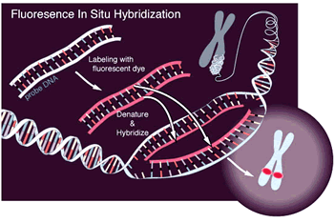
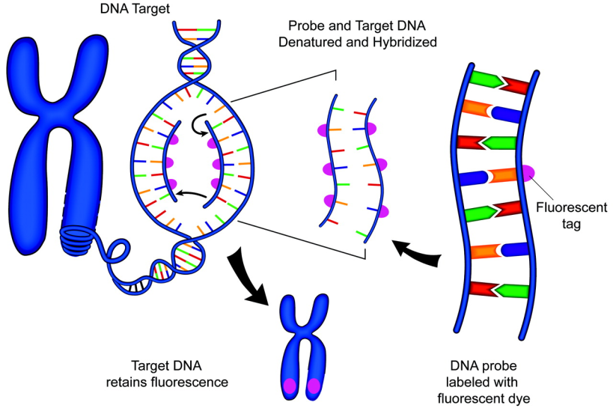
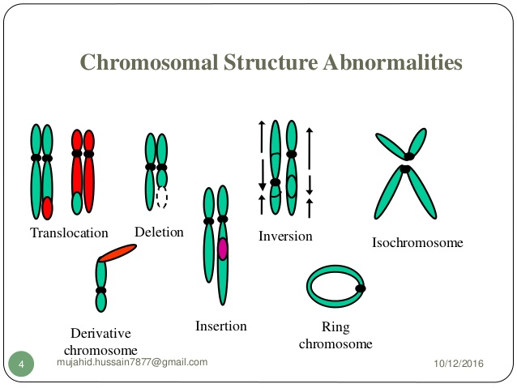

Slide 13
Molecular cytogenic techniques
FISH- Flouresence in situ Hybridization: enhances the interpretation of numerical and complex chromosomal aberrations and bridging the gap between conventional chromosome binding analysis.
It uses the fluorescent probes which specifically bind to the DNA showing higher degree of similarity.

Slide 14
Advantages
Direct FISH technique is relatively rapid and sensitive.
No cell culture needed.
Result may be easier to interpret than interpretation of compel karyotype.
Can combine FISH with immunostaining i.e. FICTION technique.
Interphase FISH is even suitable in cases with low numbers of abnormal cells.

Slide 15
Disadvantages
Need fluorescent microscope (expensive).
FISH will only provide information about the probe being tested, other aberrations will not be detected.

Slide 16
Genetically Modified Fish
Using the selective breeding, species were modified to attractive characters.
Genetic Modification refers to the changes in the Gene itself which results the growing larger and faster producing high yield to the farmer.
It also enhances the immune system of the fish to resist against the disease causing pathogens.

Slide 17
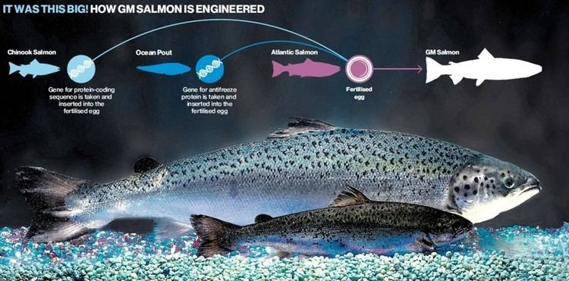

Slide 18
Questions?

