Slide 1
Unit – IV
Health Management
Nutritional Deficiency Diseases
Program : M.Sc. Zoology
Semester : III
Course : Aquaculture Technology

Slide 2
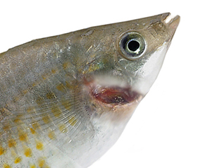
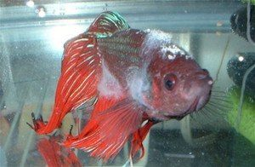
1. Bacterial diseases
https://www.interpet.co.uk/Support/The-Fish-Doctor/Diagnose-what-s-wrong/Diagnostic-Results/Bacterial-gill-disease
Bacterial gill disease
Columnaris
http://www.aquariumfishparadise.com.au/columnaris-disease/

Slide 3
Bacterial Gill diseases
Aquarium fish sometimes suffer from a disease complex (Flavobacteria, Aeromonas and Pseudomonas spp. ) called bacterial gill disease.
Although it most often affects young fishes, especially salmonids.

Slide 4
Bacterial Gill diseases
Physical Signs
  Swelling
  Redness within the gill tissue
  Deformed gills
Behavioral Signs
  Breathing rapidly
  Loss of appetite

Slide 5
Bacterial Gill diseases
Causes
  Bacterial gill disease typically occurs as a result of poor living conditions, such as overcrowding, poor water quality, high organic debris, increased temperature of the water, and increased ammonia levels.

Slide 6
Bacterial Gill diseases
Treatments
  A treatment of potassium permanganate (1-2 ppm) and salt water additives can be used to help the fish heal and recover from the infection.

Slide 7
Columnaris (Mouth Fungus)
Columnaris is a common bacterial infection (Flexibacter columnaris) in aquarium fish.
It’s highly contagious and the outcome is often fatal.

Slide 8
Columnaris (Mouth Fungus)
Physical Signs
  Frayed and ragged fins
  Ulcerations on the skin
  Epidermal loss
  White or cloudy, fungus-like patches.
  Mucus on the gills, head, and dorsal regions
  Gills will change color. Becoming light or dark brown

Slide 9
Columnaris (Mouth Fungus)
Behavioral Signs
  Breathing rapidly and laboriously
  Loss of appetite

Slide 10
Columnaris (Mouth Fungus)
Causes
    Columnaris is common where
    high bioloads or stressful conditions exist.
    These can be due to
    overcrowding, injury, inadequate diet, poor water quality and pH.
    The bacteria can stay active in fish tank for up to 32 days if the hardness is 50 ppm.

Slide 11
Columnaris (Mouth Fungus)
Treatments
  The disease does not survive in salt solutions of 1% or higher.
  Another option Oxytetracycline is regarded as a very effective.
  To prevent the spread, remove any dead fish.

Slide 12
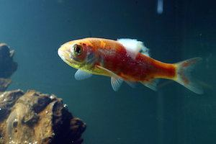
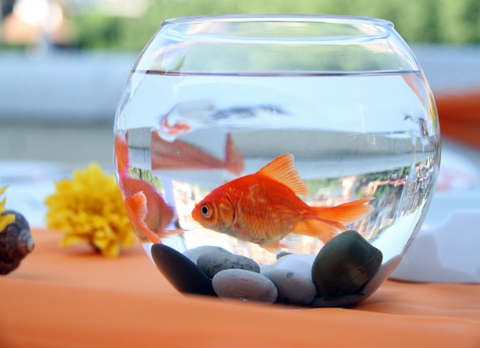
2. Fungal diseases
Saprolegnia disease (Cotton Fin Fungus)
Branchiomycosis disease (Gill rot)
http://goldfish2care4.com/goldfish-diseases/cotton-wool.html
https://www.petmd.com/fish/conditions/infectious-parasitic/c_fi_branchiomycosis

Slide 13
Saprolegnia disease (Cotton Fin Fungus)
Cotton Wool Disease, it’s a condition that typically affects aquarium fish with weak immune systems.
Characterized by the cotton wool growths, it’s fairly common and it’s important to address this immediately before it can cause a lot of damage.

Slide 14
Saprolegnia disease (Cotton Fin Fungus)
Physical Signs
  Cotton-like fluffy or wispy growth on the fins
Behavioral Signs
  No real behavioral signs. Fish tend to act fine until the fungus appears on the skin’s surface

Slide 15
Saprolegnia disease (Cotton Fin Fungus)
Causes
  Poor water quality and decomposing material can lead to Cotton Fin.
  Especially fish is bullied or fighting a lot.

Slide 16
Saprolegnia disease (Cotton Fin Fungus)
Treatments
  The basic four used are salt, Methylene blue, Malachite green, and Acriflavine.
  Malachite green is readily available and is known to be effective.

Slide 17
Branchiomycosis disease (Gill rot)
It is a fungal disease involving
gill tissues.
Causative agent: Branchiomyces sanguinis
It grows mainly in the blood vessels of gill arches, filaments and in the gill lamellae.

Slide 18
Branchiomycosis disease (Gill rot)
Transmission
  Fungal spores are transmitted by water to gills.
  These spores adhere to the gills, germinate and produce hyphae.
  The hyphae penetrate gills epithelium or within the blood vessels of gills depending on species of fungi.

Slide 19
Branchiomycosis disease (Gill rot)
Clinical signs
  Fish become weak in movement.
  Fungus develops on or in gill tissue, or penetrates the blood vessels causing obstruction, congestion and necrosis of gill tissues.
  Gills may be appearing red from impaired circulation.

Slide 20
Branchiomycosis disease (Gill rot)
Diagnosis
  Microscopical examination of wet preparation from infected gill.
  Isolation and identification of the causative agent.

Slide 21
Branchiomycosis disease (Gill rot)
Treatment
  Strict sanitation and disinfection are essential for disease control.
  Dead fishes should be collected and daily and burned or deeply buried.

Slide 22
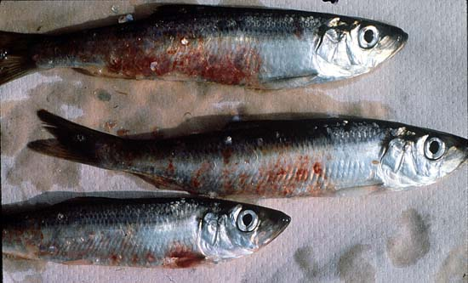
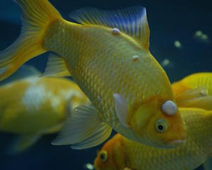
4. Viral diseases
Viral erythrocyte necrosis disease
Lymphocystis
http://www.aquariumfiltersetup.com/common-aquarium-problems/fish-disease/fish-disease-lymphocystis/

Slide 23
Viral erythrocyte necrosis disease
Viral erythrocytic necrosis virus is caused by several similar iridoviruses having double stranded DNA and an icosahedral shape ranging in size from 130-350 nm.
The viruses infect erythrocytes causing a hemolytic disease often resulting in anemia and secondary infections by other pathogens.

Slide 24
Viral erythrocyte necrosis disease
Clinical Signs
  Fish are anemic exhibiting almost white gills and pale visceral organs.
  Livers may be green in color due to bilirubin breakdown.

Slide 25
Viral erythrocyte necrosis disease
Transmission
  The virus has been transmitted by waterborne exposure.
  Adult carrier fish of susceptible species are probably the reservoirs of virus that is transmitted to juvenile fish.

Slide 26
Viral erythrocyte necrosis disease
Prognosis for Host
  The virus in Alaskan juvenile herring caused one of the first natural epizootics to be reported associated with mass fish mortality.
  Chronic to subacute mortality in juvenile Pacific herring can also occur.

Slide 27
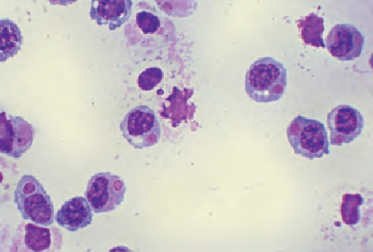
Viral erythrocyte necrosis disease
Diagnosis
  Characteristic eosinophilic inclusion bodies are present in the cytoplasm of erythrocytes when stained with Giemsa or Wright stains.
  The virus is confirmed by the observation of iridovirus particles associated with inclusion bodies using TEM.

Slide 28
Lymphocystis
This common viral infection affects fresh and saltwater fish’s skin and fins. Not serious per say as it rarely ends in death; it only disfigures fish.

Slide 29
Lymphocystis
Physical Signs
  Growths on the skin or fins (look similar to cauliflowers)
Behavioral Signs
  Do not normally behave differently from uninfected fish
  Large numbers of growths on the fins and gills could cause breathing and summing difficulties

Slide 30
Lymphocystis
Causes
This virus can only infect your fish if it’s introduced to your aquarium by an infected fish and live food.
As well as avoid feeding your fish live food or only feeding with home cultivated live food.

Slide 31
Lymphocystis
Treatments
There’s no good treatment currently available.
However, if you maintain correct water quality, chemistry, nutrition, and population density, most cases of Lymphocystis will resolve itself: warm water fish may only take a few weeks. Coldwater or cool water fish up to 6 weeks.

Slide 32
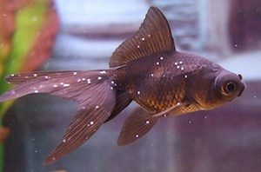
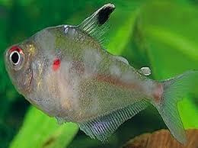
5. Protozoan diseases
Ichthyphthiris
Chilodonella
https://www.thesprucepets.com/treat-ichthyophthirius-multifiliis-1378482
https://bettacare101.com/protozoandisease/

Slide 33
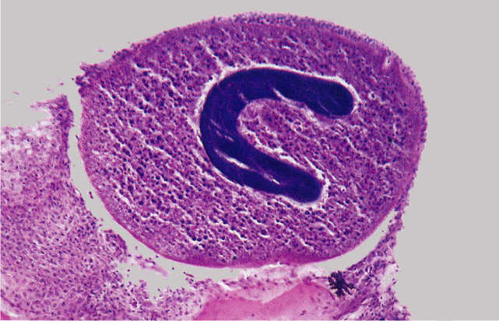
Ich (Ick or White Spot Disease)
Ich is one of the most common and persistent parasitic diseases found in aquariums.
It’s caused when a protozoan attacks and attaches itself to your fish’s body, fins, and gills.
Causative agent: Ichthyophthirius multifiliis

Slide 34
Ich (Ick or White Spot Disease)
Physical Signs
  White spots on the body and gills
  White spots may join together to form white patches
  Clamped fins

Slide 35
Ich (Ick or White Spot Disease)
Behavioral Signs
Labored breathing. Fish may gasp for air at the surface or stay by the filter to try and get more oxygen.
Loss of appetite
Fish may rub up against objects in the tank

Slide 36
Ich (Ick or White Spot Disease)
Causes
A major cause of this disease is sudden temperature drops.
Poorly-maintained aquarium.
As well as decorations or plants that are carrying cysts of the parasite.

Slide 37
Ich (Ick or White Spot Disease)
Treatment
  Daily water changes on the isolated fish.
  Increase the temperature every few hours to a maximum of
  86 degrees.
  Add aquarium salt to the tank to assist in gill function.

Slide 38
Chilodonella
Chilodonella is caused by protozoa, a type of parasite, and can be a serious treat to the health of any fish.
The disease can be hard to diagnose but is easy to treat.

Slide 39
Chilodonella
Symptoms
    Color loss
    Gill damage
    Frayed fins

Slide 40
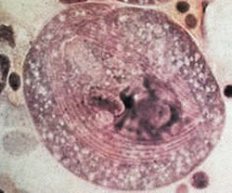
Chilodonella
Cause
  Chilodonella cyprini are heart-shaped parasites, at a size of
  40 to 60 microns, are not visible to the naked eye.
  The parasites are able to swim freely, spreading easily from fish to fish.
  Reproduction occurs by asexual division.

Slide 41
Chilodonella
Treatment
  Add aquarium salt
  Formalin: Use 2 milliliters per 38 liters for two hours
  Potassium permanganate: Use 45 milliliters per 38 liters

Slide 42
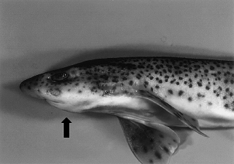
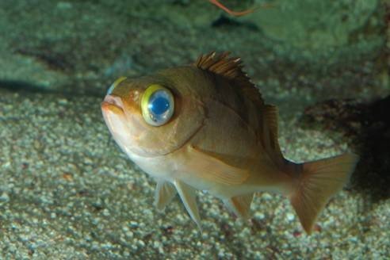
Nutritional deficiency diseases
Thyroid Hyperplasia
Amino acid deficiency

Slide 43
Thyroid Hyperplasia (Goitre – Fish)
Goitre is the most common endocrine disorder in fish.
Iodide deficiency leads to a decrease in thyroid hormone production which stimulates an increase in TSH which leads to a growth in size and number of thyrocytes, which appears as a goiter.

Slide 44
Thyroid Hyperplasia (Goitre – Fish)
Clinical Signs
  Fish will exhibit a large bilateral nodular swelling at the base of the gills extending upwards along the gill arches.

Slide 45
Thyroid Hyperplasia (Goitre – Fish)
Diagnosis
Histological examination reveals thyroid hyperplasia which appears invasive.
It may also appear metastatic due to the ectopic follicles often found in the spleen, kidney and other organs.
Thyroid hyperplasia may be difficult to distinguish from thyroid carcinoma

Slide 46
Thyroid Hyperplasia (Goitre – Fish)
Treatment
  Iodine replacement therapy is beneficial if iodide deficiency is suspected.
  Goitrogenic substances in the feed should be sought out and removed.
  Thyroxine is used to restore the negative feedback on TRH and TSH production and has been successful in treating the goitre.

Slide 47
Pathological syndrome protein/ amino acids
Reduced or abnormal amino acid intake in fish results in reduced biosynthesis of many vital substances:
  enzymes, hormones, certain pigments, and cofactors
Certain amino acids are necessary for fat/carbohydrate metabolism
Amino acids also required for formation of purines, pyrimidines, i.e. DNA, RNA
Diagnosis of protein/ amino acid deficiencies is difficult.

Slide 48
Protien / amino acid deficiency
Observation: poor FCR
Anemia
Challenge: Protien / amino acid deficiency sings similar to disease caused by other etiological agents
Most comman sign: reduction of growth

Slide 49
Amino acid deficiency
Tryptophan deficiency - scoliosis, cataract
Tryptophan and sulfur amino acid deficiency - cataracts
Methionine deficiency - bilateral cataracts
Lysine deficiency - Dorsal/caudal fin erosion, increased mortality
Treatment: A feed with proper amino acid profile is the only

Slide 50
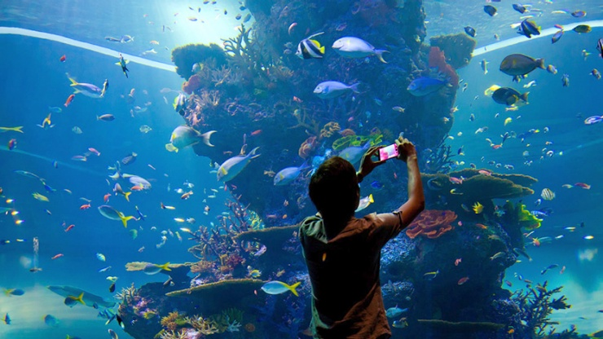
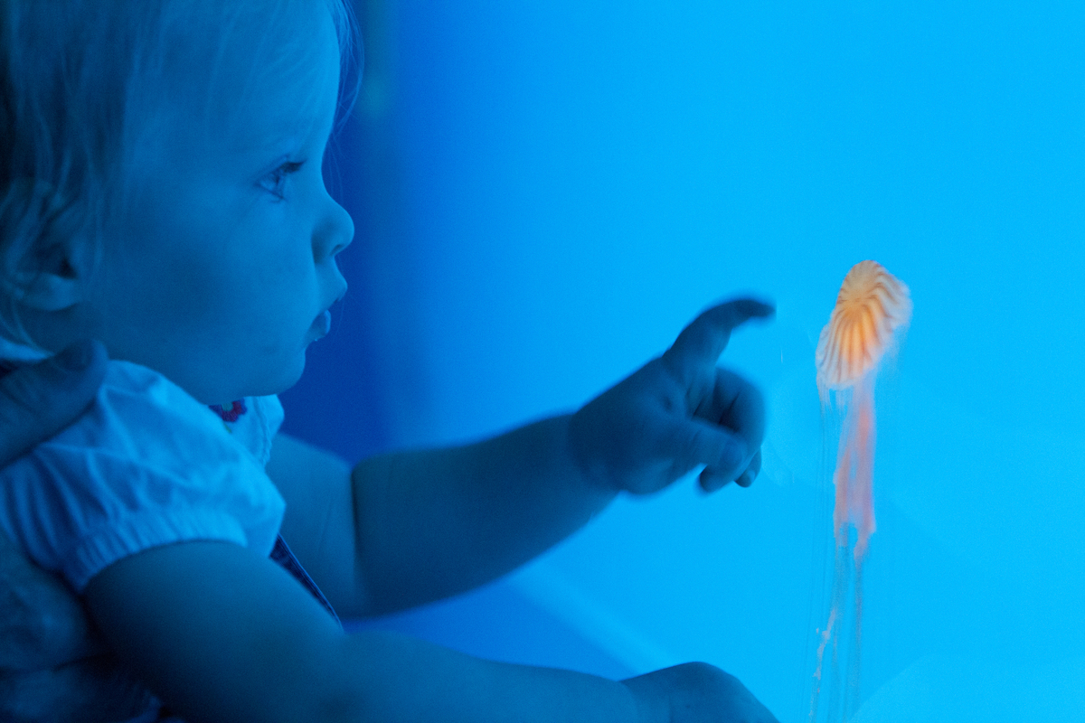
Thank you……………

