Slide 1
Unit: VI Current Contour
Recent Technological Innovations in Aquaculture
Program : M.Sc. Zoology
Semester : III
Course : Aquaculture Technology
Semester: III

Slide 2
Aquaponic Operation System
Aquaponic is the grouping of aquaculture (raising fish) and hydroponics (without soil growing plants),
They grows fish and plants together in one integrated system.
The fish waste provides good organic food source for the plants
The plants naturally filter the water for the fish
The nitrifying bacteria convert ammonia from the fish waste into nitrates, the plants can uptake & use to grow.
Fish solid waste convert into vermicompost that also good nutrition for plants

Slide 3
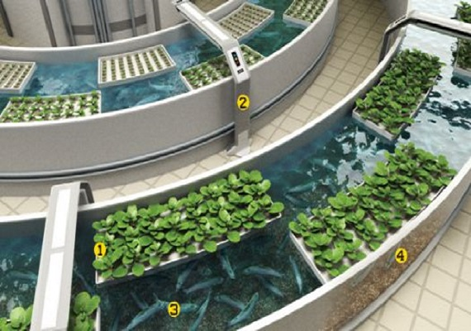
Aquaponic Operation System

Slide 4
Problem with Recirculating Aquaculture
Fish effluent giving off high amount of ammonia
Water should be discharge 10 to 20% daily
This uses a tremendous amount of water
In aquaponics, you will not discharge your water

Slide 5
Because unhealthy environment fish are prone to disease & aften treated with medicine including antibiotics
Fish disease very rare in aquaponics operation system
Higher costs, higher skill level, must provide all feed, buildup of toxins & pathogens
Advantages of recirculating system is environmental control, free of outside contaminants and fewer regulatory constraints

Slide 6
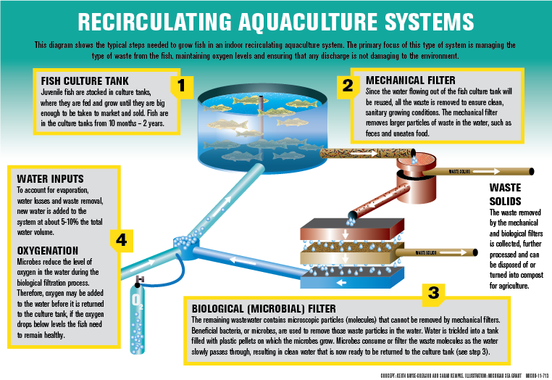
http://www.miseagrant.umich.edu/explore/fisheries/what-is-aquaculture/aquaculture-mi-diagram-750w/

Slide 7
Advantages of Aquaponics
Aquaponic gardening eliminates weeds, back strain and small animal access to your garden
They can relies on the recycling of nutrient rich water continuously
There is no toxic run-off from either hydroponics or aquaculture
Aquaponics uses only 1/10 of the water of soil based gardening and less water hydroponics recirculating aquaculture

Slide 8
No harmful petrochemicals, pesticides or herbicides can be used
It is a natural eco system
Aquaponics system can be put anywhere, use outside, green house, basement or in your living room

Slide 9
Deep Water Culture
The water from the fish tank is filtered mechanically and biologically to remove the solids from suspension
It can be converted to toxic ammonia to nitrate
This filtered water then travels down the length of a tank of water in which polystyrene rafts are floated

Slide 10
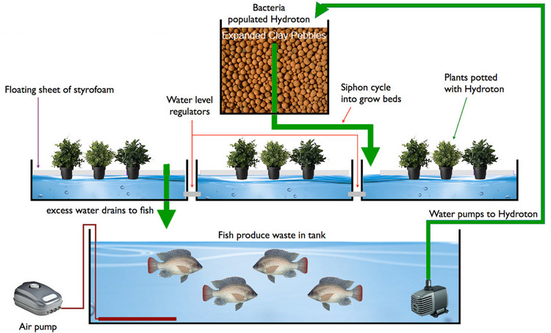

Slide 11
Media based aquaponics
Growing plants in inert planning media such as expanded clay pellets or shale
It can provides both biological filtration (conversion of ammonia to nitrates) and mechanical filtration (removal of solid wastes).
Media based system are great for home and hobby scale systems do you can grow a variety of crops.

Slide 12
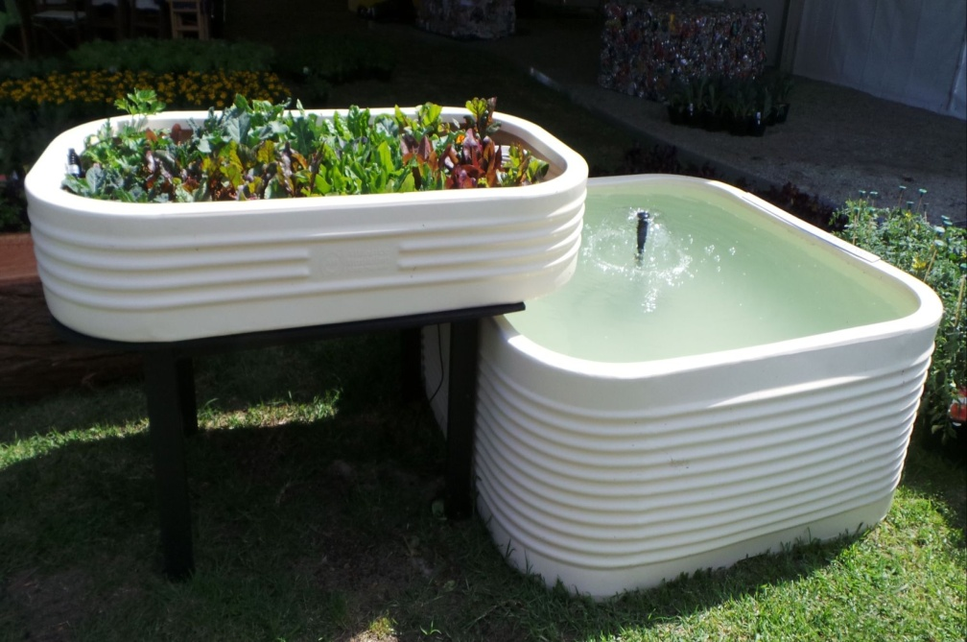
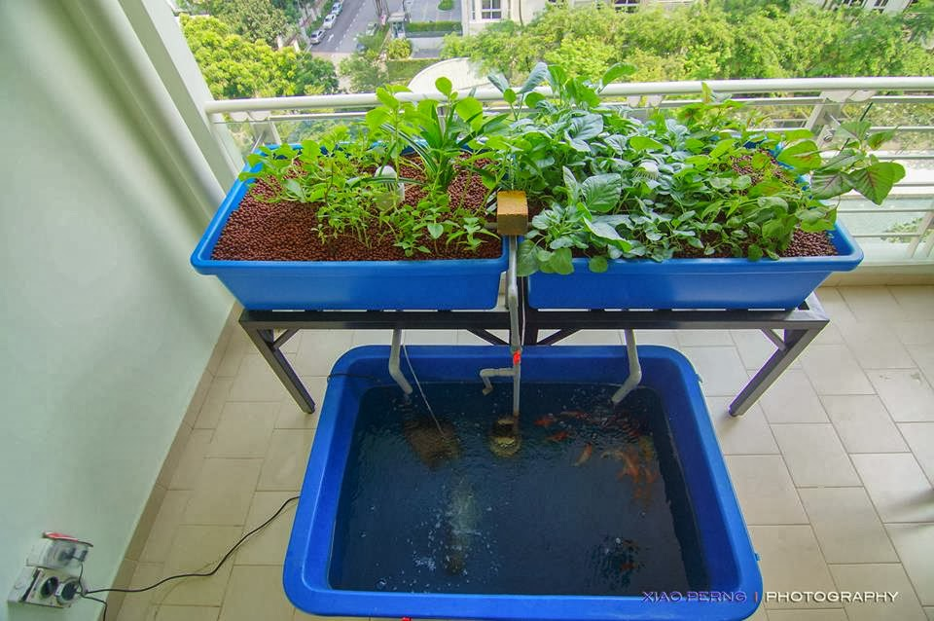

Slide 13
Nutrient film technique
NFT system works by flowing nutrient rich water through a narrow trough, such as PVC pipe
Plants are placed in holes drilled in this pipe & roots dangle freely in this stream of water

Slide 14
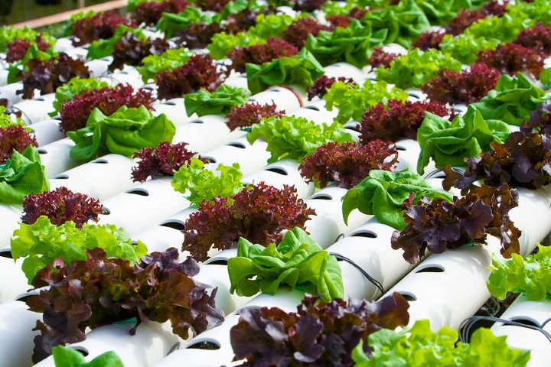
http://www.projectfeed1010.com/blog/2014/07/16/comparing-the-different-methods-of-aquaponics-growing/

Slide 15
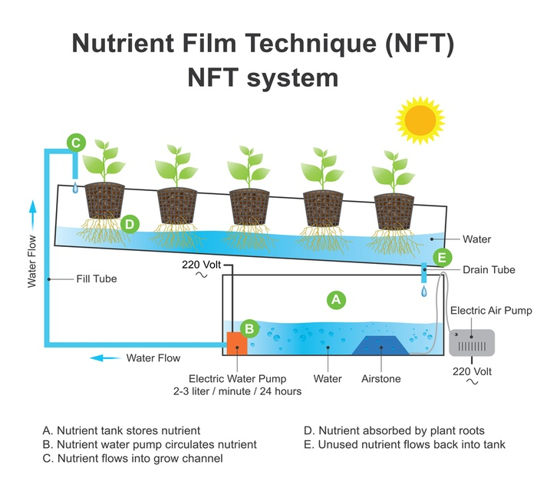
https://in.pinterest.com/pin/97531148166018351/?lp=true

Slide 16
Vertical aquaponics
One of the greatest aspects of aquaponics
It can be grow an very incredible amount of food in very small area
No method does not better than vertical aquaponics

Slide 17
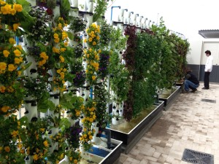
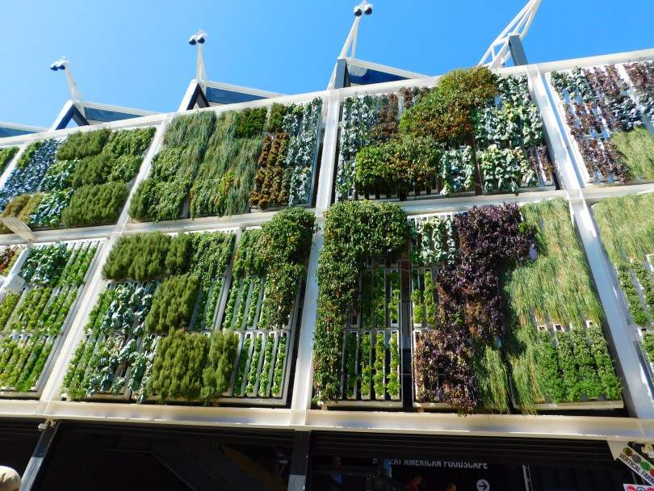

Slide 18
World offshore aquaculture development
Ocean farming facility is a new and innovative design
Challenges of more traditional inshore fish farming facility
It is located in deep water & it is suitable for water depths of 100 to 300 meters
This facility fully automated with normal operation requiring crew of just 3 to 4 people

Slide 19
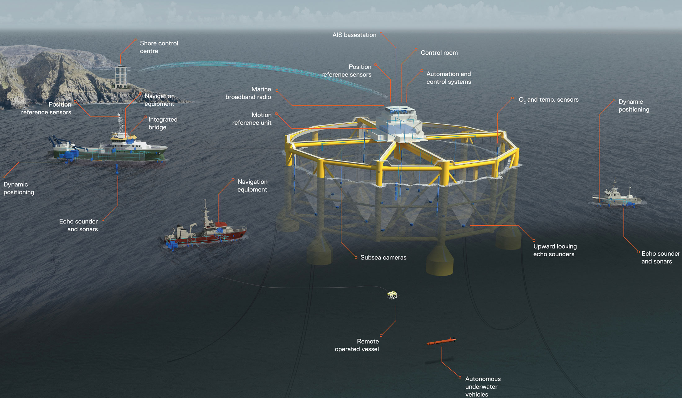
https://www.km.kongsberg.com/ks/web/nokbg0238.nsf/AllWeb/7C0B0102D79C3321C1257F8C00219350?OpenDocument

Slide 20
Questions?

