Slide 1
Aquatic Animal Diseases
Unit: IV Health Management
Program : M.Sc. Zoology
Semester: III
Course : Aquaculture Technology

Slide 2
FISH PATHALOGY
It enables the study of the disease and the disease causing pathogens in aquatic organisms which in turn provides us the knowledge about the disease and disorders caused in humans who feed on the sea food

Slide 3
NON SPECIFIC DEFENCE
It includes skin and scales, they secrete a mucus layer upon the epidermis they trap the microbes and inhibit their growth
If pathogen breeches the defense, fish develop inflammatory response that increase the flow of blood to infected areas and delivers WBCs to destroy the pathogen

Slide 4
SPECIFIC DEFENCE
It has specialized response to particular pathogens recognized by fish's body
Vaccines are used in aquaculture and ornamental fish
E.g. furunculosis in salmon

Slide 5
DISEASE
Fish carry pathogens and parasites
Fish mortality occurs
Viral, bacterial, fungal, protozoan infections occur

Slide 6
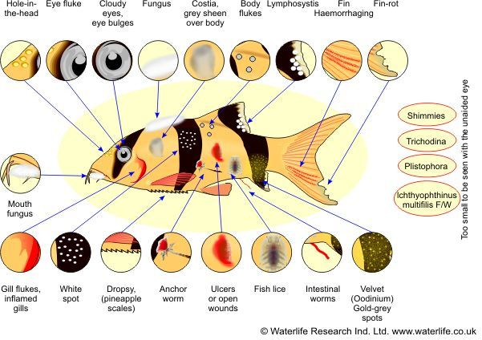

Slide 7
PARASITES
Causes disease or infection
Provides information about host population ecology
Few keep their host alive few kills their host
Parasites further divided into ectoparasite and endoparasite
Though parasites are harmful eradication of all parasites would not be beneficial
Accounts for half of life's diversity

Slide 8
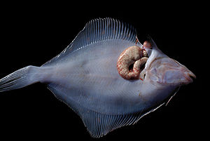
Contd….
Helps in transfer of genetic material
May facilitate evolutionary changes
Source: https://goo.gl/images/KwtaZp

Slide 9
FISH LEECH (Pisciola geometra)
Grows 20-30 mm
Feeds on blood of their victim
SYMPTOMS: 1. pale brown or white stripped patches on the body 2. stop feeding 3.sit on the bottom with their fins clamped 4. skin has a milky appearance due to increase in mucus secretion
TREATMENT: place the fish in 2% salt solution, remove the leech by forceps

Slide 10
GILL FLUKE AND SKIN FLUKE (Dactylogyrus & Gyrodactylus)
Flukes attached to the body eat the gill tissues, skin
SYMPTOMS: 1. gills move rapidly, fish gasp at the water surface 2. colors fades damaged area show mucus secretion 3. skin become red in color 4. fins become ragged 5. stops feeding
TREATMENT: formalin based medicines are used. Salt bath is used for individual fish

Slide 11
ANCHOR WORM (Lernae)
Grows up to 12 mm
SYMPTOMS: whitish green threads hang out of the fish skin, or ulcer at the point of attachment
TREATMENT: 1. water can be treated with insecticide 2. parasites removed manually 3. wounds treated with antiseptic

Slide 12
ITCH OR WHITE SPOT DISEASE (Ichthyophthirius multifiliis)
Protozoan parasite either free swimming or carried in with new fish or plants
Fish under stress from bad water conditions are more susceptible
SYMPTOMS: 1. Fish's skin and fins have tiny white spots 2. affected fish make rapid gill movement
TREATMENT: methylene blue based medicine used

Slide 13
FUNGAL INFECTION
Fungi are multicellular spore producing organisms live on other organisms or on dead matter
Fungal spores found often in aquarium water
Fish form protective mucus covering which prevent the fungal infection

Slide 14
Saprolegina diclina
Aquatic fungi affect poor health fish causes saproleginasis
SYMPTOMS: grey or white or brown cotton wool like growth on the skin or fins
TREATMENT: medicines containing malachite green are used

Slide 15
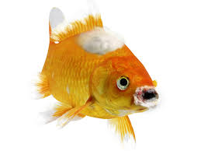
Source: https://goo.gl/images/mz2GeG

Slide 16
BACTERIAL INFECTION
Responsible for many fatal diseases
Affects the internal organs mainly which makes the infection severe
Antibiotics are used to treat the infections

Slide 17
ULCER AND HAEMORRHAGIC SEPTICEMIA
Number of different bacteria includes Aeromonas and Pseudomonas cause this disease
Transmitted from infected fish, or bad water conditions
SYMPTOMS: 1. open sore 2. ulcer 3. reddening of fin 4. color may change 5. loss of appetite
TREATMENT: antibiotics are used. If severe affected fish is separated and antiseptic is applied to the affected area

Slide 18
FIN ROT / MOUTH FUNGUS
Bacteria such as Pseudomonas and Aeromonas cause fin rot and flavobacterium cause mouth fungus
SYMPTOMS: 1. damaged split or ragged looking fins, 2. cotton wool like tufts around the mouth 3. loss of appetite 4. when chronic cause ulcer
TREATMENT: antibacterial medicines are used

Slide 19
VIRAL INFECTION
Microscopic organism
reproduces by inhabiting the host cells
use their genetic material in the host cells

Slide 20
Cyprinid herpes virus
SYMPTOMS: 1. white or grey spots formed 2. red and white patches in the gills are formed 3. sunken eyes 4. bleeding gills 5. pale patches occurs
TREATMENT: formalin is used

Slide 21
Spring viremia of carp
Caused by Rhabdovirus carpio
SYMPTOMS: 1. darkening of skin 2. pale gills 3. pop eyes 4. bleeding in gills, eyes, skin
TREATMENT: salt baths and formalin are used

Slide 22
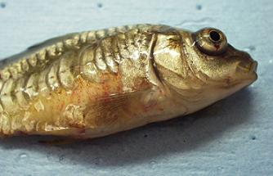
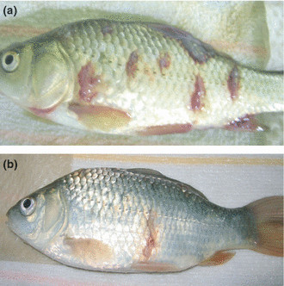
Source: https://goo.gl/images/RtyCtd

Slide 23
PREVENTION
Well fitted tank must be provided with suitable water conditions
Proper diet should be given
House only suitable species together make sure they are compatible not likely to eat each other
Select only healthy looking fish to add to the tank
Do not over stock

