Slide 1
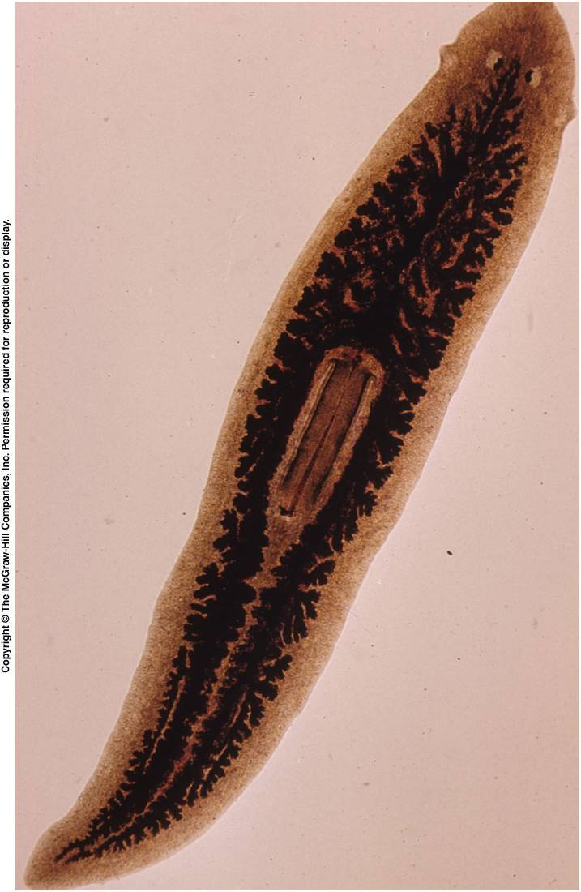
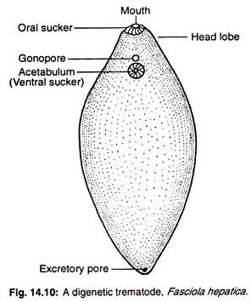
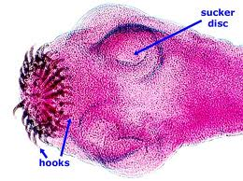
Phylum Platyhelminthes
Phylum: Platyhelminthes
Class : Turbellaria (Bipalium. Planaria )
: Termatoda (Fasciola, Opiathorchis ).
: Cestoda (Taenia solium, Echinococcus granulosus )

Slide 2
General characteristic of Platyhelminthes
Free-living (Turbellaria) and parasitic (Trematoda and Cestoda ) forms, a few may be commensals and soft bodied, unsegmented worms.
Bilateral symmetry and dorsiventrally flat worms
Three germinal layers i.e. ectoderm, mesoderm and endoderm.
Epidermis is soft - ciliated in Turbellaria. It is covered by cuticle in Trematoda and Cestoda worms.
Exo or Endo skeleton is completely absent.
The parasite has suckers or hooks or both for attachment to the host body.
They are the first animals to illustrate the development of organ system.
A true body cavity or coelome is absent (Acoelomate
Muscular system is well developed.
The alimentary canal is either absent or highly branched. Anus is absent.

Slide 3
Circulatory and respiratory systems are absent.
Excretory system consists of flame bulbs or flame cells or protonephridia connected to the excretory ducts.
Hermaphroditic; complex reproductive system
Asexual multiplication and alternation of regenerations are seen in some examples.
Nervous system and sense organs are poorly developed.
Usually hermaphrodite animals.
Fertilization is internal and development may be direct or indirect.

Slide 4
Parasitic Adaptations of Platyhelminthes
The profound changes and modifications occurring in per-suit of successful living so that the parasite is fully adapted inside the body of the host.
According to Cameron (1965), the parasites continue to lead their life successfully by adopting various modifications and compromises in some respects parallel to those found among free-living sessile animals and those which have adopted monophagy.”

Slide 5
Parasitic Adaptations of Platyhelminthes
Morphological Adaptations
Physiological Adaptations
I. Morphological Adaptations
  Transformation from external to internal
  Parasitism undoubtedly began as a chance of contact of one organism with another.
  Later the guest began to partake the food procured by the host, becoming more and more dependent on such food.
  So it was gradually changed from an ecto-to endo-parasite.

Slide 6
Parasitic Adaptations of Platyhelminthes
Two important aspects of parasitism:
The structural and functional modifications in parasites depend on the degree of parasitism.
In a successful parasitic group of animals the modifications run in two distinct directions—one leads to loss or degeneration while the other leads to gain or new attainment.

Slide 7
Parasitic Adaptations of Platyhelminthes
Degeneration
  The degeneration in helminthes particularly involves the locomotor, digestive and sensory organs.
  As the parasites live on the digested or semi-digested food of the host, their organs of locomotion and alimentation have become simplified.
  They are mostly useless.

Slide 8
Parasitic Adaptations of Platyhelminthes
(1) Organ of locomotion
Total reduction of locomotor organs is observed in adult except in the free-living larval phase when the ectoderm becomes ciliated, e.g., Miracidium and Hexacanth of flatworm.
(2) Organ of alimentation
Total disappearance in the adult tapeworm;
In the hermaphroditic adult trematode it consists of a blind gut;
In Redia stage it is further sim­plified and completely eliminated in the Sporocyst stage.
(3) Sensory organs:
The sensory organs are reduced or absent (e.g., Fasciola) in some endoparasitic platyhelminthes.
This condition can be correlated with the sedentary life of endoparasites in which they live, in a more or less uniform host’s environment.

Slide 9
Parasitic Adaptations of Platyhelminthes
New Attainment: ( 1 Integument, 2 Modification for attachment & 3 Modification for reproduction )
(1) Integument:
The integument covering the body of helminthes has become greatly modified to serve following three important functions:
(a) Absorption:
  The phenomenon of absorption is striking in larval stages.
  It develops in the lymph spaces of mollusca or in blood stream, muscle fibre or musculature of vertebrates.
  In the adult blood flukes in the hepatic portal system and in various species of liver flukes (e.g., Fasciola) in the bile tract.
  The body is leaf-shaped and dorsoventrally flattened.
  The entire integument becomes thin and undoubtedly serves partly or fully as a means for food absorption.

Slide 10
Parasitic Adaptations of Platyhelminthes
(b) Protection against the digestive juice of the host:
  In the case of the larval flukes which have to pass through stomach in order to reach the bile passage for further development.
  A cyst capsule is provided as a protection against the digestive juice.
  Certain Amphistomes and Gnathostomes (in cats, dogs and horses) remain attached to the stomach wall.
  They are provided with thick resistant integument impregnated with chitin-like substances of impermeable nature.

Slide 11
Parasitic Adaptations of Platyhelminthes
(c) Protection against abrasion:
Many trematodes living in the intestinal tracts are provided with spinous integument to guard against the abrasive action of the food and roughage passing through the gut.
These spines may be of accicular, dentate or placoid types and are rooted into the sub-integumental layer.
The oriental liver fluke Clonorchis sinensis, which was probably an intestinal parasite before it became a bile duct inhabitant, possesses a spinous integument during its larval phase

Slide 12
Parasitic Adaptations of Platyhelminthes
(2) Modification for attachment:
Essential prerequisite for parasitic life is the possession of suitable mechanism to attach strongly with host body.
(a) Acetabulum or sucking organ:
Found in all the adult flatworms which parasitise man:
  In the liver flukes it consists of two suckers on the ventral side of the body—one anterior and the other posterior to it.
  In the case of human tapewarm, it consists of either sucking tongue or groove, or four cups at the cephalic end of the worm.
  In the tapeworms, the scolex bears four large suckers (Taenia solium)

Slide 13
(b) Hooks:
In some tapeworms and nematodes, hooks are situated in or around the anterior end:
  In Taenia, hooks are arranged in double circlet at the base of rostellum.
  In the dog tapeworm, it occurs in several rows around the proboscis which may be everted.
  Hooks are often provided with series of teeth and are placed in the buccal capsule.
(c) Glands:
In some of the helminthes there have been developed in the vicinity of mouth, unicellular secretory glands which serve in:
  Anchorage in favourable habitat, and Aid in food supply.
  In trematodes these unicellular glands, known as cystogenous gland, are more common in the Cercarial stage and serve the purpose of penetration to host tissue by elaborating histolytic sub­stances.
  In hookworms (Ancylostoma)— there are glands in buccal region which are supposed to have anti-coagulative and histolytic properties.

Slide 14
Parasitic Adaptations of Platyhelminthes
II. Physiological Adaptations:
1. Intracellular digestion:
  Adult liver flukes, Fasciola hepatica feed on bile, blood, lymph and other nutrients of the host and digestion probably extracellular and takes place in the intestinal caeca.
  Reserve food is mostly in the form of glycogen and fat.
  They can take up glucose and other molecules through their body surfaces.
  The species in which nutrients are absorbed through the body surfaces, is regarded as the intracellular digestion.
  Cestodes lack any form of digestive canal, so they feed on tissue elements and inflammatory exudates of the hosts.
  All nutrients are absorbed across the tegument.
  So digestion is intracellular.

Slide 15
Parasitic Adaptations of Platyhelminthes
2. Osmoregulation:
  By the process of osmoregulation the endoparasitic helminthes maintain a relative constancy of balance of salts, ions and water in their tissues.
  Parasitic platyhelminthes such as cestodes and trematodes maintain the same osmotic pressure as that of their hosi, so there is no difficulty in maintaining life.

Slide 16
3. Anaerobic respiration:
The endoparasites live in an environment where there is more or less lack of O2.
So they have become adapted in a low metabolic rate which requires a minimum amount of oxygen.
In this case the respiration is anaerobic type consisting of extracting oxygen from food which are absorbed in the tegument.
In the absence of O2, energy releases by the fermentation of glycogen which is broken by glycolysis and form pyruvate or pyruvic acid as a hydrogen accep­tor from NAD and forms lactic acid and CO2.

Slide 17
Liver Fluke
Endoparasite in the bile duct of sheep/Man
Primary host: Vertebrate
Secondary host: Invertebrate-snail
The size varies from about 1.0 to 2.5 cm in length but the width does not generally exceed 1.0 cm.

Slide 18
Life cycle of Fasciola hepatica
The adult flukes are always oviparous and lay eggs with an operculum. In the egg the embryo develops into a pyriform (pear-shaped), ciliated larva called a
miracidium sporocyst
(in snails )
metacercaria cercariae Rediae
(on water plants)

Slide 19
