Slide 1
Stem cells
Semester: III
Subject code: 17zooc33
Department of Animal Science
Bharathidasan University
Trichy - 24

Slide 2
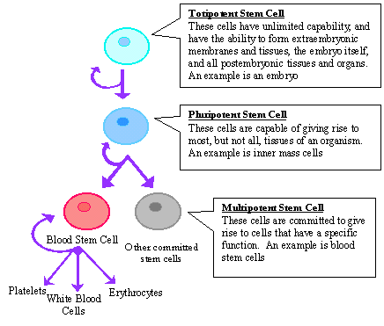
Stem Cell
A cell that has the ability to continuously divide and differentiate (develop) into various other kind(s) of cells/tissues.
They are Blank cells’ (unspecialized)
Capable of dividing and renewing themselves for long periods of time (proliferation and renewal)
Have the potential to give rise to specialized cell types (differentiation)

Slide 3
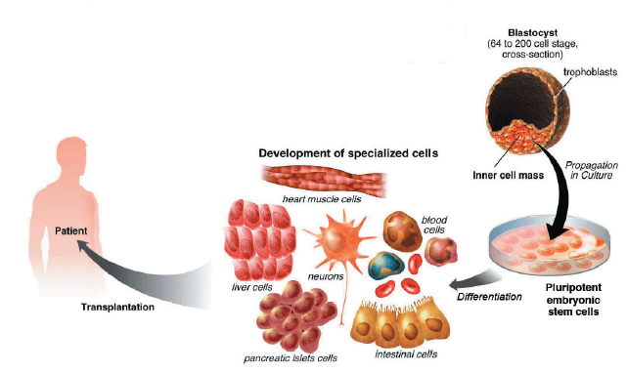

Slide 4
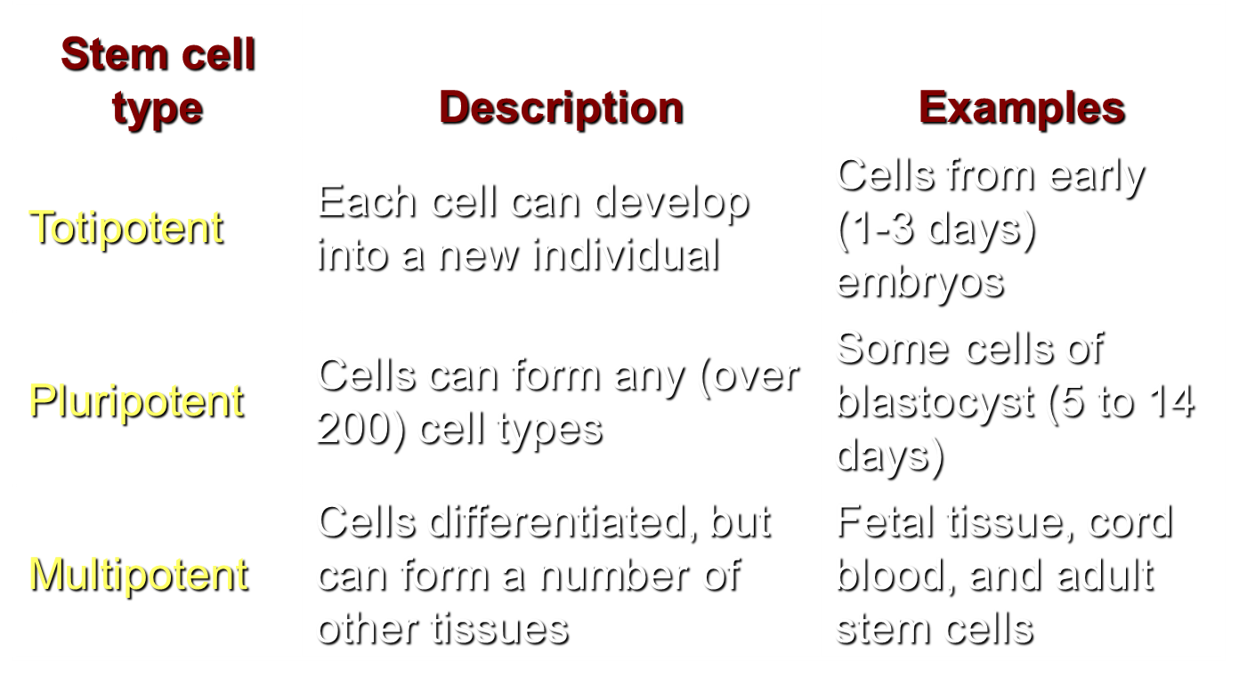
Kinds of Stem Cells

Slide 5
Types of stem cells
Embryonic stem cells come from a five to six-day-old embryo. They have the ability to form virtually any type of cell found in the human body.
Embryonic germ cells are derived from the part of a human embryo or foetus that will ultimately produce eggs or sperm (gametes).
Adult stem cells are undifferentiated cells found among specialised or differentiated cells in a tissue or organ after birth. Based on current research they appear to have a more restricted ability to produce different cell types and to self-renew.

Slide 6

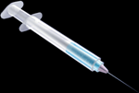
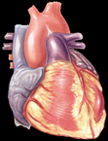
Derivation and Use of Embryonic Stem Cell Lines
Isolate inner cell mass
(destroys embryo)
Outer cells
(forms placenta)
Inner cells
(forms fetus)
Culture cells
Day 5-6
Blastocyst
“Special sauce” (largely unknown)
Heart
repaired
Kidney
Heart muscle
Notes:
The inner cell mass (the part that would form the fetus) of the embryo is isolated and disrupted to form embryonic cell lines. This process destroys the embryo. Under special culture conditions, the cells of the embryonic lines can be coaxed to form certain kinds of differentiated cell types. In theory, these differentiated cells could be used to repair or replace defective cells or tissues.

Slide 7
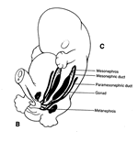
Embryonic stem cells

Slide 8
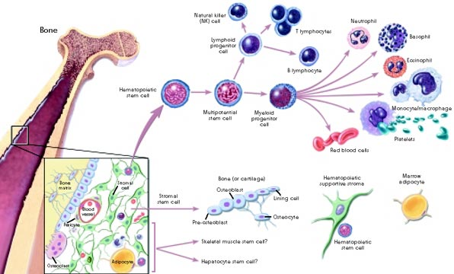
Adult stem cells

Slide 9
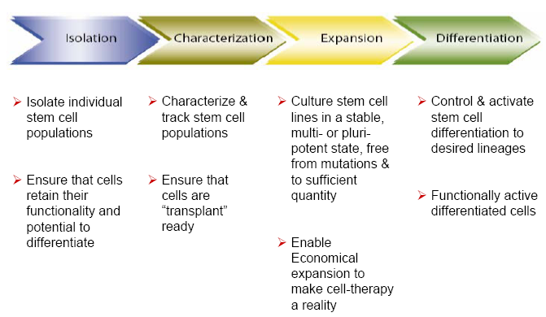

Slide 10
Characterization
At various points during the process of generating embryonic stem cell lines, scientists test the cells to see whether they exhibit the fundamental properties that make them embryonic stem cells.
These tests include;
growing and subculturing the stem cells for many months. This ensures that the cells are capable of long-term self-renewal.
Scientists inspect the cultures through a microscope to see that the cells look healthy and remain undifferentiated.
Using specific techniques to determine the presence of surface markers that are found only on undifferentiated cells.

Slide 11
Another important test is for the presence of a protein called Oct-4, which is typically made by undifferentiated cells. Oct-4 is a transcription factor, helps turn genes on and off at the right time, which is an important part of the processes of cell differentiation and embryonic development.
Examining the chromosomes under a microscope. This is a method to assess whether the chromosomes are damaged or if the number of chromosomes has changed.
However, microscopy examination of chromosomes, does not detect genetic mutations in the cells. Determining whether the cells can be subcultured after freezing, thawing, and replating.
Testing whether the human embryonic stem cells are pluripotent by;
allowing the cells to differentiate spontaneously in cell culture
manipulating the cells so they will differentiate to form specific cell types
injecting the cells into an immunosuppressed mouse to test for the formation of a benign tumor called a teratoma.
Teratomas typically contain a mixture of many differentiated or partly differentiated cell types
This is an indication that the embryonic stem cells are capable of differentiating into multiple cell types.

Slide 12
stem cells differentiation
As long as the embryonic stem cells in culture are grown under certain conditions, they can remain undifferentiated (unspecialized). But if cells are allowed to clump together to form embryoid bodies, they begin to differentiate spontaneously.
Although spontaneous differentiation is a good indication that a culture of embryonic stem cells is healthy, it is not an efficient way to produce cultures of specific cell types

Slide 13
Disease
Diabetes, Spinal cord injury, Parkinson’s disease, heart disease
Rheumatoid Artheristis
Applications
Genetic based Disease
Cystic fibrosis, Huntington’s
Leukemia and Cancer
Heart Disease
Tissue Repair
Heart tissue
Any other tissue in the body

Slide 14
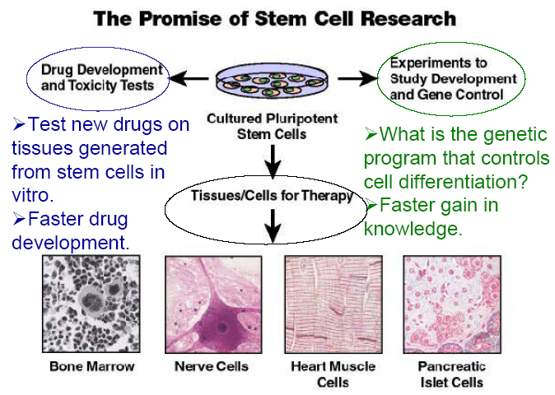

Slide 15


