Slide 1
Measurement of viability and cytotoxicity
Semester: III
Subject code: 17zooc33
Department of Animal Science
Bharathidasan University
Trichy - 24

Slide 2
MTT Assay
(3-(4, 5-dimethylthiazolyl-2)-2, 5 diphenyltetrazolium bromide) Methyl Thiazol Tetrazolium yellow tetrazole
This is a colorimetric assay that measures the reduction of yellow tetrazol by mitochondrial succinate dehydrogenase. The MTT enters the cells and passes into the mitochondria where it is reduced to an insoluble, coloured (dark purple) formazan crystal. The cells are then solubilized with an organic solvent and the released, solubilized formazan reagent is measured spectrophotometrically. Since reduction of MTT can only occur in metabolically active cells the level of activity is a measure of the viability of the cells.

Slide 3
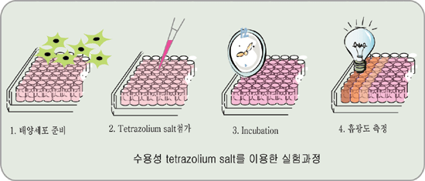

Slide 4
TRYPAN BLUE
Trypan blue is a diazo dye that has been widely used to color dead tissues or cells selectively.
The mechanism of trypan blue staining is based on it being negatively charged and not interacting with cells unless the membrane is damaged.
Undamaged cells are very selective concerning the compounds that pass through their membrane, and thus should not take up trypan blue. Therefore, all the cells that exclude the dye are considered viable.
By contrast, cells with damaged membranes are stained in a distinctive blue color readily observed under a microscope.
Thus, trypan blue dye is described as being a vital stain allowing discrimination between viable cells and cells with damaged membranes that are usually considered to be dead cells.
Since live cells are excluded from staining, this staining method is also described as a dye exclusion method.

Slide 5

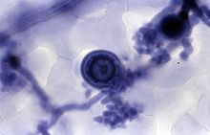
(3Z,3'Z)-3,3'-[(3,3'-dimethylbiphenyl-4,4'-diyl)di(1Z)hydrazin-2-yl-1-ylidene]bis(5-amino-4-oxo-3,4-dihydronaphthalene-2,7-disulfonic acid)

Slide 6
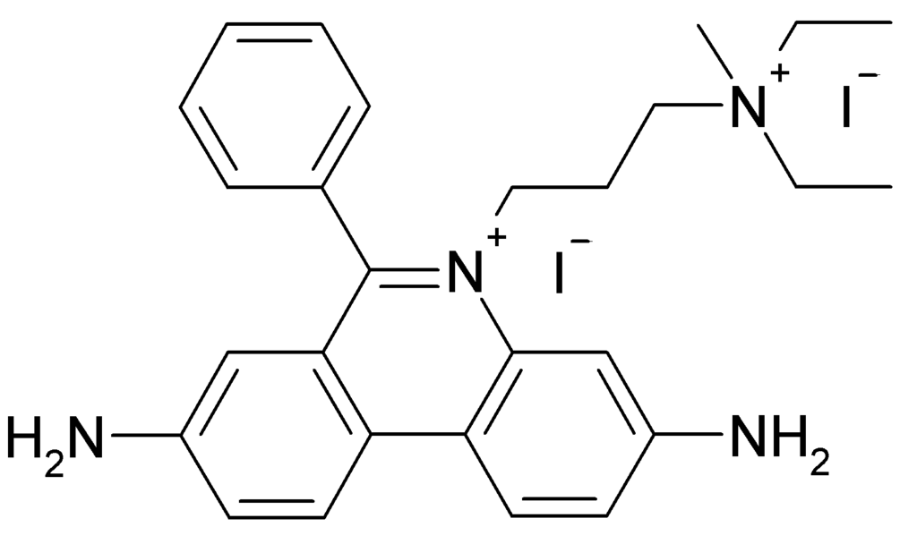
Propidium iodide staining
Propidium iodide (or PI) is a fluorescent intercalating agent that can be used to stain cells. Propidium iodide is used as a DNA stain in flow cytometry to evaluate cell viability or DNA content in cell cycle analysis, or in microscopy to visualise the nucleus and other DNA-containing organelles. Propidium Iodide cannot cross the membrane of live cells, making it useful to differentiate necrotic, apoptotic and healthy cells. PI also binds to RNA, necessitating treatment with nucleases to distinguish between RNA and DNA staining.

Slide 7
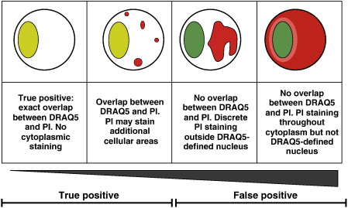
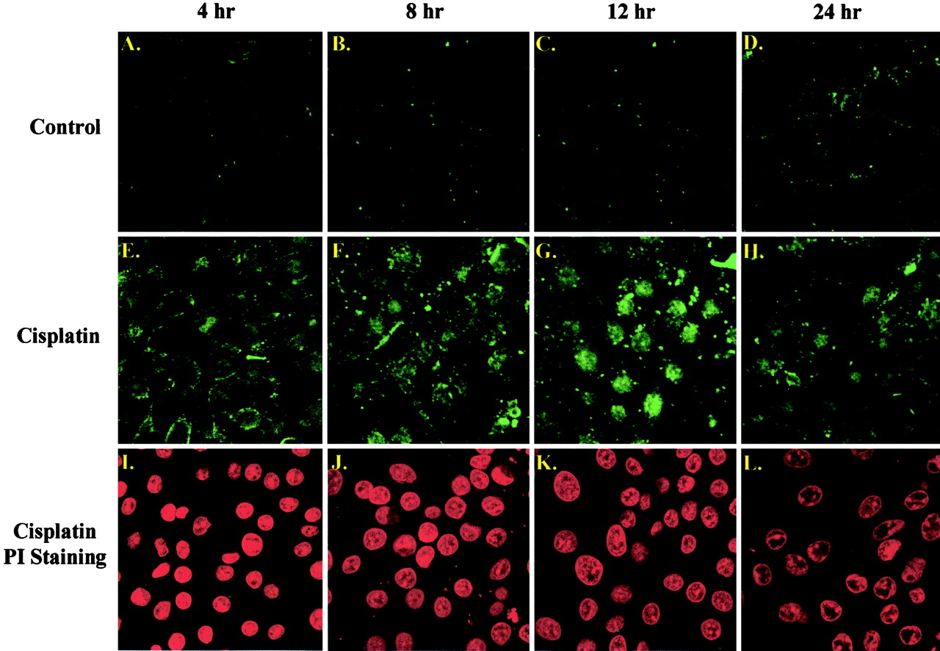

Slide 8
FDA Staining
Fluorescein diacetate (FDA) hydrolysis assays can be used to measure the enzyme activity of microbes in a sample. A bright yellow-green glow is produced and is strongest when enzymatic activity is greatest. This can be quantified using a spectrofluorometer.
It is also used in combination with propidium iodide (PI) to determine viability in eukaryotic cells. Living cells will actively convert the non-fluorescent FDA into the green fluorescent compound fluorescein, a sign of viability; while nucleus of membrane-compromised cells will fluoresce red, a sign of cell death. Currently FDA/PI staining is the standard assessment of human pancreatic islet viability with suitability for transplantation when viability score is above 70%.

Slide 9
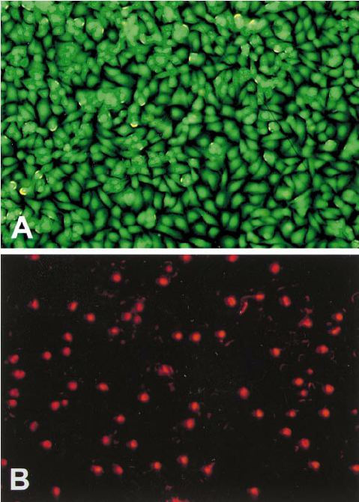
FDA staining of live cells
PI staining of PI cells

Slide 10
Cryopreservation of Cells
Passage cells
Why cryopreserve cells?
Reduced risk of microbial contamination.
Reduced risk of cross contamination with other cell lines.
Reduced risk of genetic drift and morphological changes.
Research conducted using cells at consistent low passage.
How?
Log phase of growth and >90% viability
Passage cells & pellet for media exchange
Cryopreservant (DMSO) – precise mechanism unknown but prevents ice crystal formation
Freeze at -80ºC – rapid yet ‘slow’ freezing
Liquid nitrogen -196ºC
Resuspend cells in serum
containing media
Centrifuge &
Aspirate supernatant
Resuspend cells in
10% DMSO in FCS
Transfer to cryovial
Freeze at -80ºC
Transfer to liquid
nitrogen storage tank

Slide 11
Freezing cells for storage
Remove the growth medium, wash the cells by PBS and remove the PBS by aspiration
Dislodge the cells by trypsin-versene
Dilute the cells with growth medium
Transfer the cell suspension to a 15 ml conical tube, centrifuge at 200g for 5 mts at RT and remove the growth medium by aspiration
Resuspend the cells in 1-2 ml of freezing medium
Transfer the cells to cryovials, incubate the cryovials at -80º C overnight
Next day transfer the cryovials to Liquid nitrogen

Slide 12
Working with cryopreserved cells
Vial from liquid nitrogen is placed into 37ºC water bath, agitate vial continuously until medium is thawed
Centrifuge the vial for 10 mts at 1000 rpm at RT, wipe top of vial with 70% ethanol and discard the supernatant
Resuspend the cell pellet in 1 ml of complete medium with 20% FBS and transfer to properly labeled culture plate containing the appropriate amount of medium
Check the cultures after 24 hrs to ensure that they are attached to the plate
Change medium as the colour changes, use 20% FBS until the cells are established

Slide 13
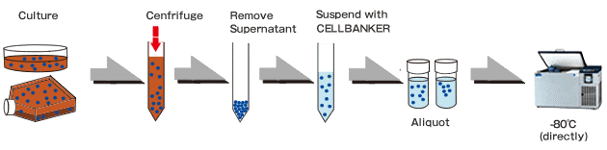
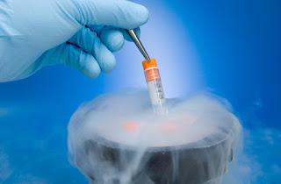
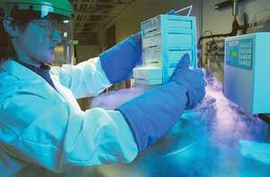

Slide 14
Contaminant’s of cell culture
Cell culture contaminants of two types
Chemical-difficult to detect caused by endotoxins, plasticizers, metal ions or traces of disinfectants that are invisible
Biological-cause visible effects on the culture they are mycoplasma, yeast, bacteria or fungus or also from cross-contamination of cells from other cell lines
Sources of Contamination
Exogenous: Metals (glassware), reagent residues (glassware), endotoxin (culture media, sera, and water), other water impurities, CO2 impurities, disinfectant residues, etc.
Endogenous: Free radicals (photo-activation of tryptophan, riboflavin, or HEPES buffer by fluorescent light)

Slide 15
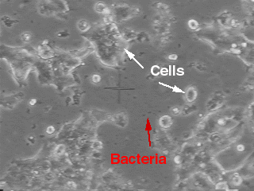
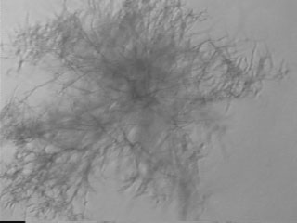
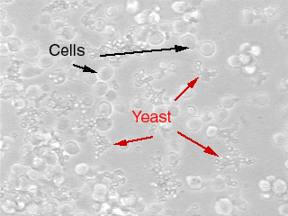
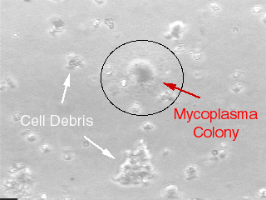
Effects of Biological Contamination’s
They competes for nutrients with host cells
Secreted acidic or alkaline by-products ceases the growth of the host cells
Degraded arginine & purine inhibits the synthesis of histone and nucleic acid
They also produces H2O2 which is directly toxic to cells
Microorganism contamination
and detection

Slide 16
Detection of contaminants
In general indicators of contamination are turbid culture media, change in growth rates, abnormally high pH, poor attachment, multi-nucleated cells, graining cellular appearance, vacuolization, inclusion bodies and cell lysis
Yeast, bacteria & fungi usually shows visible effect on the culture (changes in medium turbidity or pH)
Mycoplasma detected by direct DNA staining with intercalating fluorescent substances e.g. Hoechst 33258
Mycoplasma also detected by enzyme immunoassay by specific antisera or monoclonal abs or by PCR amplification of mycoplasmal RNA
The best and the oldest way to eliminate contamination is to discard the infected cell lines directly

Slide 17
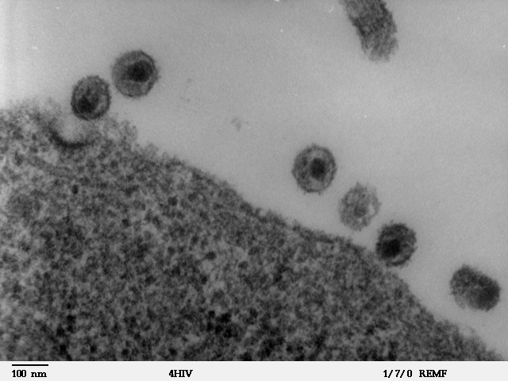
Microorganism contamination
and detection
Cells
Mycoplasma
Mycoplasma
Hoechst 33258 stain
Scanning electron microscopy
PCR-based detections for
mycoplasmas and viruses
HIV
Transmission electron microscopy

Slide 18
Monitoring and surveillance
Quarantine and test all incoming cell lines for contamination, except those from reliable sources.
Perform tests of microorganism contamination and cell-specific markers for all active cell lines and freeze aliquots of clean passages periodically.
Monitor the performance of biosafety cabinets.
Conduct annual safety training and refreshment courses (classroom or on-line) to all personnel.
Record and document all monitoring and surveillance items.
Discard and heat-destroy all contaminated cells because contamination alters cell behaviors and functions.
If cells are irreplaceable, antibiotics can be used to eradicate some bacteria and mycoplasmas. However, the experimental results need to be interpreted cautiously.

Slide 19
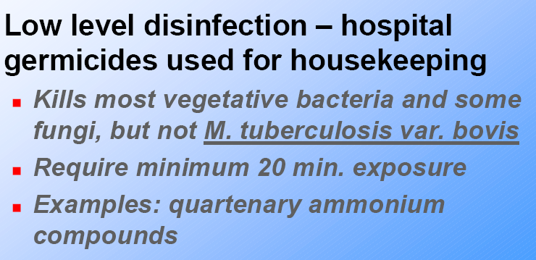
Types of disinfectants

