Slide 1
Cell Culture methods
Semester: III
Subject code: 17zooc33
Department of Animal Science
Bharathidasan University
Trichy - 24

Slide 2
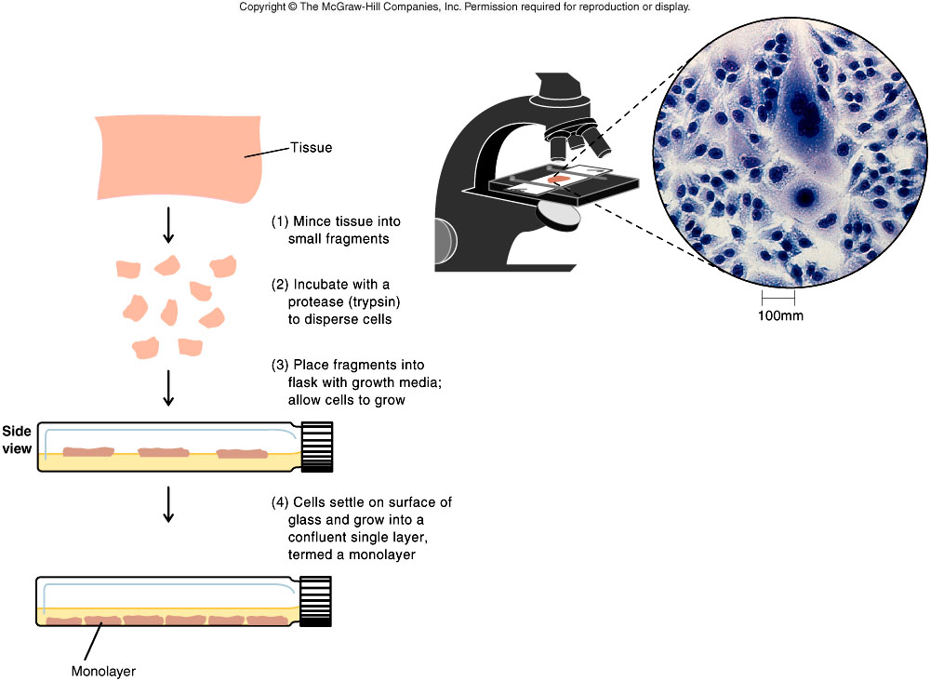
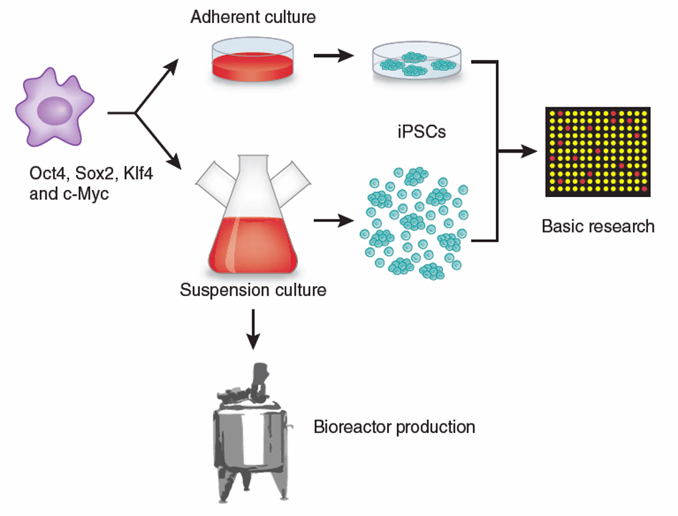
Forms of cell culture
Adherent culture
Non-adherent/Suspension culture

Slide 3
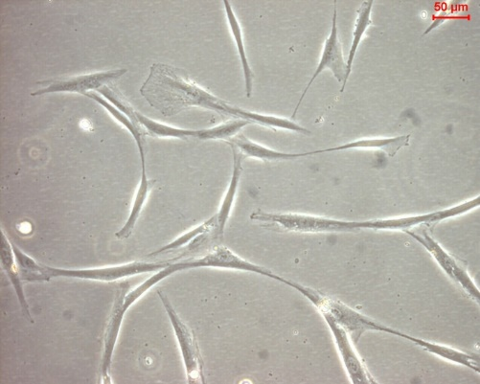
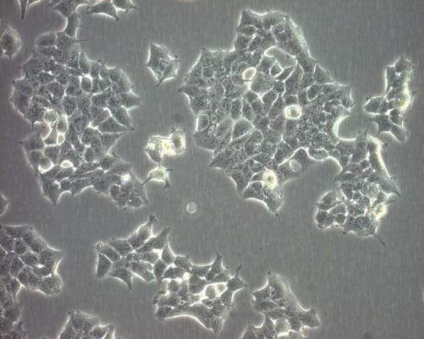
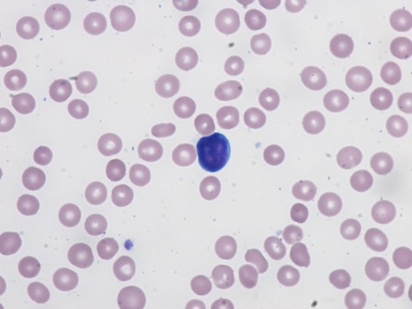
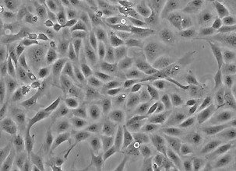
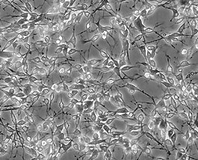
Types of cells
On the basis of morphology (shape & appearance) or on their functional characteristics.
• Epithelial like-attached to a substrate and appears flattened and polygonal in shape
• Lymphoblast like- cells do not attach remain in suspension with a spherical shape
• Fibroblast like- cells attached to an substrate appears elongated and bipolar
Fibroblastic
Epithelial
Lymphoblastic
Endothelial
Neuronal

Slide 4
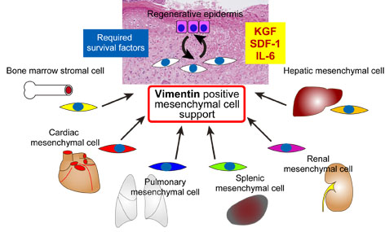
Primary cultures
Derived directly from animal tissue embryo or adult? Normal or neoplastic?
Cultured either as tissue explants or single cells
Initially heterogeneous – become overpopulated with fibroblasts
Finite life span in vitro
Retain differentiated phenotype
Mainly anchorage dependant
Exhibit contact inhibition

Slide 5
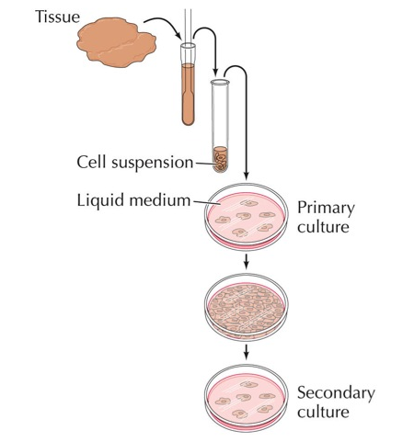
Secondary cultures
Derived from a primary cell culture
Isolated by selection or cloning
Becoming a more homogeneous cell population
Finite life span in vitro
Retain differentiated phenotype
Mainly anchorage dependant
Exhibit contact inhibition

Slide 6
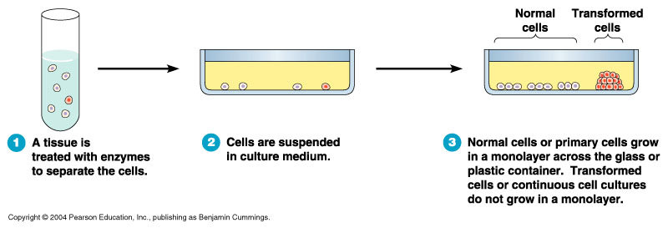
Continuous cultures
Immortalised:
Spontaneously (e.g.: spontaneous genetic mutation)
By transformation vectors (e.g.: viruses &/or plasmids)
Serially propagated in culture showing an increased growth rate
Homogeneous cell population
Loss of anchorage dependency and contact inhibition
Infinite life span in vitro
Differentiated phenotype:
Retained to some degree in cancer derived cell lines
Very little retained with transformed cell lines
Genetically unstable

Slide 7
Primary culture
Cells when surgically or enzymatically removed from an organism and placed in suitable culture environment will attach and grow are called as primary culture
Primary cells have a finite life span
Primary culture contains a very heterogeneous population of cells
Sub culturing of primary cells leads to the generation of cell lines
Cell lines have limited life span, they passage several times before they become senescent
Cells such as macrophages and neurons do not divide in vitro so can be used as primary cultures
Lineage of cells originating from the primary culture is called a cell strain

Slide 8
Cell lines
Most cell lines grow for a limited number of generations after which they ceases
Cell lines which either occur spontaneously or induced virally or chemically transformed into continuous cell lines
Characteristics of continuous cell lines
-smaller, more rounded, less adherent with a higher nucleus /cytoplasm ratio
-Fast growth and have aneuploidy chromosome number
-reduced serum and anchorage dependence and grow more in suspension conditions
-ability to grow unto higher cell density
-different in phenotypes from donor tissue
-stop expressing tissue specific genes

Slide 9
Sub culturing
Once the available substrate surface is covered by cells (a confluent culture) growth slows & ceases.
Cells to be kept in healthy & in growing state have to be sub-cultured or passaged
It’s the passage of cells when they reach to 80-90% confluency in flask/dishes/plates
Enzyme such as trypsin, dipase, collagenase in combination with EDTA breaks the cellular glue that attached the cells to the surface
Cells are cultured as anchorage dependent or independent
Cell lines derived from normal tissues are considered as anchorage-dependent grows only on a suitable substrate e.g. tissue cells
Suspension cells are anchorage-independent e.g. blood cells
Transformed cell lines either grows as monolayer or as suspension

Slide 10
Adherent cells
Suspension cells
Cells which are anchorage dependent
Cells are washed with PBS (free of ca & mg ) solution.
Add enough trypsin/EDTA to cover the monolayer
Incubate the plate at 37 C for 1-2 mts
Tap the vessel from the sides to dislodge the cells
Add complete medium to dissociate and dislodge the cells
with the help of pipette which are remained to be adherent
Add complete medium depends on the subculture
requirement either to 75 cm or 175 cm flask
Easier to passage as no need to detach them
As the suspension cells reach to confluency
Asceptically remove 1/3rd of medium
Replaced with the same amount of pre-warmed medium

Slide 11
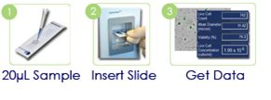

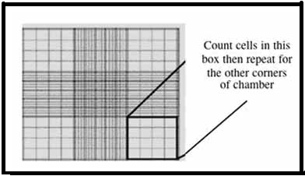
Automated cell count
CELL COUNTING
Manual cell count (Hemocytometer)
• View cell morphology, for visual confirmation after cell counting
• Take advantage of 300+ cell types and easy, wizard-based parameter set-up
• Save sample images with results securely on your computer, plus autosave results on the network for added convenience and data protection
Diagram represent cell count using hemocytometer.

Slide 12
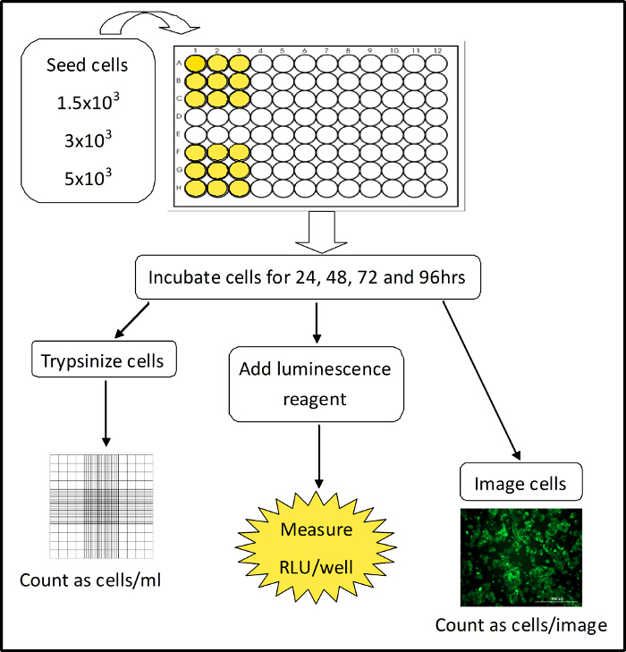
Cell toxicity
Measurement of cell death
Cytotoxicity causes inhibition of cell growth
Observed effect on the morphological alteration in the cell layer or cell shape
Characteristics of abnormal morphology is the giant cells, multinucleated cells, a granular bumpy appearance, vacuoles in the cytoplasm or nucleus
Cytotoxicity is determined by substituting materials such as medium, serum, supplements flasks etc. at a time.

Slide 13
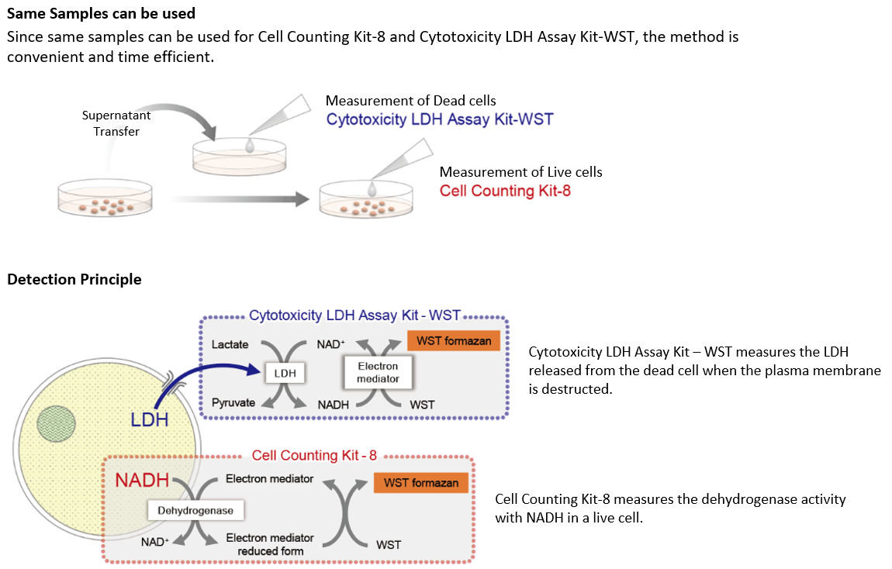

Slide 14
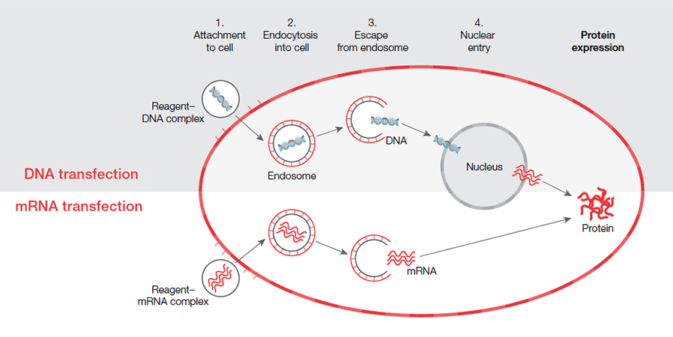
Transfection methods
Calcium phosphate precipitation
DEAE-dextran (dimethylaminoethyl-dextran)
Lipid mediated lipofection
Electroporation
Retroviral Infection
Microinjection

Slide 15
Cloning in cell culture
Due to the heterogeneous nature of animal organs, primary cell cultures potentially contain more than one type of cell. Interpretation of data arising from studies using these mixed cultures can lead to difficulties, because it may not be possible to ascertain which of the cell types present may have responded to a given treatment.
While a number of procedures have been used to enrich the cell population of interest, many scientists have resorted to cloning of cells in order to insure the purity of cell cultures.
Three major strategies have been used to produce clones, namely, the dilution technique, cloning ring technique, and robotic cell transfer.
Successful cloning is dependent on optimization of attachment substrata, basal media composition, serum source, and growth factor/hormone additions to support proliferation of the cell type at clonal (low) density.

Slide 16
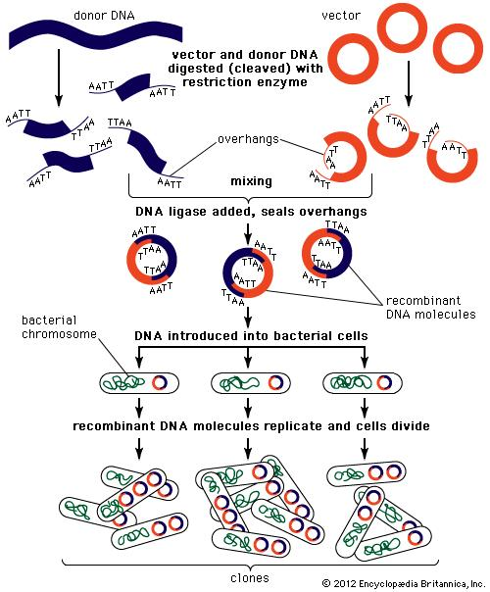

Slide 17
Apoptosis
Necrosis
Apoptosis is the process of Programmed cell death (PCD) that may occur in multi cellular organism.
Cell death initiated by a specific stimulus or as a result of several signals received from the external environment.
Apoptosis activates a series of biochemical changes in cell morphology which cause cell death.
Changes include cell blebbing, cell shrinkage, nuclear fragmentation, chromatin condensation, and chromosomal DNA fragmentation.
Apoptosis produces cell fragments called apoptotic bodies that phagocytic cells are able to engulf and quickly remove before the contents of the cell can spill out onto surrounding cells and cause cell damage.
Necrosis is a process of cell death by injury
Membrane blebbing & no loss of integrity.
Begins with shrinking of cytoplasm & mitochondria.
End with fragmentation of cell in to smaller bodies.
Affects individual cells.
Induced by non physiological stimuli like complement attack, lytic virus, hypothermia, hypoxia & ischemia. Phagocytosis by macrophages.
Significant inflammatory response.

Slide 18
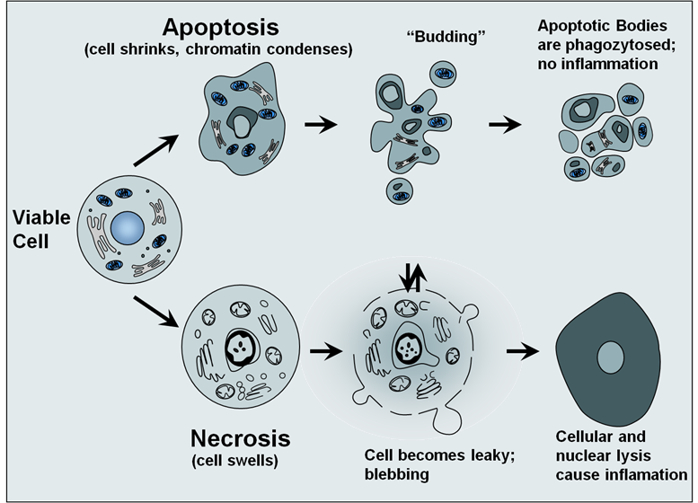

Slide 19
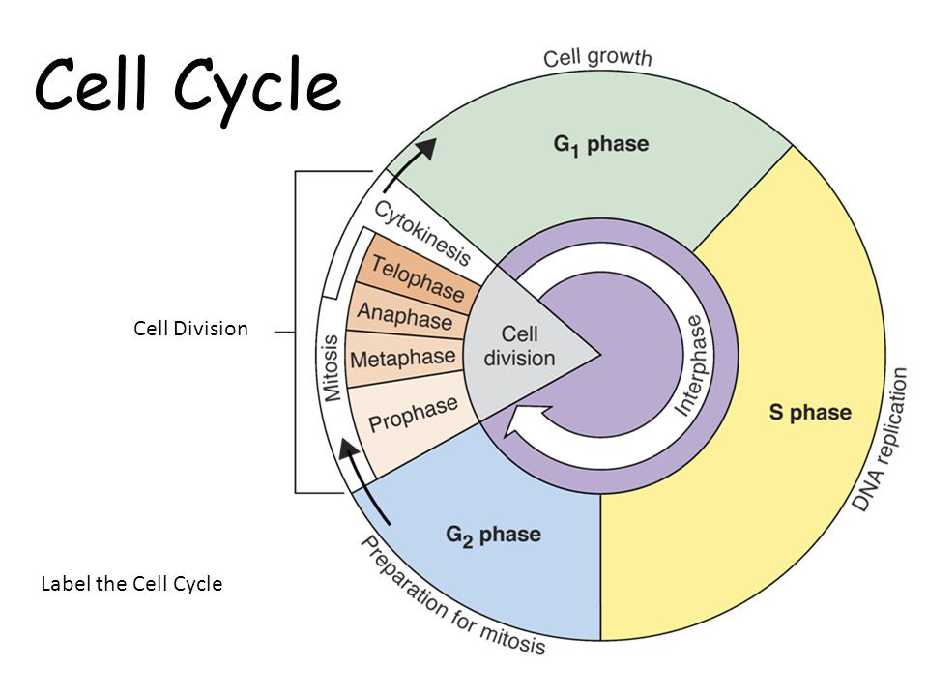

Slide 20
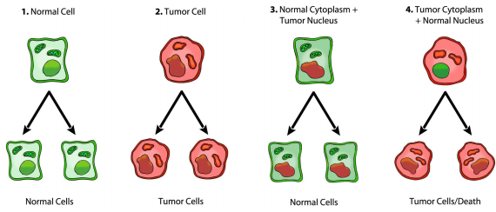
Culture of tumor cells
Tumor cells occupy the core position in tissue culture. Tumor cells are relatively easy to culture, and tumor cell lines are the most numerous in currently established cell types.
Besides, tumor is the biggest threat to human disease. As a result, tumor cell culture has become an indispensable technology in understanding the mechanism of cancer and developing anticancer drugs.
Tumor cells are significantly different from normal cells in vivo and in vitro, in terms of morphology, growth value, genetic traits and so on. The difference defined by two tumor cells cultured in vitro are fairly small but not exactly the same.

