Slide 1
Introduction to Animal Cell Culture
Semester: III
Subject code: 17zooc33
Department of Animal Science
Bharathidasan University
Trichy - 24

Slide 2
Animal tissue culture
In vitro cultivation of organs, tissues & cells at defined temperature using an incubator & supplemented with a medium containing cell nutrients & growth factors is collectively known as tissue culture
Different types of cell grown in culture includes connective tissue elements such as fibroblasts, skeletal tissue, cardiac, epithelial tissue (liver, breast, skin, kidney) and many different types of tumor cells.
Cell culture is the process by which cells are grown under controlled conditions, generally outside of their natural environment. In practice, the term "cell culture" now refers to the culturing of cells derived from multi-cellular eukaryotes, especially animal cells.
Categories of tissue culture
organ culture
explant culture
cell culture.

Slide 3
Background
1878: Claude Bernard proposed that physiological systems of an organism can be maintained in a living system after the death of an organism.
1885: Roux maintained embryonic chick cells in a saline culture.
1897: Loeb demonstrated the survival of cells isolated from blood and connective tissue in serum and plasma.
1903: Jolly observed cell division of salamander leucocytes in vitro.
1907: Harrison cultivated frog nerve cells in a lymph clot held by the 'hanging drop' method and observed the growth of nerve fibers in vitro for several weeks. He was considered by some as the father of cell culture.
1910: Burrows succeeded in long term cultivation of chicken embryo cell in plasma clots. He made detailed observation of mitosis.
1911: Lewis and Lewis made the first liquid media consisted of sea water, serum, embryo extract, salts and peptones. They observed limited monolayer growth.
1913: Carrel introduced strict aseptic techniques so that cells could be cultured for long periods.

Slide 4
Cont..
1916: Rous and Jones introduced proteolytic enzyme trypsin for the subculture of adherent cells.
1923: Carrel and Baker developed 'Carrel' or T-flask as the first specifically designed cell culture vessel. They employed microscopic evaluation of cells in culture.
1940s: The use of the antibiotics penicillin and streptomycin in culture medium decreased the problem of contamination in cell culture.
1952: Gey established a continuous cell line from a human cervical carcinoma known as HeLa (Helen Lane) cells. Dulbecco developed plaque assay for animal viruses using confluent monolayers of cultured cells.
1955: Eagle studied the nutrient requirements of selected cells in culture and established the first widely used chemically defined medium.
1961: Hayflick and Moorhead isolated human fibroblasts (WI-38) and showed that they have a finite lifespan in culture.
1964: Littlefield introduced the HAT medium for cell selection.

Slide 5
Cont….
1965: Ham introduced the first serum-free medium which was able to support the growth of some cells.
1975: Kohler and Milstein produced the first hybridoma capable of secreting a monoclonal antibody.
1978: Sato established the basis for the development of serum-free media from cocktails of hormones and growth factors.
1982: Human insulin became the first recombinant protein to be licensed as a therapeutic agent.
1985: Human growth hormone produced from recombinant bacteria was accepted for therapeutic use.
1986: Lymphoblastoid γIFN licensed.
1989: Recombinant erythropoietin in trial.
1990: Recombinant products in clinical trial (HBsAG, factor VIII, HIVgp120, CD4, GM-CSF, EGF, mAbs, IL-2).

Slide 6
Advantages
Limitations
Easy and reliable
Extensive research options are available
A model system for any type of living organism
Cultures can be exposed to reagents e.g. radio-chemicals or drugs at defined concentrations
Finally it avoids the legal, moral and ethical problems of animal experimentation
Have to develop standardised techniques in order to maintain healthy reproducible cells for experiments
Takes time to learn aseptic technique
Quantity of material is limited
Dedifferentiation and selection can occur and many of the original cellular mechanisms can be lost

Slide 7
Applications of cell culture
Model systems: Studying basic cell biology, interactions between disease causing agents and cells, effects of drugs on cells, process and triggering of aging & nutritional studies
Toxicity testing: Study the effects of new drugs
Cancer research: Study the function of various chemicals, virus & radiation to convert normal cultured cells to cancerous cells
Virology: Cultivation of virus for vaccine production, also used to study there infectious cycle.
Genetic Engineering: Production of commercial proteins, large scale production of viruses for use in vaccine production e.g. polio, rabies, chicken pox, hepatitis B & measles
Gene therapy: Cells having a functional gene can be replaced to cells which are having non-functional gene

Slide 8
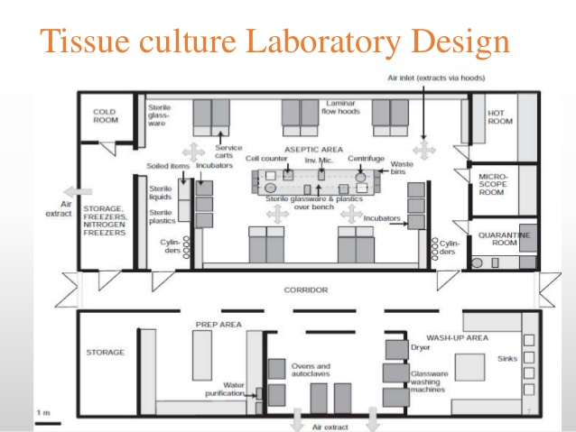

Slide 9
Equipment
Laminar cabinet-Vertical are preferable
Incubation facilities- Temperature of 25-30ºC for insect & 37ºC for mammalian cells, CO2 2-5% & 95% air at 99% relative humidity. To prevent cell death incubators set to cut out at approx. 38.5 C
Refrigerators- Liquid media kept at 4ºC, enzymes (e.g. trypsin) & media components (e.g. glutamine & serum) at -20ºC
Microscope- An inverted microscope with 10x to 100x magnification
Tissue culture ware- Culture plastic ware treated by polystyrene
Hot air oven – 50-70ºC Glass ware sterilization
Autoclave – Steam sterilization of consumables and cell culture wares

Slide 10
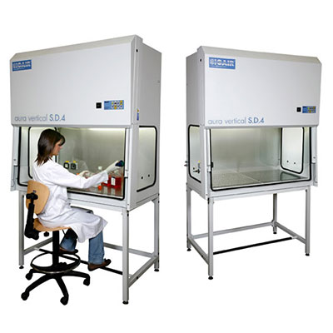
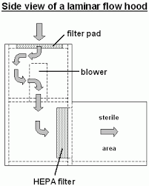

Slide 11
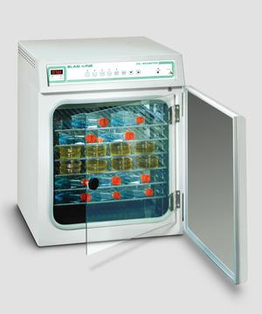
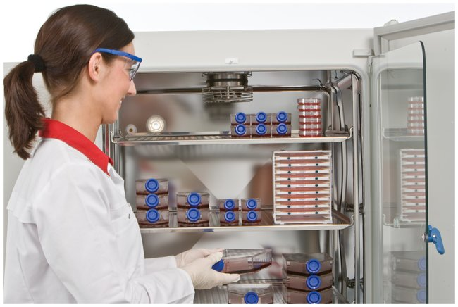
CO2 Incubator

Slide 12
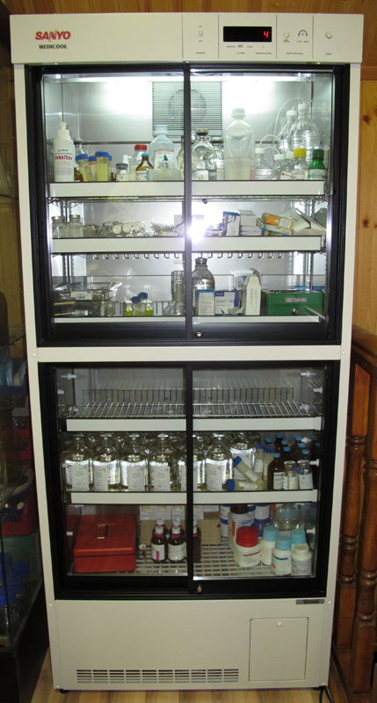
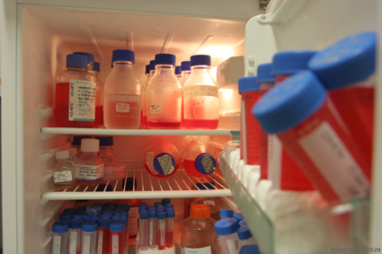
Refrigerator

Slide 13
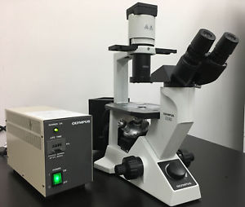
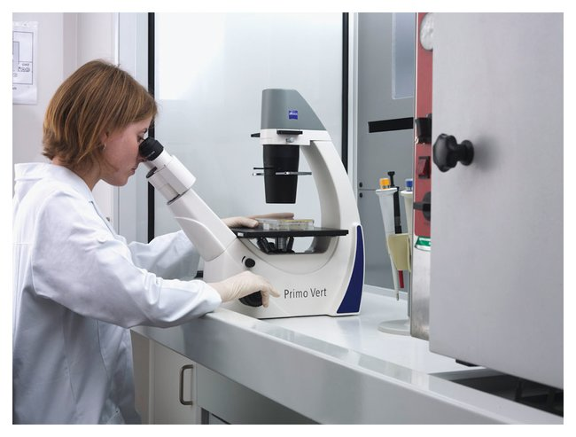
Inverted Microscope

Slide 14
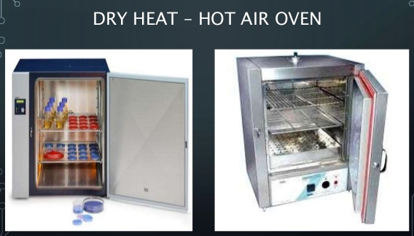

Slide 15
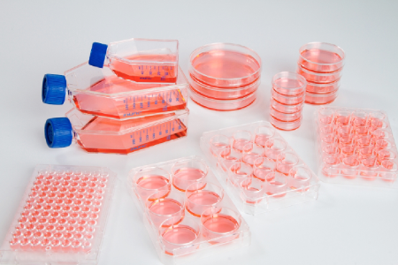
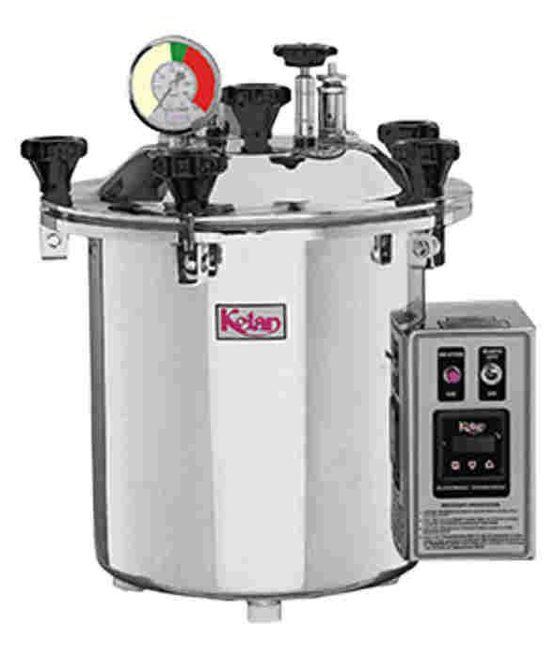
Autoclave
Cell culture wares

Slide 16
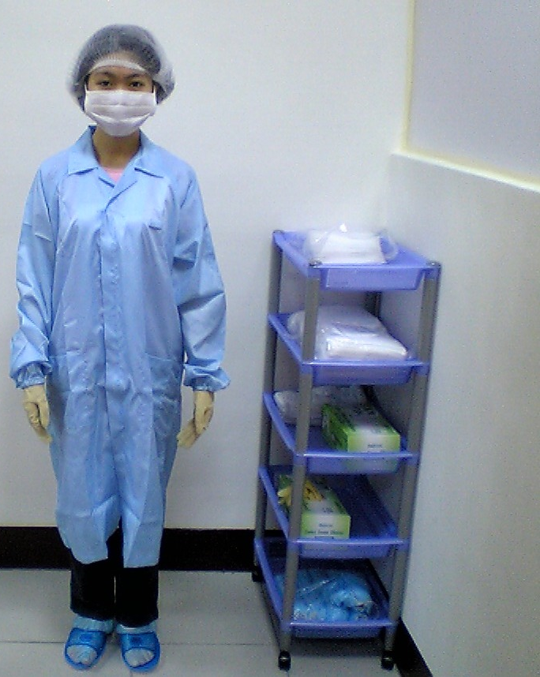
Basic aseptic conditions
If working on the bench use a Bunsen flame to heat the air surrounding the Bunsen
Swab all bottle tops & necks with 70% ethanol
Flame all bottle necks & pipette by passing very quickly through the hottest part of the flame
Avoiding placing caps & pipettes down on the bench; practice holding bottle tops with the little finger
Work either left to right or vice versa, so that all material goes to one side, once finished
Clean up spills immediately & always leave the work place neat & tidy

Slide 17
Safety aspect in cell culture
Possibly keep cultures free of antibiotics in order to be able to recognize the contamination
Never use the same media bottle for different cell lines. If caps are dropped or bottles touched unconditionally touched, replace them with new ones
Necks of glass bottles prefer heat at least for 60 secs at a temperature of 200ºC
Switch on the laminar flow cabinet 20 mts prior to start working
Cell cultures which are frequently used should be subcultered & stored as duplicate strains

Slide 18
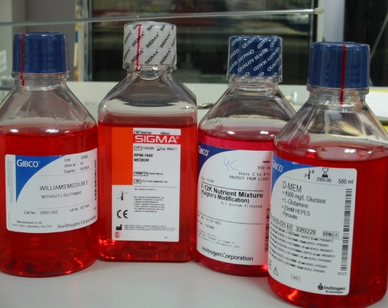
What do cells need to grow?
Substrate or liquid (cell culture flask or scaffold material)
chemically modified plastic or coated with ECM proteins
suspension culture
Nutrients (culture media)
Environment
CO₂, temperature 37ºC, humidity
Sterility
aseptic technique, antibiotics and antimycotics

Slide 19
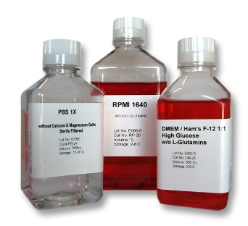
Basal Media
Maintain pH and osmolarity (260-320 mOsm/L).
Provide nutrients and energy source.
Components of Basal Media
Inorganic Salts
Maintain osmolarity
Regulate membrane potential (Na⁺, K⁺, Ca²⁺)
Ions for cell attachment and enzyme cofactors
pH Indicator – Phenol Red
Optimum cell growth approx. pH 7.4

Slide 20
Buffers (Bicarbonate and HEPES)
Bicarbonate buffered media requires CO₂ atmosphere
HEPES Strong chemical buffer range pH 7.2 – 7.6 (does not require CO₂)
Glucose
Energy Source
Components of Basal Media
Keto acids (oxalacetate and pyruvate)
Intermediate in Glycolysis/Krebs cycle
Keto acids added to the media as additional energy source
Maintain maximum cell metabolism

Slide 21
Carbohydrates
Energy source
Glucose and galactose
Low (1 g/L) and high (4.5 g/L) concentrations of sugars in basal media
Vitamins
Precursors for numerous co-factors
B group vitamins necessary for cell growth and proliferation
Common vitamins found in basal media is riboflavin, thiamine and biotin
Trace Elements
Zinc, copper, selenium and tricarboxylic acid intermediates

Slide 22
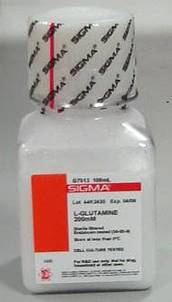
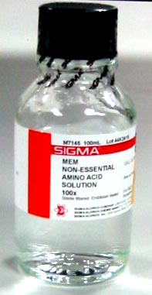
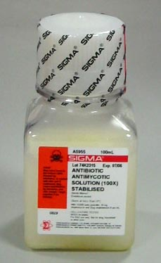
Supplements
L-glutamine
Essential amino acid (not synthesised by the cell)
Energy source (citric acid cycle), used in protein synthesis
Unstable in liquid media - added as a supplement
Non-essential amino acids (NEAA)
Usually added to basic media compositions
Energy source, used in protein synthesis
May reduce metabolic burden on cells
Growth Factors and Hormones (e.g.: insulin)
Stimulate glucose transport and utilisation
Uptake of amino acids
Maintenance of differentiation

Slide 23
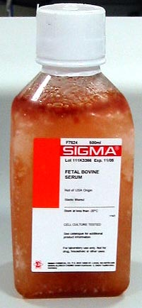
Antibiotics and Antimycotics
Penicillin, streptomycin, gentamicin, amphotericin B
Foetal Calf/Bovine Serum (FCS & FBS)
Growth factors and hormones
Aids cell attachment
Binds and neutralise toxins
Variable composition
Expensive
Heat Inactivation (56ºC for 30 mins)

Slide 24
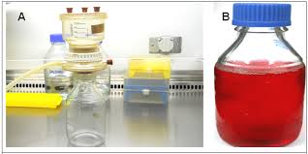
Media Preparation

