Slide 1
Thesis Writing: Steps and Strategies
By
M. Angkayarkan Vinayakaselvi
Department of English
Bharathidasan University
Tiruchirappalli- 620 024

Slide 2

Research
Research is an organized and systematic way of finding solutions to questions
A careful, serious, systematic investigation to find information

Slide 3
Types of Research
Qualitative Research
Quantitative Research

Slide 4
Qualitative: Provides insights and understating of the problem a hand
Methods:
Focus Group
Depth Interview
PhotoEthonography

Slide 5
Quantitative: Quantifies the data and generalizes the result from sample to sample population
Methods:
Telephone Surveys
Personal Interviewer
Web Survey
Hybrid method

Slide 6
Qualitative research
Meaning:
An inquiry conducted to develop insights on human behavior
To discover the way people think and feel
Deals with:
Feelings, attitudes, opinions and thoghs of human beings
Objective
To explore and discover ideas used in he ongoing processess
Sampling
Purposive
Research Type
Expository
Reasoning : Inductive
Data Collection(Verbal or narrative data
Approach: Subjective
Use:
Develop initial understanding

Slide 7
Quantitative research
Meaning:
An empirical research used to generate measurable date by employs statistical and logical techniques
Deals with
Hard facts and statistical data
Objective:
To examine cause and effect relationship between variables
Sampling:
Random
Research Type:
Conclusive
Reasoning :
deductive
Data Collection :
Numerical Data
Approach
Objective
Use
Recommends final course of action

Slide 8
Purpose of Research
To discover new facts about known phenomena
To improve and develop writing skill
To discover new techniques in writing
To satisfy researcher’s curiosity through collected information
To expand/verify existing knowledge

Slide 9
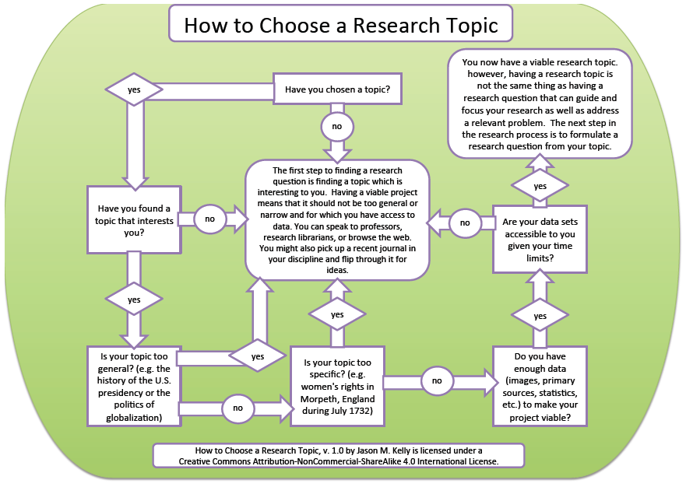

Slide 10
Finding and Limiting Topic

Slide 11
It should fulfill your research
It should create more interest
It should teach you something
It should have scope
It should evoke your thoughts and ideas

Slide 12
It should have enough information
It should be suitable for the readers
It should not be too broad
It should not be irrelevant
It should have more than one source
It should be new and popular

Slide 13
What do you propose to do?
Topic
Aim
Objectives
Literature review
Research definition
Research design
Hypothesis
Methodology
Thesis Statement
Research Ethics

Slide 14
Data Collection
Sample
Data Collection Procedure

Slide 15


Sources for conducting research

Slide 16
Library
Card Catalogue
Call number
Author’s name (surname/DOB/DOD?)
Title of the book(author’s name as it appears in the title page, PI)

Slide 17
Library
How many pages/how large a volume, illustrations, maps, charts
Subject heading
Analysis of the content
Library of Congress call number/Dewey Decimal classification

Slide 18
Periodical Indexes
Encyclopedia
Dictionaries
Biographical Dictionaries
Yearbooks
Atlases

Slide 19
Encyclopedia
Presents objective and authoritative articles on as many topics of general interest as possible
Refer the latest (or decide it based on your purpose)

Slide 20
Dictionaries
Biographical Dictionaries
Dictionaries of specified period

Slide 21
Year Books
The Americana Annual
Facts on file
New International yearbook
World Almanac and Book of facts

Slide 22
Atlases
Encyclopedia Britannica World Atlas
Rand McNally International Atlas
The National Atlas
Google Earth

Slide 23
Evaluating sources
Trusting the sources?
Authority
Accuracy
Currency

Slide 24
Authority
Importance of the Subject
Originality and soundness of the argument
Accuracy of the fact
Currency of Research

Slide 25
Accuracy and verifiability
Author's knowledge of the subject
Clarifications could be made at any time

Slide 26
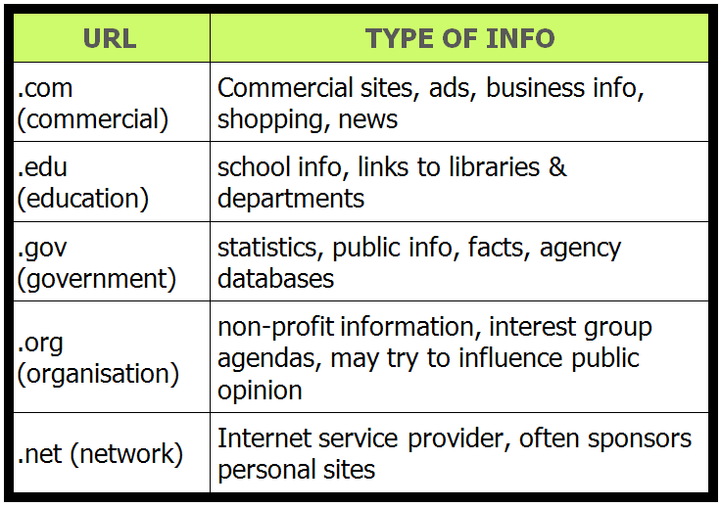
Publisher and Sponsoring Organization

Slide 27
Note making
Clear and concise
Key points
Summaries
Brief points
Linear notes
Sub-divisions indented

Slide 28
Outlining
An outline helps you to get an overall view of your paper
It figures out and relates each section of the paper
Continual revising of the working outline changes your thoughts and modifies your understanding of the subject

Slide 29
Create computer file for each version of an outline
E.g. outline 1 – outline 2
Print out each version and make out corrections

Slide 30
Inclusion of irrelevant points leads to loss of effectiveness
Include suitable ideas
Add related material together and points to the heading logically
Plan an effective introduction and a conclusion appropriate to the sequence you have worked out

Slide 31
Final Outline
After thesis statement you can create your final outline from the working outline
Submitting research project portfolio(thesis statement, final outline, early draft and final draft) to the instructor
Review all your notes
Delete irrelevant points

Slide 32
Labeling parts of an outline
A.
1.
a.
(1)
(a)
(b)
(2)
b.
2.
B.
II.

Slide 33
Types of outline
Topic outline
Short phrases
Sentence outline
Complete sentence

Slide 34
Thesis Statement
A single sentence that formulates both your topic and your point of view
An answer to the central question or problem you have raised
Do not forget to revise your thesis statement

Slide 35
Factors that shapes thesis statement

Slide 36
Purpose
Describe something
Audience
Someone likely to agree or disagree
Someone likely to be interested or uninterested in the subject
Explain something
Argue for a certain point of view
Persuades to think

Slide 37
Organizing principles

Slide 38
Chronology
Cause and effect (consequences)
Process
Deductive logic (general to specific)
Inductive logic (specific to general)

Slide 39
Methods of Development

Slide 40
To define, classify, or analyze something
To use descriptive details or give examples
To compare or contrast one thing with another
To argue for a certain point of view
Integrating quotations and sources

Slide 41
Writing Drafts
First draft
Subsequent drafts
Final draft

Slide 42
Writing with a word processor

Slide 43
Store first draft with a word processor
Create different file for each draft
After developing an outline, you can use it as the basis for your writing of the text
Create file for each major topic in your outline and copy it whenever you need it
Use split windows or multiple windows to read note files as you write the paper

Slide 44





PROFFREADING
Insert something; the text to be inserted will likely be provided in the margin
Delete
Close up space
Delete and close up
Add space

Slide 45






Transpose
Spell out
Make uppercase
Make lowercase
Let stand
Make equal space

Slide 46







Insert a comma
Insert period
Insert colon
Insert Semicolon
Insert hyphen
Insert en dash
Insert em dash

Slide 47










Slide 48
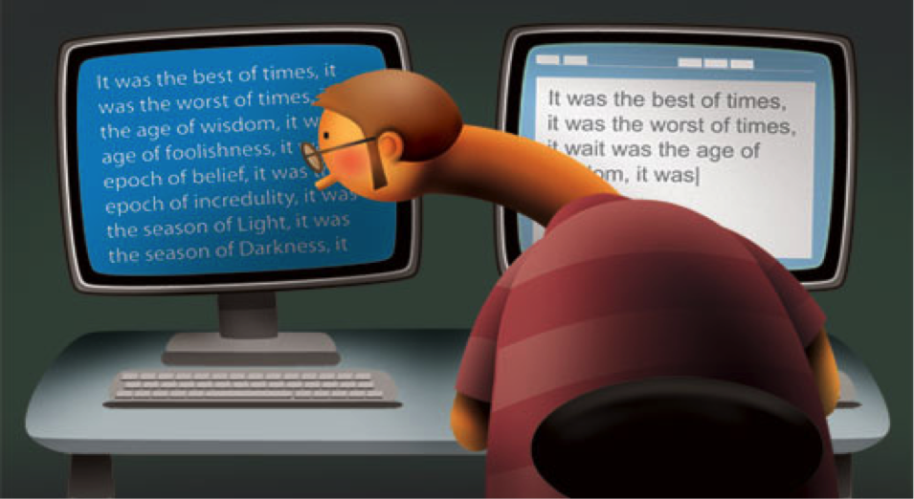
Plagiarism

Slide 49
Derived from the Latin word plagiarius (kidnapper)
To mean literary theft
Presenting another person’s ideas, information, expressions, or entire work as one’s own
A serious and an ethical offence

Slide 50
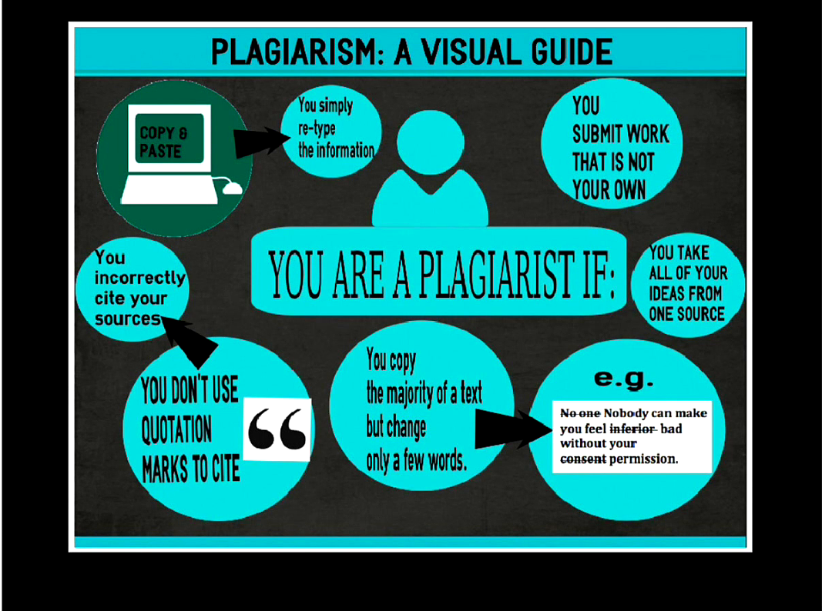

Slide 51
Types of Plagiarism
Intentional plagiarism
Unintentional plagiarism

Slide 52
Forms of Plagiarism

Slide 53
Repeating or paraphrasing wording
Taking particularly an apt phrase
Paraphrasing an argument or presenting a line of thinking
Reusing a research paper

Slide 54
Ways to avoid Plagiarism

Slide 55
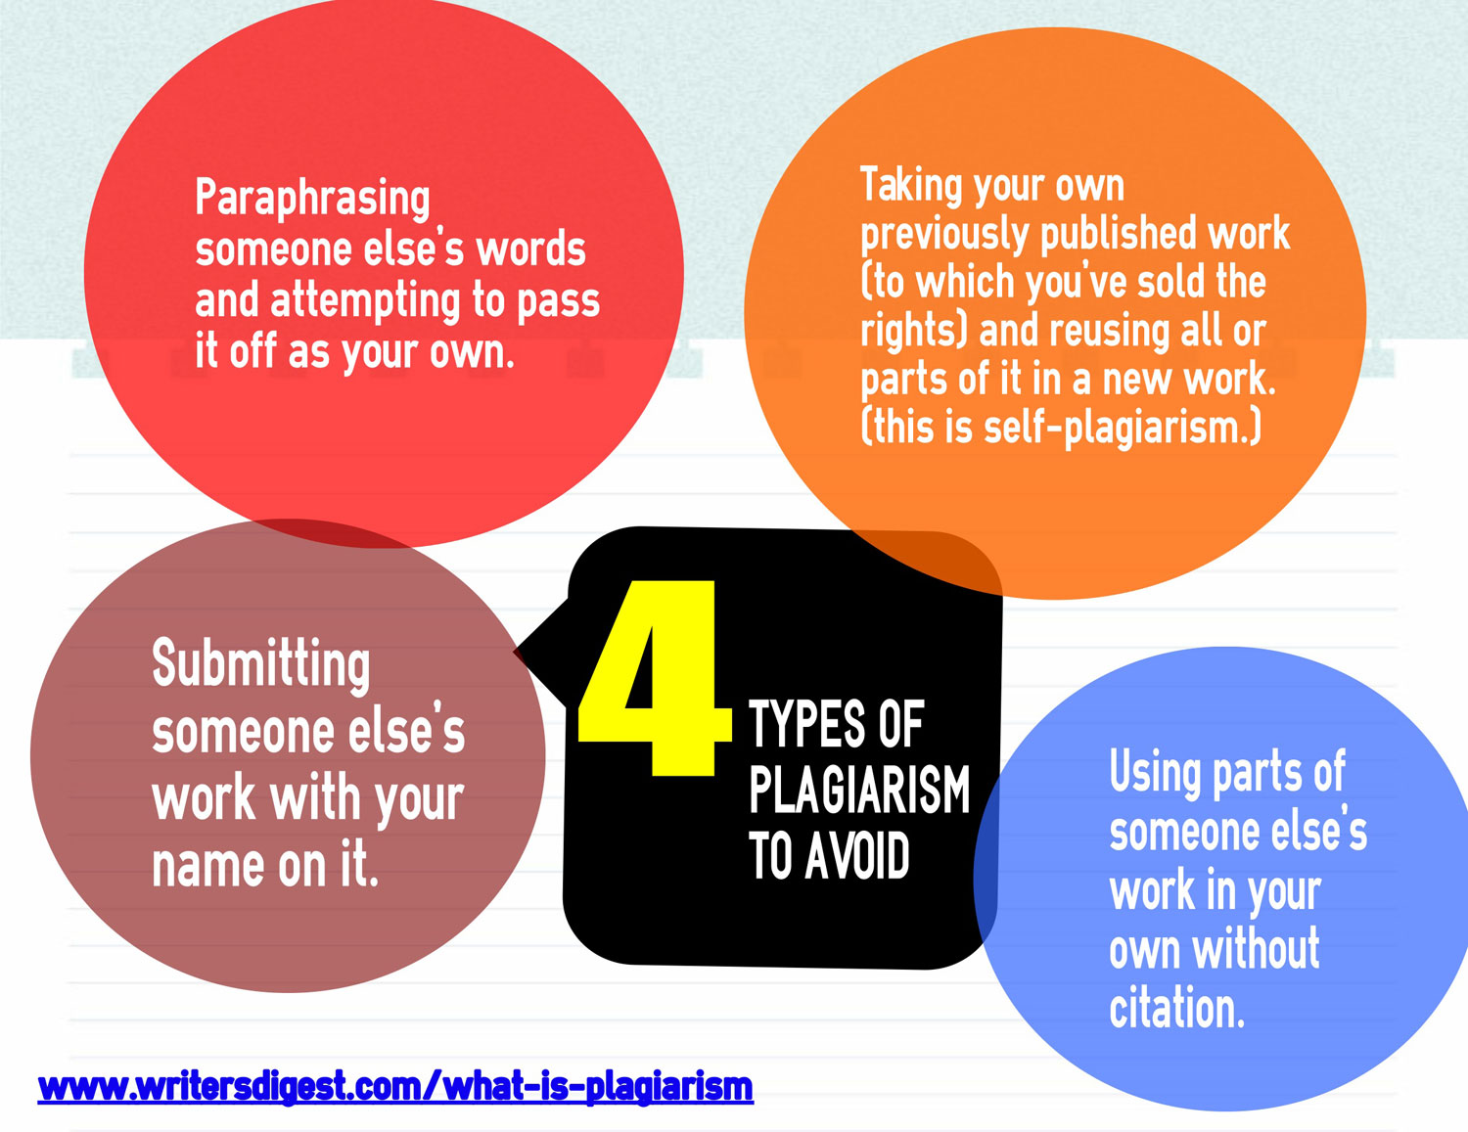

Slide 56
Keep a complete and thorough list of all the sources you discover during your research
Double check the source you have acknowledged
Know your borrowed material including quotes, facts, arguments etc.,
Keep notes and distinguish them as your ideas, summaries and exact word you copied

Slide 57
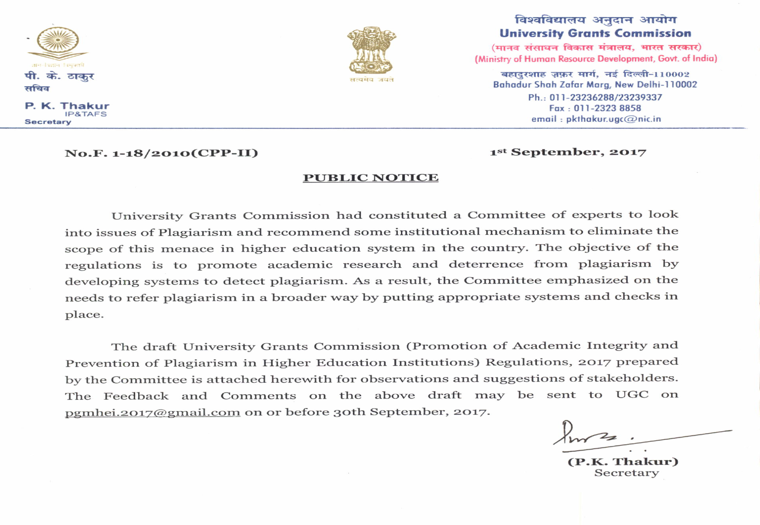
UGC

Slide 58
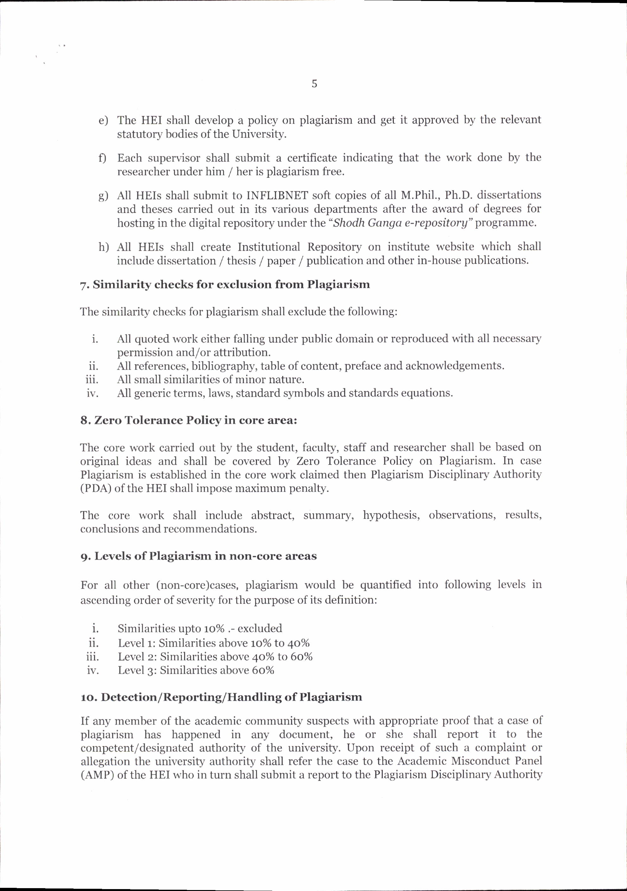

Slide 59
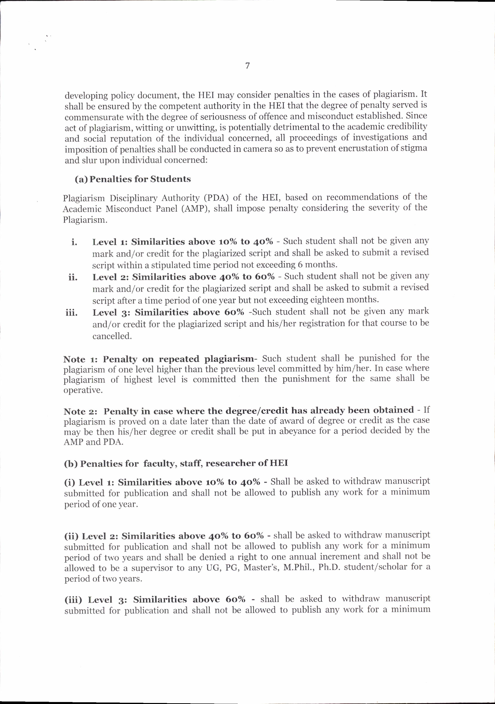

Slide 60
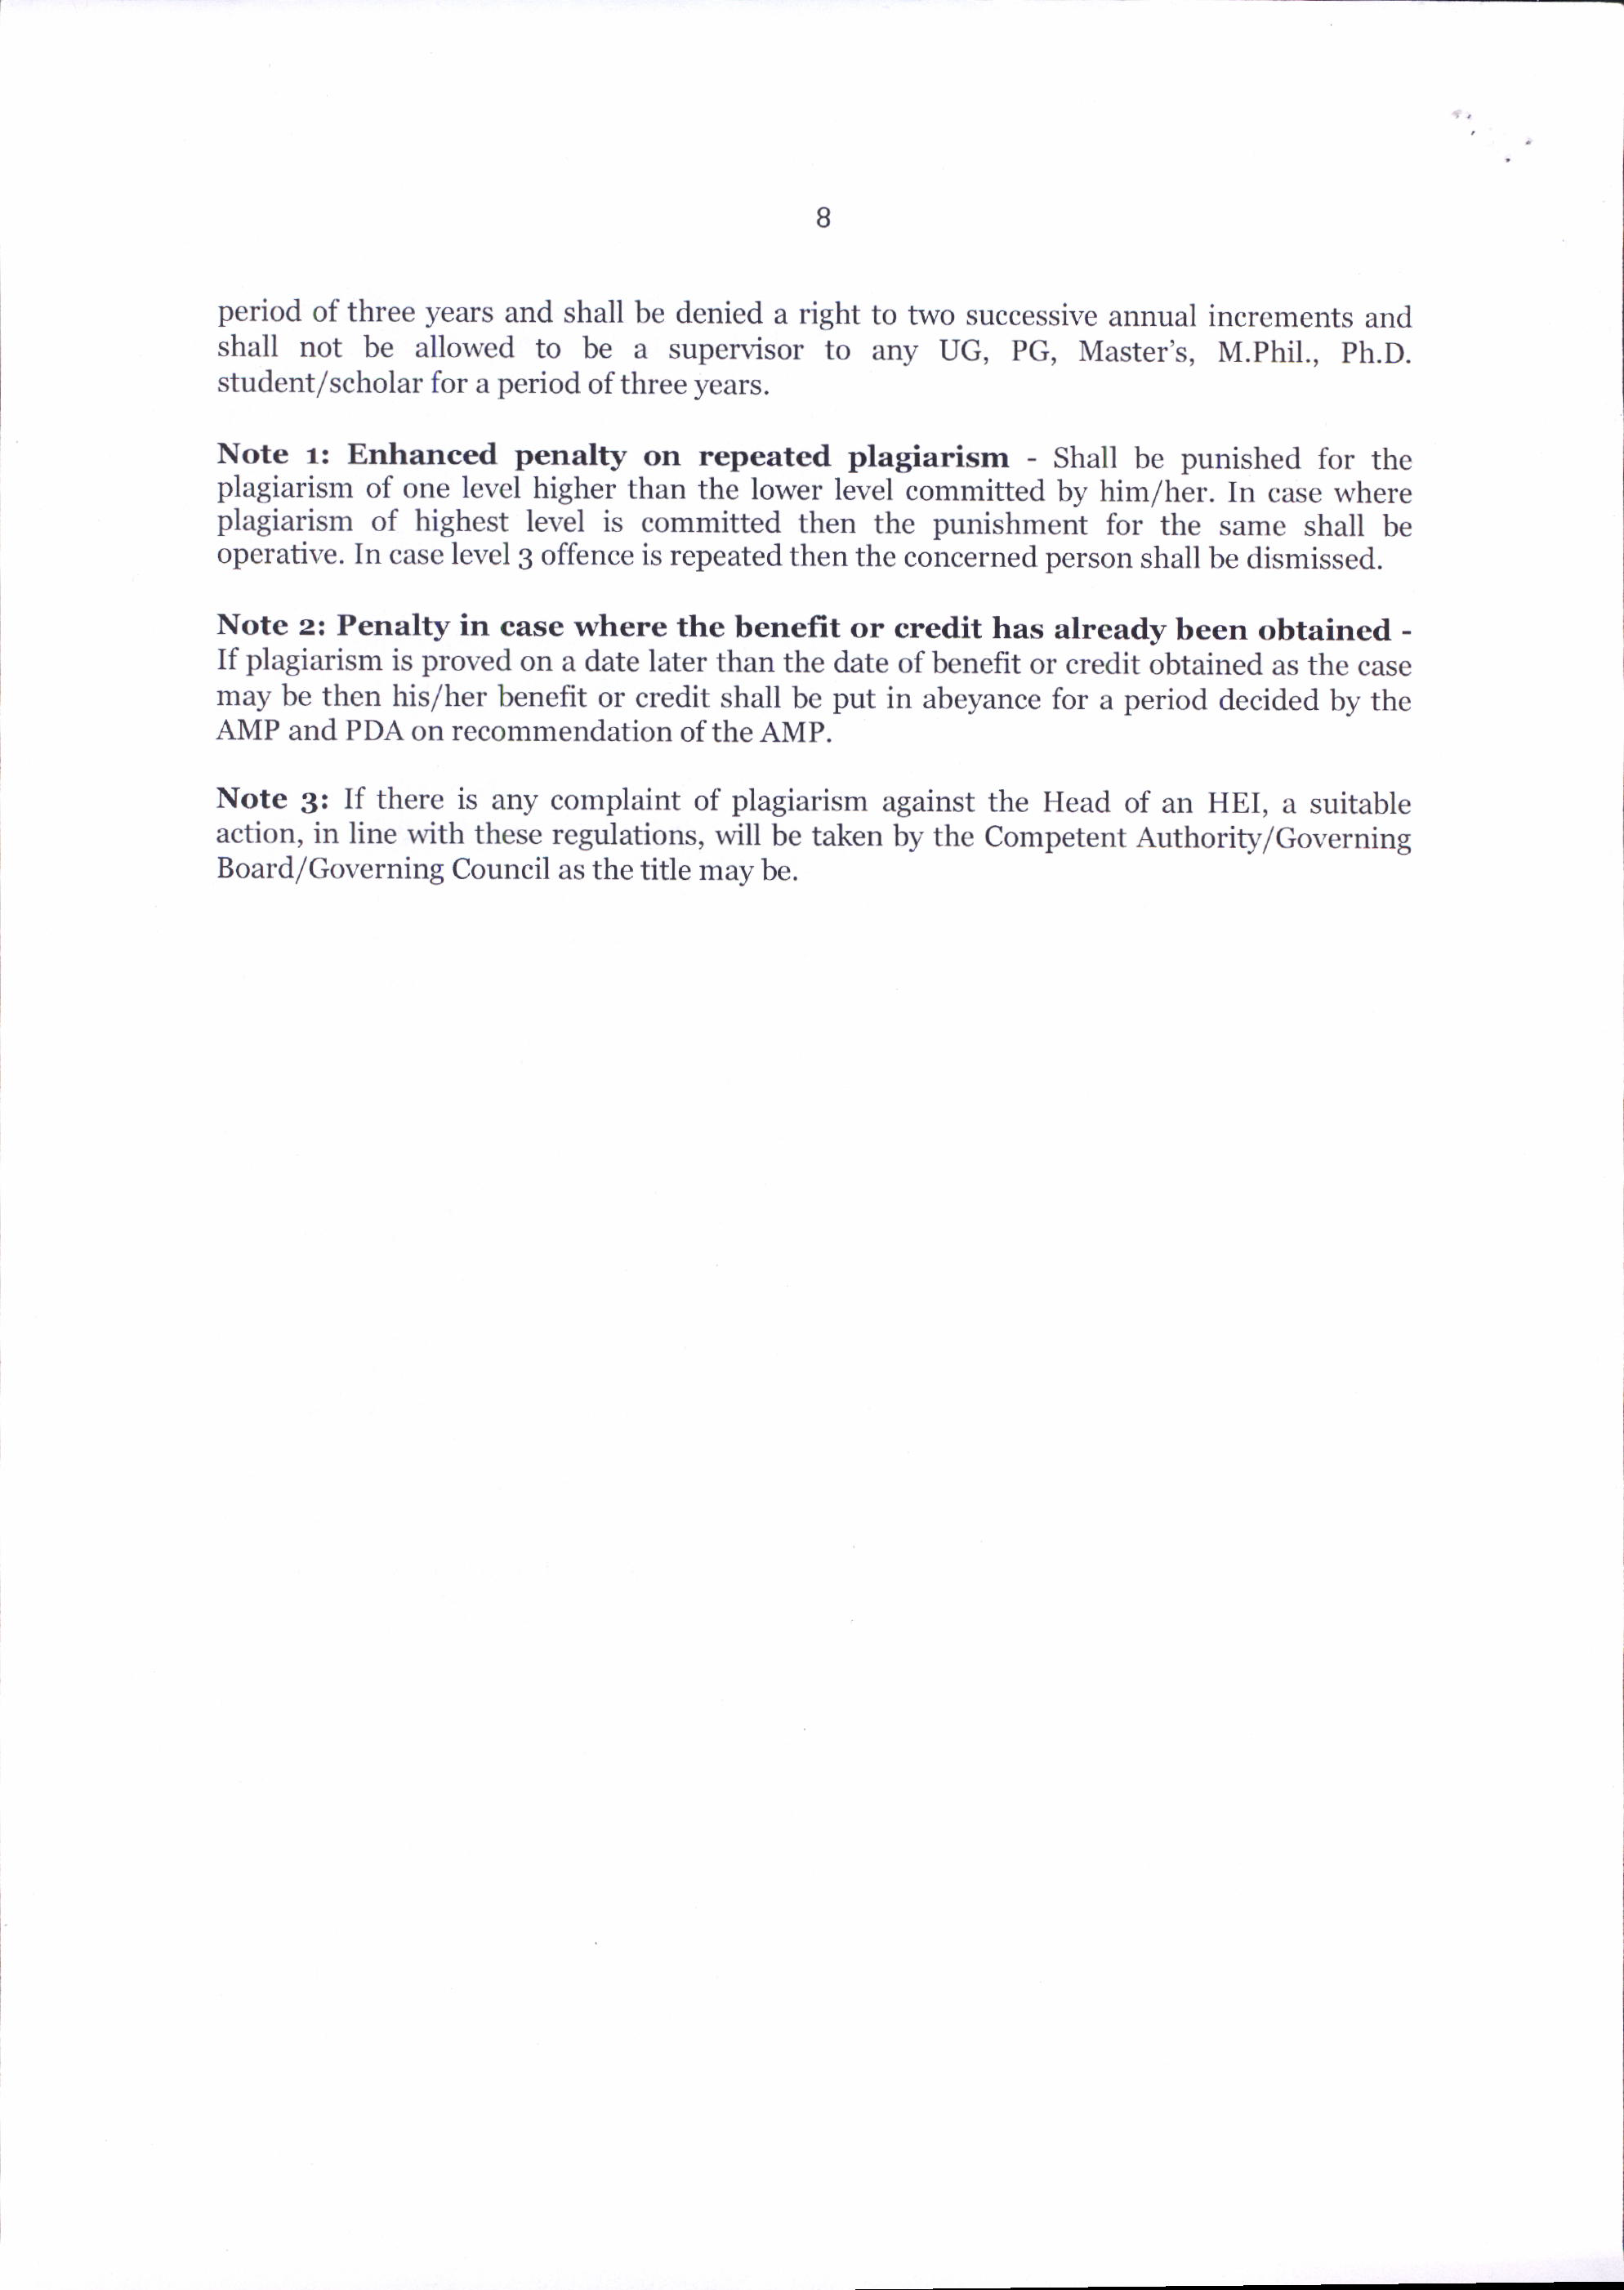

Slide 61

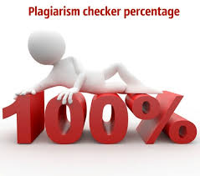
Plagiarism Software

Slide 62
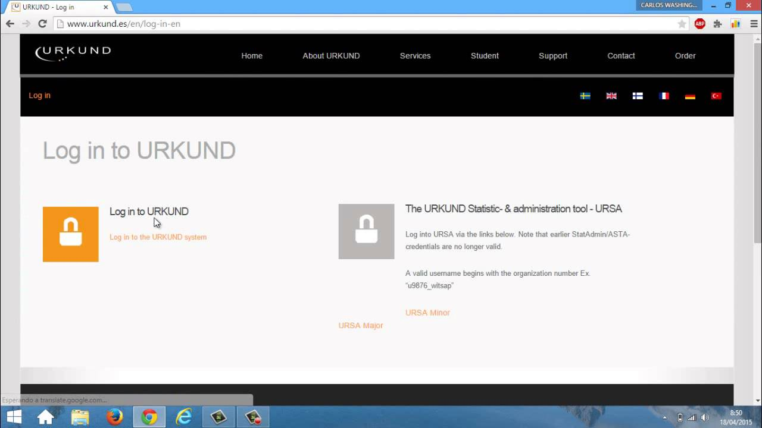

Slide 63
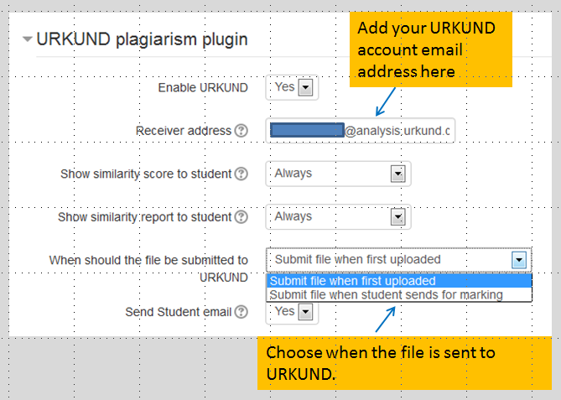

Slide 64
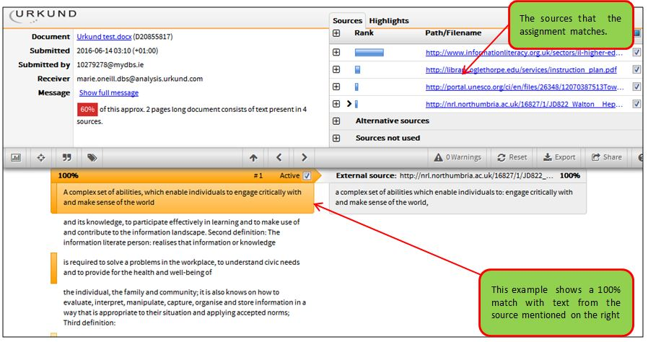

Slide 65
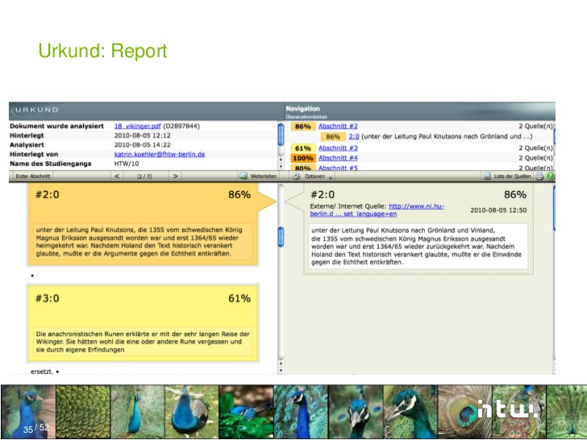

Slide 66
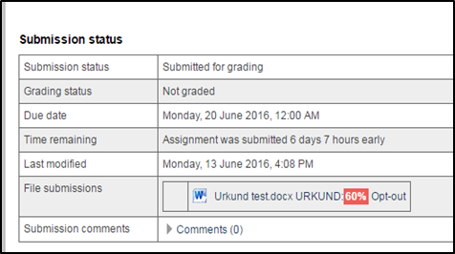

Slide 67
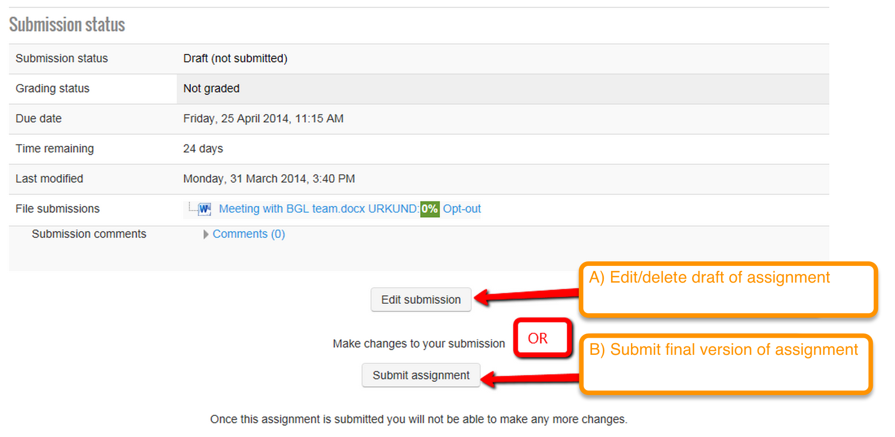

Slide 68


