Slide 1


Slide 2
Youth and Sustainable Development
P. Natarajamurthy
Associate Professor
Department of Economics
Bharathidasan University
Thiruchirapalli – 24
Tamil Nadu.
9488471737
natarajamurthy.p@bdu.ac.in

Slide 3
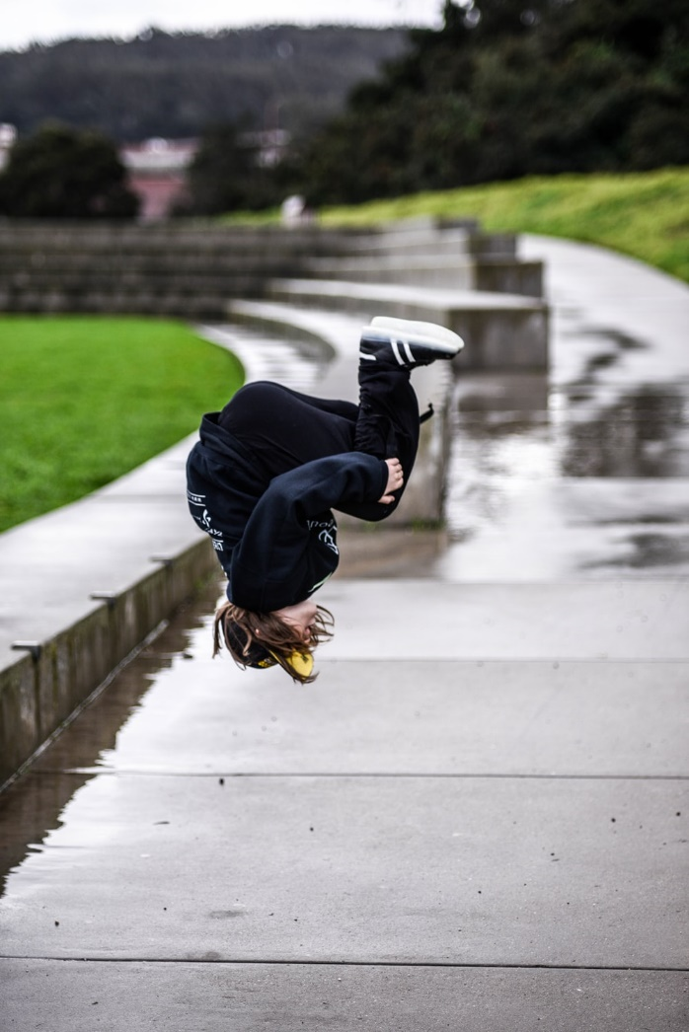
Who is Youth ?

Slide 4
Youth policy is a strategy implemented by public authorities with a view to providing young people with opportunities and experiences that support their successful integration into society and enable them to be active and responsible members of their societies, as well as agents of change.
(Council of Europe CM/Rec(2015)3)

Slide 5
The age range 15-29 is often selected for statistical purposes at EU level.
Under the Erasmus+ programme, various opportunities are available for young people aged 13 to 30.
The Council of Europe youth sector’s activities are available for young people aged 18 to 30, with justified exceptions.

Slide 6
There is no universal definition for youth population.
“Youth” is traditionally defined as a period of transition from childhood to adulthood.
In the African Youth Report (AYR) 2009 (UNECA 2009), “youths” are defined as between 15 and 39 years of age.
However, several African countries define their youth population differently.
For example,
Ghana, Tanzania and South Africa define the youth population as those between 15 and 35 years of age;
Nigeria and Swaziland define it as those between 12 and 30 years; and
Botswana and Mauritius define it as those between 14 and 25 years.
Ref.
Bar. (Mrs.) Adeline Idike. A & Eme, Okechukwu Innocent Department of Public Administration and Local Government Studies University of Nigeria, Nsukka (Email: okechukwunncnt@gmail.com )
ROLE OF THE YOUTHS IN NATION-BUILDING
Journal of Policy and Development Studies Vol. 9, No. 5, November 2015
www.arabianjbmr.com/JPDS_index.php

Slide 7
The United Nations, for statistical purposes, defines ‘youth’, as those persons between the ages of 15 and 24 years
Several UN entities, instruments and regional organizations have somewhat different definitions of youth, which the United Nations secretariat recognizes. The following table summarizes these differences:
UN Secretariat/UNESCO/ILO Youth: 15-24 UN Instruments, Statistics
UN Habitat (Youth Fund) Youth 15-32 Agenda 217
UNICEF/WHO/UNFPA Adolescent: 10-19, Young People: 10-24, Youth: 15-24 UNFPA8
UNICEF /The Convention on Rights of the Child Child until 18 UNICEF9
The draft youth policy framework Pathways for Youth from 2013 defines youth as those under 25 years old in three stages:
early adolescence (under 14),
middle adolescence (15-17),
late adolescence and early adulthood (18-24).

Slide 8
The age definition for ‘youth’ of various international organization's
The Commonwealth 15–29
United Nations Educational, Scientific and Cultural Organization (UNESCO) 15–24
International Labour Office (ILO) 15–24
UN Population Fund 10–24
World Health Organization (WHO) 10–29
World Bank 15–34
African Union 15–35
European Union (EU) 15–29

Slide 9
In India
As per National Youth Policy-2003, ‘youth’ was defined as a person of age between 13 and 35 years
As per National Youth Policy- 2014, the youth age-group is defined as 15and 29 years
The working population of India, is expected to increase to 592 million by 2020, next only to China (776 million), pointing to the fact that youth will make a significant contribution to the economic development of the country.

Slide 10

Why we need to Study about Youth ?

Slide 11
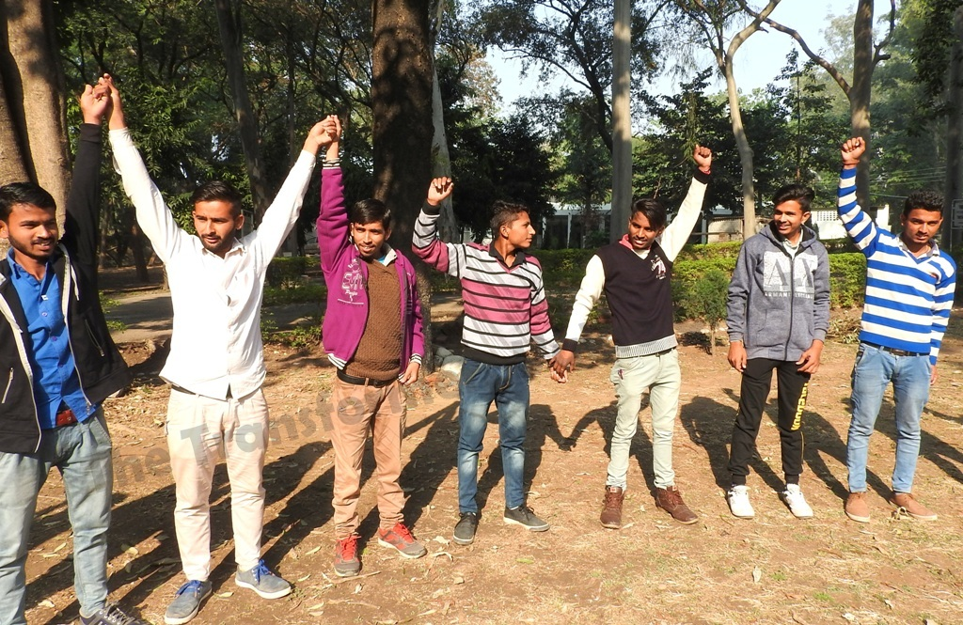
Youths are fighters.

Slide 12
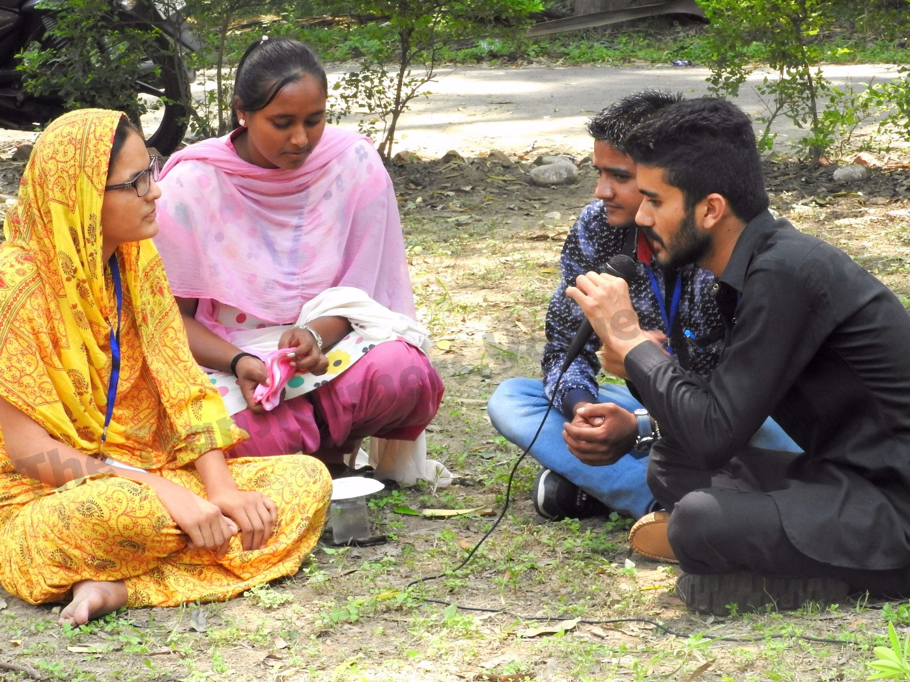
Youths are problem solvers.

Slide 13
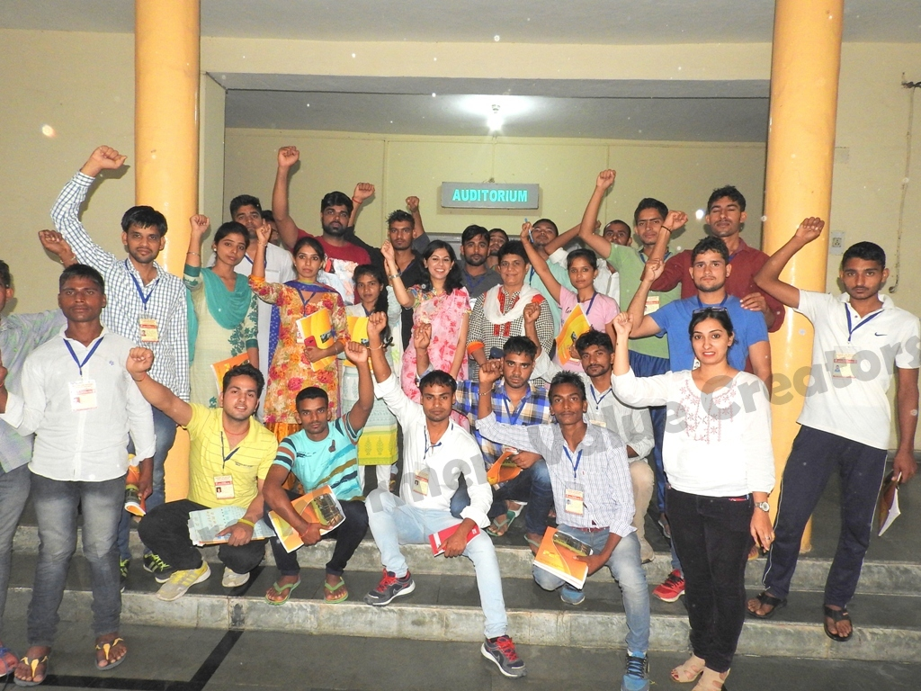
The youths are our life and nation. They will make our country proud. The country will be recognized. The youths just need the support from their fellow citizens and they will perform their duties.

Slide 14
India’s Tokyo 2020 Olympics medal winners
Weightlifter Mirabai Chanu opened India’s medal account at the Tokyo 2020 Olympics with a silver in the women’s 49kg - her first medal at the Olympics.
Neeraj Chopra became only the second Indian individual Olympic champion.
PV Sindhu - Bronze medal - women’s singles badminton
Lovlina Borgohain - Bronze medal - women’s welterweight (64-69kg)
Men’s hockey team won an Olympic medal after 41 years.
Ravi Kumar Dahiya - Silver medal - men’s 57kg freestyle wrestling

Slide 15
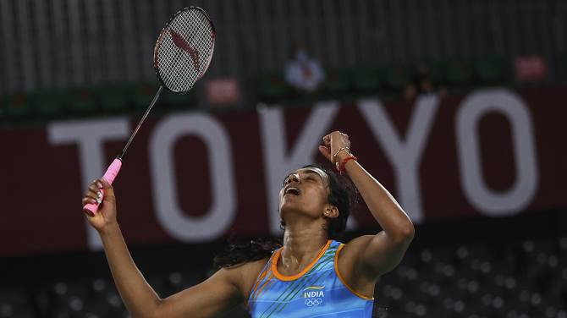
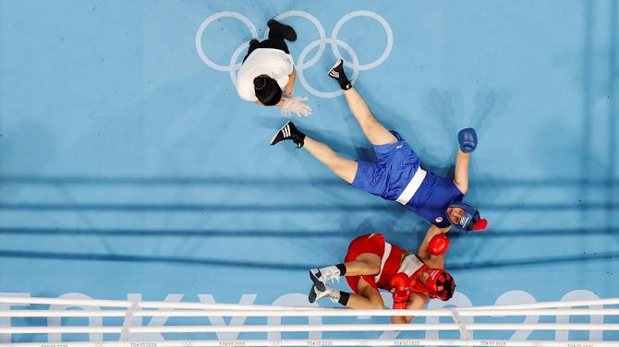

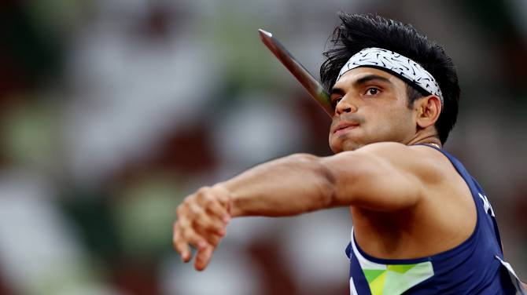
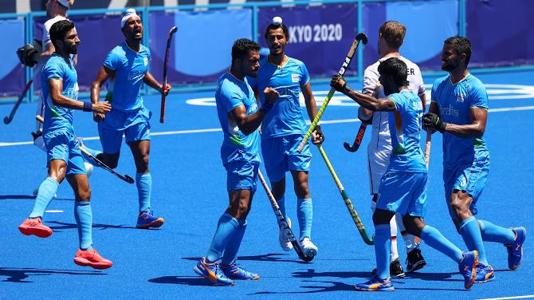

Slide 16
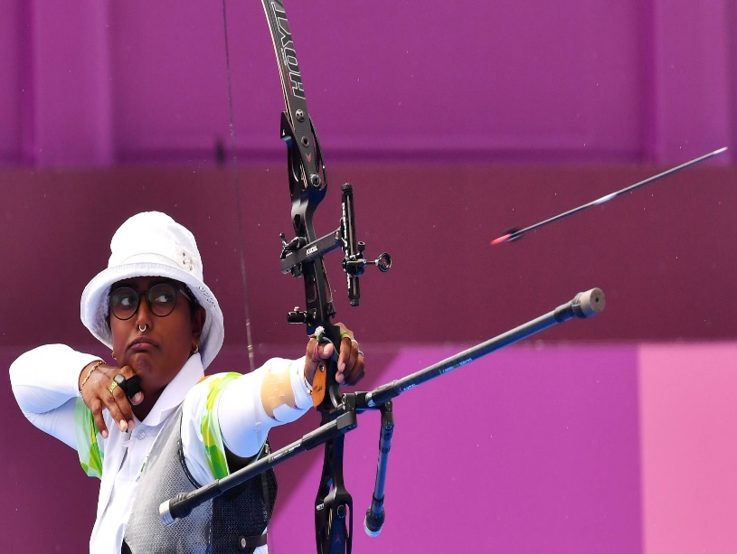
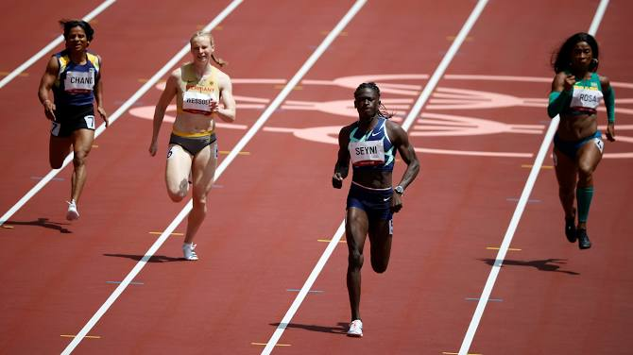
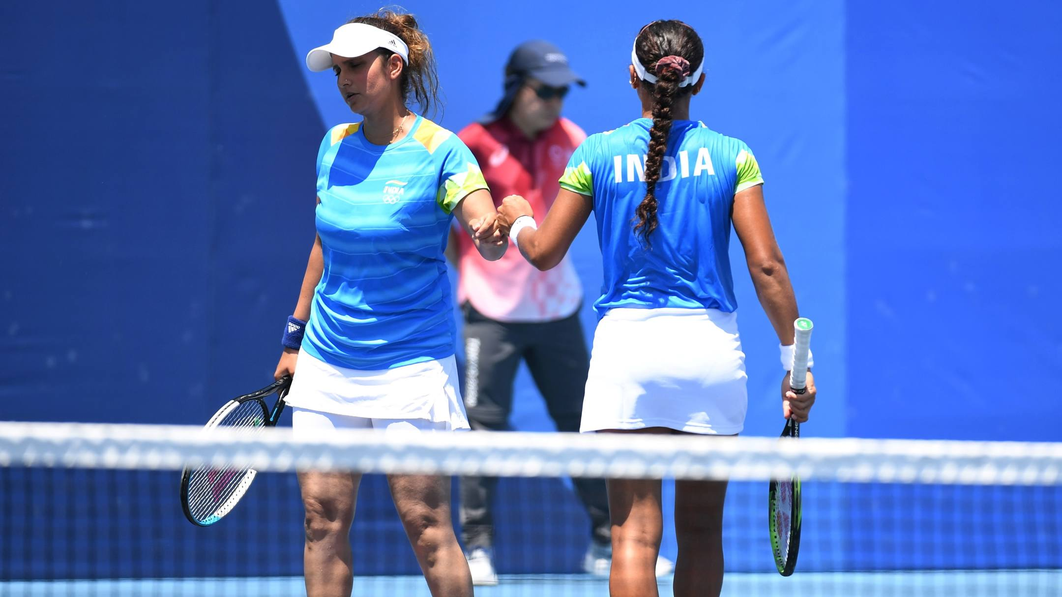

Slide 17
Six gold medals for India at Asian Youth Championships
India had earlier won eight gold, five silver and six bronze - Junior Youth ..
In all, India fetched 39 medals from the combined event, 14 ..
Read more at: http://timesofindia.indiatimes.com/articleshow/85787981.cms?utm_source=contentofinterest&utm_medium=text&utm_campaign=cppst

Slide 18
Top 5 Countries with Largest Youth Population According to UNDP Report (November 18, 2014)
India – 356 Millions
China – 269 Millions
Indonesia – 67 Millions
United States – 65 Millions
Pakistan – 59 Millions

Slide 19
Half of the world’s population is now under the age of 25 and 1.8 billion people are between the age of 11-25.
This is considered to be the largest youth generation to ever exist ( we have to make use of it).
More than 80% of youth in Japan are responsible for the economic boost of the country.
(Industries such as Manga and Anime consist of 90% of young minds that are responsible for generating a revenue of 1.3 billion Yen every year to the country.)

Slide 20
It is estimated that the average age of the population by the year 2023 would be
29 years in India whereas
in Japan it would be 47 years and
in the United States of America, it would be 40 years old.
(so we more gifted compare to other countries)

Slide 21
Global Trends
The proportion of young people is actually set to decline from 17.6 % in 2010 to 13.5 % in 2050.
(Population Division UN-DESA World Population Prospects: 2010 Revision)
The proportion of the world’s young people between the ages of 12-24 years living in Africa is expected to rise from 18 % in 2012 to 28 % by 2040.
while the shares of all other regions will decline.
The region comprising Asia and the Pacific is expected to experience the sharpest decline, from 61 % in 2012 to 52 % by 2040.
(Andrew Mason, “Adolescents and Youth: Their Numbers and Economic Roles”, Keynote Presentation at 45th Commission on Population and Development, based on Population Division UN-DESA World Population Prospects: 2010 Revision)

Slide 22
Vision
NYP-2014 provides a holistic Vision for the youth of India which is:
“To empower youth of the country to achieve their full potential, and through them enable India to find its rightful place in the community of nations”.

Slide 23
Health Status
Youth, in general the healthiest period of life, but, the international differences of mortality amongst youth are striking.
In more developed regions - Northern Africa, Eastern Asia and Western Asia - only one per cent or less - of 15-year olds do not survive to their 25th birthday.
Concurrently, the odds of dying during youth are almost twice as high in South Asia, and four times higher in sub-Saharan Africa
{Report of the Expert Group Meeting on Adolescents, Youth and Development UN-DESA (ESA/P/WP/225)}
India ranks 184th out of 191 Countries in terms of GDP% spend on healthcare, as per WHO (At present, Government spending on the healthcare industry stands at 1.15% of the Gross Domestic.)

Slide 24
“approximately half of new human immunodeficiency virus (HIV) infections are in youth aged 15 to 24 years and that no fewer than 6,500 young people are infected by the virus each day…”
General Assembly Resolutions, A/RES/56/117, 2002
“where a striking 76 per cent of young people (aged 15 to 24 years old) living with HIV are female.”
General Assembly Resolutions, A/RES/62/126, 2008
Commission for Social Development Resolutions, E/2007/26 & E/CN.5/2007/, 2007

Slide 25
In education -
142 million youth of upper secondary age are out of school, and upper secondary enrolment rates average only 14 per cent in low-income countries.
Moreover, almost 30 per cent of the poorest 12 to 14-year olds have never attended school
Employment and Poverty
There are presently 71 million young people unemployed, and many millions more are in unwarranted or informal work.
ILO estimates that 156 million youth in low and middle-income countries are living in poverty even though they are employed.
(WORLD YOUTH REPORT: Youth and the 2030 Agenda for Sustainable Development)

Slide 26
87 % live in developing countries - face challenges deriving from limited
Access
to resources
education
training
employment and
economic development opportunities
(UNO, 2007)

Slide 27
Access to School
An estimated 617 million children and adolescents around the world are unable to reach minimum proficiency levels in reading and mathematics, even though two thirds of them are in school
11 % of primary – school – age children and 20 % of lower secondary – aged children are not in school at all

Slide 28
Access to Employment
India's unemployment rate sharply rose to 7.11 % in 2020 from 5.27 % in 2019, said a report by Centre for Economic Data and Analysis (CEDA)
Total labour underutilization is more than twice as high as unemployment, affecting over 470 million people worldwide.
In 2019, more than 630 million workers worldwide, i.e., almost one in five, or 19 %, of those employed – did not earn enough to lift themselves and their families out of extreme poverty or moderate poverty.
Global skilled manpower shortage of 56.5 Million by 2020 while India to have surplus of 47 million
Skill base of Indian economy is very low. Only 2 % of Youth in the age group of 15 to 29 years receive formal Vocational Training.
Only 2.5 million Vocational Training seats are available whereas 12.8 million Youths are entering the workforce every year.

Slide 29
Global Competitiveness Report (World Economic Forum – Special Edition 2020)
According to the Report 245 million full-time jobs are expected to be lost globally by the end of 2020, which amounts to a loss of the productive capacity of 8.6 % of the global workforce

Slide 30
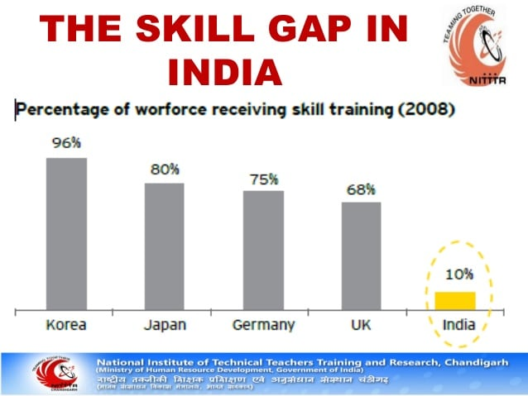

Slide 31
According to World Inequality Report 2022
World Average Income (in Euro)
Top 1 % (21.7%) - € 1,61,600
Top 10% (57.1%) – € 42, 500
Middle 40 % (29.7%) - € 5,500
Bottom 50 % (13.1%) - € 2,000
World Average Wealth(in Euro)
Top 1 % (33%) - € 11,81,400
Top 10% (64.6%) – € 2,31,300
Middle 40 % (29.7%) - € 26,400
Bottom 50 % (13.1%) - € 4,200

Slide 32
In India
Youth in the age group of 15-29 years comprise 27.5% of the population.
At present, about 34% of India’s Gross National Income (GNI) is contributed by the youth, aged 15-29 years.
The Government of India (GoI) currently invests more than Rs. 90,000 Crores per annum on youth development programmes
(Rs.37,000 crores on schemes targeted at development of youth in areas of education (80%),health, skill development and engagement and about Rs.55,000 crores on non-targeted schemes)
Total allocation for 'Entrepreneurship and Skill Development' from Rs 479.91 crore to Rs. 556.47 crore. - Feb 2, 2020
(Note: Non- Targeted - food subsidies, employment programmes like MGNREGA, health programmes related to infrastructure development, disease control and family welfare )
Approximately Rs. 2,710 per young individual per year, through youth-targeted [40.6%] (higher education, skill development, healthcare etc.) and non-targeted [59.4%] (food subsidies, employment etc.) programmes. (For 14 years)

Slide 33
Even after 72 years, we have failed to fight unemployment, poverty, corruption, illiteracy, and violence in our country.
India’s ranks in the various development index have barely grown in recent years.
For example,
India ranks
116 in the Human Capital Index,
144 in the World Happiness Index,
131 in the Human Development Index,
141 on the Gender Development Index and
112 in the Child Development Index (CDI)
122 – Global Youth Development Index
120 – Sustainable Development Index
43 – World Competitiveness Index (among 64 Countries)

Slide 34
India Specific
Top 1 % of the population hold more than one-fifth of the total national income in 2021 and the bottom half just 13%
(After New Economic Policy the income and wealth inequality increases)
Multi-Dimensional Poverty Index (MPI) prepared by Niti Aayog says one-fifth in India was Multi-Dimensionally poor

Slide 35
The report commissioned by the WHO and UNICEF
India ranked 77th on a sustainability index that takes into account per capita carbon emissions and ability of children in a nation to live healthy lives and
secures 131st spot on a flourishing ranking that measures the best chance at survival and well-being for children, according to a UN-backed report.

Slide 36
Here is the list of 17 SDG Goals:
SDG 1 No poverty
SDG 2 Zero hunger
SDG 3 Good health and well-being
SDG 4 Quality education
SDG 5 Gender equality
SDG 6 Clean water and sanitation
SDG 7 Affordable and clean energy
SDG 8 Decent work and economic growth
SDG 9 Industry, innovation and infrastructure
SDG 10 Reduced inequalities
SDG 11 Sustainable cities and communities
SDG 12 Responsible consumption and production
SDG 13 Climate action
SDG 14 Life below water
SDG 15 Life on land
SDG 16 Peace, justice and strong institutions
SDG 17 Partnerships for the goals

Slide 37
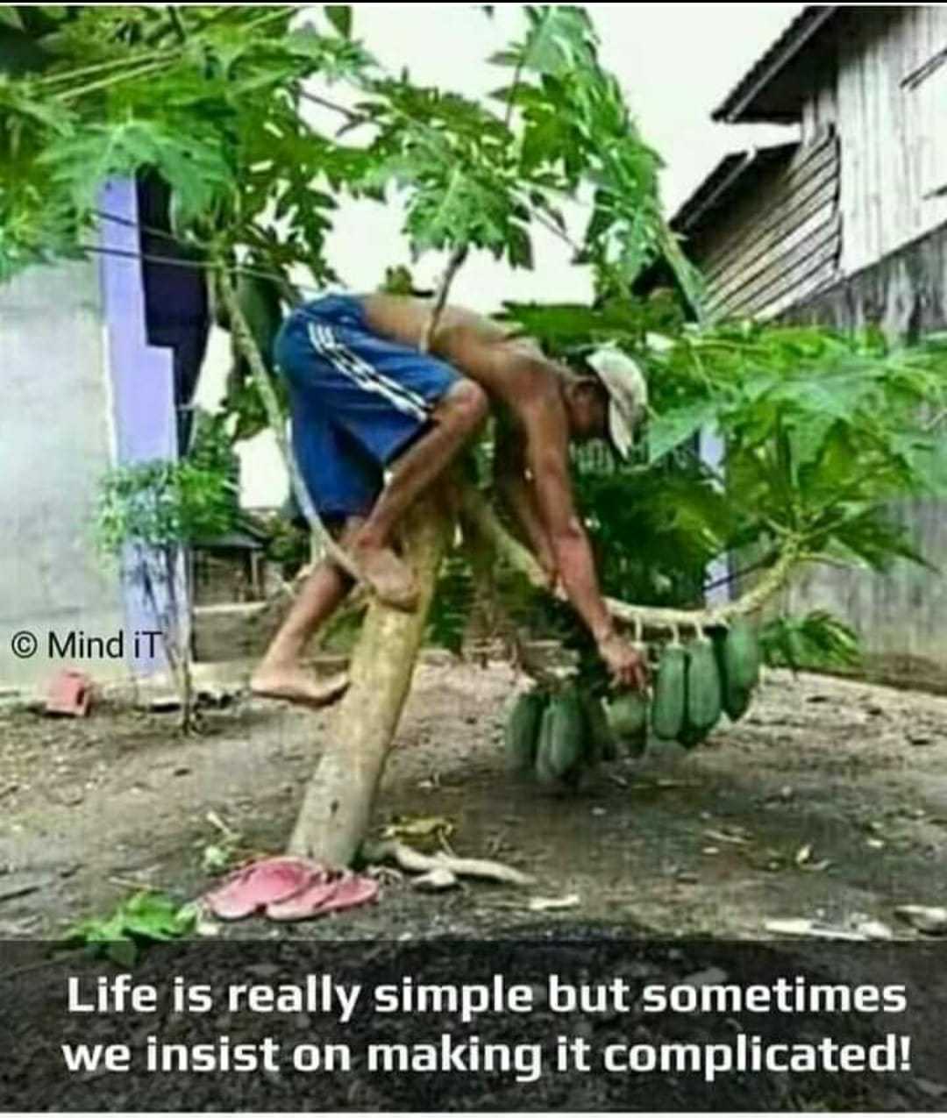

Slide 38
Education
India ranks 62nd in total public expenditure on education per student and measures of the quality of education
The country spent 3% of its total GDP on education in 2018-19 or about 5.6 lakh crore, the Economic Survey said (Nov 22, 2019), in Jul 23, 2020 it increased to 4.6%
Total allocation for 'Entrepreneurship and Skill Development' from Rs 479.91 crore to Rs. 556.47 crore. - Feb 2, 2020

Slide 39
The Organization for Economic Cooperation and Development (OECD) compiled educational data from nations across the globe each.
The most recent version for 2018 reports that, in 2015, the United States spent approximately $12,800 per student on elementary and secondary education.
That is over 35% more than the OECD country average of $9,500. At the post-secondary level, the United States spent approximately $30,000 per student, which was 93% higher than the average of OECD countries ($16,100).

Slide 40
Several countries outspent the United States for elementary and secondary education, including Austria, Norway, and Luxembourg, which spent $13,931, $14,353, and $20,900, respectively, in 2015.
Luxembourg spends the most per student at the elementary/secondary level, and Mexico spends the least at $3,300 per student.

Slide 41
Among the 34 OECD countries reporting data in 2015, 17 countries spent more than the average percentage (5%) of GDP on total government and private expenditures on education institutions for OECD countries.
Norway spent the most on education as a percentage of GDP at 6.4% followed by New Zealand at 6.3%, the United Kingdom at 6.2%, and the United States at 6.1 percent.
Conversely, 17 countries spent less than the average percentage of GDP on total education expenditures for OECD countries.
Ireland and Luxembourg reported the lowest total education expenditures as a percentage of GDP, both spending 3.5%, followed by Hungary, the Czech Republic, and Greece, all at 3.8%.

Slide 42
Corruption
Youth Must
Free From
Terrorism
Poverty

Slide 43
Denmark – 1 (87score)
India – 86 (score 41)
(Rank from 80 to 86 and Score 40, 41- 2019 & 2020)
Read more at: http://timesofindia.indiatimes.com/articleshow/80533471.cms?utm_source=contentofinterest&utm_medium=text&utm_campaign=cppst

Slide 44
Terrerism
India Ranks 8 (with 7.353)
(The GTI was developed in consultation with the Global Peace Index Expert Panel. The GTI scores each country on a scale from 0 to 10; where 0 represents no impact from terrorism and 10 represents the highest measurable impact of terrorism.)
1 – Afghanistan (9.592)
29 countries such as United Arab Emirates , Singapore, Bhutan, Cuba scores 0.000

Slide 45
The primary role of young people is to get a good education in order to become better citizens of tomorrow.
They need to learn skills to do the job that their country’s economy needs.
They also need to know how to read, write, think, understand, analyze and discuss the issues their country faces.
The entire success of the nation depends on the youths. To help other youths in building confidence and pursuing the field of interest.
Guide newcomers in every field on right lines.
They need to promote the fair image of the country before the world.
Their aim is to serve the country with their skills and talent in various fields.
They wish to refresh the culture, trend and traditions of the society.

Slide 46
The term nation building or national development is usually used to refer to a constructive process of engaging all citizens in building
social cohesion
economic prosperity and
political stability in a nation in an inclusive and democratic way.
The vision of our country lies in the hands of our youths.
They are filled with tremendous and towering ambitions.
It will be a great wastage of human resources if these youths are not given an opportunity to exercise their talent.
This beautiful land needs these youths in order for our soil to become a brighter one.
They need to learn skills to do the job that their country’s economy needs.
They also need to know how to read, write, think, understand, analyze and discuss the issues their country faces.

Slide 47
YOUNG INDIA AND WORK A SURVEY OF YOUTH ASPIRATIONS (2018 Observer Research Foundation, The World Economic Forum)
1.3 million people enter the working age population in India every month (World Bank, “Jobless Growth?” South Asia Economic Focus, Spring (2018))
Youth are making independent choices
Higher education degrees are highly valued, but youth also want new skills
While youth prefer public sector jobs, there is obvious interest in entrepreneurship
The IT Industry is the largest employer of youth
More than a third of surveyed youth are neither employed nor in education
Women prefer full-time careers, have less paid work experience, and feel less prepared
Job searches have gone digital but employers and recruiters have not: 81 percent of respondents report relying on media and internet sources
Cont…

Slide 48
Information asymmetry, lack of guidance and work experience are impeding Indian youth from meeting their career aspirations
Youth are cautiously optimistic about the gig economy
Youth are eager for skills development;
Youth see high value in human-centric and soft skills
Youth recognise existing limitations but have solutions in mind
76 % OF THE RESPONDENTS REPORT BEING VERY INTERESTED IN PURSUING SKILLS DEVELOPMENT PROGRAMMES
Over a third of youth are neither employed nor in education
Youth are looking online for job opportunities
More females are working without an employment contract than males Cont…

Slide 49
Indian youth have a strong preference for government jobs
Youth want to be an entrepreneurs, but lack of sufficient support.
Lack of guidance and work experience are the main barriers in finding desirable jobs
Youth are open to the gig economy as an additional source of income
Youth are cautiously optimistic about the gig economy for their main source of income
Human-centric skills are perceived to be most important for employability
Youth see high value in soft skills
Youth are very interested in pursuing skills development opportunities
Youth believe skills training will improve their employability

Slide 50
The Role of Youth on Sustainable Development
Improve the Role of Youth in Various Sectors
Business / IT
Politics
Administration Services
Research
Society

Slide 51
Education is the one stop solution to almost every problem in India.
Indian youth as entrepreneurs should venture into the recycling revolution taking cue from countries like Sweden, which recycles 99% of household waste and turns it into energy.
Youth as politicians - ensuring effective implementation of basic government schemes like MGNREGA, Rural electrification projects, PMGSY etc, passing of important legislatures
Youth as managers working in CSR functions should analyse the impact of their CSR,
If each Indian MNC opens 1 educational institute and takes up the funding of 1 hospital with world class facilities, the change is not far away.

Slide 52
Youth as civil servants are responsible for executing developmental work at the ground level
Youth as academicians - give moral and ethical education about respect for other gender, sticking to right values and conservation of nature
Youth as sports persons - who have achieved glory for India at International championships must motivate others and help providing them with proper coaching and training facilities.

Slide 53
Finally, youth as responsible citizens are at the core of every role that needs to be played.

Slide 54
Impact of Covid-19 on Youth (International Labour Organisation - 2020)
Age: 18 – 29
Respondents – 12, 000 (Educated Youth and Those with Internet access)
Countries – 112
73 % experienced school closure, yet not all were able to transition into online and distance learning
Sharp digital divides that exists among region
Despite the best efforts of Schools & Training
65 % young reports having learnt less since the pandemic began.
51 % believe their education will be delayed
Nine per cent feared their education would suffer and might even fail.

Slide 55
Employment
Lost by an average of two hours a day
2 of 5 young people (42 %) reported a reduction in income
Well Being
17 % of young probably affected by anxiety an depression
20 % affected in access to their basic needs
25 % engaged in Volunteerism and 27 % gave donations

Slide 56
Thank you

