Slide 1
Globalisation & Development
N.Prasanna & P. Natarajamurthy
Associat Professor of Economics
Bharathidasan University

Slide 2
What Is Globalization?
Economists:
Integration of world economies (O’Rourke & Williamson) through trade, migration and money flows (Rodrik).
Eliminating the artificial obstacles limiting the free flow of goods, services, capital, knowledge and (to a lesser degree) labour (Stiglitz).

Slide 3
General
Globalization is a process of interaction and integration among the people, companies, and governments of different nations, a process driven by international trade and investment and aided by information technology. This process has effects on the environment, on culture, on political systems, on economic development and prosperity, and on human physical well-beingin societies around the world.

Slide 4
When did Globalisation begin?
Three Views
5000 Years
500 Years
50 Years

Slide 5
World Economy – 5000 Years
The existence and development of the same world system in which we live stretches back five thousand years or more
A World System: Extensive and Persistent trade connections, sharing economic, political and perhaps also culture aspects
(World Economy= Is a large geographic zone within which there is significant exchange of essential goods as well as flows of capital and labour)

Slide 6
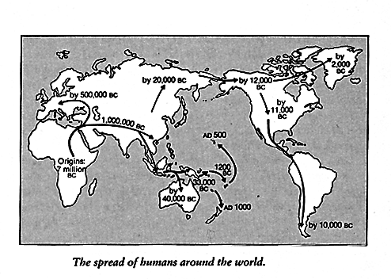
World Economy Expanded to include much of Afro-Eurasia by Bronze Age

Slide 7
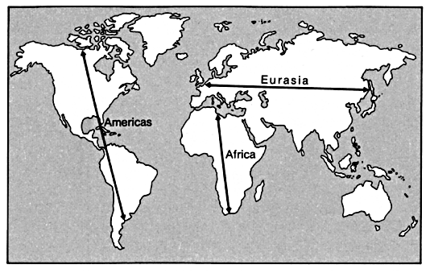
Major Axes of Continents

Slide 8
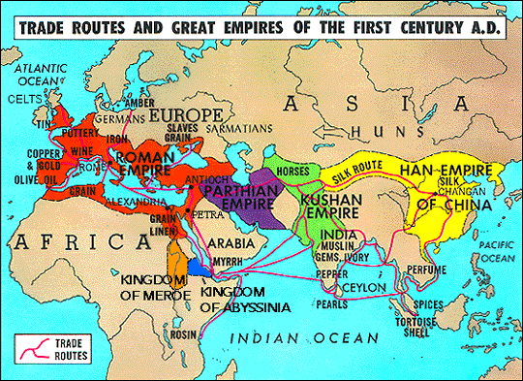
Trade,migration,cultural & technological diffusion, geo-political interaction

Slide 9
Key features of the historic economy
Market based trade
Endless accumulation
500 and 50 year economic cycles.

Slide 10
Rise of European World Economy in the C15th – 500 Years
Economically and not politically based, existence of multiple political centres is key
Endless accumulation
Emergence of Global Geo-Culture by end of the C18th
Gradual global expansion complete in C18th
Imperialism shifts in emphasis from ‘plunder’ to unequal exchange
The character of individual states largely derived from position within global economic structure

Slide 11
Capitalism
Capitalism was born in Rural England in C16th and C17th
Capitalism=Wage labour and the Factory System
Britain and the New Imperialism
Capitalism exported by UK - through imperialism and geopolitical competition
Idea of an Integrated Global Capitalism Economy really only makes sense in C19th

Slide 12
Modern Globalisation – 50 Years
Crisis of Post-war national capitalism
Manufacturing net profit 1950-70 26.2%, 1970-93 15.7%, Output 5.5% declined to 2.1%
Globalisation is response to crisis in three key ways
Global financial integration is driven by poor conditions for accumulation in the real economy and the need to promote fictitious accumulation.
Firms reorganising production in order to restore profitability. The devaluation of capital in crisis makes reorganisation easier
Political project to open up new spaces of accumulation for global capital

Slide 13
Processes of proletariatisation and enmeshing of all humanity into web of global market is finally being completed!
Although still questions about the universialisation of the “factory system” remain
Global capitalism is born!

Slide 14
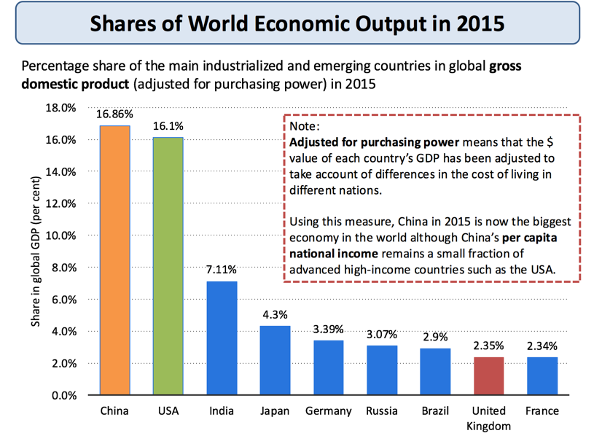

Slide 15
Characteristics of Globalisation
Greater trade in goods and services both between nations and within regions
An increase in transfers of capital including the expansion of foreign direct investment (FDI) by trans-national companies (TNCs) and the rising influence of sovereign wealth funds
The development of global brands that serve markets in higher and lower income countries
Spatial division of labour– for example out-sourcing and off shoring of production and support services as production supply-chains has become more international. As an example, the iPhone is part of a complicated global supply chain. The product was conceived and designed in Silicon Valley; the software was enhanced by software engineers working in India. Most iPhones are assembled / manufactured in China and Taiwan by TNCs such as FoxConn

Slide 16
High levels of labour migration within and between countries
New nations joining the world trading system. China and India joined the WTO in 1991, Russia joined the WTO in 2012
A fast changing shift in the balance of economic and financial power from developed to emerging economies and markets – i.e. a change in the centre of gravity in the world economy
Increasing spending on investment, innovation and infrastructure across large parts of the world
Globalisation is a process of making the world economy more inter-dependent
Many of the industrializing countries are winning a rising share of world trade and their economies are growing faster than in richer developed nations especially after the global financial crisis (GFC)

Slide 17
Among the main drivers of globalisation are the following:
Containerisation – the costs of ocean shipping have come down, due to containerization, bulk shipping, and other efficiencies. The lower cost of shipping products around the global economy helps to bring prices in the country of manufacture closer to prices in the export market, and makes markets more contestable in an international sense.
Technological change – reducing the cost of transmitting and communicating information – sometimes known as “the death of distance" – a key factor behind trade in knowledge products using web technology
Economies of scale: Many economists believe that there has been an increase in the minimum efficient scale (MES) associated with particular industries. If the MES is rising, a domestic market may be regarded as too small to satisfy the selling needs of these industries.
Opening up of global financial markets: This has included the removal of capital controls in many countries facilitating foreign direct investment.

Slide 18
Differences in tax systems: The desire of corporations to benefit from lower unit labour costs and other favourable factor endowments abroad and develop and exploit fresh comparative advantages in production has encouraged countries to adjust their tax systems to attract foreign direct investment (FDI)
Less protectionism - old forms of non-tariff protection such as import licencing and foreign exchange controls have gradually been dismantled. Borders have opened and average tariff levels have fallen – that said in the last few years there has been a rise in protectionism as countries have struggled to achieve growth after the global financial crisis.
Globalization no longer necessarily requires a business to own or have a physical presence in terms of either owning production plants or land in other countries, or even exports and imports. Many businesses use licensing and franchising to help expand their overseas operations.

Slide 19
Anti/De-Gobalisation
Globalization trends that once drove economies and markets are in retreat. Ruchir Sharma looks at the key themes that are emerging as protectionism rises.

Slide 20
1. Favour Countries With Large Domestic Economies
“In the past, rapid per-capita GDP growth was almost always propelled by rapid export growth,” says Sharma. “Now, globalization is declining, and we believe the economic advantage is shifting from traditional export powers like South Korea to countries with relatively low exports as a share of GDP and large domestic consumer markets, like India, Peru and Indonesia.”
2. Corporates with a Domestic Focus Are In
With export revenues likely to decline in a new protectionist environment, investors should watch domestic revenue-focused corporations; particularly in countries where domestic consumption is the largest driver of GDP growth.
3. Outsourcing: Less of a Boost to the Bottom Line?
Many companies enjoyed strong profit margins by outsourcing low-end jobs. As borders close, the clout of multinationals goes down, the bargaining power of local workers goes up. Since 2012, the corporate share of U.S. national income has started to inch down, and the worker’s share has been moving higher. The rise of leaders like Trump, whose policies are designed to bring companies and jobs back to America, will accelerate this trend.

Slide 21
4. Persistent Headwinds Against Strong Growth
“Even if you get tax cuts and deregulation in the U.S., it’s unlikely that a Trump administration will achieve the increased productivity levels that were enjoyed during the Reagan era,” says Sharma. “During the Regan administration, growth in the labor force was 1.6% per year. Now it is 0.3%. People are getting older and families are having less kids, and this is why we think the potential growth rate for the U.S. will remain around 2%, and not 4%.”
5. Reflation Ahead, but Not Because of Strong GDP Growth
“Before 2008, rising trade competition helped contain inflation, but de-globalization weakens that natural check,” says Sharma. He adds that wage pressure has been rising in the U.S. since 2011,¹ and will continue to do so, if fiscal stimulus is introduced when the U.S., with a 4.8% unemployment rate,² is operating at full employment capacity.
6. Latin America: The Anti-Populist Outlier
Populism is expected to continue spreading in a low-growth world with rising income and economic inequalities—but not in Latin America, says Sharma. “Latin America is one of our most significant overweights because the political cycle there is moving in a very different direction to the rest of the world. Latin American countries are still enforcing economic orthodoxy, after having already experienced the economic outcomes of populism.”

Slide 22
7. Europe: The Contrarian Trade
“The place to look for good news in 2017 is where it is least expected: Europe,” says Sharma. “Europe has already suffered two recessions within eight years, a rare double whammy that makes another downturn less likely, not more. European banks have also reduced their debt, which could set the stage for a new lending and growth cycle.”
8. China: The Big Tail Risk
“China continues pumping out debt to maintain growth, but it’s becoming less effective as time goes on,” says Sharma. “Before 2007, it took $1 of debt to generate $1 of GDP growth, but now it takes more than $4 of debt to produce the same result.” How long can this go on? “There are three metrics to watch. One is the loan-to-deposit ratio, now around 120%. The second is capital flows. The third is the interbank market, to see if funding is getting difficult. The worsening of these metrics will indicate when the debt game in China enters the endgame.”

Slide 23
References
https://www.tutor2u.net/economics/reference/globalisation
https://www.morganstanley.com/ideas/ruchir-sharma-new-trends-2017-as-globalization-reverses
A Brief Histories of Globalization(s)
European Economic History, R. N. Langlois
Thank you.

