Slide 1
INDIAN ECONOMIC THOUGHT
P. Natarajamurthy
Department of Economics Bharathidasan University

Slide 2
Introduction
Since the inception of British regime in India, i.e., during the nineteenth century, modern economic thinking started to develop gradually.
During those days economic thoughts of western countries started to influence gradually the development of Indian economic thoughts. Following slides shows the economic ideas of Dadabhai Naoroji, M.K.Gandhi and Jawaharlal Nehru

Slide 3
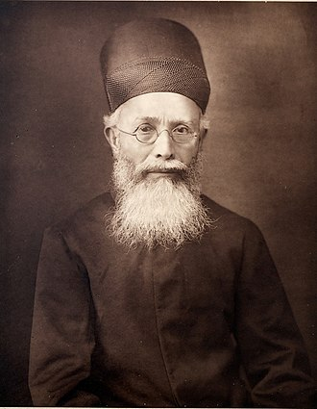
Dadabhai Naoroji
Dadabhai Naoroji (4 September 1825 – 30 June 1917), known as the Grand Old Man of India, was an educator, an early Indian political and social leader.
Dadabhai Naoroji was among the leading Indian nationalist leaders who aroused the feeling of economic nationalism and propagated for it.

Slide 4
The following points highlights the major economic ideas of Dadabhai Naoroji. The economic ideas are:
1. National Income of India
2. Taxation, Military Expenditure and Public Department
3. The Drain Theory

Slide 5
1. National Income of India:
Naoroji was not satisfied with the official estimates regarding the national income of India during the British rule.
Naoroji regarded this information regarding the country’s prosperity as insufficient and misleading.
On the basis of the official data, Naoroji himself calculated the per capita income for the years 1867-70 at Rs. 20 only.
On the other hand, the basic requirements of an ordinary labourer, as calculated by him was about Rs. 34.

Slide 6
2. Taxation, Military Expenditure and Public Department:
A glaring example of exploitation of Indian resources and discrimination of the Indians is the taxation policy adopted by the British Government.
While in England, taxes constituted 8 per cent of the income, in India it was about 15 per cent.
According to Naoroji, the main cause of India’s poverty was the excessive expenditure on European services and interest paid on public debts.

Slide 7
3. The Drain Theory:
Naoroji was famous as an economist for his “Drain Theory”.
He developed this theory to explain the conditions of poverty in India.
The drain theory emphasized the fact that the management and institutions of British India were prone to a mechanism of the economic drain.

Slide 8
Naoroji felt that under the British rule, India had the costliest administration in the world.
It had a disastrous effect on the Indian economy.
According the Naoroji, the economic resources of India were drained in two ways:

Slide 9
Con..
(a) Through internal drain, i.e., through the transfer of purchasing power by means of taxation, interest payments and profits from poor classes/regions to the rich classes/ regions,
(b) Through external drain, i.e., through unrequired exports which produced no equivalent returns in the form of imports.
Thus while internal drain refers to the exploitation of poor regions or individuals by the rich within a country, external drain implies the exploitation of a poor country by the rich.

Slide 10
Summary
Naoroji was the first economic thinker who provided the pattern of economic thought for modern India.
He was the first Indian to calculate the per-capita and national income. He believed that the economic phenomena were linked with the moral, social and political factors. In his own words
“If India did not progress under the Englishmen there was no justification for their existence here”.

Slide 11
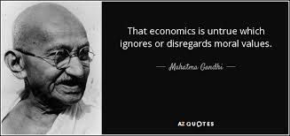
Gandhian Economics

Slide 12
Gandhian Economics
Gandhian economics is a school of economic thought based on the spiritual and socio-economic principles expounded by Indian leader Mahatma Gandhi.
Gandhi's economic ideals, much like everything else in his life, were governed by ethical and moral considerations. His stress on rural economy and emphasis on a simple life, coupled with his concern for universal well-being formed the foundation of his unique views on economics.

Slide 13
Economic Views of Gandhi:
1. Self Sufficient Village Economy
Gandhi asserts that “India lives in its villages”. That is why Gandhi stressed on the growth of rural industries such as khadi, handlooms, sericulture, handicrafts etc.
If every village distributes its surplus produce to the poor villagers then the problem of poverty and starvation would not arise. This can help eradicating poverty and thus people can be happy and self-reliant.

Slide 14
Gandhi also recommended citizens of India to use rural products.
He said, "All should make it a point of honour to use only village articles, whenever available. Given the demand, there is no doubt that most of our wants can be supplied by the villages.”
Village economy would provide maximum employment and income to inhabitants, and second, it would generate equality, freedom and justice.

Slide 15
To quote Gandhi,
"We have to concentrate on the villages being self-contained, manufacturing mainly for use..." My idea of village Swaraj is that it is a complete republic, independent..."

Slide 16
3. Industrialisation
The system of production should ensure self-sufficiency in the necessities or the primary needs. This self-sufficiency should be achieved at all levels: family, village and nation. Production process should be simple. It should be based on the locally available resources.
It should conserve the available resources instead of wasting them. It should be free from pollution.

Slide 17
Gandhi advocated strict state control over large scale industries.
He recommended nationalization of some basic and key industries.
He felt that, large scale industries are sometimes found to be wasteful, and these industries are not helpful in the generation of social and community relations.

Slide 18
Technology
Gandhi wrote: "I am not opposed to machinery as such. I am opposed to machinery which displaces labour and leaves it idle.“
Gandhi was against machines if they keep people idle, if they create an unemployment problem for them.

Slide 19
According to Gandhiji, machines should help man, improve his productivity, but they should not throw men out of employment.
Man should handle machines at will without being its slave.
He further positively asserted, “I want the concentration of wealth, not in the hands of few, but in the hands of all. Today machinery merely helps a few to ride on the backs of millions.”

Slide 20
Gandhi's Swadeshi
Mahatma Gandhi was a champion of 'swadeshi', or home economy.
According to the principle of swadeshi, whatever is made or produced in the village must be used first and foremost by the members of the village.
Swadeshi avoids economic dependence on external market forces that could make the village community vulnerable.
Swadeshi is the way to comprehensive peace: peace with oneself, peace between peoples, and peace with nature.

Slide 21
Swadeshi for Gandhi was a sacred principle - as sacred for him as the principle of truth and non-violence.
Gandhi realized that in the past, life in India was not only prosperous but also conducive to philosophical and spiritual development.

Slide 22
Summary
Gandhi's economic ideals, much like everything else in his life, were governed by ethical and moral considerations.
His stress on rural economy and emphasis on a simple life, coupled with his concern for universal well-being formed the foundation of his unique views on economics.

Slide 23
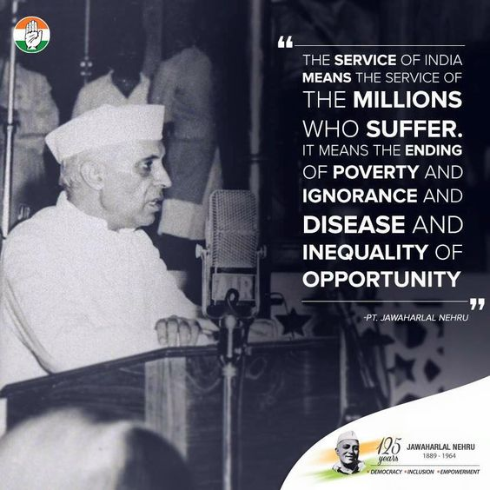
Nehruvian Economics

Slide 24
The Nehru Strategy:
The leadership of Jawaharlal Nehru as the Chairman of the National Planning Committee (NPC) set up in 1938 gave a great impetus to thinking on planning in the country.
The principal components of the Nehru Strategy of building modern India were the institution and strengthening of the planning process...

Slide 25
Con...
establishment of the public sector in Industry,
laying the base of modern agriculture,
creation of a modern scientific and technological base and
attainment of economic independence by systematic development of heavy and basic industries
maximum development of our natural and human resources.

Slide 26
Mixed economy was his answer to the problem of planning economic advance in a democratic set-up.
Though Nehru was impressed by the experiment of Russian Revolution, when it came to the selection of suitable option for development of independent India, he preferred “Mixed economy” model.
His concept of planning envisaged that people’s participation should be ensured at every stage.

Slide 27
Summary
Nehru’s concept of planning was democratic planning.
In the articulation of the concept of planning in India, he strongly favoured democratic framework which ensures that things are decided in a co-operative manner, seeking the willingness of all concerned.
Nehru tried to keep away the element of ‘coercion’ in the concept of planning.

Slide 28
Conclusion
The nineteenth century Indian economic thoughts have laid the foundation stone of Indian economy in the twentieth century.
Thus from the foregoing analysis, it has been revealed that the Indian economists of nineteenth century had realised those genuine economic problems of India which were very much connected with British colonialism and diverse nature of Indian population
They advocated some measures for removing these drawbacks of Indian economy and also for its upliftment.

