Slide 1
Dr.M.Prabavathy
Director i/c
Centre for Differently Abled Persons
Bharathidasan University cdapraba@bdu.ac.in
7200004044
Pedagogy for Inclusion of students with Hidden disabilities

Slide 2
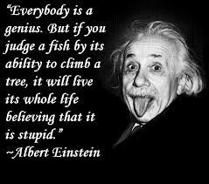

Slide 3
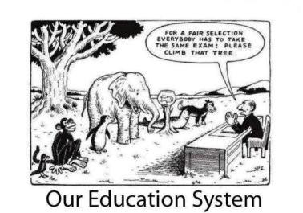

Slide 4


Slide 5
Inclusive pedagogy is a method of teaching in which instructors and classmates work together to create a supportive environment that gives each student equal access to learning.

Slide 6
Inclusive classrooms work to ensure that both teacher and student participation promote thoughtfulness and mutual respect. And research shows us that students of all backgrounds—not just marginalized groups—do better in more inclusive environments

Slide 7
UNIVERSAL DESIGN FOR LEARNING
To teach effectively, you have to reach your students, students who come to the classroom with varied backgrounds, expectations, abilities, and learning styles. This understanding is at the heart of the philosophy of practice known as universal design for learning (UDL). UDL is part of a larger movement of universal design, which works to increase access for all through designs that—from the beginning—consider needs of diverse people, not just adapting when a situation requires it. For instructors, UDL means designing your course with accessibility in mind—regardless of whether you’ve been approached by a student who may “require” such adjustments.

Slide 8
Hidden Disabilities
What are they?
Students whose impairment is immediately apparent are in the minority. The majority have what are sometimes known as “hidden disabilities”.
These are physical or mental impairments that are not readily apparent to others. They include:
learning disabilities
Depression
Epilepsy
AD/HD
mental illness
mild brain injuries
autism

Slide 9
Objectives
This Presentation Will Include Information about:
Hidden Disabilities
Learning Disorders
AD/HD
Assistive Technology for LD & AD/HD
LD & AD/HD in Higher
Education
Laws
Disability Support Services
Web Accessibility

Slide 10
Learning Disabilities
A learning disability is a permanent disorder that interferes with integrating, acquiring, and/or demonstrating verbal or nonverbal abilities and skills.
Frequently, there are some processing or memory deficits.
The disorder is often inconsistent, and each individual has a unique set of characteristics.

Slide 11
Learning Disabilities
Students who are
diagnosed with learning
disabilities have deficits
which interfere with the
ability to process
Information in one or more of the following areas:
thinking
reading
writing
spelling
speaking
mathematical
Calculations
reasoning

Slide 12
Learning Disabilities
Dyslexia is
the most common and best-known type of learning disability.
is characterized by problems in reading, spelling, writing, speaking, or listening.
may cause impairment in reading comprehension and
reduced reading experiences, which may disrupt growth of vocabulary and background knowledge.
About one-third of those who have learning disabilities also have AD/HD.

Slide 13
Learning Disabilities
Contrary to what many believe, a learning disability is not an intellectual deficit.
Individuals with learning disabilities commonly have average or above-average intelligence (IQ).
Approximately 80 percent of those with learning disabilities have been described as reading disabled.

Slide 14
Attention Deficit Disorders
Neurobiological disorders that interfere with a person's ability to sustain attention or focus on a task and to control impulsive behavior.
The prevalence of AD/HD in adults is thought to be around 4.4%

Slide 15
Attention Deficit Disorders
The most common behaviors fall into three categories:
Inattention - have a hard time keeping their mind on any one thing and may get bored with a task after only a few minutes.
Hyperactivity – always seem to be in motion;
they cannot sit still and may feel constantly restless.
Impulsivity - seem unable
to curb their immediate
reactions or think before they act.

Slide 16
Attention Deficit Disorders
Students with these disorders may have
problems sustaining
attention for longer periods of time, may
be easily distracted
and make careless mistakes rushing through work.

Slide 17
AT for Learning Disabilities and AD/HD
Because students with AD/HD share many of the same accommodation strategies as students with LD, the two disorders are frequently combined when describing their assistive technology strategies.
Speech Recognition refers to computer software
Programs which are programmed to recognize your voice.
Text is read into a microphone which the computer stores as speech files.
a great help to those who have problems with writing because of spelling problems, processing problems, or who just can't master typing.

Slide 18
AT for Learning Disabilities and AD/HD
Optical Character Recognition (OCR) is the opposite of speech recognition.
The computer takes written text and turns it into spoken language. You need a scanner, computer, the software program, which needs to have a large store of speech files.
Perfect technology for a very slow reader who wants to
read more complicated written text.
Computer Flow Charts turn ideas into a picture or flow
chart, referred to as cognitive mapping.
provides a great tool for visual learners who are having
trouble outlining or organizing their ideas for
presentations or for writing.

Slide 19
Autism spectrum disorder (ASD)
social behavior, communication and language, and a narrow range of interests and activities that are both unique to the individual and carried out repetitively. In most cases, these conditions manifest themselves during the first five years of life. They also tend to persist into adolescence and adulthood.
One in 160 children worldwide have ASD. The National Autism Association reports that among children with autism:
40% do not speak;
25%–30% speak some words at 12 to 18 months of age, but suddenly lose the skill to speak them; and
Others might speak, but not until later in their childhood.

Slide 20
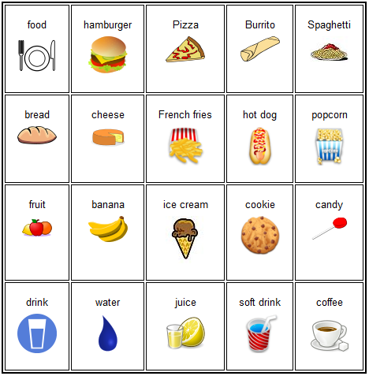
Augmentative and Alternative
Communication (AAC) device

Slide 21
MOBILE APPS FOR CHILDREN WITH AUTISM
Text-Based AAC Mobile Apps
A text-based AAC app is a text-to-speech communication aid. It reads aloud text-based messages that your child types.

Slide 22
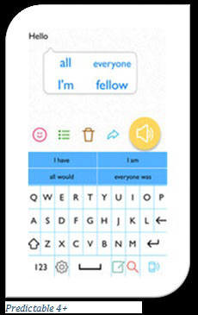
One example of a text-based AAC app is Predictable 4+. It provides word predictions to help your child type out his or her messages faster. The word prediction function is self-learning. It uses the letters your child has typed, his or her text usage patterns and vocabulary, and his or her preferred grammar and style of speech to provide accurate word predictions. When the app is opened, the screen displays three main options: a message box, a QWERTY keyboard, and a speak button. When your child types a word using the keyboard, it appears in the message box. Word predictions also appear in a bubble next to the word. For example, if your child types “hello,” word predictions such as “all,” “everyone,” I’m,” or “fellow” may appear. When he or she taps a desired word prediction, it appears in the message box. Using the previous example, the phrase “hello all” would appear after tapping “all.” Finally, after pressing the speak button, the app will read aloud the text contained in the message box.

Slide 23
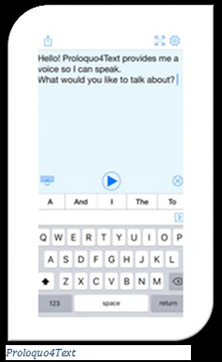
Another example of a text-based AAC app is Proloquo4Text.
The app can be set to either read the message aloud word-by-word as he or she types or only after he or she taps the play button.

Slide 24
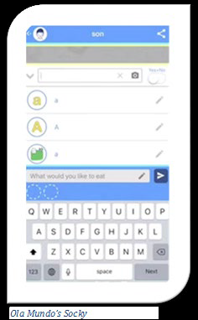
Picture-Based AAC Mobile Apps
A picture-based AAC mobile app is a picture-to-speech communication aid. It converts pictures into audio messages (via a speech synthesizer) and reads them aloud.
One example of a picture-based communicator is the Ola Mundo Socky app. When the app is opened, the screen displays three core options: a keyboard of categorized picture keys, a send button, and a message box containing the conversation thread between your child and a communication partner. The picture keys represent words divided into categories on the screen (e.g., favorites, people, actions, keywords, etc.).

Slide 25
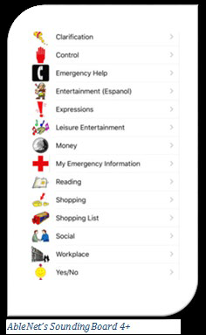
Another option is AbleNet’s SoundingBoard 4+. It consists of categorized folders of various communication topics (e.g., expressions, money, reading, emergency help, shopping, etc.) known as communication boards.

Slide 26
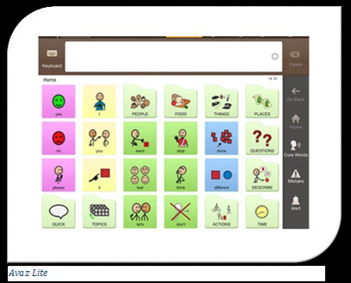
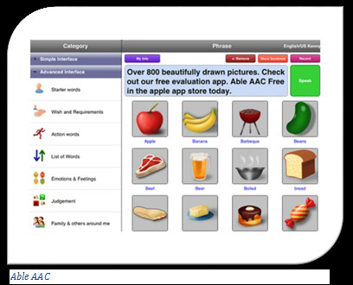
Picture- and Text-Based AAC Mobile Apps
As indicated, several AAC mobile apps offer either picture- or text-based communication. However, some apps offer both.
One example is Avaz Lite. When the app is opened, the screen displays two core options: a message box and a keyboard. The display can be toggled between picture or text modes. When in picture mode, the screen will display picture keys categorized in different folders. When in keyboard mode, a QWERTY keypad appears. Your child can mix text and pictures to create a message.
Notes:
National Autism Association. (n.d.). Autism fact sheet. Retrieved from
http://nationalautismassociation.org/resources/autism-fact-sheet/
World Health Organization. (2017, April 4). Autism spectrum disorders. Retrieved from
http://www.who.int/en/news-room/fact-sheets/detail/autism-spectrum-disorders

Slide 27
Use and Application of Assistive Technology in Education

Slide 28
CATEGORY/ AREA OF FUNCTION | ASSISTIVE TECHNOLOGY APPLICATIONS | NEED AND RELEVANCE IN CLASS- ROOM LEARNING
Reading | Electronic books, Book, adapted for page turning, Single word scanners, Predictable texts, Tabs, Talking electronic devices/software, Speech Software | For students having difficulty in reading and understanding written text and in paying attention to the reading assigned.
Writing | Pen/Pencil grips, Templates, Word processors, Word card/book/wall, software, Spelling/Grammar checker, Adapted papers | For students having problem in writing or composition
Math | Calculators, Talking Clocks, Enlarged Worksheets, Voice Output Measuring Devices, Scientific Calculators | For students having computational problems and confusions, and finding it difficult to perform well in Math lessons
Vision | Eye glasses, Magnifier, Screen Magnification, Screen Reader, Braille Large Print Books, CCTV, Audio Lesson Tapes | For students who have difficulty in seeing or lack complete vision

Slide 29
CATEGORY/ AREA OF FUNCTION | ASSISTIVE TECHNOLOGY APPLICATIONS | NEED AND RELEVANCE IN CLASS- ROOM LEARNING
Hearing | Hearing Aids, Pen and paper, Signaling Devices, Closed Captioning | For students who have difficulty in hearing or are absolute hearing impaired
Computer | Access Word prediction, Alternative Keyboards, Pointing Option, Switches, Voice recognition software | For students finding it difficult to access the computer in its standard form and have difficulty in performing academic Tasks
Augmentative/ Alternative Communication | Communication Board, Device with speech synthesis for typing, Eye gaze board/ frame, Voice output device | For students having problems in comprehension of language, and lacking the ability to express it, or are unclear in speech and demonstrate delayed expressive language

Slide 30
CATEGORY/ AREA OF FUNCTION | ASSISTIVE TECHNOLOGY APPLICATIONS | NEED AND RELEVANCE IN CLASS- ROOM LEARNING
Learning Disability and Attention Deficit Hyperactivity Disorder (ADHD) | Use Use of applications/devices depending upon the degree of disability/diculty, in the area of reading and writing (Dyslexia), handeye coordination, written expression and composition (Dysgraphia), diculty in ne motor skills, Coordination (Dyspraxia), Math (Dyscalculia) and Attention (ADHD) like - Talking electronic devices, Calculators, Electric Organizers, Highlighters, Pencil Grips, Post-its, Computers, Spelling/Grammar Checker, Electronic Organizers, Recorded materials, Hand held Scanners, Print or picture schedule, Electronic Diaries etc. | For Students having problem in language development, reading and writing (Dyslexia), hand-eye coordination, written expression and composition (Dysgraphia), diculty in ne motor skills, Coordination (Dyspraxia), Math (Dyscalculia), and ADHD.

Slide 31
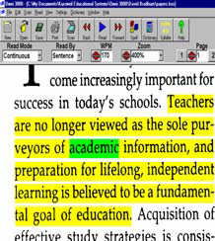
Kurzweil 3000
􀂄 reads scanned materials
and imported files while
improving reading
comprehension, speed
and fluency.
􀂄 includes highlighting,
writing and study skills
to aide in composing
writing assignments.

Slide 32
Assistive Technology
􀂇 Depending on the student’s disability, he or she
may be eligible to use assistive technology on
quizzes, exams, and out-of-class assignments.
􀂇 The student completes an Assistive Technology
evaluation with the Student Support Services coordinator in order to determine what technology would be appropriate.

Slide 33
Assistive Technology in Higher Education Survey Report
􀂇 Survey of higher education institutions regarding
their assistive technology deployment practices
􀂄 Screen Reader – 94.4%
􀂄 Screen Magnification Software – 93.1%
􀂄 OCR/Reading Solutions - 94.4%
􀂄 Speech Recognition – 91.7%
􀂄 Word Prediction Software – 66.7%
􀂄 Mouse Alternatives – 83.3%
􀂄 Hands-Free Speech Input –12.5%
􀂄 Writing Tools (software-based) – 54.2%

Slide 34
Web Accessibility & Usability
􀂇 The design of websites and web pages so that
persons with and without disabilities can access
online content to the greatest extent possible.
􀂄 Web accessibility includes making web pages readable
and usable by persons who use various assistive
technologies such as screen readers or learning
assistance software.
􀂄 Usability refers to performance, ease of use, and
understandability of web-delivered content.
􀂇 Both accessibility and usability are necessary for
effective websites.

Slide 35
Office of Disability Services
Tips for Faculty
Create a welcoming environment.
Incorporate Universal Design into teaching.
Hold students to the same standards as others.
Ask students about their strengths and difficulties.
Have textbook and other print material requests in
early, to assist ODS with alternative formatting.
Maintain confidentiality at all times.
Include a disability statement on all course syllabi.

Slide 36
The mission of the Office of Disability Services is to provide
each student with a disability an equal opportunity to
participate in the university's programs and activities. This
mission is accomplished by:
1. Creating a physically accessible, programmatically
accessible and attitudinally accessible community where
people are judged on their abilities, not their disabilities.
2. Promoting the development of a climate for everyone at
the university that is conducive to learning, personal
growth, acceptance, and appreciation of everyone
without regard to disability.

Slide 37
Conclusion
Students with hidden disabilities face a number of obstacles once they are admitted to college, but assistive technology can increase, maintain, or improve the capabilities of individuals with learning disabilities, AD/HD, or other cognitive challenges.
Rights of Persons with Disabilities Act (RPWD Act) and UNCRPD has mandated academic access in all areas of education for students with disabilities.
Student Responsibilities:
meet the essential qualifications and institutional standards.
Inform accommodation needs and provide appropriate documentation in a timely manner.
talk with faculties about accommodations in the classroom, as needed.

Slide 38
Conclusion
The keys to improving academic outcome and achievement in students with hidden disabilities are:
access to universities and their programs.
availability of reasonable accommodations.
appropriate support and resources.

