Slide 1
Towards inclusion of needs of Differently Abled Persons in Education and Research - Gender Concerns
Dr.M.Prabavathy
Assistant Professor and Director
Centre for Differently Abled Persons
Bharathidasan University
cdapraba@bdu.ac.in

Slide 2


Silent Prayer

Slide 3
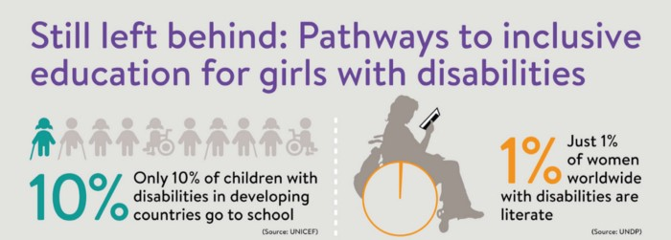

Objective of this session
In this session, we are going to analyze
WHAT
WHY
HOW
Of Disability and inclusion

Slide 4
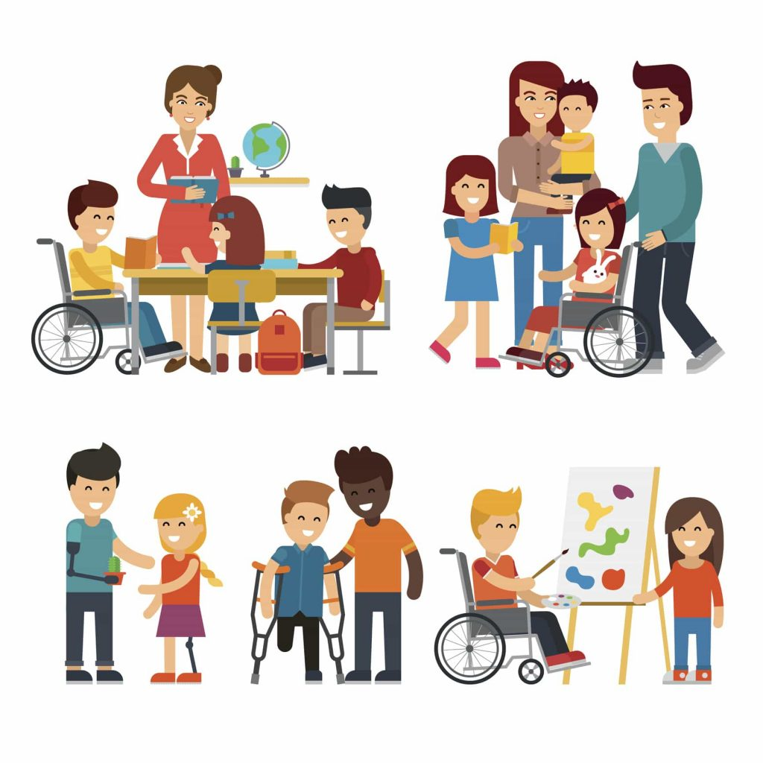

Disability and Diversity

Slide 5

Gender is a social construct that impacts attitudes, roles, responsibilities and behavior patterns of boys and girls, men and women in all societies.
Gender relations vary from society to society.
It is a women’s and people’s issues shaped by power relations in multicultural societies like India.
It deals with human concerns encompassing diversities and differences.

Slide 6
The International Classification of Impairments, Disabilities, and Handicaps of WHO
Handicap
Impairment
Disability

Slide 7
Impairment and Disability
Impairment refers to a problem with a
structure or organ of the body;
Handicap refers tois a functional limitation with regard to a particular activity and
Disability refers to a disadvantage in filling a role in life relative to a peer group.

Slide 8
What is a Disability?
Merriam-Webster Dictionary
the condition of being disabled
inability to pursue an occupation because of a physical or mental impairment;
World Health Organization
Any restriction or lack (resulting from an impairment) of ability to perform an activity in the manner or within the range considered normal for a human being.
Notes:
Different definitions of DA-dictionary-emphasizes inability to have “normal” life.
WHO and ADA have different criteria for defining

Slide 9
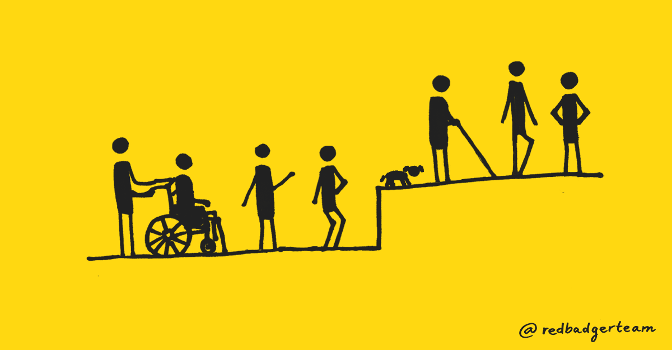
Models of Disability

Slide 10
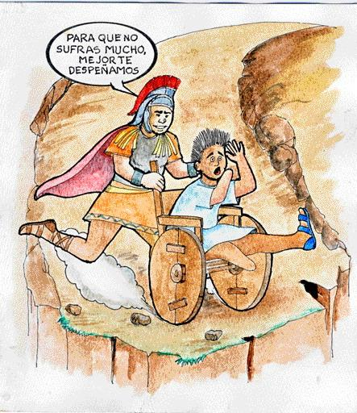
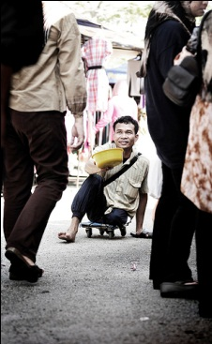
Traditional Model
I will kill you
so you stop
suffering
Disabilities as: - Will of God/test from God - Divine punishment
- More humane to end “life of pain/suffering”
Charity Model
People with disabilities considered:
inferior, useless, dependent
A burden to society, live on charity, lower social status
Families hide them out of shame
Objects of pity, humiliated in relationships with others

Slide 11
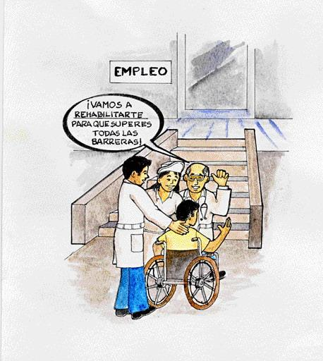
Medical or Biological Model -- Post WW II
Problem belongs to individual: disability results directly from impairment of the person.
Disability considered only a health problem, medical issue
Solutions decided by "experts”, based on diagnosis
Focus in elimination or cure of disability, “normalization”
(includes pre-natal genetic testing & selective abortion)
We will rehabilitate
you so you can overcome all barriers

Slide 12
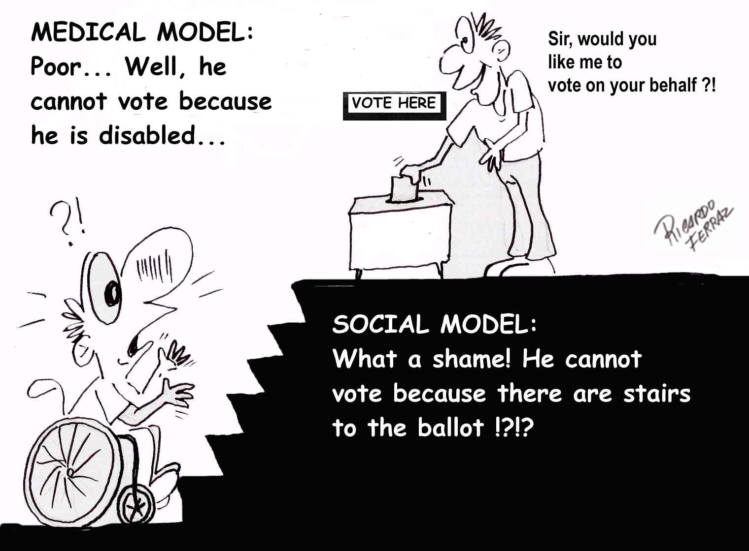
Disability Models
Biomedical/Rehabilitation Model
Disability viewed as a problem to be fixed
Society has no responsibility to accommodate
Environmental/Social Model
Disability caused/increased by environment
Society/Culture creates limitations
Minority/Human Variation Model
Disability viewed as difference without judgment value
Society accommodates differences
Notes:
Medical-”broken”, no longer fit into AB world, sorry.
Environmental- w/c-with ramp and elevator reduces impact of disability, ADHD-timed tests,
Minority-seen as diversity, DA as culture,

Slide 13

Human Rights Model
The main issue is in society rather than in the individual
Recognizes that disability is a part of society
More comprehensive and global. Considers:
- Civil and political rights (voting, freedom of expression )
- Economic, social and cultural rights (health, education ...)
- PwD and their families reclaim their place as PERSONS, with rights and duties.
Equal opportunities and full participation in political and social life.

Slide 14
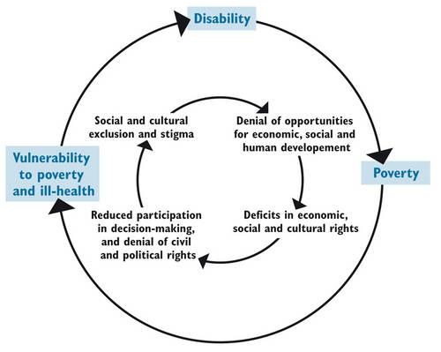
Poverty & Disability
WHO estimate approximately 15 percent of world’s population has a disability. This translates into over a million people, at least 200 million being children with disabilities (CWD), 80% of them living in developing countries.
Vicious cycle between poverty and disability

Slide 15
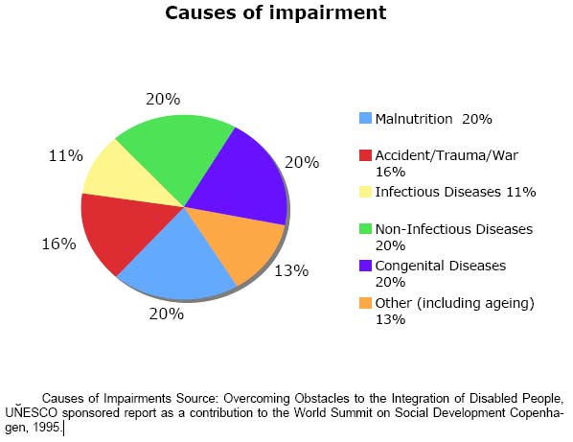
Causes of Impairments
About 80% of disabilities have causes associated to poverty. An estimated 130 million people globally acquired a disability due to malnutrition.

Slide 16
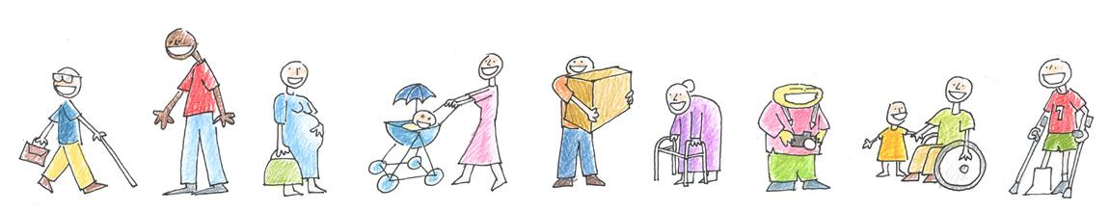
HOW IS DISABILITY DEFINED AFTER THE CRPD?
Interaction between persons with different levels of functioning and an environment that does not take those differences into consideration.
Disability= Functioning limitation x Environment
Note: we are using “functioning limitation” as a synonym of “impairment”.

Slide 17
Environment Impact in the relation between disability and functioning
FL 1 x E 0 => 0 Disability
FL 5 x E 0 => 0 Disability
FL 1 x E 1 = 1 Disability
FL 5 x E 5 = 25 Disability
FL: FUNCTIONING LIMITATION
E: ENVIRONMENT

Slide 18
The promotion of gender equality has been one of the main goals of inclusive education for several decades. Nevertheless, the distribution of male and female students with disabilities in education is still very unbalanced.

Slide 19
The National Policy on Empowerment of Women focuses on promoting gender sensitive curriculum for addressing gender discrimination at all levels of education.
.

Slide 20
The new draft of National Policy lays emphasizes on
Encourage
all irrespective of their socio-economic background
Encourage
E
M
P
O
W
E
R
Educate
Employ

Slide 21
When one analyses the present context of gender discourses, the prime concern is how gender functions as a determinant of politics of knowledge production.
Education has the inbuilt potential of initiating social change in the context of gender relations

Slide 22
Research on gender inequality (OECD 1993a:75) has shown that
Inequality in discrimination against girls and women. These conditions are created by the male norms in society
can be changed by in education
Notes:
Organisation for Economic Co-operation and Development

Slide 23
Causes of Gender imbalance
The lack of knowledge, awareness and acceptance of the reality of girls and women,
their different needs and competences,
leads to sex stereotyping and
other hidden forms of discrimination
(sexist curricula and syllabi, textbooks, teaching materials, sexist language and interactions, sex-stereotyped guidance and counselling),

Slide 24
Leads to
gender imbalance in school
employment, management, inspectorates,
insufficient consideration of women's working conditions and
health situation in the field of education and
their need of improved compatibility between work and family responsibilities OECD 2013

Slide 25
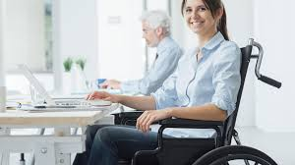
The achievement of equality between girls and boys, women and men, of all cultural and ethnic origins, is crucial to the very functioning of democracy, its development and the realisation of human rights.

Slide 26

The denial of education to girls and women contributed to the construction of their inequality.
The sexual division in society, the unequal power relationship of the sexes, the sex-segregated labour market, the sex-specific allocation of the responsibilites for children and household,
sexual harrassment and violence against girls and women obviously discriminate against girls and women.

Slide 27
NEP 2020
India’s National Education Policy 2020 (NEP) has been hailed as a new era in educational reform. However, it exists within a framework of pervasive policy gaps in the education of children with disabilities.

Slide 28

Specific disability categories and genders are affected disproportionately.
For instance, children with autism and cerebral palsy and girls with disabilities are least likely to be enrolled in schools.
Disability is most likely to inhibit a child’s access to pre-school and primary education. Less than 40% of school buildings have ramps and around 17% of schools have accessible toilets. Although technology is a key focus of the NEP, only 59% of schools across the country have access to electricity.

Slide 29
The finalized policy incorporates several recommendations of disability organizations on the 2019 draft.
The NEP asserts that children with disabilities will have opportunities for equal participation across the educational system.
A major victory is the recognition of the 2016 Rights of Persons with Disabilities Act (RPWD) and its provisions for inclusive education, defined as a system of education where students with and without disabilities learn together.
These recommendations include non-discrimination in schools, accessible infrastructure, reasonable accommodations, individualized supports, use of Braille and Indian Sign language in teaching, and monitoring among others.

Slide 30
School choice – special, regular, or home-based education?
The lack of coherence between the 2009 Right to Education Act (RTE) and the RPWD on the educational options for children with disabilities has been highlighted as a major point of contention.

Slide 31
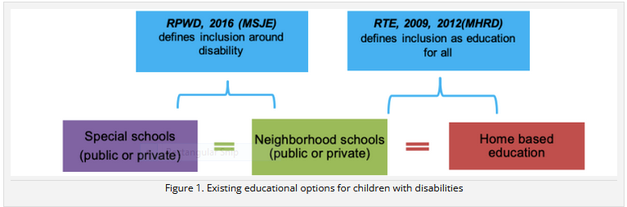

Slide 32
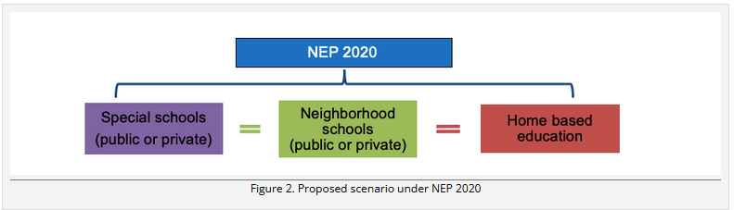

Slide 33
Status of home-based education
The NEP states that home-based education will be audited based on the norms in the RPWD. An audit of home-based education is essential as there are concerns about how children are identified to receive this provision and the quality of education provided to them. Block-level special educators have highlighted several challenges they faced in providing home-based education, including time and resource constraints, cultural norms and safety, and lack of clear curriculum and assessments.
However, the provisions on education in the RPWD focus on creating a system of inclusive education through accessible buildings and classrooms and individualized support towards full inclusion.

Slide 34
Governance of special schools
In accordance with the RPWD, the NEP includes special schools as an option for children with benchmark disabilities. However, it is unclear whether the newly re-named Ministry of Education will regulate special schools as regular schools or whether they will continue to fall under the ambit of the Ministry of Social Justice and Welfare (MSJE).
Not recognizing special schools as schools shortchanges children with disabilities – there are no clear guidelines around quality, curriculum, certification, or infrastructure. It reinforces the idea of parallel, segregated school systems for some instead of a common schooling system for all.

Slide 35
These division further shifts “social inclusion towards a charitable model of social isolation”

Slide 36
Introduction of the school complex
The NEP complicates the idea of school choice for children with disabilities by introducing school complexes and school rationalization policies. In this plan, schools within a 5-10-kilometer radius will be consolidated within one school complex. The document states that this will help ensure there are adequate resources for children with disabilities including resource centers and special educators.

Slide 37
Teachers and special educators
The NEP addresses several aspects of teacher education, preparation, and service conditions that are relevant for children with disabilities. These include short-term specialization courses to teach children with disabilities and modules on teaching children with disabilities within existing programs.

Slide 38
Standardized assessments, curricula, and target-based reforms:
The NEP emphasizes achievement of foundational literacy and numeracy (FLN) for all children by grade 3 – setting up a national mission to reach this target by 2025.

Slide 39
Gender equality as a goal of inclusive education

Slide 40
The importance of gender equality as a goal of inclusive education is evident when looking at its manifestation within official documents devised by UN agencies and other institutions to offer guidance and goals for achieving inclusive education for parents, educators and governments. A selection of these documents will be reviewed in the following section.

Slide 41
UNICEF
UNICEF (United Nations Children’s Fund) identifies gender equality as a basis for quality education: “When all children have access to a quality education rooted in human rights and gender equality, it creates a ripple effect of opportunity that influences generations to come.”(http://www.unicef.org/education/bege_70640.html)
In addition to the gender-gap in attending primary education, UNICEF further addresses the issue of gender inequality and gender discrimination within secondary education: “While gender parity has improved, barriers and bottlenecks around gender disparities and discrimination remain in place, especially at the secondary school level.” (ibid.)

Slide 42
UNESCO
As the lead agency for the ‘Education for All’ – movement (…), UNESCO (United Nations Educational, Scientific and Cultural Organization) adopted six goals for education during the World Education Forum held in Dakar, Senegal, in April 2000.
In the forum, the international community “identified six key education goals which aim to meet the learning needs of all children, youth and adults by 2025” (…).
All of these goals focus of equality and inclusion within education. The following two goals are especially relevant for achieving gender equality and the inclusion of both genders within primary and secondary education:

Slide 43
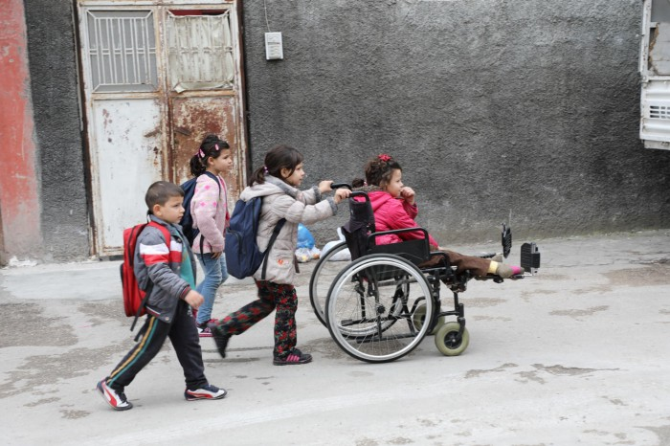
Goal 2
Ensuring that all children, particularly girls, children in difficult circumstances have access to, and complete, free and compulsory primary education of good quality.
Goal 5 Eliminating gender disparities in primary and secondary education, and achieving gender equality in education by 2025, with a focus on ensuring girls’ full and equal access to and achievement in basic education of good quality.

Slide 44
Educational inequality is caused by deeper forces in society that extend well beyond the boundaries of educational systems, institutions and processes.
A wide range of economic and social policies – as well as in education itself – will be needed if gender equality in education is to be attained.
UNESCO further suggests that the causes for gender inequality within education can be found in national curricula:

Slide 45
“An inclusive curriculum takes gender, cultural identity and language background into consideration. It involves breaking gender stereotypes not only in textbooks but in teachers’ attitudes and expectations.”

Slide 46
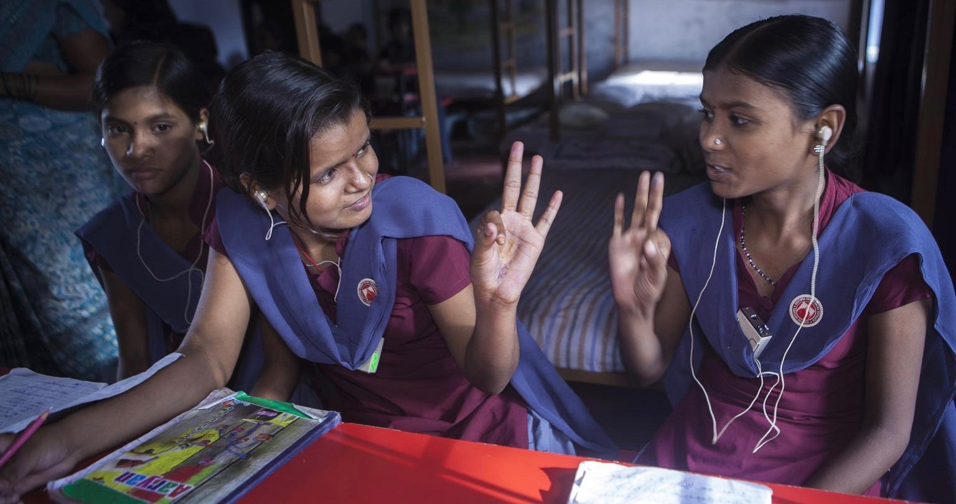

Slide 47
Read the full reports:
Still Left Behind: pathways to inclusive education for girls with disabilities
Adolescents with disabilities: enhancing resilience and delivering inclusive development
Rapid Evidence Assessment (REA) of what works to improve educational outcomes for people with disabilities in low- and middle-income countries
Watch this UNESCO webinar: Data Dive: making schools inclusive for children with disabilities
Explore the DFID conceptual framework for understanding marginalisation

Slide 48



THANK YOU !

