Slide 1
Introduction to Assistive Technology
Dr.M.Prabavathy
Asst Prof
Centre for Differently Abled Persons
Bharathidasan University
cdapraba@bdu.ac.in
Notes:
‹#›

Slide 2
The Power of Assistive Technology
“Technology has great potential in providing access for all learners. Through the use of a variety of assistive technologies, students with disabilities can have the ability to access the general curriculum. When assistive technology is appropriately integrated into the regular classroom, students are provided with multiple means to complete their work”
Janet Jendron
University of South Carolina Assistive Technology Project
“The Power of Assistive Technology”
www.fctd.info

Slide 3
What is Assistive Technology?
AT is “any item, piece of equipment, or product system, whether acquired commercially off the shelf, modified or customized, that is used to increase, maintain, or improve the functional capabilities of a child with a disability”
- 20 USC 1401(1)
AT can be anything from a simple device, such as a magnifying glass, to a complex device, such as a computerized communication system.
www.fctd.info

Slide 4
Assistive technology has also been defined as “devices and software designed specifically for those with learning or physical disabilities” and “powerful tools that support physically challenged students with equal opportunities to more fully participate in the teachinglearning process ” (Cobb, 2012, p. 47).

Slide 5
AT Fosters Inclusion
Inclusion: The practice of educating all or most children in the same classroom, including children with physical, mental, and developmental disabilities. (Association for Supervision and Curriculum Development)
AT helps students who have disabilities learn the material in a way that they can understand it
AT helps eliminate barriers students may face that prevent them from being at the same level as their classmates
www.fctd.info

Slide 6
AT Benefits ALL Students
15-20% of the general population is in need of some type of “cognitive task assistance.”
A large population of “at risk” students need assistance, but because they don’t easily fit into a diagnostic profile, they do not receive assistance; if AT is available to everyone, these students can benefit.
AT aids in all of the subject areas in school.
www.fctd.info

Slide 7
What Is Assistive Technology (AT)?
Assistive technology (AT) refers to the special devices and software that people with disabilities can use to access the environment and gain information.
The law defines an assistive technology device as any item, piece of equipment, or product system (whether acquired commercially, modified, or customized) that is used to increase, maintain, or improve the functional capabilities of individuals with disabilities.

Slide 8
Persons with Disabilities have the Right to…
Live independently
Enjoy self determination
Make choices
Benefit from education
Pursue meaningful careers
Enjoy full inclusion and integration in the economic, political, social, cultural and educational mainstream of society

Slide 9
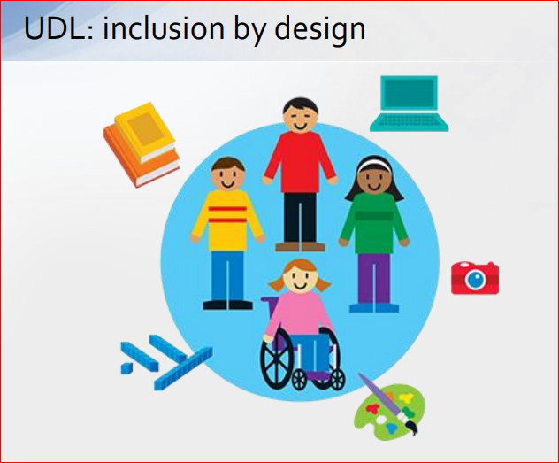
Universal Design for Learning (UDL) is a research-based framework that helps teachers plan learning to meet the diverse and variable needs of all students.
Universal Design is a principle that is borrowed from architecture.
The idea is to “build-in” accessibility, so that as many people as possible can have access.
Notes:
inclusive.tki.org.nz/guides/ universal-design-for-learning
‹#›

Slide 10
How We Teach
Child behavior
INPUT
PROCESS
OUTPUT
What if the child does not have easy access to the input (sensory) or access to the output (communication/motor)?
Notes:
‹#›

Slide 11
Input
80% of learning is through your vision
Vision and hearing are your distance senses
95% of all learning is through your distance senses
90% of learning is incidental
Learning progresses from the known to the unknown

Slide 12

The disability is not the Sensory Impairment
The disability is in
INFORMATION GATHERING
Notes:
‹#›
All learning is through your senses. Come back to senses. Not all senses are equal. Refer back to post-its.
Vision specialist in early intervention. Deaf in terms of linguistic patterns. SLPs talk about comparative language. Vision specialists talk about schemes. But all this is related. All this is going from the known to the unknown. How we learn, concept development, putting file cabinets in my head.
Do the Spelling test.

Slide 13
“The use of assistive technology to support the needs of special education students has been a revelation and has begun a small revolution in student achievement, so that many students are now able to access, develop and display what they know in ways that have never been possible for them before.”

Slide 14
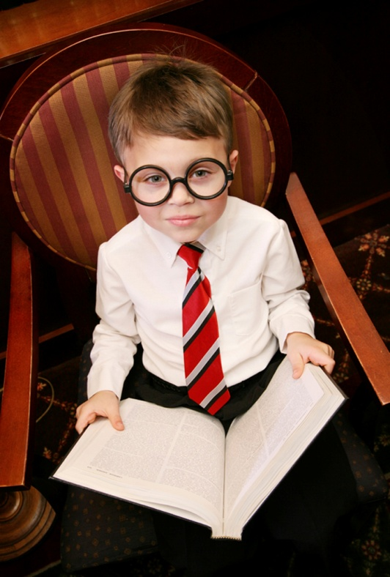
Assistive Technology in the Schools
Legal Aspects of Assistive Technology
Legislation
Implications for schools
Implementation in the Schools
Overview of assistive technology devices/services
Educational interventions
Resources
Notes:
‹#›
Providing access to the general curriculum and improving achievement for students with disabilities are primary goals of both IDEA and NCLB –
Many students with disabilities have reading and writing difficulties that make it difficult for them to achieve these goals.
Assistive Technology can be an effective tool in providing educational opportunities -
My purpose is to provide an overview of AT – give you enough information and resource materials so you can pursue more information-
Legal Basis for Assistive Technology and implications
What is looks like in the schools
not just severe students – probably implementing in your classroom
And….Resources

Slide 15

Role of Assistive Technology
Tremendous potential to promote equity for students with disabilities……
independent
self-confident
productive
integrated into school and society.
Technology is for ALL children – for students with disabilities, it may need to be more personalized.
Notes:
‹#›
Assistive Tech – levels the playing field for students w/ disabilities – it redefines what is possible for children with disabilities – enabling them to be more….
The IEP is a powerful tool to assist educators, parents and students to develop effective ways of putting AT solutions into educational programs which meet student needs and promote an equitable environment – one in which accommodations are seen as regular, normal and expected.

Slide 16

The Assistive Technology Continuum
No-tech
Low-tech
Medium-tech
Hi-tech

Slide 17

No-Tech Assistive Technology
No-tech solutions make use of procedures, services and existing conditions in the environment that do not involve the use of devices or equipment.
These might include services such as physical therapy, occupational therapy or the services of other specialists.

Slide 18
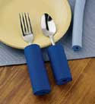

Low Tech Assistive Technology
Low-tech items are less sophisticated and can include devices such as adapted spoon handles, non-tipping drinking cups and Velcro fasteners.

Slide 19
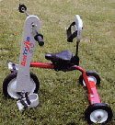
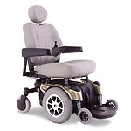

Medium Tech Assistive Technology
Medium-tech devices are relatively complicated mechanical devices, such as wheelchairs.

Slide 20

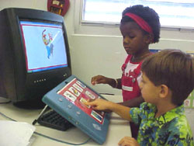

High Tech Assistive Technology
High-tech devices incorporate sophisticated electronics or computers.

Slide 21
Teaching All Students, Reaching All Learners, including Students with Disabilities as Diverse Learners
Augmentative and alternative communication devices
hearing aid and/or assistive listening device, text to speech, picture to speech
Electric wheelchair
Alerting device
environmental awareness for people who are deaf/heard of hearing, i.e. alert to file alarm, telephone, doorbell
Mouse alternatives
track ball, touch pad, head mouse
Keyboard alternatives
alternative ways of keyboarding, i.e. on-screen keyboard, touch screen
Screen readers
accessing screen via voice or touch, i.e. JAWS, Window-Eyes, TelleBraille N’ Speak
Screen magnifiers
magnify and manipulate look of the screen, i.e. built-in computer screen readers, ZoomText
Text to speech: Ureader; Read & Write; Built in on Mac OS; Kurzweil
write or choose picture and device “speaks”, i.e. Ureader, built-in (MAC), Kurzweil
Voice recognition: Dragon Naturally Speaking; iListen (Mac)
speak instead of writing or using mouse—Dragon Naturally Speaking, iListen (MAC)
Word prediction programs: Co-Writer; SoothSayer; Telepathic 2000
speak instead of writing or using mouse—Dragon Naturally Speaking, iListen (MAC)

Slide 22
Types of High-Tech Universal Assistive Technology
Variations in keyboard design
ergonomic, natural, adjustable, etc.
MP3 player/CD player/Tape Player
audio players to listen to textbooks and lectures
Optical character recognition/Scanner
scan books and notes onto PC (also used by individuals, libraries and government to store information)
Tape Recorder/Digital Recorder
record lectures, books
Word Processor
access to print, writing, communication
Text Messaging
Notes:
‹#›

Slide 23
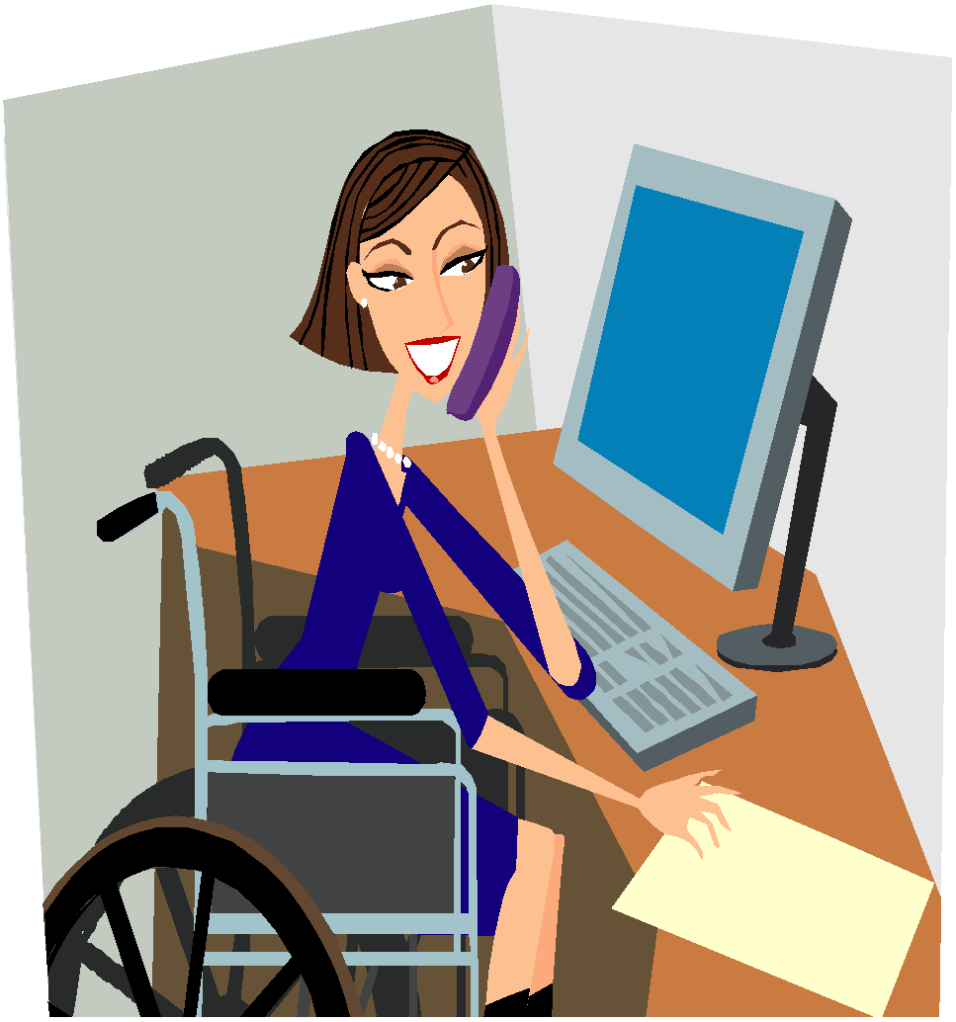
Categories of Assistive Technology
There are many types of assistive technology to aid individuals in all aspects of life.

Slide 24
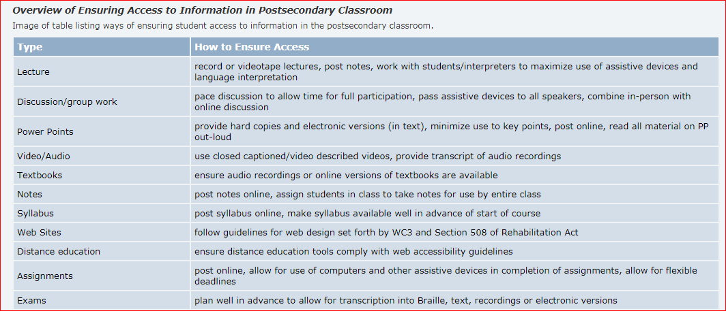

Slide 25
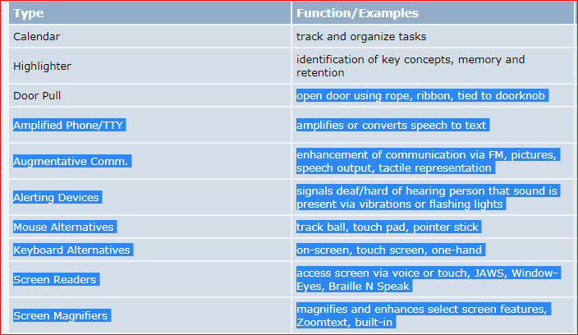

Slide 26
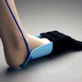
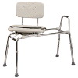

Daily living
Daily Living aids are for use in activities such as eating, bathing, cooking, dressing, toileting, and home maintenance.
Notes:
‹#›
Example: grab bars and a shower chair for bathing.

Slide 27
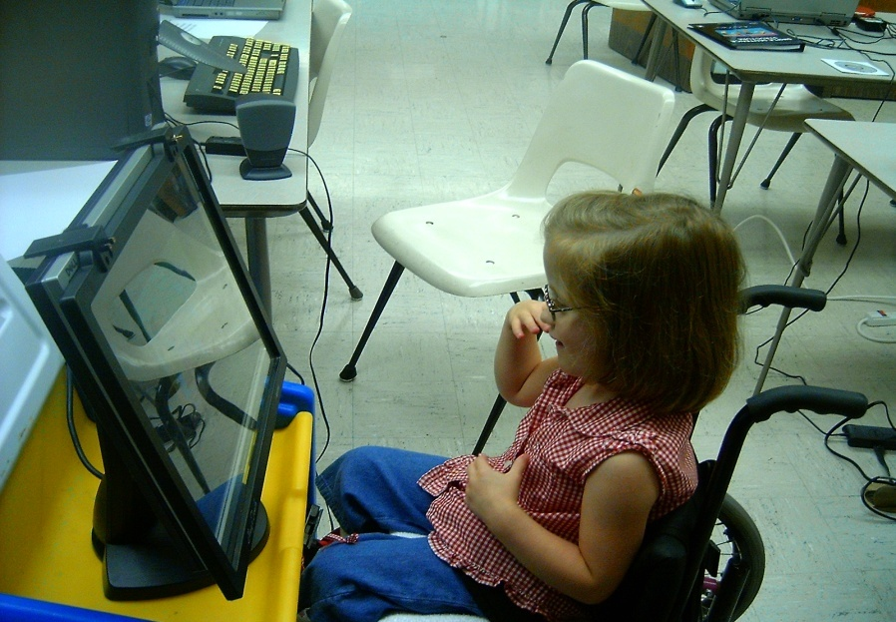
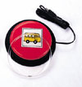

Computer technologies
Computer technologies are input and out- put devices that enable persons with disabilities to use a computer.
Notes:
‹#›
Example: Voice activated system for computer, allows an individual with limited use of hands to write articles without the need for a keyboard.

Slide 28
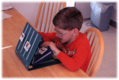
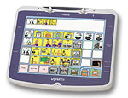
Augmentative Communication
Augmentative Communication devices provide a means for communication for persons with limited speech.

Slide 29


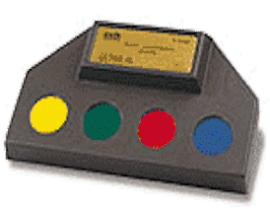
Environment Control Units
ECU’s (electronic systems) enable someone with limited mobility or fine motor skills to control devices in the home or other surroundings.
Notes:
‹#›
Example: equipping a home with electronic controls for the doors, lights, television and radio to allow greater independent functioning in the home.

Slide 30
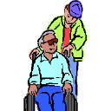
Seating and positioning
Seating and positioning accommodations to a wheelchair or other seating system to provide greater body stability, trunk /head support and an upright posture, and the reduction pressure on the skin surface (cushions, contour seats, lumbar supports).
Notes:
‹#›
Example: Equipping a wheelchair with straps to prevent injury to lower body, give greater upper body support and to secure while chair is in motion.

Slide 31

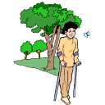

Mobility Aids
Manual and electric wheelchairs, mobile bases for custom chairs, walkers, three wheel scooters and other utility vehicles used for increasing personal mobility.
Notes:
‹#›
Example: upgrading from a manual wheelchair to a power wheel chair allowing for greater mobility and increased independence.

Slide 32
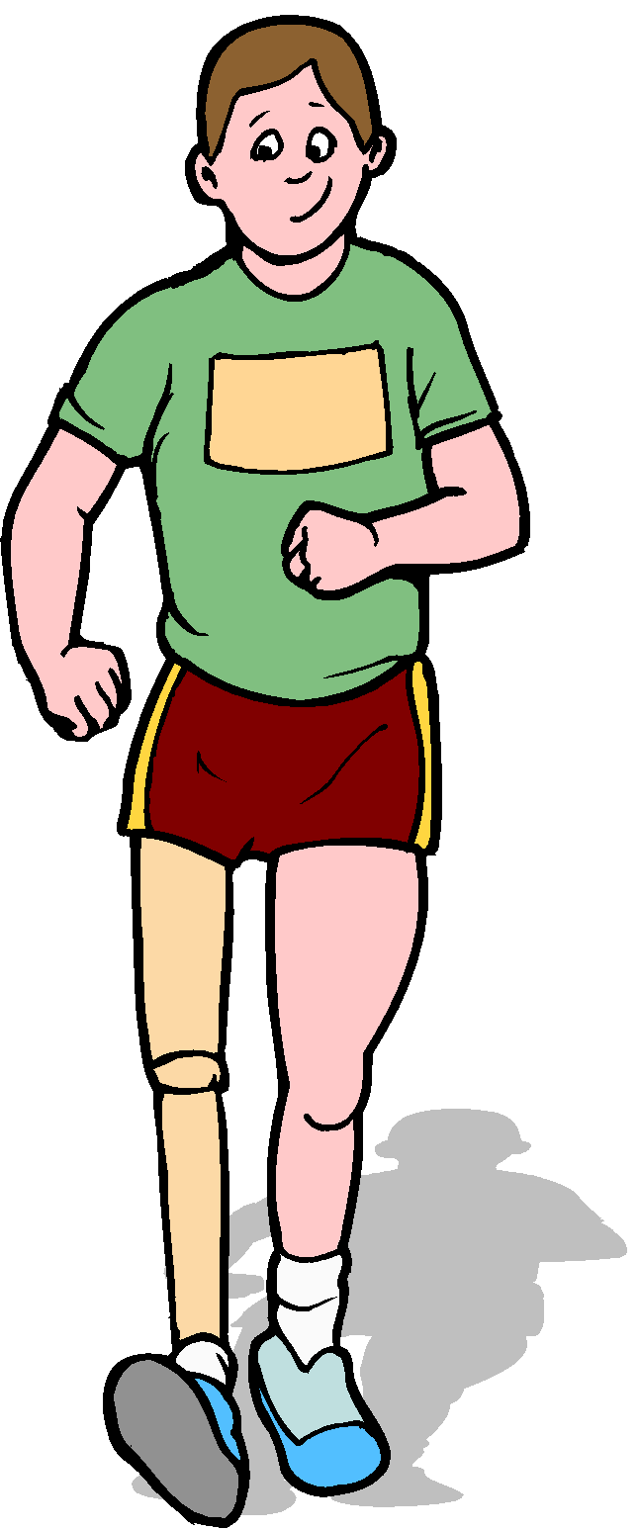
Prosthetics and orthotics
Replacements, substitutions or augmentation of missing or malfunctioning body parts with artificial limbs or other orthotic aids (splints, braces, etc.)
Notes:
‹#›
Example: using a leg prosthesis in order to walk.

Slide 33

Home, school and worksite modifications
Home and workplace modifications are structural adaptations, fabrications in the home, worksite or other areas (ramps, lifts, bathroom changes) that remove or reduce physical barriers for an individual with a disability.
Notes:
‹#›
Example: using stair glide installed in the home to have access to the first and second levels of the home for a person who has difficulty using stairs.

Slide 34

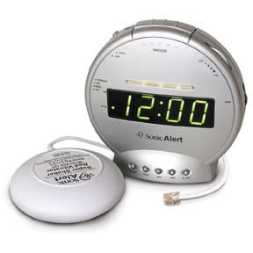
Sensory aids
Sensory assistive technologies enable an individual with hearing, sight, or other sensory impairments.
Notes:
‹#›
Examples include: magnifiers, speech output devices, telephone amplifiers, text telephones, and tactile objects.

Slide 35

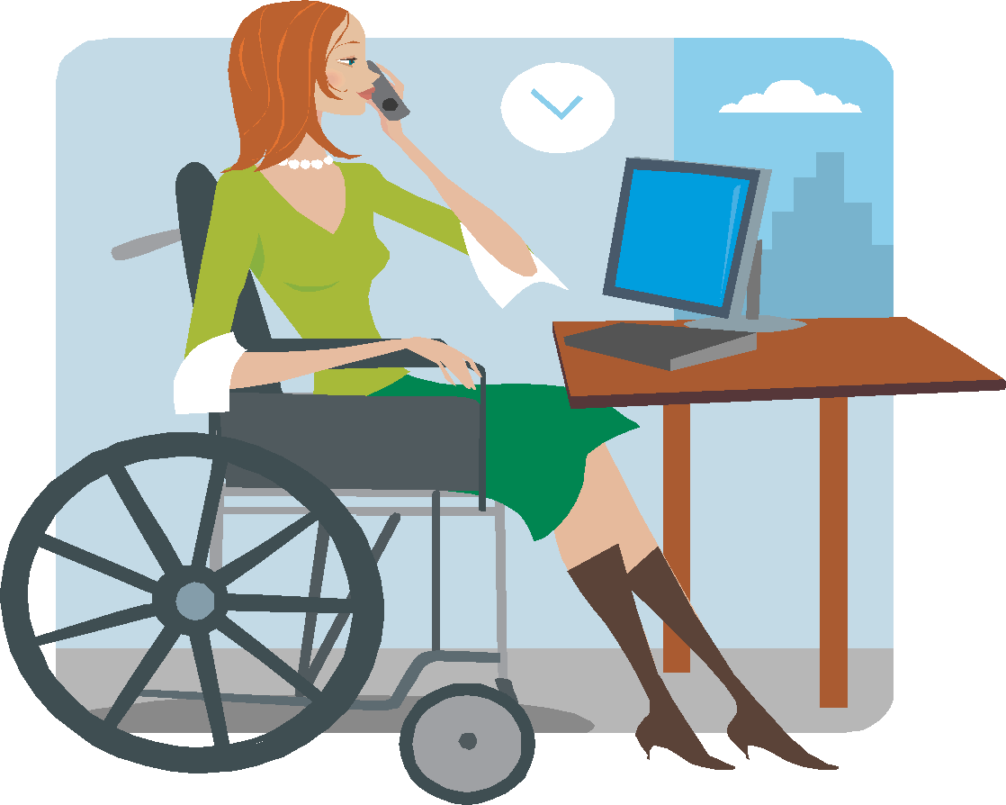
Assistive Technology Tools Learning and Studying
Print or Picture Schedule
Highlighting Text
Recording Material
Voice Output Reminders
NCR Paper
Low Tech Aids to Identify Materials
Electronic Organizers
Palm Computers
Software
Notes:
‹#›
There are a variety of tools that can help a student who struggles with the basic tasks of learning and studying. Things like organizing time, organizing information, and retrieving information can be critical to a student’s success. Here are several suggestions that can help the student who struggles with these problems.

Slide 36

Universal Design for Instruction (UDI)
Universal Design
Design products & environments to meet a wide range of needs
Ex: ramps, curbs, automatic doors
Architectural concept
Universal Design for Learning (UDL)
Make learning goals achievable by wide range of individuals
Built into instructional design/operating systems of educational materials
Not added on after the fact

Slide 37
In education:
Universal Design means planning ahead in regard to instruction, curriculum, materials, classroom layout, etc. so that children can have seamless or near seamless access.
Technology is a big part of making Universal Design a reality.

Slide 38
Today, we all accept that technology has become a major driving force contributing to the success and quality of life for everyone.

Slide 39
Low-tech Assistive Technology
Pencil grips
Planners
Audiobooks
Digital clocks
Calculators
Mid to Hi-tech Assistive Technology
Digital recorders
Digital books
Graphing calculators
Electronic math worksheets
Portable or adapted keyboards
Mobile technology (e.g., tablets, iPods, iPads, smartphones, MP3 players, etc
Reading systems that utilize a computer, scanner, and software to “read” scanned book pages out loud (e.g., Kurzweil)
Speech recognition software that allows a computer to operate by speaking to it (e.g., Siri)
Speech recognition systems that turn oral language into written text (e.g., Dragon)
Software that predicts and edits words for students who struggle with spelling (e.g., WordQ)
“Talking” calculators that assist students with math challenges
Mind mapping/outlining software
Global Positioning System (GPS)

Slide 40
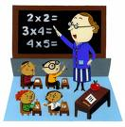
AT in the Service Learning Classroom
Low-Tech
Hard copies of notes provided by the instructor or other student
Outlines, double spaced, with key words provided by the teacher or note taker
Printed materials double-spaced and with larger print
tape recorders
Calculators with voice synthesizer
Books on tape
High-Tech
Lap top computer for note taking
Electronic spelling masters or dictionary with voice output
Word prediction software
Outline software
Reading and scanning software
Voice recognition software

Slide 41
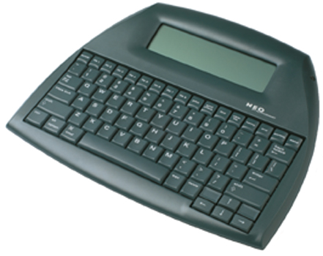

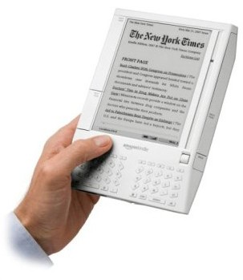
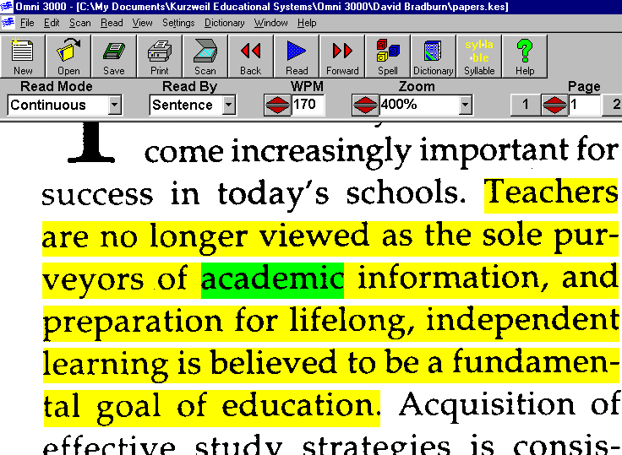
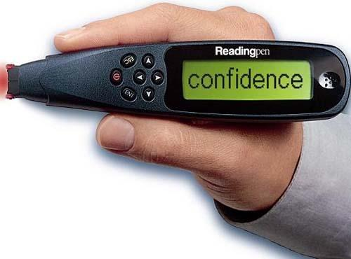
AT in the Service Learning Classroom
Reading and Scanning Software
Notes:
‹#›

Slide 42
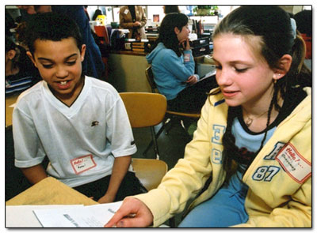

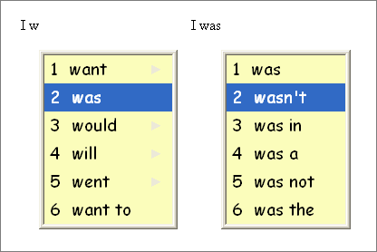

AT in the Service Learning Classroom
Voice Recognition
Writing Tool: outline and organize ideas
Word Prediction Software

Slide 43
AT in the Classroom: What about MATH?
Tech Matrix: developed by Center for Implementing Technology in Education and National Center for Technology Innovation at http://www.techmatrix.org/ .
Can select subject and types of supports needed.

Slide 44
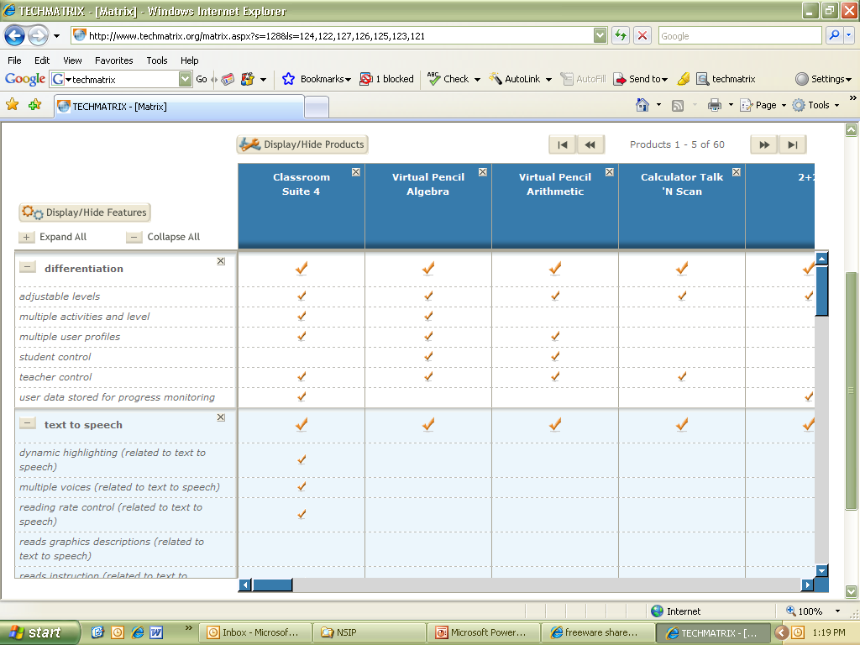
AT in the Classroom: What about MATH?

Slide 45
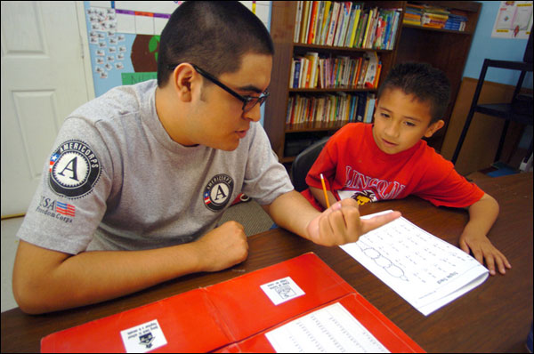
AT in the Service Environment
Low-Tech
To-do lists
Date planner (electronic or paper and pencil) and electronic reminders
Color post-it notes
Quiet space
Telephone with headset
Organized filing system
Clip board
High-Tech
Alternative keyboards and mice
Digital recorder
Ergonomic desk, height adjustable tables
Service-site modifications
Reading and scanning software
Voice recognition software

Slide 46
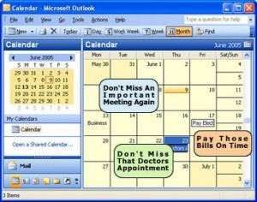
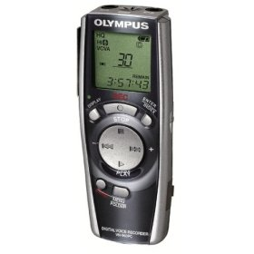
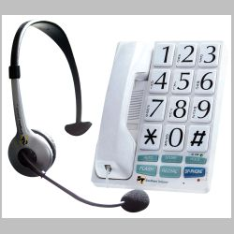
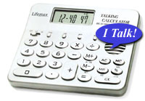
AT in the Service Environments

Slide 47
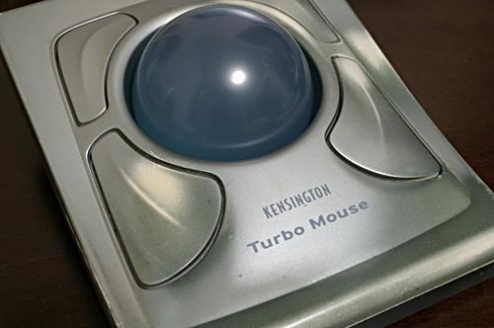
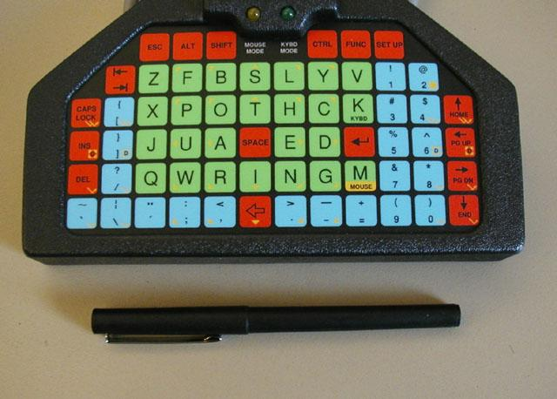
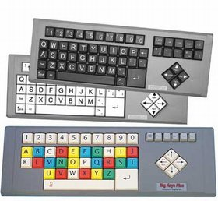
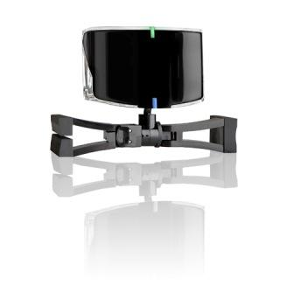
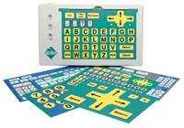
AT in the Service Environments

Slide 48
When students with disabilties are effectively able to use AT, they may experience many benefits, including:
improved academic achievement,
a more positive overall school experience,
greater enthusiasm for school,
enhanced self-esteem,
enhanced self-efficacy, and
increased time spent on academic tasks.

Slide 49


Technology Tips
Consider low-tech solutions first.
Build a network of individuals knowledgeable about equipment and low-tech strategies.
Access local, regional and national resources.
Consider adaptable equipment when purchasing new technology and other educational products.
Systems should be portable.
BE CREATIVE!
Notes:
‹#›

Slide 50

TIS Technology Tips
See Equipment Tips Handout
Provide print or tactile copy of screens
Verbal descriptions
Be cognizant of background noise
Lighting enough to see…watch for glare
Choose font, size, color for strong contrast
Paler highlighters
Uncluttered screens
Described and Caption Media Program: http://www.dcmp.org/

Slide 51


Resources
Article: Using Flexible Technology to Meet the Needs of Diverse Learners: What Teachers Can Do
Pathways to Learning for Students with Cognitive Challenges
AT 101: Assistive Technology Glossary
Universal Design for Instruction
Web Resources for Assistive Technology in the Classroom
Assistive Technology Funding in the Schools
TIS TECHNOLOGY TIPS
WVATS Mini-grants

Slide 52

WV RESOURCES
West Virginia Department of Education Office of Special Programs Contact:
Annette Carey (acarey@access.k12.wv.us)
Kathy Knighton kknighto@access.k12.wv.us 1-800-642-8541, (304) 558-2696
West Virginia Department of Health and Human Resources WV Birth to Three Program Contact: Pam Roush (304) 558-6311, 1-800-642-9704
WV Early Childhood Resource Lending Library (ECRLL) 558-5388 1-800-642-9704
West Virginia Assistive Technology System (WVATS) 1-800-841-8436, www.ced.wvu.edu
West Virginia Division of Rehabilitation Services Contact: Bev Binford, (304) 776-4702 http://www.wvdrs.org, 1-800-642-8207

Slide 53







Thank-you!
*
Notes:
‹#›

