Slide 1
SANITATION

Slide 2
STILL A DISTANT DREAM
ENVIRONMENTAL HEALTH IS IN
DANGER IN INDIA
1848 - GREAT SANITARY AWAKENING
OCCURRED IN EUROPE
2005 - SANITARY AWAKENING IS
STILL A DREAM IN INDIA
BETTER LATE THAN NEVER

Slide 3
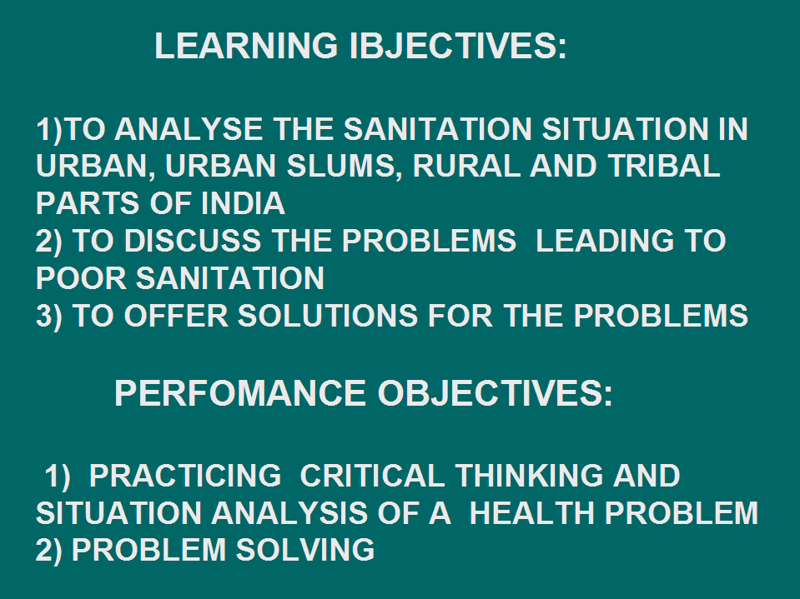
LEARNING IBJECTIVES:
1)TO ANALYSE THE SANITATION SITUATION IN URBAN, URBAN SLUMS, RURAL AND TRIBAL PARTS OF INDIA
2) TO DISCUSS THE PROBLEMS LEADING TO POOR SANITATION
3) TO OFFER SOLUTIONS FOR THE PROBLEMS
PERFOMANCE OBJECTIVES:
1) PRACTICING CRITICAL THINKING AND SITUATION ANALYSIS OF A HEALTH PROBLEM 2) PROBLEM SOLVING

Slide 4
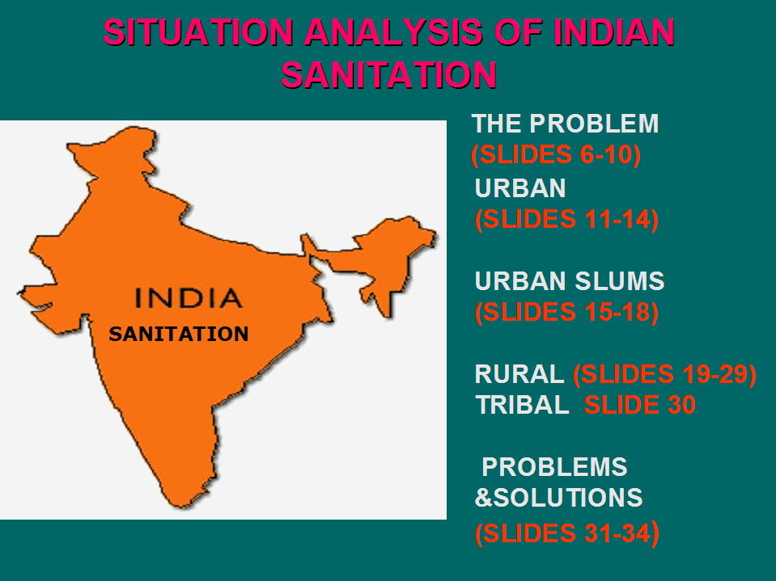
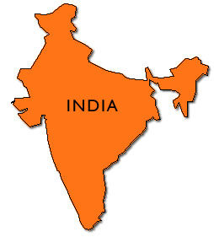
SITUATION ANALYSIS OF INDIAN SANITATION
THE PROBLEM
(SLIDES 6-10)
URBAN
(SLIDES 11-14)
URBAN SLUMS
(SLIDES 15-18)
RURAL (SLIDES 19-29)
TRIBAL SLIDE 30
PROBLEMS &SOLUTIONS
(SLIDES 31-34)
SANITATION

Slide 5
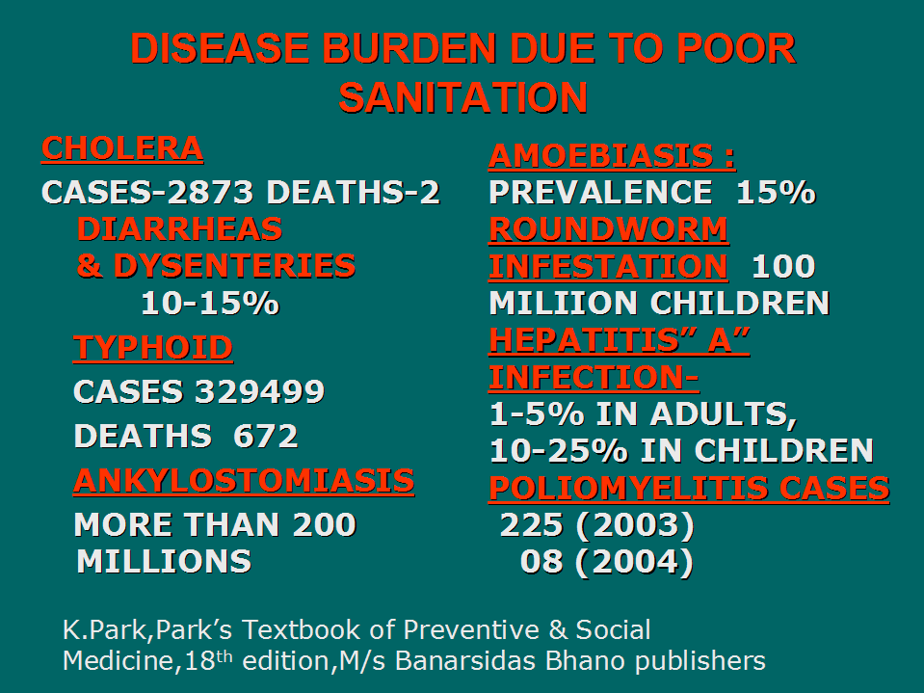
DISEASE BURDEN DUE TO POOR SANITATION
CHOLERA
CASES-2873 DEATHS-2 DIARRHEAS
& DYSENTERIES
10-15%
TYPHOID
CASES 329499
DEATHS 672
ANKYLOSTOMIASIS
MORE THAN 200 MILLIONS
AMOEBIASIS :
PREVALENCE 15%
ROUNDWORM INFESTATION 100 MILIION CHILDREN
HEPATITIS” A” INFECTION-
1-5% IN ADULTS, 10-25% IN CHILDREN
POLIOMYELITIS CASES
225 (2003)
08 (2004)
K.Park,Park’s Textbook of Preventive & Social Medicine,18th edition,M/s Banarsidas Bhano publishers

Slide 6
VECTOR BORNE DISEASES
DUE TO POOR SANITATION
MALARIA
1.34 MILLION CASES (2021), DEATHS 90
DENGUE FEVER
CASES 1.9lakh , DEATHS 346(2021)
FILARIASIS
CASES 6.43lakh (2020)

Slide 7
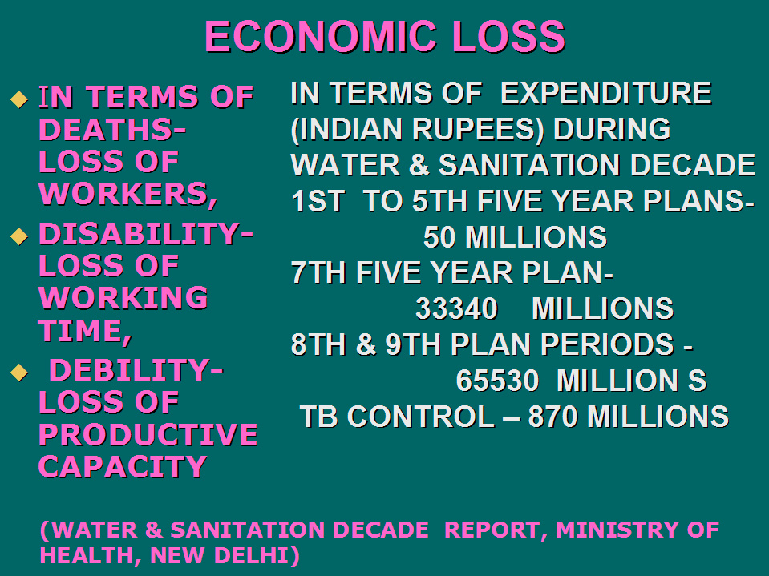
ECONOMIC LOSS
IN TERMS OF DEATHS-LOSS OF WORKERS,
DISABILITY-LOSS OF WORKING TIME,
DEBILITY- LOSS OF PRODUCTIVE CAPACITY
IN TERMS OF EXPENDITURE (INDIAN RUPEES) DURING WATER & SANITATION DECADE
1ST TO 5TH FIVE YEAR PLANS-
50 MILLIONS
7TH FIVE YEAR PLAN-
33340 MILLIONS
8TH & 9TH PLAN PERIODS -
65530 MILLION S
TB CONTROL – 870 MILLIONS
(WATER & SANITATION DECADE REPORT, MINISTRY OF HEALTH, NEW DELHI)

Slide 8
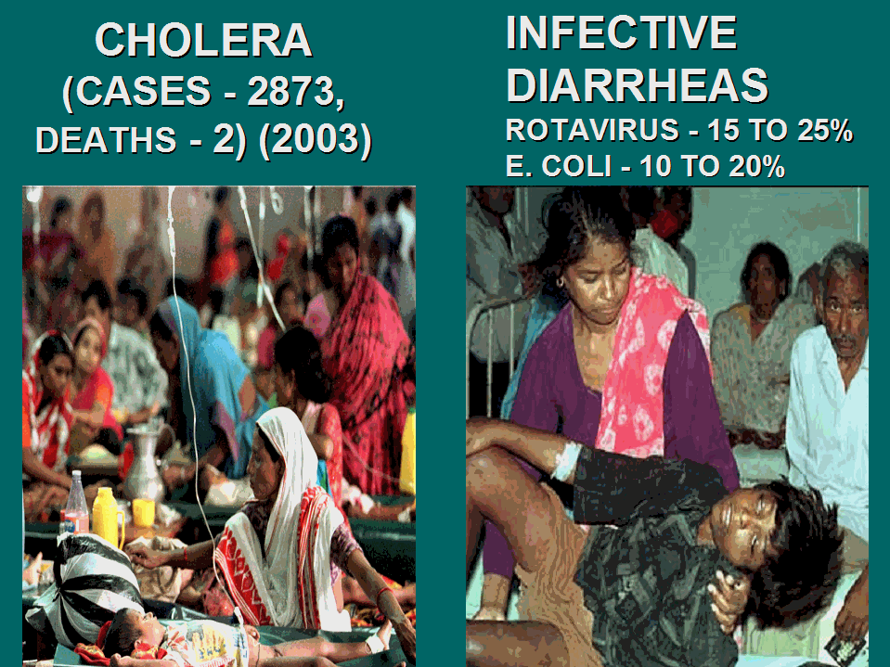
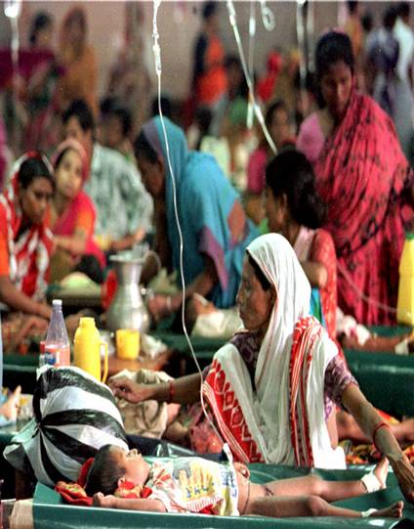
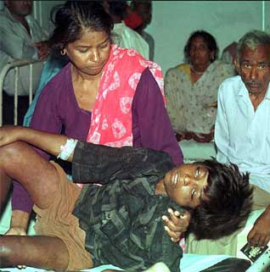
CHOLERA
(CASES - 2873,
DEATHS - 2) (2003)
INFECTIVE DIARRHEAS
ROTAVIRUS - 15 TO 25%
E. COLI - 10 TO 20%

Slide 9
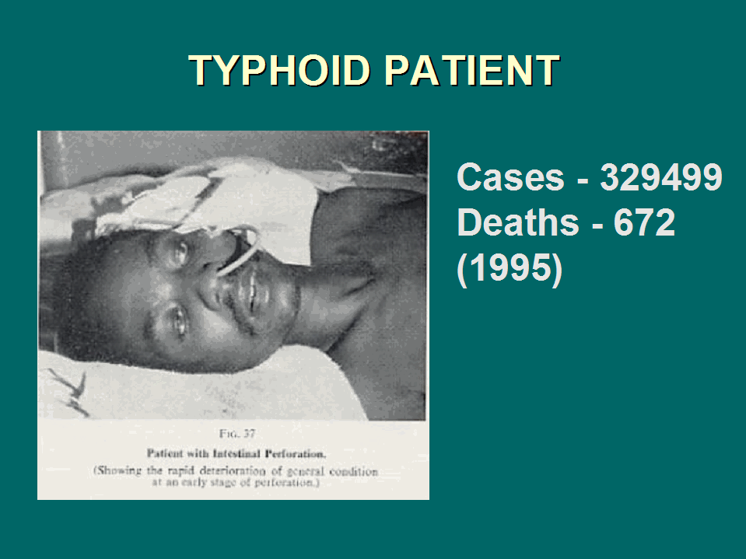
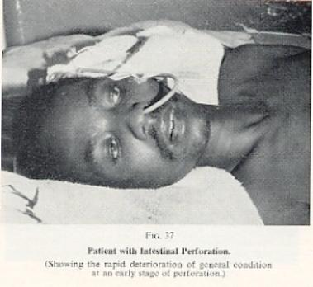
TYPHOID PATIENT
Cases - 329499
Deaths - 672
(1995)

Slide 10
URBAN INDIA
NEW DELHI –THE CAPITAL OF INDIA – A FREQUENT VICTIM FOR CHOLERA EPIDEMICS - AN INDICATOR OFF BAD SANITATION
MOST OF THE INDIAN CITIES ARE HOSTING ALL THE MAJOR COMMUNICABLE FILTH DISEASES
EVERY INDIAN CITY IS SURROUNDE BY HUNDREADS OF URBAN SLUMS, THE ABODES OF POOR SANITATION

Slide 11
FAST FOODS CENTRES
AND GETTING INFECTED
EATING FROM ROADSIDE FAST FOOD ESTABLISHMENTS HAS BECOME AN ORDER OF THE DAY
MOST COMMON PICTURE IN COSMOPOLITAN AND GROWING CITIES
HURRIEDLY EATING TO ATTEND OFFICES
PLENTY OF DUST ON EATABLES.
NO HAND WASHING BY SERVERS
THE SEWAGE RIGHT NEXT TO THE EATING PLACE WITH FLIES ON FOOD IS THE USUAL PICTURE

Slide 12
SANITATION SCENARIO AT INDIAN RAILWAY STATIONS
WHENEVER YOU ENTER ANY INDIAN CITY BY A TRAIN, YOU WILL BE GREETED BY FOUL SMELLING SEWAGE AND PEOPLE PUBLICLY DEFECATING AT THE OUTER STATION WHERE THE TRAIN STOPS FOR SIGNAL.
PASSENGERS IN A TRAIN SPITTING IN THE COCHES ITSELF
PASSENGERS THROWING ALL THE RUBBISH IN THE COACHES
PASSENGERS BADLY USING THE TOILETS IN A TRAIN
PASSENGERS SMOKING IN THE TRAIN
RAILWAY TRACKS COVERED BY FILTH AND FLIES IN STATIONS AND THESE FLIES SETTLING ON THE OPEN FOOD ITEMS ON THE PLATFORMS
Notes:
POOR QUALITY MINERAL WATER BOTTLES AND SOMETIMES EVEN UNPROTECTED WATER BOTTLES SOLD IN TRAINS
FOOD ITEMS WITHOUT PROPER COVERAGE SOLD

Slide 13
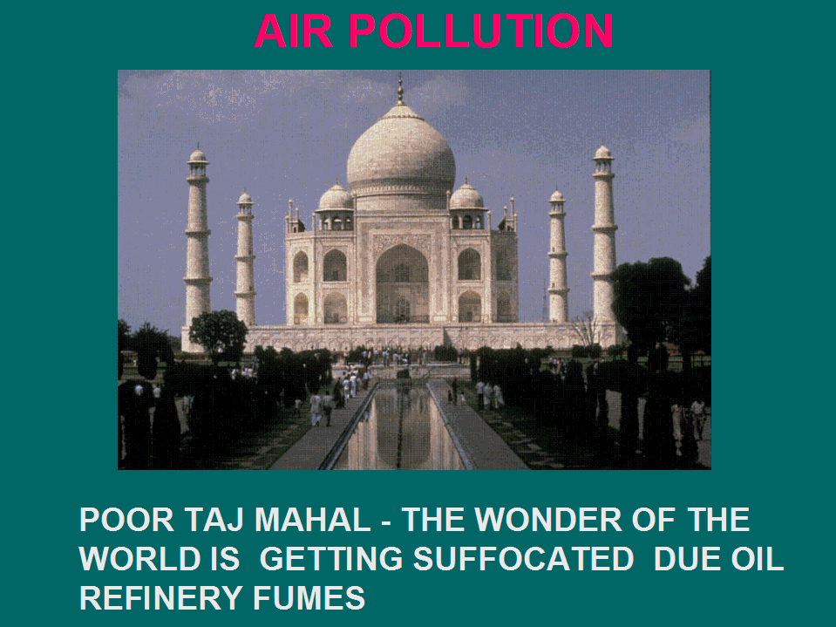
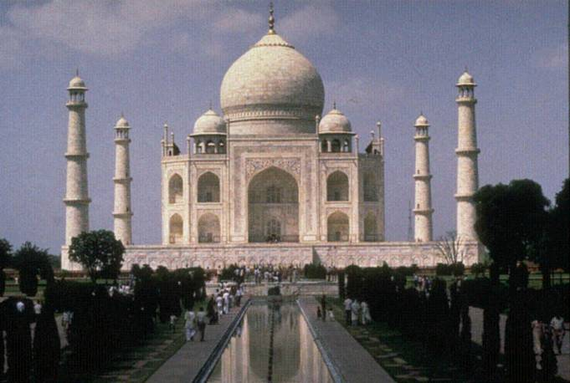
AIR POLLUTION
        POOR TAJ MAHAL - THE WONDER OF THE WORLD IS GETTING SUFFOCATED DUE OIL REFINERY FUMES

Slide 14
URBAN SLUMS
HUNDREADS OF URBAN SLUMS IN AND ARROUND ALL MAJOR INDIAN CITIES WITH POOR, YOUNG , ILLITERATE UNEMPLOYED MIGRATED POPULATION.
UNSAFE WATER,POOR DISPOSAL OF EXCRETA, SOLID WASTES AND LIQUID WASTES
NON AVAILABILITY OR ACCESSIBILITY OFHEALTHFACILITIES.
HIGH PREVALENCE OF NEGATIVE LIFESTYLES, VICES, ANTI- SOCIAL TRAITS AND INFECTIOUS DISEASES IS A THE USUAL PICTURE.

Slide 15
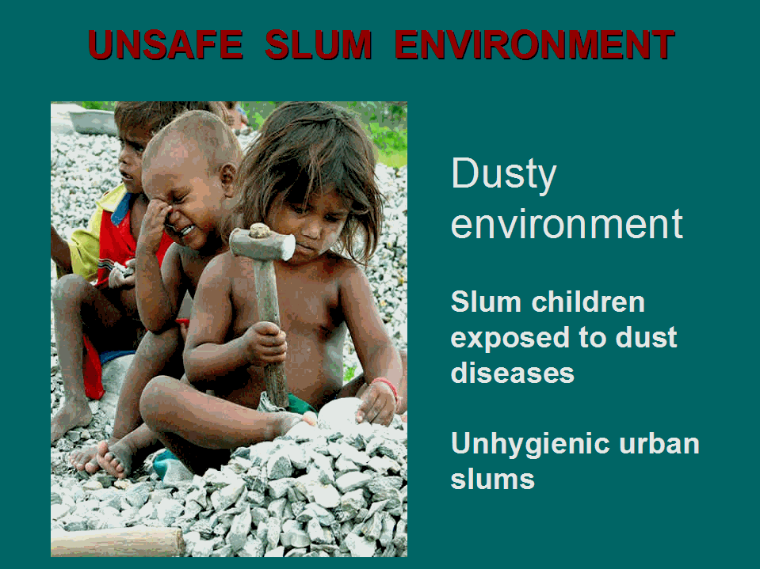
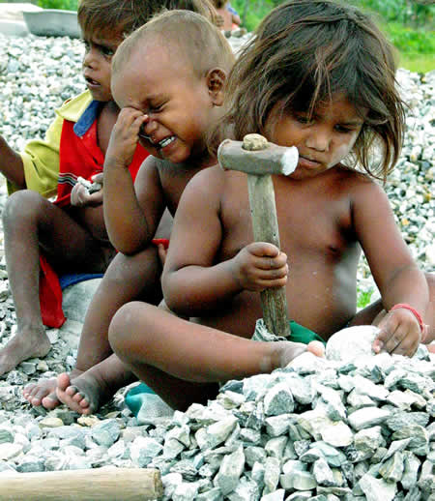
UNSAFE SLUM ENVIRONMENT
Dusty environment
Slum children exposed to dust diseases
Unhygienic urban slums

Slide 16
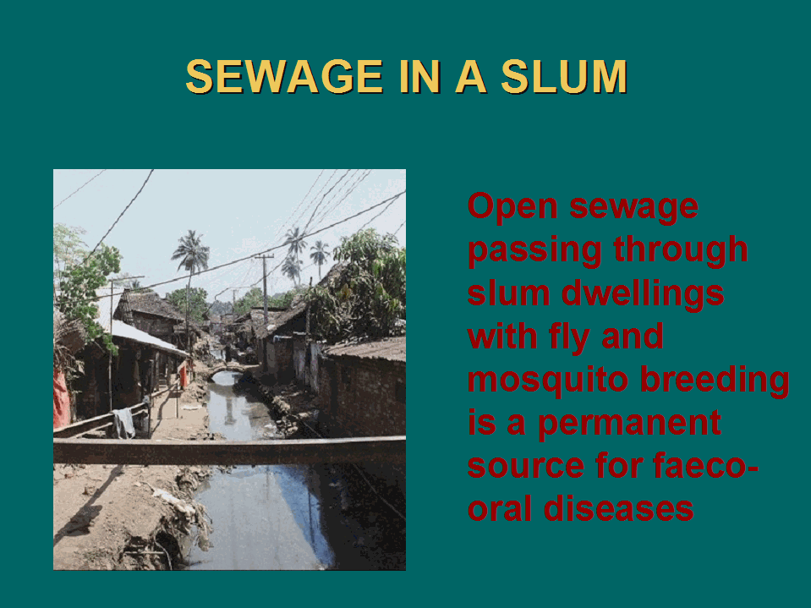
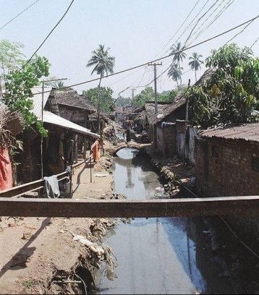
SEWAGE IN A SLUM
Open sewage passing through slum dwellings with fly and mosquito breeding is a permanent
source for faeco-oral diseases

Slide 17
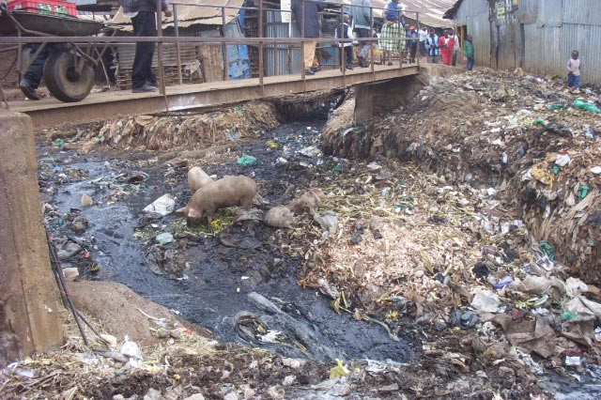
POOR SANITATION AND VECTOR BREEDING PLACES
POOR DISPOSAL OF SOLID WASTES AND LIQUID WASTES INCLUDING EXCRETA, FLY & MOSQUITO BREEDING, POOR HOUSES NOT WORTH FOR HUMAN LIVING AND NO DRAINAGE SYSTEM ARE THE USUAL SLUM FEATURES

Slide 18
RURAL SANITATION
RURAL INDIAN POPULATION (64.61% OF THE TOTAL POPULATION (2021))
MOSTLY ILLITERATE POPULATION
BASIC SANITARY FACILITIES ARE VERY MEAGRE (Safe water about 12-18% & Sanitary latrines 1-2%)
PUBLIC DEFECATION, PUBLIC URINATION, THROWING THE SOLID WASTES ON TO THE ROADS, LEAVING THE LIQUID WASTES ONTO THE ROADS ARE THE USUAL PRACTICES.
ILLFORMED OR NON EXISTING ROADS WITH MOSQUITO & FLY BREEDING PLACES

Slide 19
RURAL SOCIETY
Predominantly agriculture based
Agriculture is their life not just the occupation. Hence it dictates their life styles. Early morning, they get up and go to their fields for seeing the crop.There they defecate near the fields. Open air defecation is thus a routine practice. Moreover, they hate sentimentally to defecate in the house or near the living rooms and they eat their lunch near their fields.
High scope for feco-oral transmission.

Slide 20
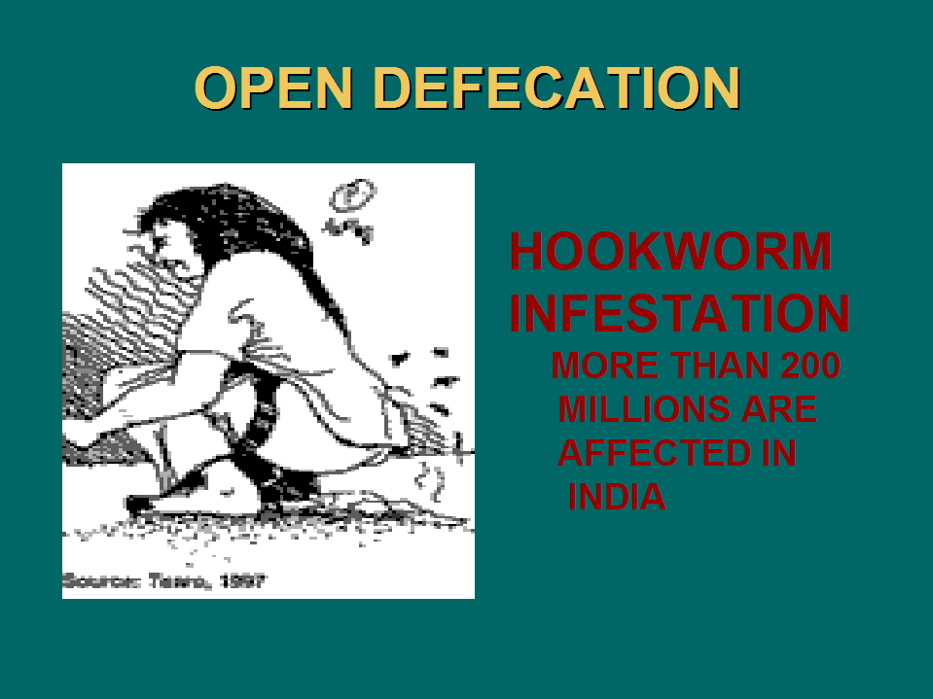
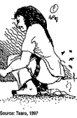
OPEN DEFECATION
HOOKWORM INFESTATION
MORE THAN 200
MILLIONS ARE
AFFECTED IN
INDIA

Slide 21
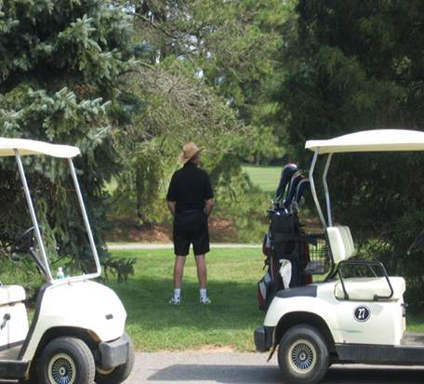

PUBLIC URINATION,
Source of contamination

Slide 22
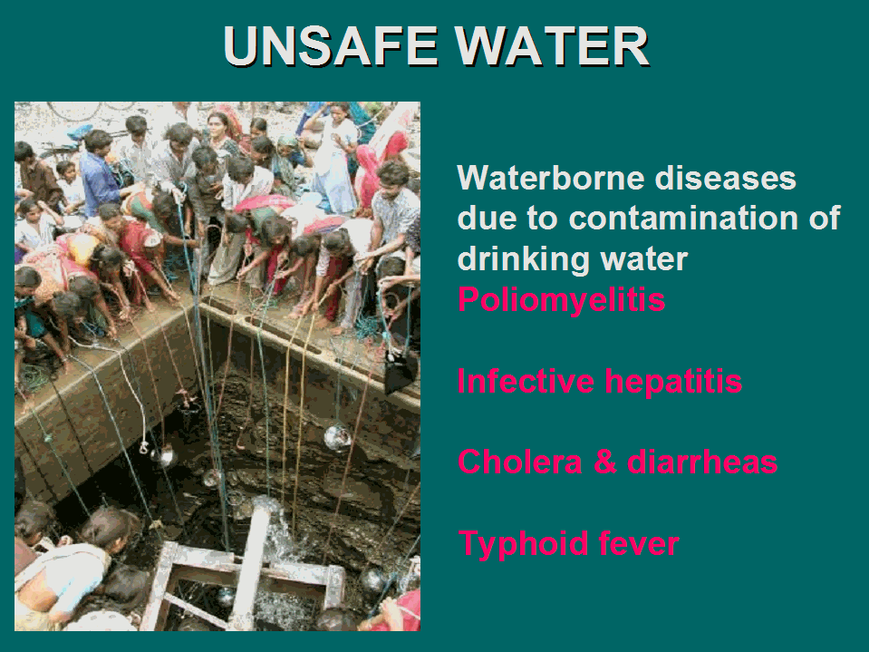
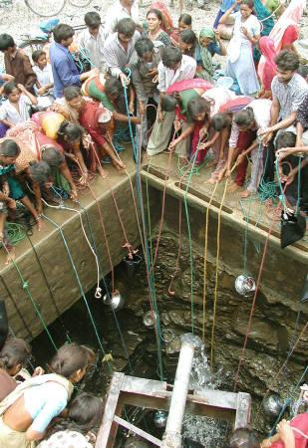
UNSAFE WATER
Waterborne diseases due to contamination of drinking water
Poliomyelitis
Infective hepatitis
Cholera & diarrheas
Typhoid fever

Slide 23
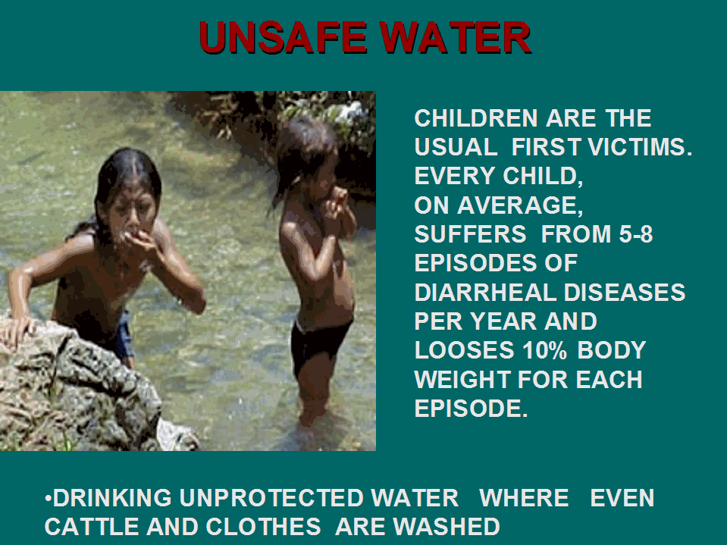
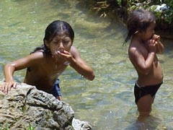
UNSAFE WATER
CHILDREN ARE THE USUAL FIRST VICTIMS.
EVERY CHILD,
ON AVERAGE, SUFFERS FROM 5-8 EPISODES OF DIARRHEAL DISEASES PER YEAR AND LOOSES 10% BODY WEIGHT FOR EACH EPISODE.
DRINKING UNPROTECTED WATER WHERE EVEN CATTLE AND CLOTHES ARE WASHED

Slide 24
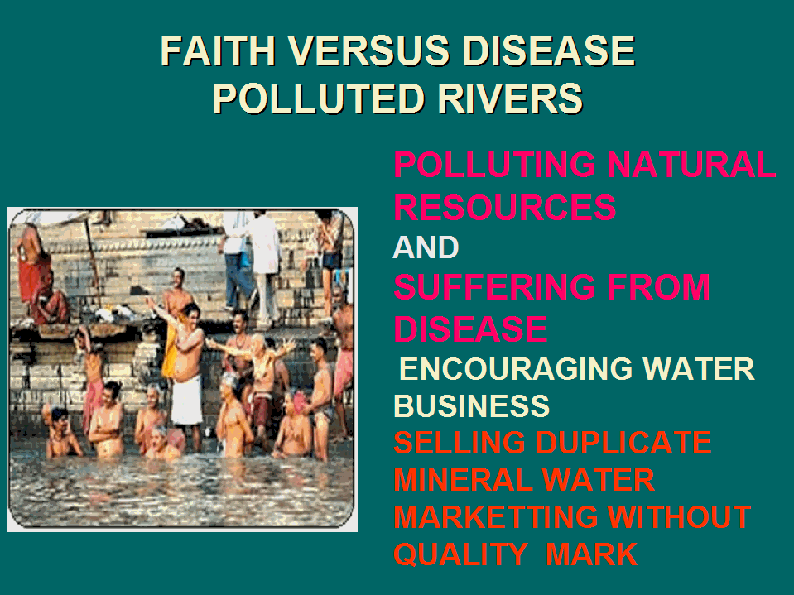
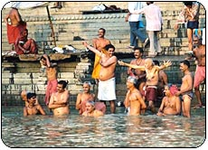
FAITH VERSUS DISEASE
POLLUTED RIVERS
POLLUTING NATURAL RESOURCES
AND
SUFFERING FROM DISEASE
ENCOURAGING WATER BUSINESS
SELLING DUPLICATE MINERAL WATER MARKETTING WITHOUT QUALITY MARK

Slide 25
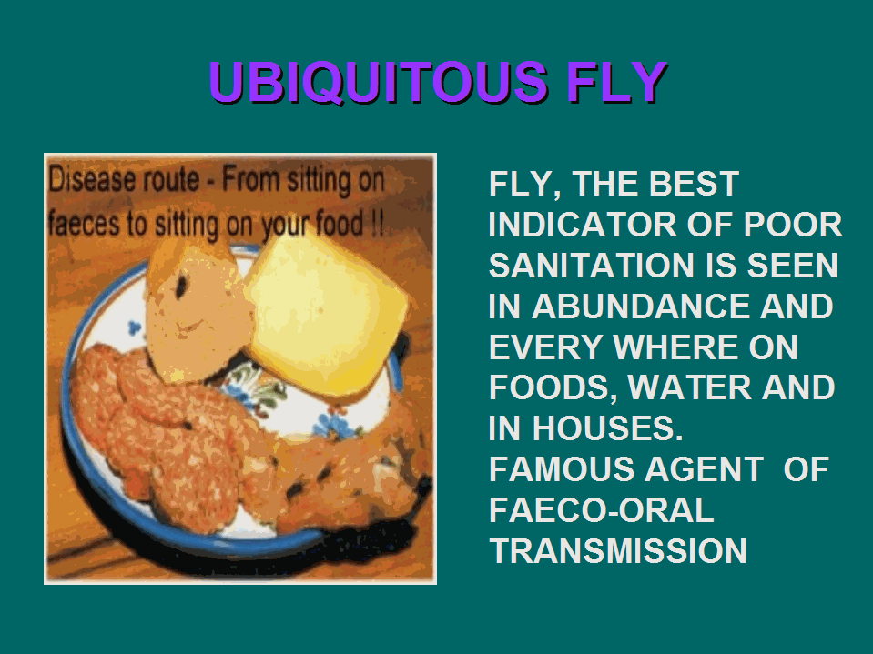
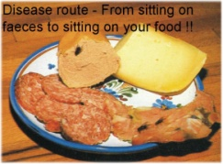
UBIQUITOUS FLY
FLY, THE BEST INDICATOR OF POOR SANITATION IS SEEN IN ABUNDANCE AND EVERY WHERE ON FOODS, WATER AND IN HOUSES.
FAMOUS AGENT OF FAECO-ORAL TRANSMISSION

Slide 26
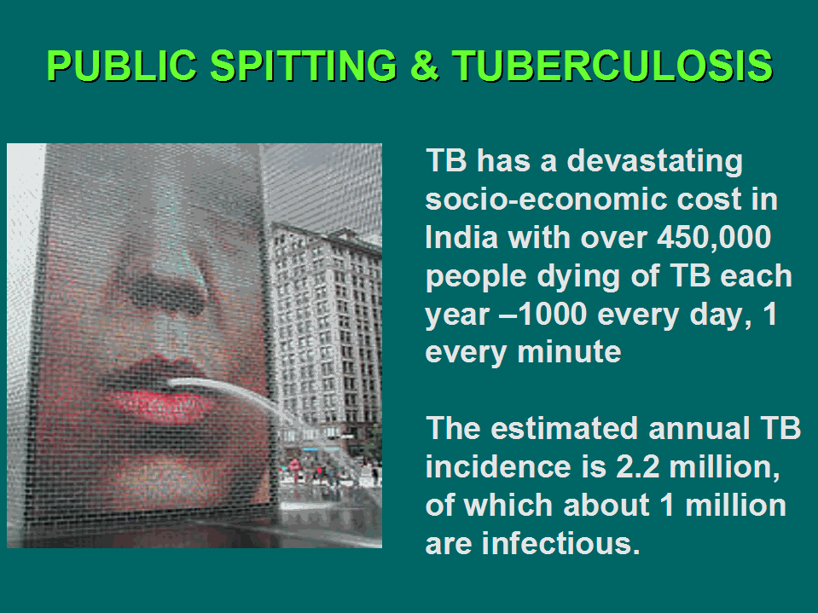
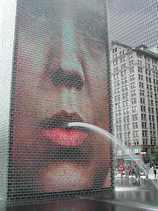
PUBLIC SPITTING & TUBERCULOSIS
        TB has a devastating socio-economic cost in India with over 450,000 people dying of TB each year –1000 every day, 1 every minute
        The estimated annual TB incidence is 2.2 million, of which about 1 million are infectious.

Slide 27
PUBLIC SPITTING IN MAHARASHTRA & TB
MAHARASHTRA STATE IN INDIA
HORRIBLE PUBLIC SPITTING IN OPEN PLACES AND TRANSPORT BUSES
HIGH PREVALENCE OF TUBERCULOSIS?

Slide 28

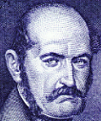
ADVOCATORS FOR HAND- WASHING UNHAPPY
MOTHER’S HANDS ARE INSTRUMENTAL FOR DIARRHEAS IN HER CHILDREN
CAUSING DYSENTRIES IN ADULTS
POOR HANDWASHING WHILE COOKING AND SERVING FOOD
POOR PRACTICE EVEN IN THE EDUCATED
HOLMES
SEMMELWEIS

Slide 29
TRIBAL INDIA
MUCH WORSE SANITATION DUE TO SUPERSTITIONS
NO PROTECTED WATER SUPPLIES AND NO SANITARY FACILITIES
DRINKING UNPROTECTED WATERS FROM STREAMS, CANALS AND RIVERS
EATING DUSTY AND SOMETIMES 3-4 DAYS OLD STALE FOOD, TUBERS AND FRUITS
MASS EATING AND MASS DRINKING

Slide 30
WHAT IS WRONG
Take it easy policy-as long as there is no immediate danger, we take everything very light.
Postponing things - we always try to postpone the things which are not of immediate benefit or danger
Never serious unless something drastic happens- only when epidemics occur we usually will be serious.
Heroism at the beginning , no follow up, escapism in politicians and callousness in program managers

Slide 31
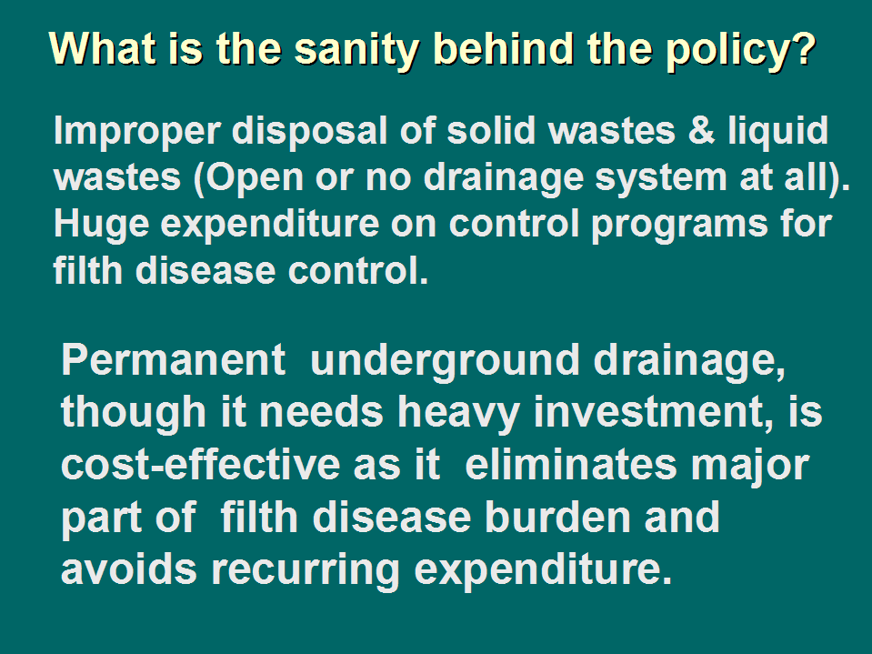
What is the sanity behind the policy?
Improper disposal of solid wastes & liquid wastes (Open or no drainage system at all). Huge expenditure on control programs for filth disease control.
Permanent underground drainage, though it needs heavy investment, is cost-effective as it eliminates major part of filth disease burden and avoids recurring expenditure.

Slide 32
APPARENT INTERVENTIONS:
CREATEING HEALTH AWARENESS
3 SAFES: SAFE WATER, SAFE FOOD AND SAFE ENVIRONMENT TO PREVENT FECO-ORAL TRANSMISSION.
SANITARY BARRIER
SANITARY LATRINES
SANITARY LAND FILLING
SOAKAGE PITS
ENCOURAGING HANDWASHING PRACTICE
COMMUNITY LATRINES
ABOLISHING PUBLIC DEFECATION & URINATION AND SPITTING

Slide 33
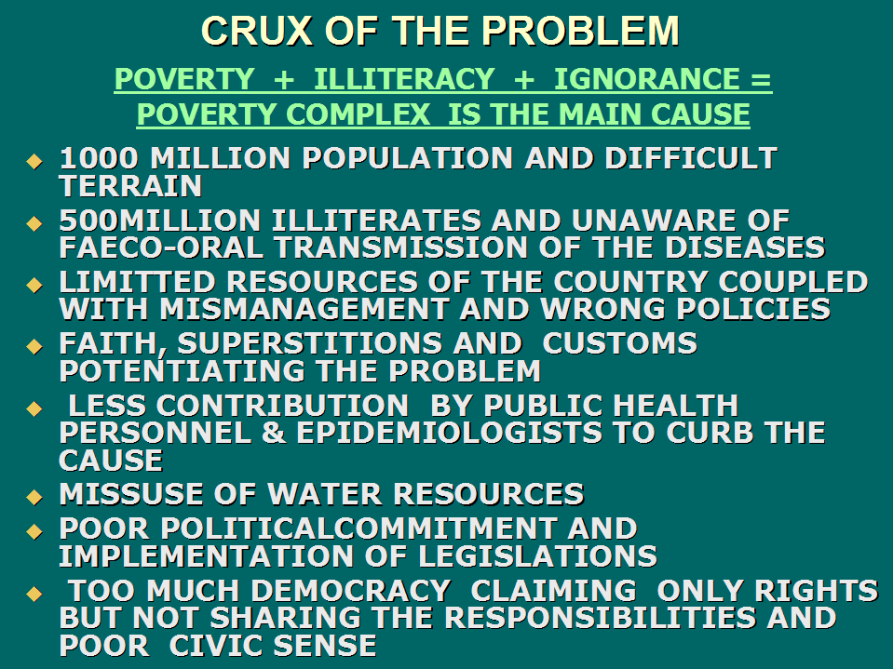
CRUX OF THE PROBLEM
POVERTY + ILLITERACY + IGNORANCE = POVERTY COMPLEX IS THE MAIN CAUSE
1000 MILLION POPULATION AND DIFFICULT TERRAIN
500MILLION ILLITERATES AND UNAWARE OF FAECO-ORAL TRANSMISSION OF THE DISEASES
LIMITTED RESOURCES OF THE COUNTRY COUPLED WITH MISMANAGEMENT AND WRONG POLICIES
FAITH, SUPERSTITIONS AND CUSTOMS POTENTIATING THE PROBLEM
LESS CONTRIBUTION BY PUBLIC HEALTH PERSONNEL & EPIDEMIOLOGISTS TO CURB THE CAUSE
MISSUSE OF WATER RESOURCES
POOR POLITICALCOMMITMENT AND IMPLEMENTATION OF LEGISLATIONS
TOO MUCH DEMOCRACY CLAIMING ONLY RIGHTS BUT NOT SHARING THE RESPONSIBILITIES AND POOR CIVIC SENSE

