Slide 1
HEALTH
Compiled by
Dr.D.Nirmala
Assistant Professor
Department of Social Work
Bharathidasan University
Tiruchirappalli

Slide 2
OBJECTIVE OF HEALTH
Health, according to the World Health Organization, is "a state of complete physical, mental and social well-being and not merely the absence of disease and infirmity".
Health is a resource to support an individual’s function in wider society, rather than an end in itself. A healthful lifestyle provides the means to lead a full life with meaning and purpose.

Slide 3
OBJECTIVES & AIMS OF HEALTH
Physical and Mental development
Character building
Development of Organic system
Healthy and happy life
Socialisation
Recreation
Self expression
Leadership and skill development
Development of hidden qualities
Self confidence
Sportsman spirit

Slide 4
PHYSICAL and MENTAL DEVELOPMENT
Physical development: the changes in size, shape, and physical maturity of the body, including physical abilities and coordination. Intellectual development: the learning and use of language; the ability to reason, problem-solve, and organize ideas; it is related to the physical growth of the brain.
CHARACTER BUILDING
Building character means learning how to handle tough or uncomfortable situations.
SOCIALISATION
main biological characteristic of humans are based on socialization: Lack of instincts, social contact requires a longer period of childhood dependency, the ability to learn and language. Those abilities are learn from healthy physical and mental capacity only.

Slide 5
DEVELOPMENT OF ORGANIC SYSTEM
Important objective of health is to develop the healthy organic system. There are 11 distinct organ systems in human beings, which form the basis of human anatomy and physiology. The 11 organ systems include the
respiratory system,
digestive and excretory system,
circulatory system,
urinary system,
integumentary system,
skeletal system,
muscular system,
endocrine system,
lymphatic system,
nervous system, and reproductive systems.

Slide 6
RECREATION
Recreational uses means those activities of a voluntary and leisure time nature that aid in promoting entertainment, pleasure, play, relaxation, or instruction.
Recreation has many health benefits, and, accordingly, Therapeutic Recreation has been developed to take advantage of this effect.
psychiatric facilities for youth and adults, and in the care of the elderly
the disabled, or people with chronic diseases.
Recreational physical activity is important to reduce obesity,

Slide 7
SELF EXPRESSION
self-expression; in fact, their psychological and physical well-being depend on it. In Imagination and Expressive Arts as Antidotes to Adversity
Engaging in creative self-expression is a wellness practice, as beneficial as spending time in nature, good nutrition, sleep, and physical exercise.
Creative self-expression reduces stress and increases a sense of well-being and other positive emotions.
It helps to heal wounds and bridge differences, supporting health, well-being, resilience, and coping abilities.

Slide 8
LEADERSHIP AND SKILL DEVELOPMENT
Effective leadership is a complex and highly valued component of health
It is an influential process, through which groups of people work towards the achievement of a common goal
Effective leadership is a complex and highly valued component of healthcare education, increasingly recognised as essential to the delivery of high standards of education, research and clinical practice
leaders within healthcare education should not rely on formal positions of authority, but instead, utilise their own appropriate leadership qualities irrespective of their level within the organisation

Slide 9
DEVELOPMENT OF HIDDEN QUALITIES
Be Empathetic
Be Intuitive
Be Creative
Be Passionate
Be a healthy Life-long Learner
Be a healthy Good Listener
Be Persuasive
Be Responsible and Kind
Be Courageous

Slide 10
Self confidence
Confidence is knowing that you have skills and positive traits, that you are able to face challenges and deal with difficult circumstances;
Confidence can also give you a positive outlook on life, increasing your mental and emotional wellbeing.
Confidence levels can change throughout your life and across different areas of your life.
Many things can influence your confidence levels such as your thoughts, feelings, actions and past experiences.
It is important to try and understand what affects your confidence because ongoing low confidence can affect your physical and emotional health, your relationships with others

Slide 11
SPORTSMAN SPIRIT
Sportsman spirit is the act of accepting one’s success with humility.
By engaging in physical activities, you can manage your weight, decrease the chances of any disease, and strengthen your body.
Sportsmanship is when competitors or viewers of competitive events treat one another with respect and exhibit appropriate behavior.
Good sportsmanship means being fair and ethical, it only happened through good healthy mind and body

Slide 12
Spectrum of health

Slide 13
Determinants of health
Biological Determinants
Behavioural and socio cultural conditions
Environment
Socio economic conditions
Health services
Aging of the population
Gender
Other factors

Slide 14
Responsibility for health
I.Individual responsibility
II.Community responsibility
III.State responsibility
IV.International responsibility

Slide 15
Community responsibility
PHC
ASHA (Accredited Social Health Activist) under National Health Mission
Village health guides scheme-1977

Slide 16
International Responsibility
-united nations system
-it covers-exchange of experts
Provisionof drugs and supplies
Border meetings
Regard to control of communicable disesases

Slide 17
Important regional mechanisms for co operation
TCDC (Technical cooperation in developing countries)
ASEAN (Association of south east Asian nations)
SAARC (South asia association for regional cooperation)
WHO acts as –a directing andco ordinating authority on international health work

Slide 18
Need and Scope of Health

Slide 19
Health
Common theme in all cultures
All communities have their own concept relate to the culture
Oldest concept of health- “ absence of disease”
In some cultures considered health and harmony are equivalent
Past few decades, reawakening period- “ Considered health is a fundamental human right and a worldwide social goal, social satisfaction of human needs to an improved quality of life, attained by all people.
In 1977, the 30th World Health Assembly- Goal “ Attainment by all citizens of the world by the year 2000 of a level of health that will permit them to lead a socially and economically productive life”
Health for all

Slide 20
Health
Adoption of health as an integral part of socio-economic development by the United Nations in 1979
In the year 2000, Millennium Development Goals
In the year 2015, Sustainable Development Goals
Goals kept health centrally positioned to ensure healthy lives
promote well-being for all at all ages

Slide 21
Health
Health is a state of complete physical, mental and social well-being and not merely an absence of disease or infirmity” – WHO
The concepts regarding health is changed;
Concept:- Health became the ultimate goal of medicine
Ecological Concept:- Health implies the relative absence of pain and discomfort and a continuous adaptation and adjustment to the environment to ensure optimal function.
Psychosocial Concept:- Health is both biological and social phenomenon
Holistic Concept:- All the sectors of society have an effect on health, in particular agriculture, animal husbandry, food, industry, education, housing, public works, food, industry, education, housing and other sectors.

Slide 22
Standard of Living
Usual scale of our expenditure
Level of education, Employment status, food, dress, house, amusements and comforts of modern living
WHO- Income and occupation, standards of housing, sanitation and nutrition, the level of provision of health, educational, recreational and other services may all be used individually as measures of socio-economic status and collectively as an index of the “ standard of living”

Slide 23
Level of living
Health
Food consumption
Education
occupation and working conditions
housing, social security, clothing, recreation and leisure and human rights
These are influenced the human well-being
Health is the most important component of the level of living

Slide 24
Quality of Life
“ The condition of life resulting from the combination of the effects of the complete range of factors such as those determining health, happiness”
Comfort in the Physical environment and a satisfying occupation
Education, social, intellectual attainments, freedom of action, justice and freedom of expression
People are now demanding a better quality of life
Therefore, governments all over the world are increasingly concerned about improving the quality of life of their people by reducing morbidity, mortality
Providing primary health care and enhancing mental, physical and social well being.

Slide 25
Physical Quality of Life Index
Physical Quality of Life Index consolidates three indicators:-
Infant mortality
Life expectancy at age one
literacy.

Slide 26
Human Development Index
A composite index focusing on three basic dimensions of human development:
To lead a long and healthy life measured by life expectancy at birth
The ability to acquire knowledge, measured by mean years of schooling and expected years of schooling
The ability to achieve a decent standard of living

Slide 27
Health & Development
Health is essential to socio-economic development has gained increasing recognition
It was a commonly a thought in the 1960s that socio-economic progress was not essential for improving the health status of people in developing countries
Substantial and rapid progress could be made through introduction of modern public health measures alone
The role of human beings in the developing process was grossly underestimated
The period1973-1977 witnessed considerable rethinking on this subject
Profound modification of the economic theory
It became increasingly clear that economic development alone cannot solve the major problems of poverty

Slide 28
Health & Development
Hunger
Malnutrition
Disease
The experiences of few developing countries e.g.:- Sri Lanka, Costa Rica, and the state of Kerala in India illustrates dramatically the way in which health forms part of the development
The efforts in the health field were simultaneously reinforced by developments in other sectors
Such as education, social welfare and land reforms
Health is the integral part of development
Health services are solely medical measures but a subsystem of an overall socio-economic system
Human health and Well being are the ultimate goal of development

Slide 29
Continues……..
Health & Hygiene
Health of a family, community, or a nation is ultimately determined by the health of individual members
Physical cleanliness- avoid diseases
Nutrition and balanced diet
Nutritious food- good health and high spirit
Provides energy- constructive activity
Work for long period
Ipropsperous country- arrange medical facilities-citizens
Investment-economic development and progress of the country

Slide 30
Importance
All round development
Physical, mental and spiritual features
Physical development is essential for both mental and spiritual development
“ A healthy mind is a healthy body”
Provision of healthful environment
Promotion of positive health

Slide 31
Continues…………
Food and Nutrition
Information about good health habits
Certain common diseases and their prevention and control
First aid and safety measures
Water and Air-Pollution and purification
Mental health and personal hygiene

Slide 32
Scope
Health education – individual
Personal contact- Understand client attitudes
Clear their doubts
Correct misconceptions
Identify and remove barriers in the way of adapting health practices
Group
Panel discussions
Conferences
Role playing
Field trip
Community
Awareness Programmes

Slide 33
Continues……
Health policy
National health policy is an expression of goals for improving the health situation
Each country develop a health policy of its own aimed at defined goals
Improving peoples health
Sustainable Development Goals
Millennium Development Goals
Health services Research
Biomedical research, to elucidate outstanding health problems and develop new or better ways of dealing

Slide 34
Continues………………..
Intersectoral research
Relationships would have to be established with the institutions concerned with the other sectors
Health services research
1981-1982 developed
Systematic study of the means by which biomedical and other relevant knowledge is brought to bear on the health of individuals and communities under a given set of conditions
Essential for continues evolution and reinforcement of health services.

Slide 35
VITAL HEALTH STATISTICS

Slide 36
VITAL HEALTH STATISTICS
Vital statistics is the numerical description of birth, death, abortion, marriage ,divorce, adoption and judicial separation of a Nation (UNO)
According to N.B. Ryder vital statistics “give cumulative summaries for successive time periods of population movements like birth, death, migration, marriage and marital dissolution as well as demographic and other relevant characteristics of the individuals involved in these events.”
It is a scientific discipline
The term “vital statistics'' is deployed to the individual determination of some vital events.
Vital statistics are the statistical yield under the civil registration system, and the information, involved within the individual civil registration records, is assembled in order to create vital statistics for the population.

Slide 37
PURPOSE OF VITAL HEALTH STATISTICS
COMMUNITY HEALT
ADMINISTRATIVE PURPOSE
HEALTH PROGRAMMED ORGANISATION
LEGISLATION PURPOSE
GOVERNMENT PURPOSE

Slide 38
USES OF VITAL HEALTH STATISTICS
To evaluate the impact of various national health policies in every nation
To plan for better futures measures for disease control
To explain the hereditary nature of the diseases
To plan and evaluate economic and social development
Primary tool for research activity
To determine the health status of the individual
To compare the health status of the individuals from one nation with another

Slide 39
SOURCE OF VITAL HEALTH STATISTICS IN INDIA
CENTREL STATISTICAL ORGANISATION
NATIONAL SAMPLE SURVEY ORGANISATION
REGISTRAR GENERAL & CENCUS COMMISSIONER
MINISTRY OF FAMILY AND HEALT
INTERNATIONAL INSTITUTION FOR POPULATION STUDY

Slide 40
TYPES OF VITAL HEALTH STATISTIC EVENTS
CRUDE BIRTH RATE
CRUDE DEATH RATE
NEO NATAL MORTALITY RATE
GENEREL FERTILITY RATE
INFANT MORTALITY RATE
MATERNAL MORTALITY RATE

Slide 41
CRUDE BIRTH RATE
Crude birth rate indicates the number of live births occurring during the year, per 1,000 population estimated at midyear.
CBR=pb​×1,000
The current birth rate for India in 2022 is 17.163 births per 1000 people, a 1.23% decline from 2021.

Slide 42
CRUDE DEATH RATE
CRUDE DEATH RATE is the total number of deaths to residents in a specified geographic area (country, state, county, etc.) divided by the total population for the same geographic area (for a specified time period, usually a calendar year) and multiplied by 100,000.
Crude death rate indicates the number of deaths occurring during the year
7.380 is the CDR in India during 2022 year

Slide 43
INFANT MORTALITY RATE
The infant mortality rate (IMR) is the number of infant deaths in a single year for every 1,000 live births in the same year. It is calculated annually by taking the number of infant deaths during the first year of life and dividing it by the number of live births throughout the same year, then multiplying by 1000.
The current infant mortality rate for India in 2022 is 27.695 deaths per 1000 live births

Slide 44
NEO NATAL MORTALITY RATE
Number of deaths during the first 28 completed days of life per 1000 live births in a given year or other period. Neonatal deaths (deaths among live births during the first 28 completed days of life) may be subdivided into early neonatal deaths, occurring during the first 7 days of life, and late neonatal deaths, occurring after the 7th day but before the 28th completed day of life.
Neonatal Mortality Rate (NMR) in India is 26 per 1000 live births during the year of 2022.

Slide 45
GENEREL FERTILITY RATE
GENERAL FERTILITY RATE is the number of resident live births for a specified geographic area (nation, state, county, etc.) during a specified period (usually a calendar year) divided by the female population age 15-44 years (usually estimated for a mid-year) for that area, and the resulting fraction multiplied by a 1,000.
Calculation: (Number of resident live births / Number of females age 15-44 years) x 1,000 Number of Resident Live Births X 1,000 Number of Females Age 15-44 Years Population
The current fertility rate for India in 2022 is 2.159 births per woman

Slide 46
MATERNAL MORTALITY RATE
The maternal mortality ratio (MMR) is defined as the number of maternal deaths during a given time period per 100,000 live births during the same year
23.8 deaths per 100,000 live births in India during the year of 2020

Slide 47
USES AND IMPORTANTS
GENERAL
ADMINISTRATIVE UTILITY
USEFULL IN POLICY PLANING
INTERNATIONAL UTILITY
BASES OF SOCIAL REFORM

Slide 48
HEALTH
MAKING POLICIES AND PROGRAMS FOR HEALTH
IMPROVEMENT IN ADMINISTRATION
COMPARISSON OF HEALTH STATUS
DETERMINATION OF HEALTH STATUS
(INDIVIDUAL, COMMUNITY, HEALTH NEEDS)

Slide 49
OTHER TYPES OF VITAL STATISTICS
AGE SPECIFIC FERTILITY RATE
TOTAL FERTILITY RATE
CRUDE MARRIAGE RATE
PREGNANCY RATE RATIO
NET REPRODUCTION RATE
ABORTION RATIO

Slide 50
AGE SPECIFIC FERTILITY RATE
The age-specific fertility rate measures the annual number of births to women of a specified age or age group per 1,000 women in that age group.
In 2020, Age specificfertility rates at age 25-29 years for India was 157.24 births per 1,000 women

Slide 51
TOTAL FERTILITY RATE
The total fertility rate is the sum of the age-specific fertility rates for all women multiplied by five. It is expressed as children per woman.
The current fertility rate for India in 2022 is 2.159 births per woman,

Slide 52
NET REPRODUCTION RATE
The average number of daughters a hypothetical cohort of women would have at the end of their reproductive period if they were subject during their whole lives to the fertility rates and the mortality rates of a given period.
It is expressed as number of daughters per woman.
1.00 (number) in 2020. In 2020, net reproduction rate for India was 1. Net reproduction rate of India fell gradually from 1.87 in 1975 to 1 in 2020.

Slide 53
CRUDE MARRIAGE RATE
The crude marriage rate is the ratio of the number of marriages in a population during a reference period over the person-years lived by the population during the same period.
It is expressed as marriages per 1,000 population

Slide 54
PREGNANCY RATE RATIO
PREGNANCY RATE is the total number of resident pregnancies including live births, induced abortions, and fetal deaths per 1,000 women aged 15-44 years for a specified geographical area (country, state, county etc.) during a specified time period.
The current pregnancy rate for India in 2022 is 17.163 births per 1000 people

Slide 55
ABORTION RATIO
The number of spontaneous and induced abortions/100 live births/year.
The abortion rate in India at 47 abortions per 1000 women aged 15–49 years during the year of 2020.

Slide 56
SHORT COMING OF VITAL HEALTH STATUS IN INDIA
Lack of uniformity
Voluntary registration
Incomplete information
Under registration
Lack of accuracy
Errors made by the authorities

Slide 57
FACTORS INVOLVED IN THE PROCESS OF DISEASE TRANSMISSION

Slide 58
Disease Transmission
Transmission is a process in which several events happen one after the other in the form of a chain. Hence, this process is known as a chain of transmission
Six major factors can be identified
The infectious agent, The reservoir, The route of exit, The mode of transmission, The route of entry and The susceptible host

Slide 59
INFECTIOUS AGENTS
Protozoa
are micro-organisms made up of one cell
Bacteria
are also micro-organisms made up of one cell, but they are much smaller than protozoa and have a different structure
Viruses
are infectious agents that do not have the structure of a cell. They are more like tiny boxes or particles and are much smaller than bacteria
Helminths
are worms made up of many cells

Slide 60
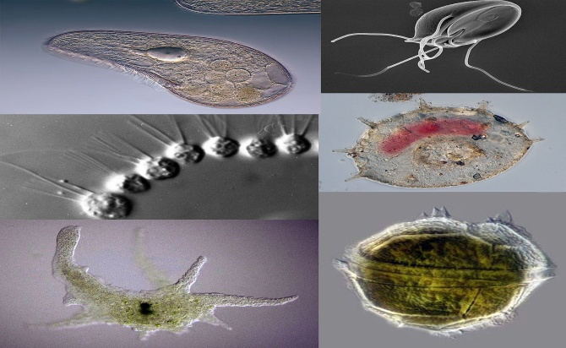
PROTOZOA
Protozoa are one-celled animals found worldwide in most habitats. Most species are free living, but all higher animals are infected with one or more species of protozoa. Infections range from asymptomatic to life threatening, depending on the species and strain of the parasite and the resistance of the host.
On the basis of light and electron microscopic morphology, the protozoa are currently classified into six phyla. Most species causing human disease are members of the phyla Sacromastigophora and Apicomplexa.
Common infectious diseases caused by protozoans include:
Malaria
Giardia
ToxoplasmosiI

Slide 61
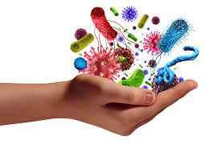
BACTERIA
Bacteria are single-cell organisms that are neither plants nor animals.
They usually measure a few micrometers in length and exist together in communities of millions.
There are many different types of bacteria. One way of classifying them is by shape. There are three basic shapes.
Spherical: Bacteria shaped like a ball are called cocci, and a single bacterium is a coccus. Examples include the streptococcus group, responsible for “strep throat.”
Rod-shaped: These are known as bacilli (singular bacillus). Some rod-shaped bacteria are curved. These are known as vibrio. Examples of rod-shaped bacteria include Bacillus anthracis (B. anthracis), or anthrax.
Spiral: These are known as spirilla (singular spirillus). If their coil is very tight they are known as spirochetes. Leptospirosis, Lyme disease, and syphilis are caused by bacteria of this shape.

Slide 62
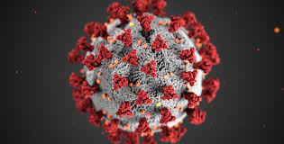
VIRUS
A virus is an infectious agent of small size and simple composition that can multiply only in living cells of animals, plants, or bacteria.
Viruses can infect a variety of living organisms, including bacteria, plants, and animals.
Virus affect an living organism through four method
Direct contact transmission, Indirect transmission, Common vehicle transmission, Airborne transmission

Slide 63
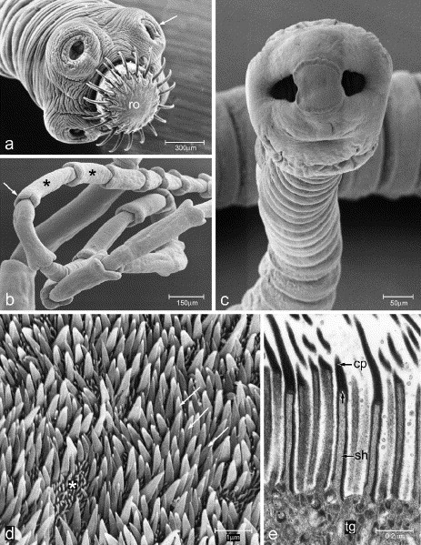
Helminths
The helminths are worm-like parasites. The clinically relevant groups are separated according to their general external shape and the host organ they inhabit. There are both hermaphroditic and bisexual species. The definitive classification is based on the external and internal morphology of egg, larval, and adult stages.
Infection can cause physical, nutritional and cognitive impairment in young, developing children.

Slide 64
Reservoirs of infectious agents
Many infectious agents can survive in different organisms, or on non-living objects, or in the environment
Some can only persist and multiply inside human beings, whereas others can survive in other animals, or for example in soil or water.
The place where the infectious agent is normally present before infecting a new human is called a reservoir
Humans and animals which serve as reservoirs for infectious agents are known as infected hosts.

Slide 65
Route of exit
Before an infectious agent can be transmitted to other people, it must first get out of the infected host. The site on the infected host through which the infectious agent gets out is called the route of exit.
Respiratory tract
The routes of exit from the respiratory tract are the nose and the mouth. Some infectious agents get out of the infected host in droplets expelled during coughing, sneezing, spitting or talking, and then get transmitted to others
Gastrointestinal tract
The anus is the route of exit from the gastrointestinal tract (or gut). Some infectious agents leave the human body in the stool or faces
Some types of infectious agents can exit the body through breaks in the skinwhich are present in the blood and get out of the human body when a mosquito bites through the skin to suck blood.

Slide 66
Modes of transmission
Once an infectious agent leaves a reservoir, it must get transmitted to a new host if it is to multiply and cause disease. The route by which an infectious agent is transmitted from a reservoir to another host is called the mode of transmission.

Slide 67
DIRECT MODE OF TRANSMISSION
TOUCH
SEXUAL INTER COURSE
BITING
PROJECTION OF DROPLETS
ACROSS PLACENTA

Slide 68
INDIRECT MODE OF TRANSMISSION
AIR BORNE
VEHICLE BORNE
VECTOR BORNE

Slide 69
Direct transmission refers to the transfer of an infectious agent from an infected host to a new host, without the need for intermediates such as air, food, water or other animals. Direct modes of transmission can occur in two main ways:
Person to person: The infectious agent is spread by direct contact between people through touching, biting, kissing, sexual intercourse or direct projection of respiratory droplets into another person’s nose or mouth during coughing, sneezing or talking. A familiar example is the transmission of HIV from an infected person to others through sexual intercourse.
Transplacental transmission: This refers to the transmission of an infectious agent from a pregnant woman to her fetus through the placenta. An example is mother-to-child transmission (MTCT) of HIV.

Slide 70
Indirect transmission is when infectious agents are transmitted to new hosts through intermediates such as air, food, water, objects or substances in the environment, or other animals. Indirect transmission has three subtypes:
Airborne transmission: The infectious agent may be transmitted in dried secretions from the respiratory tract, which can remain suspended in the air for some time. For example, the infectious agent causing tuberculosis can enter a new host through airborne transmission.
Vehicle-borne transmission: A vehicle is any non-living substance or object that can be contaminated by an infectious agent, which then transmits it to a new host. Contamination refers to the presence of an infectious agent in or on the vehicle.
Vector-borne transmission: A vector is an organism, usually an arthropod, which transmits an infectious agent to a new host. Arthropods which act as vectors include houseflies, mosquitoes, lice and ticks.

Slide 71
Route of entry
Successful transmission of the infectious agent requires it to enter the host through a specific part of the body before it can cause disease. The site through which an infectious agent enters the host is called the route of entry.
Some infectious agents get into the body with contaminated food, water or on hands.

Slide 72
Susceptible hosts
After an infectious agent gets inside the body it has to multiply in order to cause the disease.
In some hosts, infection leads to the disease developing,
Individuals who are likely to develop a communicable disease after exposure to the infectious agents are called susceptible hosts

Slide 73
Multiple Causation of Disease

Slide 74
“ a Condition in which body health is impaired, a departure from a state of health, an alteration of the human body interrupting the performance of vital functions”- Webster
“ a condition of the body or some part or organ of the body in which its functions are disrupted or deranged”.-Oxford English Dictionary
“ a maladjustment of the human organism to the environment” –Ecological perspective

Slide 75
The capacity of one variable to influence another. The first variable may bring the second into existence or may cause the incidence of the second variable to fluctuate.
The act of or process of causing
The act or agent which produces an effect

Slide 76
Multiple Causation of Disease
Pettenkofer of Munich ( 1819-1901) - Early proponent of Multiple Causation of Disease
Lung cancer, Coronary heart disease, Mental illness- These diseases could not be explained by one cause factor.
There are social, economic, cultural, genetic and psychological factors
For example:- Tuberculosis is not merely due to tubercle bacilli
Factors – Poverty, overcrowding, malnutrition also plays a role.
The term agent is replaced by causative factors
Need to identify multiple causes of disease
The purpose of knowing the multiple factors of disease is to quantify and arrange them in priority sequence for modification to prevent or control disease.

Slide 77
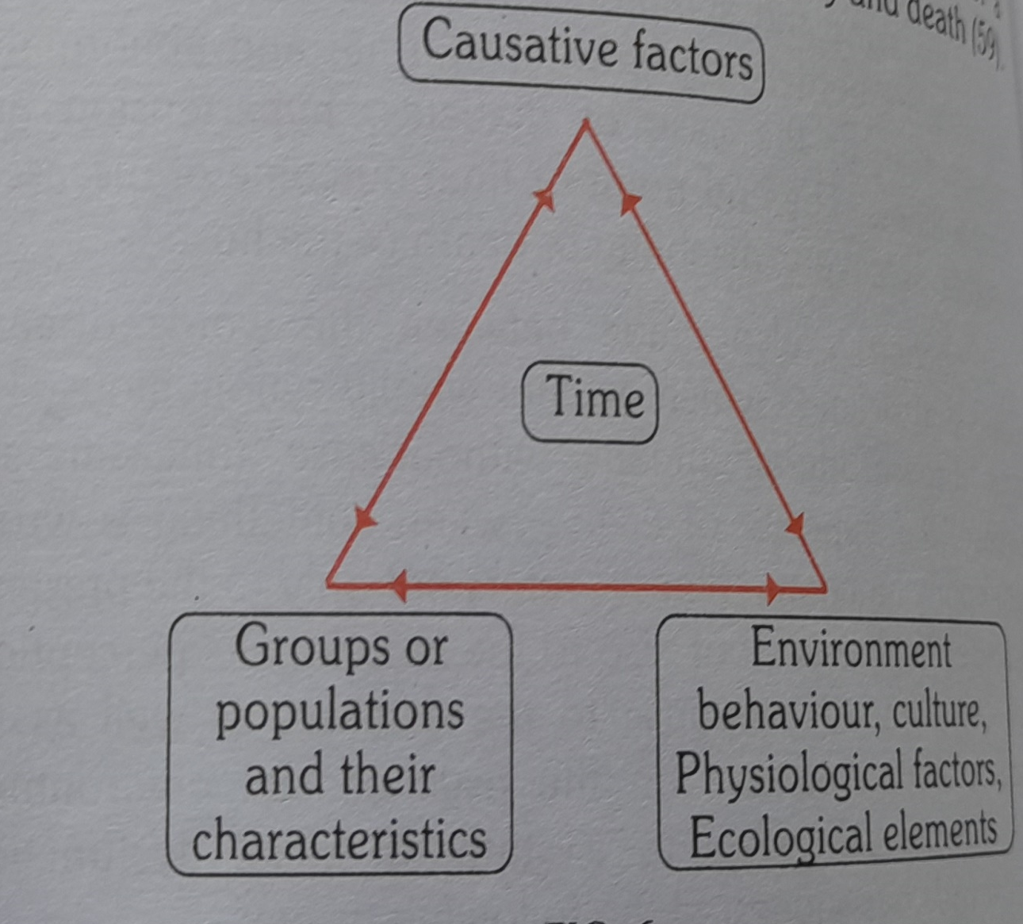
Triangle of epidemiology

Slide 78
Triangle of Epidemiology
It presents an adapted and advanced model of the triangle of epidemiology
This new model includes all facets of the communicable disease model
Make it more relevant and useful with regard to the today’s diseases
Conditions, disorders, defects, injuries and deaths
It also reflects the cause of current illness and conditions
Behaviour, lifestyle factors, environmental causes, ecologic elements
Physical factors and chronic diseases
The term agent replaced by Causative factors – Identify the multiple causes

Slide 79
Web of Causation
This model of disease causation was suggested by MacMahon and Pugh
In their book “Epidemiologic Principles and methods”
This model ideally suited in the study of chronic disease
Disease agent is not known, But is the outcome of interaction of multiple factors
The web of causation – all predisposing factors of any type and their complex interrelationship with each other.

Slide 80
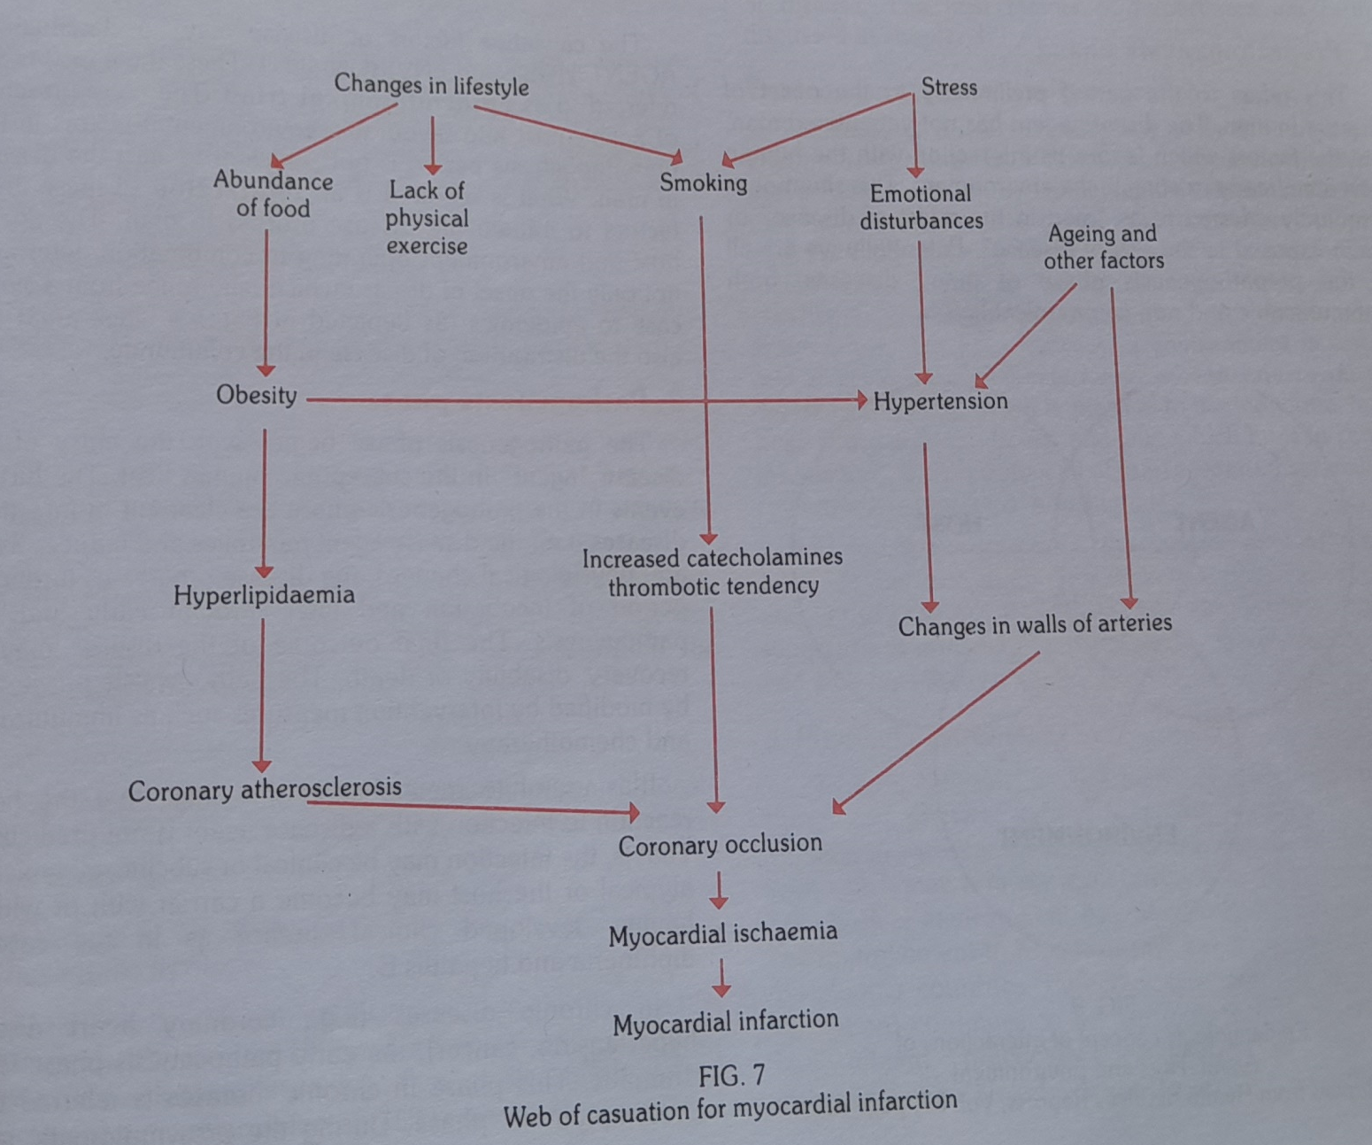
Web of causation for myocardial infarction

Slide 81
Obesity is a complex disease involving an excessive amount of body fat. Obesity isn't just a cosmetic concern. It's a medical problem that increases the risk of other diseases and health problems, such as heart disease, diabetes, high blood pressure and certain cancers.
Hyperlipidemia (high cholesterol) means your blood has too many lipids (fats) in it. These can add up and lead to blockages in your blood vessels. This is why high cholesterol can put you at risk for a stroke or heart attack.
Coronary atherosclerosis- Atherosclerosis is thickening or hardening of the arteries caused by a buildup of plaque in the inner lining of an artery. Risk factors may include high cholesterol and triglyceride levels, high blood pressure, smoking, diabetes, obesity, physical activity, and eating saturated fats.). If the plaques rupture, you can have a heart attack
Catecholamines generate moderately elevated levels of platelet count which enhances the risk of thrombosis.
Hypertension is when blood pressure is too high. Blood pressure is written as two numbers. The first (systolic) number represents the pressure in blood vessels when the heart contracts or beats. The second (diastolic) number represents the pressure in the vessels when the heart rests between beats

Slide 82
Arteries, a critical part of your cardiovascular system, are blood vessels that distribute oxygen-rich blood to your entire body. These tube-like vessels and the muscles inside them ensure your organs and tissues have the oxygen and nutrients they need to function.
Coronary occlusion: When one or more of the coronary arteries suddenly becomes completely blocked, a heart attack (injury to the heart muscle) may occur.
Myocardial ischemia occurs when blood flow to the heart muscle (myocardium) is obstructed by a partial or complete blockage of a coronary artery by a buildup of plaques(In medicine, a small, abnormal patch of tissue on a body part or an organ. Plaques may also be a build-up of substances from a fluid, such as cholesterol in the blood vessels.)
A heart attack (medically known as a myocardial infarction) is a deadly medical emergency where your heart muscle begins to die because it isn't getting enough blood flow. This is usually caused by a blockage in the arteries that supply blood to your heart.

Slide 83
Continues……
The web of causation does not imply that the disease cannot be controlled unless all the multiple causes or
Chains of causation or at least a number of them are appropriately controlled or removed
Removal or elimination of just only one link or chain may be sufficient to control disease
Provided that link is sufficiently important in the pathogenetic process (Pathogenetic: Pertaining to genetic cause of a disease or an abnormal condition. For example, BRCA 1 and BRCA2 are genes that, when mutated, are responsible for many cases of cancer of the breast. Therefore, these genes are pathogenetic.
(BReast CAncer gene 1) and BRCA2 (BReast CAncer gene 2) are genes that produce proteins that help repair damaged DNA. Everyone has two copies of each of these genes—one copy inherited from each parent.
Both mutations increase the risk of ovarian cancer, as well as pancreatic cancer. A BRCA1 mutation can also increase the risk of cervical, uterine, and colon cancer, while BRCA2 can increase the likelihood of stomach, gallbladder, and bile duct cancer, plus melanoma.

Slide 84
HEALTH INDICATORS
National Health Indicators

Slide 85
Health
Health is defined as “a state of complete physical, mental & social wellbeing, and not merely an absence of disease or infirmity”
This statement has been amplified to include the ability to lead a “socially and economically productive life”
Health cannot be measured in exact measurable forms
Measurement have been framed in terms of illness (or lack of health), consequences of ill-health (morbidity, mortality) & economic, occupation & domestic factors that promote ill health

Slide 86
National Health Indicators
Health indicators are used to measure health status of the community. They are defined as parameters that can measure changes in the level of health. In fact, they are indirect parameters or variables that assess state of the health of the community. Indicators can be:
1. Rates
2. Ratios
3. Number (in a specific place and time).

Slide 87
Uses of Health Indicators
Measurement of the health of the community.
Compare health status of one community with another whether in the same continent or globally.
Assessment of health care needs.
Proper allocation of human and non-human resources according to the needs.
Monitoring and evaluation of health services, activities, and programs.
Compare health status of different areas or groups of people over time.

Slide 88
Characteristics of Indicators
Valid: They should actually measure what they are supposed to measure, e.g. use of case fatality rate to measure severity of a disease.
2. Reliable: give similar results when the measure is used for the same person in different times with similar circumstances.
3. Objective: does not depend on subjective feelings of the persons, but depends on defined standards.
4. Sensitive: they should be sensitive to the changes in the measured condition .
5. Specific: only reflects the changes in the measured condition.

Slide 89
Characteristics of Indicators (continued)
6. Feasible: they should have the ability to obtain data needed.
7. Relevant: they should contribute to the understanding of the phenomenon of interest.
Notes:
89

Slide 90
Indicators
WHO defines Indicators as
“variables which measure change”

Slide 91
Health Indicator
A health indicator is a variable that provides a single numeric measurement of an aspect of health within a population for a special period of time, normally a year.

Slide 92
Factors influencing health Indicators
Health is multidimensional
Each dimension is influenced by numerous factors
Economic, occupational, cultural, educational, social

Slide 93
Health Indicators
Mortality indicators
Morbidity indicators
Disability rates
Nutritional status indicators
Health care delivery indicators
Utilization rates
Indicators of social and mental health
Environmental indicators
Socio-economic indicators
Health policy indicators
Indicators of quality of life
Other indicators

Slide 94
Mortality Indicators
Crude Death Rate (CDR)
Number of death per 1000 population during one year.
Crude Death rate for Jordan is 5 per 1000
Many of the former Socialist countries of Eastern Europe and Central Asia, Sweden, Switzerland, Austria, Greece, Italy and Germany had a crude death rate (CDR) higher than crude birth rate (CBR), causing a negative population growth if immigration is insufficient to compensate. All other countries had higher birth rates than death rates.

Slide 95
In 2022, crude death rate for India was 7.3 deaths per thousand population.
Over the last 50 years, crude death rate of India was declining at a moderating rate to shrink from 16.73 deaths per thousand population in 1971 to 7.19 deaths per thousand population in 2020.

Slide 96
Which state has highest crude death rate in India?
In 2018, the state of Kerala, with 6.7 deaths per 1,000 inhabitants, had the highest urban death rate.
It was followed by Chhattisgarh and Odisha.
On the contrary, the region of Delhi had the lowest urban deaths during the same period

Slide 97
Demographics of India
Population | 1.4 billon(2022)
Density | 500 people per.sq.km (2011 est.)
Growth rate | 1.1% (2020 est.)
Birth rate | 18.2 births/1,000 population (2020 est.)

Slide 98
Population Growth Rate
Population Growth Rate: Growth of the population size in one year expressed in percent.
Total Fertility Rate: The number of children that would be born per women if she were to live to the end of the childbearing years and bear children at each age in accordance with the prevailing age-specific fertility rates.

Slide 99
The current fertility rate for India in 2022 is 2.159 births per woman, a 0.6% decline from 2019. The fertility rate for India in 2019 was 2.220 births per woman, a 0.89% decline from 2018. The fertility rate for India in 2018 was 2.240 births per woman, a 1.37% decline from 2017.

Slide 100
Life Expectancy at Birth
The numbers of years a newborn baby would live if subjected to present mortality risks prevailing for each age group in the population.
Estimated for both sexes separately.
Good indicator of socioeconomic development
Positive health indicator of long time survival

Slide 101
How much is the life expectancy at birth in India?
In India the average life expectancy of a female is 70.7 years and for male it is 68.2 years. If a child survives its first one year from his birth in India then the life expectancy increases to 71.1 years from 69.4 years

Slide 102
Which Indian state has lowest life expectancy?
The lowest life expectancy has been recorded in the State of Madhya Pradesh for rural males and
Assam for rural females.
The lowest life expectancy has been recorded in BIHAR both for urban males and females during 2022.

Slide 103
Which country lives the longest?
Countries ranked by life expectancy
# Country Life Expectancy (both sexes)
1 Hong Kong 85.29
2 Japan 85.03
3 Macao 84.68
4 Switzerland 84.25

Slide 104
Which Indian state has longest life expectancy?
Kerala
List
Rank State Life expectancy at birth
(2010–20)
1 Kerala 74.9
2 Delhi 73.2
3 Jammu and Kashmir 72.6

Slide 105
Crude Birth Rate (CBR)
CBR is defined as number of births per 1000 population during one year.
Crude Birth Rate in Jordan is 27 per 1000 population.
CBR is dependent on the age structure of the population.
A population with a large proportion in the childbearing age naturally has a higher crude birth rate than a population with predominance of either children or people beyond fertile age.
The high crude birth rate in Africa arises from the combination of high fertility and a young age structure.

Slide 106
In 2020, crude birth rate for India was 17.44 births per thousand population. Crude birth rate of India fell gradually from 38.82 births per thousand population in 1971 to 17.44 births per thousand population in 2020.

Slide 107
Infant Mortality Rate (IMR)
The annual number of children less than one year of age who die per 1000 live birth.
Indicator of health status of not only infants but also whole population & socioeconomic conditions.
Sensitive indicator of availability, utilization &effectiveness of health care, particularly perinatal care.

Slide 108
What is the current infant mortality rate in India?
The current infant mortality rate for India in 2022 is 27.69 deaths per 1000 live births, a 3.36% decline from 2018.
The infant mortality rate for India in 2018 was 32 deaths per 1000 live births, a 4.24% decline from 2017.

Slide 109
The Most Common Causes of Infant Mortality Worldwide
Pneumonia
Diarrhoea (dehydration)
Major Causes of Infant Mortality in developed countries include:
Congenital Malformation
Infection
Short Infant death Syndrome (SIDS)

Slide 110
Definition of Childhood Mortality
Infant Mortality: Number of deaths of infants one year of age or younger per 1000 live births.
Perinatal Mortality: The total number of deaths of the fetus from a gestational age of 22 weeks to the seventh day of life of the newborn.
Neonatal Mortality: Only includes deaths in the first 28 days of life.
Post-Neonatal death: Only includes deaths after 28 days of life but before one year.
Child Mortality: Includes deaths within the first five years after birth.

Slide 111
Child Mortality Rate (Under-Five Mortality Rate)
The annual number of children dying between birth and exactly five years of age, expressed per 1000 live births.
Correlates with inadequate MCH services, malnutrition, low immunization coverage and environmental factors
Current child Mortality rate (Under 5 Mortality Rate) in Jordan is 28 per 1000
Other indicators are Perinatal mortality rate, Neonatal mortality rate, Stillbirth rate, etc.
Correlates with inadequate antenatal care and perinatal care.

Slide 112
Causes of Child Mortality
According to UNICEF most child mortality result from one of the following causes or a combination of:
Acute Respiratory Infection (ARI)
Diarrhoea
Malaria
Measles
Malnutrition
Perinatal Disorders

Slide 113
Mortality Indicators
Maternal Mortality Rate
Number of maternal deaths per year per 100000 women aged 15-49 years. (Reproductive Age of women is 15-49 years).
Accounts for the greatest number of deaths among women of reproductive age in developing countries.

Slide 114
Maternal Mortality
(Maternal Death) Definition
According to WHO “A maternal death is defined as the death of a women while pregnant or within 42 days of termination of pregnancy, irrespective of the duration and site of the pregnancy, from any cause related to or aggravated by the pregnancy or its management but not from accidental or incidental causes”.

Slide 115
Major Causes of Maternal Death (Maternal Mortality)
According to WHO Report (2005) Major Causes of Maternal Death are:
Severe bleeding/hemorrhage (25%)
Infections (13%)
Unsafe abortions (13%)
Eclampsia (12%)-seizure
Obstructed labor (8%)-a failure to progress due to mechanical problems
Other direct causes (8%)
Indirect causes (20%), such as malaria, anemia, HIV/AIDS, CVD (a general term for conditions affecting the heart or blood vessels)- complicate pregnancy or are aggravated by it.

Slide 116
Maternal Mortality Ratio (MMR)
Number of deaths of women from pregnancy-related causes per 100000 live births.
The MMR is used as a measure of the quality of a health care system.
Measures the risk of death among pregnant and recently delivered women.
Current MMR in Jordan is 38 per 100000 live births.
WHO, UNICEF,and UNFPA Report:
The Worst Countries (2003): Sierra Leone (2000), Afghanistan (1900), Malawi (1800), Angola (1700), Niger (1600), Tanzania (1500).
Lowest Rates (2005): Iceland (0), Austria (4), USA (11)

Slide 117
Mortality Indicators
Disease Specific Death Rate
Mortality rate which is computed for specific diseases. E.g. TB mortality is 23 per 100000 population per year .
Proportional Mortality Rate
Proportion of all deaths attributed to the specific disease
E.g. Coronary heart disease causes 25 to 30 % of all deaths in developed world.

Slide 118
Morbidity Indicators
Morbidity Indicators reveal the burden of ill health in a community, but do not measure the subclinical or inapparent disease states.
Incidence
The number of new events or new cases of a disease in a defined population, within a specified period of time. E.g. Incidence of TB is 168 per100000 population per year.
Prevalence
The total number of all individuals who have disease at a particular time divided by population at risk of having disease at this point of time
Reflects the chronicity of the disease
E.g. Prevalence of TB (sputum+ve in population) is 249 per 100000 population

Slide 119
Morbidity Indicators
Notification rates is calculated from the reporting to public authorities of certain diseases . yellow fever , poliomyelitis, cholera, plague
They provide information regarding geographic clustering of infections, quality of reporting system
Attendance rates at health centers.
Admission, Readmission and discharge rates.
Duration of stay in hospital – reflects the virulence and resistance developed by the etiological factor
Absence from work or school.
- reflects economical loss to the community
Hospital data constitute a basic and primary source of information about diseases prevalent in the community.

Slide 120
Disability Rates
Sullivan’s Index refers to “expectation of life free of disability”.
Sullivan’s Index = life expectancy of the country -probable duration of bed disability and inability to perform major activities
It is considered as one of the most advanced indicators currently available.
HALE - Health Adjusted Life Expectancy.
It is based on the framework of WHO
It is based on life expectancy at birth but includes an adjustment for time spent in poor health.
It is the equivalent number of years in full health that a newborn can expect to live based on current rates of ill-health and mortality.

Slide 121
Disability Rates
DALYs: Disability-Adjusted Life Years.
A comprehensive indicator including both losses of healthy years due to disability and premature death.
DALYs is an indicator that measures the disease burden in a population, taking into account not only premature mortality but also disability caused by disease or injury.
Two things needed to measure DALYs are
- Life table of that country, to measure the losses from premature deaths
- Loss of healthy life years resulting from disability; the disability may be permanent (polio) or temp (TB, leprosy), physical / mental.

Slide 122
Disability Rates
Uses of DALYs
To assist in selecting health service priorities
To identify the disadvantaged groups
Targeting health interventions
Measuring the results of health interventions
Providing comparable measures for planning & evaluating programs
To compare the health status of different countries
DALY express years of life lost to premature death and years lived with disability for the severity of the disability
One DALY is one lost year of healthy life

Slide 123
Disability Rates
Premature death – defined as one that occurs before the age to which a dying person could have expected to survive if he or she was a member of a standardized mode population with a life expectancy at birth equal to that of world longest surviving population e.g. Japan
QALY- Quality Adjusted Life Year.
It is the most commonly used to measure the cost effectiveness of health interventions .
It estimates the number of years of life added by a successful treatment or adjustment for quality of life.

Slide 124
Nutritional Status Indicators
Nutritional Status is a positive health indicator.
Newborns are measured for their
i. Birth–weight ii. Length iii. Head circumference
They reflect the maternal nutrition status
Pre-school children Anthropometric measurements
Weight – measures acute malnutrition
Height – measures chronic malnutrition
Mid-arm circumference - measures chronic malnutrition
Growth Monitoring of children
Measuring weight-for-age, height-for-age, weight-for- height, head & chest circumference and mid-arm circumference.
Adults Body Mass Index (BMI) is an indicator of Underweight and Obesity. Underweight, Obesity and Anemia are generally considered reliable nutritional indicators.

Slide 125
Low Birth Weight
Low Birth Weight: The proportion of newborns with low birth weight is the % of children born with a weight less than 2500 grams.

Slide 126
Growth Monitoring of children
(Most Commonly Used Anthropometric Indicators for Children)
*Weight-for-age (WFA), Underweight in children. The proportion of underweight in children is the % of children in a specific age group with weight –for- age below -2SD (standard deviations) of a reference group.
*Combines effects on past and present episodes of disease or malnutrition.
*Grading: Normal +2 SD to -2 SD
Moderate < -2 SD
Severe < - 3 SD

Slide 127
Growth Monitoring of children
(Most Commonly Used Anthropometric Indicators for Children)
Height-for-age (HFA), stunting in children. The proportion of stunting in children is the % of children in a specific age group with height-for-age below -2SD of a reference group.
Integrates effects over whole of life up to age of measurements. Insensitive to acute episodes.
Grading: Normal +2 SD to -2SD
Moderate < -2 SD
Severe < -3 SD

Slide 128
Growth Monitoring of children
(Most Commonly Used Anthropometric Indicators for Children)
Weight-for-height (WFH), wasting in children. The proportion of wasting in children is the % of children in a specific age group with weight-for-height below
-2SD of a reference group.
Indicates current or recent episodes, insensitive to small but normal proportioned individuals.
Grading: Normal +2 SD to -2SD
Moderate < -2SD
Severe < -3SD

Slide 129
Growth Monitoring of children
(Most Commonly Used Anthropometric Indicators for Children)
Mid-upper arm circumference (MUAC): Single figure of 16.5 cm for all children between 1 and 5 years (Reference Standard). It is commonly used as indicator of body shape substituting for BMI in adults and weight –for-Height (WFH) Wasting in children.
Indicates current or recent episodes. Fast, cheap, reliable (with careful training). Good predictor of mortality risk. Needs only approximate ages.
MUAC Grading: Normal > 13.5 cm
Moderate 12.5 cm – 13.5 cm
Severe <12.5 cm

Slide 130
Health Care Delivery Indicators
These indicators reflect the equity of distribution of health resources in different parts of the country and of the provision of health care
population per physician 526
Population – bed ratio 1:1701
Population per dentist 1747
Population per nurse 324
Population per pharmacist 1164

Slide 131
HEALTH MANPOWER (Jordan)
Registered Doctors
In 2020, there were over 1.2 million doctors registered with the Indian Medical Council across the south Asian country. This was significant increase from over 827 thousand doctors in the country in 2010.
1164

Slide 132
Registered Dentists
India has the second highest number of dentists in the world: 2.7 lakh are registered with the Dental Council of India (DCI). In 2020, the country achieved more than the ideal dentists-to-population ratio of 1:5,000, as against the 1:7,500 recommended by the WHO.

Slide 133
Registered Nurses 12.5 L registered nurses, ANM-2020
Population per doctor The doctor-population ratio in India is 1:1456 against the WHO recommendation of 1:1000.

Slide 134
Population per bed

Slide 135
Utilization Rates
Utilization Rates is expressed as the proportion of people in need of a service who actually receive it in a given period, usually a year
It depends on availability & accessibility of health services and the attitude of an individual towards health care system
Proportion of infants who are fully immunized
Proportion of pregnant women who receive ANC care or have institutional deliveries
Percentage of population who adopt family planning
Bed occupancy ratio, bed-turn over ratio, etc.

Slide 136
Indicators of Social and Mental Health
Rates of suicide, homicide, other crime, road traffic accident, juvenile delinquency, alcohol and substance abuse, domestic violence etc.
These indicators provide a guide to social action for improving the health of people.
Social and mental health of the children depend on their parents. E.g. Substance abuse in orphan children, smoking

Slide 137
Environmental Indicators
These reflect the quality of physical and biological environment in which diseases occur and people live.
The most important are those measuring the proportion of population having access to safe drinking water and sanitation facilities.
These indicators explains the prevalence of communicable diseases in a community
The other indicators are those measuring the pollution of air and water, radiation, noise pollution, exposure to toxic substances in food and water

Slide 138
Health Policy Indicators
The single most important indicator of political commitment is allocation of adequate resources
The relevant indicators are
Proportion of GDP spent on health services- 9%
Proportion of GDP spent on health related activities like water supply and sanitation & housing and nutrition
Proportion of total health resources devoted primary health care

Slide 139
Indicators of Quality of Life
Life expectancy is no longer important
The Quality Of Life has gained its importance
Physical Quality of Life Index
It consolidates Infant mortality, Life expectancy at age of 1yr and Literacy.
For each component the performance of individual country is placed on a scale of 1- 100.
The composite index is calculated by averaging the three indicators giving equal weight to each
The resulting is placed on the 0 to 100 scale.
The PQLI does not consider the GDP.

Slide 140
Indicators of Quality of Life
  Human Development Index
  Life expectancy at birth
  Literacy rate
  Income- GDP per capita income
  The result is placed on the 0 to 1 scale

Slide 141
Other indicators
Social indicators
  Population, families, educational, earning
  Basic Needs indicators
  Calories consumption, access to water, illiteracy, Dr per population
  Health for All Indicators

