Slide 1
NUTRITION AND HEALTH
Compiled by
Dr.D.Nirmala
Assistant Professor
Department of Social Work
Bharathidasan University
Tiruchirappalli

Slide 2
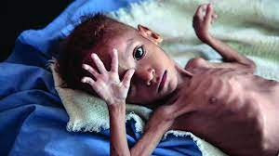
MALNUTRITION

Slide 3
MALNUTRITION DEFINITION
Malnutrition refers to deficiencies, excesses, or imbalances in a person’s intake of energy and/or nutrients (WHO).
Malnutrition occurs when the body doesn't get enough nutrients. Causes include a poor diet, digestive conditions or another disease.
Symptoms are fatigue, dizziness and weight loss. Untreated malnutrition can cause physical or mental disability.
Treatment must address any underlying conditions and replace missing nutrients.

Slide 4
CAUSES OF MALNUTRITION Primary reasons
LOW INCOME
SCARCITY OF FOOD SUPPLY
IGNORANCE &
ERRONEOUS FOOD HABBITS
OVER POPULATION

Slide 5
Secondary reasons
OBESITY,INSULIN,RESISETANCE AND DIABATES
DIARRHEA,INTESTI-NAL MALABSORPTION
INFECTIONS ESPECIALLY RESPIRATORY
METABOLIC AND RENAL DISEASES

Slide 6
TYPES OF MALNUTRITION
Under nutrition which includes wasting (low weight-for-height), stunting (low height-for-age) and underweight (low weight-for-age);
Micronutrient-related malnutrition, which includes micronutrient deficiencies (a lack of important vitamins and minerals) or micronutrient excess; and
Overweight, obesity and diet-related non-communicable diseases (such as heart disease, stroke, diabetes and some cancers).

Slide 7
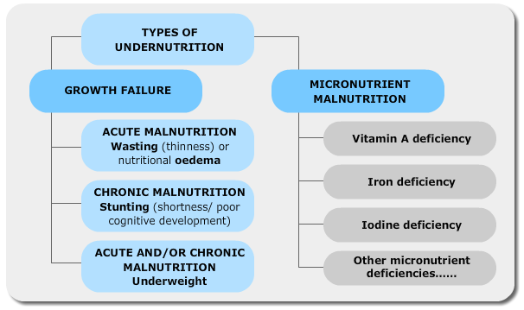

Slide 8
Symptoms of malnutrition
Some signs and symptoms of malnutrition include:
a lack of appetite or interest in food or drink
tiredness and irritability
an inability to concentrate
always feeling cold
depression
loss of fat, muscle mass, and body tissue
a higher risk of getting sick and taking longer to heal
longer healing time for wounds
a higher risk of complications after surgery

Slide 9
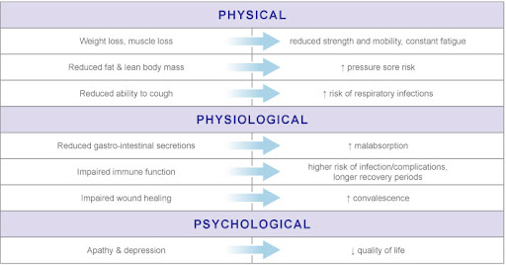
DISEASES RELATED TO MALNUTRITION

Slide 10
World statistics of malnutrition
Malnutrition, in all its forms, includes under nutrition (wasting, stunting, underweight), inadequate vitamins or minerals, overweight, obesity, and resulting diet-related non-communicable diseases.
1.9 billion adults are overweight or obese, while 462 million are underweight.
Globally in 2020, 149 million children under 5 were estimated to be stunted (too short for age), 45 million were estimated to be wasted (too thin for height), and 38.9 million were overweight or obese.
Around 45% of deaths among children under 5 years of age are linked to under nutrition. These mostly occur in low- and middle-income countries. At the same time, in these same countries, rates of childhood overweight and obesity are rising.
The developmental, economic, social, and medical impacts of the global burden of malnutrition are serious and lasting, for individuals and their families, for communities and for countries.

Slide 11
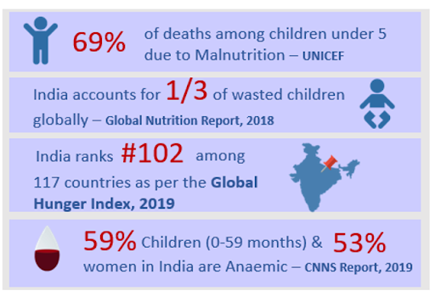
Malnutrition in India

Slide 12
WHO POLICY
Led by WHO and the Food and Agriculture Organization of the United Nations (FAO), the UN Decade of Action on Nutrition calls for policy action across 6 key areas:
creating sustainable, resilient food systems for healthy diets;
providing social protection and nutrition-related education for all;
aligning health systems to nutrition needs, and providing universal coverage of essential nutrition interventions;
ensuring that trade and investment policies improve nutrition;
building safe and supportive environments for nutrition at all ages; and
strengthening and promoting nutrition governance and accountability, everywhere.

Slide 13
Nutrients

Slide 14
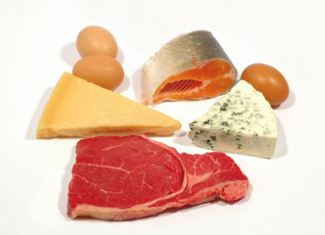
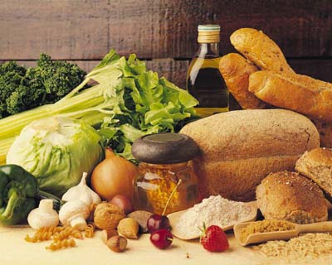
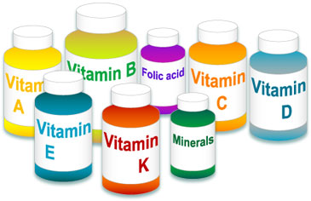
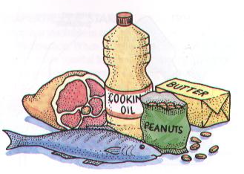

What is a Nutrient…?
- Nutrients are the essentials for the normal functioning of the human body
Includes:
Carbohydrates
Proteins
Fats and Lipids
Vitamins
Minerals
Water

Slide 15
Facts about Nutrients
So-called nonessential nutrients are those that can be synthesized by the cell if they are absent from the food
Essential nutrients cannot be synthesized within the cell and must be present in the food
In some animals, microorganisms living in the gut may synthesize essential nutrients, which are then released into the bloodstream
In most living organisms, nutrients provide not only the energy necessary for certain vital processes but also the various materials from which all structural and functional components can be assembled

Slide 16
Organic Nutrients
The organic nutrients are the necessary building blocks of various cell components that certain organisms cannot synthesize and therefore must obtain preformed.
These compounds include carbohydrates, protein, and lipids.
Other organic nutrients include the vitamins, which are required in small amounts, because of either the catalytic role or the regulatory role they play in metabolism.

Slide 17
Nutrition in Animals
Simple observation reveals that the animal kingdom is dependent on plants for food.
Even meat-eating, or carnivorous, animals such as the lion feed on grazing animals and thus are indirectly dependent on the plant kingdom for their survival.
Omnivores are miscellaneous species whose teeth and digestive systems seem designed to eat a relatively concentrated diet, since they have no large sac or chamber for the fermentation of fibrous material
Carnivores necessarily form only a small portion of the animal kingdom, because each animal must eat a great many other animals of equivalent size in order to maintain itself over a lifetime.
As an evolutionary response to this problem, many leaf eaters, or herbivores, have developed a pouch at the anterior end of the stomach, called the rumen, that provides a space for the bacterial fermentation of ingested leaves.

Slide 18
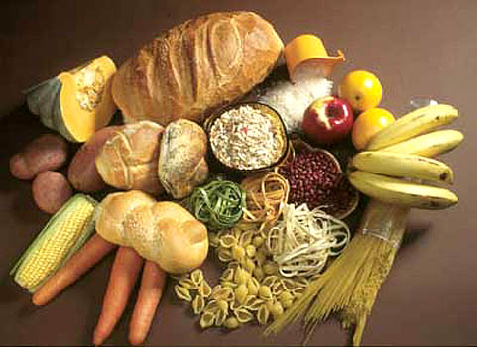
Carbohydrates
By Sanjay Kottapalli and Satya Krishnan

Slide 19
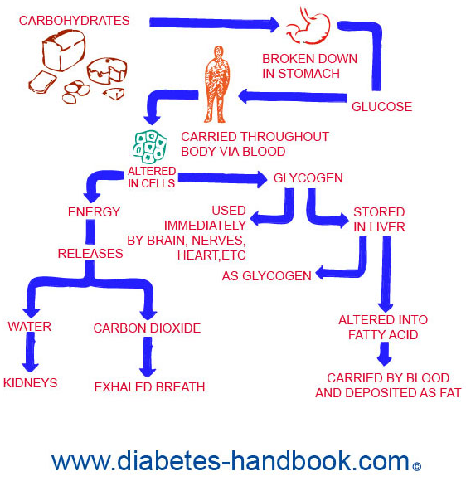
Functions
Primary source of energy
Used in lieu of proteins and other energy sources
Dietary fiber- (essential, non-digestable carbohydrates)
Calories per Gram: 4 Calories
Ideal Percentage of Calories from Carbs: 55%

Slide 20
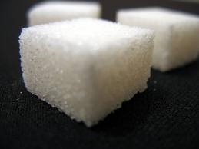
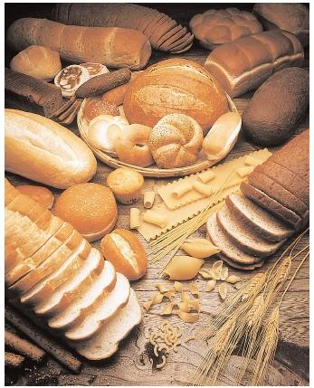
Simple vs Complex Carbs
Simple Carbohydrates:
made of one or two sugar molecules
fast burning
digested quickly; provide immediate bursts of energy
EX: table sugar, honey, soft drinks
Complex Carbs:
many sugar molecules chemically bound together
slow burning
digested slowly; provide long lasting, stable energy
EX: oatmeal, whole grain bread, cheerios

Slide 21
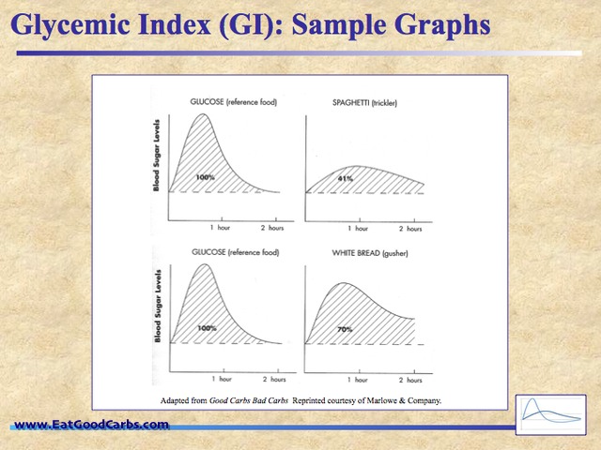
Glycemic Index
Measure of how much a carb raises blood sugar levels
Higher Glycemic Index: Pure glucose (100)
Lower GI: Kidney beans (<55)
Generally, more nutrient dense foods are lower on the GI scale while empty calorie foods are higher up

Slide 22
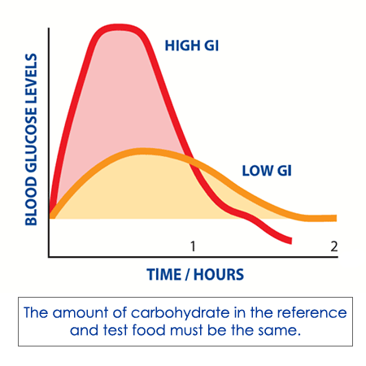
Glycemic Index (cont.)
More nutrient dense foods are lower on the GI scale while empty calorie foods are higher up
Higher GI foods are useful in situations when one needs instant calories and energy (hypoglycemia, insulin overdoses)

Slide 23
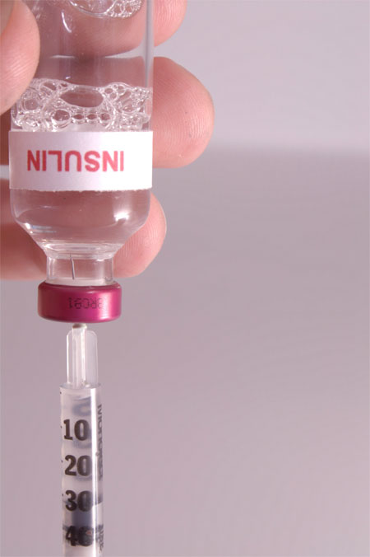
Simple Sugars
Consuming simple sugars can overexert the pancreas and lead to Type 2 diabetes
Sugars burn fast and force the body to overproduce insulin or store it as fat
Foods high in simple sugars are often empty calories

Slide 24

Diabetes Statistics
People who eat food with a higher glycemic index are at a higher risk of type 2 diabetes
http://www.truestarhealth.com/Notes/1202003.html#Diet-Options
Participants on a high fiber diet had 10% glucose levels than the standard
http://www.truestarhealth.com/Notes/1202003.html#Diet-Options

Slide 25
Fats

Slide 26
Function Calories Per Gram
1 gram=9 calories

Slide 27
Percent of daily calories for fat
25%-35%

Slide 28
The Controversy Between Saturated Fat and Heart Diseases
For the past 5 (maybe even more) decades, mankind has been told, and has believed, that there was a link between saturated fat and heart disease.
In the past 6 months-a year, scientists have released the theory that there really isn’t any relationship between saturated fat and heart disease.
Now in days, there is a controversy between who is right, and who is wrong.
Evidence has shown that there are other places on this planet, whose main part of their diet is saturated fat based food, and yet they don’t have that many heart disease epidemics.

Slide 29
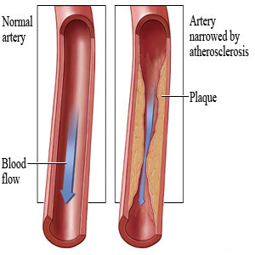
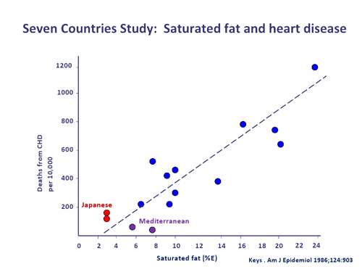
The Controversy Between Saturated Fat and Heart Diseases
http://www.cuisinevegan.com/wp-content/uploads/2010/07/clogged-heart.jpg
http://scepticalnutritionist.com.au/wp-content/uploads/2012/04/seven-countries-study.jpg

Slide 30
2 Main Fats (Saturated & Unsaturated)
Unsaturated | Unsaturated & Saturated | Saturated
One or more double bonds with carbon Liquid at room temp Increases HDLs Long-lasting shelf-life Melting point is low Recommended daily consumption is 10% | Triglyceride Este Linkage High caloric, energy content Energy storage | No double bonds with carbon. Solid at room temp Increases LDLs Quickly spoiled Melting point is high Recommended daily consumption is 30%

Slide 31
Unsaturated & Saturated
Trans fats are made by hydrogenating (or adding a hydrogen) to vegetable oils, in order to make them more solid. They are also called “partially hydrogenated oils”. On top of increasing LDLs like saturated fats, they also reduce HDLs, making them more dangerous than saturated fats.

Slide 32
A Video on the Dangers of Fats
Click Here for YouTube video

Slide 33

Proteins
By: Christian Sana
Jack Moles

Slide 34
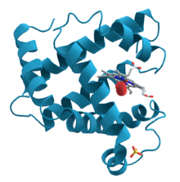
Proteins, What They Are
Proteins-are biochemical compounds consisting of one or more polypeptides typically folded into a globular or fibrous form, facilitating a biological function.
So Proteins are an essential thing to live, they help to keep us alive and well.

Slide 35
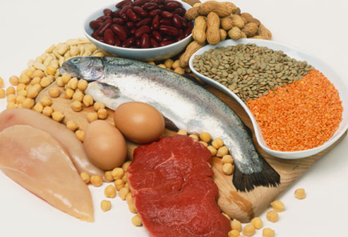
What Proteins Do For The Body
Proteins help us maintain a healthy lifestyle. They keep us healthy and are found in meats.
Proteins also give you a good source of other important tings that are needed. They have sodium, fats, and Potassium.

Slide 36
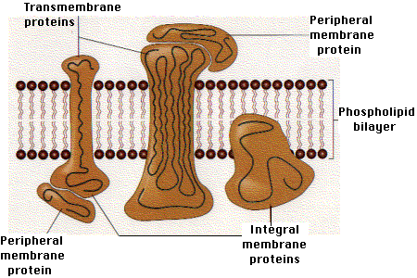
How Much Protein Do You Need
Our protein needs depend on our age, size, and activity level. The standard method used by nutritionists to estimate our minimum daily protein requirement is to multiply the body weight in kilograms by .8, or weight in pounds by .37.

Slide 37
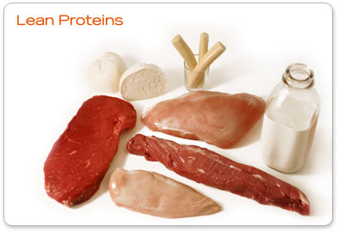
How Do You Get it
Some of the most healthy ways to incorporate protein into your daily diet is through the basic fish, chicken, and meat.
The most healthiest ways to gain protein in regular meals is through sushi, eggs, ground sirloin, red meat, chicken tenderloins, Pork Chops, edamame

Slide 38
Vitamins By Kelly Konstant and Christen Massouras

Slide 39

Vitamins
Any of a group of organic compounds that are essential for normal growth and nutrition and are required in small quantities in the diet because they cannot be synthesized by the body

Slide 40
Top 5 Functions of Vitamins
Supplies nutrients to our body not given by the food that we consume
Assures good balance of nutrients in our body; homeostasis
Helps extend our age and wellness
Increases immune system and bone health
Helps memory health

Slide 41
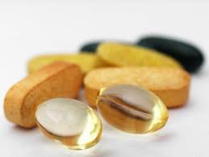
Water Soluble VS Fat Soluble
Water soluble is capable of dissolving in water
Fat soluble vitamins requires fat to be present in order to be properly absorbed
List of Fat soluble vitamins
Vitamin A, E, D, K

Slide 42

Why Fat soluble vitamins can lead to excess
Vitamins that are fat soluble are stored in your fat, Because of this reason there can be an excess of vitamins stored in your unused body fat that will not be released from the body.

Slide 43

Nutrient Deficiency
Nutrient Deficiency- Absence or insufficiency of some factor needed for normal growth and development (www.fao.org)

Slide 44

The Complex B Vitamins
The vitamin B-complex refers to all of the known essential water-soluble vitamins except for vitamin C.
These include thiamine (vitamin B1), riboflavin (vitamin B2), niacin (vitamin B3), pantothenic acid (vitamin B5), pyridoxine (vitamin B6), biotin, folic acid and the cobalamins (vitamin B12).
(evitamins.com)

Slide 45

How many Vitamins should we take a day?
Up to age 50, 1,000 milligrams (mg) a day; thereafter, 1,200 mg. If you don't get at least three servings of dairy a day, fill the gap with a supplement.
Just because one person takes a pill and they feel better that doesn't mean that the pill was responsible for the effect. So no its not always the vitamin that keeps you healthy.

Slide 46

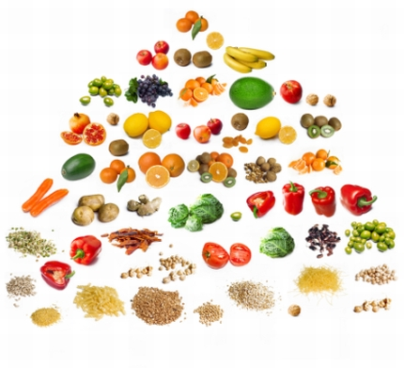

Minerals
By Emma and Lizzie

Slide 47
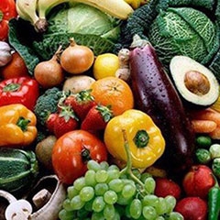

What is a Mineral?
Minerals are macroelements. Macroelements are elements that our bodies need in large amounts. Some examples of minerals are calcium, magnesium, sodium, potassium, phosphorus, chlorine, and sulphur. Minerals are also a trace or microelements. Microelements are elements that our body needs in small amounts. Some examples are iron, zinc, manganese, copper, iodine,
cobalt, nickel, fluorine, vanadium,
chromium, molybdenum, selenium,
tin, and silicon.

Slide 48

General Function of Minerals
The two general functions of minerals are building and regulating. These functions affect the skeleton and soft tissue. Minerals help your body’s heartbeat, prevent blood clots, control your body fluids, nerve response, and the flow of oxygen from the lungs to your tissue. Minerals also help your short term memory.

Slide 49
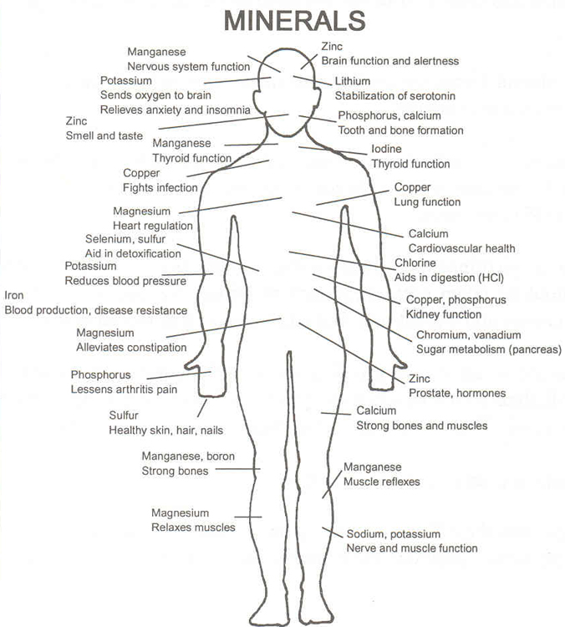
Five Main Functions of Minerals
Catalysts for many biological reactions within the body (function)
muscle response
the transmission of messages through the nervous system
the production of hormones
digestion, and the utilization of
nutrients in foods

Slide 50
Minerals vs. Vitamins
Both are needed to maintain a healthy body
Vitamins release energy from food, developing red blood cells, blood clotting, maintain healthy skin/eye/hair
Minerals help in bone and tooth formation, blood coagulation, muscle contraction, keeping acid-alkaline balance in blood
Minerals are NOT vulnerable to heat, chemicals reactions, sunlight- indestructible
Vitamins ARE vulnerable
Vitamins can be divided into water soluble stored in the body) and fat-soluble (dissolved in the body’s fat cells and gets stored)
Minerals can be macro minerals (need large amounts by the body) and trace minerals (only need in small qualities)
What’s a trace mineral?
Any element that is required in minutes quantities or physiological functioning

Slide 51
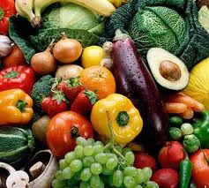
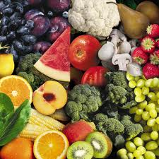

What Foods Have Minerals?
Look for colorful foods! Like deep red or greens!
Fruits and vegetables provide our bodies with minerals and vitamins
-they are also found in nuts, protein

Slide 52

YAY MINERALS!
The End

Slide 53
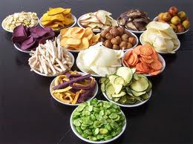
Fiber
Jordyn Imaña

Slide 54
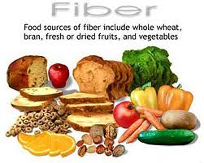
Function
Adds bulk to your diet
Helpful in controlling weight
Aids digestion
Helps prevent constipation

Slide 55
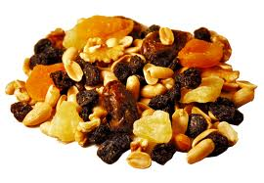
Recommended Daily Intake
25 grams in girls/women under 50
30-38 grams in boys/men under 50

Slide 56
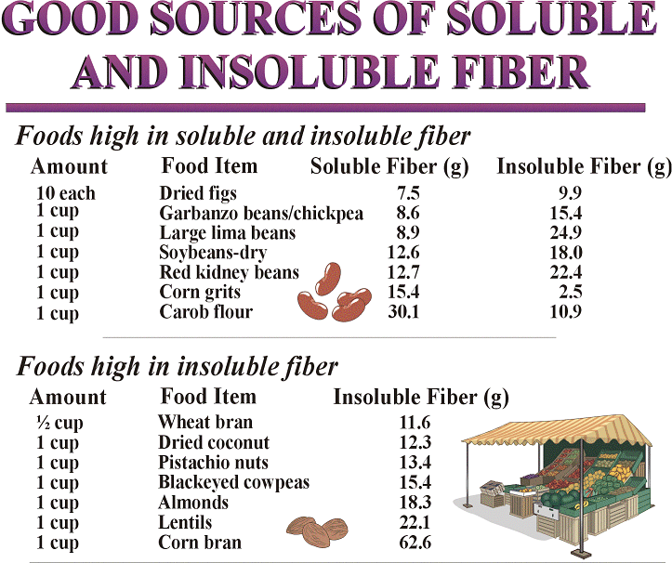
Insoluble vs Soluble
Soluble fibers attract water and form a gel, which slows down digestion
Sources of soluble fiber: oatmeal, oat cereal, lentils, apples, oranges, pears, oat bran, strawberries, nuts, flaxseeds, beans, dried peas, blueberries, psyllium, cucumbers, celery, and carrots
Insoluble fibers are considered gut-healthy fiber because they have a laxative effect and add bulk to the diet, helping prevent constipation
Sources of insoluble fiber: whole wheat, whole grains, wheat bran, corn bran, seeds, nuts, barley, couscous, brown rice, bulgur, zucchini, celery, broccoli, cabbage, onions, tomatoes, carrots, cucumbers, green beans, dark leafy vegetables, raisins, grapes, fruit, and root vegetable skins

Slide 57
Stats
The average American consumes about 15 grams of fiber per day
A diet high in fiber, particularly breakfast cereals, can reduce a woman’s risk of developing coronary heart disease by up to 23%

Slide 58


Water
Non-Caloric (0 Cal per gram)
Major Function: Essential to life.
Regulate body temperature
Transports Nutrients
Shock Absorption
Your body is Mostly Water! (40-60% of body weight)
Sources- Anything in diet counts Juices, Veggies, Fruit, etc. (Except Diuretics-things that make you urinate (caffeine=coffee/pop)

Slide 59

How Much Water Do You Need?
There are a LOT of formulas…a lot are good but the best way to know you’re hydrated is to check your urine. IT SHOULD BE….
CLEAR (Close to water) AND
COPIOUS (Urinating a lot)

Slide 60


Water…..
You can only live for about 3-4 Days with no Water…
75% of Americans are chronically dehydrated.
In 37% of Americans, the thirst mechanism is so weak that it is mistaken for hunger.
Even MILD dehydration will slow down one's metabolism as 3%.
One glass of water will shut down midnight hunger pangs for almost 100% of the dieters studied in a University of Washington study.
Lack of water, the #1 trigger of daytime fatigue.
By the time a person feels thirsty, his or her body has lost over 1 percent of its total water amount.

Slide 61
BALANCED DIET

Slide 62
DIET & BALANCED DIET
DIET : Kind of foods a person or group which lives
BALANCED DIET : Variety of food such contains different quantity and proportions that need the energy, amino acids, vitamins, minerals, fats, carbohydrates and other nutrients adequately need for maintain health. A balanced diet has became an accepted means to safeguard a population from nutritional deficiency
According to WHO committee all nation should follow and prepare national food policy and nutritional settings for maintain balanced diet for the citizens.

Slide 63
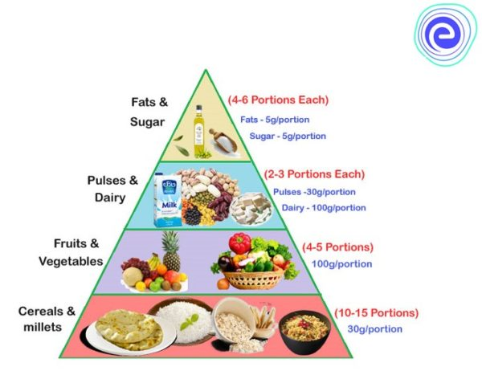
BALANCED DIET CHART

Slide 64
Importance of a Balanced Diet
Balanced Diet leads to a good physical and a good mental health.
It helps in proper growth of the body.
Also, it increases the capacity to work
Balanced diet increases the ability to fight or resist diseases.

Slide 65
DIETARY GOALS
FAT should limit approximately 15-30% of daily intake
Saturated FAT should contribute not more than 10% of total energy intake. Unsaturated vegetable oil should be substituted for the remaining FAT requirement
Excessive consumption of refined carbohydrate should be avoided, some amount of carbohydrates is rich in natural fiber should be taken
Sources rich in energy such as fats and alcohol should be restricted
Salt intake should be reduced to an average of not more than 5g per day (in India avg 15g per day)
Protein should approximately 10-15 % of daily intake
Junk foods such as soft drinks that supply empty calories it should be reduced
A healthy diet is good for your physical and mental health.
It can reduce the risk and severity of obesity, heart disease, diabetes, hypertension, depression and cancer.

Slide 66
ESSENTIAL FACTORS OF BALANCED DIET
CARBOHYDRATES
PROTEINS
FATS
MINERALS
WATER
VITAMIN
FIBER

Slide 67
Balanced diet food in life span
INFANCY
Babies usually double their length and triple their weight between birth and one year of age. Breast milk generally supplies a baby with the required amounts of nutrients, fluids and energy up to about six months of age. It is recommended that infants be exclusively breastfed up to around six months of age.
SCHOOL GOING STUDENTS
During childhood, children tend to vary their food intake (spontaneously) to match their growth patterns. Children’s food needs vary widely, depending on their growth and their level of physical activity. Like energy needs, a child’s needs for protein, vitamins and minerals increase with age.

Slide 68
ADOLSCENCE
he extra energy required for growth and physical activity needs to be obtained from foods that also provide nutrients, instead of just ‘empty calories’.
Takeaway and fast foods need to be balanced with nutrient-dense foods such as wholegrain breads and cereals, fruits, legumes, nuts, vegetables, fish and lean meats.
Milk, yoghurt and cheese (mostly reduced fat) should be included to boost calcium intake – this is especially important for growing bones. Cheese should preferably be a lower salt variety.
Adolescent girls should be particularly encouraged to consume milk and milk products.

Slide 69
YOUNG ADULTS
Moving away from home, starting work or study, and the changing lifestyle that accompanies the late teens and early 20s can cause dietary changes that are not always beneficial for good health. Nutrients recommendations depend upon lifestyle and physical activity.
OLD AGE
Physical activity is not much during old age hence carbohydrates and fats need to be restricted. But there is muscle loss and fragility of bones is common, hence protein is required to make up for the loss and for maintaining growth of cells.
Since teeth start falling off hence chewing becomes difficult and thus milk is a good option for old people.

Slide 70
Benefits of balanced diet
Control Body Weight. ...
Fight Off Disease. ...
Have More Energy. ...
Sleep Better. ...
More Brain Power.

Slide 71
NUTRITION AND HEALTH

Slide 72
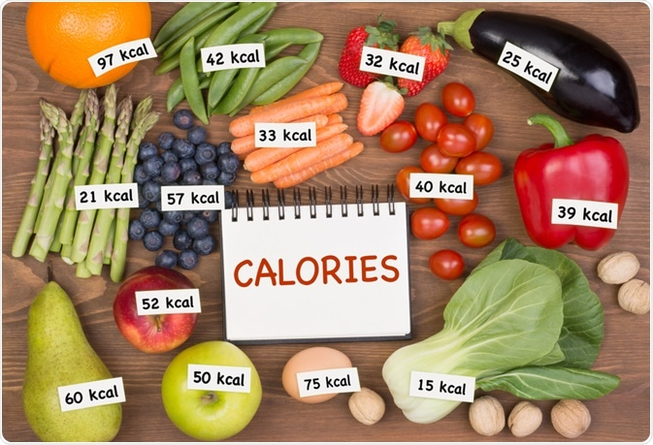
CALORIC REQUIREMENT

Slide 73
MEASSUREMENT OF ENERGY
g.
The energy value of food is required has long expressed in terms of Kilocalorie(kcal) C.
Energy requirement is the amount of food energy needed to balance energy expenditure in order to maintain body size, body composition and a level of necessary and desirable physical activity consistent with long-term good health. This includes the energy needed for the optimal growth and development of children, for the deposition of tissues during pregnancy, and for the secretion of milk during lactation consistent with the good health of mother and child.
Human energy requirements are estimated from measures of energy expenditure plus the additional energy needs for growth, pregnancy and lactation. Recommendations for dietary energy intake from food must satisfy these requirements for the attainment and maintenance of optimal health, physiological function and well-being.

Slide 74
CALORIE
A calorie is a unit of energy. "calorie" to mean a unit of energy that could come from a variety of sources, In a nutritional sense, all types of food — whether they are fats, proteins, carbohydrates or sugars — are important sources of calories, which people need to live and function.
Calories keep the body functioning. All of the processes that the body performs require energy to keep moving. Calories provide our bodies with this energy that is necessary to sustain our daily lives.
A calorie in nutrition is actually 1,000 of these small calories. These units of 1,000 small calories are also sometimes called large calories, dietary calories, nutritional calories, food calories and Calories with a capital C.
Different types of macronutrients have standard amounts of calories.
One gram of protein has 4 calories.
One gram of carbohydrates has 4 calories.
One gram of fat has 9 calories

Slide 75
FACTS ABOUT CALORIE
Calorie requirement of human body is calculated by the Harris-Benedict formula and Katch Mcarlde formula
Adolescence need more high amount of C due to body change
Nuts are rich in Calorie
Pregnant women need extra 300 C per day
There are two types of calorie:
A small calorie (cal) is the amount of energy required to raise the temperature of 1 gram (g) of water by 1º Celsius (º C).
A large calorie (kcal) is the amount of energy required to raise 1 kilogram (kg) of water by 1º C. It is also known as a kilocalorie.
1 kcal is equal to 1,000 cal.

Slide 76
Calories Needed Each Day
It’s important to know the number of calories you need to eat to stay healthy
How many calories you need each day ENERGY IN— depends on a few things:
Your age
Whether you are male or female
How active you are
Not Active—Not much ENERGY OUT. Does only light activity needed for daily life
Somewhat Active—Some ENERGY OUT. Does physical activity equal to walking quickly for 1 ½ to 3 miles (about 30–40 minutes) each day. Plus, does light activity needed for daily life.
Very Active—A lot of ENERGY OUT. Does physical activity equal to walking quickly for more than 3 miles each day (more than 40 minutes). Plus, does light activity needed for daily life.

Slide 77
REQUIREMENT OF CALORIE
Not everybody needs the same number of calories each day. People have different metabolisms that burn energy at different rates, and some people have more active lifestyles than others.
The recommended intake of calories per day depends on several factors, including:
overall general health
physical activity demands
sex
weight
height
body shape

Slide 78
CALORIES RICH FOODS
Proteins: Red meats, pork, chicken with skin on (roast or broil don’t deep fry for your health), salmon or other oily fish, beans, whole milk, eggs, cheese, full-fat yogurt.
Carbohydrates: potatoes, brown rice, whole grain pasta, whole grains, whole grain breads.
Fats: Nuts and nut butters, olives, avocado, butter, salad dressings, mayonnaise, high-fat cheeses.

Slide 79
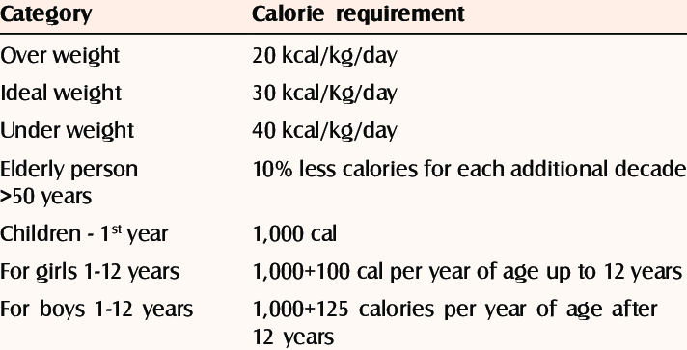
REQUIRED CALORIE BASED ON BODY WEIGHT

Slide 80
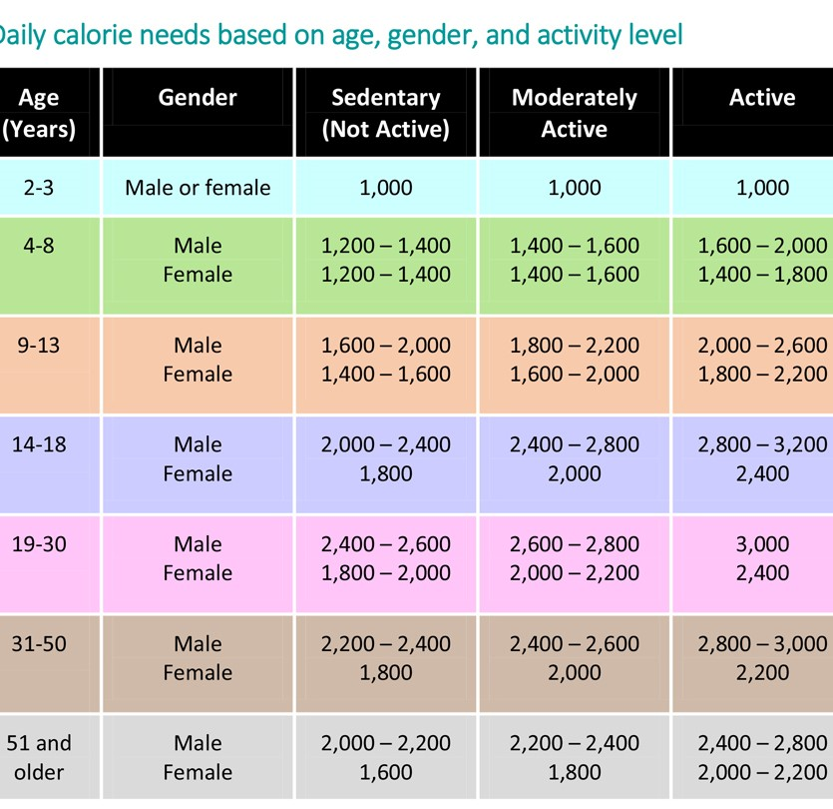
DAILY CALORIE NEEDS BASED ON age, gender and activities

Slide 81
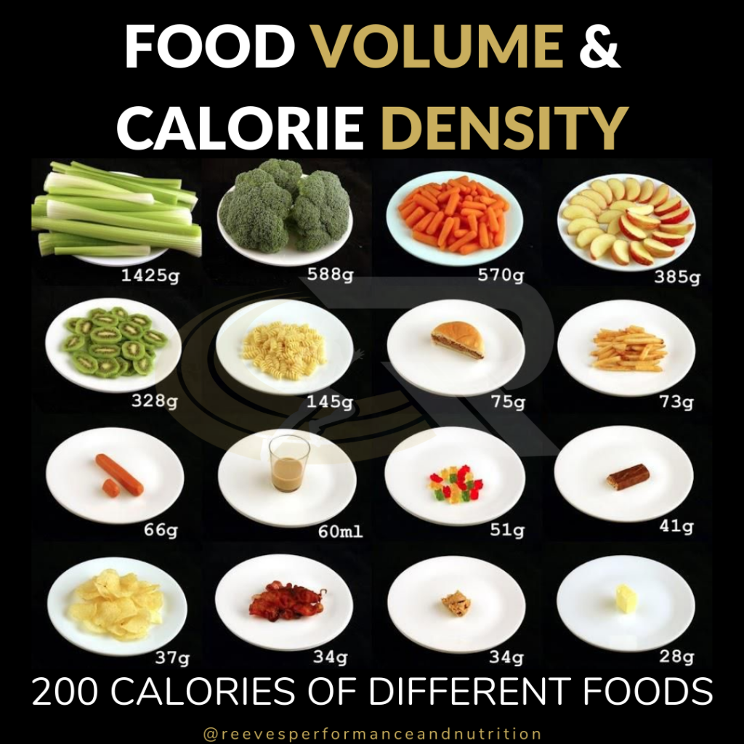
CALORIE & DENSITY

Slide 82
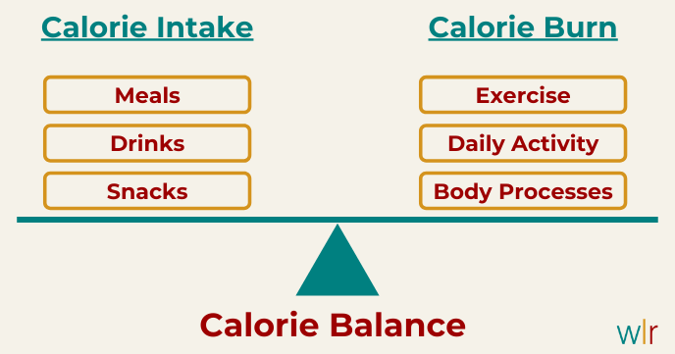

Slide 83
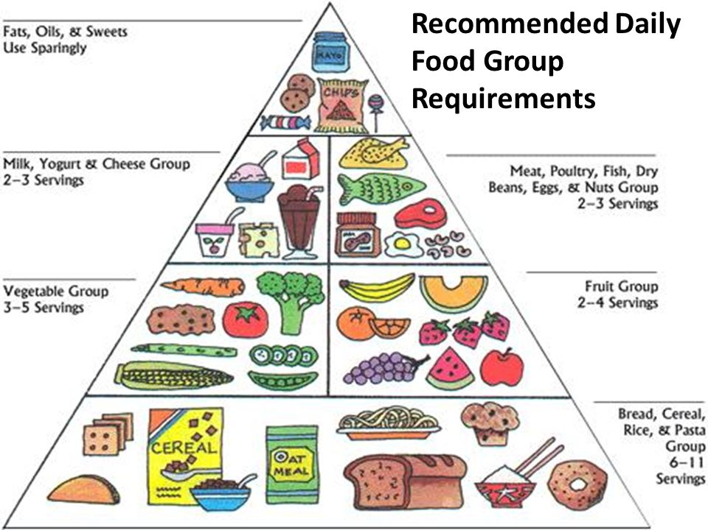
BALANCED CALORIE FOOD

Slide 84
PREVENTION OF NUTRITION PROBLEMS
UNIT - II

Slide 85
NUTRITIONAL PROBLEMS
Nutritional deficiency occurs, when the body does not absorb or get from the food for the required amount of nutrient. Deficiency can lead to variety of health problems these can include digestions problems skin disorder, stunted or defective bone growth and even dementia

Slide 86
TYPES OF NUTRITIONAL PROBLEMS
PROTIEN ENERGY MALNUTRITION
MICRO NUTRIENT DEFICIENCY
CHRONIC DISEASES
EATING DISSORDERS

Slide 87
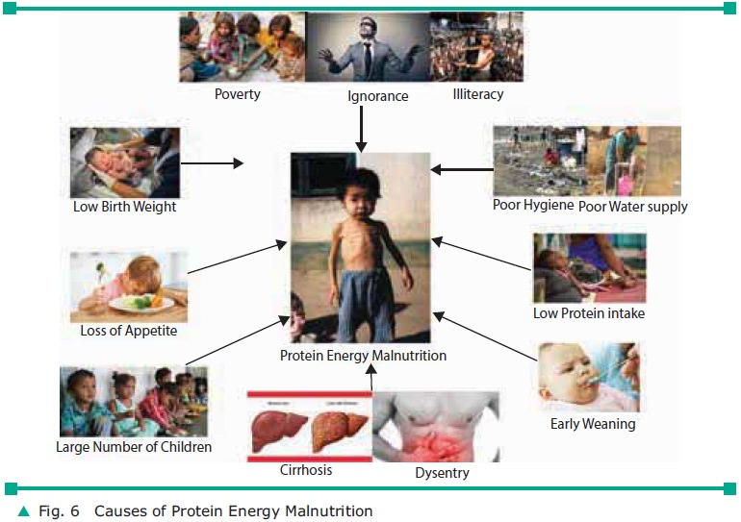
PROTEIN ENERGY MALNUTRITION

Slide 88
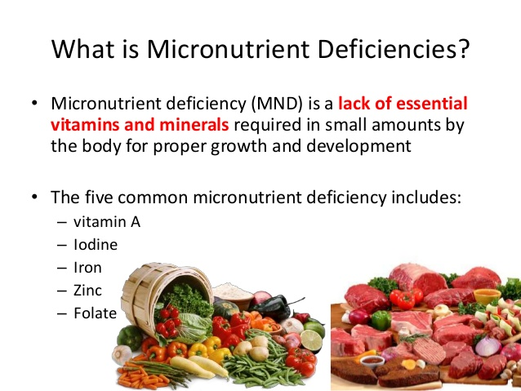

Slide 89

CHRONIC DISEASES

Slide 90
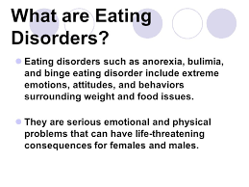
EATING DISORDERS

Slide 91
CAUSES OF NUTRITIONAL DEFICIENCY
Low socio economic status
Illiteracy
Lack of awareness regarding nutrients and requirement
Over population
Decreased food production
Lack of health care
Large families
Cultural influences
Infections
Superstitious beliefs and misconceptions
poverty

Slide 92
PREVENTION OF NUTRITION DEFICIENCY
Add Fiber in food
Get adequate Vitamin D
Eat healthy fat and omega-3
Boost antioxidants
Choose whole grains
Consume magnesium and calcium rich food
Consume vegetables more in food

Slide 93
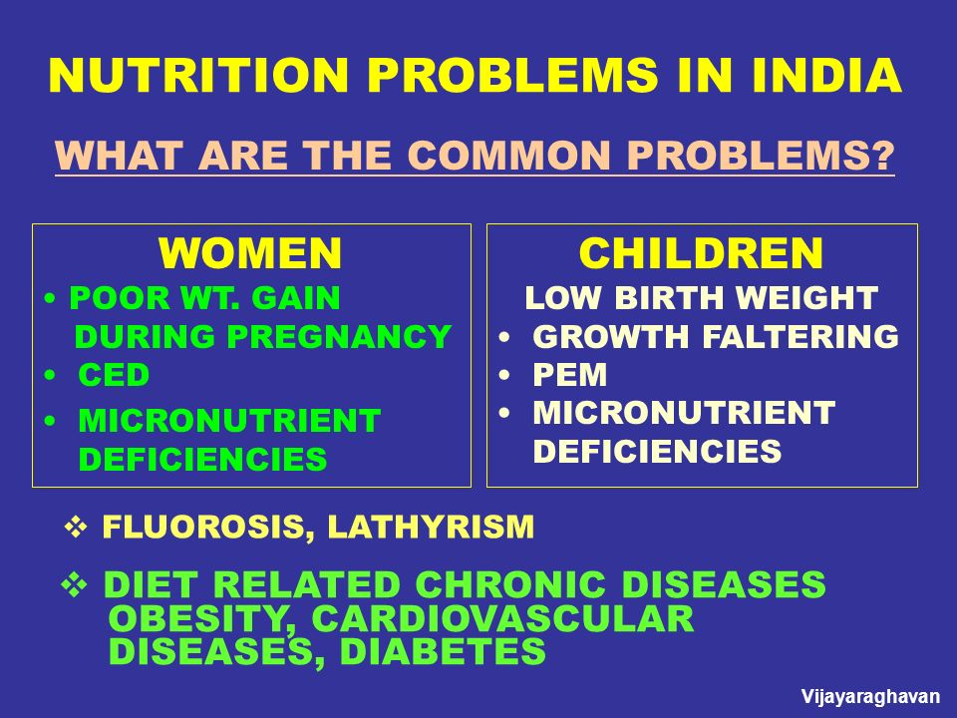

Slide 94
MAJOR NUTRITIONAL PROGRAMME IN INDIA
ICDS
SPECIAL NUTRITIONAL PROGRAMME
BALWADI NUTRITION PROGRAMME
MID DAY MEAL PROGRAMME- school students
MID DAY MEAL SCHEME
NATIONAL IODINE DEFICENCY CONTROL PROGRAMME
Vit- A Prophylaxis programme
PROPHYLAXIS AGAINST NUTRITIONAL ANEMIA

Slide 95


Slide 96
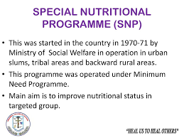

Slide 97
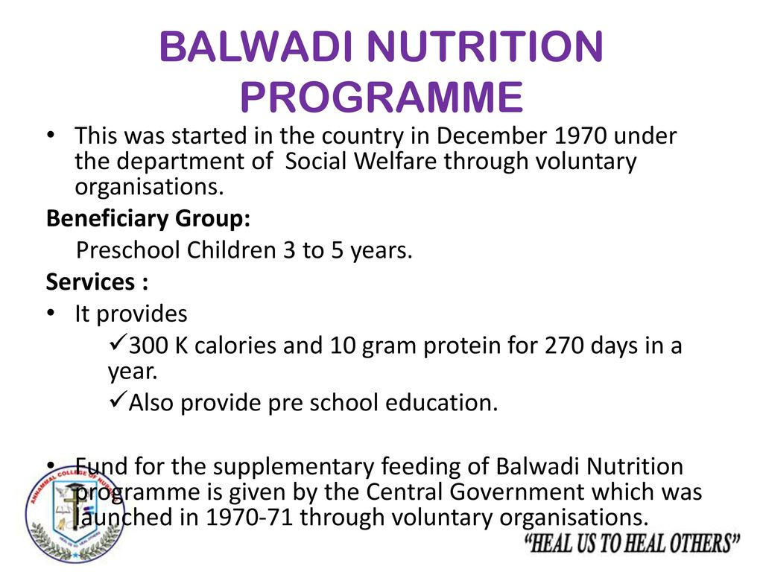

Slide 98
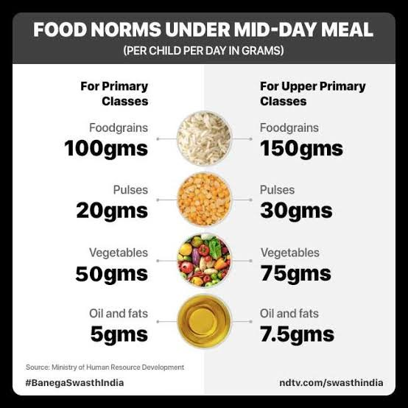

Slide 99
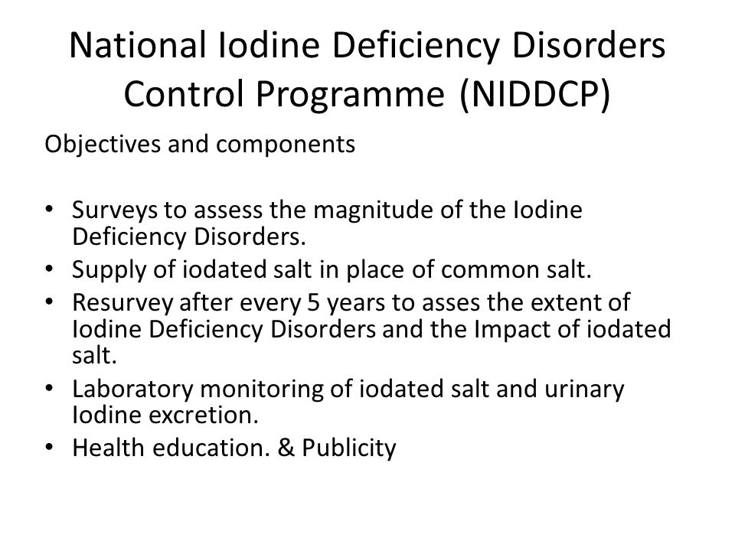

Slide 100
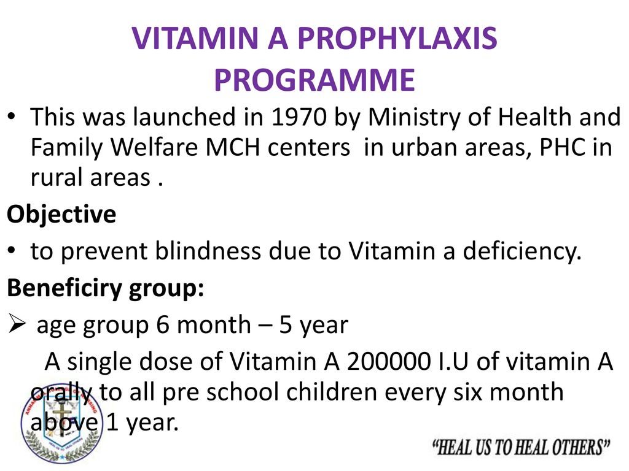

Slide 101
