Slide 1

First Aid

Slide 2
First Aid
covers
Chain of Survival
What is First Aid?
Scene Survey
Initial Assessment
Victim Assessment Sequence
Bleeding Control
Shock
Burns
Choking
Fractures
Heart Attack
Basic First Aid for Wounds
Dressing and Bandages
Amputation
Checking for Spinal Injuries
Stroke (Brian Attack)
Bites and Stings

Slide 3
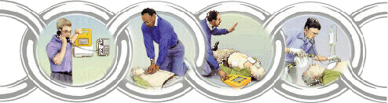
Chain of Survival
In order for a person to survive
Early
Access “9-911”
Early
First Aid/CPR
You
Early
Defibrillation
EMS on
Scene
Early
Advanced Care
Hospital

Slide 4
What is meant by first aid and CPR?
It includes initial intervention in a serious condition prior to professional medical help being available, such as performing cardiopulmonary resuscitation (CPR) while waiting for an ambulance, as well as the complete treatment of minor conditions, such as applying a plaster to a cut.

Slide 5
What does defibrillation mean?
: an electronic device that applies an electric shock to restore the rhythm of a fibrillating heart.
It uses an electrical shock to reset the electrical state of the heart so that it may beat to a rhythm controlled by its own natural pacemaker cells.

Slide 6
Basic First Aid
What Is First Aid?
The immediate care given to an injured or suddenly ill person.
DOES NOT take the place of proper medical treatment.
medical help that you give to somebody who is hurt or ill before the doctor arrives.

Slide 7
Scene Survey
When confronted with an accident or illness on duty it is important to assess the situation to determine what kind of emergency situation you are dealing with, for your safety, the victim’s safety and that of others.
Do a quick survey of the scene that includes looking for three elements:
Hazards that could be dangerous to you, the victim, or bystanders.
The cause (mechanism) of the injury or illness.
The number of victims.
Note: This survey should only take a few seconds.
Notes:
Speaker’s Notes:
Tell the EMS personnel about your findings, so that they can fully recognize the extent of the problem.

Slide 8
Initial Assessment
Goal of the initial assessment:
Visually determine whether there are life-threatening or other serious problems that require quick care.
Determine if victim is conscious - by tap and shout. Check for ABC as indicated:
A = Airway Open? – Head-tilt/Chin-lift.
B = Breathing? – Look, listen, and feel.
C = Circulation? – Check for signs of circulation.
Note: These step-by-step initial assessment should not be changed. It takes less than a minute to complete, unless first aid is required at any point.
Breathing
Bleeding
Shock
Burn
Choking
Heart Attack
Fractures

Slide 9
Victim Assessment Sequence
Assessment Sequence Components:
If victim is responsive
Ask them what injuries or difficulties they are experiencing.
Check and provide first aid for these complaints as well as others that may be involved.
If victim is not responsive (Unconscious or incoherent).
Observe for obvious signs of injury or illness:
Check from head to toe
Provide first aid/CPR for injuries or illness observed.

Slide 10
Bleeding Control
Control Methods For External Bleeding:
Direct pressure stops most bleeding.
Wear medical exam gloves (if possible)
Place a sterile gauze pad or a clean cloth over wound
Elevation injured part to help reduce blood flow.
Combine with direct pressure over the wound (this will allow you to attend to other injuries or victims).
If bleeding continues, apply pressure at a pressure point to slow blood flow.
Pressure point locations:
Brachial (Top of elbow)
Femoral (Inside upper thigh)

Slide 11
Bleeding Control Cont.
Control Methods For Internal Bleeding:
Signs of internal bleeding:
Bruises or contusions of the skin
Painful, tender, rigid, bruised abdomen
Vomiting or coughing up blood
Stools that are black or contain bright red blood
What to Do:
For severe internal bleeding, follow these steps:
Monitor ABC’s (Airway Breathing Circulation)
Keep the victim lying on his/her left side. (This will help prevent expulsion of vomit from stomach, or allow the vomit to drain and also prevent the victim from inhaling vomit).
Treat for shock by raising the victim’s legs 8” – 12”
Seek immediate medical attention

Slide 12
Shock
Shock refers to circulatory system failure that happens when insufficient amounts of oxygenated blood is provided for every body part. This can be as the result of:
Loss of blood due to uncontrolled bleeding or other circulatory system problem.
Loss of fluid due to dehydration or excessive sweating.
Trauma (injury)
Occurrence of an extreme emotional event.

Slide 13
Shock Cont.
What to Look For
Altered mental status
Anxiety and restlessness
Pale, cold, and clammy skin, lips, and nail beds
Nausea and vomiting
Rapid breathing and pulse
Unresponsiveness when shock is severe

Slide 14
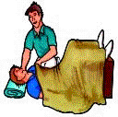
Shock Cont.
What to Do
After first treating life-threatening injuries such as breathing or bleeding, the following procedures shall be performed:
Lay the victim on his or her back
Raise the victim’s legs 8” – 12” to allow the blood to drain from the legs back to the heart.
Prevent body heat loss by putting blankets and coats under and over the victim

Slide 15
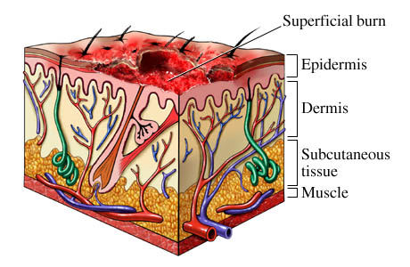

Burns
Burns have been described as:
First-degree burns (Superficial)
Only the skin’s outer layer (epidermis) is damaged.
Symptoms include redness, mild swelling, tenderness, and pain.
Usually heals without scarring.
What to Do:
Immerse in cold water 10 to 45 minutes or use cold, wet cloths.
Cold stops burn progression
May use other liquids
Aloe, moisturizer lotion
Notes:
Two layers
Epidermis
Dermis
Epidermis
Outer cells are dead
Act as protection and form water tight seal

Slide 16
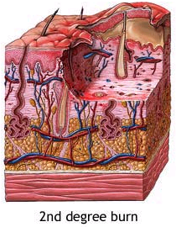

Burns Cont.
Second-degree burns (Partial Thickness)
Epidermis and upper regions of dermis are damaged.
Symptoms include blisters, swelling, weeping of fluids, and severe pain.
What to Do:
Immerse in cold water / wet pack
Aspirin or ibuprofen
Do not break blisters
May seek medical attention

Slide 17
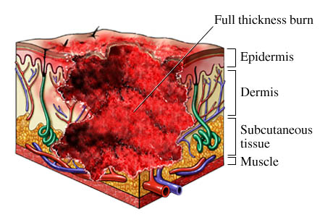

Burns Cont.
Third-degree burns (Full Thickness)
Severe burns that penetrate all the skin layers, into the underlying fat and muscle.
Symptoms include: the burned area appears gray-white, cherry red, or black; there is no initial edema or pain (since nerve endings are destroyed)
What to Do:
Usually not necessary to apply cold to areas of third degree
Do not apply ointments
Apply sterile, non-stick dressings (do not use plastic)
Check ABC’s
(Airway Breathing
Circulation)
Treat for shock
Get medical help

Slide 18
Burns Cont.
Burn injuries can be classified as follow:
Thermal (heat) burns caused by:
Flames
Hot objects
Flammable vapor that ignites
Steam or hot liquid
What to Do:
Stop the burning
Remove victim from burn source
If open flame, smother with blanket, coat or similar item, or have the victim roll on ground.
Determine the depth (degree) of the burn
Notes:
Determine the extent of the burn
Determined by percentage of body area burned
Patient’s hand approximately 1%
Apply the rule of nines

Slide 19
Burns Cont.
Chemical burns
The result of a caustic or corrosive substance touching the skin caused by:
Acids (batteries)
Alkalis (drain cleaners- often more extensive)
Organic compounds (oil products)
Notes:
May occur from any toxic substance that comes in contact with the skin
Mostly caused by Alkaline (alkali) and acid
Protect yourself from exposure or injury

Slide 20
Chemical Burns
car battery acid
bleach
ammonia
denture cleaners
teeth whitening products
pool chlorination products

Slide 21
Burns Cont.
What to Do:
Remove the chemical by flushing the area with water
Brush dry powder chemicals from the skin before flushing
Take precautions to protect yourself from exposure to the chemical
Remove the victim’s contaminated clothing and jewelry while flushing with water
Flush for 20 minutes all chemical burns (skin, eyes)
Cover the burned area with a dry, sterile dressing
Seek medical attention
Notes:
Dry Chemicals
Reaction with water can worsen burn
(1) “Brush - then flush”
(2) Remove victims clothing (shoes & socks)

Slide 22
Burns Cont.
Electrical Burns
A mild electrical shock can cause serious internal injuries.
There are three types of electrical injuries:
Thermal burn (flame) – Objects in direct contact with the skin are ignited by an electrical current.
Mostly caused by the flames produced by the electrical current and not by the passage of the electrical current or arc.
Arc burn (Flash) – Occurs when electricity jumps, or arcs, from one spot to another.
Mostly cause extensive superficial injuries.
True Electrical Injury (contact) – Occurs when an electric current truly passes through the body.

Slide 23
Burns Cont.
What to Do:
Make sure the scene is safe
Unplug, disconnect, or turn off the power.
If that is impossible, call the power company or EMS for help.
Do not contact high voltage wires
Consider all wires live
Do not handle downed lines
Do not come in contact with person if the electrical source is live
Check ABCs. (Airway Breathing Circulation)
If the victim fell, check for a spinal injury.
Treat the victim for shock by elevating the legs 8” – 12” if no spinal injury is suspected.
Seek medical attention immediately.
Notes:
Scene Safety
Do not contact high voltage wires
Consider all wires live
Do not handle down lines
Do not come in contact with patient if the electrical source is live

Slide 24
Choking
Choking occurs when breathing is impeded by a constricted or obstructed throat or windpipe. In some cases, the airflow is completely blocked, and in other cases, insufficient air passes through to the lungs, resulting in oxygen deprivation.

Slide 25
Choking
What is it?
Obstruction in the airway.
General Precaution
If someone is coughing, leave the person alone.
Do not perform the.
Keep eyes on that person.
Ask the person if he/she needs help.
Signs and Symptoms
Person is not able to breath or talk due to obstruction, choking sign given, distressed, and panic.
Hands wrapped around the neck is universal sign for choking.

Slide 26
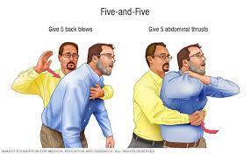
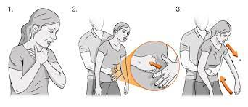
Heimlich Maneuver

Slide 27

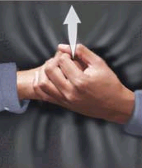
Choking Cont.
What to Do:
Perform Heimlich Maneuver if you are properly trained
Conscious Victim:
Approach from behind and wrap arms around the victim’s waist.
Place one fist just above the victim’s navel with the thumb side against the abdomen.
Second hand over the fist.
Press into the victim’s abdomen with one upward thrust
Repeat thrust if necessary.
Try to pop the obstruction out with swift thrusts in and up.
Continue until the obstruction is relieved or victim collapses.
Have someone call for help.
Note: Always stay calm.

Slide 28
Choking Cont.
What to Do:
Unconscious Victim:
Ask someone to call 9-911 for help
Lower victim to floor on back or left side and perform Heimlich Maneuver
Open airway with tongue-jaw lift
Look inside mouth – if you cannot see anything, do not do a finger sweep
Try to give two full rescue breaths
If these do not go in, reposition the head and give another breath
Perform abdominal thrusts
Continue until successful or help arrives

Slide 29
Fractures
There are two categories of fractures:
Closed (Simple) fracture
The skin is intact and no wound exists anywhere near the fracture site.
Open (Compound) fracture
The skin over the fracture has been damaged or broken.
The wound may result from bone protruding through the skin.
The bone may not always be visible in the wound.

Slide 30
Fractures Cont.
What to Look for:
General signs and Symptoms:
Tenderness to touch.
Swelling.
Deformities may occur when bones are broken, causing an abnormal shape.
Open wounds break the skin.
A grating sensation caused by broken bones rubbing together
can be felt and sometimes even heard.
Do not move the injured limb in an attempt to detect it.
Loss of use.

Slide 31
Fractures Cont.
Additional signs and symptoms include:
The history of the injury can lead to suspect a fracture whenever a serious accident has happened.
The victim may have heard or felt the bone snap.

Slide 32
Heart Attack
Heart Attack – Usually that happens when one of the coronary arteries is blocked by an obstruction or a spasm.
Signs and symptoms of a heart attack include:
Pressure in chest, fullness, squeezing, or pain that lasts more than a few minutes or that goes away and comes back.
Pain spreading to the shoulders, neck, or arms.
Chest discomfort with lightheadedness, fainting, sweating, nausea, or shortness of breath.

Slide 33
Heart Attack
What to Do:
Call EMS or get to the nearest hospital emergency department with 24-emergency cardiac care.
Monitor victim’s condition.
Help the victim to the least painful position, usually sitting with legs up and bent at the knees.
Loosen clothing around the neck and midriff (the part of your body between your chest and your waist)
Determine if the victim is known to have coronary heart disease and is using nitroglycerin.
If the victim is unresponsive, check ABCs and start CPR, if needed.

Slide 34
Coronary heart disease is the term that describes what happens when your heart's blood supply is blocked or interrupted by a build-up of fatty substances in the coronary arteries. Over time, the walls of your arteries can become furred up with fatty deposits.

Slide 35
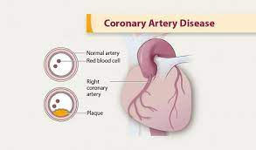

Slide 36
Basic First Aid for Wounds
Open Wounds
A break in the skin’s surface that results in external bleeding and may allow bacteria to enter the body that can cause infection
Abrasion
The top layer of skin is removed with little or no blood loss
Scrape
Laceration
A cut skin with jagged, irregular edges and caused by a forceful tearing away of skin tissue
Incisions
Smooth edges and resemble a surgical or paper cut

Slide 37
Basic First Aid for Wounds Cont.
Open Wounds Cont.
Punctures
Deep, narrow wounds such as a stab wound from a nail or a knife in the skin and underlying organs
Avulsion
Flap of skin is torn loose and is either hanging from the body or completely removed
Amputation
Cutting or tearing off of a body part such as a finger, toe, hand, foot, arm, or leg

Slide 38
Basic First Aid for Wounds Cont.
What to Do:
Wear gloves (if possible) and expose wound
Control bleeding
Clean wounds
To prevent infection
Wash shallow wound gently with soap and water
Wash from the center out / Irrigate with water
Severe wound?
Clean only after bleeding has stopped

Slide 39
Basic First Aid for Wounds Cont.
Wounds Care
Remove small objects that do not flush out by irrigation with sterile tweezers.
If bleeding restarts, apply direct pressure.
Use roller bandages (or tape dressing to the body)
Keep dressings dry and clean
Change the dressing daily, or more often if it gets wet or dirty.

Slide 40
Basic First Aid for Wounds Cont.
Signs of Wound Infection:
Swelling, and redness around the wound
A sensation of warmth
Throbbing pain
Fever / chills
Swollen lymph nodes
Red streaks
Tetanus (lock jaw), should receive injection in first 72 hours.

Slide 41
Dressings and Bandages
The purpose of a dressing is to:
Control bleeding
Prevent infection and contamination
Absorb blood and fluid drainage
Protect the wound from further injury
What to Do:
Always wear gloves (if possible)
Use a dressing large enough to extend beyond the wound’s edges.
Cover the dressing with bandages.

Slide 42
Dressings and Bandages Cont.
Bandage can be used to:
Hold a dressing in place over an open wound
Apply direct pressure over a dressing to control bleeding
Prevent or reduce swelling
Provide support and stability for an extremity or joint
Bandage should be clean but need not be sterile.

Slide 43
Amputation
What to Do:
Control the bleeding
Treat the victim for shock
Recover the amputated part and whenever possible take it with the victim
To care for the amputated body part:
The amputated part does not need to be cleaned
Wrap the amputated part with a dry sterile gauze or other clean cloth
Put the wrapped amputated part in a plastic bag or other waterproof container
Keep the amputated part cool, but do not freeze
Place the bag or container with the wrapped part on a bed of ice
Seek medical attention immediately

Slide 44
Checking for Spinal Injuries
Spinal Injuries
Head injuries may indicate that there are possible spinal injuries
It may have been moved suddenly in one or more directions, damaging the spine.
What to Look For
General signs & symptoms
Painful movement of the arms or legs
Numbness, tingling, weakness, or burning sensation in the arms or legs
Loss of bowel or bladder control
Paralysis of the arms or legs
Deformity (odd-looking angle of the victim’s head & neck

Slide 45
Checking for Spinal Injuries Cont.
What to Do:
Stabilize the victim against any movement.
Check ABCs. (Airway Breathing Circulation)
Unresponsive Victim:
Look for cuts, bruise, and deformities.
Test response by pinching the victim’s hand, and bare foot.
If no reaction, assume the victim may have spinal damage.

Slide 46
Checking for Spinal Injuries Cont.
Responsive Victim
Upper Extremity Checks:
Victim wiggles fingers.
Victim feels rescuer squeeze fingers.
Victim squeeze rescuer’s hand.
Lower Extremity Checks:
Victim wiggles toes.
Victim feels rescuer squeezes toes.
Victim pushes foot against rescuer’s hand.

Slide 47
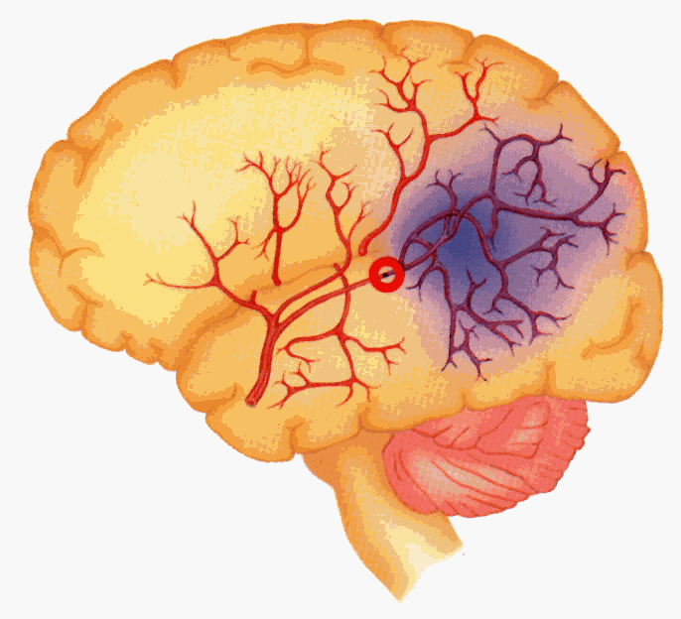
Stroke (Brain Attack)
What is Stroke?
Tissue damage to area of the brain due to disruption in blood supply, depriving that area of the brain of oxygen.

Slide 48
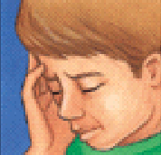
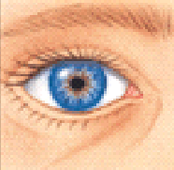
Stroke (Brain Attack) Cont.
Signs and Symptoms of Stroke:
Weakness or numbness of the face, arm, or leg (usually on one side of the body)
Blurred or decreased vision, especially in one eye.
Problems speaking or understanding
Unexplained, severe headache
Dizziness, unsteadiness, or sudden fall

Slide 49
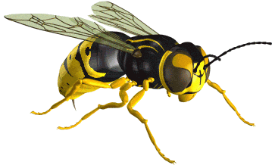
Bites and Stings
Insect stings and bites
What to Look For:
Check the sting site to see if a stinger and venom sac are embedded in the skin.
Bees are the only stinging insects that leave their stingers and venom sacs behind.
Scrape the stinger and venom sac away with a hard object such as a long fingernail, credit card, scissor edge, or knife blade.
Reactions generally localized pain, itching, and swelling.
Allergic reaction (anaphylaxis) occurs will be a life threatening.

Slide 50
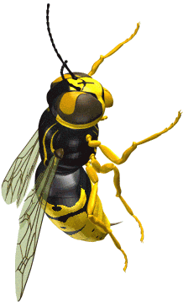
Bites and Stings Cont.
Insect stings and bites Cont.
What to Do:
Ask the victim if he/she has had a reaction before.
Wash the sting site with soap and water to prevent infection.
Apply an ice pack over the sting site to slow absorption of the venom and relieve pain.
Because bee venom is acidic, a paste made of baking soda and water can help.
Seek medical attention if necessary.

Slide 51
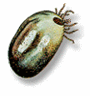
Bites and Stings Cont.
Tick bites
Tick can remain embedded for days without the victim’s realizing it.
Most tick bites are harmless, although ticks can carry serious diseases.
Symptoms usually begin 3 to 12 days after a tick bites.

Slide 52
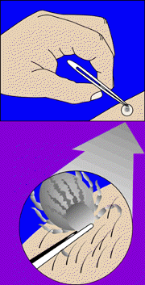
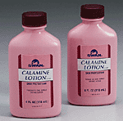
Bites and Stings Cont.
Tick Bites Cont.
What to Do:
The best way to remove a tick is with fine-pointed tweezers. Grab as closely to the skin as possible and pull straight back, using steady but gentle force.
Wash the bite site with soap and water.
Apply rubbing alcohol to further disinfect the area.
Apply an ice pack to reduce pain.
Calamine lotion may provide relief from itching.
Keep the area clean.
Continue to watch the bite site for about one month for a rash.
If rash appears, see a physician.
Also watch for other signs such as fever, muscle aches, sensitivity to bright light, and paralysis that begins with leg weakness.

Slide 53
Basic First Aid
Summary
The following information from this presentation have been covered:
Chain of Survival
What is First Aid?
Scene Survey
Initial Assessment
Victim Assessment Sequence
Bleeding Control
Shock
Burns
Choking
Fractures
Heart Attack
Basic First Aid for Wounds
Dressing and Bandages
Amputation
Checking for Spinal Injuries
Stroke (Brian Attack)
Bites and Stings

Slide 54
Basic First Aid
Summary cont.
Assess the situation
Ask for permission to help if possible unless the person is unconscious, then use “implied consent”
Call for help when necessary
Stabilize the situation before help arrives
Try to remain calm and do not panic

