Slide 1
UNIT – IV : Discipline and Grievance Handling
Mechanism for resolution of Industrial Disputes - Discipline - Causes of Indiscipline - Maintenance of discipline.-Domestic enquiry - concept and practice - Principles of Natural Justice - Some important industrial pronouncements - Principles of Hot stove rule-Grievance handling - Constitution of Grievance committee - Meaning of Grievance – Sources of grievance, benefits, redressal machinery-Industrial Establishment
(Standing Orders) Act, 1946.

Slide 2
Mechanism for resolution of Industrial Disputes or settlement mechanisms
Conciliation officer under Section 4 of the Act,1947
Works committee under Section 3 of the Act,1947
Labour court under Section 7 of the Act,1947
Boards of conciliation under Section 5 of the Act, 1947
Labour Tribunal under Section 7A of the Act, 1947
National tribunal under Section 7B of the Act, 1947

Slide 3
Settlement Mechanisms
collective bargaining
If these fails, then other mechanisms of settlement involve
conciliation,
Arbitration
and voluntary arbitration.
These methods are considered to be the appropriate alternatives for collective bargaining.

Slide 4
Conciliation
Conciliation is the procedure in which there is an involvement of a third party who provides assistance to the parties in dispute to carry out negotiation between them. The two types of machinery that are available for executing the conciliation functions are:
By the conciliation officers who work in the department of labour
The Conciliation Board is a body of several members consisting of a chairman, two to four members as the representatives of the employers and the employees. These members are to be appointed by the government on parties recommendation.
Section 4 of the Industrial Dispute Act, 1947 lays down the function of a conciliation officer which is to create a kindred atmosphere within the industry which will help the parties to settle the disputes between them. This is a function with an administrative nature and not a judicial one.

Slide 5
Voluntary arbitration
Arbitration means a procedure which involves a third party in the form of a single arbitrator or a board of arbitrators who are assigned with the duty to resolve the dispute between the parties. Voluntary symbolises self willingness and consent. Therefore voluntary arbitration means that the parties who are involved in the dispute willfully agree to the decision taken by the arbitrator or the board of arbitrators without any outside compulsion.

Slide 6
Adjudication
Adjudication can also be termed as the compulsory settlement of the industrial dispute in concern by labour courts, industrial tribunals, and national tribunal as provided by the Industrial Dispute Act,1947. The terms adjudication and arbitration have minute differences if placed in our country.

Slide 7
Adjudication
Adjudication of the industrial dispute will take place by a three-tier system which will be inclusive of the following:
Labour court- The Industrial Dispute Act, 1947 under Section 7 provides for the constitution of a labour court. The appropriate government in the form of notification in the official gazette can lead to the constitution of a labour court for resolving the disputes in an industry. The labour court consists of one person who is an independent judge or a judge of the High court or the District court. The judge can also be a former judge of the labour court itself with an experience of about 5 years. The matters handled by the labour court are provided in the second schedule of the Industrial Dispute Act, 1947 which consists of:
  The legality in the order passed by the employer under the orders that are standing
  The implications of the standing orders
  Granting of relief that should be available to the workmen in the industry which has been dismissed from them.
  Withdrawal of any privilege that a workman is subjected to
  All matters other than that coming under the purview of the industrial tribunal.

Slide 8
Adjudication
Industrial tribunal- The provision for the industrial tribunal is provided under Section 7A of the Industrial Dispute Act, 1947. One or more industrial tribunals can be set up by the government according to his desire with the courts being provided with wider jurisdiction in comparison with the labour court. It is not to be considered as a permanent body but body set up for temporary purpose for hearing on an ad-hoc basis only. As the courts are having wider jurisdiction, the issues that will be taken into consideration by the courts will also be large in number. Broadly the issues handled by the industrial tribunal have been listed below:
  Wages of the employee which included the mode of payment of wages also
  Bonus and provident funds that are provided
  Working hours of the employees
  Rationalisation
  Leaves that are granted to the employees inclusive of the wages received and the holidays provided to them
  Rules associated with the maintenance of discipline in the industry among the employees.
  Any other matter which may be considered to be heard and discussed necessarily.
National tribunal- A national tribunal is formed by the Central Government by an official gazette for adjudication of the industrial disputes that are considered to be of national importance. Two people according to the choice of the government are appointed to the role of an assessor in the national tribunal. If a dispute between two parties of an industry reaches the national tribunal, then both the labour court and the industrial tribunal loses its jurisdiction over the matter.

Slide 9
Discipline
the practice of training people’s mind and body
Change the incorrect behaviour
to obey rules
behave well
control your actions

Slide 10
Causes of Indiscipline
Lack of Proper Leadership
Lack of Supervision
Violation of Rights of Employees
Absence of Grievance Settlement Machinery
Lack of Proper Promotional Policy
Employer's Attitude
Lack of Communication
Lack of Proper Rules and Regulations
Divide and Rule Policy
Bad Working Conditions

Slide 11
Maintenance of discipline
1. The rules and regulations should be framed with mutual coordination and acceptance of the management and employees.
2. All the rules should be evaluated and updated from time to time to ensure their relevance and utility.
3. Rules should be formulated based on the nature of work and working conditions, Separate rules have to be framed for employees in the office and in the field.
4. Every employee should be treated the same way under the disciplinary procedure.

Slide 12
Maintenance of discipline
5. All the employees should know the penalties for violation of different rules.
6. The disciplinary procedure should ensure that an employee does not repeat a similar act of indiscipline in the future.
7. The entire procedure including the appeal and review of all the disciplinary actions should be mentioned in the employee’s handbook or collective agreements.
8. The procedure should provide for a legal as well as a human approach.

Slide 13
Maintenance of discipline
The leading art
Get rid of all the distractions
The workplace should be a happy place
Be considerate of the generation gap
Allow enough room for your employees to work
Regularly communicate with your staff

Slide 14
Domestic Enquiry
A domestic inquiry is a search for truth, facts, or circumstances concerning charges alleged by the employer against its employee.
It is an inquiry created by the management against its own employee for his misconduct.
an internal hearing held by an employer to ascertain whether an employee is guilty of misconduct.
The purpose of a domestic inquiry is to find out the truth of the allegations made against the workman.

Slide 15
concept and practice
Charge-sheet
Suspension
Service of charge-sheet
Explanation
Notice of enquiry
Enquiry
Fact-findings
Decision
Service of the order

Slide 16
Principles of Natural Justice
Natural justice implies fairness, reasonableness, equity and equality. Natural justice is the concept of common law.
“Hearing rule”
“Bias free decision”
“Reasoned Decision”
In India the principles of natural justice are provided in Article 14 and 21 of the Constitution.

Slide 17
Industrial pronouncements
a formal or authoritative announcement or declaration.
1. Industrial Policy of 1948
the first industrial policy 1948 was delivered by Dr. Shyama Prasad Mukherjee, the Minister of Industry of India On April 6, 1948.

Slide 18
major industries were divided into four groups:
State Monopoly Industries: It featured industries that worked with atomic energy, trains, armaments, and ammunition.
Government-controlled industries: This category covered industries that were important to the country. Fertilizers, heavy machinery, defense equipment, heavy chemicals, and other categories were mentioned in this category.
Mixed-sectors industries: Industries that were allowed to function autonomously in the private or governmental sector fell under this group. The government was given permission to assess the situation in order to acquire any extant private enterprise.
Private-sectors industries: This category includes industries that were not addressed in the previous categories. Small firms and small industries were given a lot of attention, which resulted in the use of local resources and the creation of jobs.

Slide 19
Industrial pronouncements
2. Industrial policy resolution, 1956
After the 1948 Industrial Policy, it was India’s second comprehensive pronouncement on industrial growth.
Major characteristics of this policy are:
A new classification system for industries has been developed.
Focus on the promotion of Village and small-scale industries.
Eliminate regional disparities in order to achieve growth.
Started taken Initiatives for the welfare of labor.
The private sector is treated equally and without discrimination.

Slide 20
classified industries into three groups
Schedule A industries were those that the state or government had a monopoly over.
Schedule B industries are authorized by the state to establish new units in this category, but the private sector was not barred from establishing or expanding existing units, such as synthetic, rubber, aluminum, chemical industries, fertilizer, and so on.
Schedule C industries are those industries that were not included in the above-mentioned industries were classified as Schedule C industries.

Slide 21
Indian policy statement, 1973
In the Indian Policy Statement of 1973, 6 high-priority types of industries or “core industries” were chosen, the term “Core Industries” was included in this policy.
Crude Oil
Oil Refining
Electricity
Iron and Steel Industry
Cement,
Coal

Slide 22
major changes occurred
The policy helps to bring the agricultural and industrial sectors closer together.
The list of industries that are reserved for small businesses has been increased.
Cottage and domestic businesses were given special protection by regulation.
The generation and transmission of electricity were given top priority.

Slide 23
Indian policy statement, 1977
In December 1977, on behalf of the Janata Government, George Fernandes, the union industries minister announced the Indian Policy Statement.
The following are some of the policy’s highlights:
Self-employment opportunities in the household and cottage industries.
Investment in the small industry is limited to Rs.1 lakh.
Limit the power of large corporations.
The growth of ancillary industries.
To make technology and management knowledge available to small and cottage companies.
Rehabilitating and reviving ill units.
Small-scale industries with a capital investment of between 1 and 15 lakhs rupees.
Infrastructure and growth of small-scale and village industries are basic industries.
‘Cottage industries‘ needs are met by capital goods businesses.
Agriculture and small-scale industries such as petrochemicals, fertilizers, and pesticides are examples of high-tech industries.

Slide 24
Industrial policy, 1980
In July 1980 a new Industrial Policy was announced. The following are the main characteristics of this policy:
For faster growth of the rural area, Handlooms, handicrafts, and Khadi industry get so much attention
Decided to raise the efficiency of the public sector undertakings.
Balanced growth is encouraged.
Unauthorized extra production capabilities established for industrial homes are regulated and controlled.
Improving the public sector’s performance.
Promote industrially backward, small, and cottage industries for economic federalism.

Slide 25
New industrial policy, 1991
Under the leadership of P. V. Narasimha Rao, Manmohan Singh introduced the industrial policy on July 24, 1991.
By this policy, the first time India opened the door of the country’s Economy for global exposure by introducing three major steps:
Reduce the import duties,
Opened reserved sector for the private companies,
Devalued the Indian currency to increase the export.

Slide 26
The following are the main characteristics of NIP, 1991:
Licensing for businesses for improving the quality of production.
The abolition of FERA was introduced to provide a major relief to the industries engaged in export activities.
process of import of technology in India was simplified.
Foreign Investment Policy has been liberalized.
To promote exports and bring global competitiveness in Indian Industry, policies were created for the shifting of quality standards from Indian Standard Industries and International Standard Organisation.
create competitive economic conditions to make the industry more accountable to our society

Slide 27
Principles of Hot stove rule
The "Hot-Stove Rule" of Douglas McGregor gives a good illustration of how to impose disciplinary action without generating resentment. This rule draws an analogy between touching a hot stove, and undergoing discipline. When you touch a hot stove, your discipline is immediate, with warning, consistent, and impersonal

Slide 28
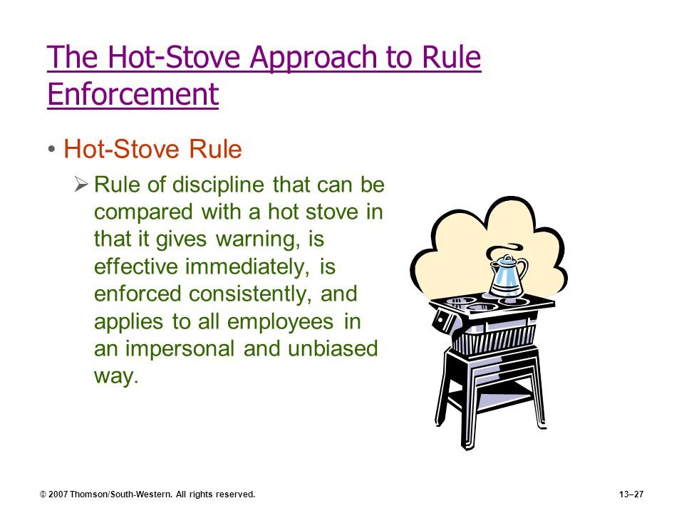

Slide 29
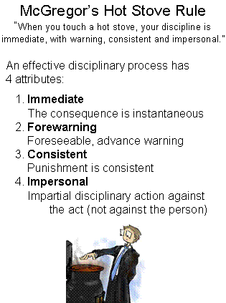

Slide 30
Grievance handling
Grievance handling is the management of employee dissatisfaction or complaints
(e.g. favouritism,
workplace harassment,
or wage cuts).
By establishing formal grievance handling procedures, you provide a safe environment for your employees to raise their concerns.

Slide 31
Meaning of Grievance
A grievance is any dissatisfaction or feeling of injustice having connection with one’s employment situation which is brought to the attention of management.
a cause of distress
a real or imagined cause for complaint, especially unfair treatment
is a complaint.
It can be formal

Slide 32
Meaning of Grievance
According to Michael Jucious, ‘grievance is any discontent or dissatisfaction whether expressed or not, whether valid or not, arising out of anything connected with the company which an employee thinks, believes or even feels to be unfair, unjust or inequitable’.
In short, grievance is a state of dissatisfaction, expressed or unexpressed, written or unwritten, justified or unjustified, having connection with employment situation.

Slide 33
Constitution of Grievance committee
At least three members of the Grievance Committee shall be present in a meeting.
The power of the committee is solely to hear representations by the persons directly involved in grievances, to mediate voluntary adjustment by the parties, and to advise adjustment by the administration when appropriate.

Slide 34
Sources of grievance
1. Economic:
Employees may demand for individual wage adjustments. They may feel that they are paid less when compared to others. For example, late bonus, payments, adjustments to overtime pay, perceived inequalities in treatment, claims for equal pay, and appeals against performance- related pay awards.
2. Work environment:
It may be undesirable or unsatisfactory conditions of work. For example, light, space, heat, or poor physical conditions of workplace, defective tools and equipment, poor quality of material, unfair rules, and lack of recognition.

Slide 35
Sources of grievance
3. Supervision:
It may be objections to the general methods of supervision related to the attitudes of the supervisor towards the employee such as perceived notions of bias, favouritism, nepotism, caste affiliations and regional feelings.
4. Organizational change:
Any change in the organizational policies can result in grievances. For example, the implementation of revised company policies or new working practices.

Slide 36
Sources of grievance
5. Employee relations:
Employees are unable to adjust with their colleagues, suffer from feelings of neglect and victimization and become an object of ridicule and humiliation, or other inter- employee disputes.
6. Miscellaneous:
These may be issues relating to certain violations in respect of promotions, safety methods, transfer, disciplinary rules, fines, granting leaves, medical facilities, etc.

Slide 37
Benefits of Grievance Handling Procedure
It encourages employees to raise concerns without fear of reprisal.
It provides a fair and speedy means of dealing with complaints.
It prevents minor disagreements developing into more serious disputes.
It serves as an outlet for employee frustrations and discontents
It saves employer’s time and money as solutions are found for workplace problems.
It helps to build an organizational climate based on openness and trust.

Slide 38
Benefits of Grievance Handling Procedure
To enable the employee to air their grievance
To clarify the nature of the grievance
To investigate the reasons for dissatisfaction
To obtain, where possible, a speedy resolution to the problem
To take appropriate actions and ensure that promises are kept
To inform the employee of their right to take the grievance to the next stage of the procedure, in the event of an unsuccessful resolution

Slide 39
redressal machinery
Redressal Agencies under the Consumer Protection Act:
The Consumer Protection Act provides for setting up of a three-tier enforcement machinery at the District, State, and the National levels.
They are referred to as the 'District Forum', 'State Commission', and the 'National Commission'.

Slide 40
Industrial Employment (Standing Orders) Act, 1946
This Act is to require employers in industrial establishments to formally define conditions of employment under them and submit draft standing orders to certifying Authority for its Certification.
Standing order is set of rules specified in this schedule of the act. It was enacted to prevent exploitation of the workman. Employer used to give his own conditions

Slide 41
Industrial Employment (Standing Orders) Act, 1946
specified certain rules or subject matter of the specified set of rules are
Classification of workman (whether he is a temporary or permanent, Badli workman)
Working hours, holidays as well as wage rates
Shift working
Attendance and late coming
Procedure in applying leave and holidays
Requirement to enter premises by certain or specific gates and liability to search
Closing and opening up industrial establishment
Termination of employment and procedure for serving the notice
Suspension or dismissal for misconduct or any act or omission
Remedies available for a workman in case of unfair labor practices
Any other matter which may be prescribed.

Slide 42
? Doubts
Thank you

