Slide 1
Unit – IV - Soft Skills
Soft Skills – Effective Public Speaking Skills – Presentation Skills – CV Preparation – Problems in Facing Interview – Interview Techniques

Slide 2
Soft Skills
Soft skills are character traits and interpersonal skills that characterize a person's relationships with other people. In the workplace, soft skills are considered to be a complement to hard skills, which refer to a person's knowledge and occupational skills.

Slide 3
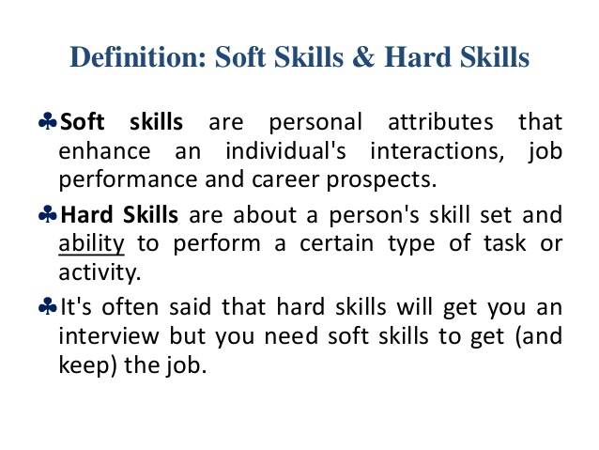

Slide 4
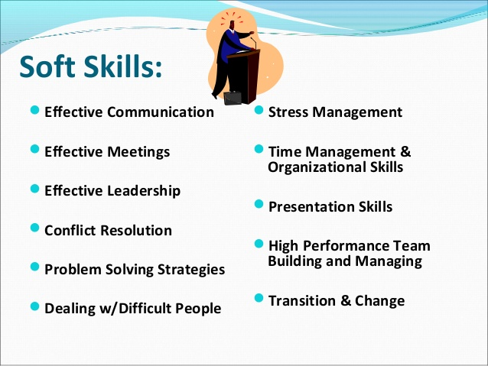

Slide 5
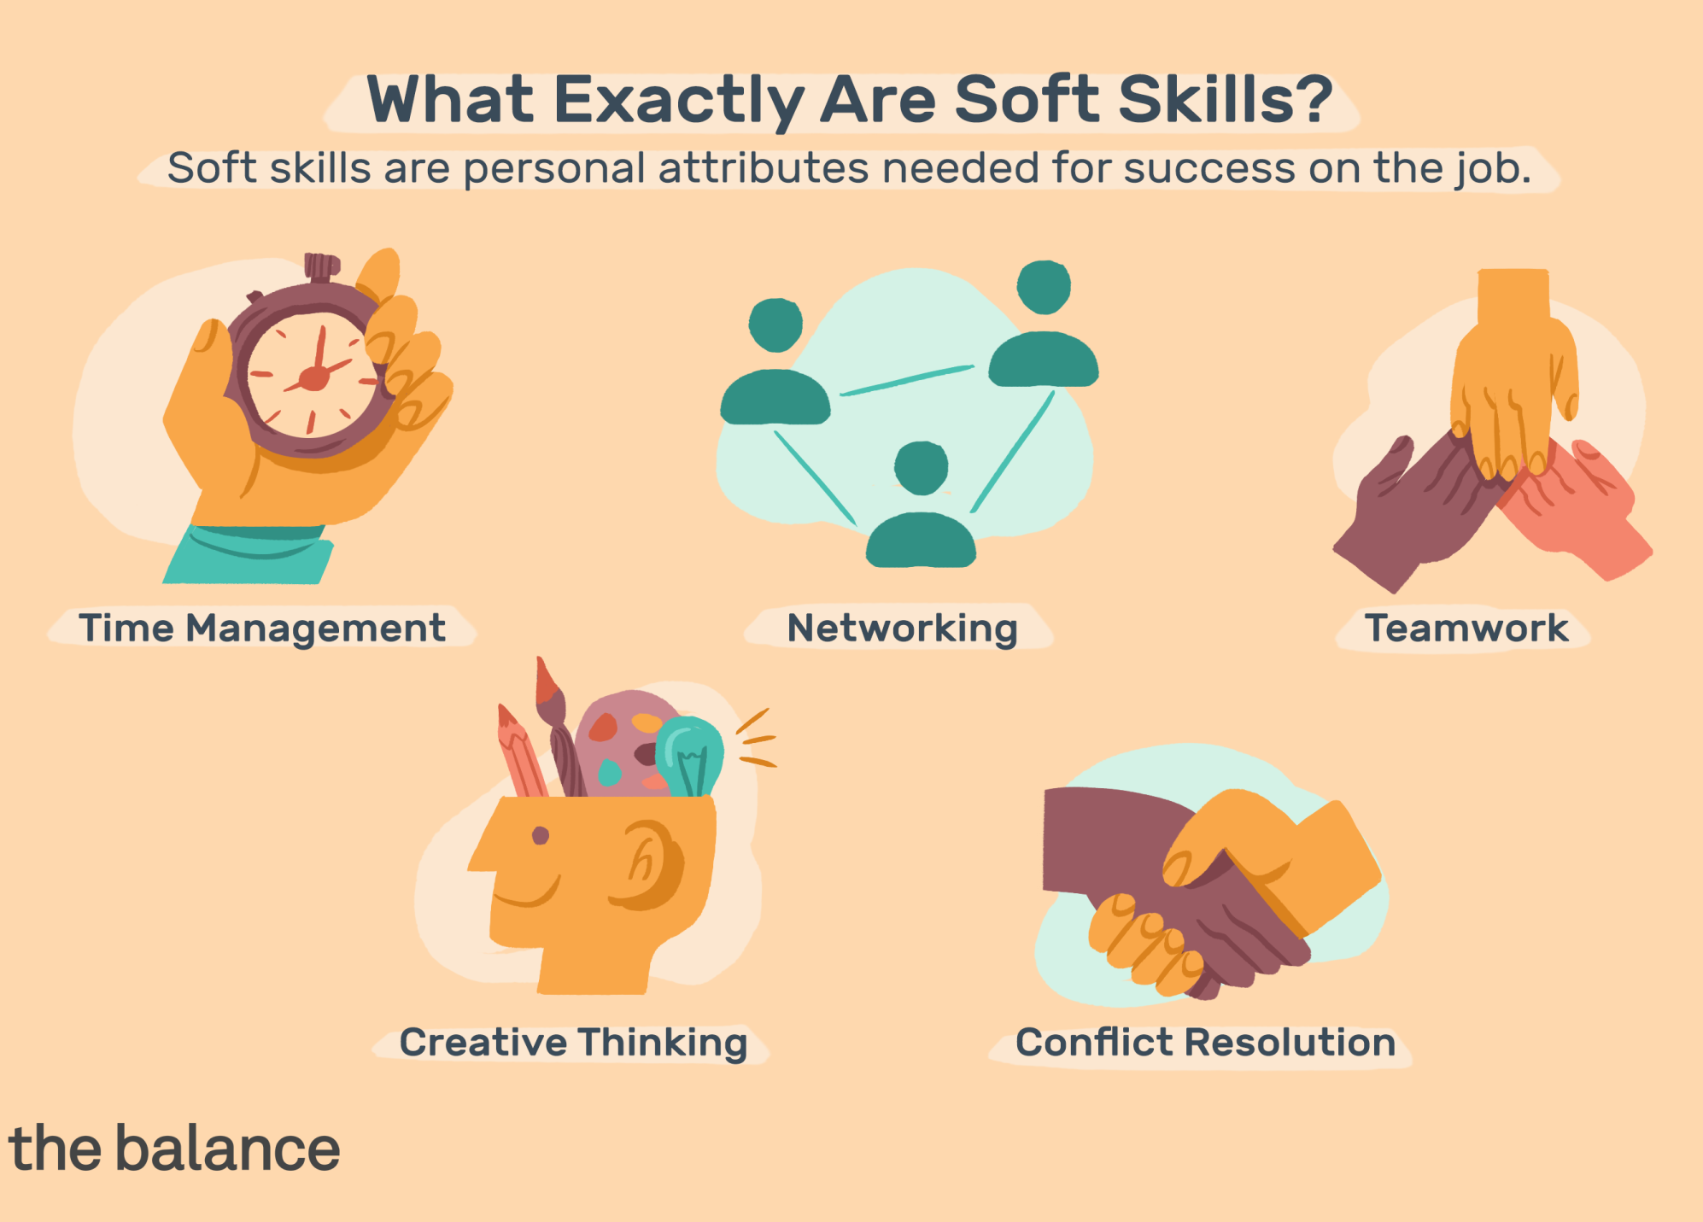

Slide 6
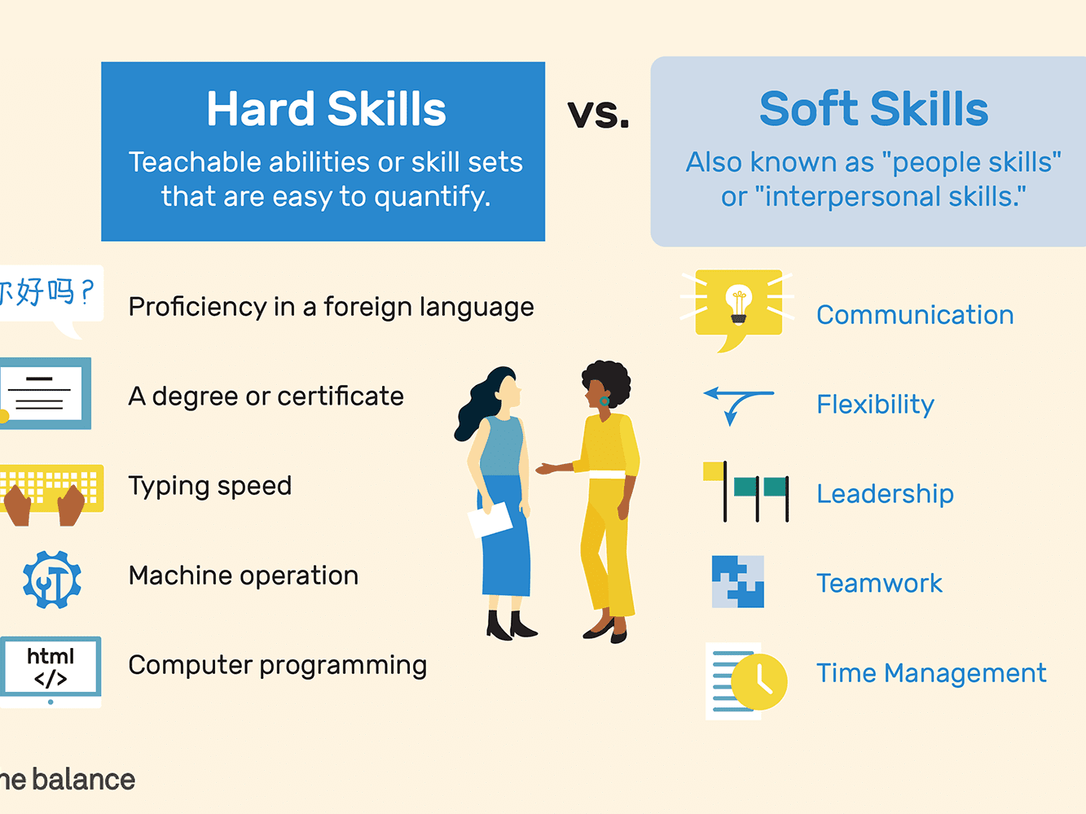

Slide 7
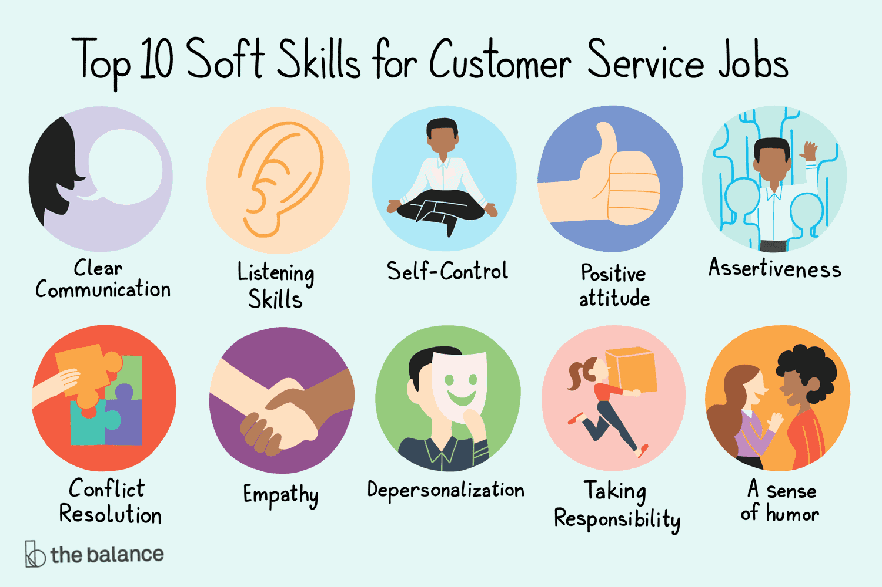

Slide 8
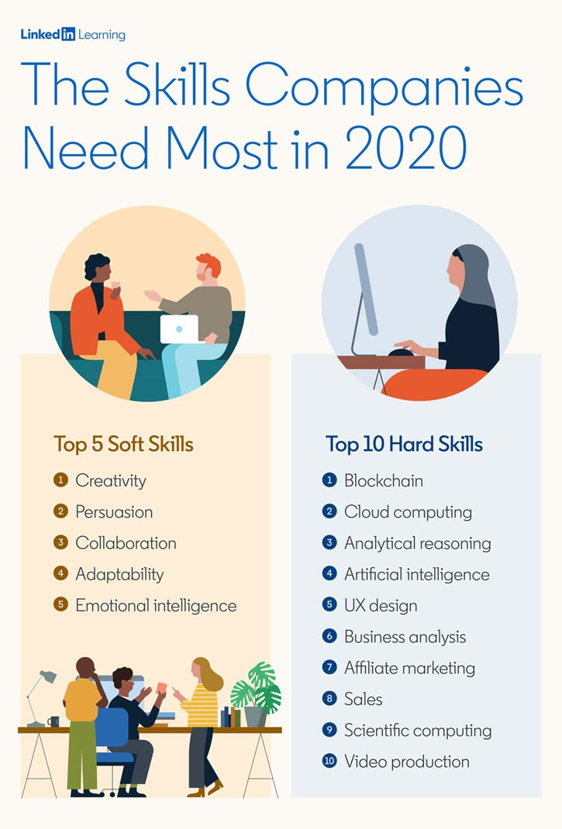

Slide 9
Soft Skills
Communication
Teamwork
Problem-solving
Time management
Critical thinking
Decision-making
Organizational
Stress management
Adaptability
Conflict management
Leadership
Creativity
Resourcefulness
Persuasion
Openness to criticism

Slide 10
Public Speaking Skills
Plan appropriately.
Practice.
Engage with your audience.
Pay attention to body language.
Think positively.
Cope with your nerves.
Watch recordings of your speeches.

Slide 11
Public Speaking Skills
Based on a submission on “in”, the seven(7) elements of public speaking are the speaker, the message, the channel, the listener, the feedback, the interference, and the situation. The speech communication process starts with the speaker – the person who initiated the conversation or talk.

Slide 12
What is Public Speaking?
Public speaking is a soft skill that requires excellent communication skills, enthusiasm, and the ability to engage with an audience. Public speakers make presentations to a group.
Presentations range from speaking to a small group of employees to presenting to a large audience at a national conference or event. The same skill set and ability to be comfortable speaking in public are required regardless of the size of the group.

Slide 13
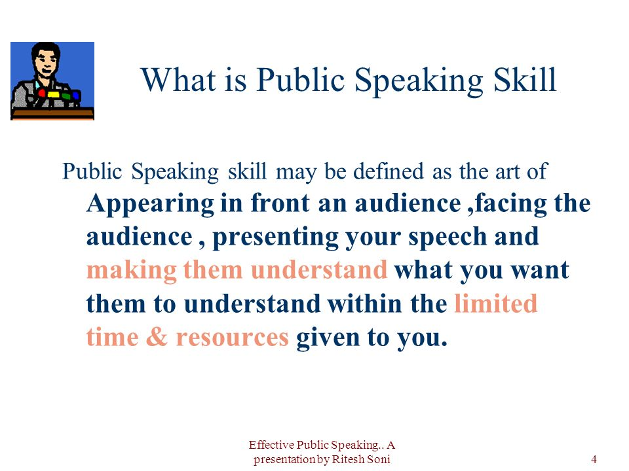

Slide 14
Public Speaking Skills
Plan appropriately.
Practice.
Engage with your audience.
Pay attention to body language.
Think positively.
Cope with your nerves.
Watch recordings of your speeches.

Slide 15


Slide 16
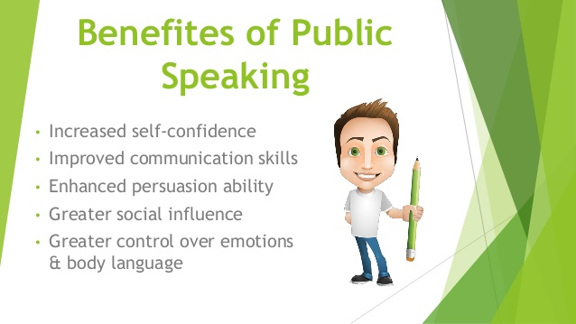

Slide 17
Presentation Skills
Presentation skills are the skills you need in delivering effective and engaging presentations to a variety of audiences. These skills cover a variety of areas such as the structure of your presentation, the design of your slides, the tone of your voice and the body language you convey.

Slide 18
Types of Presentations:
1) Providing Information. ...
2) Teaching a Skill. ...
3) Reporting Progress. ...
4) Selling a Product or Service. ...
5) Making a Decision. ...
6) Solving a Problem.

Slide 19
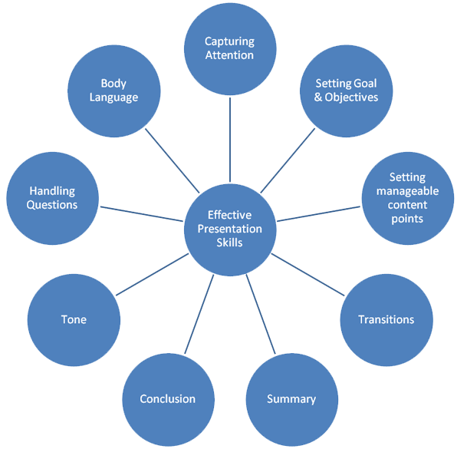

Slide 20
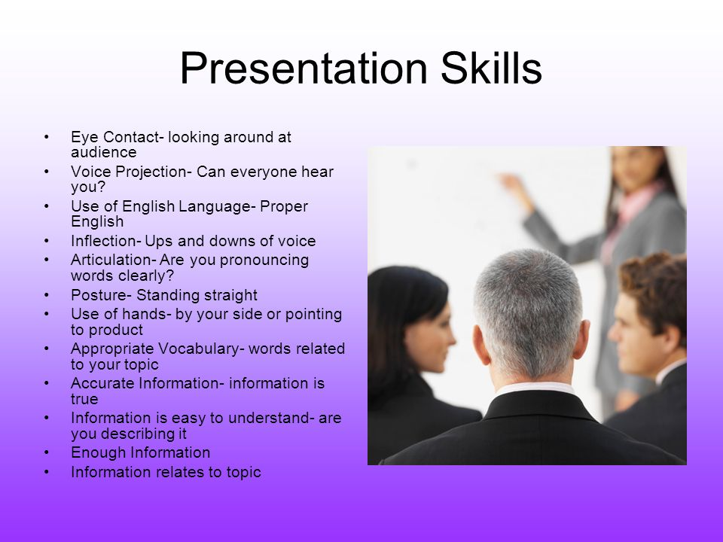

Slide 21
CV Preparation
Make sure you know when to use a CV.
Pick the best CV format.
Add your contact information the right way.
Start with a CV personal profile (CV summary or CV objective)
List your relevant work experience & key achievements.
Build your CV education section correctly.

Slide 22
Important Sections of CV
Professional Summary
Areas of Expertise
Work Experience (in reverse chronological order)
Education and Training
Personal Skills/Languages (and proficiency level)
Digital Competence
Additional Information (including publications, presentations, projects, conferences, seminars, honors and awards, memberships, references, citations)

Slide 23
General Dos and Don'ts for Writing a CV:
DO NOT include anything that can be viewed as political, religious, or controversial.
DO double check your contact information and make sure your email address sound professional.
DO NOT include an explanation of why you left a prior position.
DO proofread your CV several times and ask a friend to do the same.
DO NOT rely on spellcheck. Double and triple check to make sure grammar and spelling are correct. Spellcheck will not correct homonyms.
DO take the time to download your document as a PDF and read it for widows and orphans; a widow is when the last line of a paragraph appears at the top of the next page, whereas an orphan is when the first line of a paragraph appears at the bottom of the first page. This also gives you the opportunity to adjust formatting issues prior to submitting your CV to a potential employer.
DO NOT use third-person writing on the CV (for example, “lead high-performing teams” vs. “leads high-performing teams.”

Slide 24
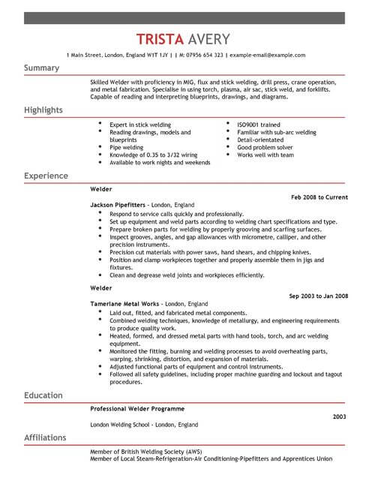

Slide 25
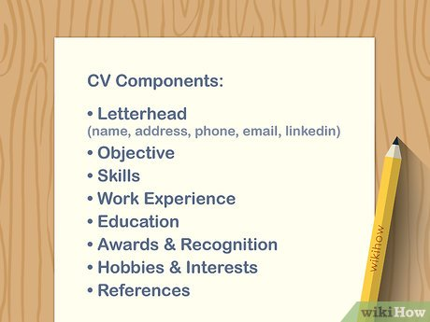

Slide 26
Problems in Facing Interview
1. Some things should not be measured in an interview. Few start an interview with a list of the things they want to assess. Many things just can’t be measured accurately during an interview including: many technical skills, team skills, intelligence, attitude and physical skills. Giving them a work sample or test is often superior.
2. Using historical information to predict the future. Interviews cover what happened in the past. Unfortunately, in a fast-changing world “the way you did something yesterday” simply wouldn’t work in today’s “new normal.”
3. Interview questions are not directly related to the needed skills. Most questions and “solve this problem” scenarios are developed independently and are not tied to a specific “required” skill or knowledge. There is no script or plan to ensure the right things are covered so that interviewers don’t just make up whimsical questions.
4. Inconsistent questions. There is no interview question “script” prepared for most interviews, so that the same questions are not asked of each candidate, which causes serious comparison and reliability issues.
5. No weights. Interview questions are frequently not “weighted” or prioritized, so minor questions receive the same weight in the final rating as the most important ones.

Slide 27
Problems in Facing Interview
6. No scoring sheet. There is no “scoring sheet” to ensure that interviewees are rated consistently on the same factors. Many final decisions are made based solely on memory. Scoring sheets forces the interviewers to make their decision based solely on the factors on the scoring sheet.
7. No agreement on good answers. Almost universally, interviewers asked questions without first determining what is a weak, good and a great answer. As a result, the exact same answer will get different “scores” from different interviewers.
8. Interviews are inherently misleading. The basic foundation of the interview is based on the premise that during the interview, candidates are acting “normally” and are telling the truth. This is unlikely because most candidates are scared to death before, during and after interviews. The interview situation is by definition “unreal” and “words” often should not be taken as proof. It is not “the job” and therefore what happens during the interview might not be representative of what one would actually do on the job. The goals of many interviews are unfortunately focused on finding “faults” in the candidates, as opposed to finding their positive aspects.
9. Saying what they want to hear. Interviewees frequently provide the “answers” that they believe that the interviewer wants to hear, rather than the most accurate answer. Interviewees frequently lie or omit key facts, unfortunately, interviewers do the same.

Slide 28
Problems in Facing Interview
10. Non- job related factors influence decisions. Numerous subjective factors like body language, accent, height, handshake, dress, coming late may distract from a focus on the answers provided. Because of stereotypes, it is also true that demographic factors (race, sex, age, national origin) may also impact the results.
11. Practice makes perfect. Preparation changes interview results. So if you think you are getting spontaneous answers, be aware of the thousands of Internet articles, sample questions and videos that can super prepare candidates for anything. Individuals that that have not been in a job search for a long time might be “rusty” in their interview skills. While unemployed candidates that have recently gone through numerous interviews could benefit from their “extensive practice” and do better.
12. Your specific interview questions may be known in advance. In addition to generic questions, with the use of glassdoor.com, be aware that whatever specific questions your firm has asked in the past (and their answers) are likely to be posted.

Slide 29
Problems in Facing Interview
13. Behavioral interviews have inherent weaknesses. Behavior interviews rely 100 percent on candidate provided (and possibly exaggerated) descriptions of how they handled a problem in the past. Also be aware that they may have acted that way because of cultural rules and constraints that would be completely different today, at your firm.
Extrapolating forward on how they would act six months from now, even though they have long since changed, and in your unique culture/environment can be misleading. Asking candidates to describe how they “handled” a certain situation has some serious inherent problems.
First: what the candidate is describing to you may have happened, but you can’t actually know the extent of their contribution to the described action. Second: if their verbal descriptions or their delivery happens to be “clumsy,” their accomplishments will likely be underrated (even though they actually did what they described). And third, in our current fast-changing world, you might not even want them to act the same way.
14. Lack of future view. Most interviews and all behavioral interviews focus on the past but whoever is hired will be working in the present/future. Most interviewers fail to ask candidates to forecast the future and to provide an outline of the plans that they will use to identify and solve upcoming problems.
15. Not hiring for “this” and “the next job.” Hiring managers can be shortsighted. They frequently interview and hire based 100 percent on their own short-term needs. Companies should hire individuals for both “this” and a future job but most interview questions are not designed to assess “future” competencies that will be needed in their “next job” in the company.

Slide 30
Problems with the interviewer
16. The interviewer. The sex, age and experience of the interviewer dramatically impacts their assessment of any candidate. If the person they are interviewing is “different” than them, the result will also be different. All-too-often, interviewers act like they are junior psychologists and may make snap but inaccurate judgments about candidates.
17. Bias and prejudice. Some interviewers have biases or make stereotypes that eliminate individuals for nonbusiness reasons.
18. Interviewers are not trained. Almost everyone assumes that interviews are easy and don’t require training. Managers only receive cursory training and therefore they don’t know the pitfalls that can lead to bad interviewing and hiring results. Because “mystery shoppers” are not used, HR has no direct way of knowing what might be happening during an individual manager’s interviews.
19. The interviewer has arbitrary knockout factors. Many interviewers seem to arbitrarily make up subjective “knockout factors”, which prematurely and often unfairly screen out qualified candidates. Many of these knockout factors are based on personal prejudices.
20. Interviewer fatigue. After many interviews in a row, the interviewer is tired and their judgment weakens.

Slide 31
C) Common interview process errors
The actual design of the interview process can cause many problems.
21. No structure. The less structure, the less reliable are the results. Using the same structure around the globe may be a problem because local cultures and laws vary.
22. The timing. The time of day that the interview was held has an impact upon its results because the energy level of interviewers and interviewees changes. Someone that has gone through five back-to-back interviews will perform differently than someone who had a break. And because multiple candidates are involved at different times of the day or on different days, it makes accurately comparing interview results that occurred at different times or days “difficult”.
23. The length of interviews varies – interviews are often very short, making realistic assessment difficult. And due to time and business pressures, managers often eagerly make snap, “first impression” decisions, which can be inaccurate. Comparing candidates that had interviews of significantly different lengths is also difficult.
24. The order of the interview. If you are the first among all candidates in the interview process, you’re less likely to be hired then if you are the last candidate. Unfortunately, where you appear in the order of interviews impacts your odds of success.
25. Consistent location. Even the place where the interview is held (if it is not consistent for all candidates) can influence the candidate’s assessment (i.e. lunch interviews produce different results than conference room interviews).
26. Interviews are held in person. This makes them expensive, because of the use of an interviewer’s time. Also requiring an “in person” interview means that many working people simply won’t show up. Advances in technology now make it possible to hold inexpensive live video interviews over the Internet. Live video interviews and telephone preliminary interviews can save both travel costs and candidate time without impacting quality.

Slide 32
Problems in Facing Interview
27. Travel fatigue. Often interviewees are flown in for the interview the night before and jet lag makes them underperform. Interviewers can suffer the same issues.
28. Selling is limited. Not enough time is spent during the interview selling the candidate, so those with multiple choices might not accept.
29. Skills demonstrated in the interview are not required for “this job.” Interview scores tend to vary based on the candidates interpersonal and communication skills but this particular job might not require even average interpersonal skills. Thus some jobs (i.e. receptionist, salesperson and recruiter) lend themselves to being assessed through interviews, while for some other jobs (like programmers, artists and meter readers), interviews may be horrible predictors of the candidates on the job success because they work alone.
30. Panel interviews. Panel or group interviews are often intimidating, because of the number of people in the room hurling question after question at the single interviewee. Often an assumption is made that panel interviews reduce the chance of bias or prejudice, but that is not automatically true if the team leader is powerful and successfully encourages others to share their bias. Candidates can also become frustrated when “the wrong person” asks a question (for example, when an HR person asks a technical question and a technical manager asked a question that should have been asked by HR).

Slide 33
Problems in Facing Interview
1.Facing an interview panel instead of a single interviewer
Many job applicants attend an interview with the expectation or impression that they’ll be face to face with a single interviewer. So, they’re quite intimidated when they find themselves facing an interview panel. Even the most strong-willed of interviewees can become puzzled if they have a face a barrage of questions in quick succession without getting sufficient time and scope to reflect on them.
2.Inconvenient Location
These days there is an increasing tendency on the part of the employers or interviewers to schedule interview sessions out of the office premises. Interviewers strongly feel that they’ll be able to assess a job applicant in a better manner if they make observations (about the candidate) in an informal setting. However, holding interviews in a restaurant (in contrast to conference interviews) can sometimes affect an interviewee’s performance and may not be the right way to evaluate him.
3.Making an assessment of what might be asked
Many candidates make the mistake of making a pre-assessment of what might be asked during the interview based on their past experience. So, they’re in a spot when they find themselves fielding questions for which they were not prepared. The best defence for this problem is to keep a flexible approach.
4.Questions might completely vary from candidate to candidate
Many job applicants wait for their turn with the expectation that there is a questionnaire script prepared in advance. They feel relieved when they come to know the questions from candidates emerging out of the conference room. So, they’re in a fix when they see themselves facing unfamiliar questions.
5.Questions may not be consistent with the required skills
More often than not, some questions asked by the interviewer may not be in consonance with the skills required for the job position. Interviewers do not prepare a script in advance containing relevant questions.

Slide 34
Problems in Facing Interview
6.Not prepared to face situational questions
Nowadays, situational or behavioural questions are a standard feature of an interview process for which a majority of the job applicants are not prepared. Long gone are the days when one had to answer simple and candid questions like ‘Tell me something about yourself’ and ‘what are your strengths and weaknesses?’
7.Answering questions to satisfy the interviewer
Many job seekers answer questions with the intention of satisfying the interviewer. This results in their giving false facts or fibbing to frame sugar-coated replies.
8.Subjective factors matters a lot
Factors such as dress, body language, tonal accent, and how one greets an interviewer are also taken into account when evaluating an applicant. So, if a candidate is not appropriately dressed or turns up late for the interview can create problems and jeopardize his chances of landing the job.
9.The duration of the interview
An interview that lasts for a very short time may be insufficient to make a thorough assessment of a candidate. On the other hand an interview that drags on for an extended period can tire out both the interviewer and interviewee making realistic appraisal difficult.
10.Interview order
This is a problem which is beyond the control of the candidate. Surveys about interviews have clearly brought to light one interesting trend and that is the candidate being interviewed first often does not end up getting the job.

Slide 35
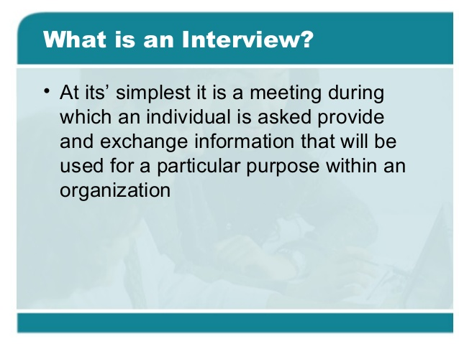

Slide 36
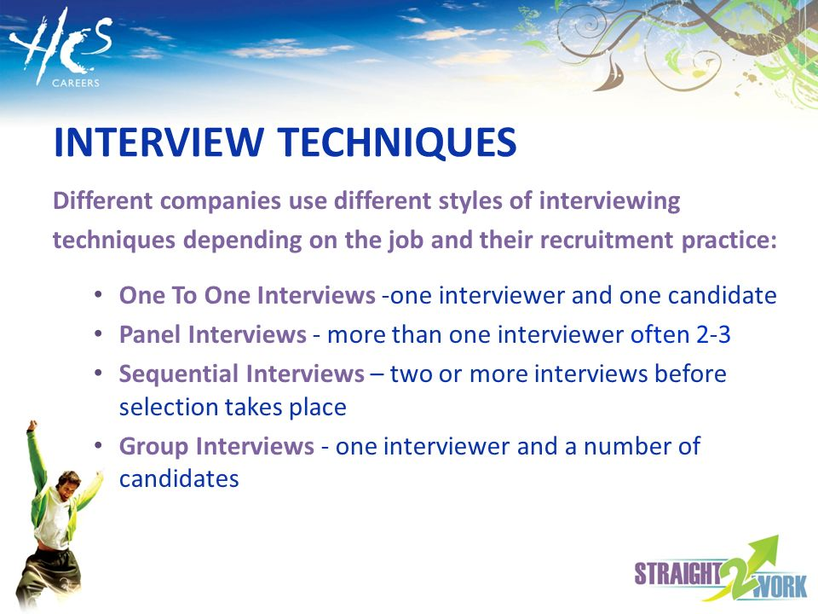
Interview Techniques

Slide 37
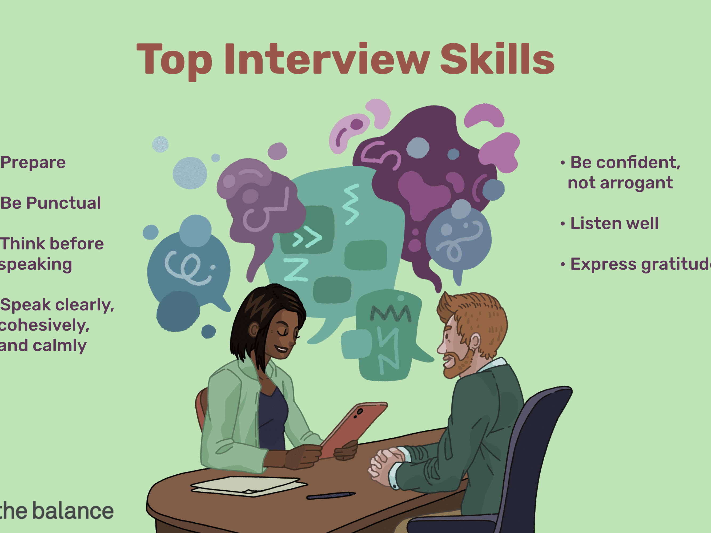

Slide 38
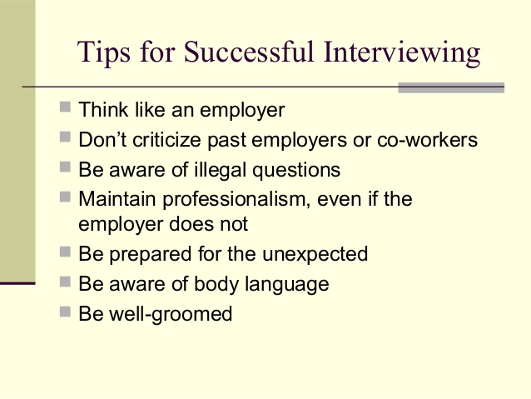

Slide 39
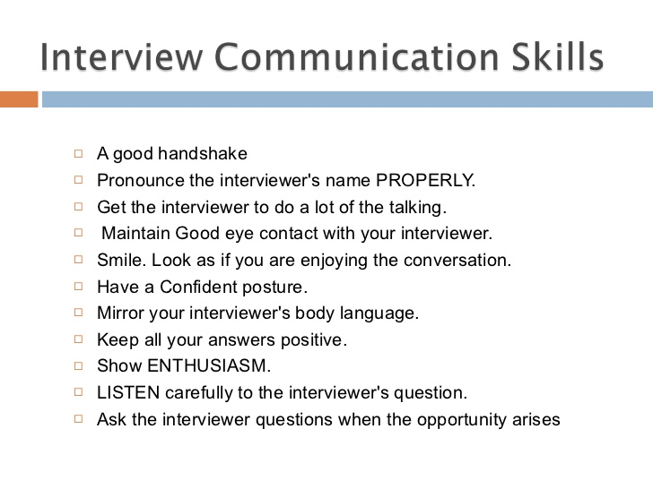

Slide 40
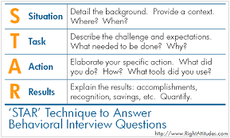

Slide 41
Interview Techniques
Do your research. ...
Look sharp. ...
Don't show up empty handed. ...
Arrive early. ...
Project enthusiasm. ...
Listen carefully. ...
Give specific examples. ...
Ask questions.

Slide 43
STEPS TO A SUCCESSFUL INTERVIEW BEFORE AN INTERVIEW
Research: Learn as much as you can about the position and the company beforehand - know the company’s products and services. Sources for this research are your Career Services Center, the Library and the Internet.
Practice: Practice interviews with a career counselor, friend, family member or by yourself in front of a mirror. Be prompt and
prepared: Arrive 10 to 15 minutes early bring extra copies of your resume, your list of references, a pen and paper, and the list of questions you have for the interviewer.
Be prepared to discuss both your strengths and your weaknesses: Make a list of your skills and key assets. Then reflect on past jobs/experiences and pick out one or two instances when you used those skills successfully. When exploring your weaknesses, be able to discuss the ways in which you addressed these weaknesses to make them a strength.

Slide 44
DURING AN INTERVIEW
Introduce yourself in a courteous manner
Have a firm handshake
Act professionally:
Dress appropriately!
First impressions count!
Keep your answers brief and concise
Ask questions
Maintain a conversational flow
Smile, nod, give nonverbal feedback to the interviewer
Be enthusiastic:
have a positive attitude
Ask about the next step in the process
Thank the interviewer

Slide 45
AFTER AN INTERVIEW
Ask the interview for a business card and promptly send a thank you note.
Keep the thank you note brief, but reiterate your interest in the position
Review the interview process and your performance
Evaluate your interview

Slide 46
HOW TO DRESS FOR INTERVIEW SUCCESS
Men and Women
Conservative two-piece business suit/Conservative long-sleeved shirt/blouse
Make sure your shoes are clean and polished
Comb your hair: conservative style and out of your face
Trim your fingernails and make certain that they are clean
Use minimal cologne or perfume
Carry a notepad or portfolio case

Slide 47
HOW TO DRESS FOR INTERVIEW SUCCESS
Men
Wear a silk tie, in an understated pattern: the colors should complement the suit
Dark shoes
Facial hair should be well groomed
Do not wear jewelry other then a wedding ring or college ring

Slide 48
HOW TO DRESS FOR INTERVIEW SUCCESS
Women
Always wear a suit with a jacket
Wear low heels/pumps
Conservative hosiery at or near skin color Don’t carry a purse into the interview
If you wear nail polish, choose a clear or conservative color
Wear minimal makeup

