Slide 1
T test and Anova

Slide 2
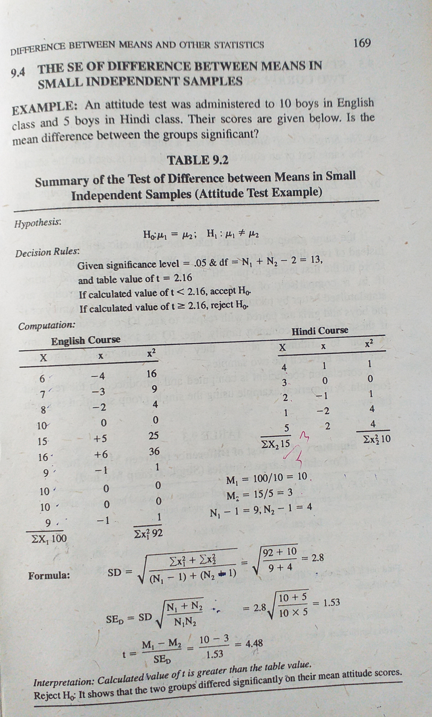

Slide 3
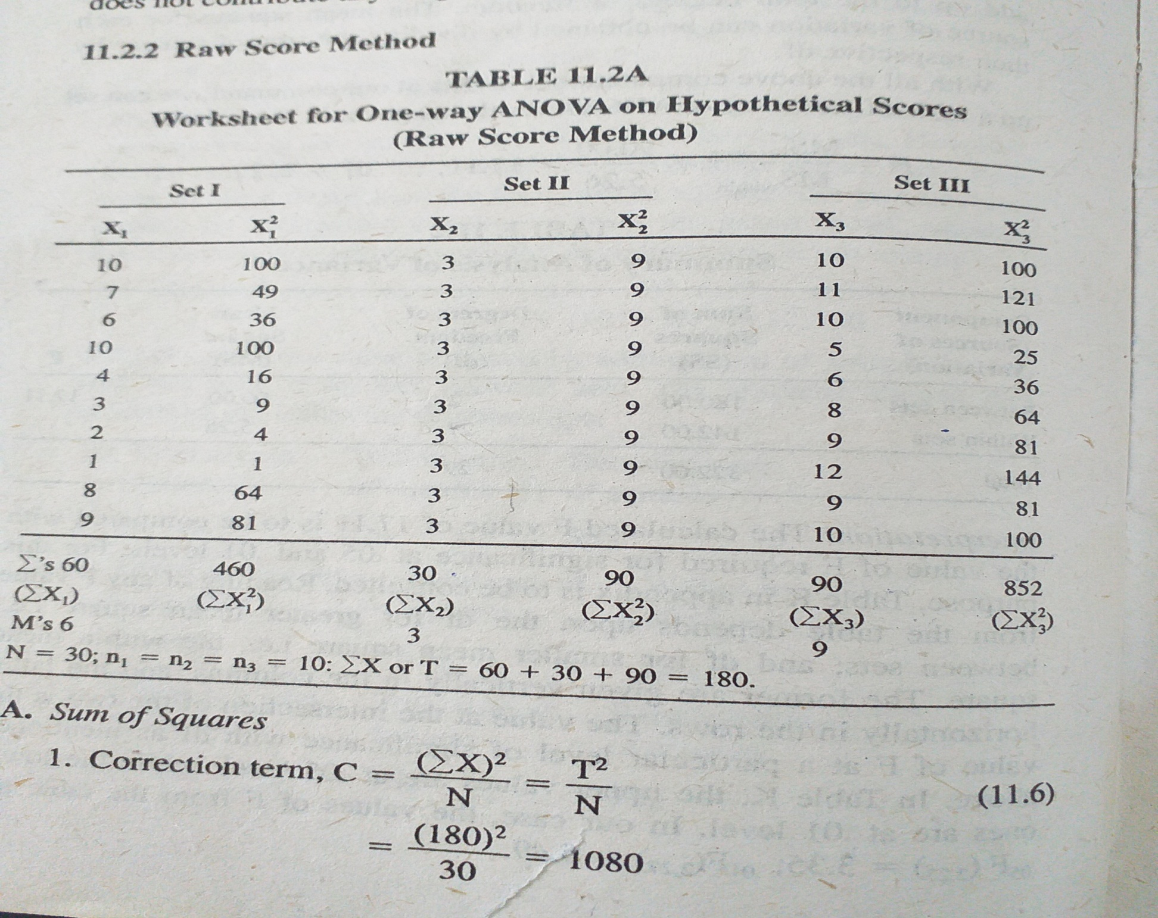

Slide 4
