Slide 1

Definitely Abled Women
who overcame their disability
Dr.M.Prabavathy
Head, Centre for Differently Abled Persons
Bharathidasan University
cdap@bdu.ac.in

Slide 2
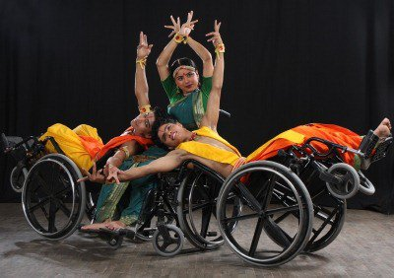

Slide 3
These
WOMEN with DISABILITIES have proved that it is just a state of mind. Let us Learn about the amazing people who have not let their disability hold them back them in any way.

Slide 4
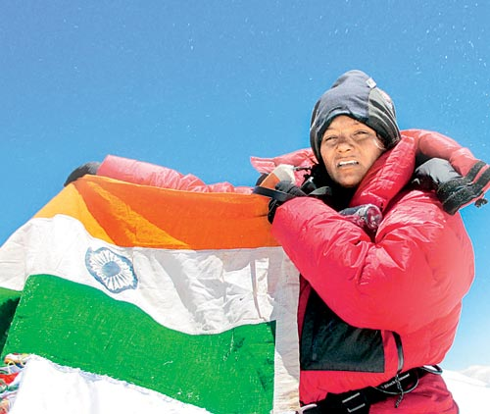
First Indian amputee to conquer the Mount Everest
Arunima Sinha

Slide 5
27-year-old lost her left leg in an unfortunate incident on April 11, 2011 when some robbers pushed her out of a moving train.
Achievement: Despite the fact that she lost a leg, she did not gave up the spirit of her life and defied all conceivable odds.
Infact, Arunima decided to convert her weakness into her biggest strength and by her true determination, on May 21, 2013, she achieved the rare feat to become the first Indian amputee to conquer the Mount Everest, with the help of a prosthetic leg. Beside setting an example to the world, Arunima also made India, a proud nation when she hoisted the Indian tricolour flag at the peak of the Mount Everest.

Slide 6
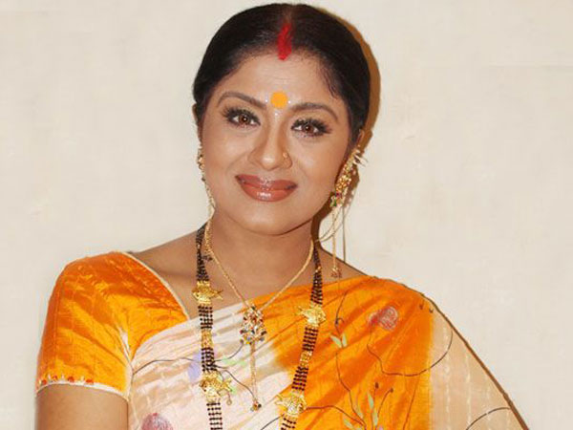
This Indian actress and classical dancer needs no introduction. Born in Kerala, this 50-year-old artist met with an accident when she was just 16. Doctors missed a small wound in her ankle and plastered it, which later got infected and there was no alternative left but to amputate her leg. She overcame her disability by getting a prosthetic “Jaipur Foot” and became one of the most popular and acclaimed classical dancers of the country.
SUDHA CHANDRAN
Having performed Bharatnatyam internationally, Chandran has also been a known figure in the Indian television and film industry. Having received many awards for her amazing talent, Chandran is an inspiration to many!

Slide 7
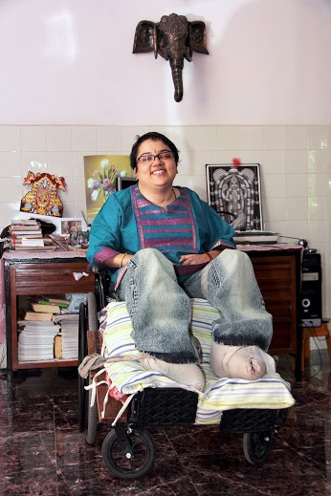
PREETHI SRINIVASAN
Preethi Srinivasan was the captain of the under-19 Tamil Nadu women’s cricket team. Even after the unfortunate swimming accident that left her paralyzed below the neck, she continues to inspire other lives through her organization Soulfree. She has started to provide hope to women with severe disabilities and assists them in fulfilling their highest human potential by providing a basic quality of life.

Slide 8
DHAND
Suffering from brittle bone disease, 57-year-old Dhand lost her hearing at the age of 12 and stands 3.3 feet tall. But, this disability was not strong enough to stop her from pursuing her passion for painting, for which she has even won a national award. Apart from this, she has received many awards at the state and national level for painting and photography. She is now imparting this art to other students and conducts classes at her house. Not only this, she is an active social worker and donates to various organizations working with children with mental and physical disability.

Slide 9
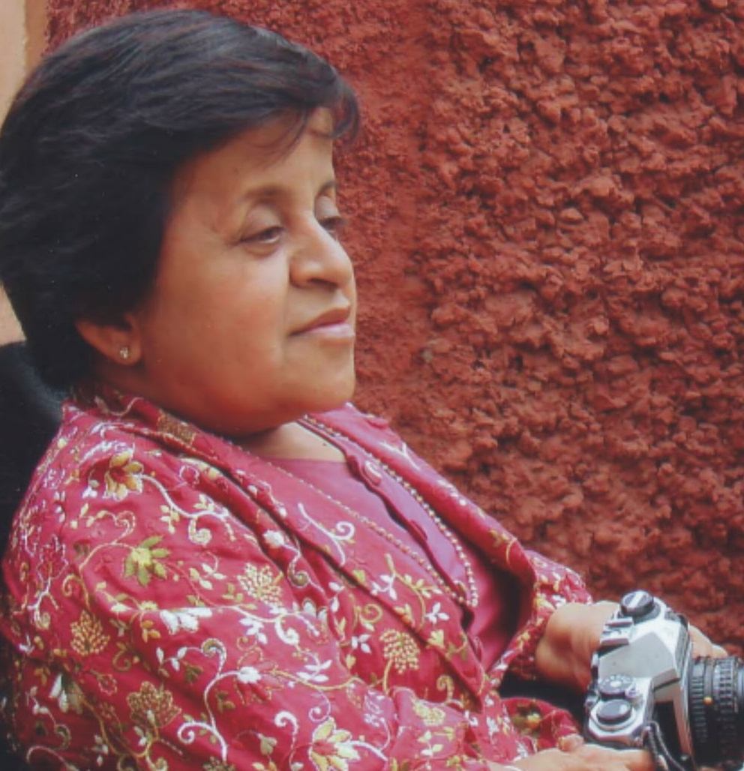
Sadhna Dhand

Slide 10
Malathi Krishnamurthy
This international para-athlete from Bangalore was paralyzed completely at the tender age of one after a high fever. A regular electric shock treatment for two years got the strength of her upper body back, but below the waist her body remained weak. Holla decided to live life in the best possible way and chose sports to excel in.
She started participating in various games at college, and today she has taken part in various international events including the Para-Olympics. She won Gold in 200m, shot put, discus and javelin throw at the 1989 World Masters’ Games in Denmark. She has over 300 medals in her kitty, and is also the proud recipient of the Arjuna Award and Padma Shri. She runs the Mathru Foundation to help disabled children from rural India.

Slide 11
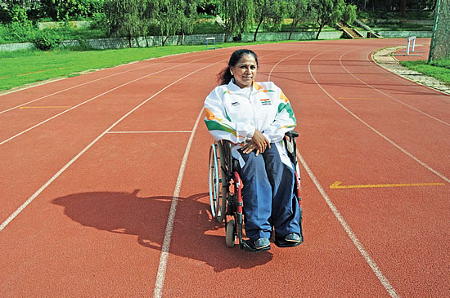

Slide 12
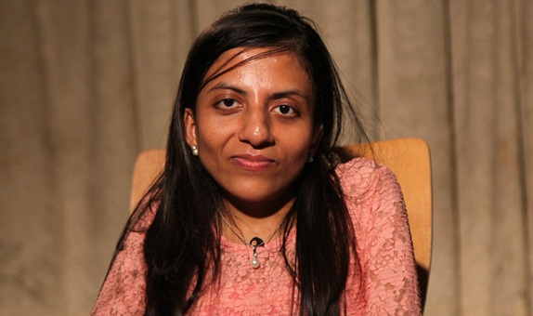
Ira Singhal
Ira Singhal from Delhi, who is the topper of UPSC 2014, is a great inspiration for women and the physically challenged people around the world. She suffers from Scoliosis, a spine related disorder which restricts her arm movement, yet she has become the first disabled person to top this prestigious exam.

Slide 13
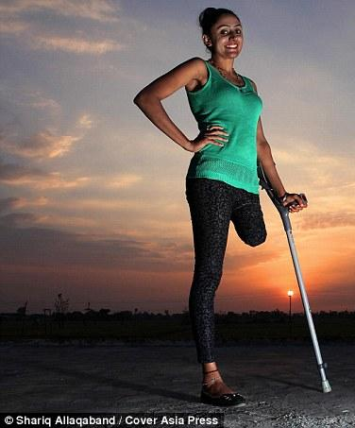
Subhreet Kaur Ghumman
India's inspirational one-legged dancer - who lost her limb through harrowing hospital blunders - finds love Subhreet Kaur Ghumman, 27, lost her leg after a road accident in 2009.
The young nurse needed seven operations on her leg after infection set in In February she auditioned for India's Got Talent and came second
Going to the gym played a huge part in her recovery

Slide 14
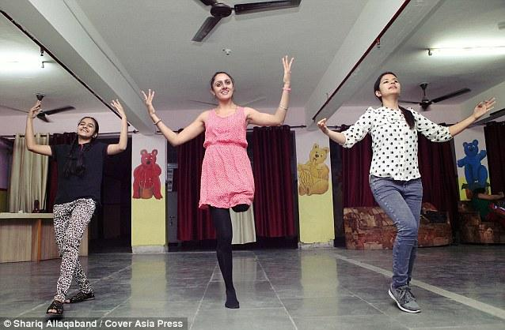
She did not faint when she saw hundreds of ants eating up her paralyzed leg in hospital; she did not cringe when she saw fingers falling off one by one from her injured leg; she did not die despite the doctors giving up on her and she did not allow life to push her into the darkest corner of accidental disability after a doctor erroneously chopped off a vital vein in her left thigh. Meet Shubhreet Kaur Ghumman, the one-legged dancing wonder, who gives SANGEETA YADAV a lesson in life well fought & well lived

Slide 15
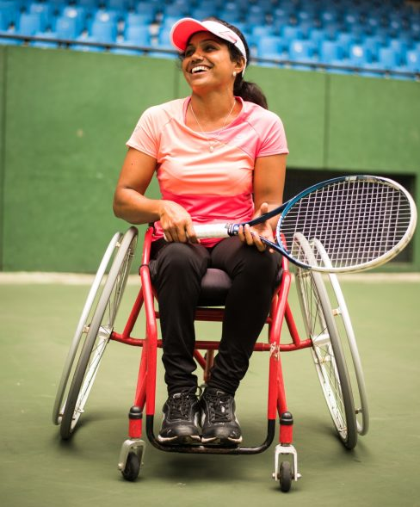
Bangalore-based Prathima Rao was all of 3 years old when she lost the use of her right leg to polio. She was forced to use a caliper to move around, and continues to do so till date. This has not stopped her, however, from making a name for herself as an international wheelchair tennis player.
Prathima’s tryst with tennis can be traced back to the days of her divorce. Battling depression and struggling to cope with the changes in her personal life, she sought – and found – solace in tennis.
Prathima is optimistic about participating in the 2020 Paralympics, and strongly believes in the potential that India has to produce the world’s best wheelchair tennis players.

Slide 16
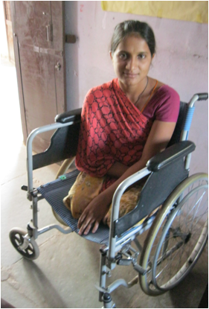
Sita

Slide 17
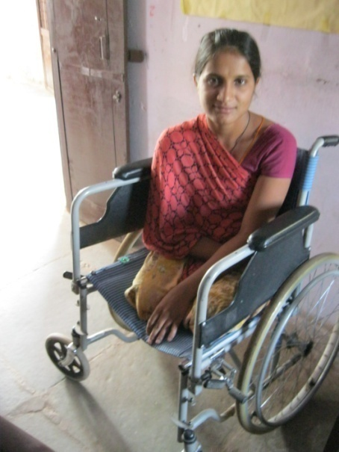
Sitting on a wheelchair Sita, 20, is a picture of courage and determination. Looking at her bright, smiling face, one can never imagine that this simple girl from Fatehpura village in Chittorgarh district of Rajasthan has been to hell and back
.Kidnapped, gang rape, physical disability and abandonment – the youngster has faced each of these horrific situations with fortitude and emerged a stronger person. Not one to be cowed down, she not only fought for justice and sent her violators to prison but today she is trying to rebuild her life from scratch.

Slide 18
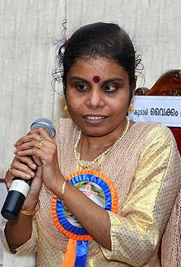
Vaikom Vijayalakshmi is a playback singer from Kerala, India.^{[2]} She is an expert in a rare musical instrument called Gayatriveena.
2012: Kerala State Film Award – Special Mention for "Kaatte Kaatte" from Celluloid^{[10][11]}
2013: Kerala State Film Award for Best Singer for "Ottakku Padunna" from Nadan
2014: Filmfare Award for Best Female Playback Singer - Malayalam for "Ottakku Padunna" from Nadan
2014: Mirchi Music Awards (South) for Upcoming Female Vocalist of the year for "Ottakku Padunna" from Nadan ^{[12]}
2014:Nominated - Asianet Film Awards for Best Playback Singer(Female) - "Ottakku Padunna" from Nadan
2014: Jaycey Film Awards for Best Singer for "Ottakku Padunna" from Nadan ^{[13]}
2014:Nominated - 3rd South Indian International Movie Awards for Best Female Playback Singer - "Ottakku Padunna" from Nadan
2014: Eenam Swaralaya Awards for song of the year - "Ottakku Padunna" from Nadan
2014:Nominated - Asiavision Awards for Best Singer(Female)-"Ottakku Padunna" from Nadan
2014:Nominated - Vijay Award for Best Singer(Female)-"Puthiya Uligai" from Yennamo Yedho
2014: C.K.M.A Malayalam film Awards for Best female singer

Slide 19
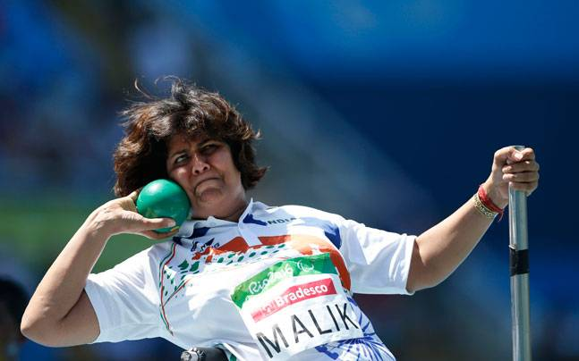
Deepa hails from an army background and had an upbringing that instilled a never-say-die attitude in her. Her husband who is by her side in Rio was at war in 1999, putting his life on the line for the country during the Kargil conflict. Despite Deepa undergoing surgery for the tumour which would paralyse her and her husband who could be at her bedside only months later
My handicap is my strength, Paralympic medallist Deepa Malik

Slide 20
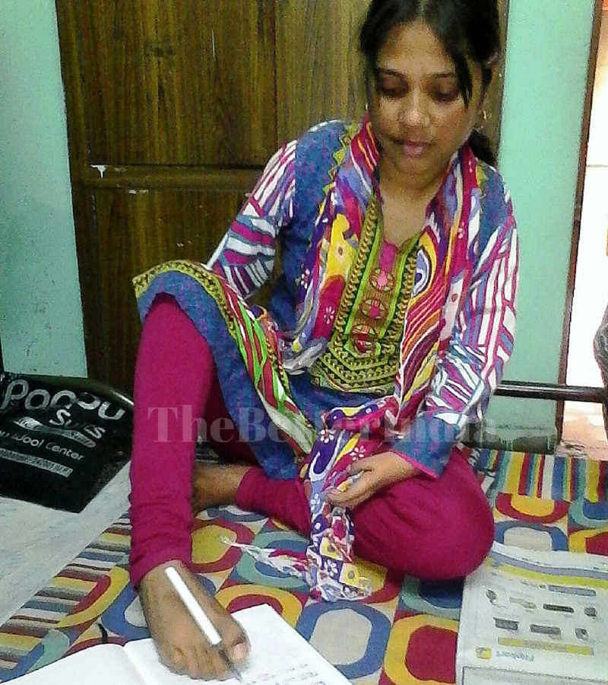
Pushpa Singh
Despite being disabled from birth, Pushpa Singh has broken all stereotypes and overcome tough challenges – she works as a computer teacher in a local college and has recently been elected to the Block Development Council (BDC) in her area small village in Shravasti, a backward district in Uttar Pradesh, is one of six siblings, and has been physically disabled since birth.
What amazed them was a flawless demonstration of operating the computer with her feet. “She seemed devoted and earnest so we did not think twice before selecting her,” he says.

Slide 21
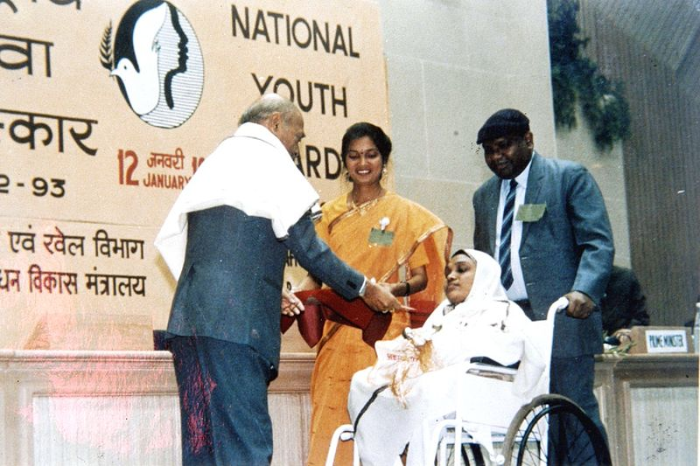
Rabiya receives the 1993 National Youth Award from the Prime Minister of India Narasimha Rao
In January 2001, she was awarded the first Kannagi Sthree Sakthi Puraskar award for the year 1999 for her contribution to upliftment and empowerment of women

Slide 22
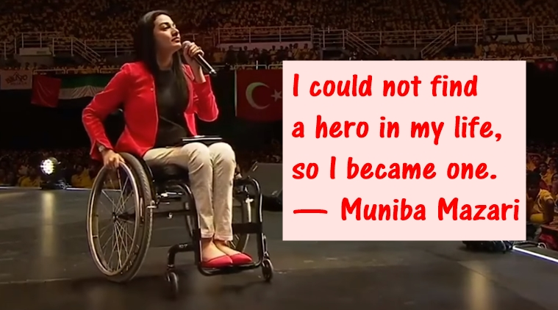
‘Paralysed’ Pakistani motivational speaker Muniba Mazari’s words will leave you inspired

Slide 23
Married at the age of 18 for the happiness of her father, Muniba Mazari’s life took a drastic turn when she met with a car accident that left her paralysed from her hip at 21. Her backbone was crushed and she sustained multiple fractures to her arm, shoulder, ribs and collarbone. As if that wasn’t traumatic enough, her doctor soon informed her that she would never be able to walk, paint or bear children.

Slide 25

Friends we have seen only a few drops of the great ocean
To
inspire us ,to motivate us to lead a meaningful life

Slide 26
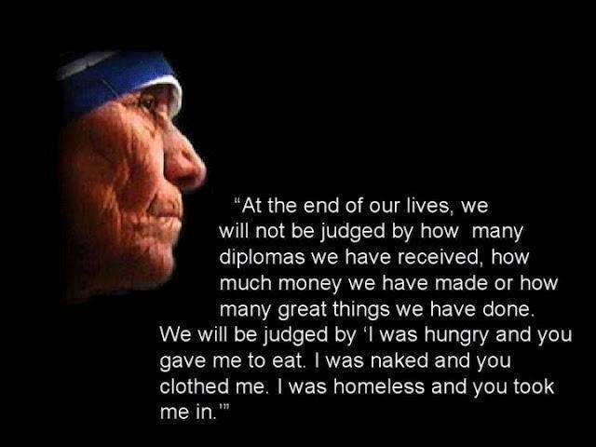

Slide 27
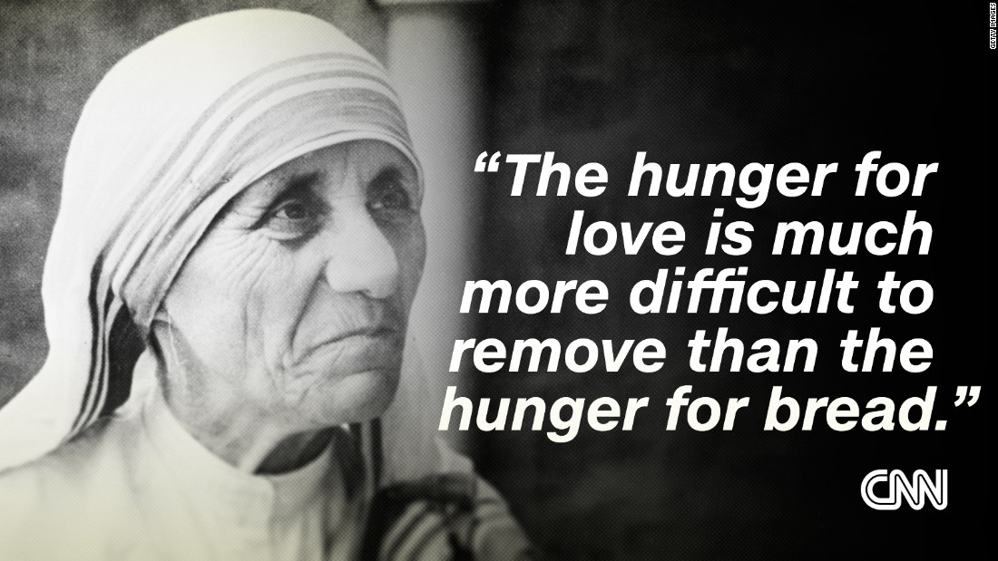

Slide 28
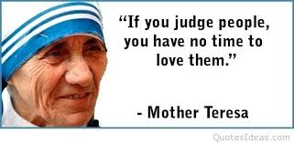

Slide 29
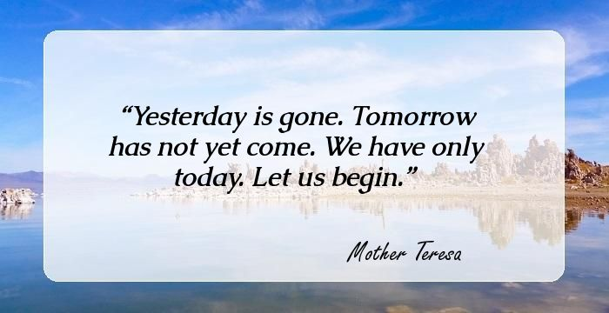

Slide 30
Thank you
for your
passionate
listening

